Slide 1
Coupling isobaric physics with isochoric dynamics
Kohei Kawano
Numerical Prediction Division,
Japan Meteorological Agency (JMA)

Slide 2
Outline
  Nonhydrostatic model ASUCA
Issues of suspicious convection growth seen in the JMA’s regional model
  are these issues due to simple coupling “isobaric physics with isochoric dynamics” ?
Consideration and trial on coupling isobaric physics with isochoric (height-based) dynamics
  To explore these issues, another coupling method which incorporates the change of cell volume in condensation is tested
    Description of the coupling method
  Tests and Results

Slide 3
specification of the dynamical core “ASUCA”
 | ASUCA
Governing equations | Flux form Fully compressible equations
Prognostic variables | ρu, ρv, ρw, ρθ_{m}, ρ
Spatial discretization | Finite volume method
Time integration | Runge-Kutta 3rd (long and short)
Treatment of sound | Conservative Split explicit
Advection | Combining 3rd and 1st order upwind with flux limiter by Koren(1993)
Numerical diffusion | None
Treatment of rain-drop | Time-split
Coordinate | Generalized coordinate or Conformal mapping + constant height-based
Grid | Arakawa-C (hor.) Lorentz (ver.)

Slide 4
Time integration loop of ASUCA
(Simplified from the viewpoint of dynamics-condensation)
Start of time integration loop
Physical process
Δt
Δt/2
RK3 loop (long)
Δt/3
ADJ
Advection, Colioris, Curvilinear, Rayleigh damping
Δτ
1step
Start of sound loop
Start of RK3 loop (short)
HE-VI
Time integration of ρu/J, ρv/J (τ → τ + Δτ)
End of RK loop (short)
Time integration of ρw/J (τ → τ + Δτ)
End of sound loop
Time integration of ρ/J(τ → τ + Δτ)
End of RK loop (long)
Time integration of ρθm/J(τ → τ + Δτ)
Adjustment physics
Microphysics
Time integration with the tendencies of adjustment physics
End of time integration loop
Exchanging halo of ρw/J(τ+Δτ)

Slide 5
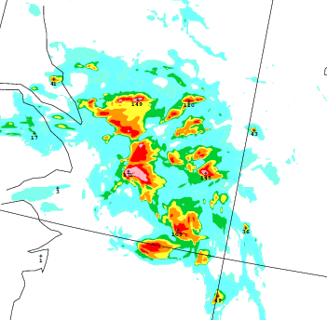
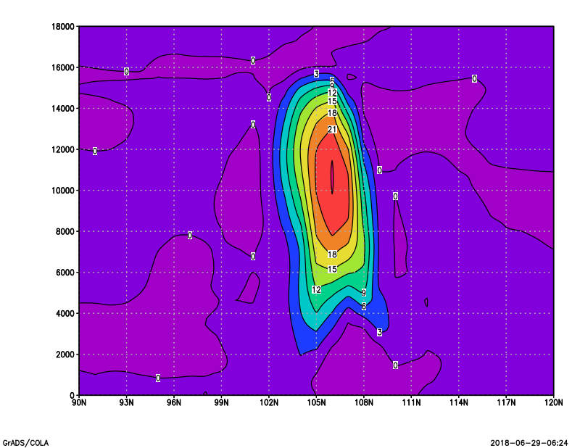
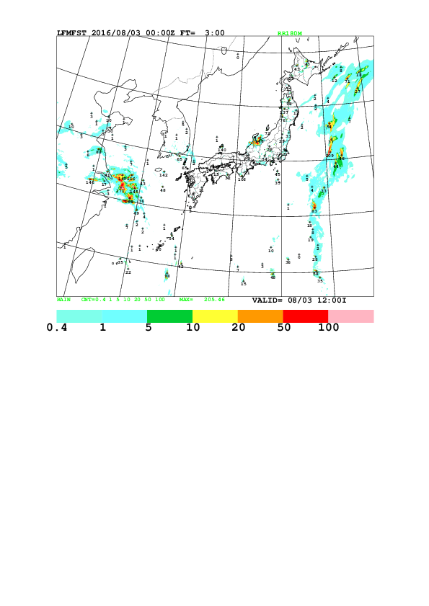
motivation
JMA’s operational regional model
  issues of suspicious convection growth
Z(m)
updraft
Operational regional model
Dx=dy=2km, dt=16.666s
For test: dt=15s for monitoring

Slide 6

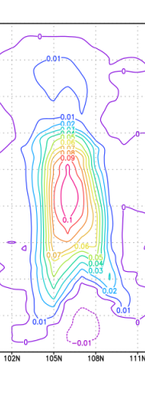
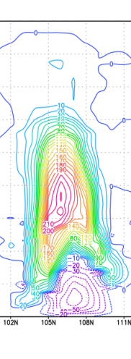
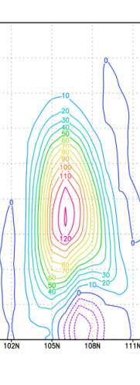
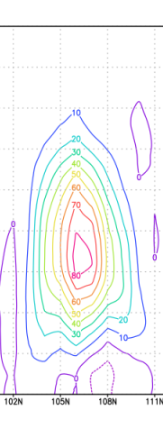
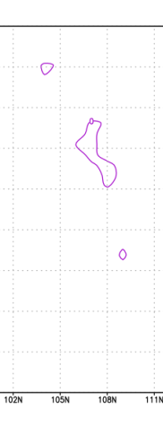
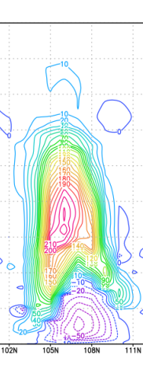
motivation
at a column convection is occurred
  repeat of local pressure increasing and decreasing
    pressure increase (>2hPa/15s) by latent heat
    mitigating local high pressure through following dynamics steps
    are repeated every time step. It seems unrealistic.
extremely strong updraft
Δθ
significant pressure increase by latent heat
  Local high pressure is mitigated through following dynamics steps
significant pressure increase by latent heat
extreamly strong updrafts
（>20m/s)
Max:+0.1K/s
Max:+240Pa
Max:+120Pa
Max:+80Pa
Max:+240Pa
Δt
Δt=15s
Δt
Δt
Δt
Δt/2
Δt/2
Δt/2
Δt/2
Δt/3
ADJ
Δθ
Δt/3
ADJ
Δθ
Δt/3
ADJ
Δθ
Δt/3
N step
N+1 step

Slide 7
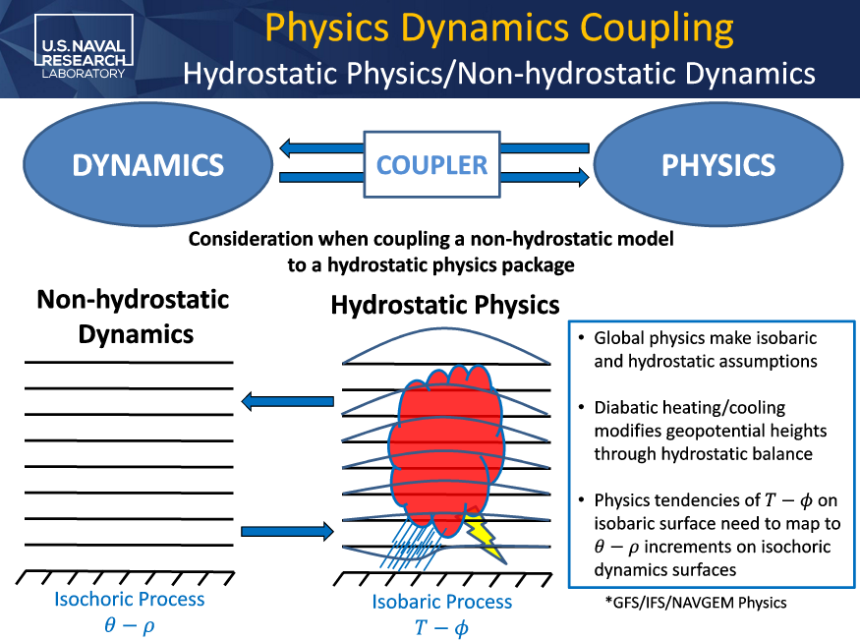
motivation
Our suspicion: are these two issues due to simple coupling “isobaric physics with isochoric dynamics” ?
  explore the issues comparing to another coupling method which incorporates the change of cell volume in condensation.
↓ We refer to this slide concept
Alex Reinecke et al: COUPLING PHYSICAL PARAMETARZATION TO A THREE-DIMENSIONAL SEM MODEL.
ECMWF workshop:Shedding light on the greyzone
https://www.ecmwf.int/en/learning/workshops/shedding-light-greyzone
48h NEPTUNE forecast
Most significant difference in tropical upper troposphere
Large difference associated with deep convection in tropics

Slide 8
Outline
  Nonhydrostatic model ASUCA
Issues of suspicious convection growth seen in the JMA’s regional model
  are these issues due to simple coupling “isobaric physics with isochoric dynamics” ?
Consideration and trial on coupling isobaric physics with isochoric (height-based) dynamics
  To explore these issues, another coupling method which incorporates the change of cell volume in condensation is tested
    Description of the coupling method
  Tests and Results

Slide 9
Coupling isobaric physics with isochoric dynamics
Current coupling
  passes inputs to physics, then receives tendencies (Δθ)
  assume that total density in each cell is kept constant. ⇒ dp≠0
physics
coupling
dynamics
isobaric
isochoric
dp=0
Δθ
c
dρ=0
dp>0
inputs
Cell volume expansion
Local high pressure will be mitigated through following dynamics steps

Slide 10
Coupling isobaric physics with isochoric dynamics
Coupling (Test): incorporates the change of cell volume in condensation
  passes inputs to physics, then receives tendencies (Δθ)
  assume that pressure in each cell is kept constant. ⇒ dρ≠0
    incorporates the change of cell volume
    Tendencies could be distributed to multiple cells
coupling
dynamics
physics
c
c
Δθ
z
inputs
S
S

Slide 11
Coupling isobaric physics with isochoric dynamics
Coupling (Test): incorporates the change of cell volume in condensation
  passes inputs to physics, then receives tendencies (Δθ)
  assume that pressure in each cell is kept constant. ⇒ dρ≠0
    incorporates the change of cell volume
    Tendencies could be distributed to multiple cells
coupling
dynamics
physics
(*1)
(Assume isobaric process)
dp=dρ・RT+ρR・dT=0
→ dρ=-ρ・dT/T=-ρπdθ/T=-ρ・dθ/θ (1)
(total mass conservation)
d(ρzS)=0
→ dz=-z・dρ/ρ (2)
With (1) and (2)
⇒ dz=z・dθ/θ
Assumption: Δθ causes cell volume expansion only in vertical and upside, dz (*1)
c
dz
isobaric
c
Δθ
z
inputs
S
S

Slide 12
Coupling isobaric physics with isochoric dynamics
Coupling (Test): incorporates the change of cell volume in condensation
  passes inputs to physics, then receives tendencies (Δθ)
  assume that pressure in each cell is kept constant. ⇒ dρ≠0
    incorporates the change of cell volume
    Tendencies could be distributed to multiple cells
coupling
dynamics
physics
Assumption: upper cells are lifted by lower cells expansion
(*1)
(Assume isobaric process)
dp=dρ・RT+ρR・dT=0
→ dρ=-ρ・dT/T=-ρπdθ/T=-ρ・dθ/θ (1)
(total mass conservation)
d(ρzS)=0
→ dz=-z・dρ/ρ (2)
With (1) and (2)
⇒ dz=z・dθ/θ
Assumption: Δθ causes cell volume expansion only in vertical and upside, dz (*1)
c
dz
isobaric
c
Δθ
z
inputs
S
S

Slide 13
Coupling isobaric physics with isochoric dynamics
Coupling (Test): incorporates the change of cell volume in condensation
  passes inputs to physics, then receives tendencies (Δθ)
  assume that pressure in each cell is kept constant. ⇒ dρ≠0
    incorporates the change of cell volume
    Tendencies could be distributed to multiple cells
coupling
dynamics
physics
Assumption: upper cells are lifted by lower cells expansion
    mapping Δρ, Δθ to original cells
(*1)
(Assume isobaric process)
dp=dρ・RT+ρR・dT=0
→ dρ=-ρ・dT/T=-ρπdθ/T=-ρ・dθ/θ (1)
(total mass conservation)
d(ρzS)=0
→ dz=-z・dρ/ρ (2)
With (1) and (2)
⇒ dz=z・dθ/θ
Assumption: Δθ causes cell volume expansion only in vertical and upside, dz (*1)
c
dz
isobaric
c
Δθ
Δρ,Δθ’
Δρ,Δθ’
z
inputs
S
S

Slide 14
Coupling isobaric physics with isochoric dynamics
Coupling (Test): incorporates the change of cell volume in condensation
  passes inputs to physics, then receives tendencies (Δθ)
  assume that pressure in each cell is kept constant. ⇒ dρ≠0
    incorporates the change of cell volume
    Tendencies could be distributed to multiple cells
coupling
dynamics
physics
Assumption: some mass goes out of model top
Assumption: upper cells are lifted by lower cells expansion
    mapping Δρ, Δθ to original cells
Δρ,Δθ’
(*1)
(Assume isobaric process)
dp=dρ・RT+ρR・dT=0
→ dρ=-ρ・dT/T=-ρπdθ/T=-ρ・dθ/θ (1)
(total mass conservation)
d(ρzS)=0
→ dz=-z・dρ/ρ (2)
With (1) and (2)
⇒ dz=z・dθ/θ
Assumption: Δθ causes cell volume expansion only in vertical and upside, dz (*1)
c
dz
isobaric
c
Δθ
Δρ,Δθ’
Δρ,Δθ’
z
inputs
S
S

Slide 15
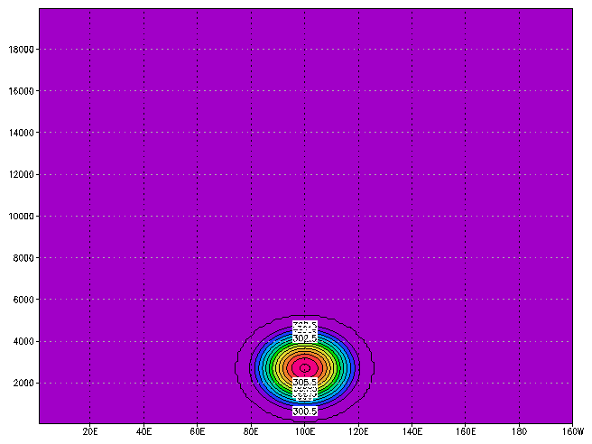
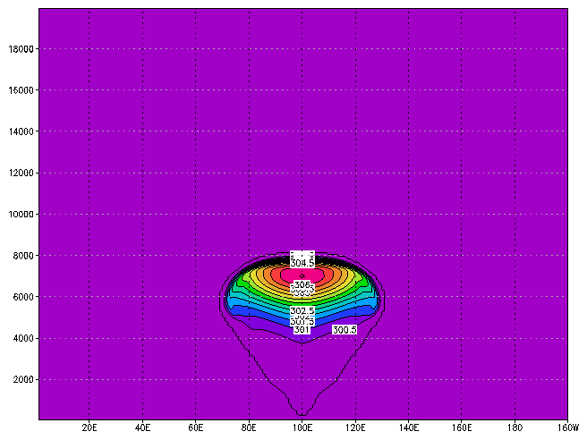
Warm bubble test
dx=dz=100m
dt=10s
PT(FT=0)
PT(FT=10min)
Check the representation of warm bubble rising
  [Initial state]: add PT perturbation(+6.6K), and make initial state (vertically balanced)
  [Tend_cntl]: add PT tendency(+6.6K/Δt) at adjustment physics in 1st step with current coupling
  [Tend_test]:add PT tendency (+6.6K/Δt) at adjustment physics in 1st step with experimental coupling incorporates the change of cell volume
As for [Tend_cntl] and [Tend_test], does it work? How is the Initial behavior comparing to [Initial state]? Is there any obvious difference in the final distribution of W or PT among these tests?

Slide 16
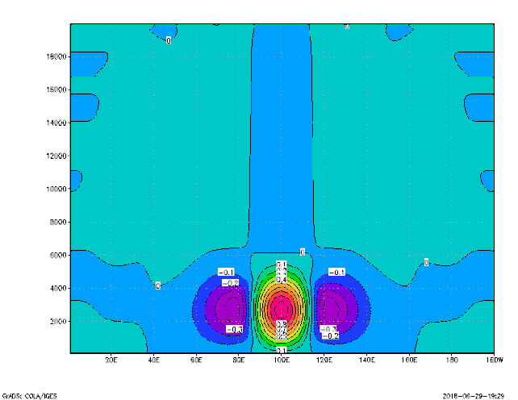
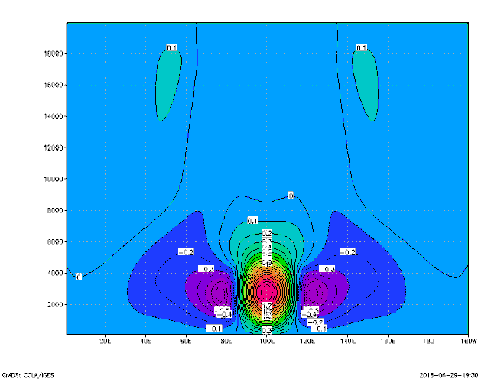
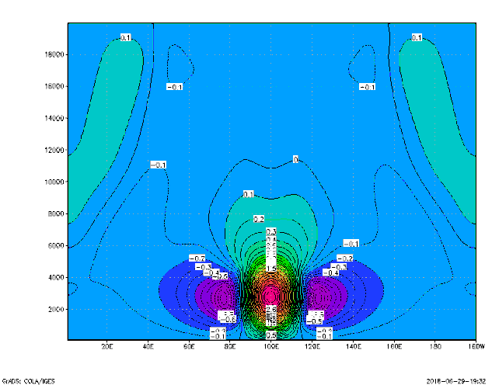
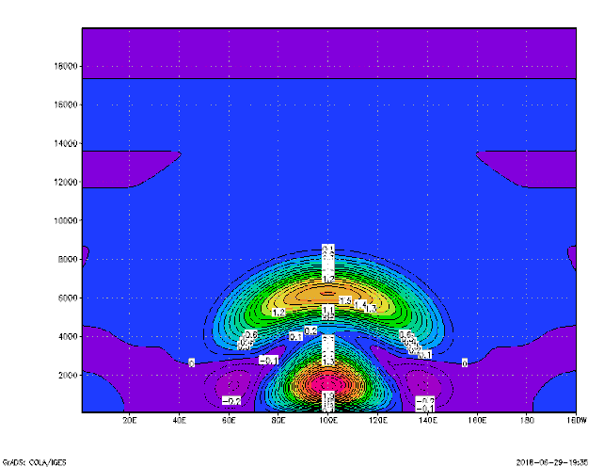
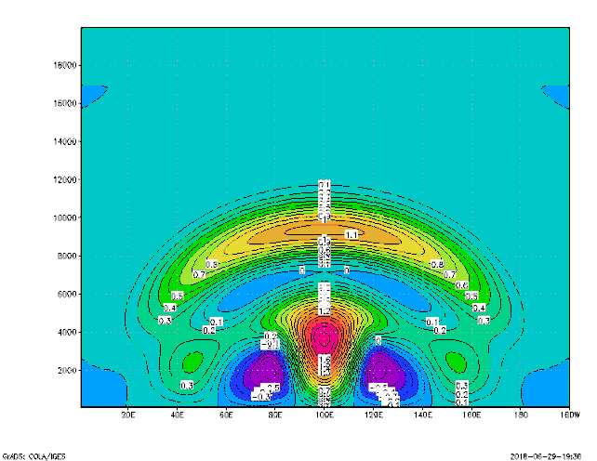
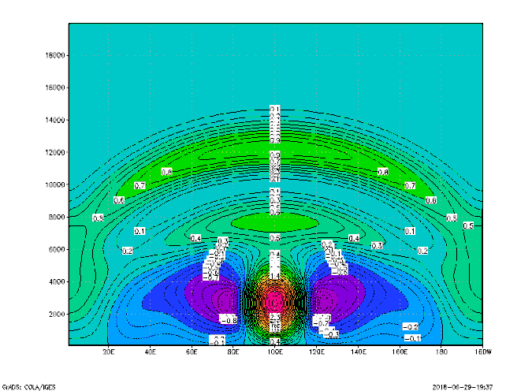
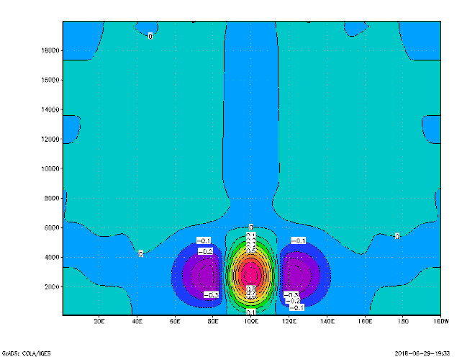

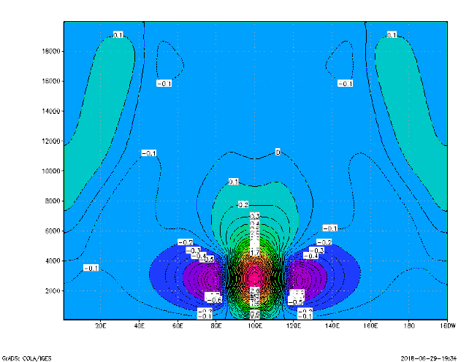
Initial behavior is different between [Tend_cntl] and [Tend_test]
W [m/s]
Initial state
1step
2step
3step
Tend_cntl
1step
2step
3step
generates acoustic waves…
Tend_test
1step
2step
3step
Smoothly start, same as
[initial state] test

Slide 17
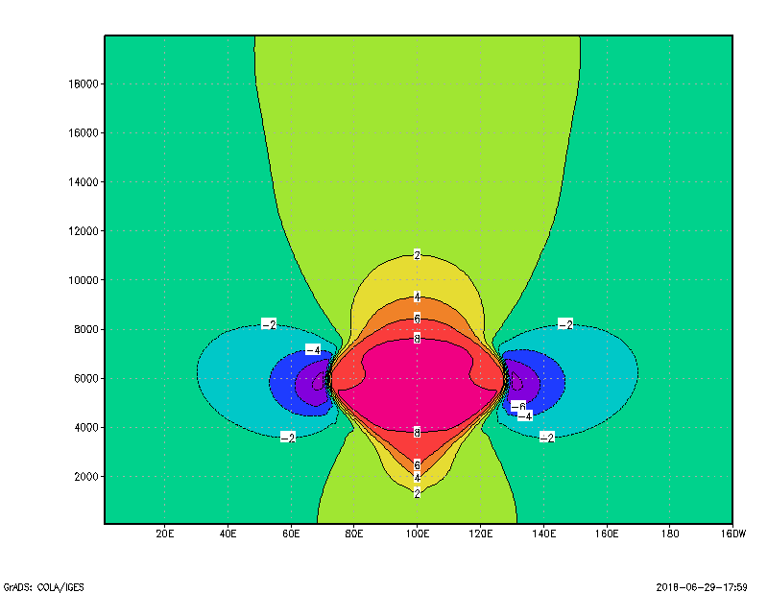
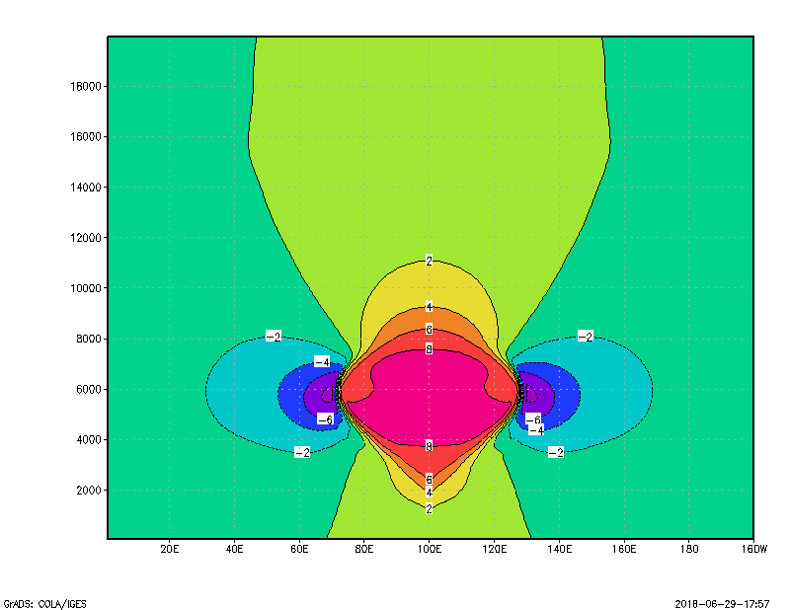
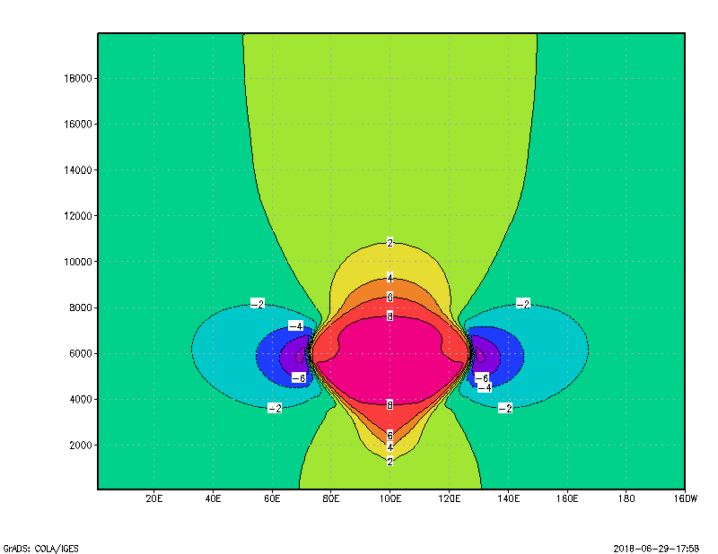
At 10min
Initial state
W [m/s]
Tend_cntl
Tend_test
Strength of updraft is similar to [Tend_cntl] test

Slide 18
From a warm bubble test
Current coupling
  can represents the main characteristics of rising warm bubble
    strength of updraft does not change comparing to [initial state] test
  tend to generate acoustic waves
    by the repeat of local pressure increasing and decreasing
Experimental coupling
  can represents the main characteristics of rising warm bubble
    strength of updraft does not change comparing to the current coupling
  not generate acoustic waves
    repeat of local pressure increasing and decreasing is modified, as expected

Slide 19
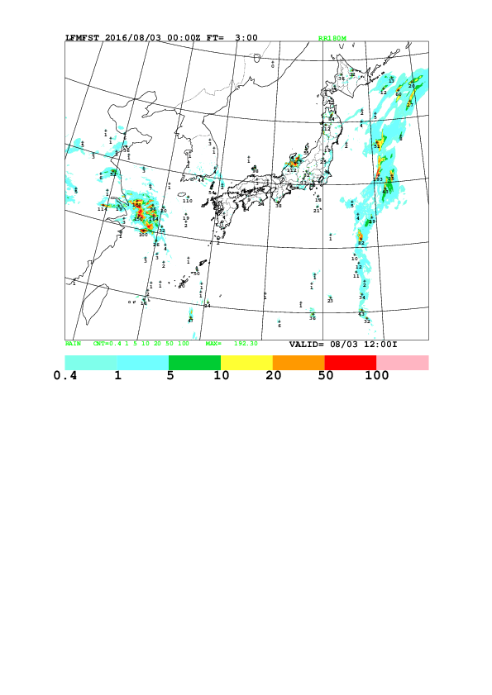
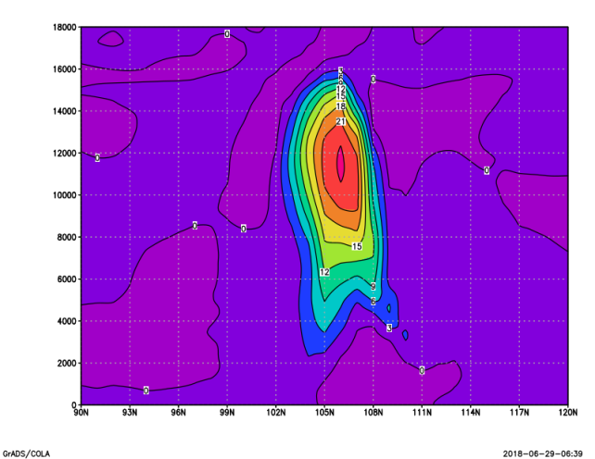
“extremely strong updrafts” case
TEST
strength of updraft were not inherently changed.
Cntl (current coupling)
extreamly strong updrafts
（>20m/s)

Slide 20
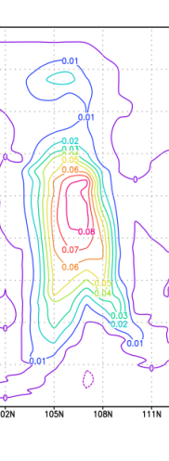
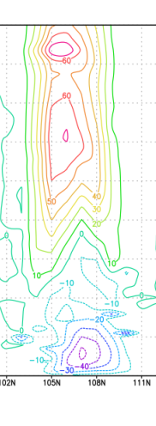
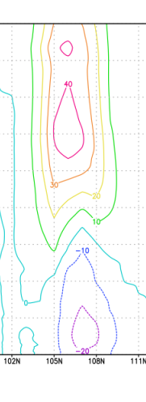
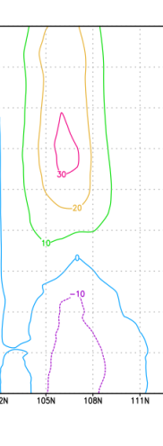
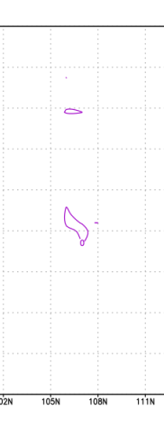
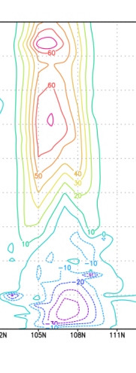
Δθ
Max:+70Pa
strength of updraft were not inherently changed.
Pressure increased above cells PT tendency is added
Max:+0.1K/s
Max:+40Pa
Max:+30Pa
Max:+70Pa
TEST
Same behavior observed in warm bubble test
Cntl(current coupling)
Δθ
extreamly strong updrafts
（>20m/s)
Max:+0.1K/s
Max:+240Pa
Max:+120Pa
Max:+80Pa
Max:+240Pa
Δt
Δt
Δt
Δt
Δt/2
Δt/2
Δt/2
Δt/2
Δt/3
ADJ
Δθ
Δt/3
ADJ
Δθ
Δt/3
ADJ
Δθ
Δt/3
N step
N+1 step

Slide 21
Conclusion
Issues of suspicious convection growth seen in the JMA’s regional model
  repeat of local pressure increasing and decreasing
  extremely strong updraft
Simple coupling method which incorporates the change of cell volume (isobaric) in condensation is tested
  can mitigate repeat of local pressure increasing and decreasing
  do not affect to mitigate the strength of updraft
    we need to keep study to address the strong updraft issue including another approach other than PDC coupling

Slide 22
BACKUP

Slide 23
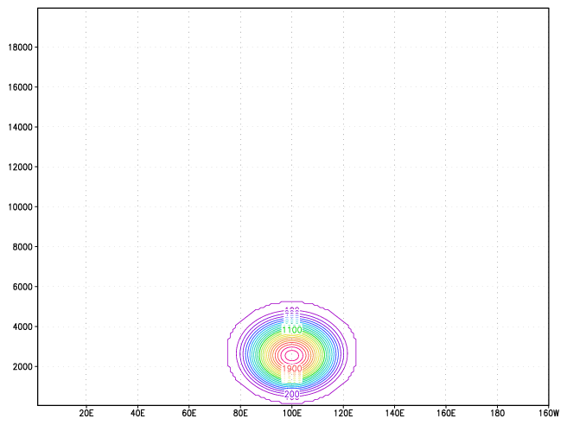
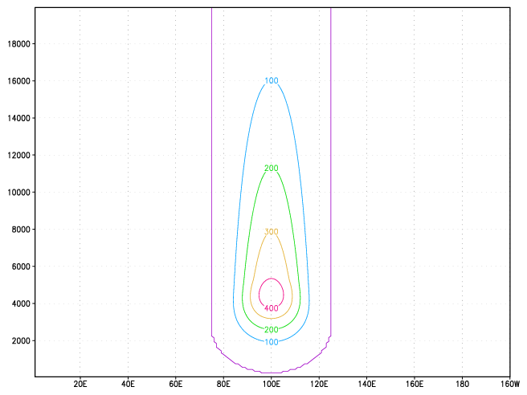
Reaction to the tendency in detail
Δt
Δt
Δt/2
Δt/2
Δt/3
ADJ
Δθ
Δt/3
ADJ
ini
1st step
2nd step
Monitoring Just after
the adjustment at 1st step
pressure change from initial state
Pressure increased at cells PT tendency is added
Pressure increased above cells PT tendency is added
Tend_cntl
Contour interval: 100Pa
Tend_test
Contour interval: 100Pa
Max:+1800Pa
Max:+400Pa

Slide 24
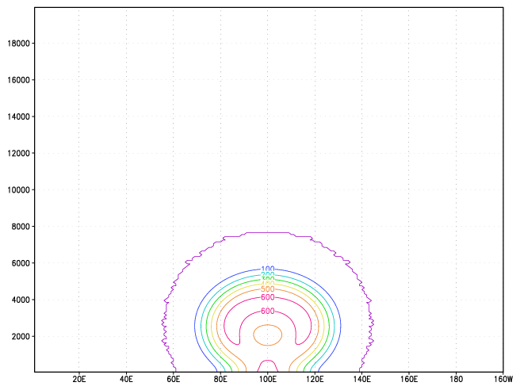
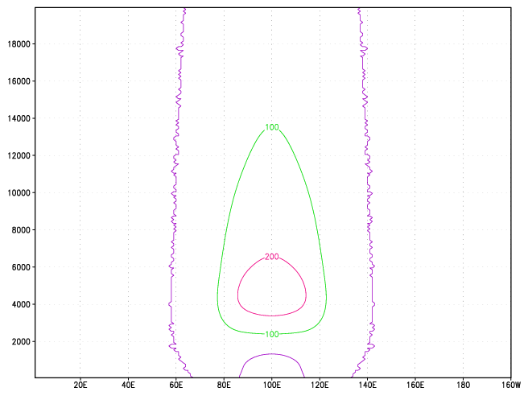
Reaction to the tendency in detail
Δt
Δt
Δt/2
Δt/2
Δt/3
ADJ
Δθ
Δt/3
ADJ
ini
1st step
2nd step
Monitoring Just after
the RK1 at 2nd step
pressure change from initial state
Local high pressure is mitigated through following dynamics steps
Local high pressure ( relatively small ) is mitigated through following dynamics steps
Tend_cntl
Contour interval: 100Pa
Tend_test
Contour interval: 100Pa
Max:+600Pa
Max:+220Pa

Slide 25
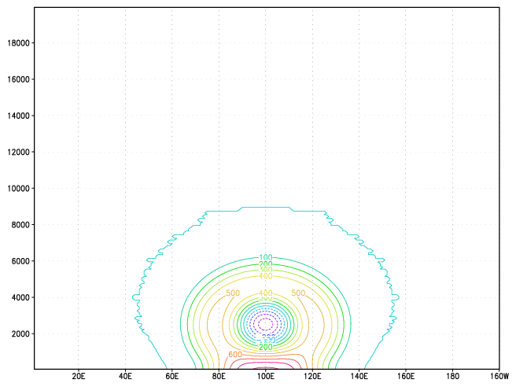
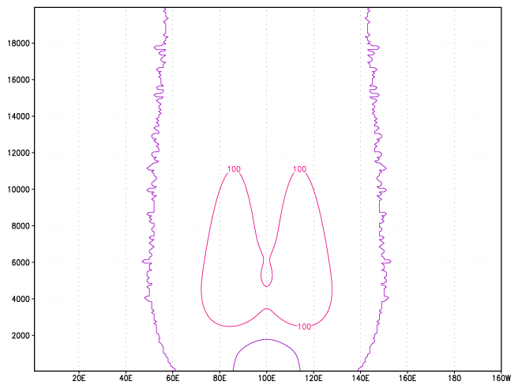
Reaction to the tendency in detail
Δt
Δt
Δt/2
Δt/2
Δt/3
ADJ
Δθ
Δt/3
ADJ
ini
1st step
2nd step
Monitoring Just after
the RK2 at 2nd step
pressure change from initial state
Local high pressure is mitigated through following dynamics steps
Local high pressure ( relatively small ) is mitigated through following dynamics steps
Tend_cntl
Contour interval: 100Pa
Tend_test
Contour interval: 100Pa

Slide 26
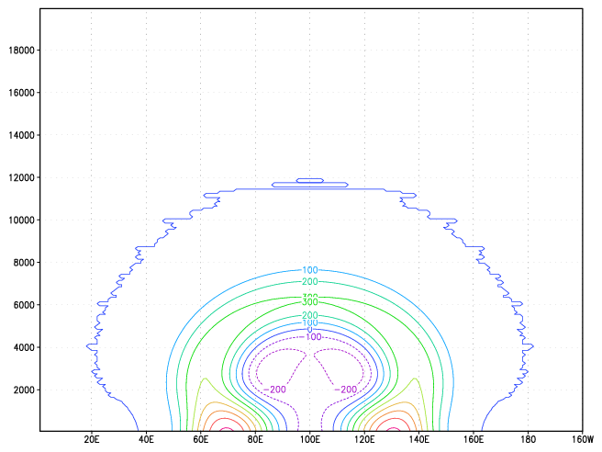
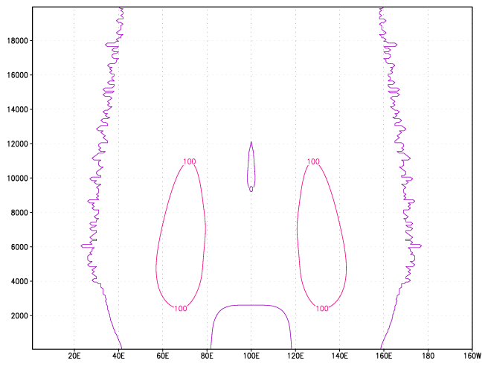
Reaction to the tendency in detail
Δt
Δt
Δt/2
Δt/2
Δt/3
ADJ
Δθ
Δt/3
ADJ
ini
1st step
2nd step
Monitoring Just after
the RK3 at 2nd step
pressure change from initial state
Local high pressure is mitigated through following dynamics steps
Local high pressure ( relatively small ) is mitigated through following dynamics steps
Tend_cntl
Contour interval: 100Pa
Tend_test
Contour interval: 100Pa

Slide 27
Governing equations of ASUCA
  ( x1, x2, x3) : physical space.
  (ˆx1, ˆx2, ˆx3) : computational space.
Density is used as the prognostic variable for mass conservation
J is a Jacobian of the coordinate transformation
u, v, w : velocity components in the physical space
ˆu, ˆv, ˆ w : those in the computational space
ρ : total mass density
qα : ratio of the density of a water substance α
to the total mass density
The RHS terms involve not only physics processes, Coriolis terms and curvature terms but also the terms arising from change of density due to precipitation and physical processes.

Slide 28
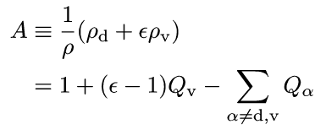

ASUCA’s prognostic variable involved with energy
Equation of state

Slide 29
Schematic structure of the “Physics Library”
PBL
RAD
SURF
PBL_INI
RAD_INI
SURF_INI
GRID
GRID
GRID
・・・・
PARM
PARM
PARM
PBL_RUN
RAD_RUN
SURF_RUN
COMM
CONST
MONITOR
・・・・
Vars(nz)
Tendency(nz)
Model A
Model B
Model C
The “Physics Library” is designed to be plugged in easily to any models
  The physical processes implemented in the “Physics Library” are vertically one-dimensionalized.
ASUCA passes inputs (Vars(nz)) to library, then receives tendencies (tendency(nz)) from library.

Slide 30
Implementation of physical processes
Physical processes are expected to provide tendencies. ASUCA just receives tendencies and temporally integrate with them.
Column based physical processes include only the vertical one-dimensional loop
The horizontal loops are parallelized using OpenMP.
Modularity and high efficiency are satisfied.
kij -ordering
Three-dimensional arrays in space are stored sequentially in the order of z (k), x (i) and y (j).
real:: pt(nz,nx,ny), tend_pt(nz,nx,ny)
real:: qv(nz,nx,ny), tend_qv(nz,nx,ny)
real:: pt_1d(nz), tend_pt_1d(nz)
!$OMP PARALLEL DO SCHEDULE(DYNAMIC) &
!$OMP& PRIVATE(pt_1d,tend_pt_1d)
do j = 1, ny
do i = 1, nx
pt_1d(1:nz) = pt(1:nz,i,j)
qv_1d(1:nz) = qv(1:nz,i,j)
call pp_A(i,j,tend_pt_1d,tend_qv_1d,pt_1d,qv_1d,…)
tend_pt(1:nz,i,j) = tend_pt_1d(1:nz)
tend_qv(1:nz,i,j) = tend_qv_1d(1:nz)
end do
end do
!$OMP END PARALLEL DO
real(8) :: pt(nz, nx, ny)
kij-ordering
Better load balance among PEs
kij-ordering
Better cache hit ratio with vertical one dimensional calculation
In practice, physics tendencies are converted to those of ASUCA’s prognostic variables
Notes:
30

