Slide 1
Improving climate model coupling through complete mesh representation
CMDV-Software
Robert Jacob, Iulian Grindeanu, Vijay Mahadevan, Jason Sarich
July 12, 2018
3rd Workshop on Physics Dynamics Coupling
Support: U.S. DOE BER “Climate Model Development and Validation” project

Slide 2
The other coupled problems…
Figure from Center for Multiscale Modeling of Atmospheric Processes

Slide 3
Ocean-atmosphere exchange fluxes of heat, radiation, momentum, water
For interface-fluxes (heat, momentum) choice in DOE E3SM is to interpolate atmosphere to finer ocean grid, then calculate fluxes, then (for atm) interpolate back.
Atmosphere-computed fluxes (radiation, rain) interpolated directly to ocean
Flux interpolation must conserve globally
SensibleHeat = A (T_{a} – T_{s})
T_{a}
T_{s}
T_{s}

Slide 4
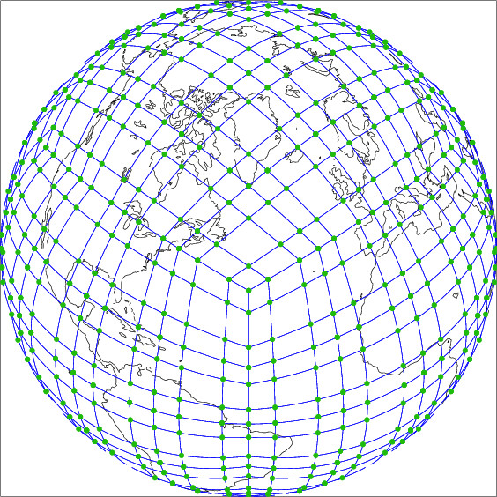
Atmosphere and ocean grids to couple in E3SM
HOMME SE (with GLL points)
MPAS FV

Slide 5
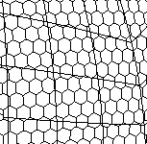
The Intersection (overlap) mesh

Slide 6
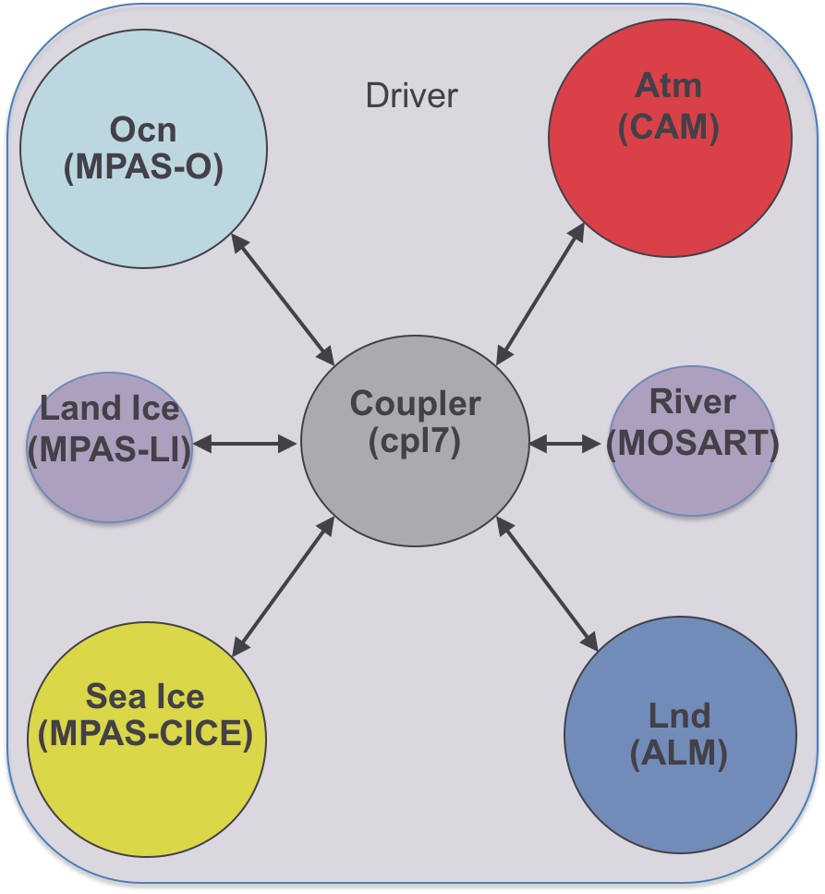
Climate Model Coupling software
MCT datatypes used in coupler, driver and model “caps”.
Driver
Coupler
MPAS-CICE
ELM
Time
MPAS-O
CAM
Processors

Slide 7
Model Coupling Toolkit
A library of Fortran90 datatypes and functions for building parallel coupled models.
2-sided parallel MxN send/recvs for moving data (with MPI)
Support for online parallel interpolation using offline-calculated weights.
Model registry, decomposition descriptors, distributed data type, communication tables.
Functions for time accumulation, spatial averaging and merging.
Programmer must write the “cap layer” or other interface.
No prescription on overall model architecture
Current release: MCT 2.10.0 (April, 2018)
First version in production: MCT 2.1 (CCSM3, June, 2004)
Used in OASIS3-MCT (many models) and
CIME cpl7 (E3SM1.0, CESM2.0)

Slide 8
Current coupling workflow: offline/online offline phase
Generate grid
Convert to SCRIP format
Feed grids to program that finds intersection and calculates weights.
Obtain weights file in SCRIP format
Point model config file to weights file.
MPAS: grid-gen, HOMME: internal or GenerateCSMesh
(some of the above can output SCRIP)
SCRIP or ESMF_Regridder or TempestRemap
Ex: map_ne30np4_to_oEC60to30v3_conserve.161222.nc
cime/config/($model)/config_grid.xml

Slide 9
Current coupling workflow: offline/online online phase: init
Separately in each model. Stores model-preferred decomposition
Only the total number of dofs.
Trivial decomposition
Read a block and scatter. Each node picks out what it needs.
Figure out and store communication needed to complete a mapping.
Between model and coupler. Within coupler.
Define MCT GSMaps
Communicate grids to coupler
Define coupler GSMaps
Read in weight files.
Initialize MCT SparseMatrix
Initialize MCT Routers/Rearrangers

Slide 10
Current coupling workflow: offline/online online phase: run
Stored in an MCT AttributeVector
Use MCT sMatAvMult method
Stored in an MCT AttributeVector
Receive new data from source model
Perform local sparse-matrix-vector multiply
Send remapped data to destination model

Slide 11
Two problems with current system
The atmosphere->ocean interpolation does not take advantage of the high-order SE grid
The offline-online system is fragile and poorly documented

Slide 12
Current coupling workflow: offline/online offline phase
Generate grid
Convert to SCRIP format
Feed grids to program that finds intersection and calculates weights.
Obtain weights file in SCRIP format
Point model config file to weights file.
MPAS: grid-gen, HOMME: internal or GenerateCSMesh
(some of the above can output SCRIP)
SCRIP or ESMF_Regridder or TempestRemap
Ex: map_ne30np4_to_oEC60to30v3_conserve.161222.nc
cime/config/($model)/config_grid.xml
Generate dual of SE grid!
Notes:
Left out a step of the offline workflow

Slide 13
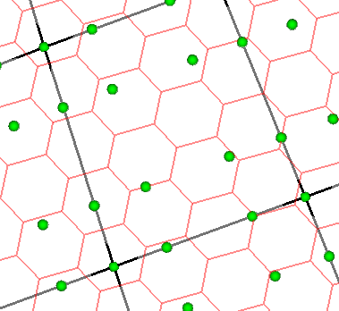
How SE-> FV can take advantage of SE
Use the polynomials to find the value at the point in the intersected ocean mesh (which is Finite Volume with all values at cell centers)
Notes:
Show what we would like to do with the info in the SE grid.

Slide 14
But…...
The two main programs for generating interpolation weights,
SCRIP and
ESMF_Regridder
can only do
Finite Volume to
Finite Volume (or FD)

Slide 15
For an FV algorithm, have to construct a dual of the SE grid
Treat each GLL point as the center of a polygon.

Slide 16
Constructing an SE dual grid is not trivial
Draw a polygon around each GLL node
For conservative interpolation, area of polygon around GLL point must match weight of GLL node
Must use an iterative process, similar to spring dynamics, tweaking the polygons until the areas are correct.

Slide 17
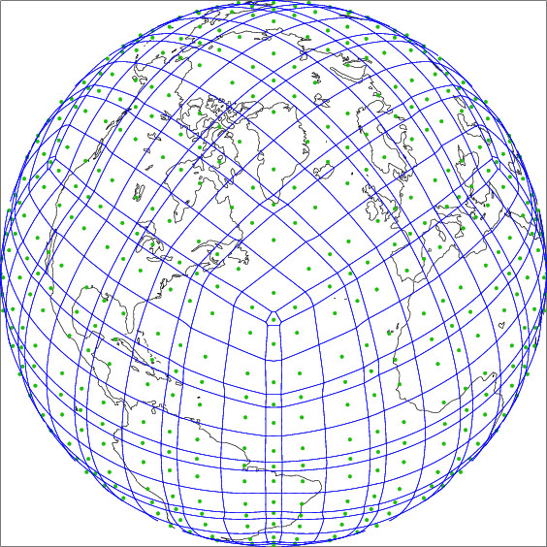
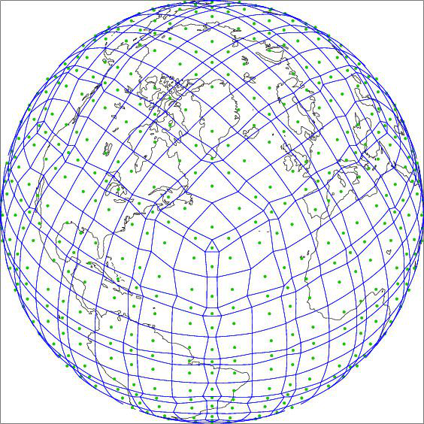
Types of dual grids (“chevron”, “natural”)
Allow pentagons and hexagons. Converges fast. But some hexagons become non-convex (chevrons). SCRIP can’t do non-convex grids.
Figures by Mark Taylor
Only use centers of the GLL subcell grids to make polygons. All convex but many irregular shapes (after tweaking for area)

Slide 18
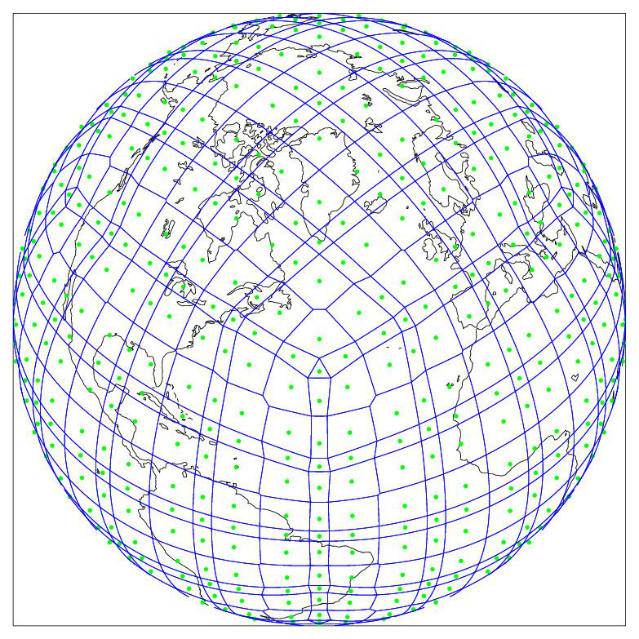
Types of dual grids (“pentagons”)
To remove the irregular shapes, selectively allow (convex) pentagons.
This is the dual grid currently used to calculate weights in atmosphere-ocean interpolation for E3SM/CESM.
Figures by Mark Taylor

Slide 19
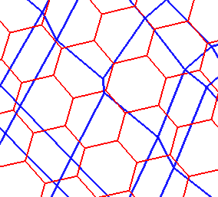
Intersection of SE-dual and MPAS

Slide 20
A solution to first problem: TempestRemap
TempestRemap provides offline generation of conservative, consistent and/or monotone linear maps between meshes.
Supports both source and target grids which are either finite-volume based or finite element.
https://github.com/ClimateGlobalChange/tempestremap
Paul A. Ullrich and Mark A. Taylor, 2015: Arbitrary-Order Conservative and Consistent Remapping and a Theory of Linear Maps: Part 1. Mon. Wea. Rev., 143, 2419–2440, doi: 10.1175/MWR-D-14-00343.1
Paul A. Ullrich, Darshi Devendran and Hans Johansen, 2016: Arbitrary-Order Conservative and Consistent Remapping and a Theory of Linear Maps, Part 2. Mon. Weather Rev., 144, 1529-1549, doi: 10.1175/MWR-D-15-0301.1.

Slide 21
The other problem with the current method...
Total offline workflow poorly documented.
Easy to lose provenance at each step.
Need to generate map sets for different resolution combinations.
E3SM 1 degree fully coupled case (no ice sheet) has 6 maps.
100s of mapping files in our input data repository
Bottleneck to trying simulations with different grids.
Possible Solution
Support online interpolation by replacing MCT with MOAB!

Slide 22
MCT’s idea of the mesh (grid)
MCT only knows about the number of grid points or “degrees of freedom”, dof.
Each grid must have its points numbered with integers. One unique integer per unique point.
Numbering up to user/model.
Must be consistent if the same grid appears in more then one model.
MCT GlobalSegmentMap records how grid points are assigned to processors.
Does not have enough information to find intersection of 2 meshes

Slide 23
Mesh-Oriented datABase (MOAB)
Library for representing, manipulating structured, unstructured mesh models.
Supported mesh types: (not just dof numbers)
FE zoo (vertices, edges, tri, quad, tet, pyramid, wedge, knife, hex)
Polygons/polyhedra
Structured mesh
Optimized for memory usage first, speed second
Implemented in C++, but uses array-based storage model
Avoids C++ object-based allocation/deallocation
Allows access in contiguous arrays of data
Mesh I/O from/to various formats
HDF5 (custom), vtk, CCMIO (Star CD/CCM+), Abaqus, CGM, Exodus, NetCDF
Allows a complete representation of the mesh!
Notes:
MOAB does not have datatypes that grow with N or P. Knows more then just total dof. Knows difference between vertex, edge, face.

Slide 24
What does a complete representation of the mesh mean?
Not just dofs, know what is an edge, a vertex, a face, what is shared on a node and across nodes.
P0
v2
v1
v4
P1
v1
t1
t1
e1
e3
t2
t2
t3
v5
v3
v2
e1
v3
v5
t3
t4
e2
v1
e2
e2
v2
e1
t1
e1
v6
v4
t2
t3
v5
v4
v3
P2

Slide 25
Compute mesh intersection
Compute the ”coverage”, and migrate the source mesh to cover the target elements
MOAB uses an advancing-front algorithm with fast adjacency queries for intersection
Compute the coverage source (HOMME) mesh to cover the local MPAS elements
Compute the mesh intersection between HOMME and MPAS meshes

Slide 26
MOAB-TempestRemap tool (mbtempest)
mbtempest is a parallel, offline, conservative remapping tool that is based on MOAB and TempestRemap libraries
Support conservative projections between FV FV, DG CG, SE FV field discretization combinations in source and destination components
mbtempest supports a scalable workflow to load pre-partitioned input component meshes, compute remapping weights and apply weight matrix onto solution vector
The development of parallel NetCDF writing of the weight matrix is in progress
The integration of the online remapper with E3SM is ongoing; Scalability studies being performed on DOE machines Theta and Cori-KNL.
mbtempest dependencies: MPI, HDF5, NetCDF (C++), TempestRemap, Eigen3
A third tool along with SCRIP, ESMF_Regridder
MOAB repository: https://bitbucket.org/fathomteam/moab
Notes:
Abbreviations:
FV: Finite Volume
DG: Discontinuous Galerkin (DoFs on shared edges are duplicated)
CG: Continuous Galerkin (DoFs on shared edges are not duplicated)
SE: Spectral Element (can be CG or DG); HOMME uses SE + CG
- Currently we only support reduction on to the root process and using serial write of the weight matrix data to a file; Need to make this parallel but it hasn’t been a priority. Certainly this needs some work.

Slide 27
Online MOAB-regridder coupling workflow
Offline phase: only the mesh generation step
Online phase init:
For each component in E3SM
Replicate component meshes with MOAB database
Migrate MOAB mesh from component PEs to coupler PEs
Compute pair-wise mesh intersections in parallel
Compute projection weights with TempestRemap
Store weights in a parallel SparseMatrix datastructure (not MCT)
Online phase run:
Send solution data from a source component to coupler
Execute parallel matvec operation to compute remapped solution
Communicate solution to target component from coupler

Slide 28
Advancing front intersection
Computing mesh intersection with the advancing front algorithm is an independent task in parallel once we have the full coverage mesh
Several opportunities to accelerate with fine-grained parallelism (threads)

Slide 29
Implementation in E3SM
cime_driver (Initialize mesh in MPAS)
cime_init
component_init_cc
ocn_mct_init (in MPAS)
#ifdef HAVE_MOAB
call mpas_moab_instance(domain_ptr) ! should return MPOID ..
call mpas_log_write('initialized MOAB MPAS ocean instance... ')
#endif
cime_driver (Initialize mesh in coupler)
cime_init
component_init_cx !called once for each model
call seq_mctext_gsmapInit(comp(1))
#ifdef HAVE_MOAB
call cplcomp_moab_Init(comp(1))
#endif

Slide 30
Current status
Can compile and build E3SM that
Instantiates MOAB
Defines full meshes in HOMME and MPAS
Migrates full meshes to coupler
Computes intersection in coupler
Computes weights
Migrates data from atmosphere to coupler
Applies weights
Migrates regridded data to ocean

Slide 31
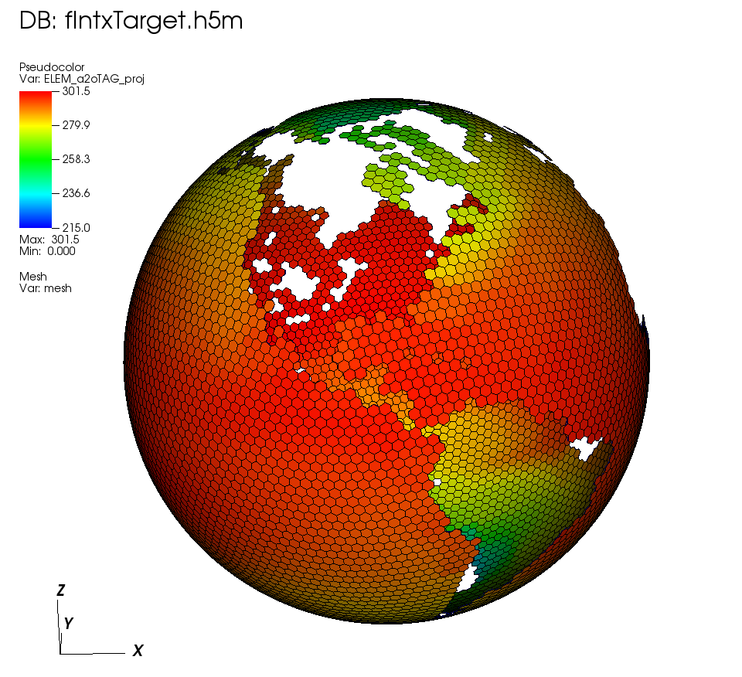
Online interpolation results
Interpolation of lowest atmosphere layer temp from HOMME to MPAS working in parallel

Slide 32
Next steps
Use TempestRemap-generated maps in current online-offline system (for E3SM v1.x)
Implement full data pathway (all fields exchanged) with MOAB-based system
Scaling and performance studies of MOAB system.
Replace MCT-based driver with MOAB-based driver (E3SM v2.0)

Slide 33
More info: http://sigma.mcs.anl.gov/moab-library/
Soon in http://github.com/E3SM-Project/E3SM
cime/src/drivers/mct/
cime/src/drivers/moab/

