Slide 1
Across the ‘grey zone’ of ocean resolutions
Helene Hewitt
Malcolm Roberts, Pierre Mathiot, Daley Calvert, Dave Storkey, Pat Hyder (Met Office)
Andrew Coward, Bablu Sinha, Joel Hirschi (NOC)
Sophia Ashby (University of Reading)
Mike Bell, Eric Chassignet, Arnaud Czaja, David Ferreira, Steve Griffies, Julie McLean, Adrian New
EU Primavera, Hadley Centre Climate Programme, NERC ACSIS
helene.hewitt@metoffice.gov.uk
@ht_hewitt
Hewitt et al., Ocean Modelling, 2017

Slide 2
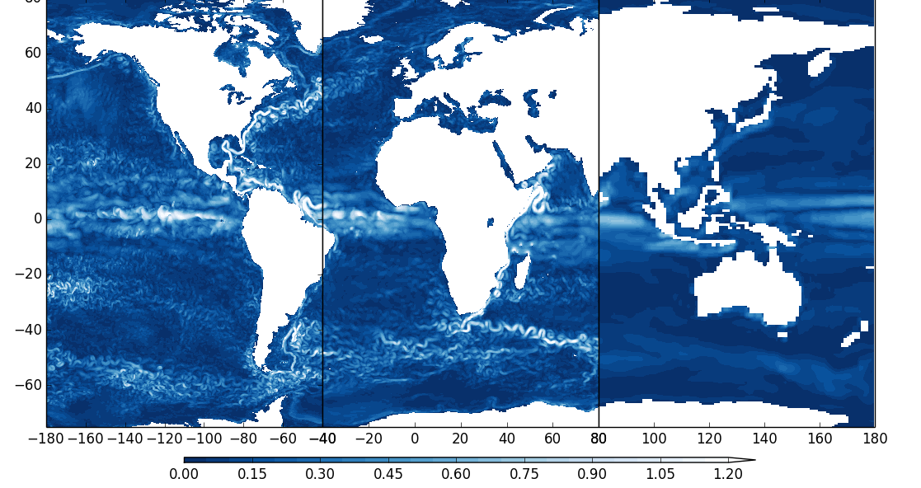
Outline
1/12°
1/4°
1°
Introduction
Horizontal resolution in (global) ocean forced models
Traceable hierarchies and parameterisation
Sensitivity to resolution in coupled systems
Vertical resolution
Summary
See Hewitt et al. (2017) review in Ocean Modelling

Slide 3
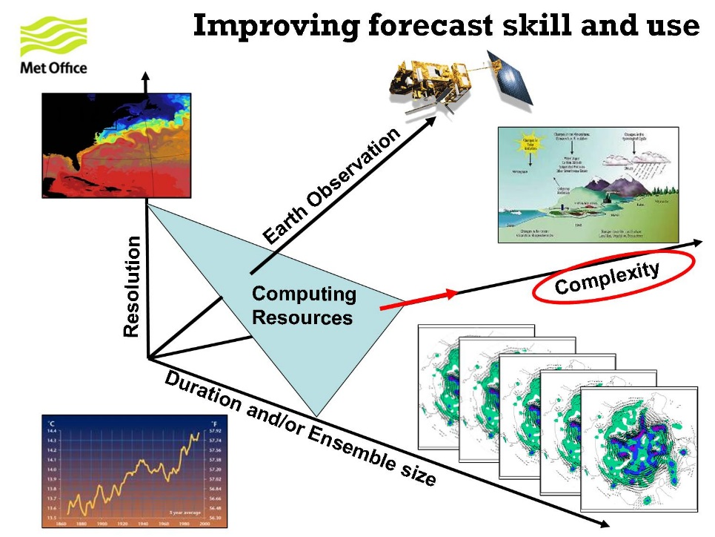
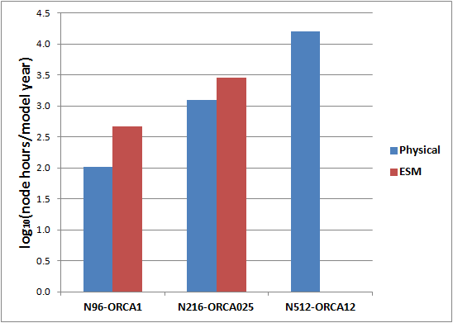
1. Introduction
Scientifically, resolution should be chosen based on the scales that can be resolved
However, the choice of resolution is usually made on the basis of computational constraints
Shorter range predictions can run with higher resolution models – climate models are very constrained in the choices

Slide 4

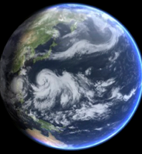

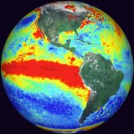
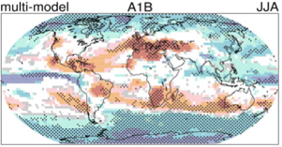





Global Physical Modelling
Unified Prediction across Timescales
Hours Days Weeks Months Seasons Decades Centuries
1/12°
1/4°
1°
NWP - Atmosphere, Ocean, Waves
GloSea
Decadal
Climate Change & UKESM1
Deterministic
MOGREPS
Component Models
GA7 , GL7, GO6, GSI7/8
Coupled AOIL Model
GC3.0
WaveWatch III

Slide 5
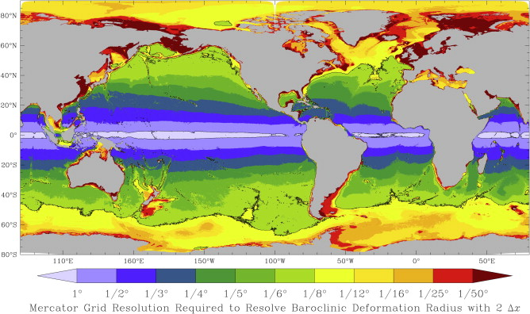
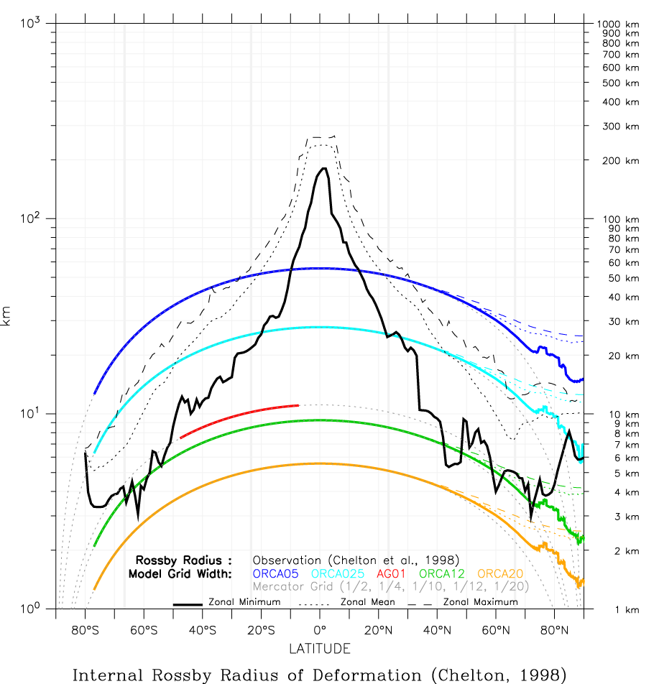
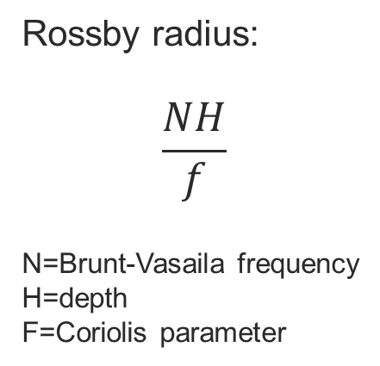
Resolving the Rossby radius
Rossby radius:
$$\frac{NH}{f}$$
N=Brunt-Vasaila frequency
H=depth
F=Coriolis parameter
Hallberg 2013
Markus Scheinert, Drakkar 2012

Slide 6
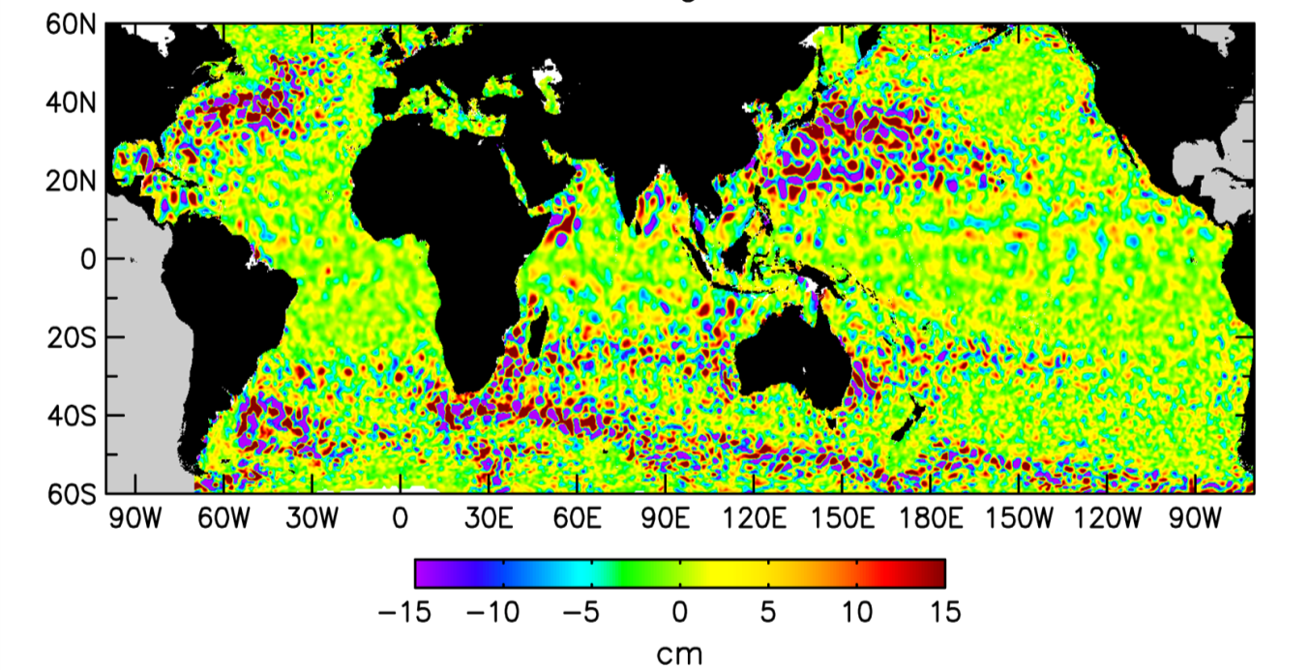
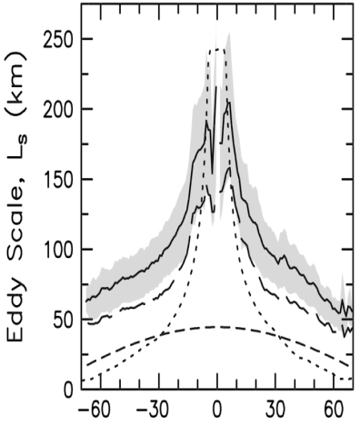
Observations of mesoscale eddies
Coherent vortices, radius of about 50-100 km
Generated by baroclinic and barotropic instabilities
~215,000 eddies with 4 weeks or longer lifetime over 20 years (Chelton et al., 2011)
They are everywhere in the ocean!
Chelton et al., 2011

Slide 7
Spanning the eddy regime
1/12°
1/4°
1°
Across resolution the approach to parameterizing eddies changes
Discuss Gent-McWilliams (GM) scheme for parameterizing eddies
Note the existence of a grey zone
Eddy permitting
How to parameterise?
GM? Isopycnal mixing?
Scale selective?
Eddy resolving
No GM, low isopycnal mixing
Eddy parameterising
GM and isopycnal mixing

Slide 8
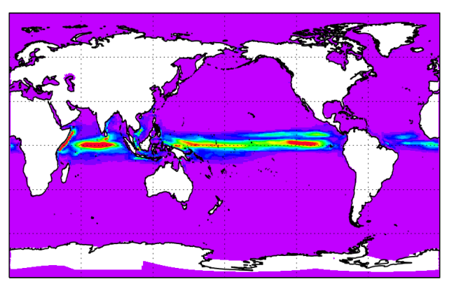
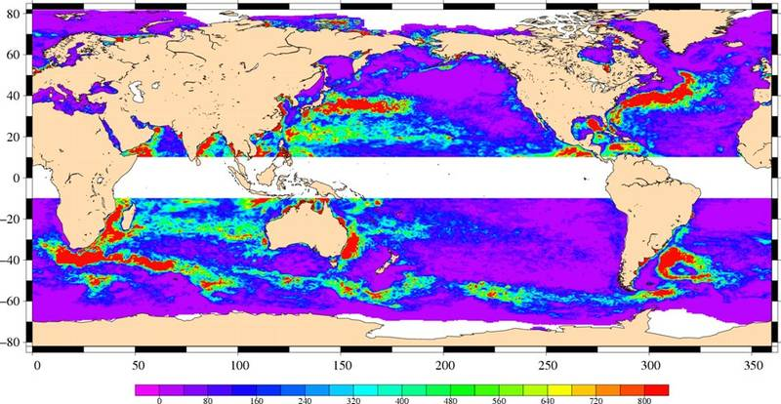
2. Horizontal resolution in forced ocean models
1°
1/4°
Boundary currents and fronts
Topographic control
Impact of eddies and their parameterisation
1/12°
AVISO
Pierre Mathiot

Slide 9
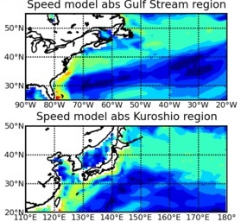
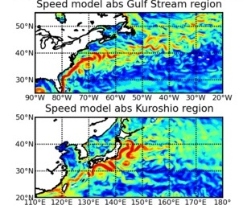
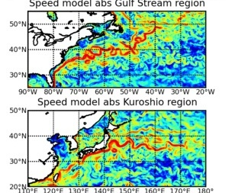
Boundary currents and fronts
1°
1/4°
1/12°
Move from diffusive regime to inertial regime as resolution increases
Both separation and penetration varies as resolution increases
Pat Hyder

Slide 10
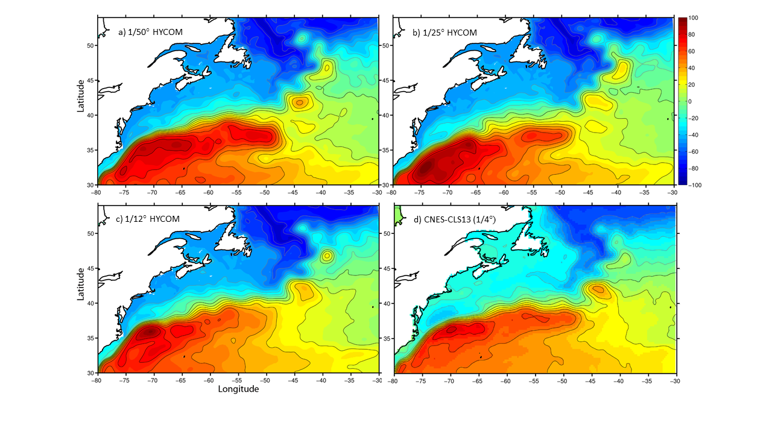
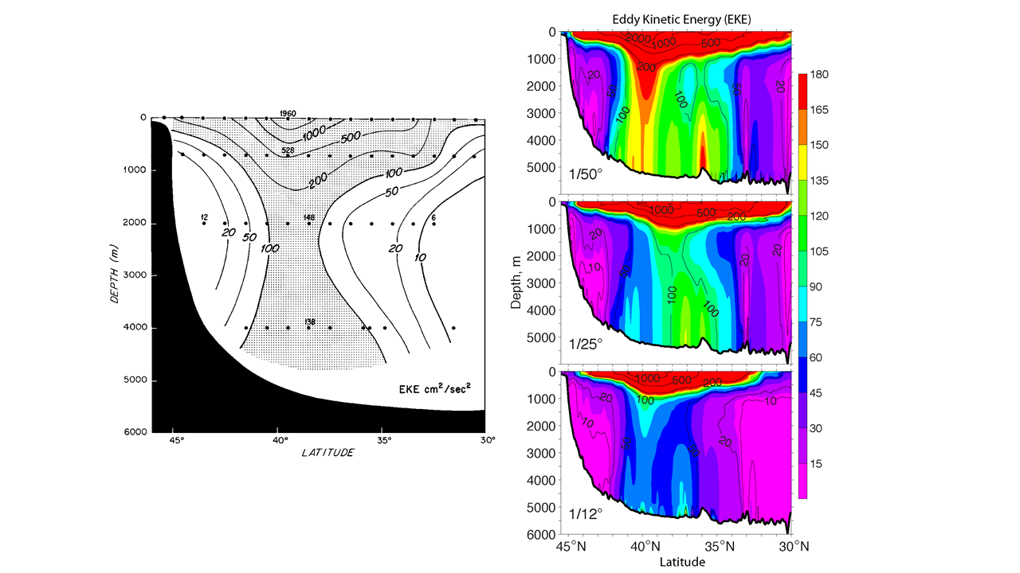
Impacts beyond 1/12º
Chassignet and Xu, 2017

Slide 11
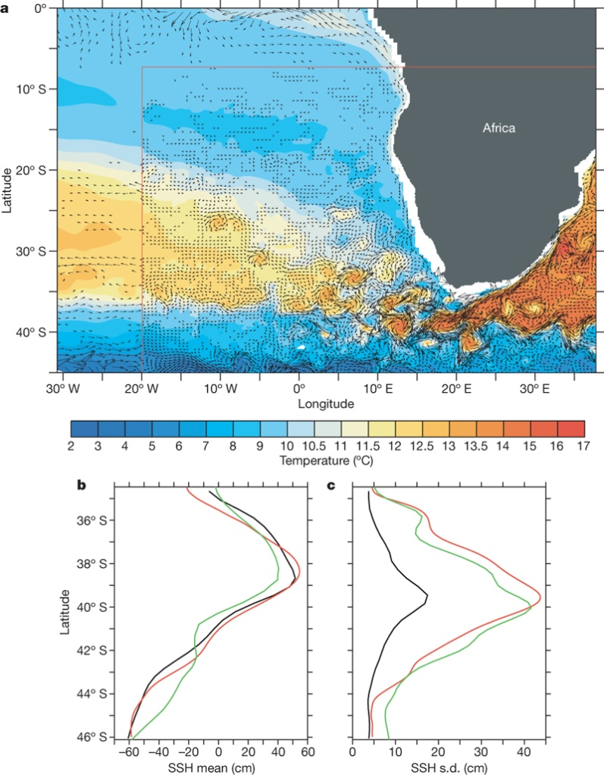
Eddies at the Agulhas retroflection
Resolution is essential for capturing eddies shed from the retroflection
Representing the Agulhas is key to the long term properties of a climate model
1/2°
1/10°
AVISO
Biastoch et al., 2008

Slide 12
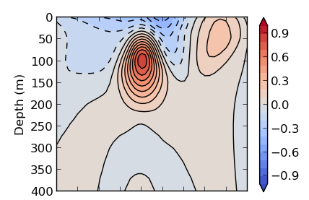
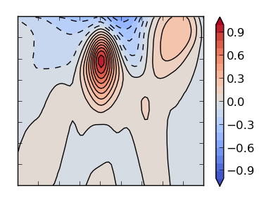
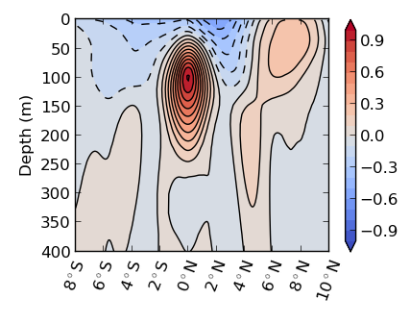
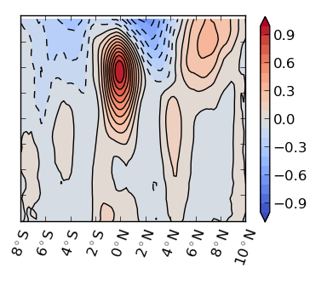
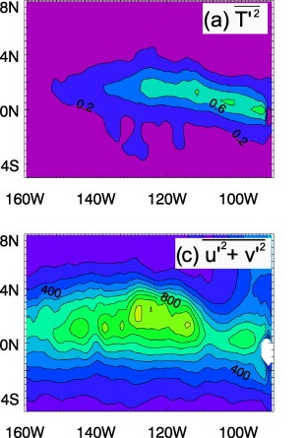
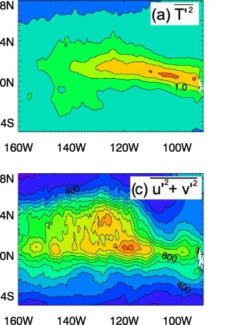
1°
1/4°
Equatorial resolution
1/12°
Observations
Ocean model resolution will have little impact on El Nino once Kelvin and Rossby waves resolved (Guilyardi et al., 2004)
Resolution is important for Tropical Instability Waves
Heating by TIWs ~75% greater at high resolution during La Nina → reduced cold bias and enhanced asymmetry in ENSO
1°
Crocker and Graham
1/4°
Graham, 2014

Slide 13
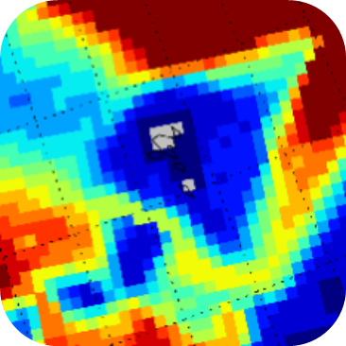
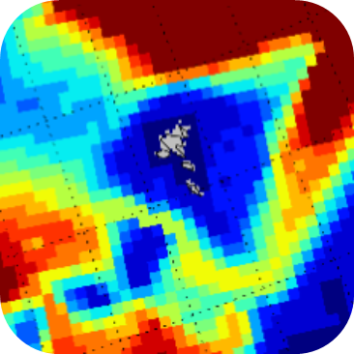
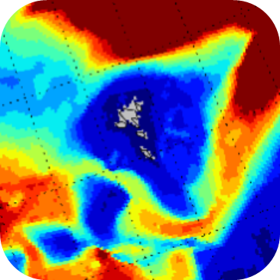
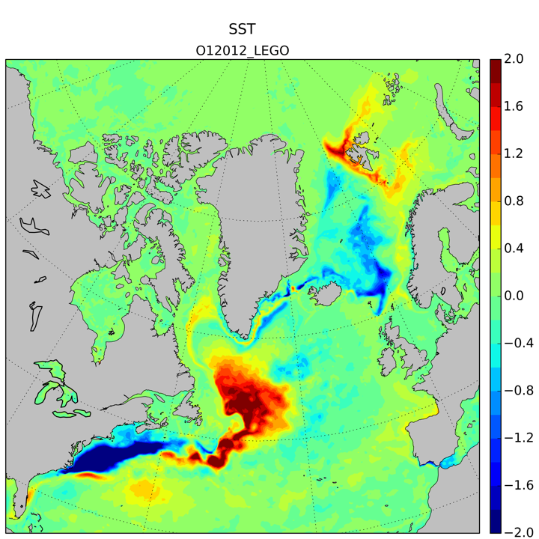
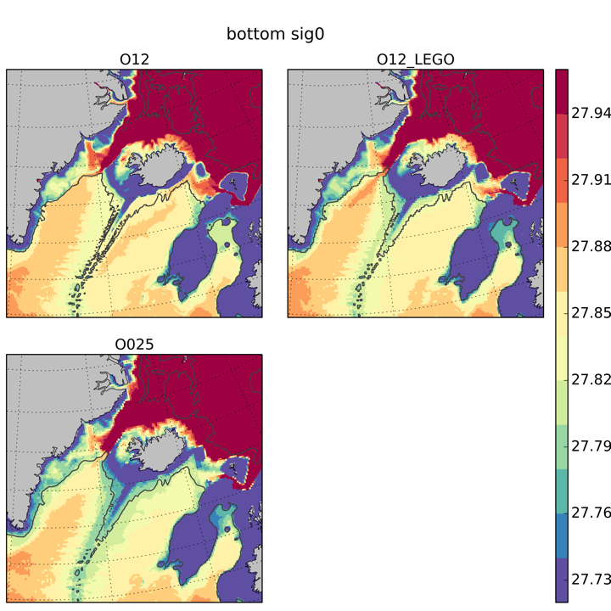
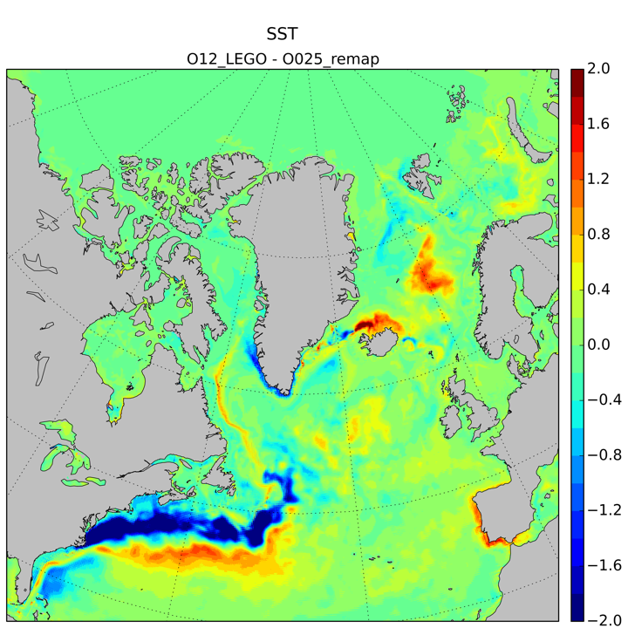
Topographic effects
Grid
resolution
Bathymetry resolution
Resolution of bathymetry is key factor in choice of the grid resolution.
Overflows and Gulf Stream pathways very sensitive to the bathymetry.
Strengthening of NADW cell is due to bathymetry (seen going from O12_LEGO to O12).
O25
O12_LEGO
O12
Bathymetry
 | Obs | 025 | 12_L | 12
DS | 2.9 | 2.2 | 3.1 | 2.4
FBC | 1.9 | 2.1 | 2.1 | 2.3
Grid
Mathiot et al., in prep.
SST differences

Slide 14
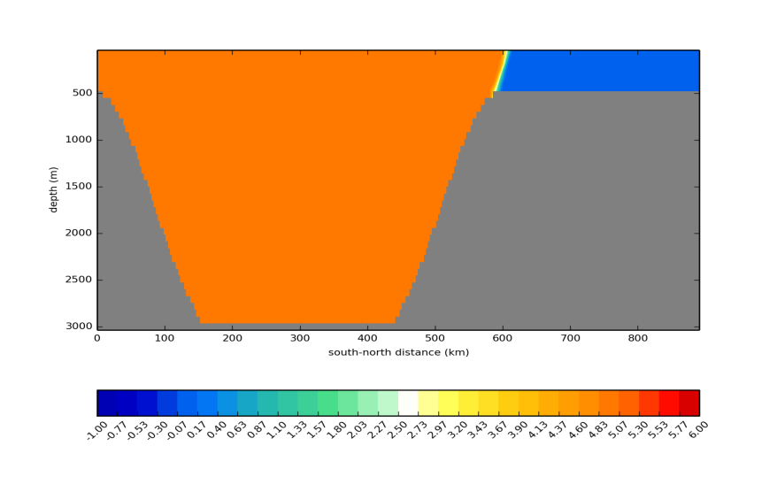
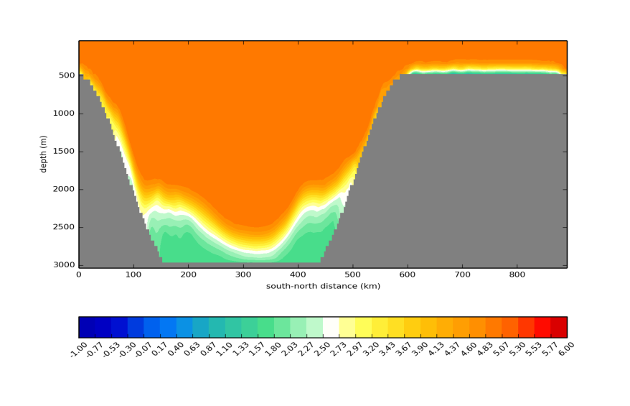
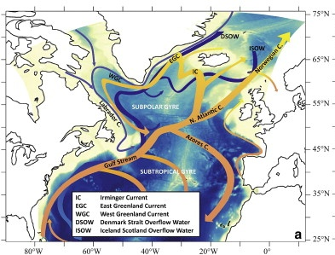
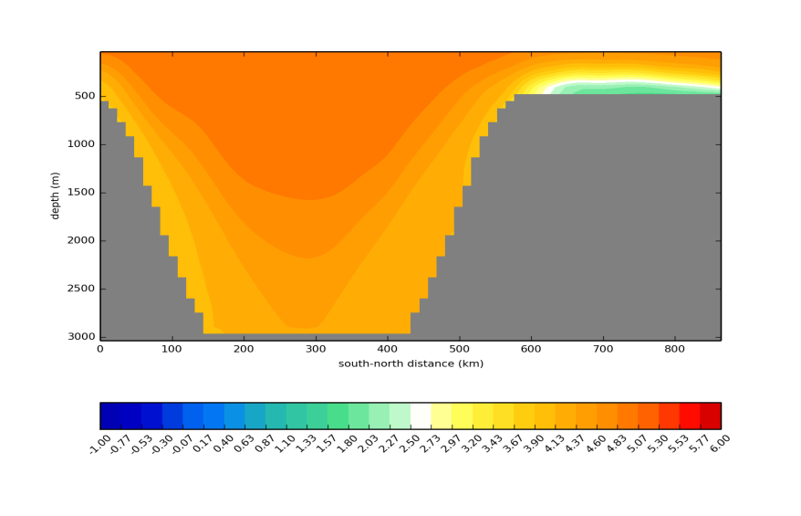
Overflow resolution
Horizontal and vertical resolution required to capture overflows
Winton et al. (1998) estimate 3-5 km required horizontally and 30-50 m vertically
Other approaches to vertical resolution later
Marzocchi et al., 2015
Dave Storkey

Slide 15
3. Traceable hierarchies and parameterisation

Slide 16
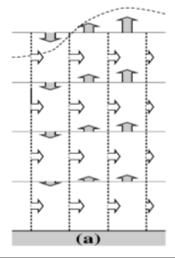
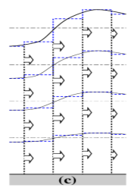
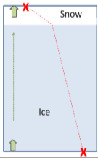
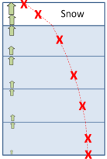
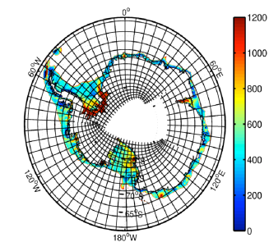
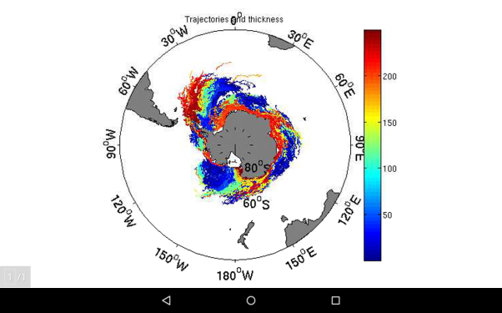
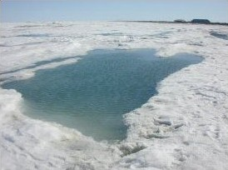
Example: traceable hierarchy at GO6
Nonlinear
free surface
Multi-layer sea ice thermodynamics
Enabling better understanding of the impacts of resolution on climate
GO6 + GSI8
ORCA12
Zero-layer
Multilayer
linear free surface
z*
ORCA025
Lagrangian
Icebergs
Ice shelf
cavities
Explicit
representation
of melt ponds
ORCA1
Storkey et al., GMDD

Slide 17
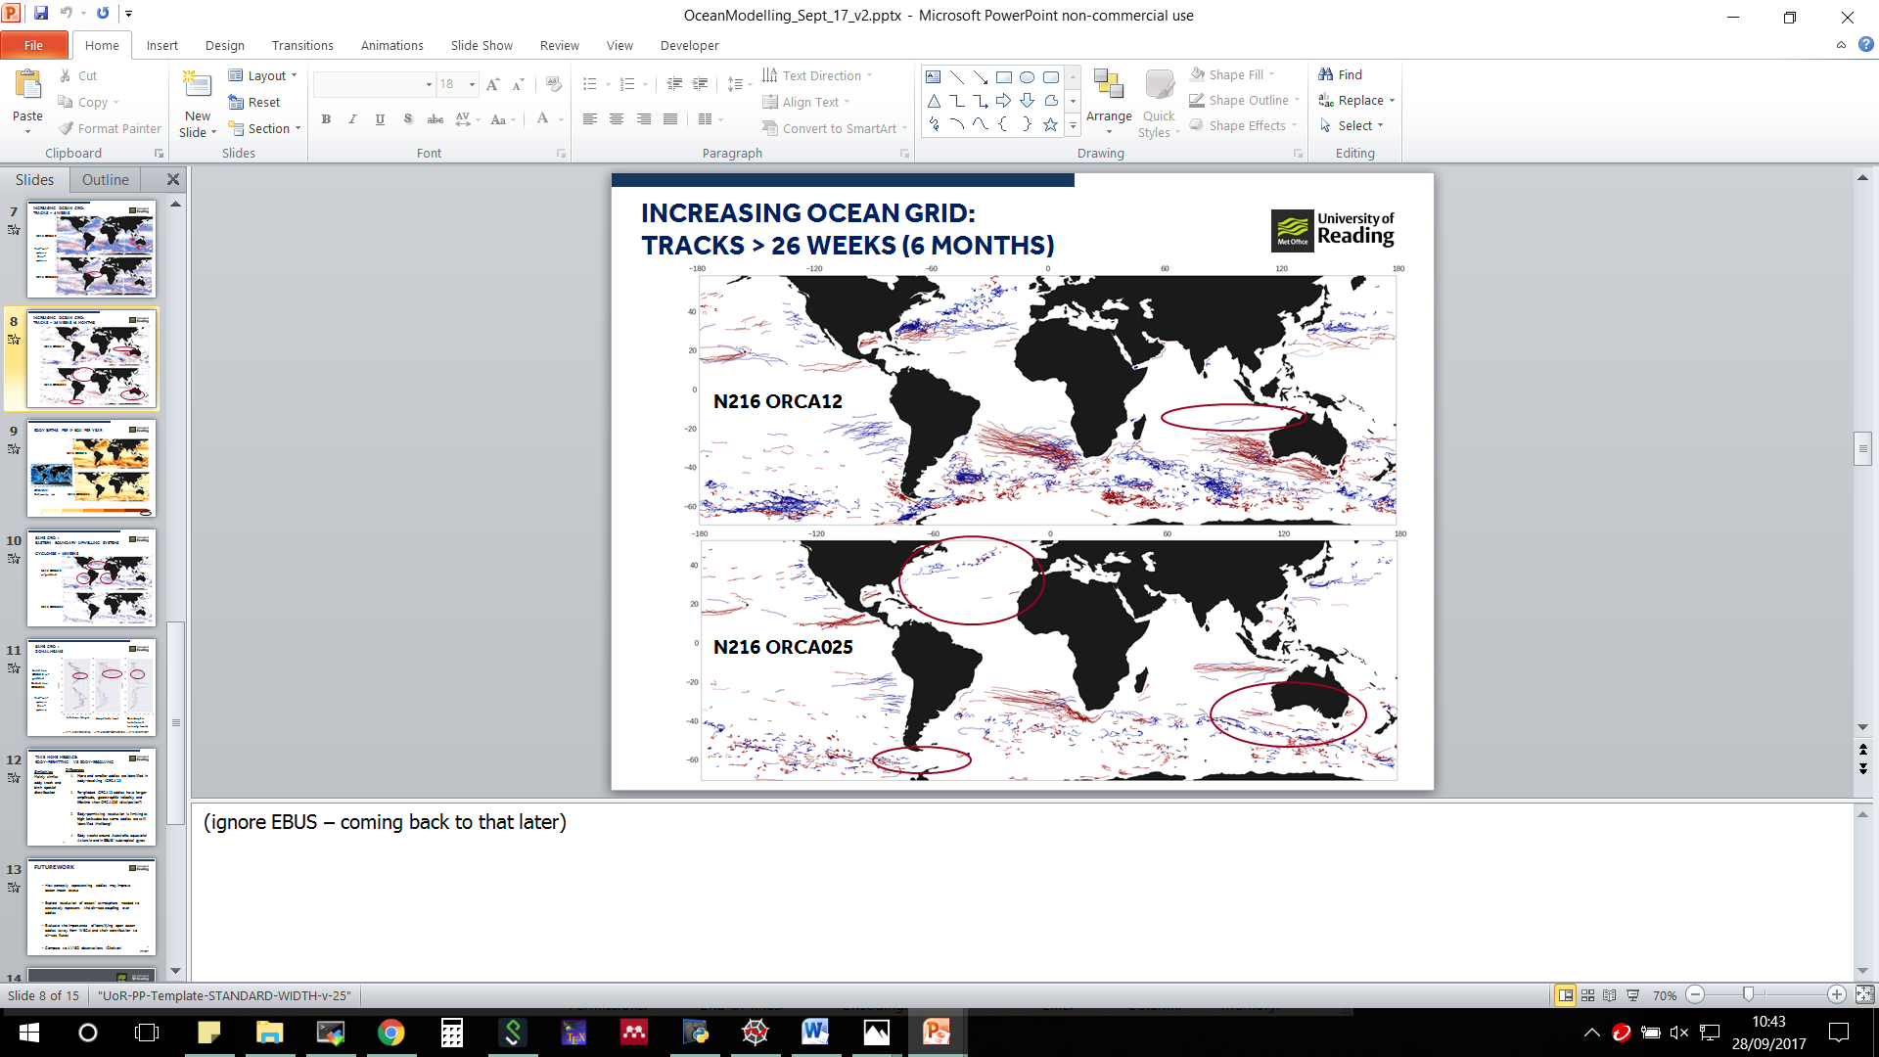
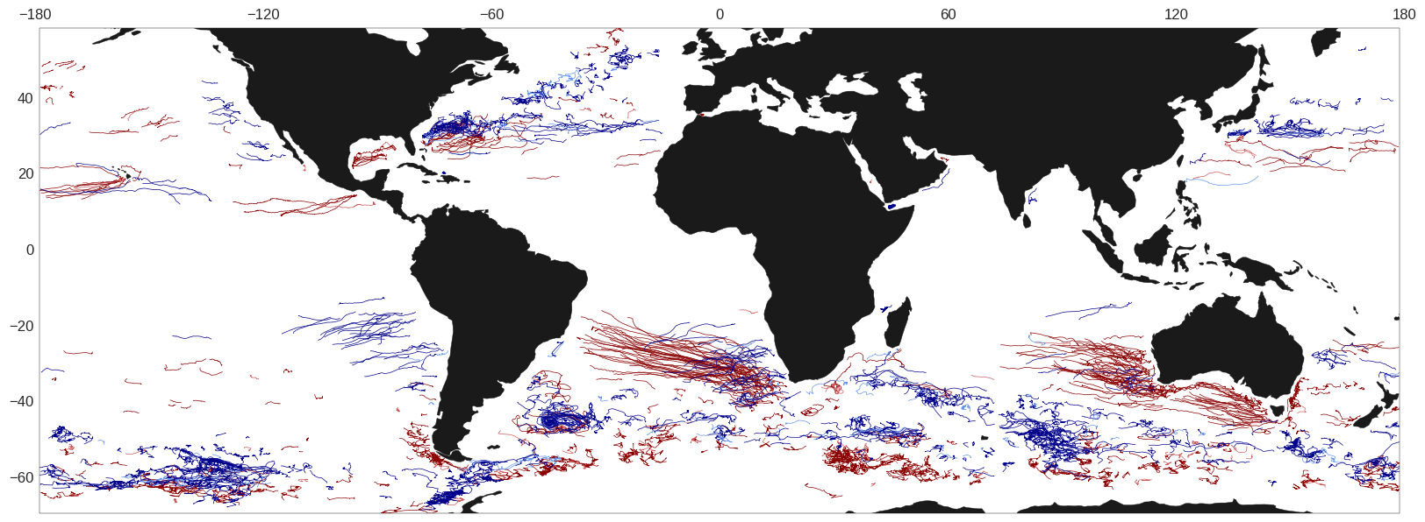
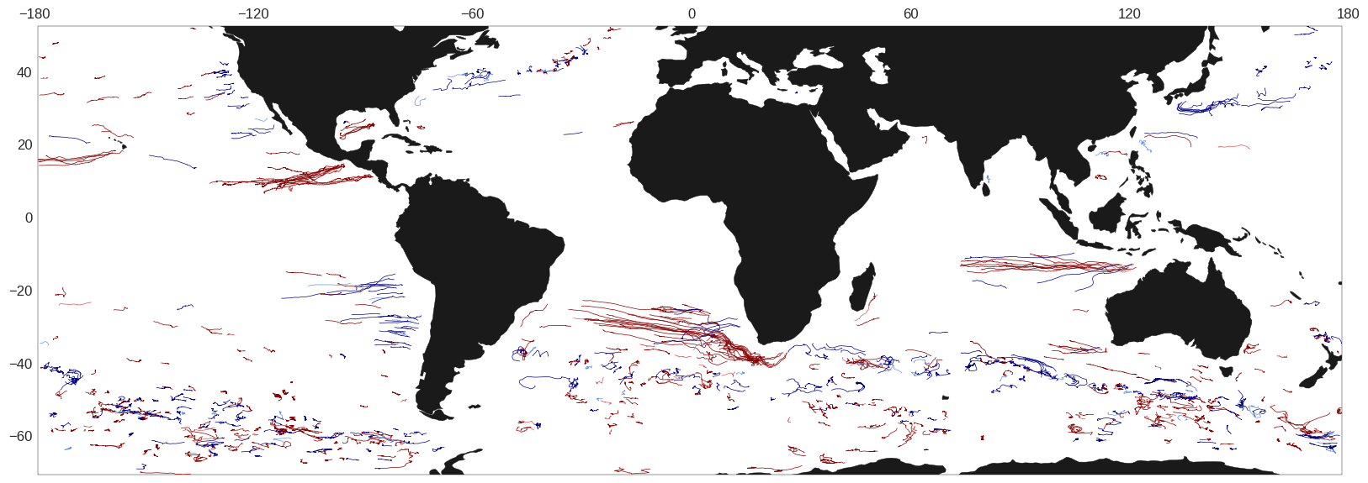
Mesoscale eddies
Red= anti-cyclonic
Blue = cyclonic
N216 ORCA12
Tracks > 26 weeks
N216 ORCA025
Ashby et al., in prep.
Notes:
(ignore EBUS – coming back to that later)

Slide 18
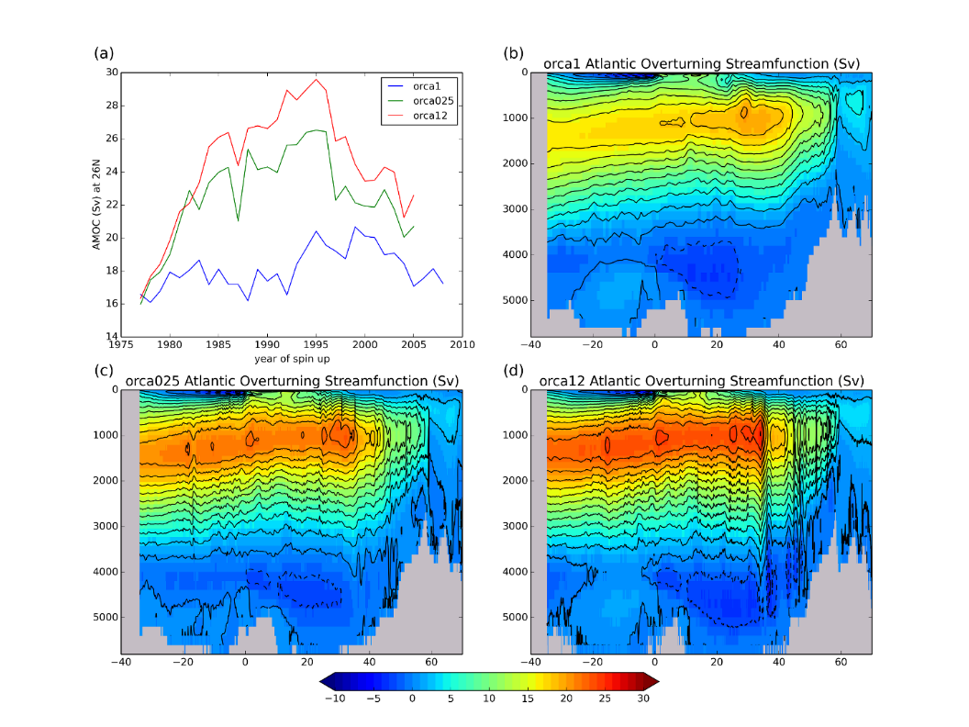
AMOC in GO6 hierarchy
Large variation in behaviour of AMOC across the hierarchy
Higher resolutions overshoot but still tend to a higher AMOC
Model dependent behaviour? Highly sensitive to Labrador Sea convection
Storkey et al., GMDD

Slide 19
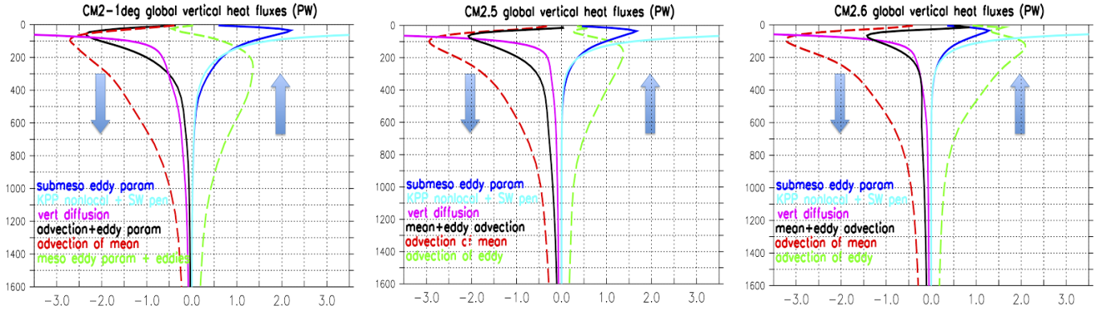
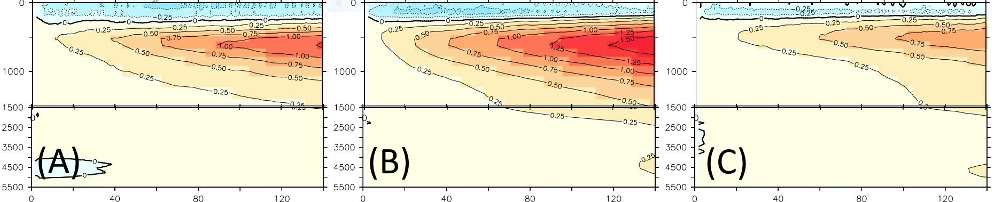
Role of eddies in the heat budget
Eddies play an important role in the heat budget - globally transporting heat upwards
Southern Ocean: eddy energy penetrates deep into water column
Mid-latitude gyres: eddy activity compensates Ekman pumping
Important consideration for spinup and model biases
Griffies et al., 2015

Slide 20
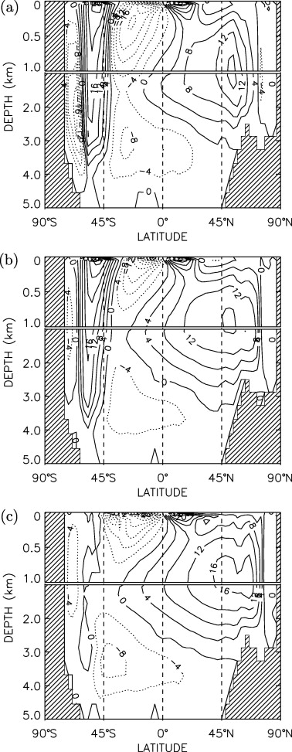
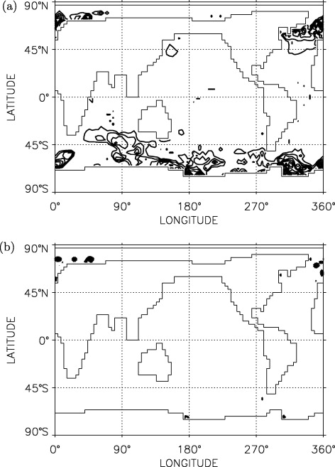
Parameterising eddies
Κ =Thickness diffusion
Gent & McWilliams, 1990
Danabasoglu et al., 1994

Slide 21


Von Storch et al., 2016
Impacts of GM parameterisation
GM allows coupled model to be run without flux adjustment-ocean can transport sufficient heat
Salinity also affected by GM-increasing GM reduces temperature biases but increases salinity biases
Gordon et al., 2000

Slide 22

Eddy saturation/compensation
Eddy saturation means that the ACC doesn’t spin-up in response to increased winds
Climate change response of low resolution models could be compromised unless GM parameterisation can account for this
Subject of current research (David Marshall)
Munday et al., 2013

Slide 23


Parameterise as a function of resolution?
Can you switch eddy parameterisation on only when resolution is insufficient to parameterise eddies?
Switch on GM when Rossby radius < 2*dy
Hallberg, 2013

Slide 24



Scale-aware parameterisations
Represent eddy momentum fluxes via backscatter parameterisation
Ideas based on reinjecting energy that would have been dissipated at the gridscale back to the large-scale
Negative Laplacian or non-Newtonian stress tensor
Jansen et al., 2015
Cooper and Zanna, 2015

Slide 25

4. Sensitivity to resolution in coupled systems
Ocean resolution is likely to affect both atmosphere and ocean
Largest air-sea fluxes in frontal regions with high EKE
Evidence for impacts in the coupled system

Slide 26
Intrinsic variability
Ocean intrinsic variability forces low frequency ocean variability in eddying regions
Can be seen in ¼ degree model but not 2 degree model
Potential forcing of atmosphere in these regions
Penduff et al., 2011

Slide 27


SST-windstress relationship
Positive correlations indicate where ocean leads atmosphere
Ocean becomes more important as resolution increases
Once eddies and fronts present, not strongly sensitive to resolution
Deficiency in physics of atmospheric boundary layer parameterisations? (Song et al., 2009)

Slide 28


Impact of boundary currents on atmosphere
Modelled rain rates depend on resolution of SST field
Effects may be seen into upper troposphere
Minobe et al. 2008

Slide 29


Eddies imprint on atmosphere
Imprint of eddies seen in atmosphere - downwind momentum mechanism appears to dominate
Do we see such a strong coupling in the model and does it matter which grid fluxes are calculated on? (S. Ashby)
Frenger et al., 2013

Slide 30

Eddies affecting atmosphere circulation
Differences between models with actual SST and SST filtered to remove eddies
Difference in wind, SLP and transient KE
Ma et al., 2015

Slide 31


Improved winter blocking at eddy permitting resolution
Reduction in SST bias moving from 1 degree to ¼ degree improved blocking
Bias largely due to steering of North Atlantic current
Scaife et al., 2011

Slide 32


Atmosphere response to SST errors
SST errors due to topographic steering
Response: (1) meridional heat advection by a mean wind anomaly; (2) meridional heat advection by the transient eddies; and/or (3) ascent and the associated adiabatic cooling over the western boundary currents (WBC) and their extensions
3 dominates in these experiments
Lee et al., 2017

Slide 33

Emerging paradigm
Need sufficiently high resolution in atmosphere model to capture connection to upper tropsphere
Arnaud Czaja

Slide 34


Impact of eddy-atmosphere interaction on the ocean
Interaction of eddies with the atmosphere impacts on the ocean circulation
Ma et al., 2016

Slide 35
Exploring resolution
x 1950 CO2
4
ORCA1/025/12 + N216
ORCA1/025/12 + N96/512
1
Resolution hierarchy of GC3.
Ocean components is GO6 – NEMO at ORCA1 (L), ORCA025 (M) and ORCA12 (H).
Atmosphere resolutions – 150km (N96; L), 60km (N216; M), 25km (N512; H).
Control and 4xCO2.
0
30
130
SPIN-UP
CTL/4xCO2
 | 150km N96 L | 60km N216 M | 25km N512 H
ORCA1 1 deg L | DECK/MIPs UKESM PD, CTL, HIST, 4XCO2 | CTL
ORCA025 1/4 deg M | PD | DECK/MIPs PD, CTL, HIST | CTL, HIST, 4XCO2
ORCA12 1/12 deg H |  | CTL | PD, CTL, HIST, 4XCO2
GC3: Williams et al., JAMES, in press
GO6: Storkey et al., GMDD
HighRes-MIP: Haarsma et al., GMD, 2016
EU-PRIMAVERA, NERC ACSIS

Slide 36




Impact of resolution
GC2 coupled model
Changes in SST biases
Stronger AMOC at ORCA12
Associated with interhemispheric shift in SST and ocean heat transport
Continuing work with longer control and transient experiments
AMOC at N512-1/12°
AMOC at N216-1/4°
Hewitt et al., 2016
Roberts et al., 2016

Slide 37




Impact on mean state
1/4°
1/12°
Improved northward heat transports
Linked to stronger Gulf Stream
Impact on SST field reduces surface heat flux error
Roberts et al., 2016

Slide 38









Preliminary: Sensitivity of climate change response to resolution
Resolution vs ensemble spread
N96-ORCA1
N512-ORCA025
N512-ORCA12
Heat uptake
MLD change
Daley Calvert, Pierre Mathiot, Mike Bell, Malcolm Roberts, Helene Hewitt
AMOC change

Slide 39



5. Vertical resolution/ coordinates
Choose vertical resolution to allow the baroclinic models to be represented
Need at least 3 grid points between modal crossings
75 levels turns out to be sufficient for 1st and 2nd modes
Stewart et al., 2017

Slide 40

Other coordinate choices
Z (with partial steps)
S (terrain following) (with partial steps and combined with z)
Non-linear free surface
Advantages and drawbacks with all approaches but try to make best choice for the application
In particular, s coordinates may be a good approach in the overflows to provide vertical resolution
Madec et al., 2016

Slide 41


Vertical resolution in coupled models
Large-scale warming of SST
Enhanced seasonality in Tropics
Bernie et al., 2008

Slide 42
6. Summary
Tropics and boundary currents suggest a minimum 1/4° horizontal resolution-although note that this resolution is deficient in terms of heat budget and big uncertainties as to parameterisation approach
Benefits of eddy-resolving include eddies, fronts and topographic control. Emerging results are likely to lead to improved parameterisations or improved evidence for high resolution
Traceable model hierarchies allow systematic assessment and greater understanding
Evidence that coupled processes associated with boundary currents, fronts and eddies affect the mean state of both ocean and atmosphere in coupled models
Vertical resolution considerations are resolving diurnal cycle (1m near surface) and baroclinic modes. Overflows require specific consideration (coordinates or parameterisation)

Slide 43
Resolution choices for different applications
Short range ocean forecasting: resolution to resolve mesoscale features
Seasonal: sufficient ocean resolution for accurate atmospheric circulation, Equatorial regions but also mid-latitudes
Decadal: ocean memory becomes important – need accurate circulation particularly in subpolar gyre and overflows
Climate: long-term heat and freshwater budget and circulation to get accurate response (including impact of eddies)

Slide 44
Questions for physics dynamics coupling
Can parameterisations be improved to mitigate deficiencies of models that aren’t eddy resolving? Can scale-aware parameterisations in the ocean impact on coupled response?
How should resolution of both atmosphere and ocean components be chosen and do we need to think about the resolution on which fluxes are calculated?
Will atmospheric boundary layer parameterisations/resolution need to be revisited in light of coupled processes?

Slide 45


The next frontiers in global ocean models
Eddies and shelf processes
Shelf sea enabled global model
Nutrient and carbon exchange with global ocean
Global marine impacts incl. coastal sea level
Marine methane release
Interactions at the kilometric scale and in the shelf/near shelf region are areas of new research
ORCA12
ORCA025
ORCA1
High resolution improves currents, eddies, open ocean processes BUT...
...need tides and shelf processes to capture well-mixed regions
Stratification (JJA) from shelf 1/15º°
Stratification (JJA) from global 1/12º°

Slide 46
Processes models resolve
1/60º 1/12º 1/4º 1º
Typical resolution of ocean models spans the regime of mesoscale phenomena
Need to parameterise below the resolved scales
Key is to understand the compromises in the choice of resolution

Slide 47


Impact of ocean current coupling on the ocean
Coupling of surface currents to atmosphere feeds back on ocean circulation
Renault et al., 2016

