Slide 1
Parallel Physics-Dynamics Coupling in an Atmosphere Model
Aaron S. Donahue and Peter M. Caldwell
3rd Workshop on Physics Dynamics Coupling (PDC18)
July 12th, 2018
This work was performed under the auspices of the U.S. Department of Energy by Lawrence Livermore National Laboratory under Contract DE-AC52-07NA27344 IM Release Number LLNL-PRES-754353

Slide 2
Outline
Introduction
Climate Impact
Performance Impact
Stability Impact
Overstabilization
Mass Conservation
Conclusions

Slide 3
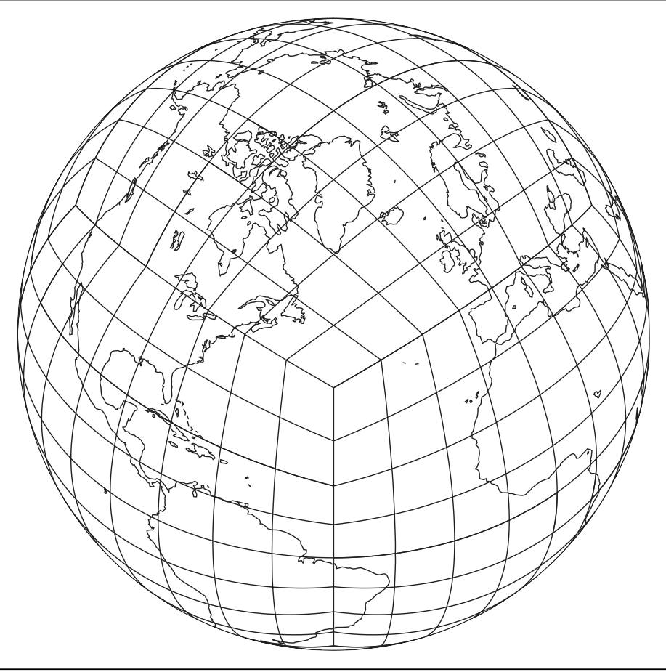
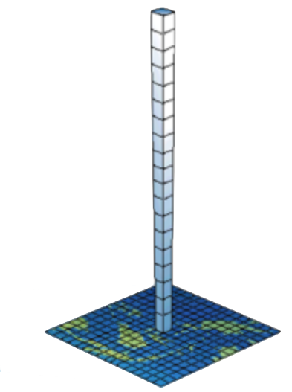
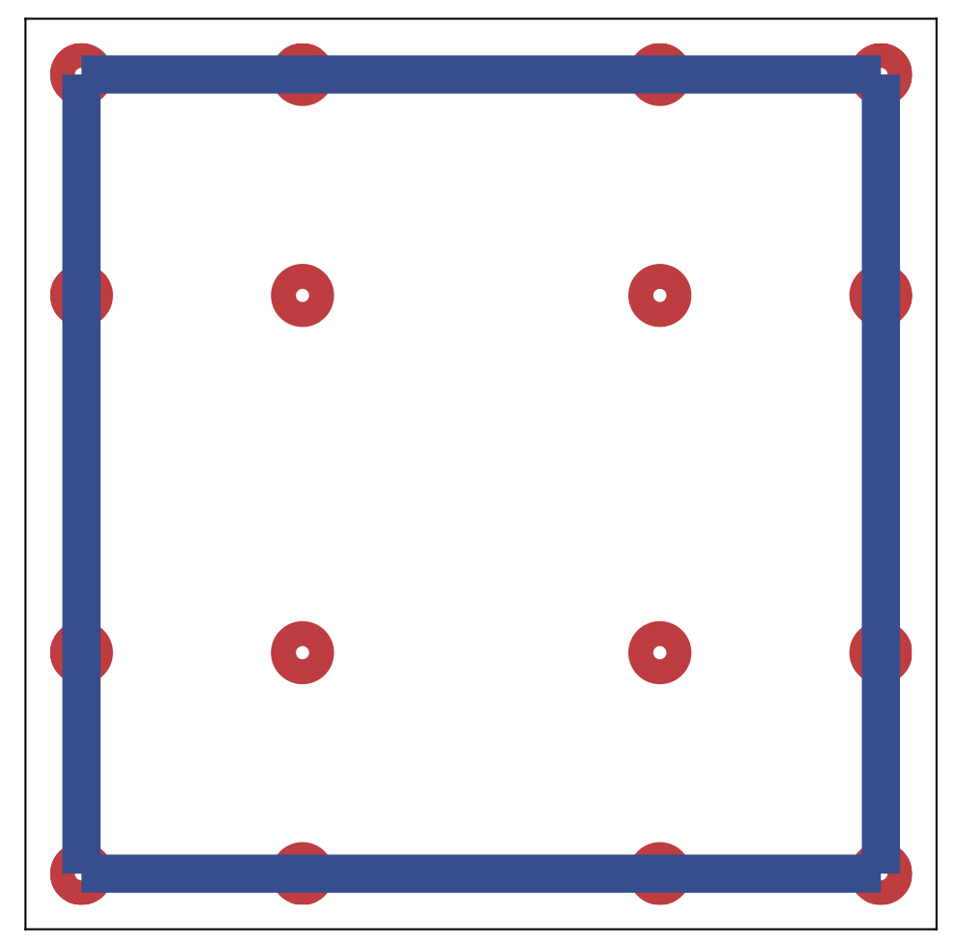
Introduction
(B) Dynamics is solved on individual elements.
(C) Physics is solved over a set of columns defined by the Gauss-Lobatto points of a spectral element.
(A) The Earth is divided into a cubed sphere of quadrilateral elements.
Figure: Dynamics and physics domain for the E3SM atmosphere model. (A) Cubed sphere, (B) example element, (C) example physics column. Image credit: Dennis et al. (2012) Int. J. of High Performance Computing Applications (A and B).

Slide 4
Coupling methods:
Sequential Split (SS, aka time split/fractional steps): State is updated after each process.
state^{n}
Proc1
tend1^{n}
state^{n*}
Proc2
tend2^{n}
state^{n+1}
Used in E3SM physics and for E3SM physics/dynamics coupling.
Parallel Split (PS , aka process/additive split): All processes are computed from the same state.
Proc1
tend1^{n}
state^{n}
state^{n+1}
Used in E3SM microphysics
Proc2
tend2^{n}

Slide 5
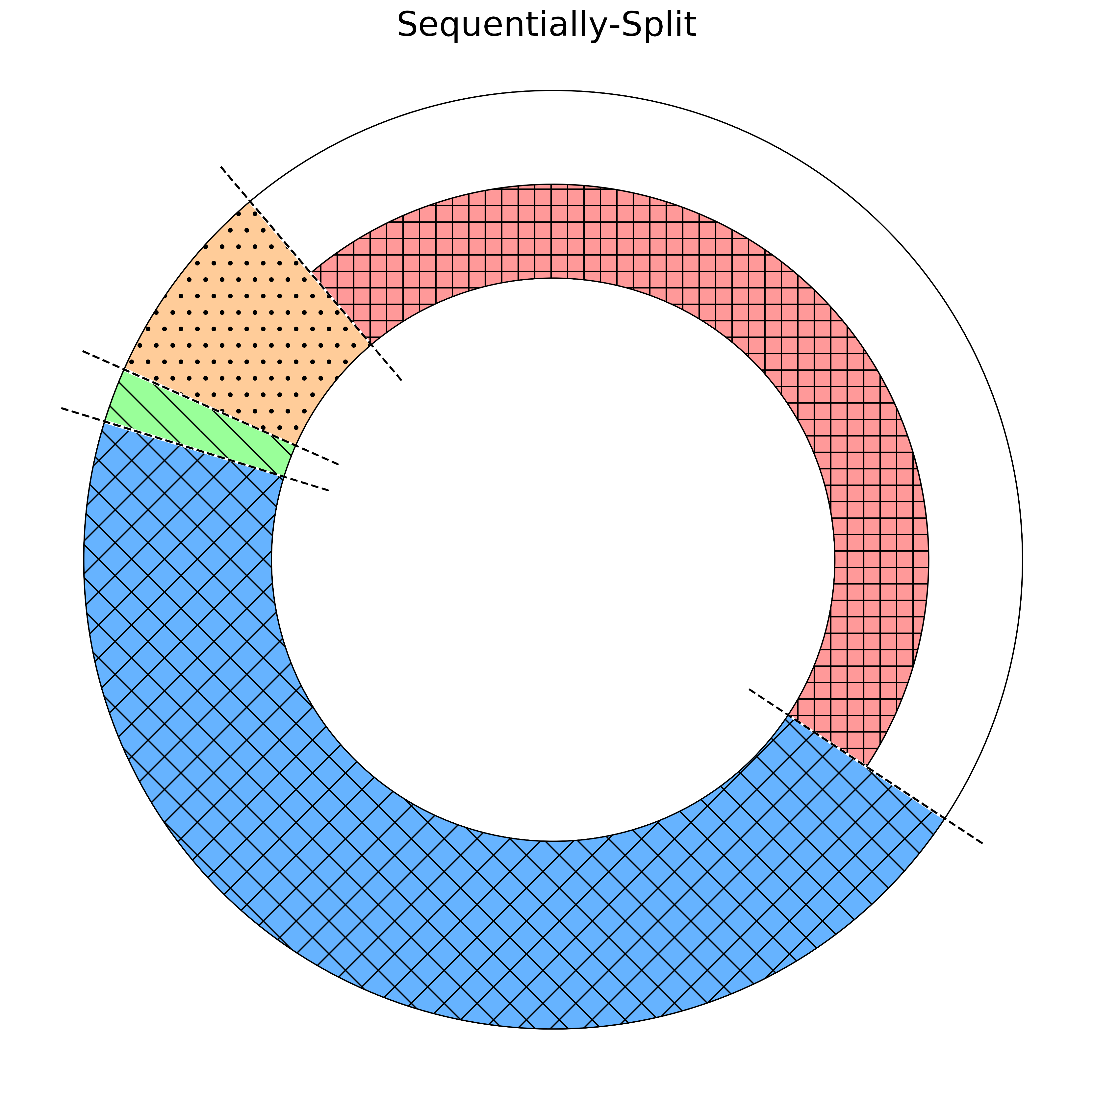
Sequentially-Split (SS)
a).
Excess physics processors sit idle.
Outer Loop:
Physics Processor
Inner Loop:
Dynamics and Physics Processor
Figure: Order of operations in the E3SM atmosphere model for sequential-splitting (left) and parallel-splitting (right) for a case where more cores than elements are used. The inner loop depicts cores assigned to dynamics, the outer loop is all other cores.

Slide 6
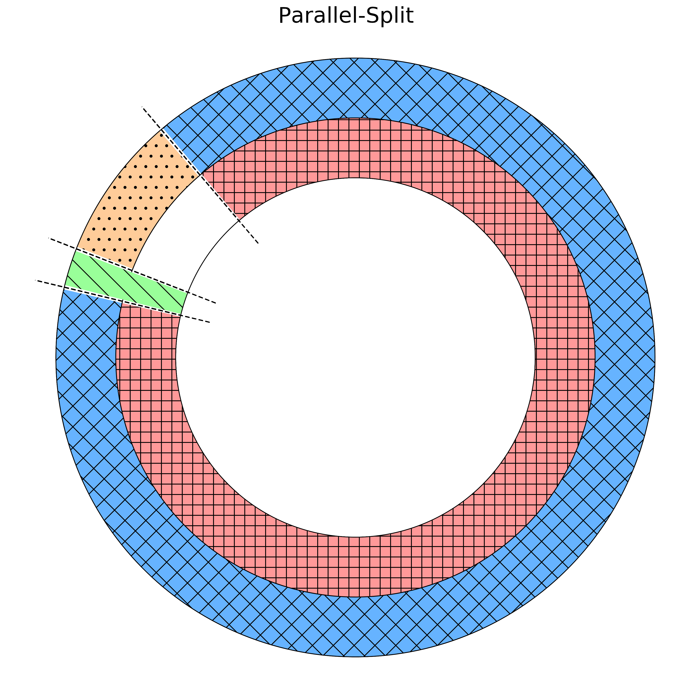
Sequentially-Split (SS)
a).
b).
Parallel-Split (PS)
Less time spent idle.
Outer Loop:
Physics Processor
Inner Loop:
Dynamics and Physics Processor
Faster time to solution
Outer Loop: Physics Processor
Inner Loop: Dynamics Processor
Figure: Order of operations in the E3SM atmosphere model for sequential-splitting (left) and parallel-splitting (right) for a case where more cores than elements are used. The inner loop depicts cores assigned to dynamics, the outer loop is all other cores.

Slide 7
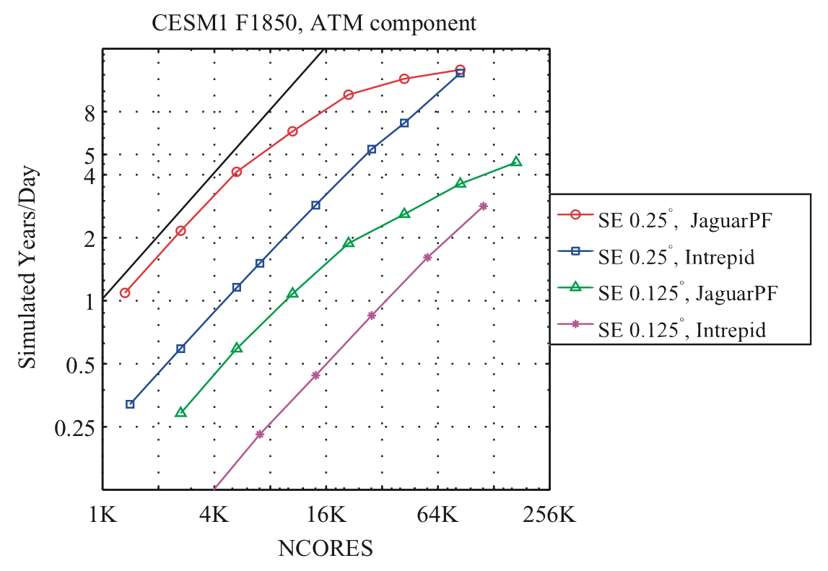
Resolution | # of dynamics elements | # of physics columns
$${7.5}^{°}$$ | 96 | 866
$${2.7}^{°}$$ | 726 | 6536
$${1.9}^{°}$$ | 1536 | 13826
$${1.0}^{°}$$ | 5400 | 48602
$${0.25}^{°}$$ | 86400 | 777602
SS: Upper limit on scalability equals the # of elements
The spectral element (SE) dycore is scalable up to the number of elements.
Physics scales up to the total number of columns (which is 9x greater than the number of elements).
Scalability of the model is limited to the total number of elements.
PS: Expand to greater # of cores, potentially up to # of columns
Figure: Scalability of the SE-Dycore. Image credit: Dennis et al. (2012) Int. J. of High Performance Computing Applications.
Figure 3: Scalability of CAM-SE, Dennis et al., “CAM-SE: A scalable spectral element dynamical core for the Community Atmosphere Model” (2012), Int. J. of High Performance Computing Applications.

Slide 8
Parallel-split Implementation:
Dynamics
state*
state^{n+1}
state^{n}
Physics
tend_{physics}
Implementation is relatively straightforward:
Dynamics and Physics are passed the same state
Physics produces a tendency and dynamics produces an intermediate state
The physics tendency is then used to update the state for the next timestep

Slide 9
Outline
Introduction
Climate Impact
Performance Impact
Stability Impact
Overstabilization
Mass Conservation
Conclusions

Slide 10
The climate impact of switching to PS is surprisingly small
Parallel-Split
Sequentially-Split
Figure: Annual total precipitation $\left(mm/day\right)$ based on 5 year climatologies for parallel-split (top-left), sequentially-split (top-right) simulations, and their difference (bottom), $∆t=300s$.

Slide 11
Parallel-Split
Sequentially-Split
Difference
The most significant differences between the solutions are observed in the temperature at high altitudes (~200mb) and concentrated in the polar regions.
Interannual variability at high latitudes is quite large, so differences seen here may not be significant.
Figure: Annual zonal temperature $\left(K\right)$ based on 5 year climatologies for parallel-split (top-left), sequentially-split (top-right) simulations, and their difference (bottom), $∆t=300s$.

Slide 12
Outline
Introduction
Climate Impact
Performance Impact
Stability Impact
Overstabilization
Mass Conservation
Conclusions

Slide 13
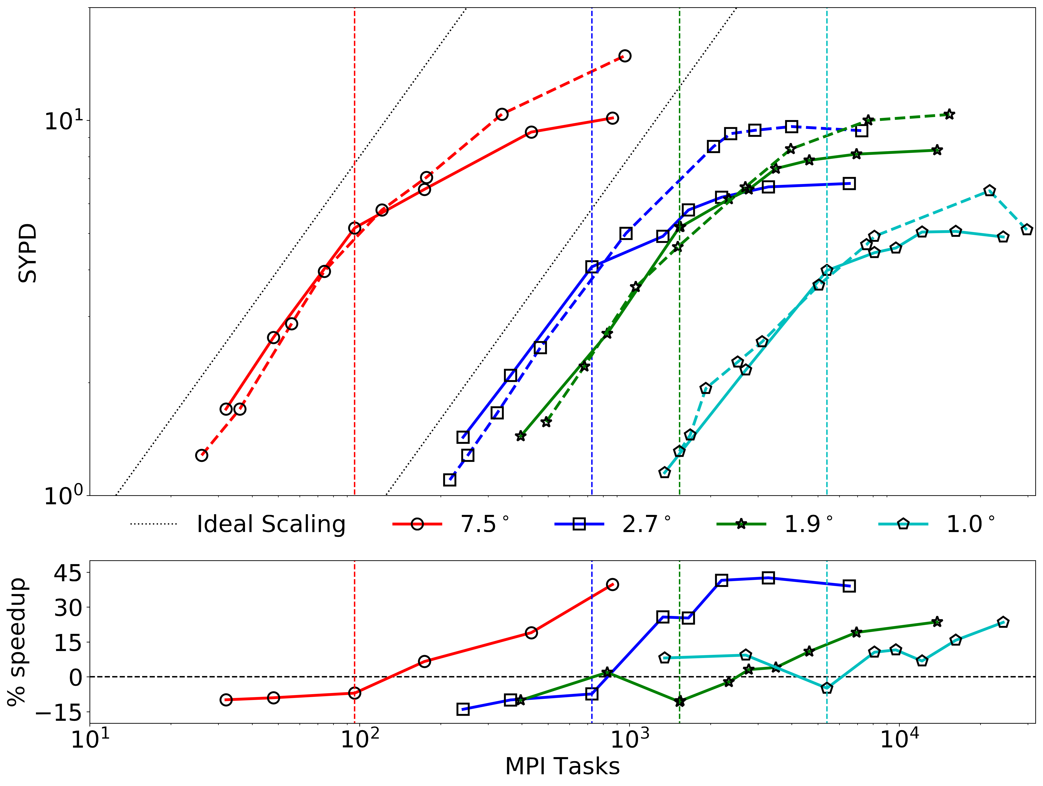
Proper physics/dynamics load balancing extends and application of the PS method extends the scalability of the model.
At the highest core counts communication costs begin to dominate limiting the scalability of either coupling method.
Comparison of parallel- and sequentially- split performance;
at low core counts communication costs limit the performance of PS,
at large core counts PS is up to 20-40% faster than sequentially-split.
Figure: Scalability of the model and % speedup for parallel-split runs vs. sequentially-split runs. Horizontal dashed lines represent the scalability limit of the spectral element dynamics core. All runs use a timestep of $∆t=300s$.

Slide 14
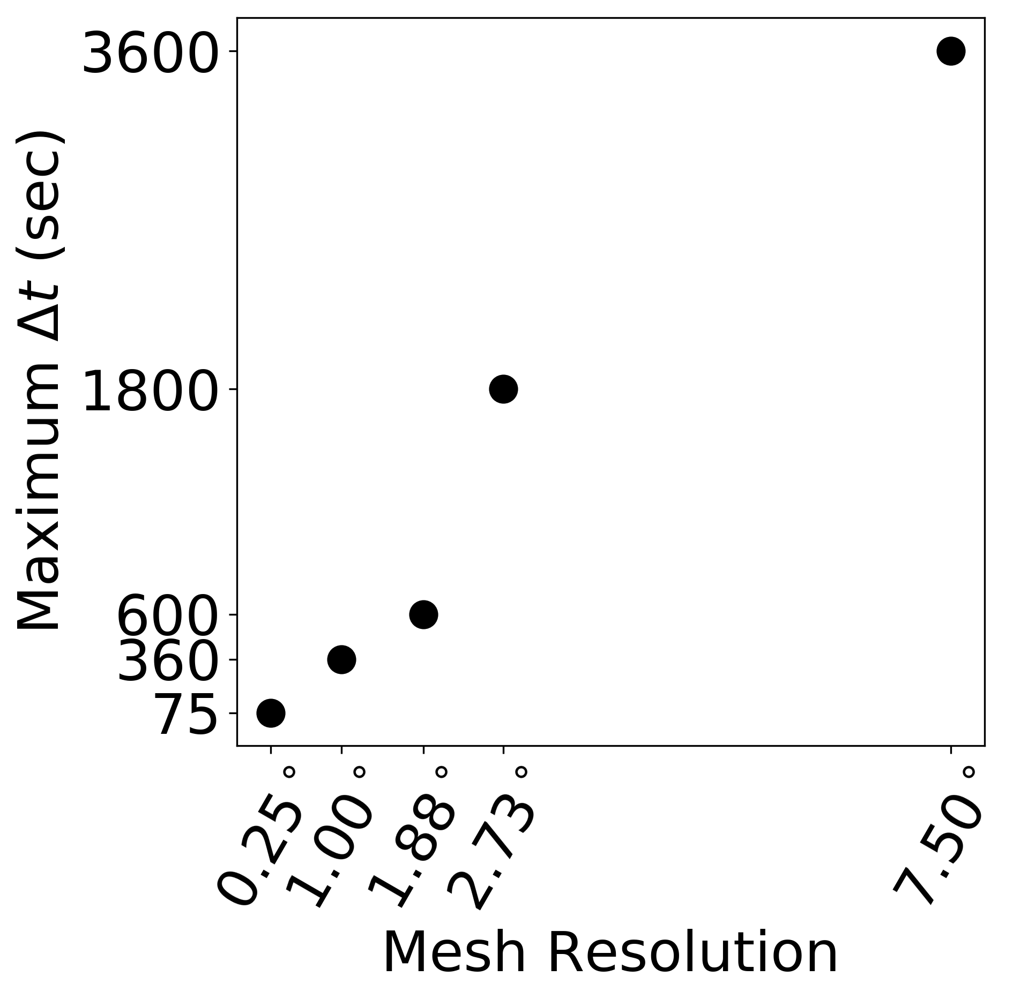
Parallel-split coupling allows for faster runtimes at similar computational cost as slower sequentially-split coupling runs.
For similar computation cost, PS offers more throughput.
For a given throughput PS is cheaper.
Cheap
Expensive
Fast
Slow
Figure: Model performance comparison for sequentially-split (solid lines) and parallel-split (dashed lines) simulations. All runs use a timestep of $∆t=300s$.

Slide 15
Outline
Introduction
Climate Impact
Performance Impact
Stability Impact
Overstabilization
Mass Conservation
Conclusions

Slide 16
Stability Impact
PS consistently requires a smaller timestep to remain stable. On average this value is 6 times smaller than what is required for SS simulations.
6x
Figure: Suggested $∆t$ for parallel-split coupling by average mesh resolution.

Slide 17
Stability Impact
PS consistently requires a smaller timestep to remain stable. On average this value is 6 times smaller than what is required for SS simulations.
6x
WHY?
Timestep Stability Criteria?
Mass Conservation?
Figure: Suggested $∆t$ for parallel-split coupling by average mesh resolution.

Slide 18
Stability Criteria:
Sequential Split (SS):
state^{n}
Proc1
tend1^{n}
state^{n*}
Proc2
tend2^{n}
state^{n+1}
$∆t$ constraint based on Proc1
$∆t$ constraint based on Proc2
Parallel Split (PS):
Proc1
tend1^{n}
state^{n}
state^{n+1}
Proc2
tend2^{n}
$∆t$ constraint based on the combined tendencies of Proc1 and Proc2

Slide 19
Simple Example: Advection-Diffusion
$$\frac{∂q}{∂t}+α\frac{∂q}{∂z}+Dq=0$$
Stability Criteria
Advection only: $∆t≤\frac{∆z}{α}$
provided the proper upwind scheme is applied.
Diffusion only: $∆t≤\frac{2}{D}$
for $D>0$
Advection
Diffusion

Slide 20
Simple Example: Advection-Diffusion
$$\frac{∂q}{∂t}+α\frac{∂q}{∂z}+Dq=0$$
Stability Criteria
Advection only: $∆t≤\frac{∆z}{α}$
provided the proper upwind scheme is applied.
Diffusion only: $∆t≤\frac{2}{D}$
for $D>0$
$α_{dyn}$ $∙∆t$
$${(α}_{dyn}+α_{phy})∙∆t$$
PS can have a smaller or larger timestep requirement, depending on the signs of advection terms.
$$α_{phy}∙∆t$$

Slide 21
Simple Example: Advection-Diffusion
$$\frac{∂q}{∂t}+α\frac{∂q}{∂z}+Dq=0$$
Stability Criteria
Advection only: $∆t≤\frac{∆z}{α}$
provided the proper upwind scheme is applied.
Diffusion only: $∆t≤\frac{2}{D}$
for $D>0$
$$D_{dyn}∙∆t$$
$${(D}_{dyn}+D_{phy})∙∆t$$
$$D_{phy}∙∆t$$
PS has a stricter timestep requirement

Slide 22
Simple Example: Advection-Diffusion
$$\frac{∂q}{∂t}+α\frac{∂q}{∂z}+Dq=0$$
$α_{dyn}$ $∙∆t$
$$D_{dyn}∙∆t$$
PS has a different timestep requirement than SS
$${(D}_{dyn}+D_{phy})∙∆t$$
$${(α}_{dyn}+α_{phy})∙∆t$$
$$D_{phy}∙∆t$$
$$α_{phy}∙∆t$$

Slide 23
Outline
Introduction
Climate Impact
Performance Impact
Stability Impact
Overstabilization
Mass Conservation
Conclusions

Slide 24
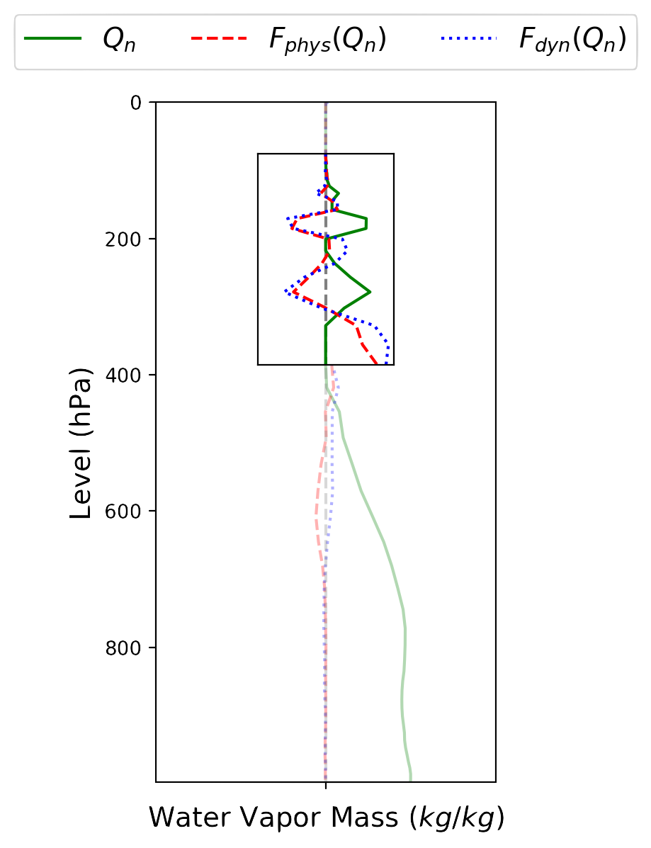
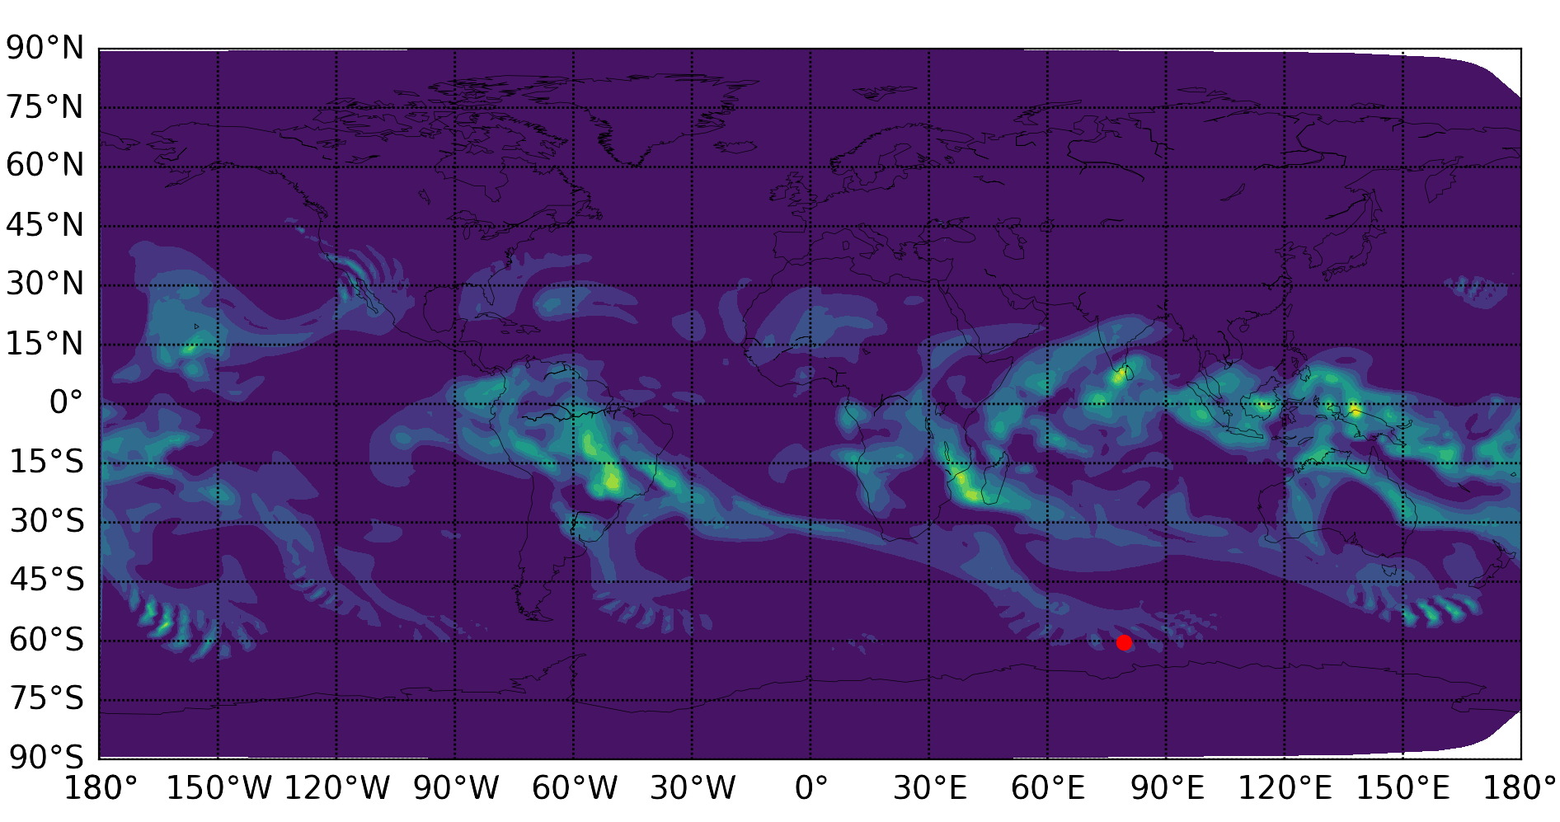
Stability Impact
At the default timestep of $∆t=1800s$ the model generates $2∆x$ instabilities throughout the domain.
Figure: Global water vapor mass $Q_{n}$ $\left(kg/kg\right)$ at 278 hPa (left) and vertical water vapor mass with water vapor tendencies for physics, $F_{phys}\left(Q_{n}\right)$, and dynamics, $F_{dyn}\left(Q_{n}\right)$ (right). Default timestep, $∆t=1800s$, mesh resolution=$1^{°}$.
Similarly, physics and dynamics tendencies for $2∆z$ instabilities ”overstabilize” the solution. Causing more instabilities to form.

Slide 25
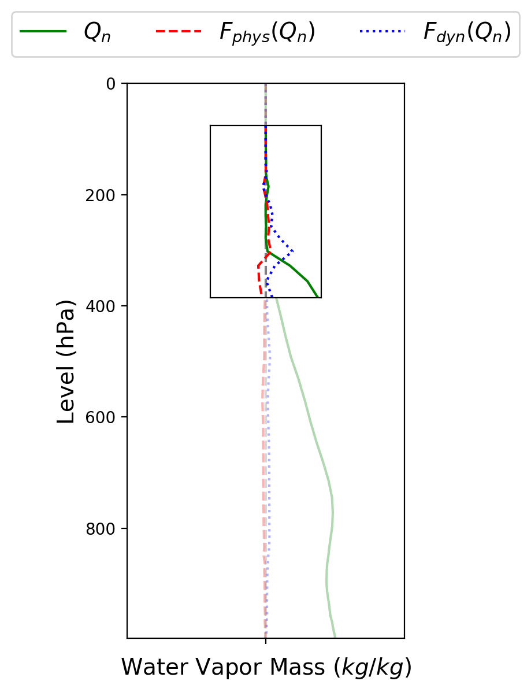
An instability forms in the vertical column.
Both Physics and Dynamics act to damp sharp gradients to stabilize the solution.
The combined tendencies of physics and dynamics “overstabilize” the solution generating a separate instability in the vertical.
Figure: Vertical water vapor mass $Q_{n}$ $\left(kg/kg\right)$, with water vapor tendencies for physics, $F_{phys}\left(Q_{n}\right)$, and dynamics, $F_{dyn}\left(Q_{n}\right)$ at every timestep leading to instabilty. Default timestep, $∆t=1800s$, mesh resolution=$1^{°}$.

Slide 26
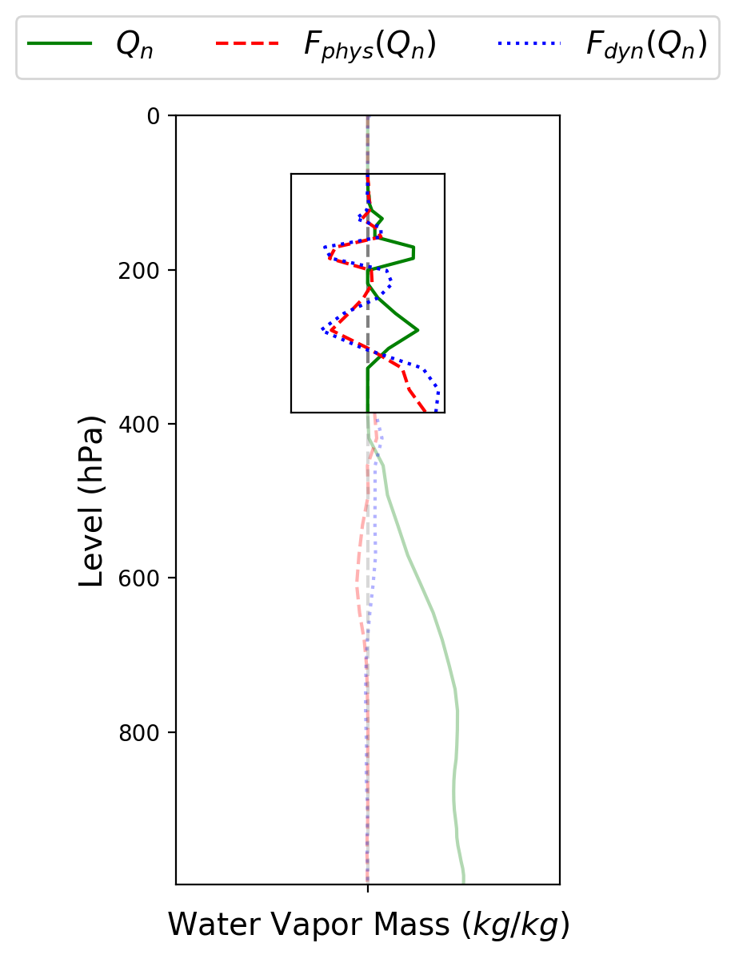
An instability forms in the vertical column.
Both Physics and Dynamics act to damp sharp gradients to stabilize the solution.
The combined tendencies of physics and dynamics “overstabilize” the solution generating a separate instability in the vertical.
Figure: Vertical water vapor mass $Q_{n}$ $\left(kg/kg\right)$, with water vapor tendencies for physics, $F_{phys}\left(Q_{n}\right)$, and dynamics, $F_{dyn}\left(Q_{n}\right)$ at every timestep leading to instabilty. Default timestep, $∆t=1800s$, mesh resolution=$1^{°}$.

Slide 27
Outline
Introduction
Climate Impact
Performance Impact
Stability Impact
Overstabilization
Mass Conservation
Conclusions

Slide 28
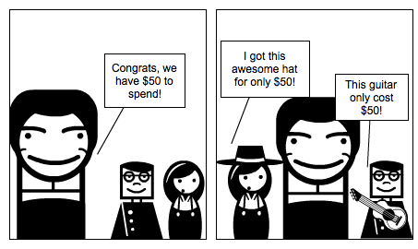
Issue - Overconsumption
This problem is encountered any time parallel time splitting is used
Two processes can independently remove mass from the same point, which when compounded can lead to an overconsumption of the local resources, i.e. negative mass.
At the phys/dyn level this occurs frequently, as much as 1/3 of the pts. for liquid cloud water.
We currently just set negative values to zero.
Note, this actually occurs for sequential tendency splitting in SE dynamics as well
“Clipping” negative tendencies violates conservation.
Is this acceptable? Is there a better way?
Parallel yet isolated processes can over-deplete resources when combined.

Slide 29
Issue - Overconsumption

Slide 30
Issue - Overconsumption
Dynamics
Physics
Sequential Splitting:
Dynamics moves mass, then physics removes mass
Parallel Splitting:
Dynamics prescribes a tendency to move mass.
Physics prescribes a tendency to remove mass.
Both are applied to the same location in space.
Potential Mass Conservation Issues

Slide 31
Issue - Overconsumption
Clipping: Setting all negative masses to zero.
Mass Fixer:
Weighted Horizontal Distribution: Drawing mass from neighboring nodes horizontally.
Weighted Vertical Distribution: Drawing mass from neighboring levels vertically.
Full Element Distribution: Drawing mass from all points within an element.

Slide 32
Mass Conservation
Dynamics
Physics
$$\frac{∂q}{∂t}+U\frac{∂q}{∂x}=0$$
$$\frac{∂q}{∂t}+Dq=0$$
Consistent-Parallel Splitting:
Dynamics prescribes a tendency to move mass.
Physics prescribes a tendency to remove mass.
Physics tendency is advected along with dynamics.

Slide 33
Mass Conservation
Dynamics
Physics
$$\frac{∂q}{∂t}+U\frac{∂q}{∂x}=0$$
$$\frac{∂q}{∂t}+Dq=0$$
Consistent-Parallel Splitting:
Dynamics prescribes a tendency to move mass.
Physics prescribes a tendency to remove mass.
Physics tendency is advected along with dynamics.

Slide 34
Conclusions
After implementing parallel physics/dynamics, we found:
Little change to model climate*.
For a given number of core hours, PS allows for faster time to solution than SS (at higher core counts)*.
Parallel splitting requires smaller ∆t for stability, canceling the benefit of faster throughput.
Due to overcompensation between physics and dynamics.
PS leads to mass conservation errors.
* At the timestep needed for stability in parallel-splitting

Slide 35
Conclusions
After implementing parallel physics/dynamics, we found:
Little change to model climate*.
For a given number of core hours, PS allows for faster time to solution than SS (at higher core counts)*.
Parallel splitting requires smaller ∆t for stability, canceling the benefit of faster throughput. A smaller timestep isn’t all bad -> more accurate.
Due to overcompensation between physics and dynamics.
Apply stabilization mechanisms (i.e. hyperviscosity) after physics/dynamics coupling.
PS leads to mass conservation errors.
Better handling of mass conservation (i.e. tendency advection)
* At the timestep needed for stability in parallel-splitting

Slide 36
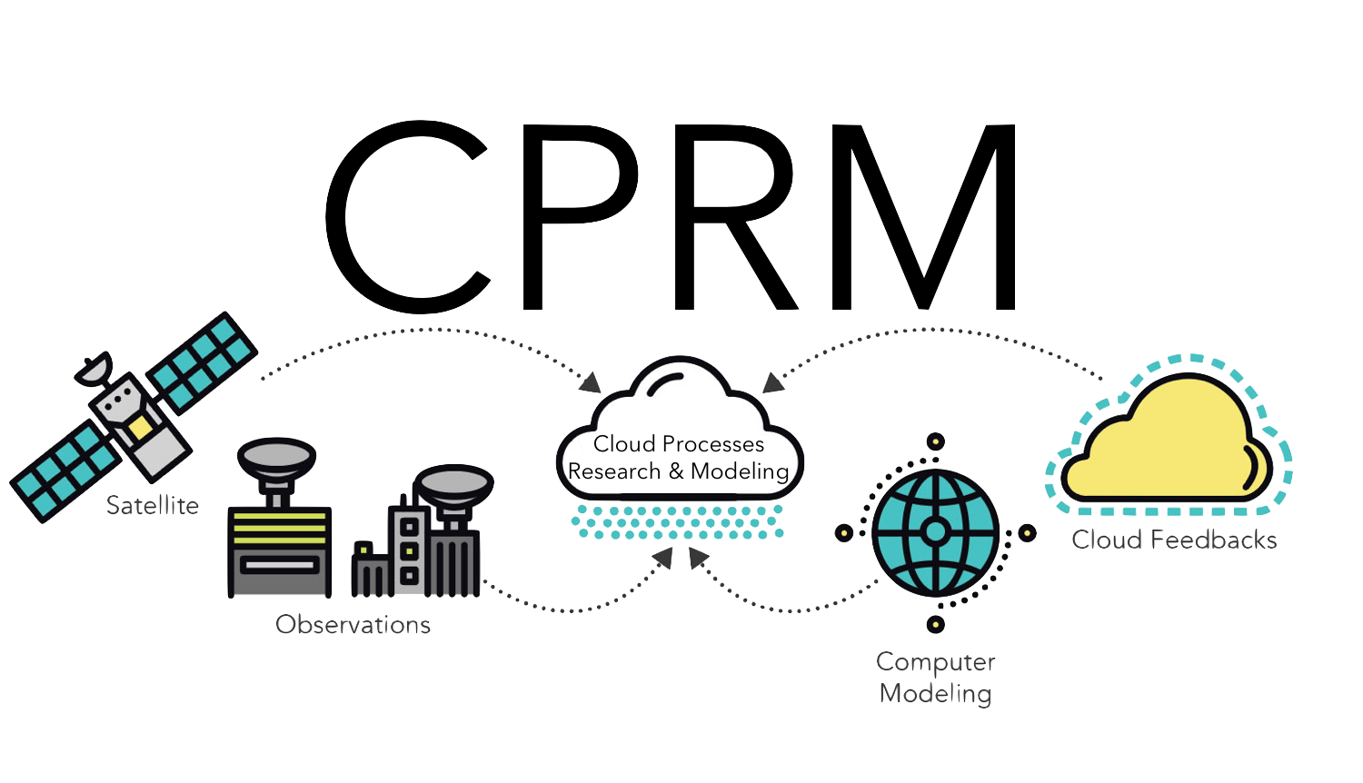
Acknowledgements:
This work was supported by the DOE Code Modernization and Validation-Software Engineering (CMDV-SE) project.
Questions?

Slide 37
Extra Slides

Slide 38
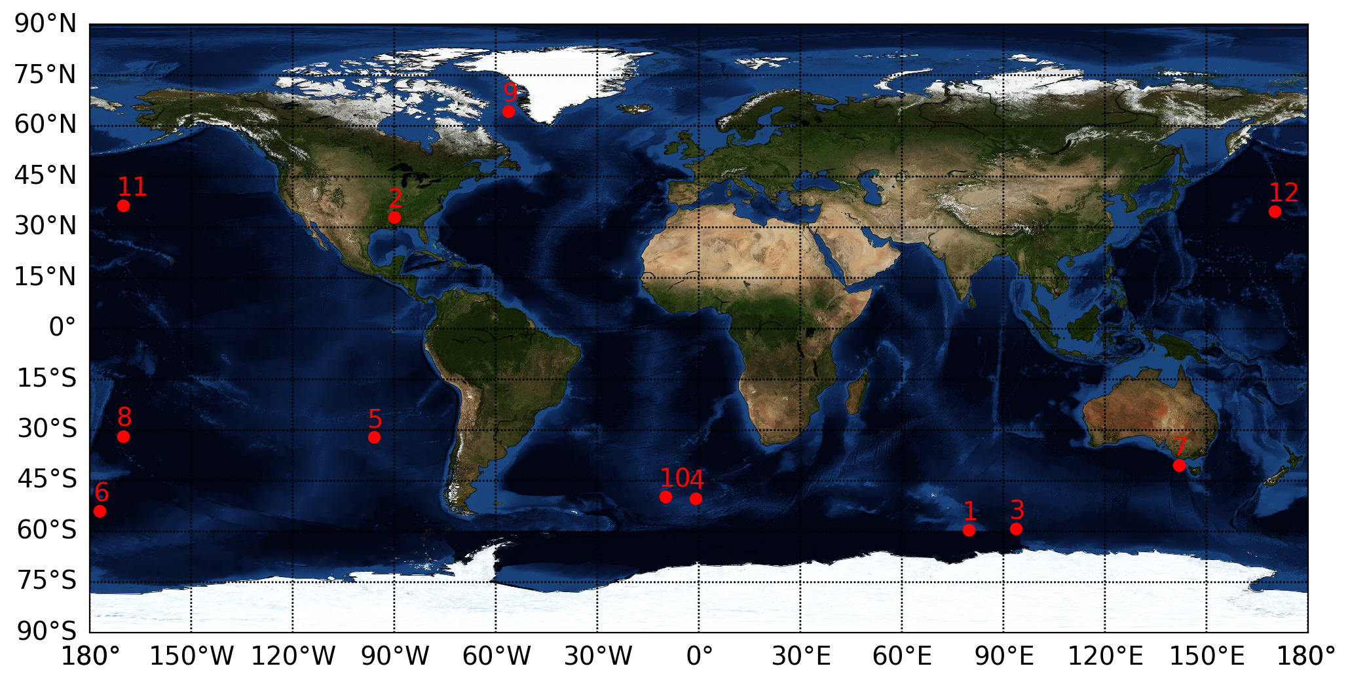
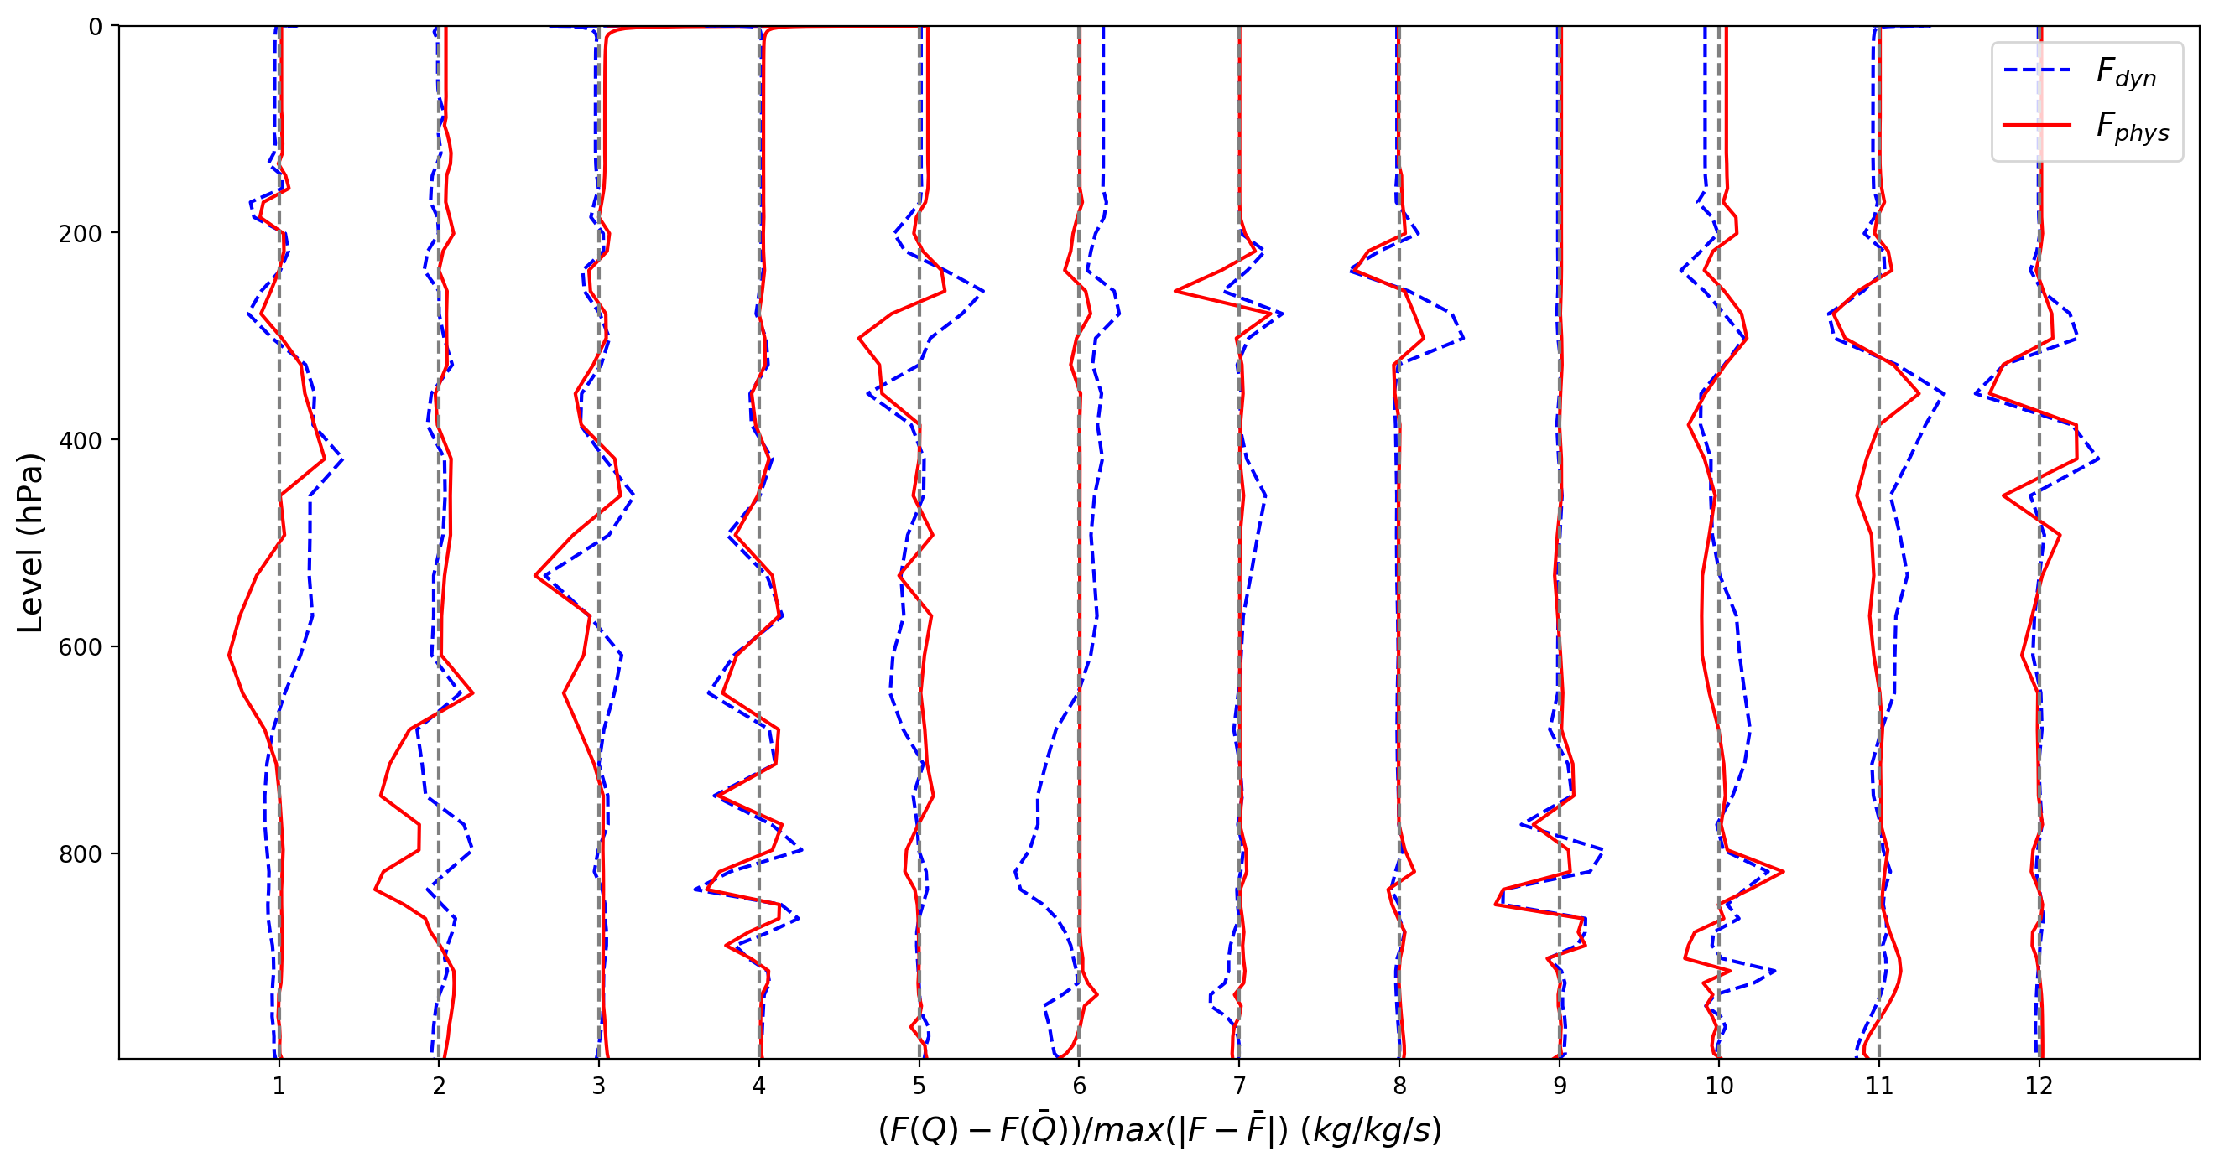

Slide 39
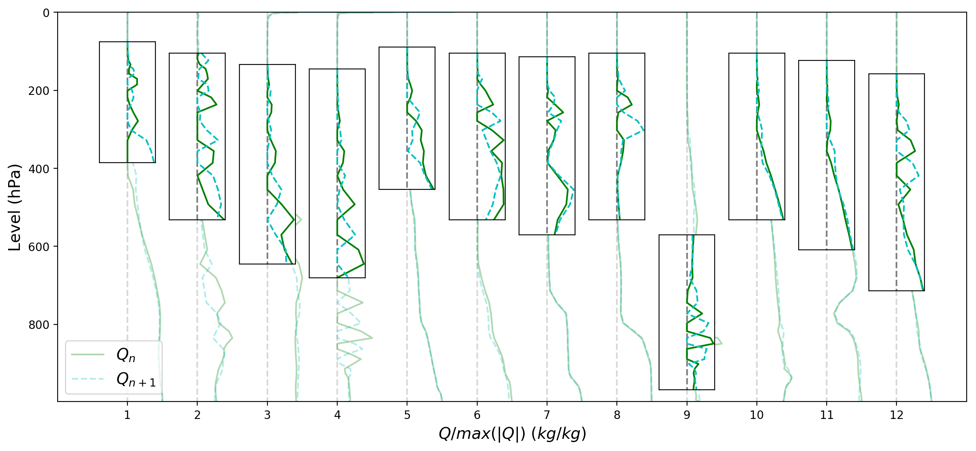

Slide 40
Surface Coupling
CAM_Run1
CAM_Run2
CAM_Run3
CAM_Run4
stepon_run1
phys_run2
stepon_run3
Write Output
phys_run1
stepon_run2

Slide 41
Surface Coupling
Physics Core
CAM_Run1
CAM_Run2
CAM_Run3
CAM_Run4
stepon_run1
phys_run2
SKIP
Write Output
phys_run1
stepon_run2
CAM_Run1
CAM_Run2
CAM_Run3
CAM_Run4
stepon_run1
stepon_run2
stepon_run4
SKIP
stepon_run3
Dynamics Core

Slide 42
Coupling Strategies:
A. Sequential-Update Split (SUS, aka time split/fractional steps): State is updated after each process
used in E3SM physics
state^{n}
Proc1
tend1^{n}
state^{n*}
Proc2
tend2^{n}
state^{n+1}
B. Sequential-Tendency Split (STS, aka no step splitting): The tendency from Proc1 is used by Proc2
state^{n}
Proc1
tend1^{n}
Proc2
state^{n+1}
option to couple E3SM physics and SE dynamics
C. Hybrid-Update-Tendency Split (HS, some processes SUS, some STS): Mass conserved variables are updated after each process (SUS), all others use the tendency from Proc1 in Proc2 (STS).
state^{n*}
state^{n}
Proc1
tend1^{n}
Proc2
tend2^{n}
state^{n+1}
E3SM default

Slide 43
Coupling Strategies:
A. Sequential-Update Split (SUS, aka time split/fractional steps): State is updated after each process
used in E3SM physics
state^{n}
Proc1
tend1^{n}
state^{n*}
Proc2
tend2^{n}
state^{n+1}
B. Sequential-Tendency Split (STS, aka no step splitting): The tendency from Proc1 is used by Proc2
state^{n}
Proc1
tend1^{n}
Proc2
state^{n+1}
option to couple E3SM physics and SE dynamics
C. Hybrid-Update-Tendency Split (HS, some processes SUS, some STS): Mass conserved variables are updated after each process (SUS), all others use the tendency from Proc1 in Proc2 (STS).
state^{n*}
state^{n}
Proc1
tend1^{n}
Proc2
tend2^{n}
state^{n+1}
E3SM default

Slide 44
$$f^{n}$$
$$f^{∗}=f^{n}+{∆t}_{D}Df^{n}$$
$$f^{n+1}=f^{∗}+{∆t}_{P}Pf^{∗}$$
$$f^{n+1}$$
$$Dynamics=F_{D}$$
$$f^{n}$$
$$f^{n+1}=f^{n}+∆t\left(F_{D}+F_{P}\right)$$
$$f^{n+1}$$
$${Physics=F}_{P}$$

Slide 45
Coupling Strategies:
A. Sequential-Update Split (SUS, aka time split/fractional steps): State is updated after each process
used in E3SM physics
state^{n}
Proc1
tend1^{n}
state^{n*}
Proc2
tend2^{n}
state^{n+1}
B. Sequential-Tendency Split (STS, aka no step splitting): The tendency from Proc1 is used by Proc2
state^{n}
Proc1
tend1^{n}
Proc2
state^{n+1}
option to couple E3SM physics and SE dynamics
C. Parallel Split (PS, aka process/additive split): All processes are computed from the same state
Proc1
tend1^{n}
state^{n}
state^{n+1}
used in E3SM microphysics
Proc2
tend2^{n}
What is the advantage of switching to Parallel Split over Sequential Splitting?

Slide 46
Overconsumption - Example
Dynamics:
$\frac{∂q}{∂t}+δ_{D}q=0$
$$\frac{∂q}{∂t}+δ_{D}q+δ_{P}q=0$$
Physics:
$\frac{∂q}{∂t}+δ_{P}q=0$

Slide 47
Overconsumption - Example
Dynamics: $\frac{∂q}{∂t}+δ_{D}q=0$
Physics: $\frac{∂q}{∂t}+δ_{P}q=0$
Sequentially-Split
Dynamics: $q^{∗}=(1−δ_{D}∆t)q^{n}$
Physics:$q^{n+1}=(1−δ_{P}∆t)q^{∗}$
Parallel-Split
Dynamics: $F_{D}=−δ_{D}∆t∗q^{n}$
Physics:$F_{P}=−δ_{P}∆t{∗q}^{n}$
$q^{n+1}=(1−δ_{P}∆t−δ_{D}∆t)q^{n}$

Slide 48
Mass Conservation
There is a clear formation of $2∆x$ waves forming at the mid-latitudes.
This is likely due to mass “clipping” which occurs when the conservation of mass has been violated.
Mass conservation violations increase with larger time step.

Slide 49
Mass Conservation
Dynamics
Physics
$$\frac{∂q}{∂t}+U\frac{∂q}{∂x}=0$$
$$\frac{∂q}{∂t}+Dq=0$$

Slide 50
Mass Conservation
Dynamics
Physics
$$\frac{∂q}{∂t}+U\frac{∂q}{∂x}=0$$
$$\frac{∂q}{∂t}+Dq=0$$
Sequential Splitting:
Dynamics moves mass, then physics removes mass

Slide 51
Mass Conservation
Dynamics
Physics
$$\frac{∂q}{∂t}+U\frac{∂q}{∂x}=0$$
$$\frac{∂q}{∂t}+Dq=0$$
Sequential Splitting:
Dynamics moves mass, then physics removes mass
Parallel Splitting:
Dynamics prescribes a tendency to move mass.
Physics prescribes a tendency to remove mass.
Both are applied to the same location in space.
Potential Mass Conservation Issues

Slide 52
Mass Conservation
This problem is encountered any time parallel time splitting is used
Two processes can independently remove mass from the same point, which when compounded can lead to an overconsumption of the local resources, i.e. negative mass.
At the phys/dyn level this occurs frequently, as much as 1/3 of the pts. for liquid cloud water.
We currently just set negative values to zero.
Note, this actually occurs in sequential tendency splitting in SE dynamics as well
“Clipping” negative tendencies violates conservation.
Is this acceptable? Is there a better way?

Slide 53
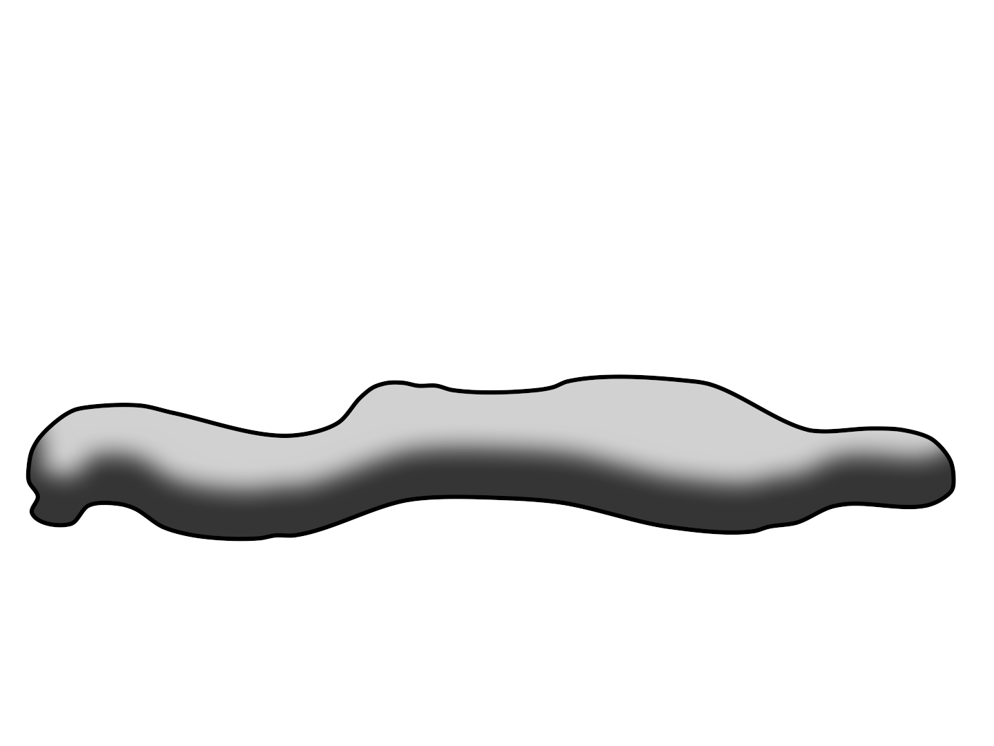
Mass Conservation
Clipping: Setting all negative masses to zero.
Weighted Horizontal Distribution: Drawing mass from neighboring nodes horizontally.
Weighted Vertical Distribution: Drawing mass from neighboring levels vertically.
Full Element Distribution: Drawing mass from all points within an element.
C
A
Using a weighted distribution approach will preserve global mass more effectively!
D
B
Tendency Advection: Apply dynamics to the physics tendencies.

