Slide 1
Physics-dynamics coupling and task parallelism
Terry Davies
Dynamics Research
3rd Workshop on Physics Dynamics Coupling
PDC18, ECMWF July 2018

Slide 2
Plan
History
Physics-dynamics time stepping
All physics parallel?
Physics forcing
Physics-dynamics coupling

Slide 3
1990 Split-explicit Hydrostatic UM. Advection + sequential physics, 3 adjustment steps . Option to reduce advection time step if polar night jet was too strong. This led to running with longer (3x) physics time step in regional model, halving the cost and giving the same accumulated rainfall.
2002 Non-hydrostatic UM operational. SISL numerics. Used for regional and global NWP and climate modelling.
Caya et al 1998. Consequences of using splitting method for implementing physical forcings in a semi-implicit semi-Lagrangian model.
ECMWF Seminars: Recent developments in numerical methods for
atmospheric modelling September 1998 The origin of noise in semi-Lagrangian integrations. Aidan McDonald
2003 Analysis of Parallel versus Sequential Splittings for Time-Stepping Physical Parameterizations, 2005 Mixed Parallel–Sequential-Split Schemes for Time-Stepping Multiple Physical Parameterizations
Mark Dubal, Nigel Wood, Andrew Staniforth
History

Slide 4
Non- hydrostatic Unified Model
New dynamics. Latitude-longitude C-grid staggering. Hybrid-height terrain-following vertical coordinate Charney-Philips vertical staggering. 2TL Semi-Lagrangian advection, semi-implicit time stepping with off-centring. Eulerian forward-backward continuity equation to conserve mass for climate. 3d Helmholtz solver GCR(k).
Parallel slow physics, sequential fast physics shown to be appropriate time step coupling for long (semi-implicit) time steps.
Variable resolution option developed for 1.5km UK model (UKV).
Regional models use rotated latitude-longitude grid and nesting suite used to run LAMs anywhere.
2014 ENDGame version to reduce off-centring and cost of the solver.
V-at-the-poles, semi-Lagrangian treatment of continuity equation, cheaper solver, iterative time-stepping.

Slide 5
Target scheme and time stepping
$$\frac{DX}{Dt}=Lin+Non+Slow+Fast$$
where
$$Slow$$
physics are radiation, microphysics (cloud and precipitation) and
sub-grid orography (gravity wave drag and low-level blocking) and where
physics are surface exchanges, boundary layer mixing (vertical mixing) and convection (showers).
$$Fast$$
The target scheme is
$X^{n+1}={[X+\left(1−α\right)Δt\left(L+N\right)]}_{d}^{n}$ $+$($1−$ $α_{S})ΔtS_{d}^{n}+\text{(}1− α_{F})ΔtF_{d}^{n}$
$+ α{Δt\left(L+N\right)}^{n+1}$ + $α_{S}ΔtS^{n+1}$ +$α_{F}ΔtF^{n+1}$
To reduce non-linear coupling and calculations, a suitable scheme may be written as
$${(X−αΔtL)}^{n+1}={[ X+\left(1−α\right)Δt\left(L+N\right)+ΔtS ]}_{d}^{n} + αΔtN^{∗}+ΔtF^{∗∗}$$
where
$$N^{∗}$$
and
$$F^{∗∗}$$
represent appropriate estimates for time-level
$n+1.$

Slide 6
Time-level n cycle = 1
CLD/LSP
RAD
GWD
PHYS1
u_adv = u(n)
ADD – PHYS1
SL (n+phys1)
SURF
PHYS2
u_adv = u(Helm)
CON
BL
HELM (SL, phys2)
cycle=cycle + 1
Y
cycle<3
N
Time-level n+1
www.metoffice.gov.uk © Crown Copyright 2018, Met Office

Slide 7
Physics time stepping
$${(X−αΔtL)}^{n+1}={[X+\left(1−α\right)Δt\left(L+N\right)+ΔtS]}_{d}^{n}+αΔtN^{∗}+ΔtF^{∗∗}$$
(1)
$$Slow$$
physics each operate from time-level
$$n$$
input
input so in theory they could be computed simultaneously, i.e. in parallel.
$$Fast$$
mixing processes have smaller time-truncation error when they are computed using
the latest model state, i.e. mixing needs to be a sequential process.
If the time step is small enough, can
$$Fast$$
mixing processes also be run in parallel? Does
$${(X−αΔtL)}^{n+1}={[X+\left(1−α\right)Δt\left(L+N\right)+ΔtS+ΔtF]}_{d}^{n}+αΔtN^{∗}$$
give similar results as equation (1)?
$$.$$

Slide 8
Time-level n
2
CLD/LSP
RAD
GWD
PHYS1
ADD – PHYS1
1
SURF
PHYS2
2
CON
cycle = 1
u_adv = u(n)
BL
PHYS 1+2
SL (n+physics)
cycle = 2
HELM (SL)
u_adv = u(Helm)
cycle=cycle + 1
Y
cycle<3
N
Time-level n+1
www.metoffice.gov.uk © Crown Copyright 2018, Met Office

Slide 9
Parallel physics tests in UKV
Parallel physics 1 > sequential physics2
> cycle (sequential SL(time-level n + physics) sequential solver
UKV looks the same and is 15% faster
Parallel physics 1 > parallel physics2 > add physics
> cycle (sequential SL(time-level n + physics) sequential solver
UKV looks the same and is 15% faster

Slide 10
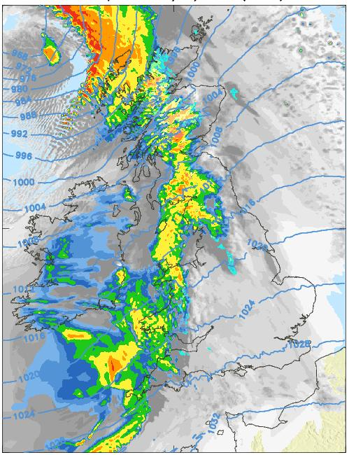
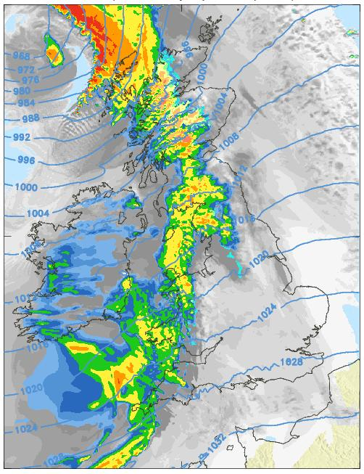
22 hour UKV forecasts of PMSL, rainfall rate and cloud for 22UTC 8/1/2015

Slide 11
Parallel physics tests in UKV
No interpolation of physics to departure points i.e. physics at arrival points.
• Parallel physics1 -> sequential physics2
– cycle (Parallel SL(time-level n), add physics, sequential solver )
• UKV fails after 40 (60 second) steps.
• Parallel physics1, parallel physics2
– cycle (Parallel SL(time-level n), add physics, sequential solver)
.
Time stepping scheme is inconsistent.
Time-level n quantities MUST be at departure points – target scheme is
$X^{n+1}={[X+\left(1−α\right)Δt\left(L+N\right)]}_{d}^{n}$ $+$($1−$ $α_{S})ΔtS_{d}^{n}+\text{(}1− α_{F})ΔtF_{d}^{n}$
$+ α{Δt\left(L+N\right)}^{n+1}$ + $α_{S}ΔtS^{n+1}$ +$α_{F}ΔtF^{n+1}$

Slide 12
Parallel physics tests in Global N512
Time step
steps
Max w
Run max
step
Time(hr)
Control
600
144
3.0
3.0
129
24
Parallel
600
33
34.7
34.7
33
fail
5.5
300
40
37.5
37.5
40
fail
3.3
150
89
52.6
52.6
89
fail
3.7
120
192
47.6
47.6
192
fail
6.4
90
480
10.5
31.0
423
12
75
576
3.1
5.4
364
12
60
720
2.8
7.0
382
12

Slide 13
Parametrization problems and The End
1. Partially-resolved processes
No numerical convergence – grey zone.
Need extra prognostics to provide memory to process and to advect information.
2. Large forcing at grid-scale – mainly due to strong latent heating.
Dynamics can only represent linear variation or discontinuity/gradient near grid-scale.
Unbalanced state, grid-scale noise.
Large vertical velocities in non-hydrostatic models due to forcing (no hydrostatic
balance – compare with vertical velocity diagnosed from integrated mass divergence
in hydrostatic models).
Need to apply forcing at filter scale > grid scale.
Horizontal mixing/diffusion needs to be targeted to avoid weakening gradients.
3. Lower boundary condition/interaction with surface/drag.

