Slide 1
Reduced numerical precision guided by physics-dynamics coupling
Matthew Chantry
Tim Palmer, Peter Duben
Jan Ackmann, Sam Hatfield, Milan Kloewer,
Andrew McRae, Leo Saffin, Tobias Thornes

Slide 2
Weather prediction:
Unresolved scales

Slide 3
Weather prediction:
Imperfect parameterisations

Slide 4
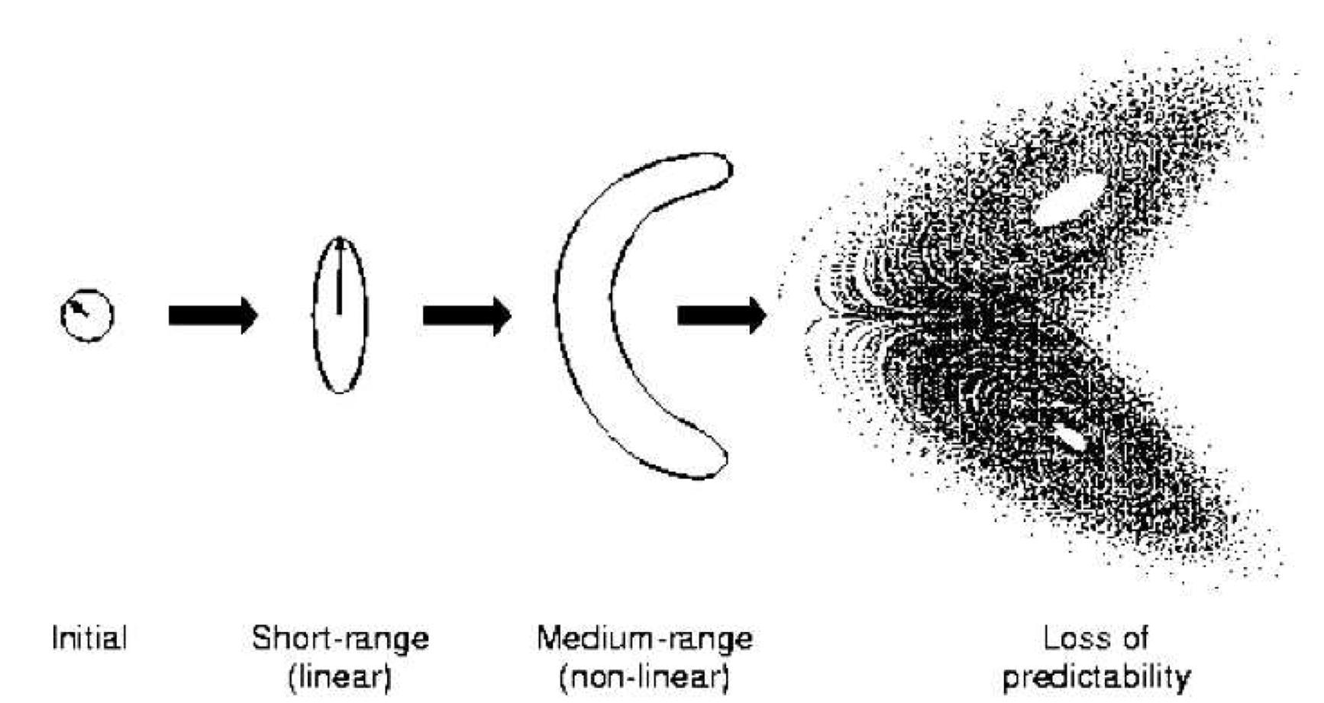
Ensembles and stochasticity
Problem
Weather forecasting attempts to predict a highly chaotic dynamical system.
Initial condition errors will grow exponentially.
Solution
Propagate an ensemble of initial conditions forward to (hopefully) include the truth in the distribution of possible answers.
Random elements are added to the model to increase spread. e.g. SPPT, SKEBS, SPT.
Source: ECMWF IFS documentation

Slide 5
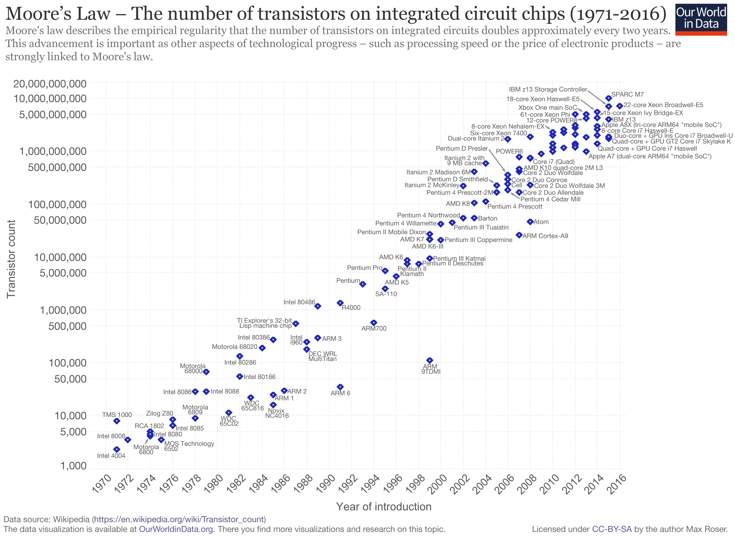
Why care about precision?
New computers are bigger but not faster.
Reaching physical limits of transistor size.
Parallel computing is the main route to higher grid resolution.
Energy consumption
MetOffice supercomputer: 2.7 MW of electricity.
Looking for any possible paths to faster/more efficient code.
Moore’s “law”:
twice as many transistors per chip every 2 years

Slide 6
Floating point numbers
Method to encode numbers in binary
Significand
Exponent
Think of
Precision
Magnitude
Computers have standards layouts for these numbers
52 significand bits
23 significand bits
10 significand bits
This talk: focus on the significand (precision).

Slide 7
“New” types of computers
GPU - Graphs processing unit
Massively parallel.
Used for machine learning, where high precision is often unnecessary.
Support half-precision floats.
Lower precision, parallel computations
FPGA - Field programmable gate arrays
Programming at a logic gate level (very hard).
Configure a chip to solve only your equations (very power efficient).
Can use arbitrary numerical precisions (not just double, single, half).
Now available on cloud computing, e.g. Amazon, Microsoft.
Can we take advantage of these developments?

Slide 8
What’s been done
Single precision
Met office - Pressure solve (operational) and large-scale precipitation.
ECMWF - “full” forward integration model. Now used for testing and future model development.
MeteoSwiss - most of model running operationally (60% savings over double).
Lower than single
Reduced GCMs and simplified models at Oxford.
Nemo ocean model in mixed precision at Barcelona Supercomputing Center.

Slide 9
What we’d like to do
Precision driven by the uncertainty in the model.
Dynamics accurate to the level masked by uncertainty in parameterisation schemes.
See upcoming paper by Subramanian et al.
Precision errors in parameterisations comparable to deviation from truth scheme.
What we’ve actually done so far
Investigation of impact of reduced precision in absence of coupling.
Precision in coupled models tuned for “minimal” change in output.

Slide 10
Emulated reduced precision
Replace standard precision declaration with our derived types.
Emulates arbitrary precision without large language/hardware changes (e.g. CUDA/FPGAs).
Increases run-time, only useful for investigation.

Slide 11
Spectral space OpenIFS

Slide 12
Spectral dynamical core schematic
Grid-point computations
What we’ve done
Reduced precision calculations in spectral-space only.
Spectral transforms and grid-point calculations in double precision.
Will …
introduce rounding errors to prognostic variables: vorticity, temperature etc.
Won’t …
cover all algorithmic error propagation
Inverse
Fourier transform
Fourier transform
Inverse Legendre transform
Legendre transform
Spectral computations

Slide 13
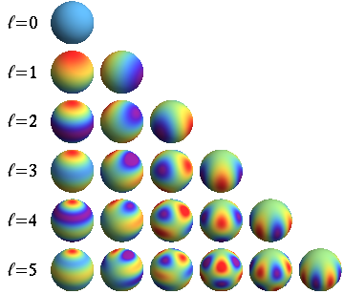
Why spectral space?
Spectral models represent fields as a sum of modes representing different lengthscales.
Can we reduce precision when calculating the small scales?
This is appealing due to the high inherent uncertainty in small scale dynamics (parametrisation, viscosity, data-assimilation,…).

Slide 14
Double
precision
(52)
Single
precision
(23)
Hurricane Sandy
27/10/12 00:00
850hP wind speed
T255L91 ~ 80km
8
significand
bits

Slide 15
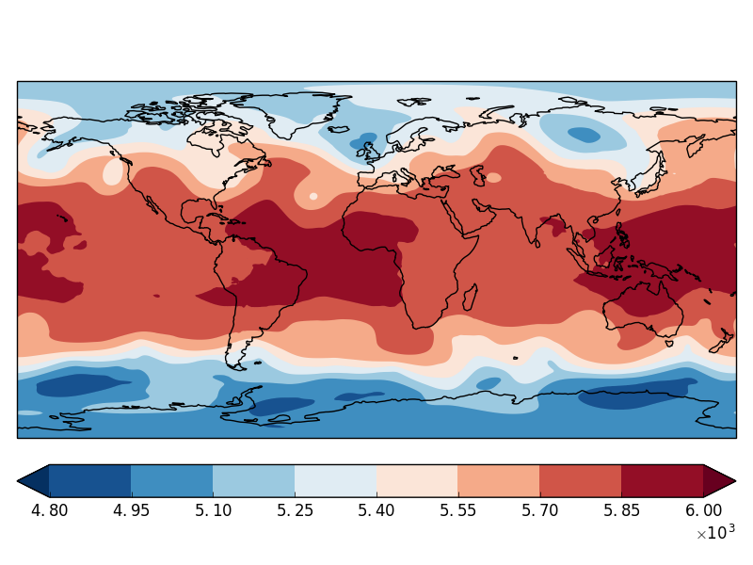
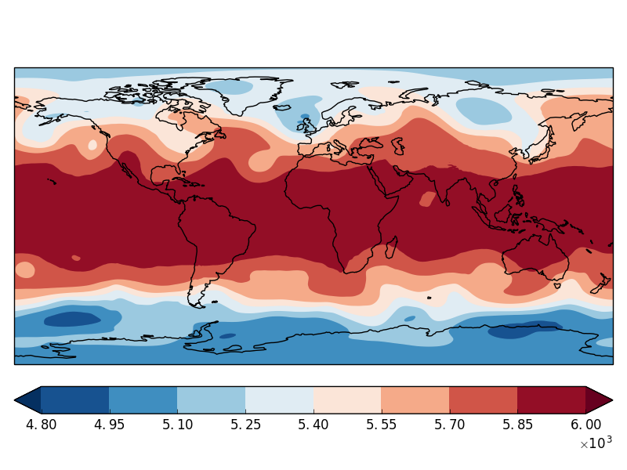
No need for scale-selectivity?
Z500hP after 120hours
Double precision (52 sbits)
Single precision (23 sbits)
16 significand bits
8 significand bits
Bias in uniform 8 sbits.

Slide 16
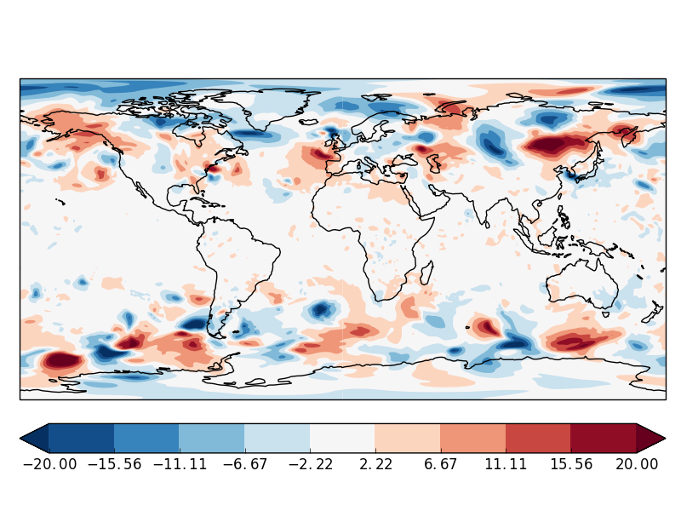
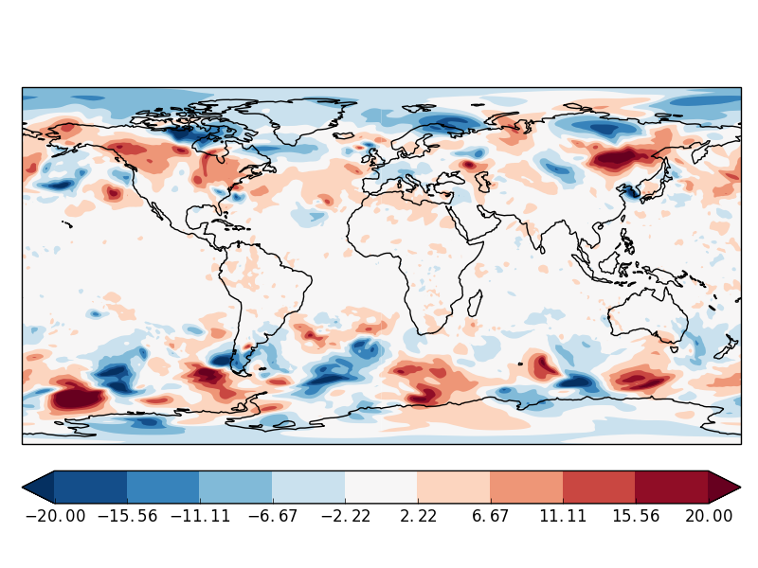
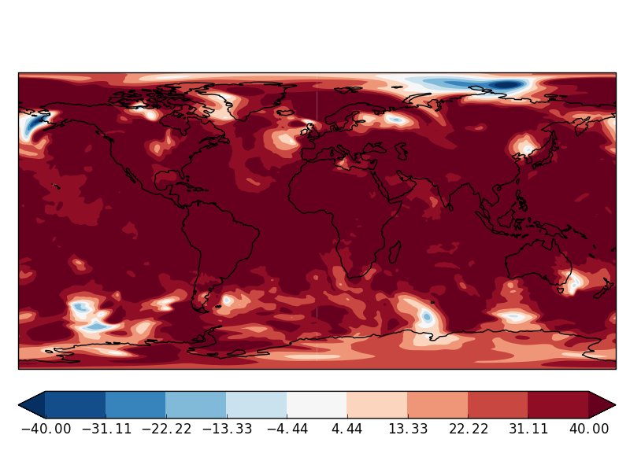
No need for scale-selectivity?
Z500hP after 120hours
Double precision (52 sbits)
Db - Single precision
Db - 16 significand bits
Db - 8 significand bits
Global bias

Slide 17
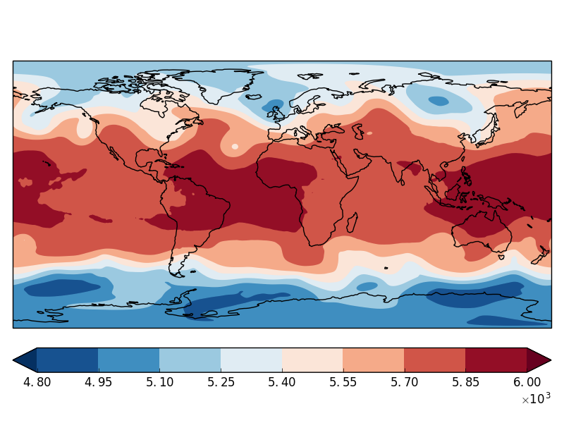
First-order scale-selectivity
Z500hP after 120hours
Double precision (52 sbits)
Single precision (23 sbits)
16 significand bits
8 significand bits + …
… double precision zero mode

Slide 18
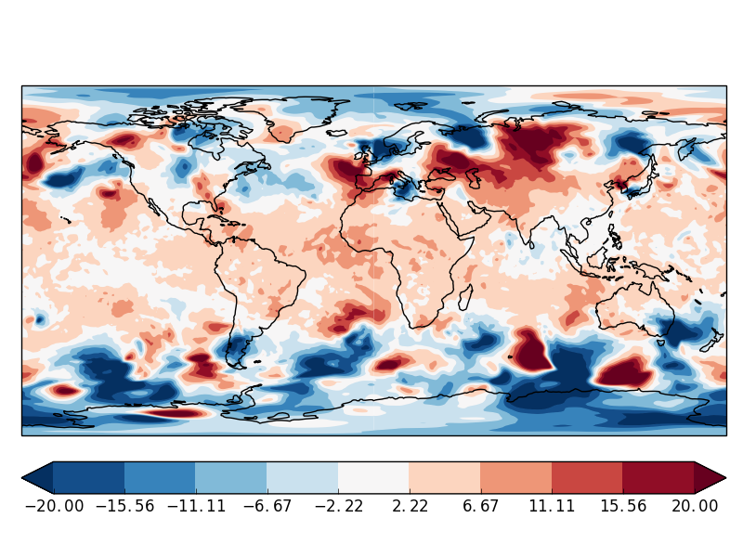
First-order scale-selectivity
Z500hP after 120hours
Double precision
Db - Single precision
Db - 16 significand bits
Db - 8 significand bits + …
… double precision zero mode

Slide 19
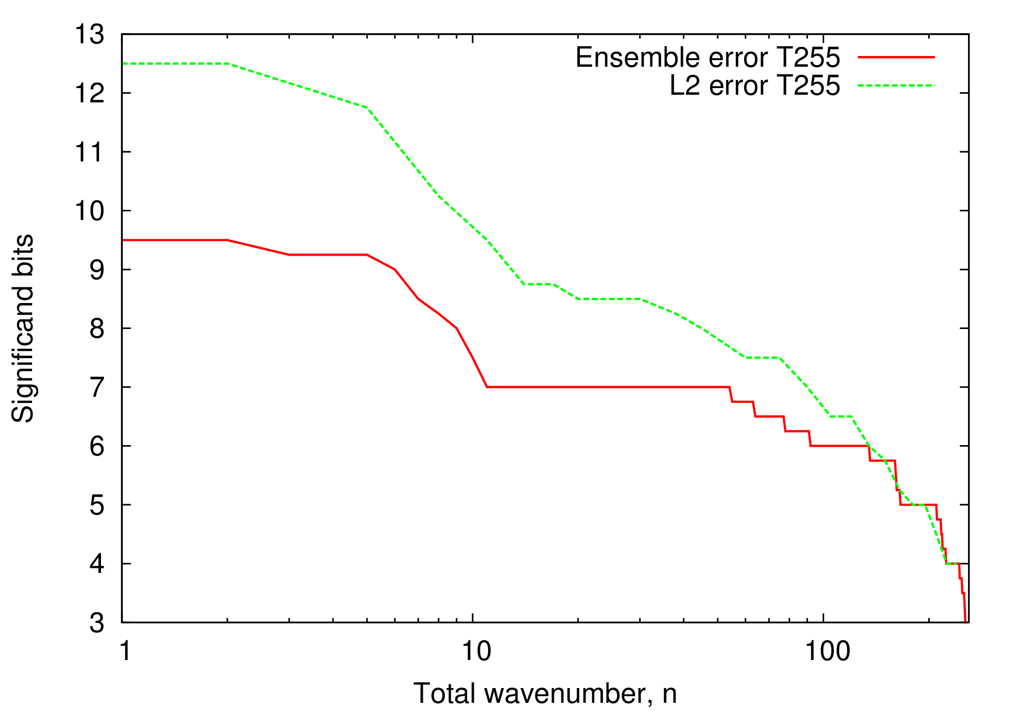
How many bits?
Half
precision
~80km horizontal resolution

Slide 20
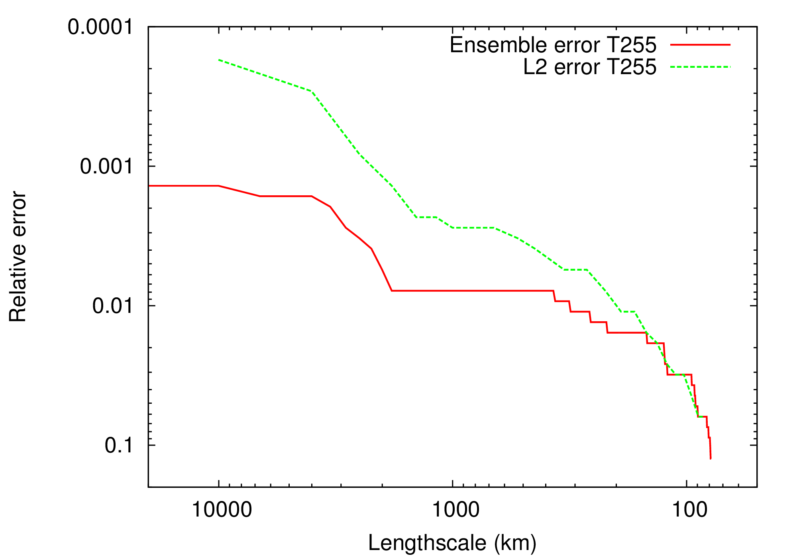
What error does this introduce?
~80km horizontal resolution

Slide 21
Climate investigation
11 year integration at T159L91 (~125km horizontal resolution).
10 member ensembles for 2005-2015: double precision single precision half precision (zero mode in double precision)
Do reduced precision errors accumulate?

Slide 22
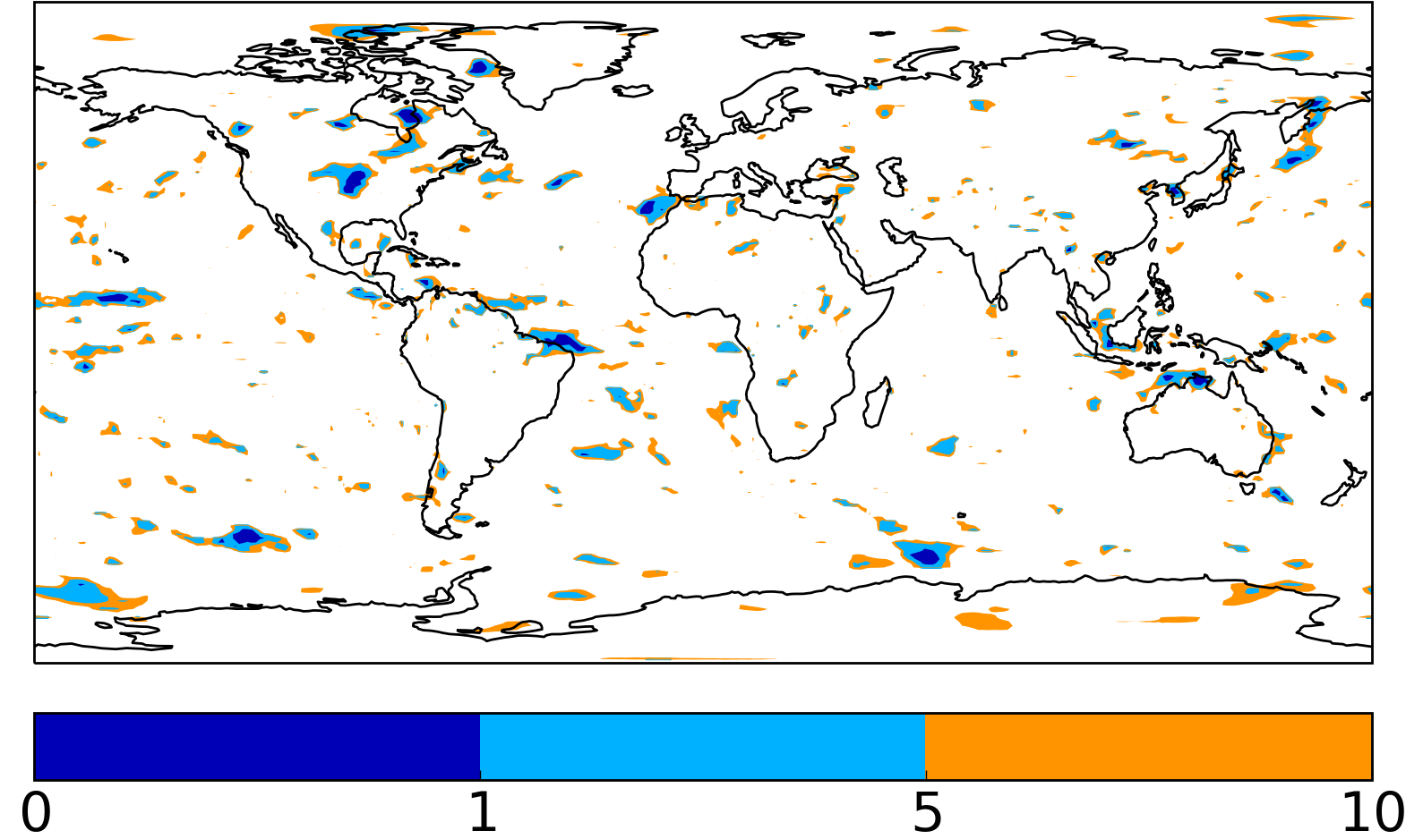
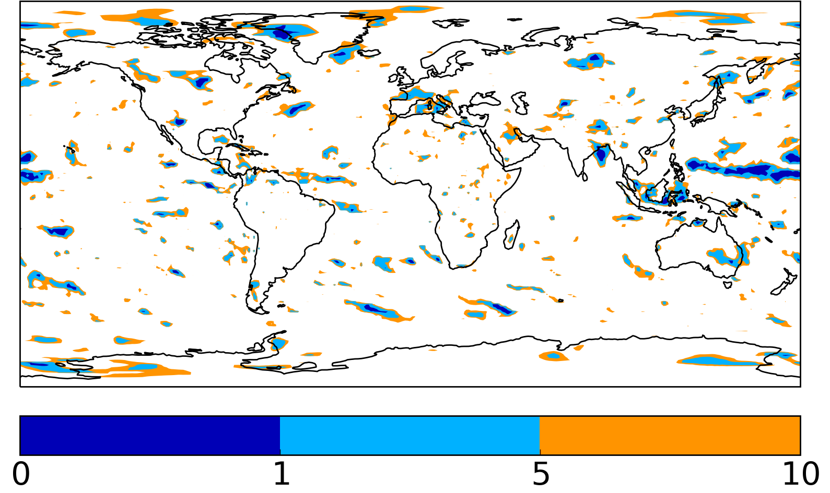
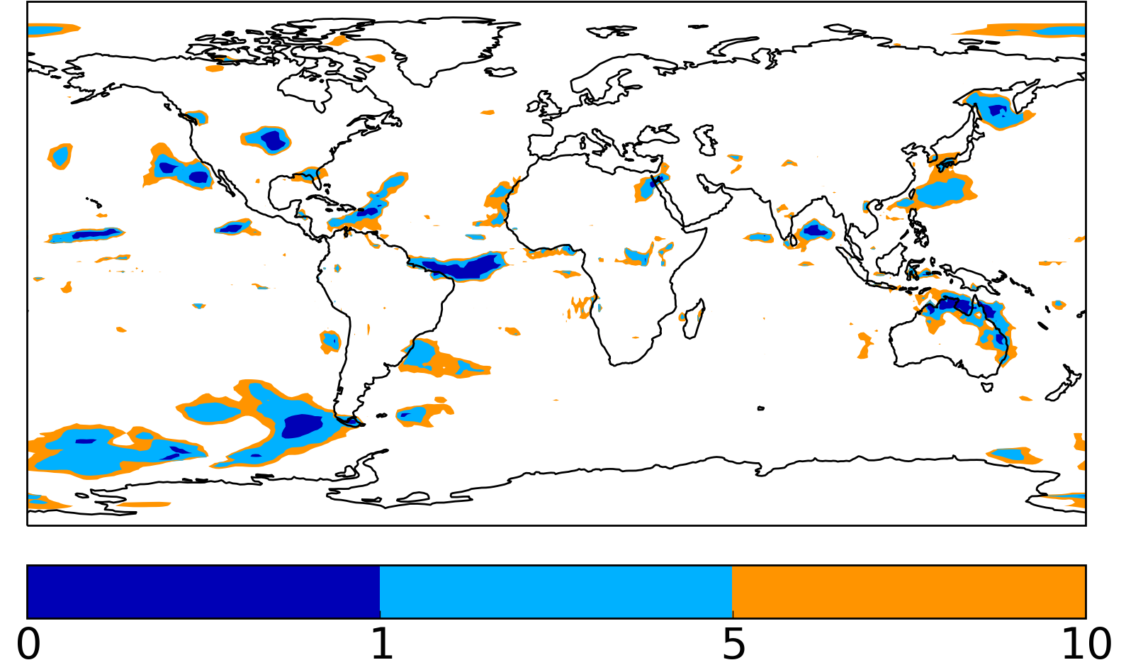
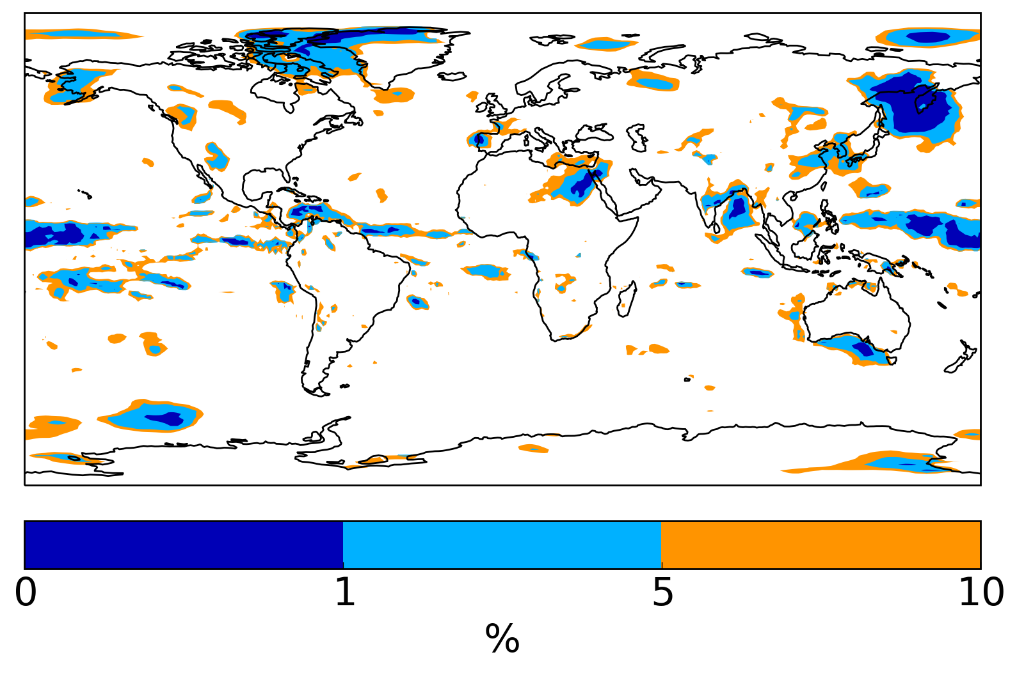
T-test difference from double precision
Single precision
Half precision (zm)
Accumulated precipitation
Significance level, %
Significance level, %
Proportion of significant grid points 3.2%
Proportion of significant grid points 5.5%
Mean
2m temperature
Significance level, %
Significance level, %
Proportion of significant grid points 4.6%
Proportion of significant grid points 7.7%

Slide 23
High resolution tests
T511: ~40km grid spacing (compare with ~20km UKMO/ECMWF ensembles).
10 start dates between 1999 and 2017.

Slide 24
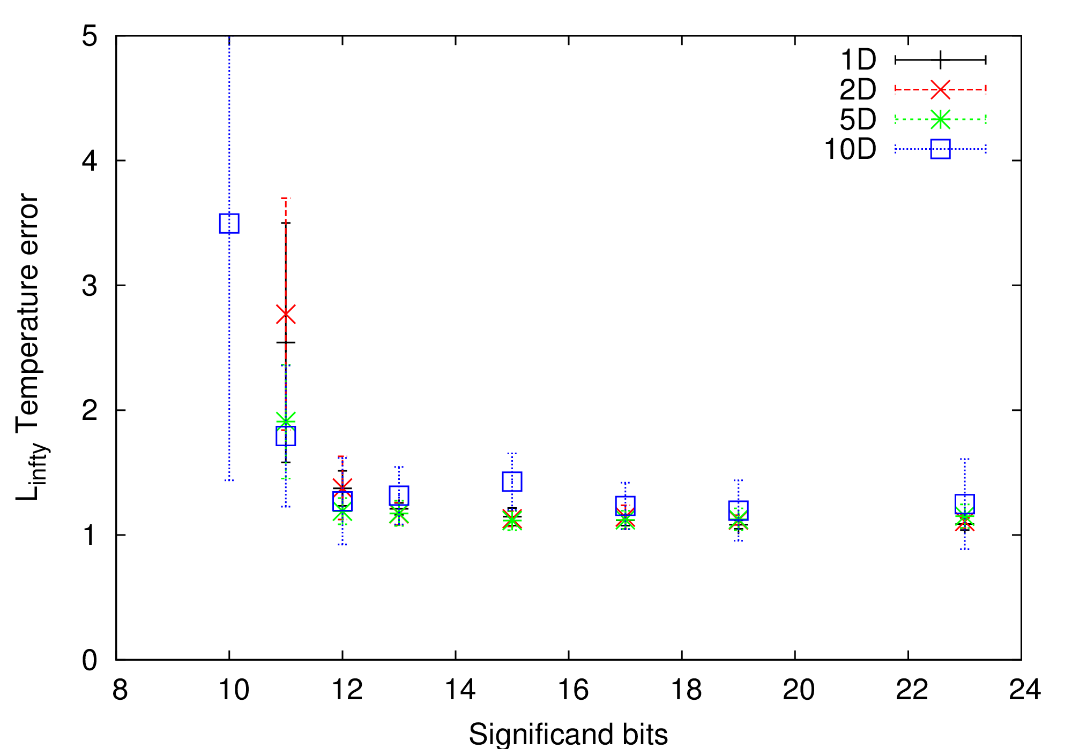
L2-norm — Global precision
Temperature error
relative to single precision

Slide 25
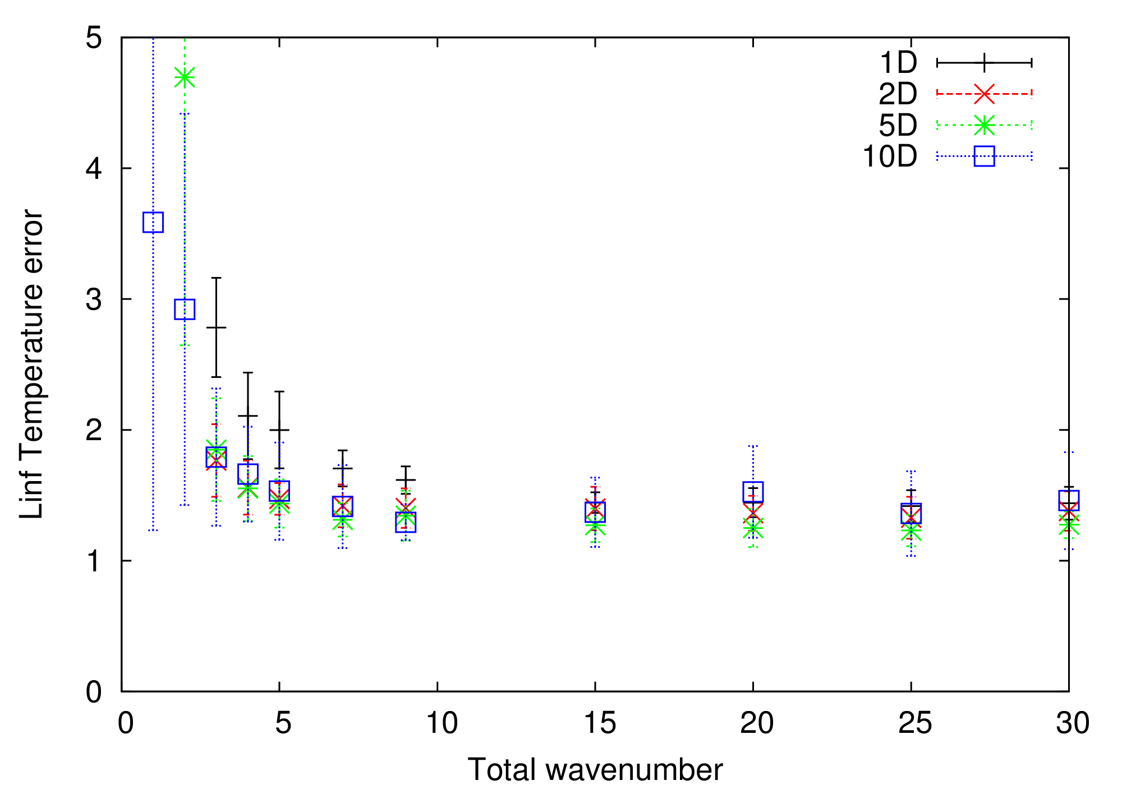
Half-precision from which wavenumber?
Temperature error
relative to single precision
99.97% modes at half precision

Slide 26
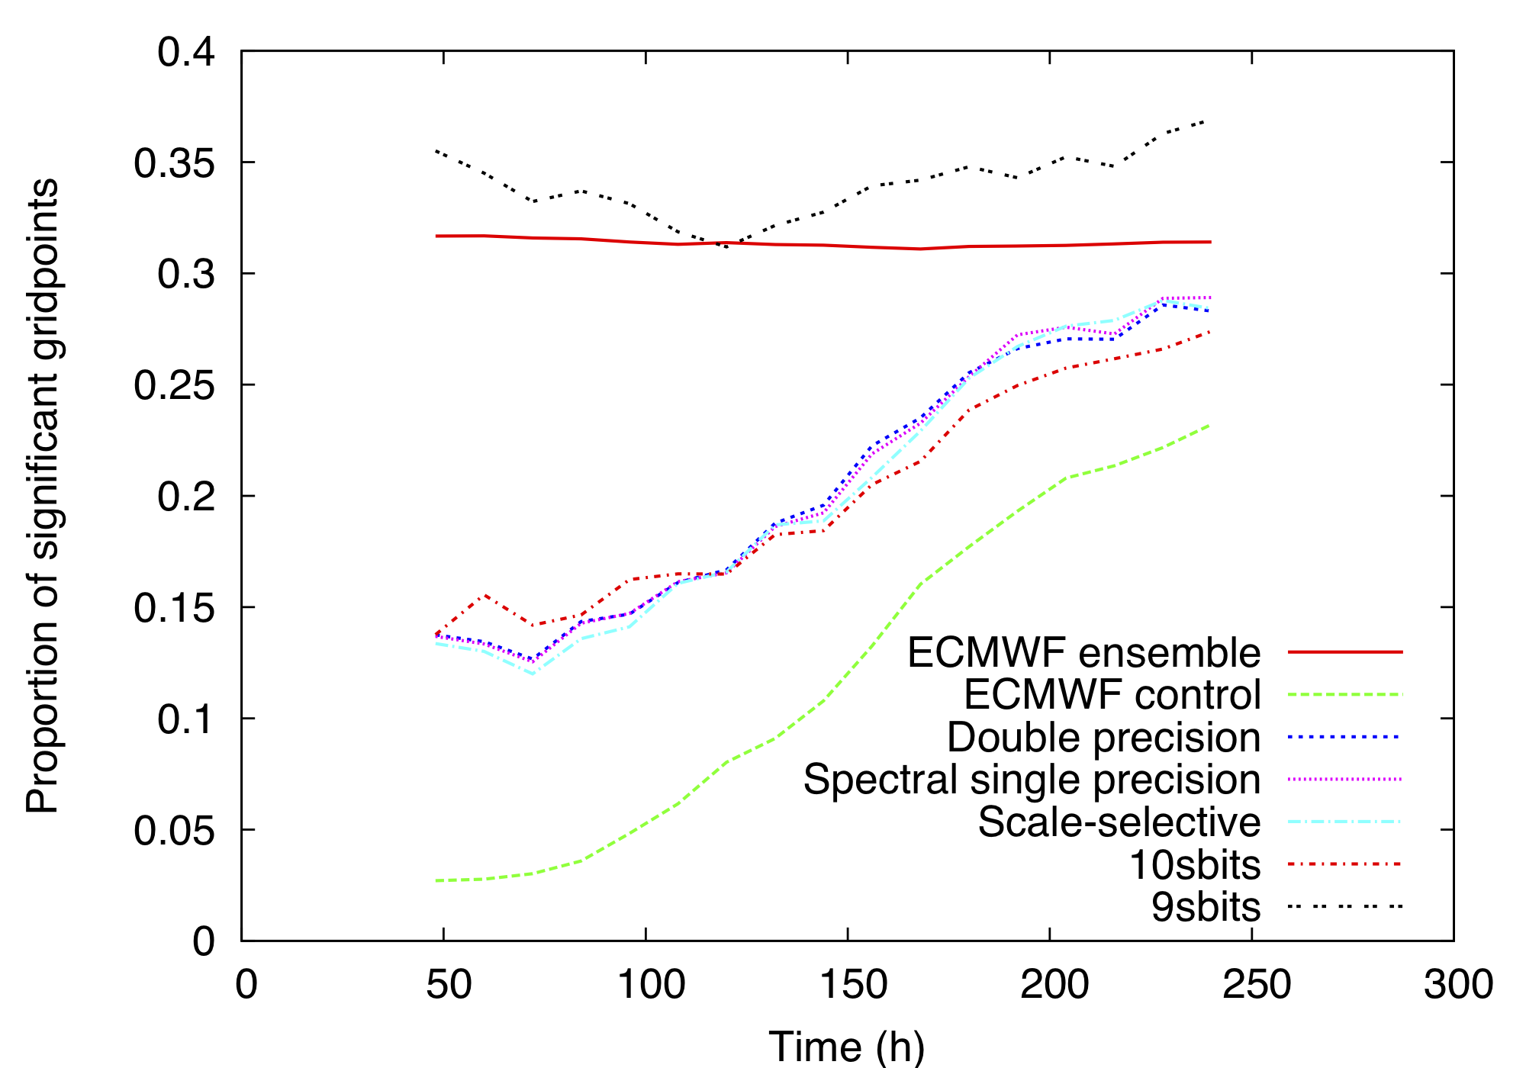
Plausible ensemble member?

Slide 27
Legendre transforms OpenIFS
Sam Hatfield

Slide 28
Spectral dynamical core schematic
Grid-point computations
Legendre transforms
Matrix multiplication - O(N³) operations.
Linear, can rescale variables to fit within dynamic range of half-precision.
How large are the errors introduced?
Inverse
Fourier transform
Fourier transform
Inverse Legendre transform
Legendre transform
Spectral computations

Slide 29
Hurricane Sandy
Double precision for m=0, half-precision for all other values of m.

Slide 30
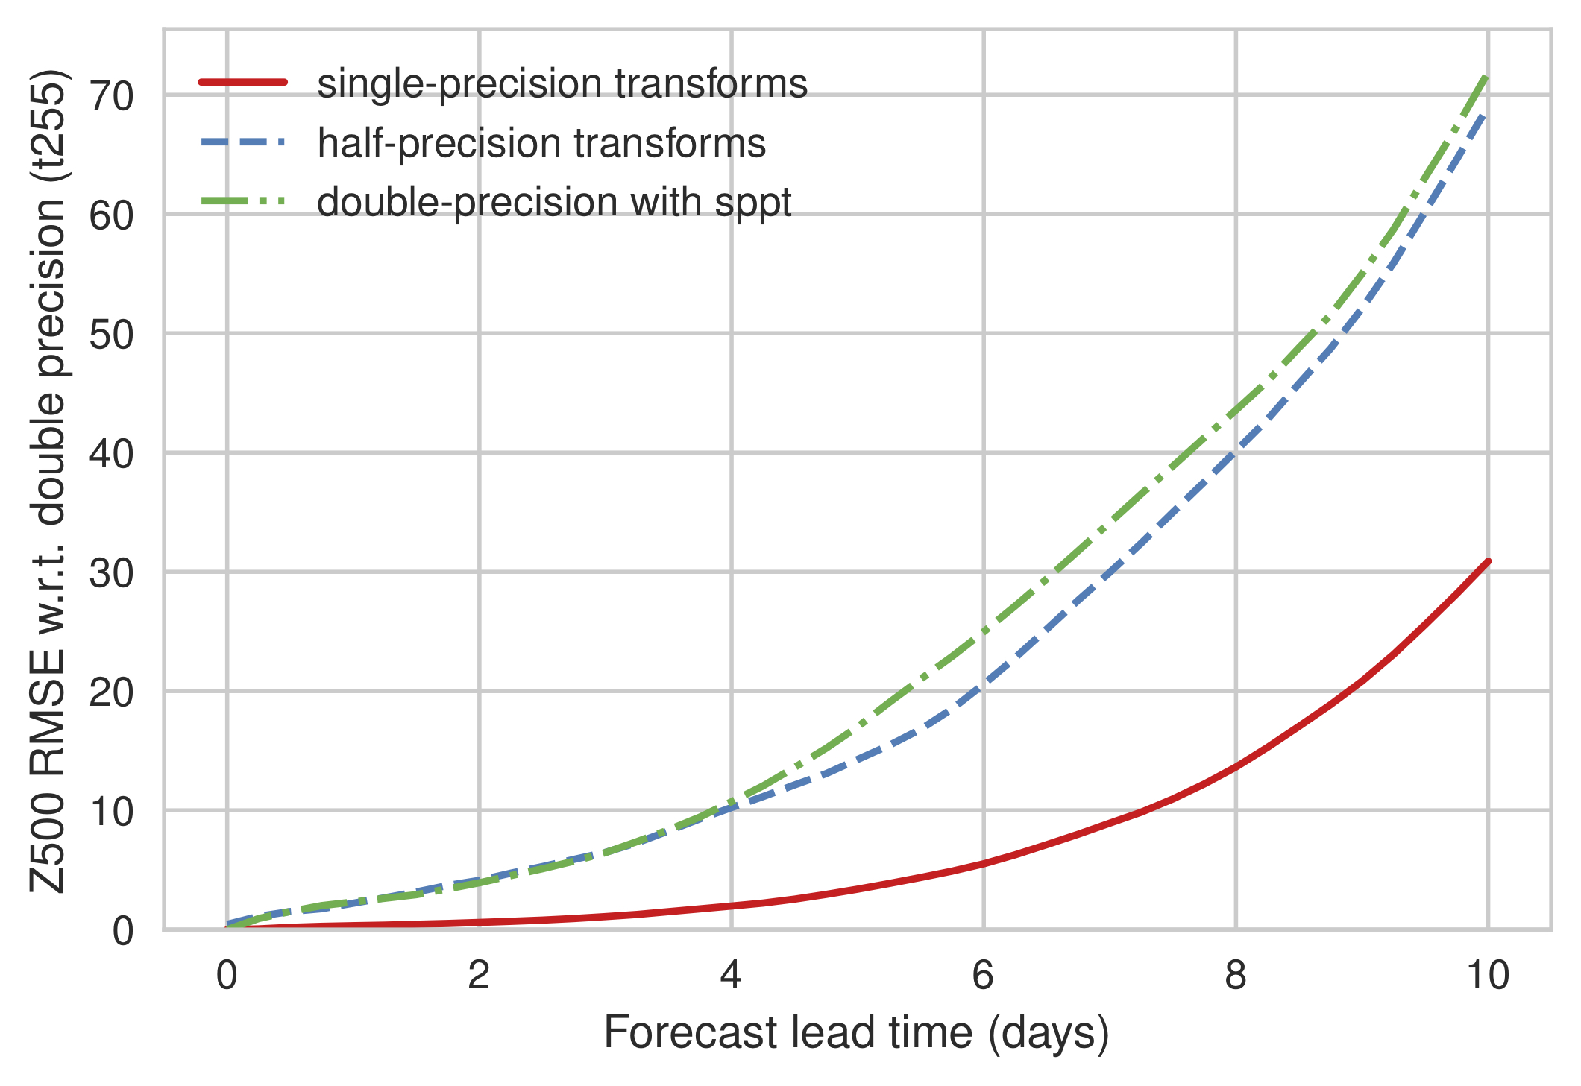
Deviation from double precision

Slide 31
Physical parameterisations
SPEEDY and OpenIFS
Leo Saffin

Slide 32
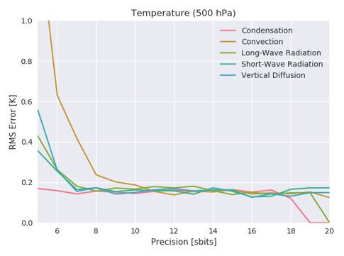
SPEEDY
T30 spectral model
8 vertical levels
Simplified physics
1 week “forecast”
Half-precision plausible for many schemes.

Slide 33
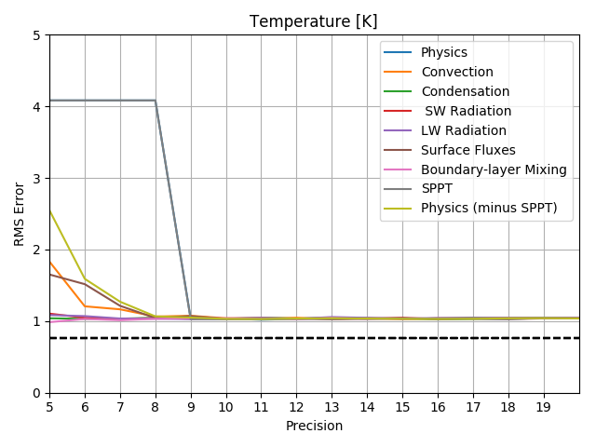
SPEEDY-SPPT
Introduce Stochastic Perturbation of Parameterisation Tendencies (SPPT) to Speedy
Equivalent scheme to IFS.
Allows precision to be reduced further.
SPPT scheme first to fail! Caused by spectral transforms involved in SPPT.

Slide 34
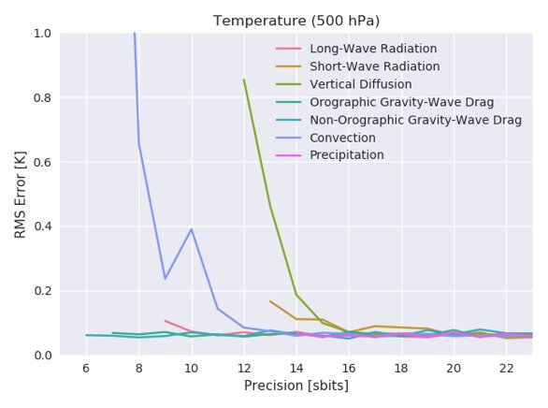
OpenIFS
T21, 60 levels
1-day forecast
More scheme dependent precision than SPEEDY.
Initial tests at T159 fail at similar precisions or higher.
Now testing with SPPT, higher resolution and longer runs.

Slide 35
And more!

Slide 36
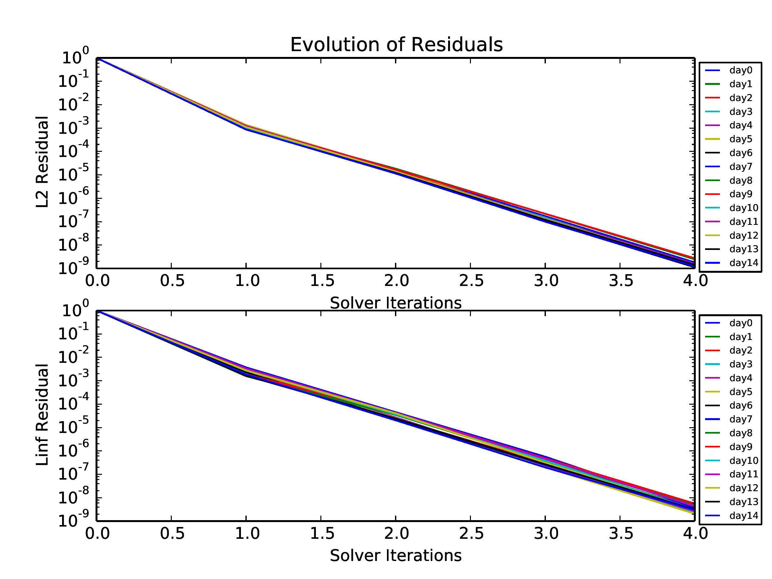
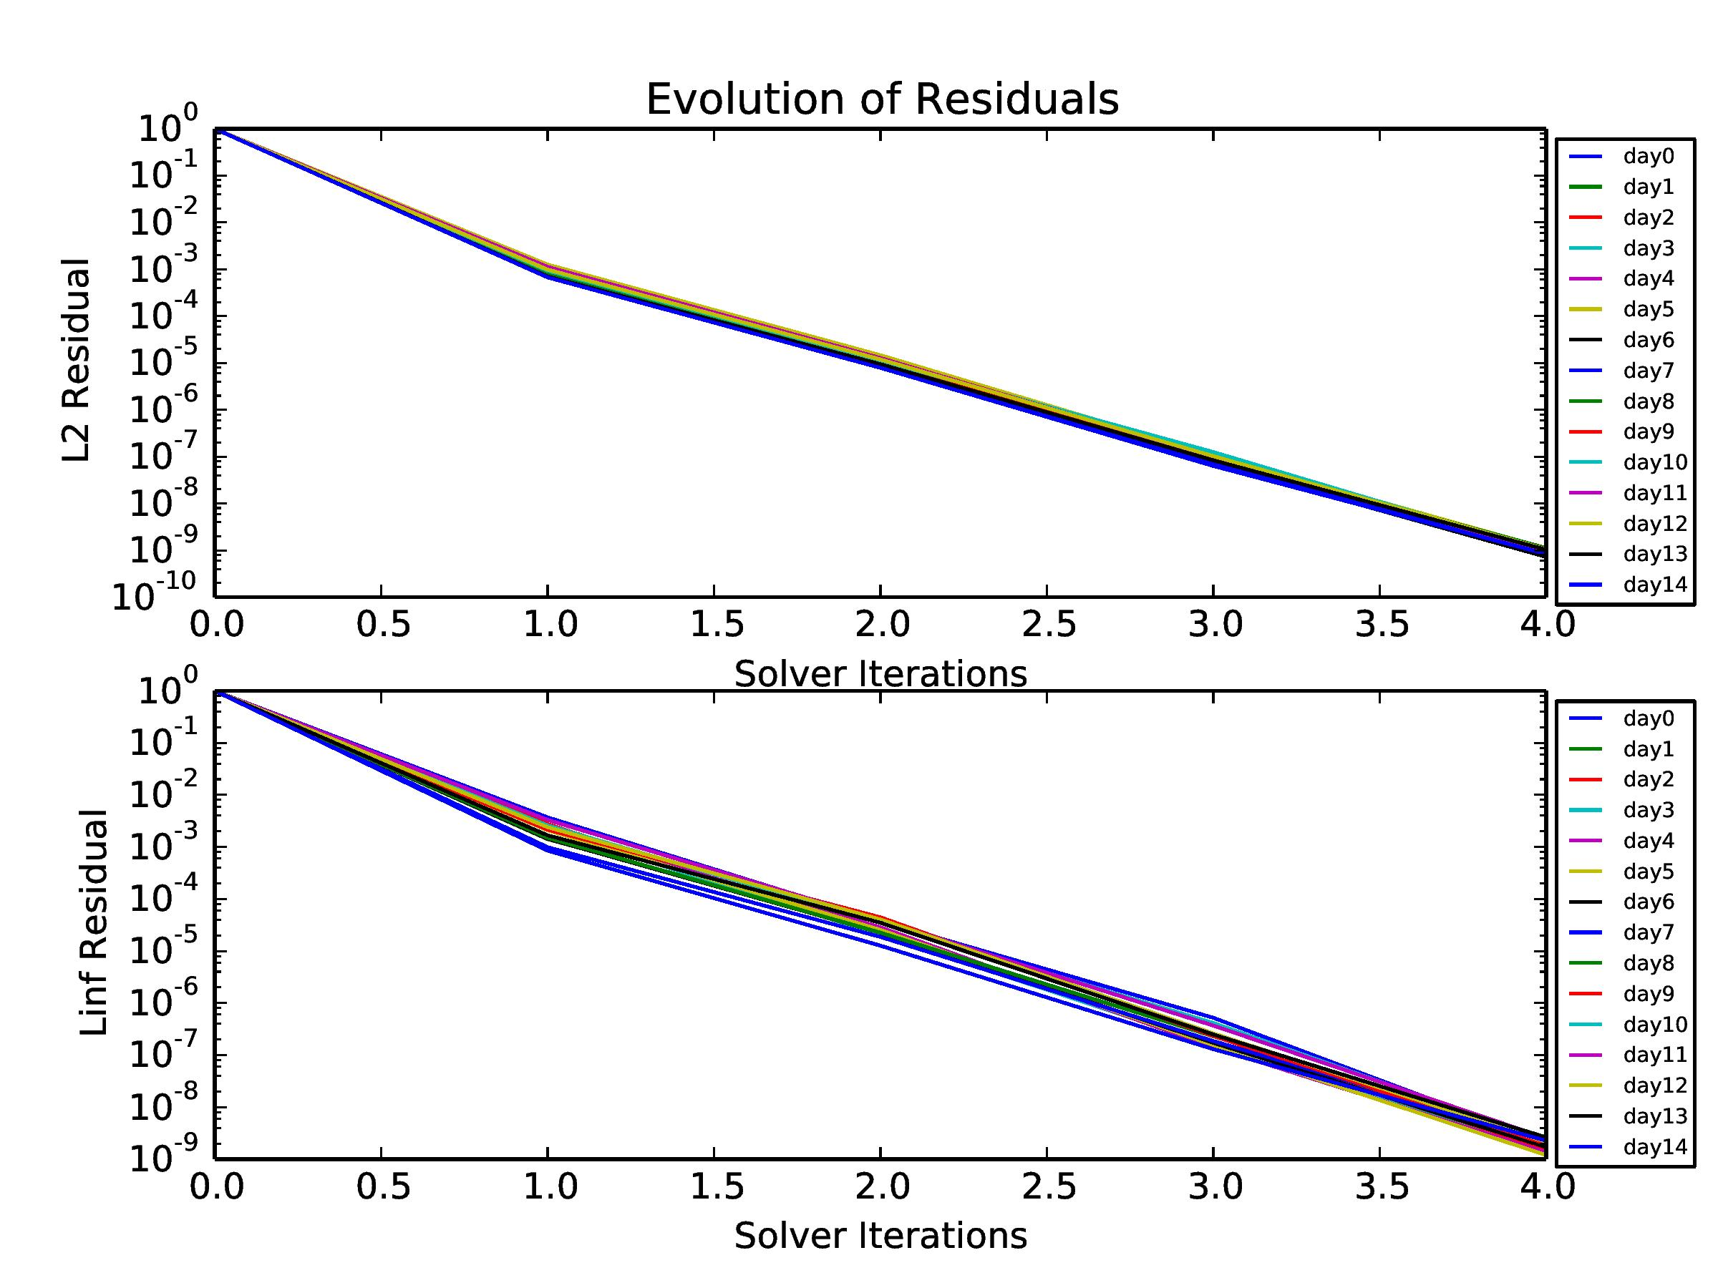
Preconditioning linear solvers
Jan Ackmann
Rossby-Haurwitz wave - MPDATA timestepping scheme
10 significant bits
Double precision
Retain high precision at the poles
Work with Piotr Smolarkiewicz

Slide 37
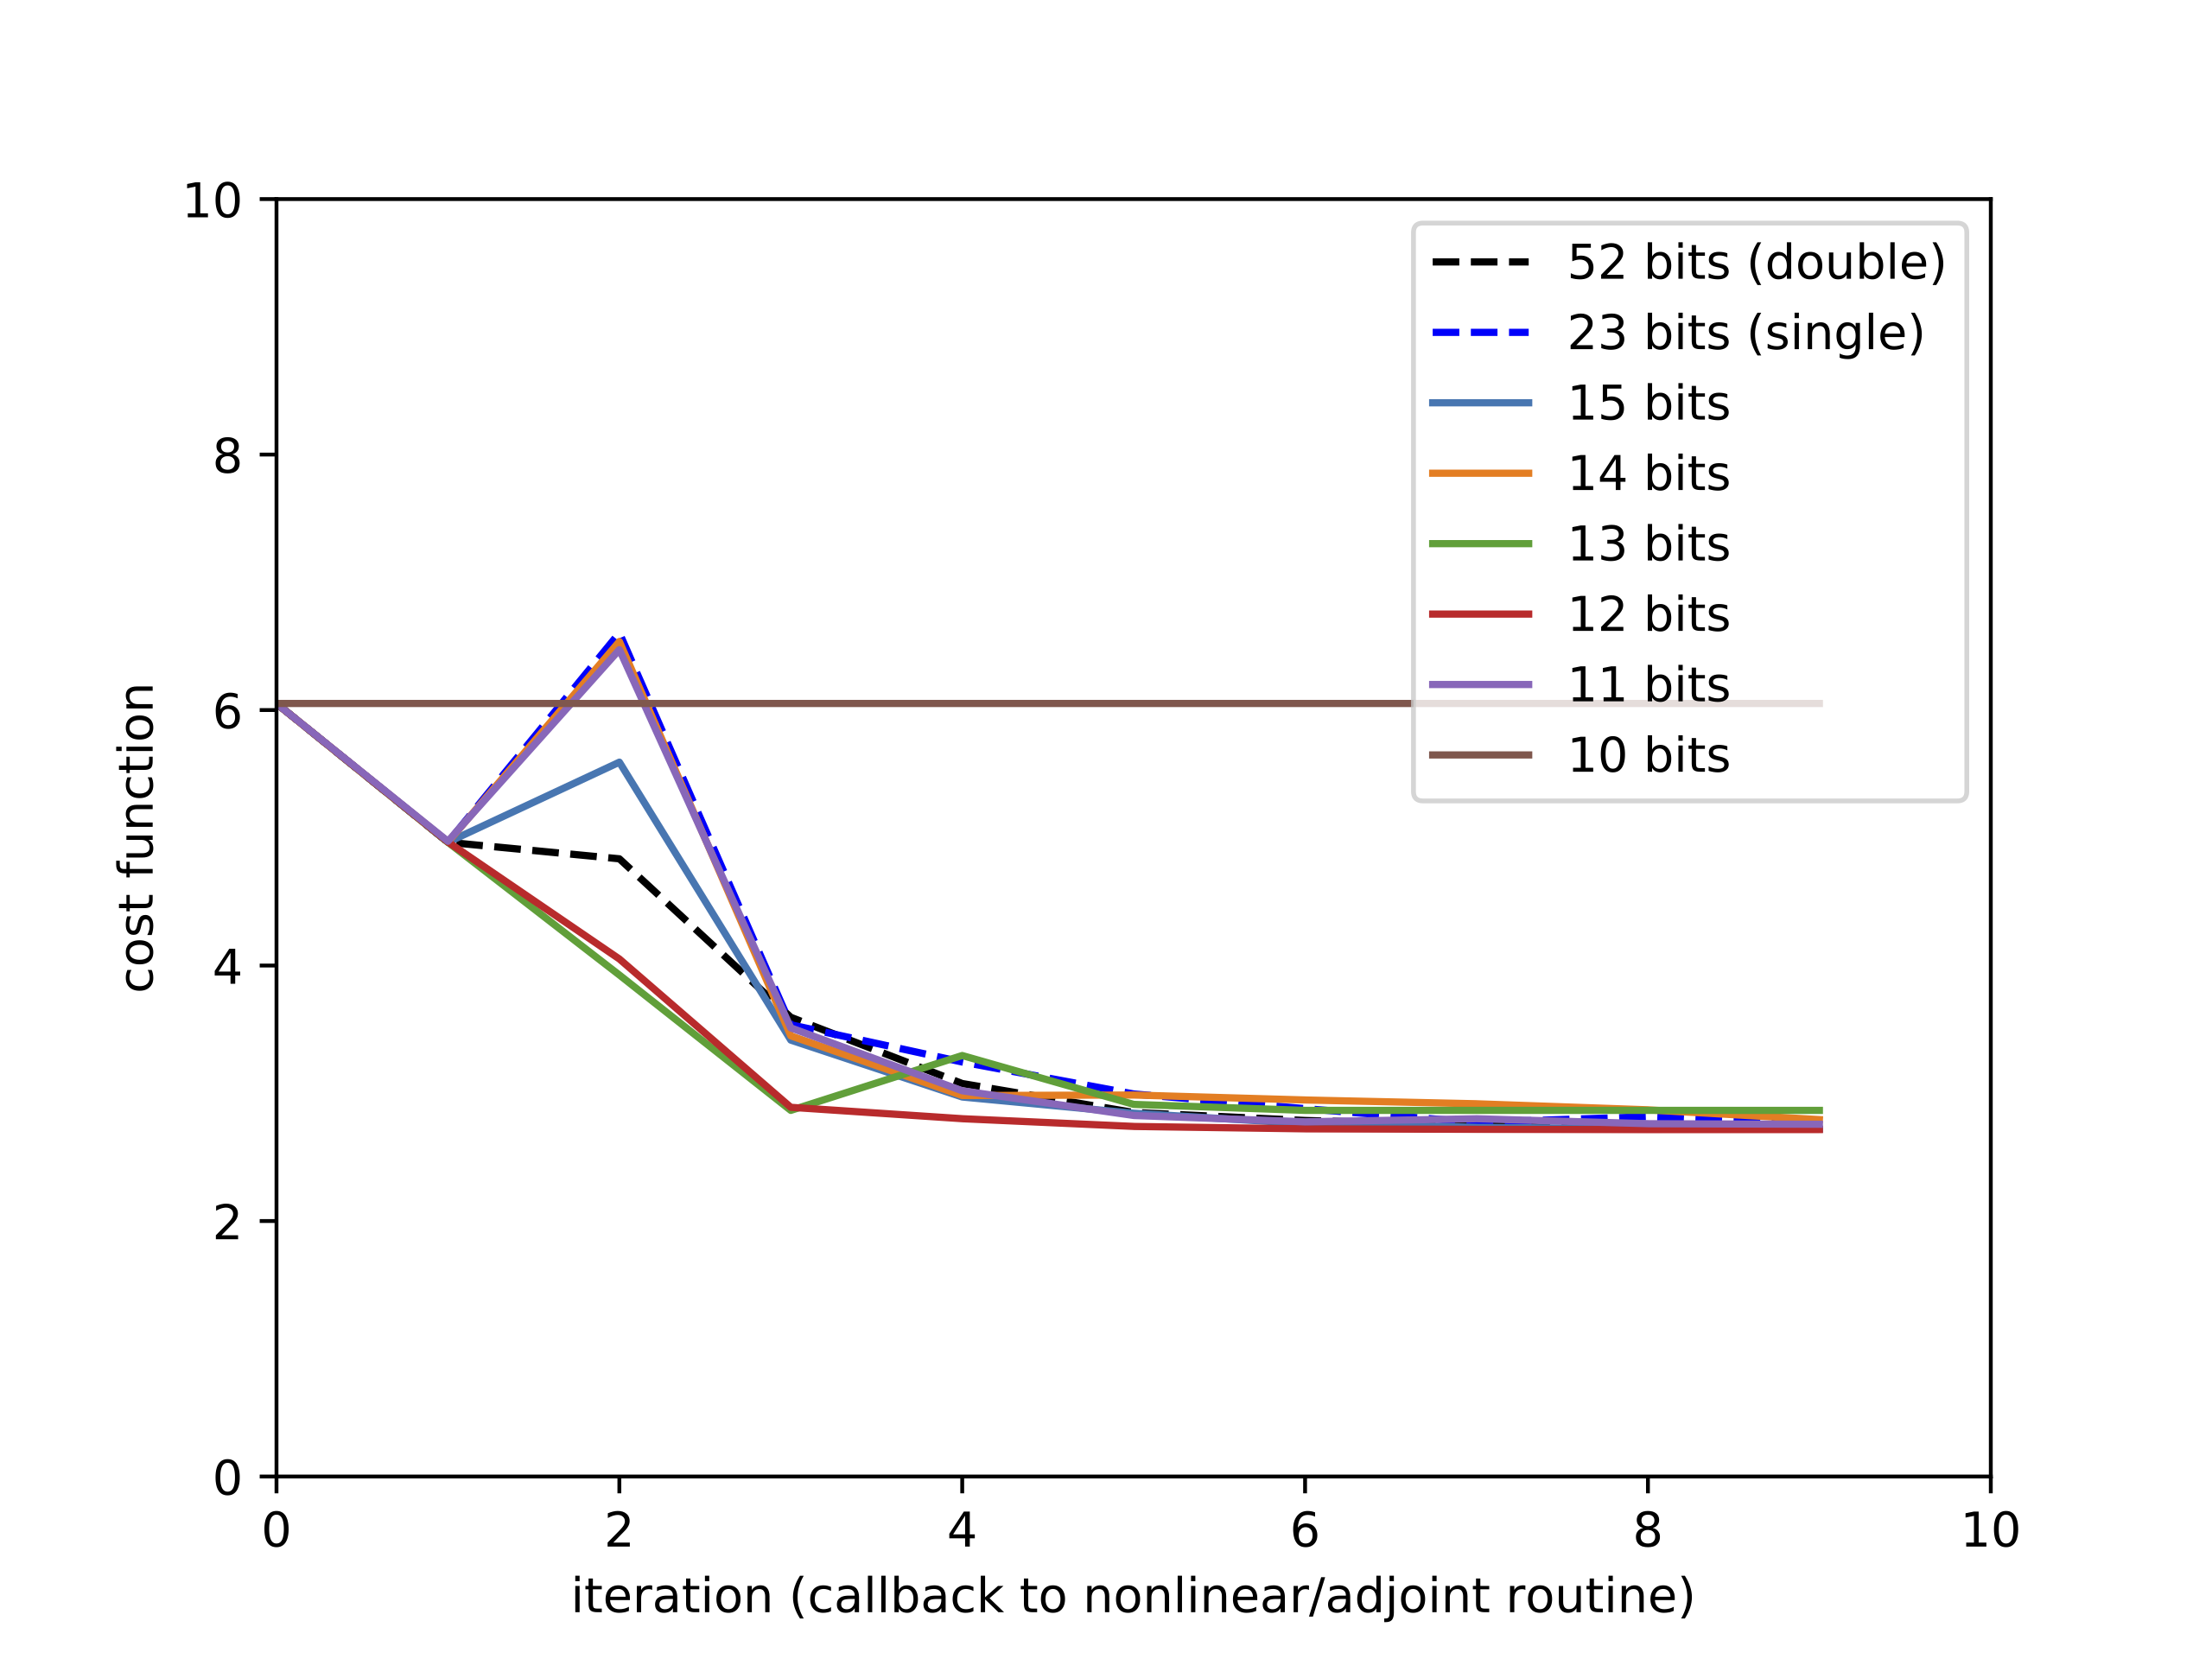
Adjoint-based minimisation in MITGCM
Andrew McRae
Shallow water simulation using floats and half-precision posits.

Slide 38
Alternate number types:
better for low precision?
Milan Kloever
Shallow water simulation using floats and half-precision posits.

Slide 39
Take away?
Precision can generally be reduced below single…
…but not all fields/computations to half-precision.
Can we do more to be guided by knowledge of uncertainty?
Doing this job completely will take man-hours, but save computer costs (or allow higher resolutions). Overall savings?

