Slide 1
Deciphering ancient microbes with modern population genomic databases
Nabil-Fareed Alikhan & Zhemin Zhou

Slide 2
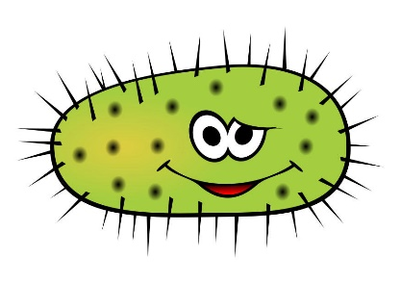
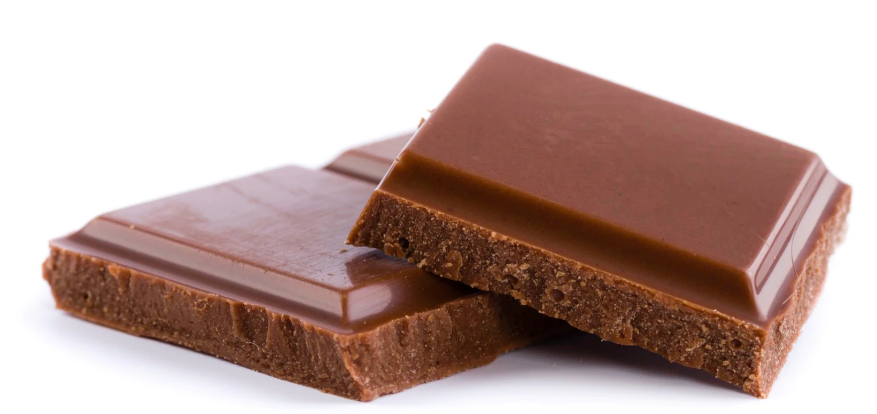
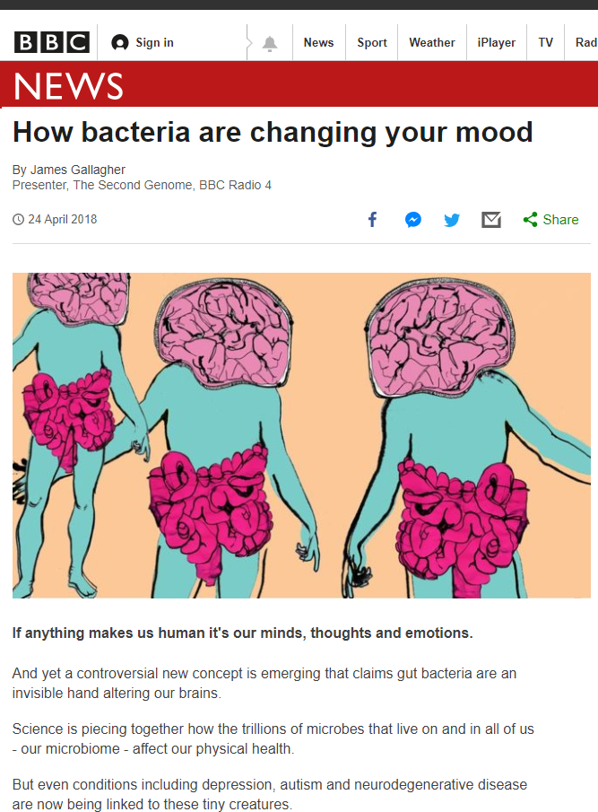
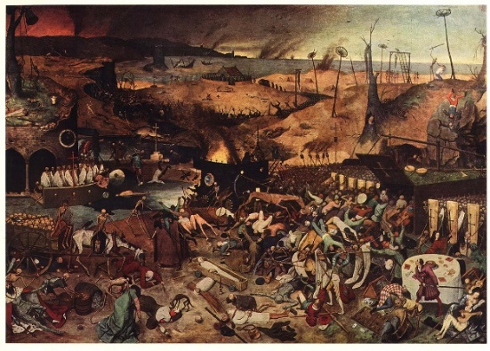
Microbes matter!
Evolved responses (e.g. AMR)
In your food
Affects your mood
Can be really bad dudes
Prevention?
Education?
Public health measures?
Disease
How did we react;
As individuals?
As a society?
Most microbes are unculturable

Slide 3
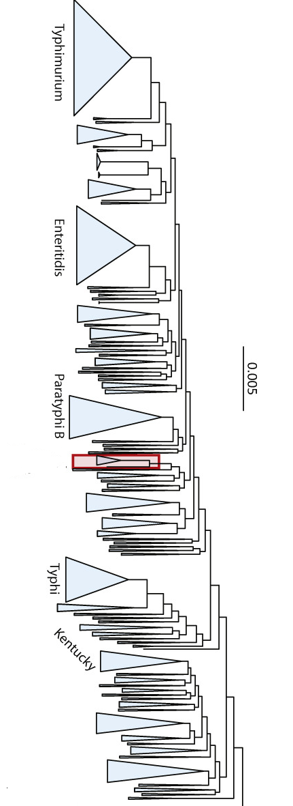
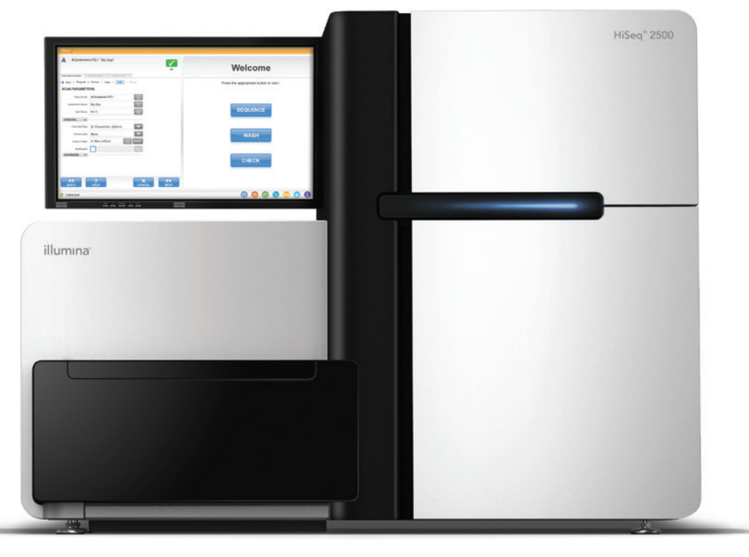
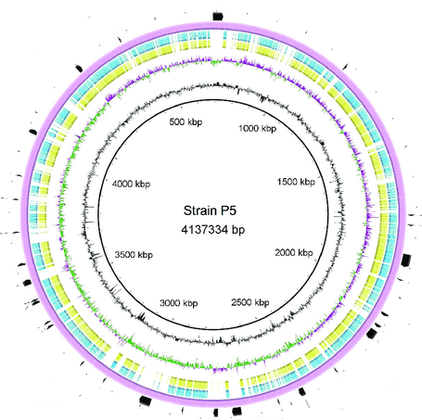
Metagenomics as an approach to survey microbial diversity
Sample Prep.
Shotgun sequencing
Taxonomic binning/ classification
Read mapping and genome reconstruction
Comparative analysis
ATGATAAC….
Salmonella?
Y. Pestis?
Weyrich et al. 2015 Journal of Human evolution 79
Tang et al. 2018 Frontiers in Microbiology 9:279
Zhou et al. 2018
Current Biology 28:15
Sandra
NextSeq
SPARSE
EnteroBase
See Sandra’s talk: 4pm Pathogen genomics session

Slide 4
Low read numbers makes Taxonomic classification difficult
ATGATAACATGATAACATGATA…. X 300 Million
Unidentifiable (50-99%)
Identifiable:
Host (5-20%)
Pathogenic bacteria (0.001-0.1%)
Other bacteria (5-30%)
Post-mortem contaminant (~50%)
A lot of luck involved!
Taxonomic profilers | Taxonomic binners
Smaller database of established markers (e.g. 16S rRNA) | Large database of whole genome sequences
Most reads are unassigned | Assigns every read to a species
Higher precision | Very sensitive
e.g. MIDAS, MetaPhlan, QIIME | e.g. SPARSE, MALT, Kraken, SIGMA
Low sensitivities | Low accuracy/precision

Slide 5
SPARSE improves precision by 3 fold & handles aDNA
CAMI challenge: Mixture of real reads derived from environmental isolates (Szcyrba et al. 2015 Nature Methods 14)
Revisiting familiar aDNA datasets from Kay et al. 2015 Nat Comms 6:6717, Maixner et al. 2016 Science 351:6269, & Rasmussen et al 2015 Cell 163:3.
Host | Expected Pathogen | SPARSE | SIGMA | Kraken | MetaPhlan
206BP Hungarian mummy | 0.02% M.tuberculosis
5300BP ‘Iceman’ | 0.01% H. Pylori
Bronze age human | 0.01% Y. pestis
C. diptheriae &
M. leprae
S. enterica, V. cholerae
V. parahaemolyticus
Zhou et al. 2017 bioRxiv 215707
Zhou et al. 2018 RECOMB 2018: Research in Computational Molecular Biology pp 225-240.

Slide 6
SPARSE assess the quality of matches
Match to Genome 1 | Match to Genome 2
Regions found in other species | Species specific regions
Only in a few genomes of the same species | Found across the species
Possibly plasmid regions? Or conserved elements (ribosomal genes)? | Housekeeping genes ?
800 hits!
Which match is more reliable?
Zhou et al. 2017 bioRxiv 215707
Zhou et al. 2018 RECOMB 2018: Research in Computational Molecular Biology pp 225-240.

Slide 7
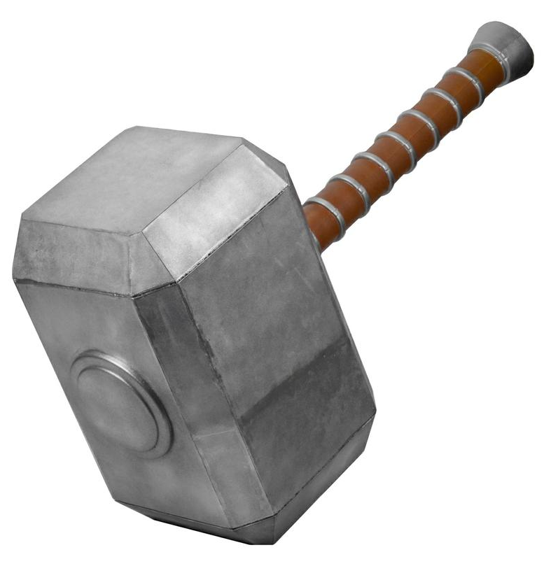
SPARSE uses a normalised reference database
If all you have is a hammer everything looks like a nail
If the majority of your reference genomes are Salmonella, everything will look like Salmonella.
ATGATAACAT…. X 300 Million
101,680 genomes (all of life; <300MB) clustered into groups (<1% genetic divergence)
First pass assignment uses 1 representative / cluster (28,732 total)
Zhou et al. 2017 bioRxiv 215707
Zhou et al. 2018 RECOMB 2018: Research in Computational Molecular Biology pp 225-240.

Slide 8
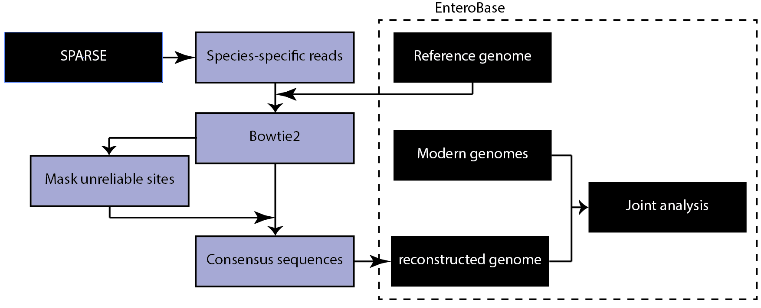
Integration back into EnteroBase

Slide 9
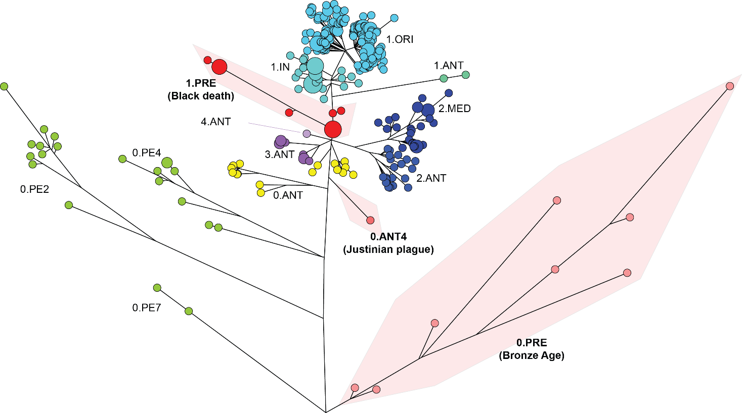
Integration back into EnteroBase: Yersinia pestis
741 Yersinia pestis genomes
Maximum likelihood phylogeny using conserved SNVs
21 ancient genotypes in three groups
1.PRE (Bos 2011, 2016; Spyrou 2016)
0.ANT4 (Feldman 2016)
0.PRE (Rasmussen 2015; Valtueña 2017)
High genetic diversity in Bronze Age strains
RT5 (Spyrou 2018)?
ORI: Orientalis
MED: Medievalis
ANT: Antiqua
PE: Pestoides
Interactive version: http://bit.ly/PestisTree

Slide 10
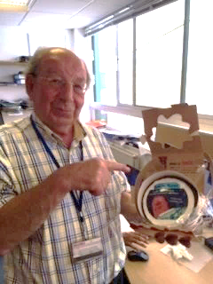
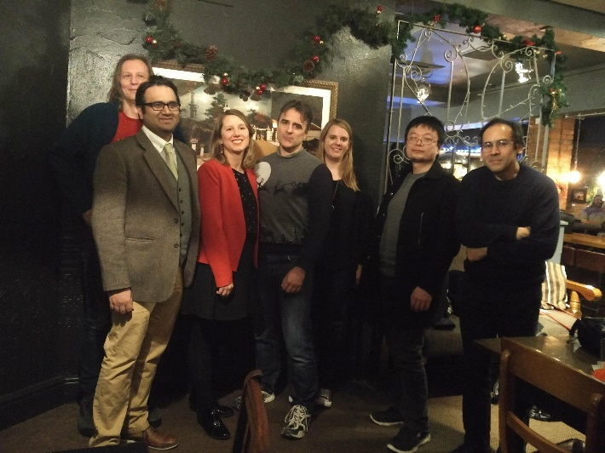
4pm Pathogen genomics session
“Recovery of ancient oral pathogens by integrated analysis of serial dental calculus samples and modern genomes”
SPARSE
https://github.com/zheminzhou/SPARSE
EnteroBase
https://enterobase.warwick.ac.uk/
GrapeTree
https://github.com/achtman-lab/GrapeTree
Mark Achtman
Sandra Bedarida
Zhemin Zhou
William Tyne
Khaled Mohammed
Martin Sergeant
Chris Quince
Nina Luhmann
Funding:

Slide 11
SPARSE improves precision by 3 fold & handles mixed samples
CAMI challenge: Mixture of real reads derived from environmental isolates
Strain-level predictions. Simulated mixture of 2-5 E. coli strains in metagenomic samples.
Samples 1 -16
Only missed 1 / 52
Expected
SPARSE

