Slide 1
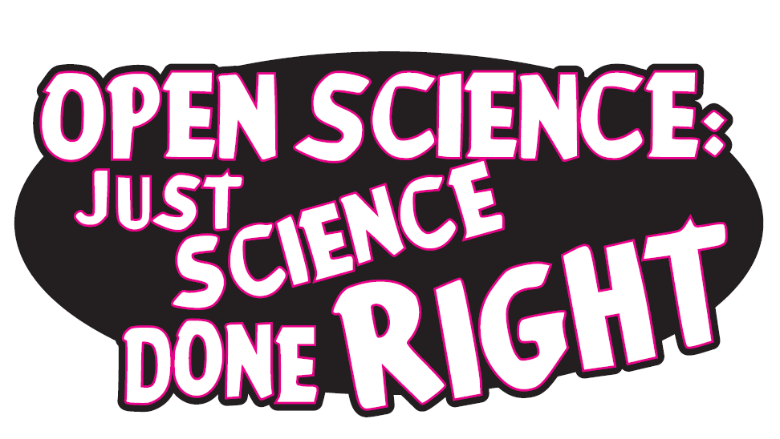
Dr. Jon Tennant
@protohedgehog
PUBMET Annual conference 20-21 September, Zadar, Croatia
https://orcid.org/0000-0001-7794-0218

Slide 2
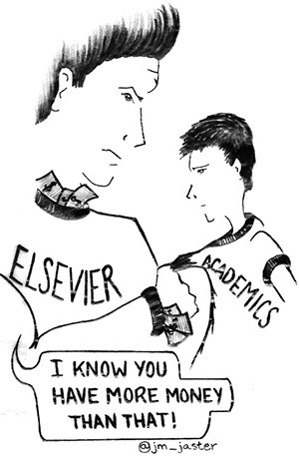
Why Open Science?
Slow and wasteful
Ruled by commercial interests
Copyright is broken
Serials crisis
Access crisis
Reproducibility crisis
Illusion of academic freedom
Questionable research practices
Closed science means people suffer
Science is not working as it should be
Previous slide: Melanie Imming, & Jon Tennant. (2018,
June 8). Sticker open science: just science done right.
Zenodo. http://doi.org/10.5281/zenodo.128557
@protohedgehog

Slide 3
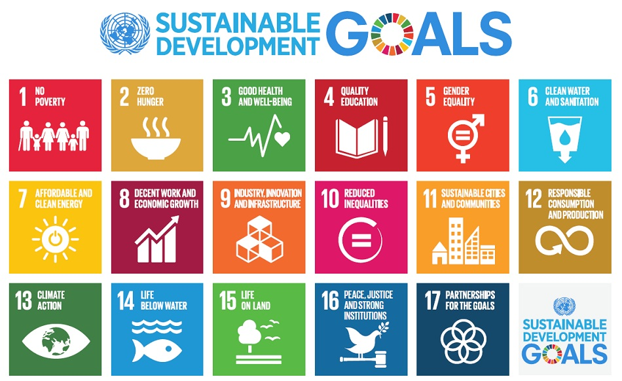
Do you believe that science can help us solve these problems?
http://www.who.int/mediacentre/events/meetings/2015/un-sustainable-development-summit/en
@protohedgehog

Slide 4
YES!
But then you also must acknowledge that by preventing access to research, we are acting against meeting these goals.
And this is what the present scholarly publishing industry is doing. In exchange for our money.
It’s not a bug. It‘s a feature.
https://paywallthemovie.com/
@protohedgehog

Slide 5
For researchers, it‘s like going to a restaurant, bringing all of your own ingredients, cooking the meal yourself, and then being charged $40 for a waiter to bring it out on a plate for you.
You are the provider, the product, and the consumer.
@protohedgehog

Slide 6
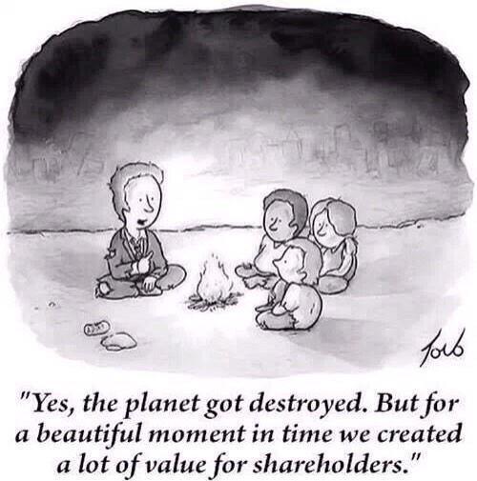
Why Open Science now?
Things are getting worse
Low public trust in science
Reproducibility/accessibility crises
Co-option of Open Science
Commercial interests strengthening
We have to act now, as a global community and take control of [Open] Science.
@protohedgehog

Slide 7
What is “Open Science”, exactly?
Open Science is about using science to help address the major challenges to society, and undoing the damage that commercial interests have caused to research in the last half century. (Moi)
or...
Open Science is the movement to make scientific research, data and dissemination accessible to all levels of an inquiring society, amateur or professional. (Wikipedia)
or…
Open Science represents a new approach to the scientific process based on cooperative work and new ways of diffusing knowledge by using digital technologies and new collaborative tools. (European Commission)
@protohedgehog

Slide 8
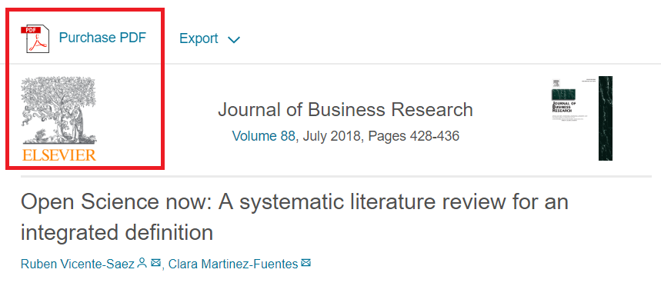
I feel like often we talk about “open science” as a different entity to “science”.
“Open Science is transparent and accessible knowledge that is shared and developed through collaborative networks.”
“Open science describes the practice of carrying out scientific research in a completely transparent manner, and making the results of that research available to everyone. Isn’t that just ‘science’?”
THIS IS VERY BAD
THIS IS VERY GOOD
https://genomebiology.biomedcentral.com/articles/10.1186/s13059-015-0669-2
https://www.sciencedirect.com/science/article/abs/pii/S0148296317305441
@protohedgehog

Slide 9
What’s the fuss?
Because OS has become a poorly-defined process- based concept
Divorced from any human, value-based element
Treated as distinct from ‘good’ science
This makes it very easy AGAIN for commercial interests to co-opt
After 20 years of relentless campaigning, only about 25% of published research articles are publicly accessible (Piwowar et al., 2018).
https://peerj.com/articles/4375/
@protohedgehog

Slide 11
Freedom
Fairness
Justice
Truth
FAIR principles
TOP guidelines
Principles of Open Scholarship, by Tony Ross-Hellauer (Source, CC BY).

Slide 12
Ask the audience
For you, is Open Science:
A process? An ideal? A vision? A principle? A club? A political agenda? A fad? A distraction? Exclusive?
People have called it all of these at one point or another…
@protohedgehog

Slide 13
Is Open Science a ‘movement’?
“..a group of people working together to advance their shared political, social, or artistic ideas.”
Movements have a direction.
Movements have shared goals.
Movements are defined by commonality.
Who is defining these for Open Science?
Who is leading this movement?
What happens if you’re ‘outside’ this movement?
What happens when a ‘movement’ can’t answer these questions..?
@protohedgehog

Slide 14
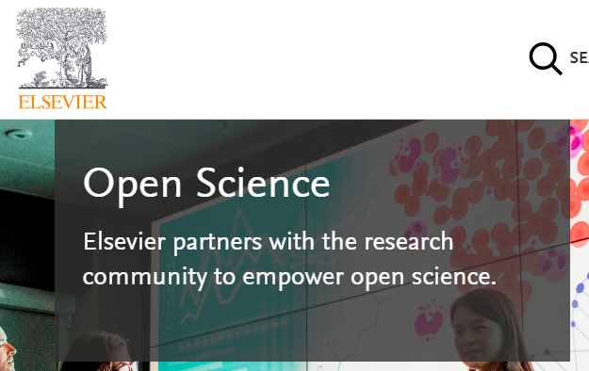
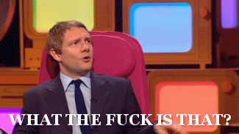
Who is leading the change?
Elsevier?
Springer Nature?
Organisations stuck in a pre-digital mindset with a key product developed in the 17th Century.
Basically the reason why the Open Science ‘movement’ began.
Business models based on exclusion, exploitation of privilege, homogeneity, discrimination, extortion etc...
Who pay lip service to Open Science, while simultaneously subverting it to meet their own intentions.
@protohedgehog

Slide 15
Recent events have been a bit odd…
Now with 1096 supporting signatures!!
Elsevier and the Lisbon Council get miffed and respond..
http://fossilsandshit.com/response-to-president-paul-hofheinz-of-the-lisbon-council-regarding-elsevier-and-the-open-science-monitor/
@protohedgehog

Slide 16
Cough
Dated 28th August
https://zenodo.org/record/1405079#.W5dYdej7RPY
@protohedgehog

Slide 17
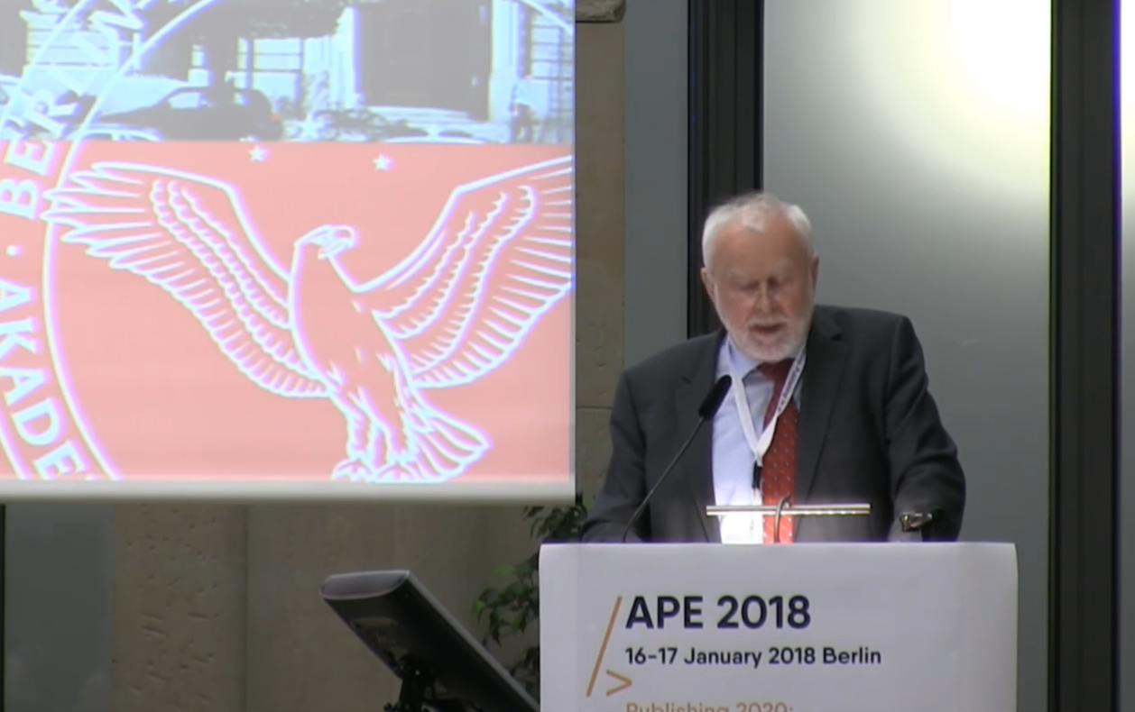
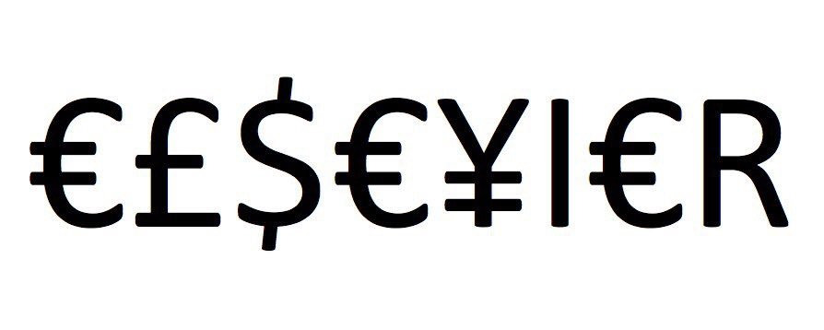
Germany versus Elsevier
“One big publisher stated: if your country stops subscribing to our journals, science in your country will be set back significantly. I responded […] it is interesting to hear such a threat from a producer of envelopes who does not have any idea of the contents.”
Martin Grötschel, President of the Berlin-Brandenburg Academy of Sciences and Humanities
#HERO
#villain
@protohedgehog

Slide 18
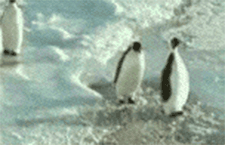
Have you ever met an average academic?
50% of academics are stupider than the average academic.
A system defined by cultural inertia.
Publish or perish mentality is still strong.
Generally terrified of new technologies.
What happened to doing good science? What are the incentives for that?
We are all penguins.
@protohedgehog

Slide 19
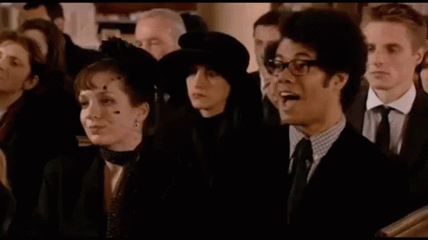
But academics are also generally terrible at making predictions...
“Open Access will never catch on.”
“Preprints will never be a thing.”
“Sharing our data won’t ever be mandatory.”
“Open peer review is fake news.”
“It doesn’t matter if research isn’t reproducible.”
“Open Science is just a fad.”
I wonder if they ever get tired being wrong all the time…
@protohedgehog

Slide 20
Principles in open science
Drivers
Barriers
Reduce publication bias.
Increase replicability.
Increase reliability of scientific record.
Make publicly funded research publicly accessible.
Make research more efficient.
Increase public trust.
Foster collaboration.
Sustainable research.
Fear of scooping or ideas being stolen.
Fear of not being credited for ideas.
Fear of errors and public humiliation.
Fear of risk to reputation.
Fear of reduced scientific quality.
Fear of information overload.
Fear of career compromise.
Fear of backlash from senior figures.
Fear of being different.
@protohedgehog

Slide 21
Your career
Open Science
SOCIAL AND TECHNICAL BARRIERS
@protohedgehog

Slide 22
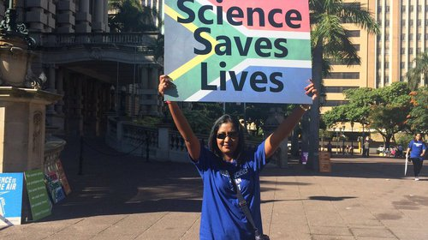
AN OPEN SCIENCE EDUCATION CRISIS
Can we break the cycle through training?
@protohedgehog

Slide 23
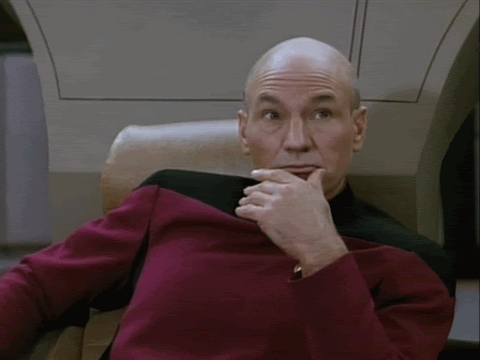
Attitudes versus practice
“60.8% of researchers do not self-archive their work even when it is free and in keeping with journal policy.”
“In a field where OA seems of practical and ethical importance for the sharing of knowledge promoting health equity, it is surprising that researchers do not make their papers available when they are legally able to do so without any cost.”
https://health-policy-systems.biomedcentral.com/articles/10.1186/s12961-017-0235-3
@protohedgehog

Slide 24
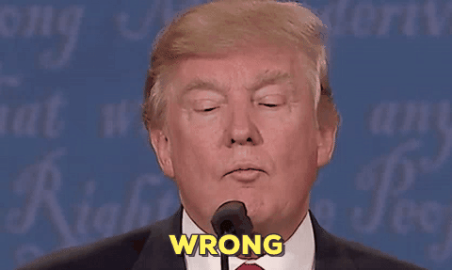
“Open Access is too expensive.”
Common view about high costs is due to a combination of monopolisation and political broadsiding and sabotage by commercial publishers.
@protohedgehog

Slide 25
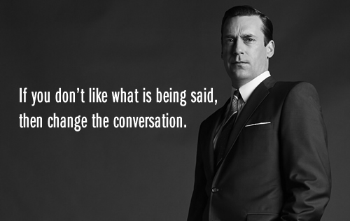
It is time to change the conversation
Open Science is AWESOME!
@protohedgehog

Slide 26
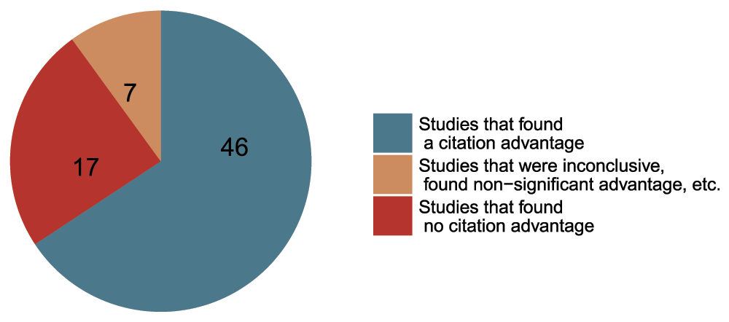
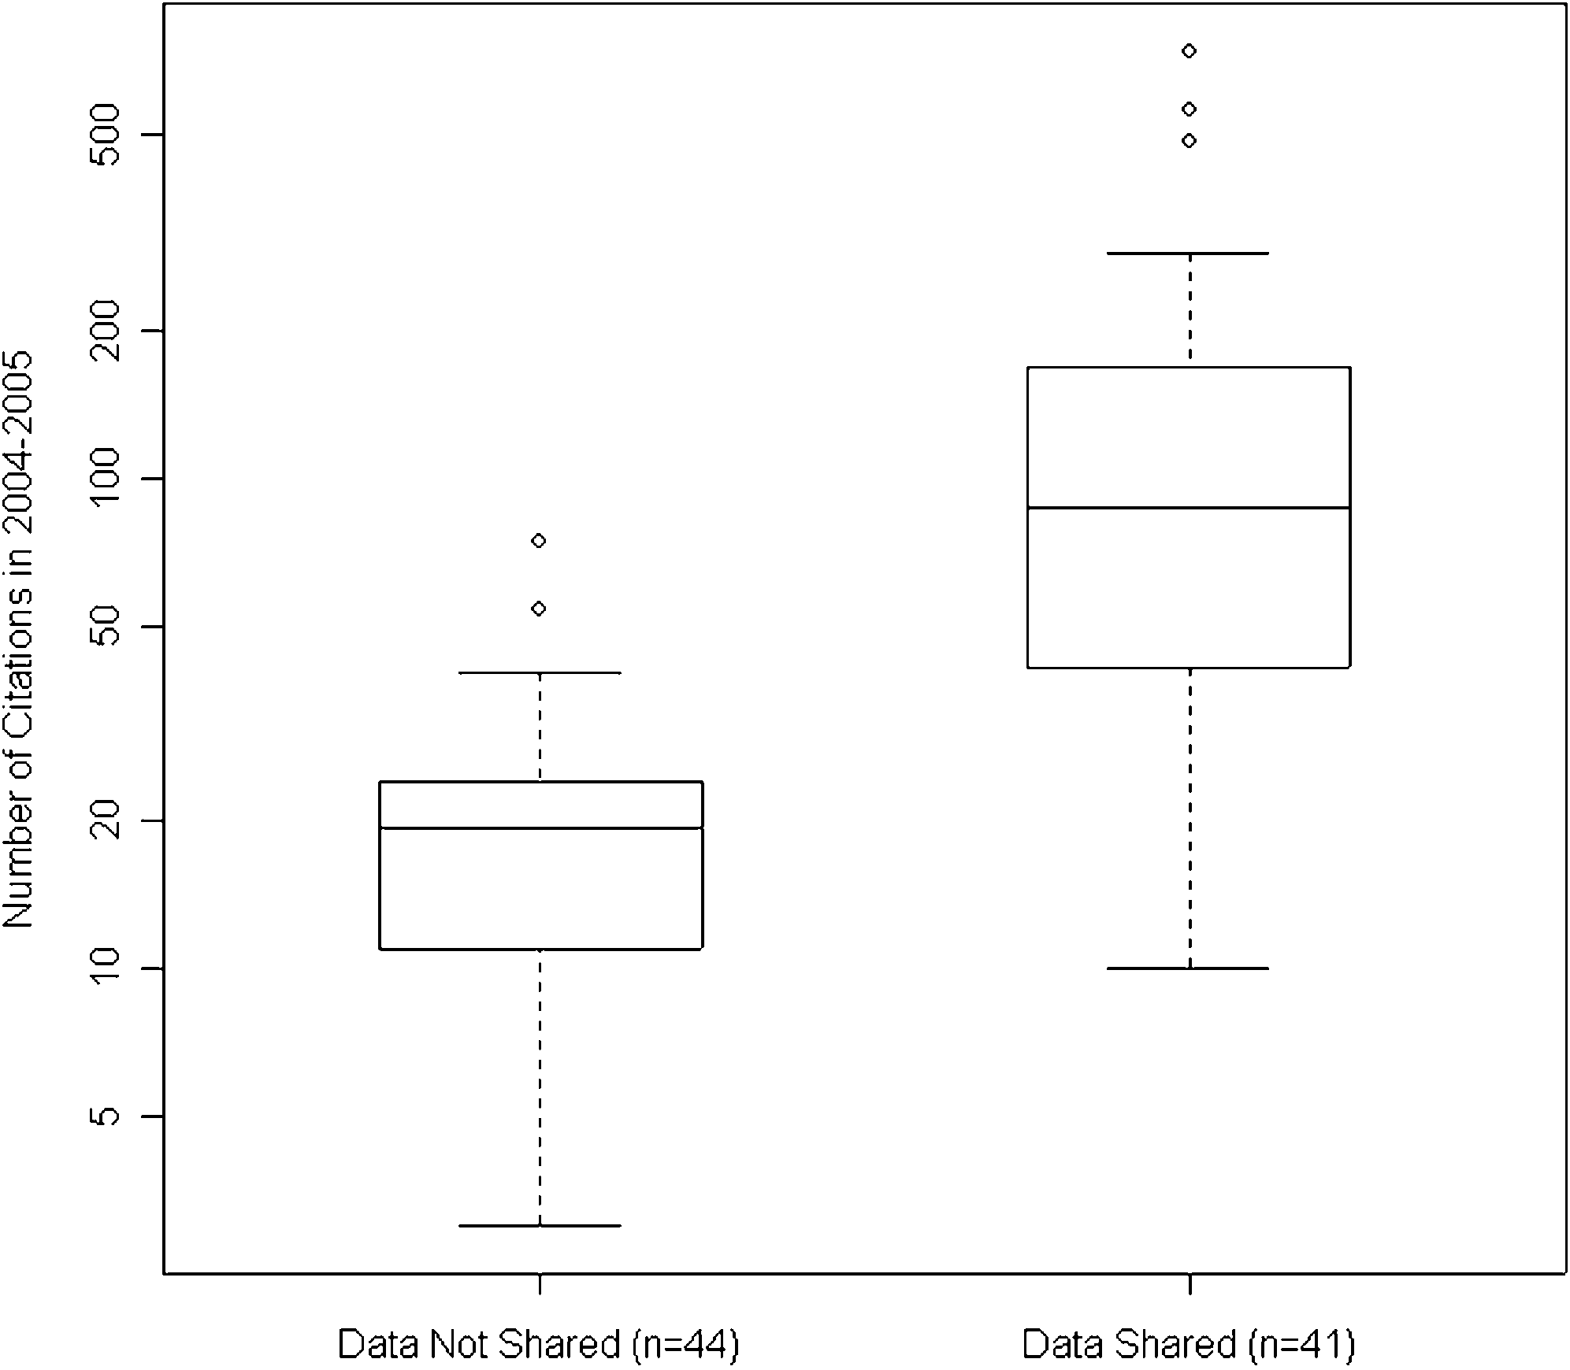
Openness is good for your work and career
Rapid communication
Greater exposure
More citations, faster
http://whyopenresearch.org
https://peerj.com/articles/175
Data from The Open Access Citation Advantage Service, SPARC Europe, accessed March 2016.
http://f1000research.com/articles/5-632/v3
@protohedgehog

Slide 27
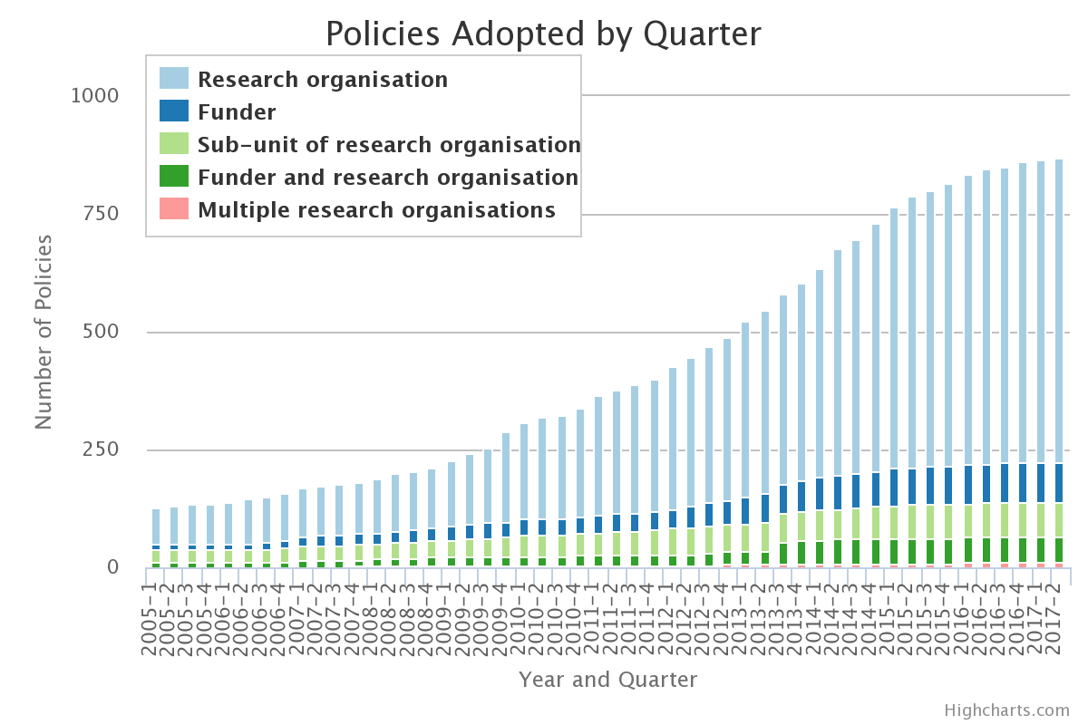
The future is OPEN
http://roarmap.eprints.org
We should be in a position where we are able to influence our academic system, not be stifled by the current actors in it.
@protohedgehog

Slide 28
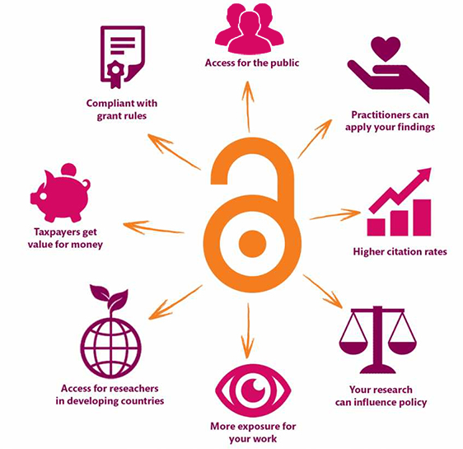
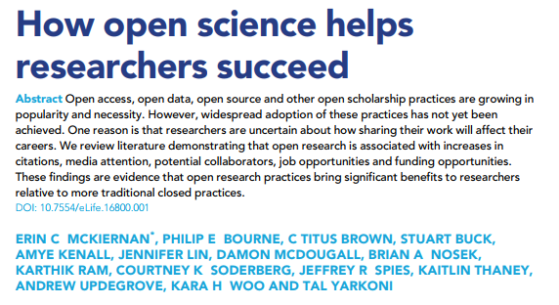
Open is better for EVERYONE
https://elifesciences.org/articles/16800
@protohedgehog
https://kib.ki.se/en/publish-analyse/open-access

Slide 29
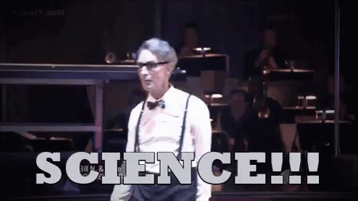
Being more open helps YOU so much
Increases dissemination of your research.
Increases your academic profile.
Emphasises your core values.
Increases your collaborations.
Makes you a more effective researcher.
@protohedgehog

Slide 30
Your career
Open Science
SOCIAL AND TECHNICAL BARRIERS
@protohedgehog

Slide 31
Your career
Open Science
TECHNICAL BARRIERS
SOCIAL BARRIERS
EDUCATION
@protohedgehog

Slide 32
What do we need to change cultures?
Education, training, support.
Empowerment and leadership for the next generation.
Shifting power dynamics to reduce bias and abuse.
Building a global community based on sharing and collaboration.
Massive-scale engagement to re-align Open Science with current incentive structures.
@protohedgehog

Slide 33
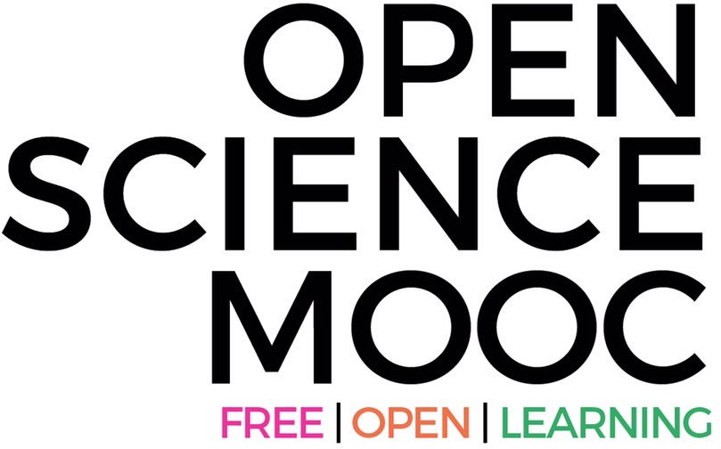
Our vision of the future
To help make ‘Open’ the default setting for all global research.
We want to help create a welcoming and supporting community, with good tools, teachers, and role-models, and built upon a solid values-based foundation of freedom and equitable access to research.
@protohedgehog

Slide 34
How do we get to where we want?
Imagine a future defined by the values of Open Science:
Freely available public good
Rigorous and reproducible
Open to ALL
Isn’t that just GOOD science?
@protohedgehog

Slide 35
Skeptical? You should be. Challenges:
Working models exist and show ‘Open Science’ is a more effective process.
Simultaneous uptake of new behaviours across the whole scholarly ecosystem.
Standardised communication between a range of key participants.
Interoperability between specific and diverse communities.
Increasing the role and recognition of ‘Open Science’ across the board.
Getting research funders (and researchers..) interested.
But it’s not as new as you think.
Science was founded on openness.
We closed it down.
It’s time to open it up again.
@protohedgehog

Slide 36
The ultimate goal
Pooling knowledge and resources to create a decentralised scholarly infrastructure, with communities as the focus.
Inclusivity
Equality
Accountability
Freedom
Fairness
Justice
Truth
Rigour
Transparency
Reproducibility
SCIENCE AS A PUBLIC GOOD FOR THE BETTERMENT OF SOCIETY
#PeopleNotProfits
http://elephantinthelab.org/do-we-need-an-open-science-coalition/
@protohedgehog

