Slide 1
Volunteering, It is good for the students, communities and the University : Reflections on STEM volunteering
Dr Scott Turner.
The University of Northampton

Slide 2
Who am I?
Associate Professor in Computing and Immersive Technology
Volunteering
Chair of the University of Northampton STEAM Steering group.
National STEM Ambassador
Code Club volunteer
Member of organizing team for a programming competition

Slide 3
Impact On Students (Conn et al, 2014)
• 85% of students said that engaging in volunteering increased their communication skills;
• 79% said that it had increased their confidence in their own abilities and 77% said that it increased their understanding of other people;
• 78% of recent graduates under 30 years old talked about volunteering in interview;
• 51% of recent graduates under 30 who are in paid work say that volunteering helped them to secure employment.

Slide 4
NCCPE have found that “students identified the opportunity to burst out of the student ‘bubble’ as one of the most valued aspects of volunteering”

Slide 5
Impact on Society (Conn et al, 2014)
Based on 2014 figures -30% of students 30 hours per year
Estimated monetary value of £160m per year

Slide 6
The value of student volunteering
Students bring talent, time and enthusiasm
a new demographic - broadening diversity
Student volunteers challenge misconceptions and are positive ambassadors for their University
Student volunteers gain confidence,
skills,
and high levels of satisfaction
Students can try new things to clarify career options
Brewis, Russell and Holdsworth, 2010.

Slide 7
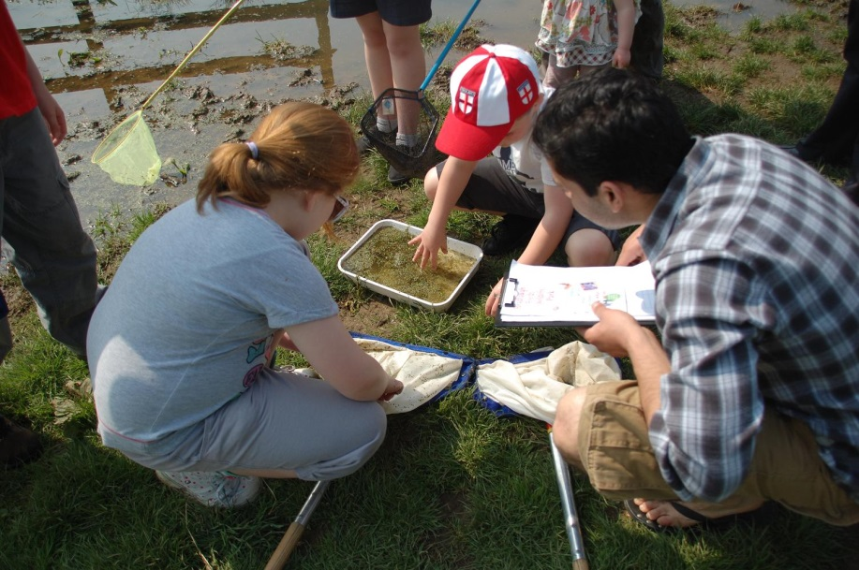
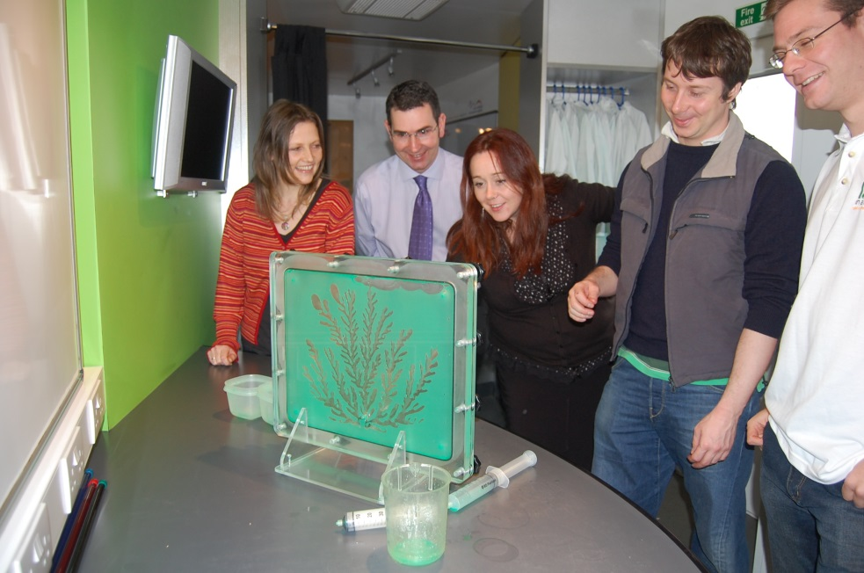
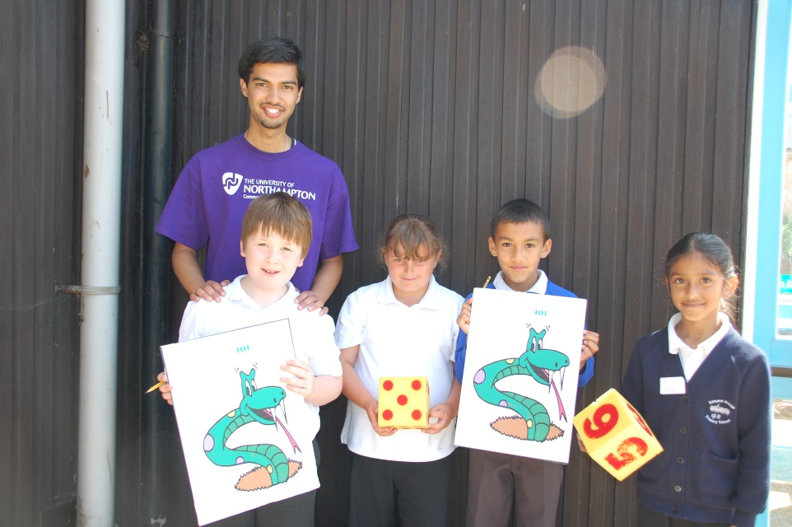
A over a decade of STEM experience.

Slide 8
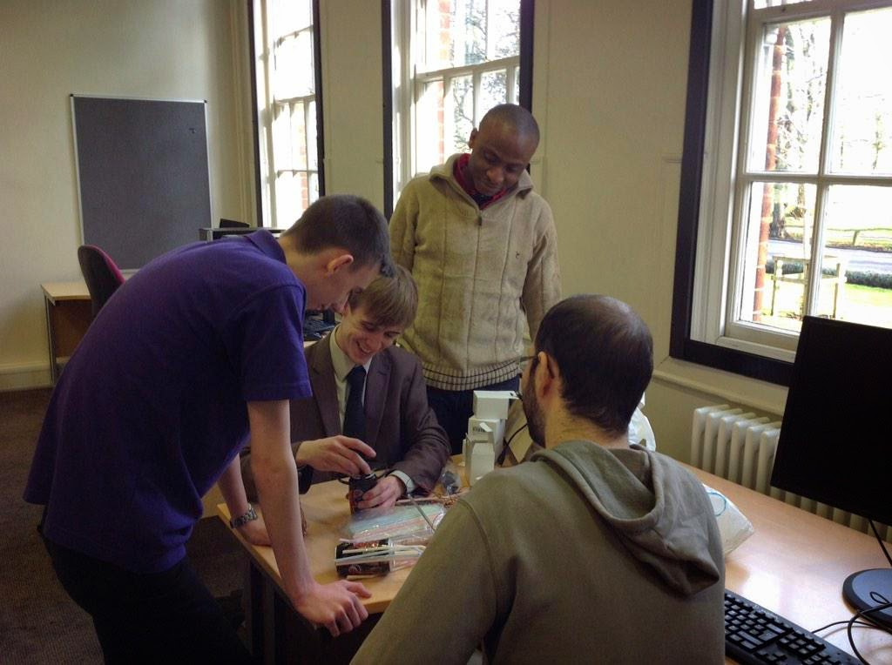
Junkbots training
One of those in the picture has lead a junkbots session.
One has support one.
(c) Linda Davis-Sinclair
(c) Linda Davis-Sinclair

Slide 9
And what students think…
I have gained an appreciation of being able to apply and impart my knowledge to younger students. Personally, I feel that I have developed in terms of my confidence, creativity and science-based skills. Working with STEM has further reinforced my passion for science.
Working with the children was amazing. Showing them that science was fun as well as interesting and getting them to interact with the experiments we did gave me an immense sense of achievement.
Being a STEM Champion has helped me improve my communication
skills considerably. I believe I have
enhanced my skill set.
Student STEM Champions

Slide 10
Cross-University Steering Group

Slide 11
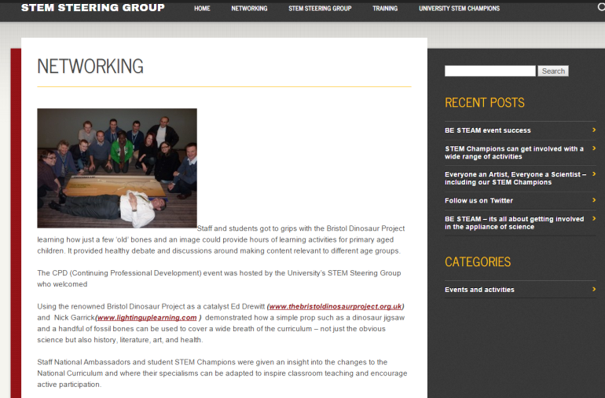
Cross-University Steering Group - Aims
Planning, co-ordination and promotion of STEM activities
Networking opportunities for students, staff, schools and community groups interested in STEM
Promote interest and aspiration in STEM in local schools
Increase University student identification with their STEM subject

Slide 12
Coordinated training – networking and employability
Recognition by the University
Opportunities for peer mentoring and staff/student mentoring to develop student-led STEM workshops
The University STEM network of staff and students
Becoming a National STEM Ambassador enhancing employability

Slide 13
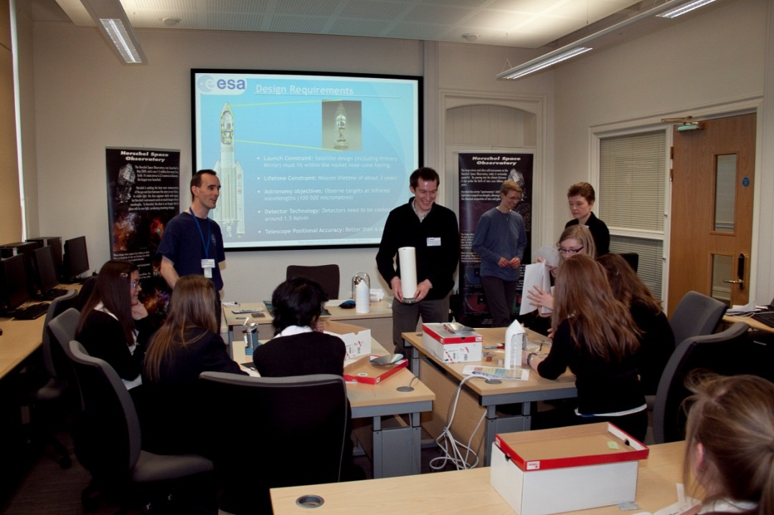
Feedback on training
I now have a better understanding of employability and how it will help me
Very useful to see how National STEM fits into the University
It has helped me to be more confident
University STEM Champions, 2014.

Slide 14
Computing Historic Case Studies
1.‘Supporting’
A third year student on a BSc Computing course.
Delivering robot-based activities, in schools,
developed the confidence to run part of an activity on his own
2. ‘Supervisor’
A second year BSc Computing both supervised and unsupervised, delivering STEM activities.
On STEM Steering group, bringing a student perspective.

Slide 15
Quote
“Being a STEM Champion and National STEM Ambassador means that I can take advantage of events both here at the University and regionally. I can pick and choose what I get involved in, so recently when I was asked if I could run a Blogging workshop for Year 10 students from Thomas Becket School, I jumped at the opportunity. I planned the session and then with help from fellow STEM Champions, we enabled the students to write up their experiences of their aspiration day. It was not without challenges but it was very interactive and great fun.”

Slide 16
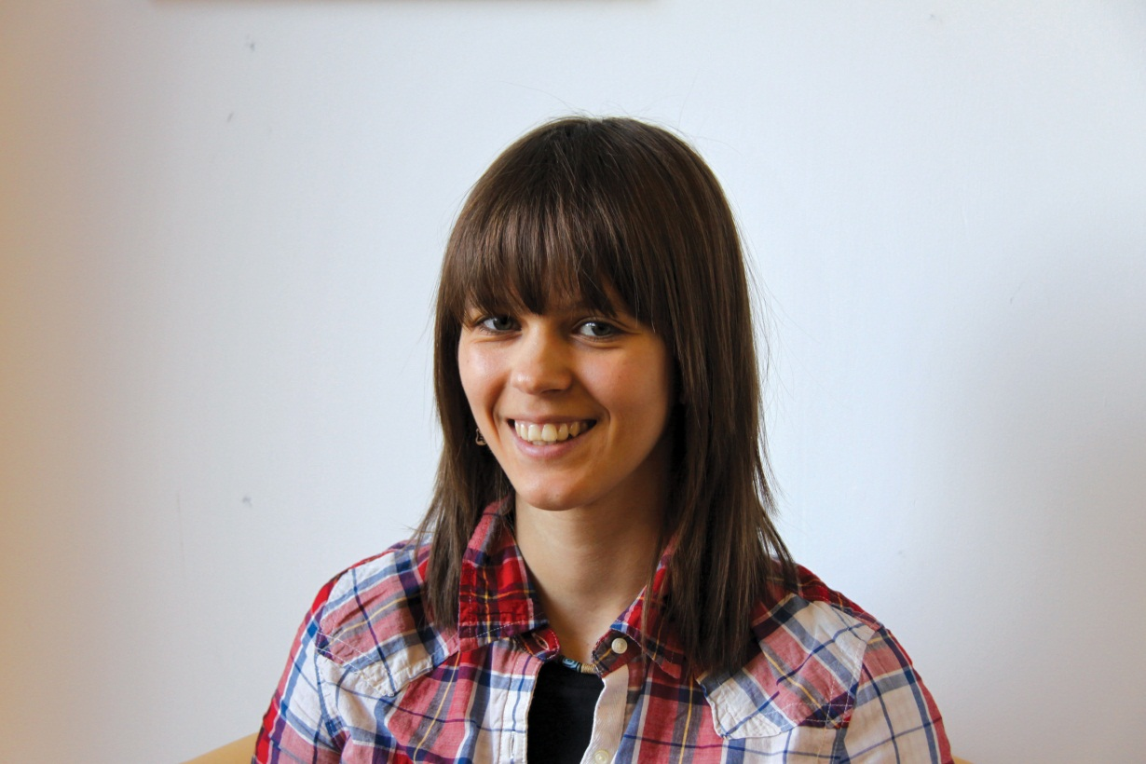
Meet Aleksandra - Leader
BSc Computing, 2011. Now Research (part-time) student
Women into Engineering, 2010, workshop leader.
“Redefining Women into IT” project, 2011, workshop leader.
International Women’s Day, 2013, careers workshop.

Slide 17
Aleksandra inspired

Slide 18
Aleksandra transformed

Slide 19
Personal Reflection
Confidence building
Being treated like the ‘expert’
Taking the lead on something.
Would these students have done well anyway?
Not just about CV enhancement
Enjoyment
Not every stage is everyone.
Some are using to get into teaching.

Slide 21
Participant feedback.
I liked it because we got to make things and we got to see how science works.
I learnt a lot of interesting facts. I learnt that Physics can be really interesting and there are lots of jobs available.
Where do I start? An amazing action packed day!
School students, 2011-2013

Slide 22
References and Bibliography
Brewis, G., Russell, J & Holdsworth, C. (2010). Bursting the Bubble
Conn Z, Fernandez S, O’Boyle A, Brewis G (2014) Students, Volunteering and Social Action on the UK: History and Policies http://discovery.ucl.ac.uk/10021114/1/141029_SH_SV_Studyv8small.pdf
Turner, Scott J (2015) Enhancing computing student employability skills through partnership working in STEM outreach. Paper presented to: 11th China - Europe International Symposium on Software Engineering Education (CEISEE 2015), Westsächsische Hochschule Zwickau (WHZ), Germany, 29-30 April 2015
Sinclair, John M, Allen, Stuart C H, Davis, Linda, Goodchild, Tricia, Messenger, Julie and Turner, Scott J (2014) Enhancing student employability skills through partnership working in STEM outreach: the University of Northampton approach. Paper presented to: Higher Education Academy (HEA) Science, Technology, Engineering and Mathematics (STEM) 3rd Annual Teaching and Learning Conference 2014: Enhancing the STEM Student Journey, University of Edinburgh, 30 April-01 May 2014.

