Slide 1
ORCID US Community Showcase
September 12, 2018 - Celebrating 100+ Members!
Presented by the ORCID US Community, supported by LYRASIS, in partnership with ORCID, Boston College, Cornell University, New York University, University of North Carolina at Chapel Hill, and University of Virginia
Notes:
Sheila

Slide 2
Agenda
ORCID US Community Overview
Global ORCID Overview
Highlights from US research institutions:
University of North Carolina at Chapel Hill
New York University
Boston College
Cornell University
University of Virginia
ORCID US Community Resources
Questions & Discussion

Slide 3
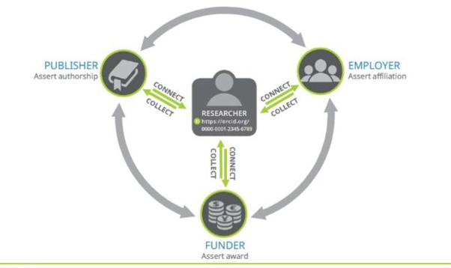
ORCID: Open Researcher & Contributor ID
https://orcid.org/0000-0002-1196-6279

Slide 4
ORCID US Community
National consortial ORCID membership for US research institutions: http://orcid-us.org
Building a community of practice around ORCID in the US
Lowest discounted membership fee: $4,300/calendar year
Dedicated technical & community support

Slide 5
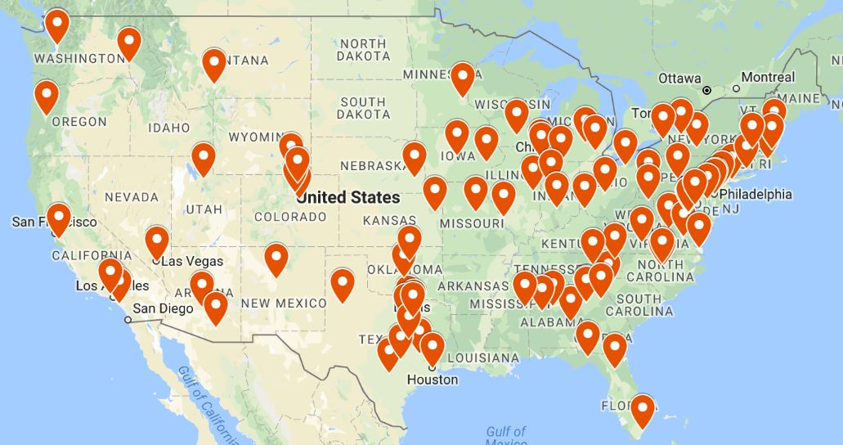
ORCID US Community
102 institutional members!
http://orcid-us.org

Slide 6
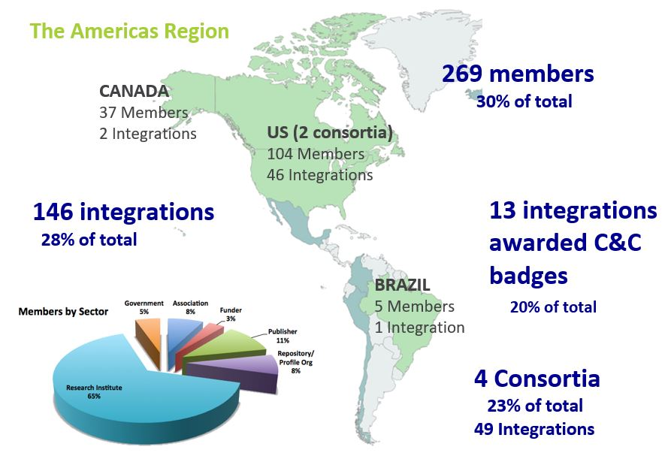
ORCID: Americas Region

Slide 7
ORCID: Global Picture

Slide 8
ORCID @ University of North Carolina at Chapel Hill
Notes:
Barrie

Slide 9
ORCID Outreach at the University of North Carolina at Chapel Hill

Slide 10
Invited by Office for Research to lead ORCID Outreach
Office for Research requested Libraries take the lead in communications and outreach to promote and support ORCID adoption in fall 2016.
ORCID Outreach Team began planning in early 2017.
Office for Research obtained ORCID premium consortium membership (via NERL) in late summer 2017.

Slide 11
Key Points
ORCID’s Collect & Connect program
No more batch loading by institutions to avoid duplicate ORCID iD creation.
UNC ORCID portal to handle creation and connection of UNC ORCID iDs.
Chose to adopt an opt-in process; not a campus requirement (slow grow).
Initial key partners:
Office of Research
Scholarly Communications librarians

Slide 12
Key University Libraries Activities
Develop a plan and process for ORCID implementation.
Liaise with Office of Research Information Systems in developing UNC ORCID Creation & Connection portal.
Create, purchase ORCID outreach materials.
Pilot the program and portal with a small group and use feedback to refine and expand.
Share materials and launch ORCID outreach campus-wide.

Slide 13
Implementation Timeline, 2017-18
Summer 2017 | Preparation, including: technical development of portal LibGuide updates, and development of marketing materials
Fall 2017 | Push for all faculty to obtain an ORCID iD. Pilot test UNC ORCID portal with a small group of faculty.
Spring 2018 | Promote UNC ORCID portal for creating ORCID iDs and connecting them to UNC-Chapel Hill ID.

Slide 14
Implementation Timeline, 2018-19
Summer/Fall 2018 – Spring 2019 | Promote further to faculty/researchers via targeted presentations and swag: Responsible Conduct of Research course (early career researchers) New faculty orientation Faculty Council Scholarly Communications Committee Individual units: Chemistry, Pharmacy, Allied Health….. scheduling more every day Pilot sign-up sessions with faculty and other groups. Continue discussions with Office of Research and others about ORCID integrations. Initiate selected integrations.

Slide 15
Engaging Public Services Librarians
Brief advance announcement at Libraries All Staff Meeting, Fall 2017
"Connect-a-thon" and departmental presentations for librarians, Oct 2017 - Feb 2018
Dedicated meeting with all public services librarians, Feb 2018
Provided swag, handout, and slide decks for meetings with faculty, Spring 2018

Slide 16
Swag: Pens & Pins
Pens with UNC portal URL
For librarian distribution to faculty, researchers
Pins
Asking librarians to wear buttons when meeting with faculty

Slide 17
UNC-Chapel Hill ORCID Statistics
As of August 1st, 5378 ORCID records are registered with unc.edu e-mail addresses (more UNC-Chapel Hill affiliates likely have ORCIDs but registered with a non-unc.edu email).
153 ORCID iDs linked to UNC-Chapel Hill ID since ORCID portal launch*.
Health Sciences Library librarians recorded 99 consultations/interactions that involved discussion of ORCID in 2017-18.
74 faculty 5 fellows & postdocs
7 staff 2 residents 9 graduate students
2018-19 Goals:
Significantly increase UNC-linked ORCID iDs .
Standardize collection of ORCID outreach statistics across the University Libraries.

Slide 18
UNC-Chapel Hill ORCID Outreach Team
5 librarians from across UNC Libraries
Health Sciences Library
Davis Library (main graduate library)
Kenan Sciences Library
Contact: ORCIDTeam@unc.edu
LibGuide: http://guides.lib.unc.edu/orcid

Slide 19
ORCID @
New York University
Notes:
Stuart

Slide 20
ORCID @ New York University
Consortial member of ORCID (via NERL)
Separate support approaches by campus (Washington Square & Medical Center)

Slide 21
NYU Washington Square Campus and ORCID
Challenges:
230 majors/programs, 50k students, hundreds departments/schools/institutes
No centralized Persistent ID authority
Response:
Link ORCID to Research Data Management instructional efforts

Slide 22
NYU Libraries Data Services and Research Data Management (RDM):
ORCID advocacy integrated with 30+ hours/semester of RDM instruction per semester
Targets are faculty, graduate/postgraduate researchers
Departmental liaison outreach to encourage ORCID use for internal scholarly output tracking

Slide 23
MedCenter, circa 7300 active faculty
Sophisticated in house database of faculty publications
Intense interest in improved author/faculty name matching
Also interested in ORCID based publication harvesting

Slide 24
Library urges faculty to join ORCID and to authorize the Library to manage their ORCID publication listings
Two mass emailings and sustained nudging via publication notifications
As of today, about 28% of all active faculty have ORCID IDs, but close to 50% of faculty who have published in the last 3 years
Harvesting by ORCID from PubMed/WOS -- 50-100 citations a week

Slide 25
Stuart Spore
stuart.spore@med.nyu.edu
Nicholas Wolf
Nicholas.wolf@nyu.edu
MedCenter ORCID write up: https://shorturl.at/hsD49

Slide 26
ORCID @
Boston College
Notes:
John

Slide 27
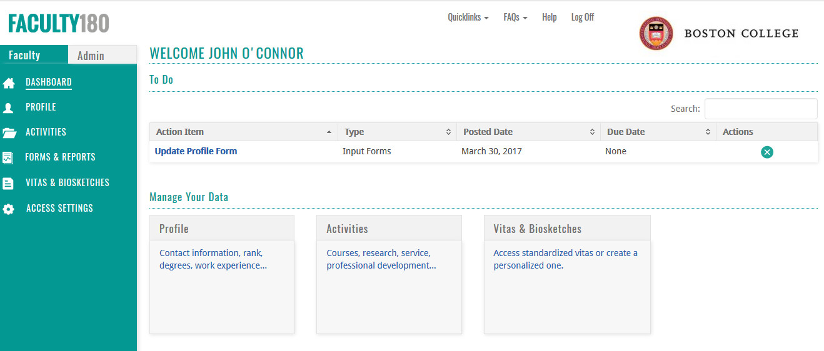

Slide 28
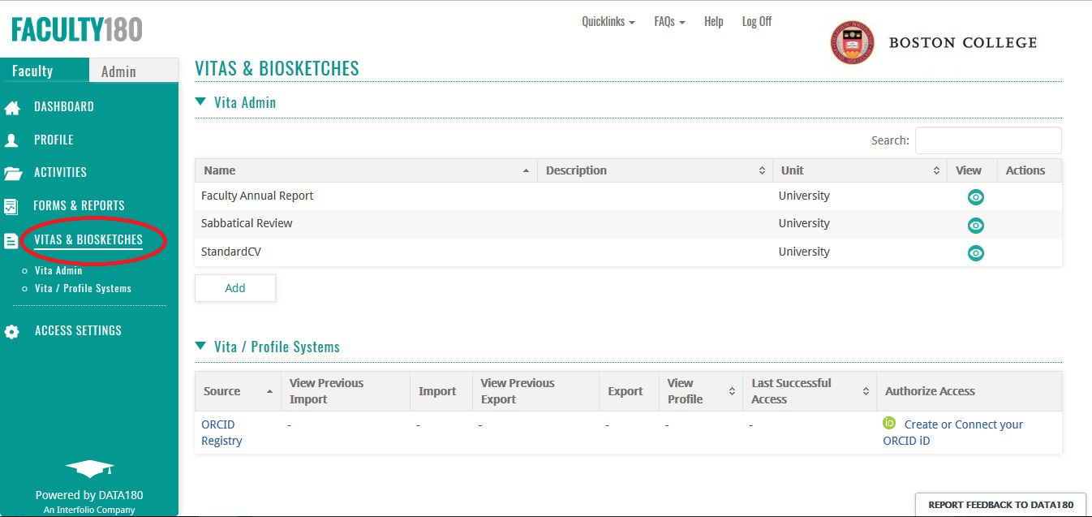

Slide 29
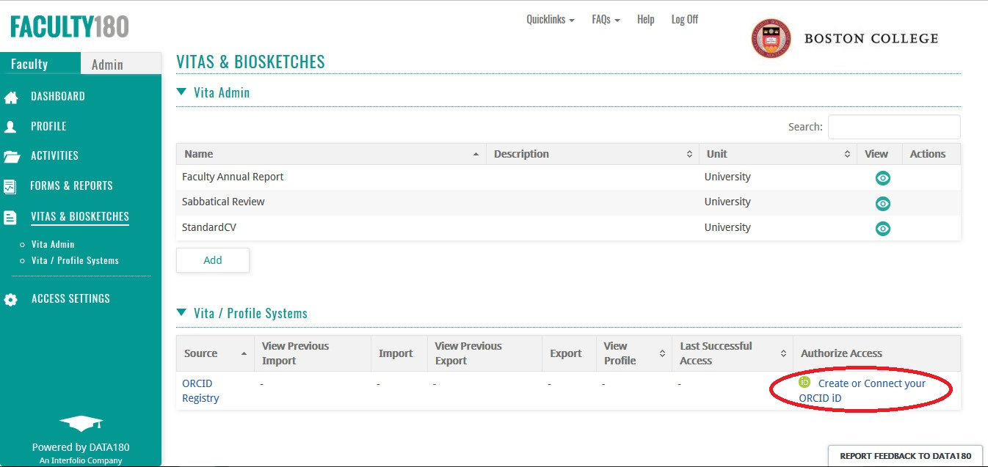

Slide 30
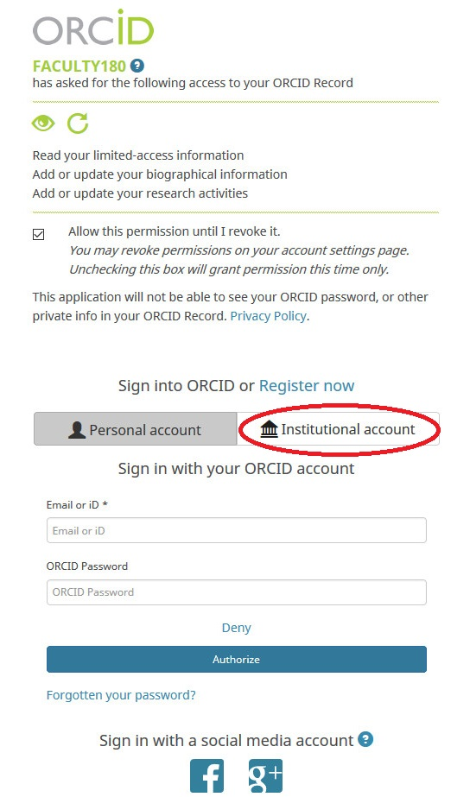

Slide 31
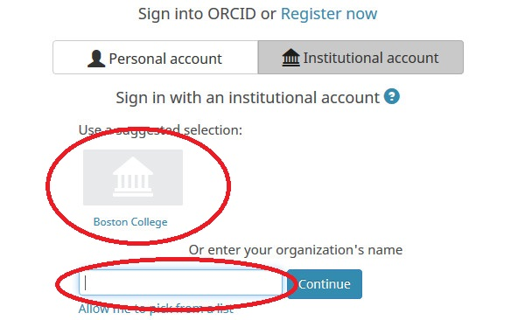

Slide 32
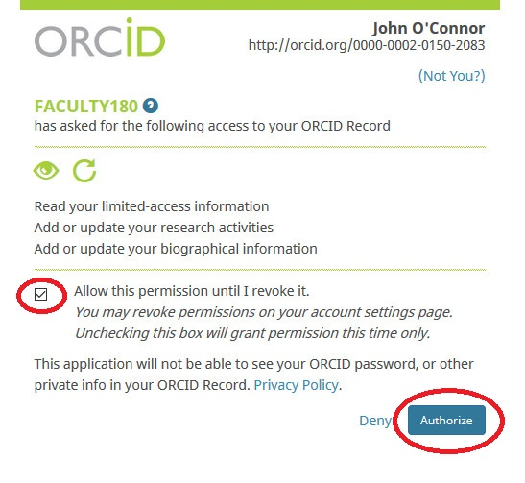

Slide 33
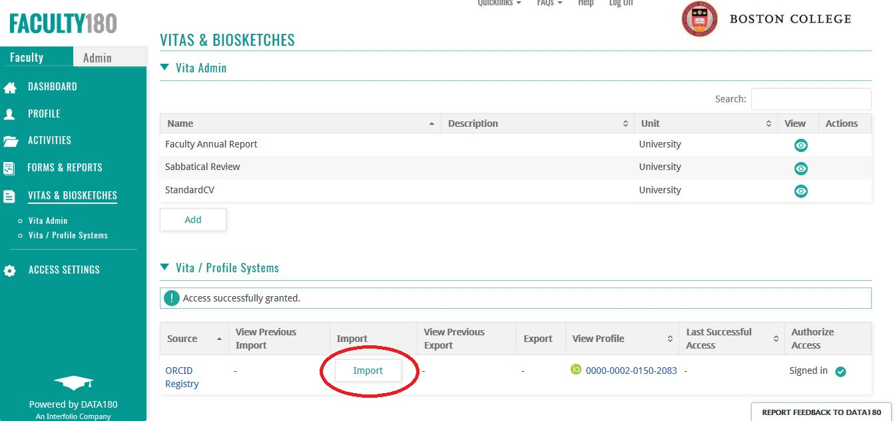

Slide 34
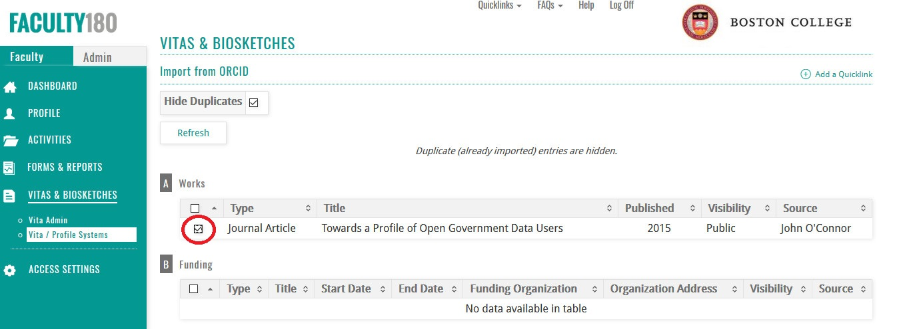

Slide 35
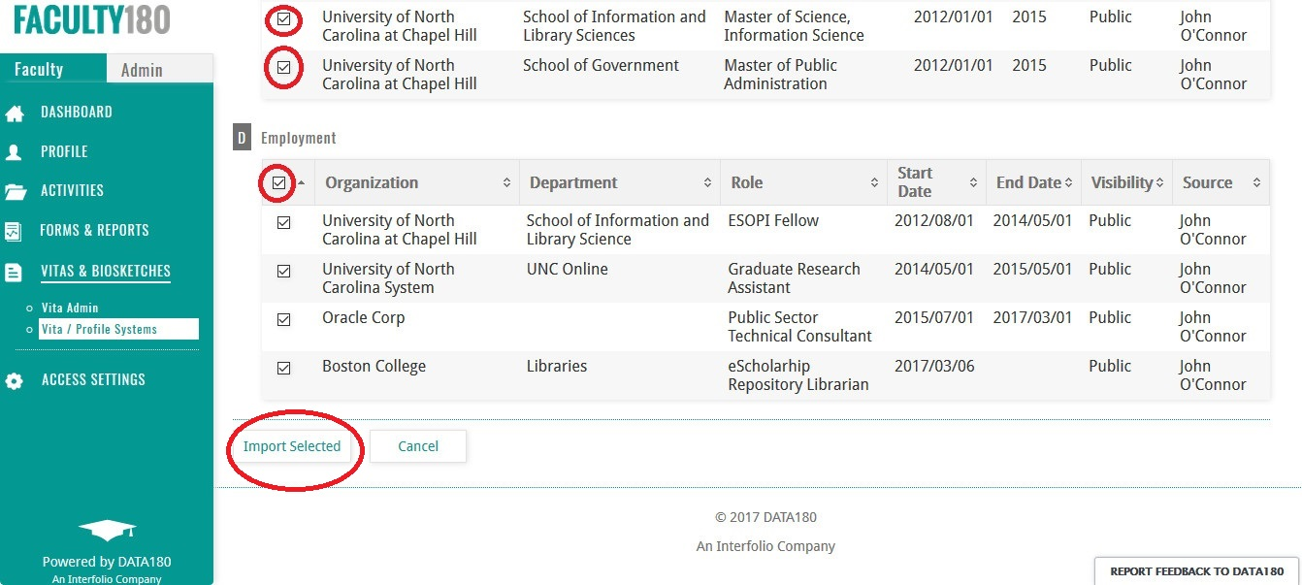

Slide 36
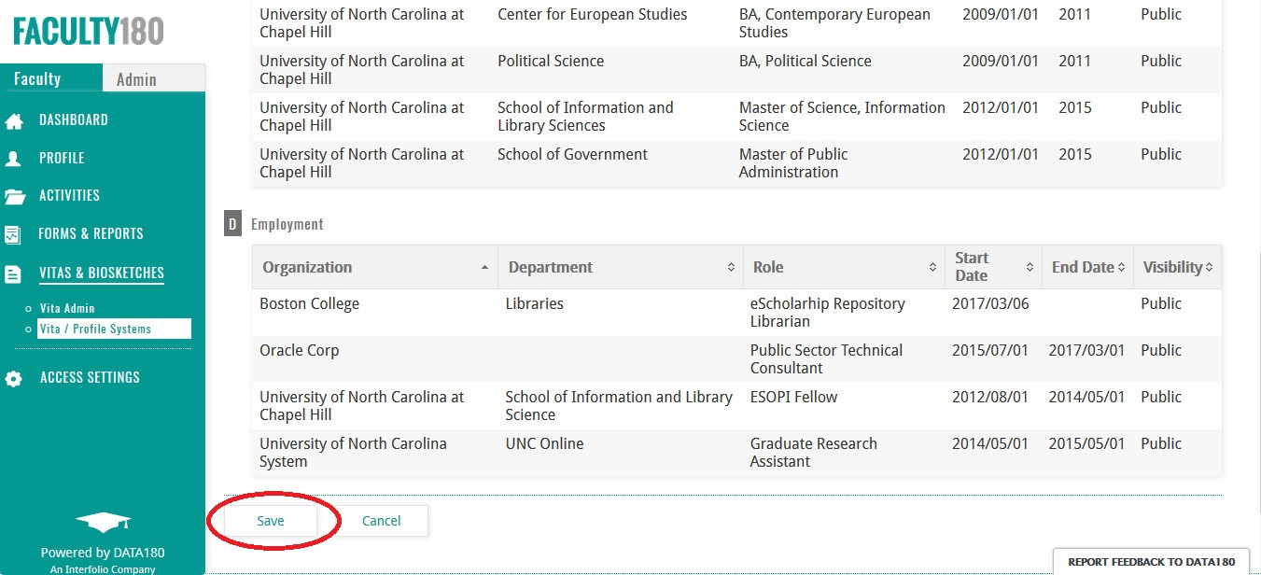

Slide 37
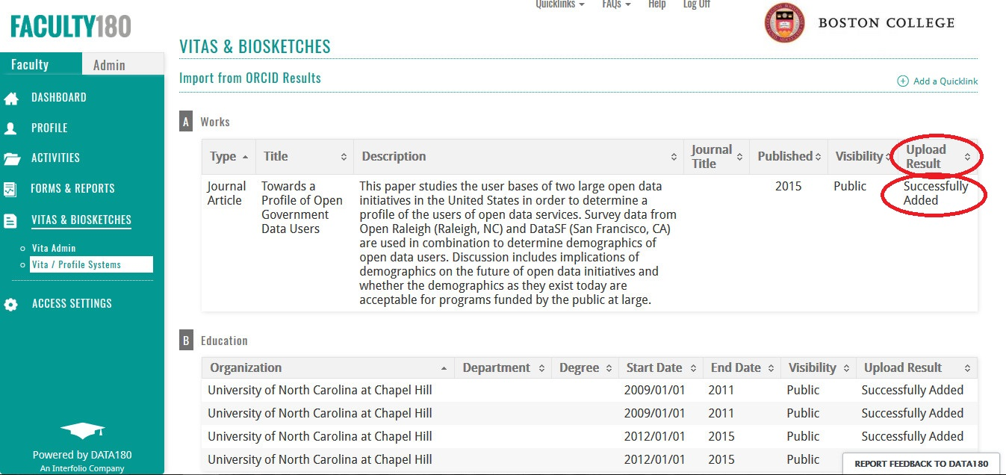

Slide 38
ORCID @
Cornell University
Notes:
Simeon

Slide 39
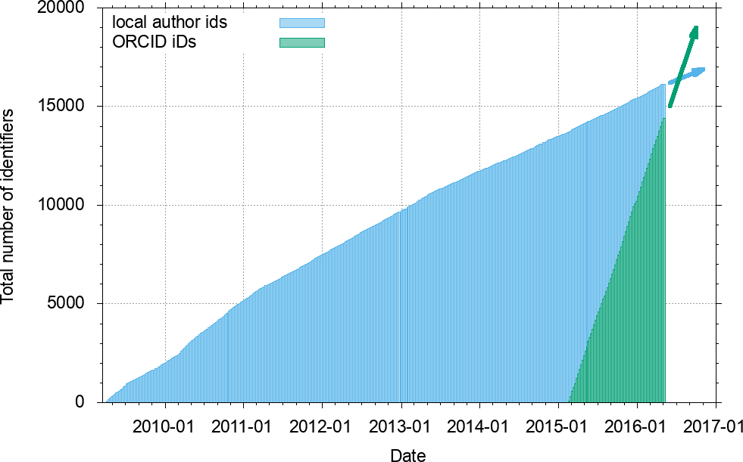
ORCID @ arXiv.org
Local author ids first introduced pre-ORCID in 2009 (~15k created in the first 6 years, ~2.5k/year), ORCID iD connection introduced in early 2015.
Rapid initial adoption has continued
Now ~53k connected ORCID iDs (~6k/year)
Universal >> local !

Slide 40
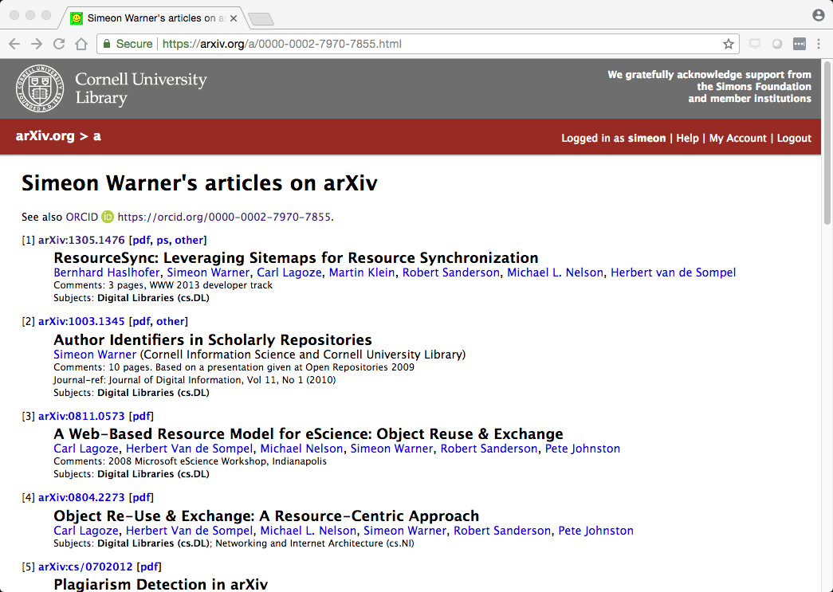
arXiv author id page tied to ORCID
Replaced local ids
Shows articles on arXiv
Links to ORCID record

Slide 41
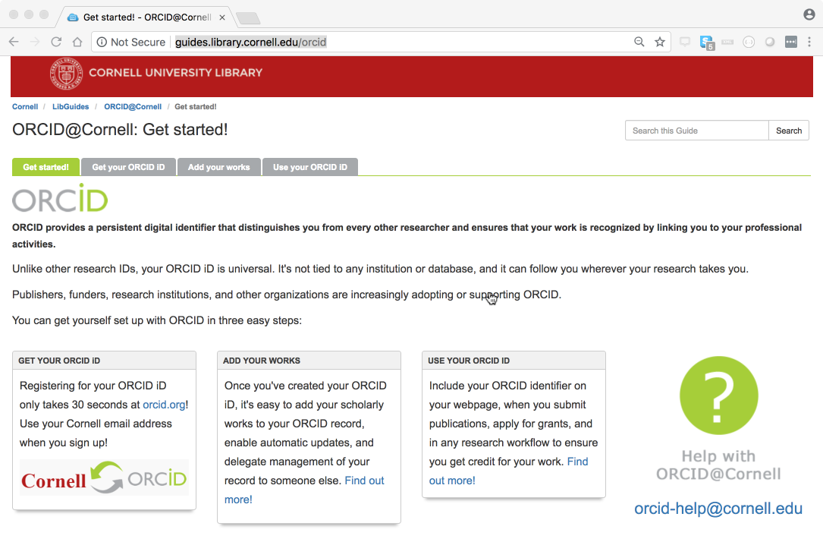
ORCID @ Cornell
LibGuide is the primary entry point for information about ORCID
Benefits
How to
Contact point

Slide 42
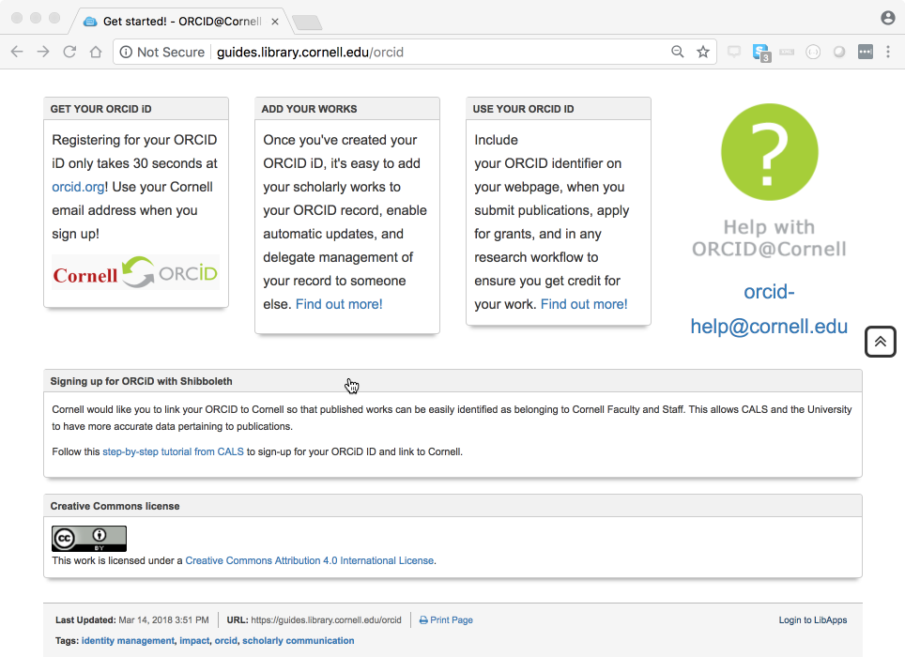
Cornell CALS (College of Agriculture and Life Sciences) using ORCID as part of faculty reporting
Make link to local identity (“netid”) via Shibboleth Institutional login

Slide 43
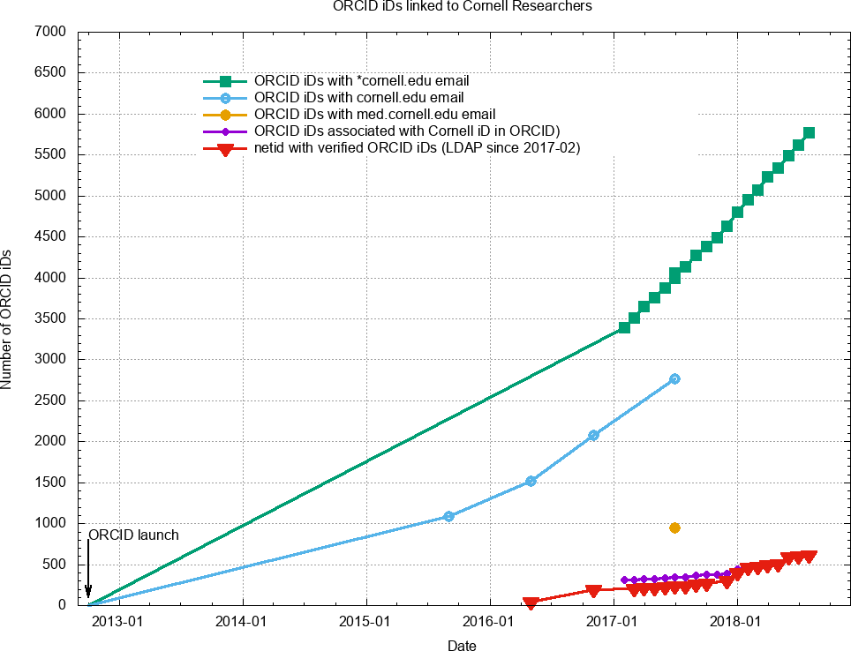
631 authenticated associations (mostly CALS and Library)
⇒ Promotion required for adoption

Slide 44
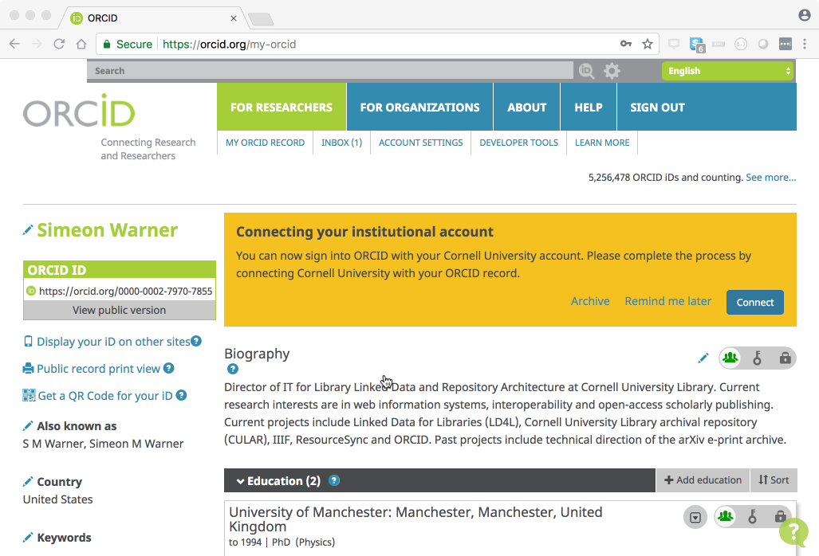
After normal institutional login (shown earlier in webinar) ORCID offers the opportunity to connect
(screencast of full process at https://youtu.be/eTJgTWwWLUU )

Slide 45
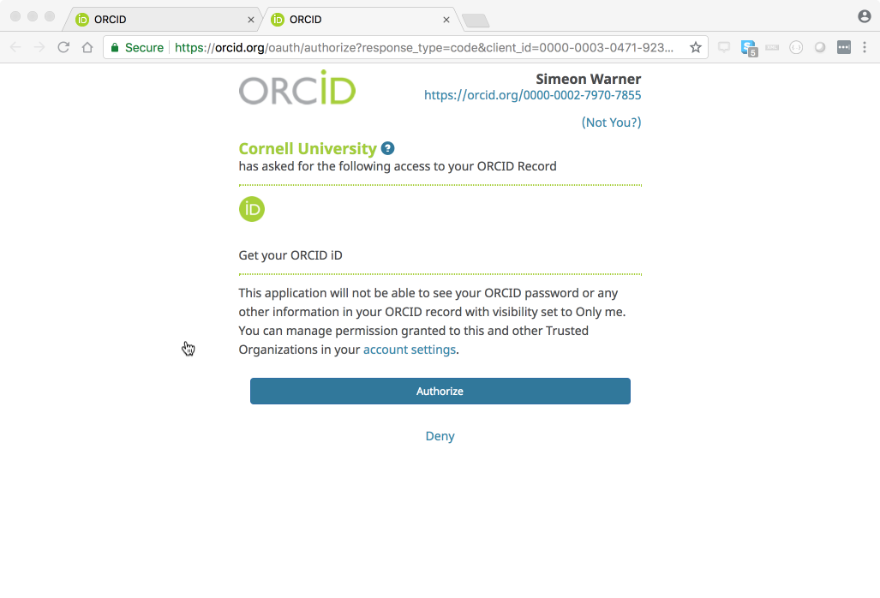
Asks only for permission to get iD. We are not updating ORCID records

Slide 46
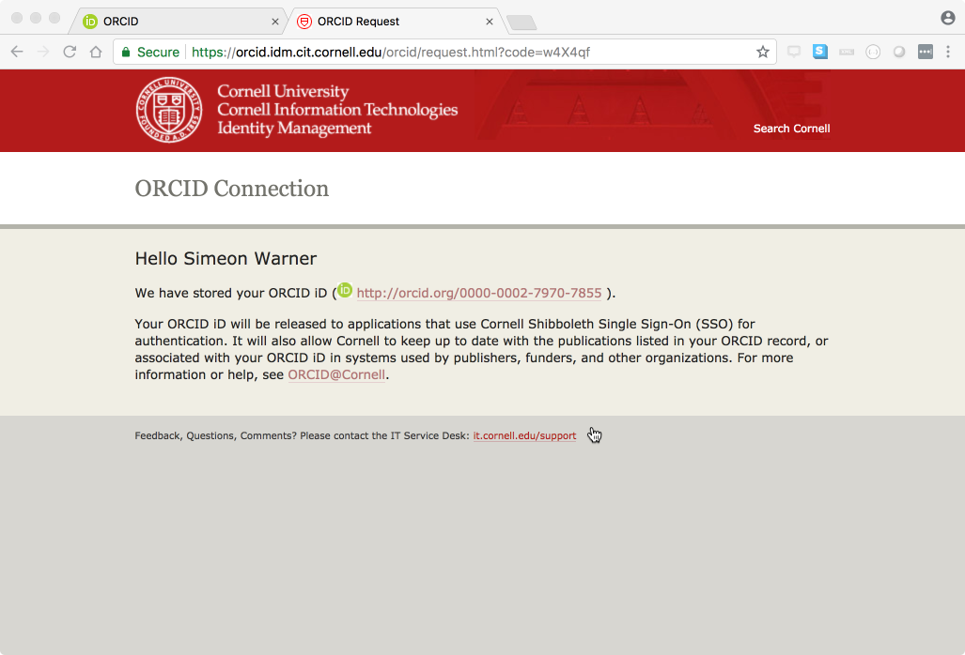
Cornell IT page confirms connection recorded
ORCID iD then available via LDAP as eduPersonOrcid attribute

Slide 47
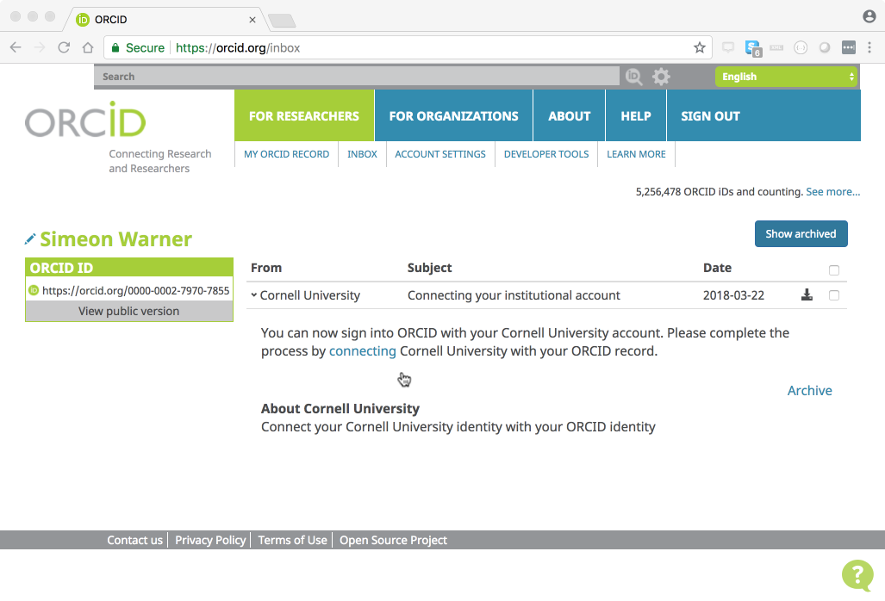
2nd try -- if user doesn’t connect then ORCID leaves message in inbox to do so later

Slide 48
ORCID @
University of Virginia
Notes:
Sherry

Slide 49
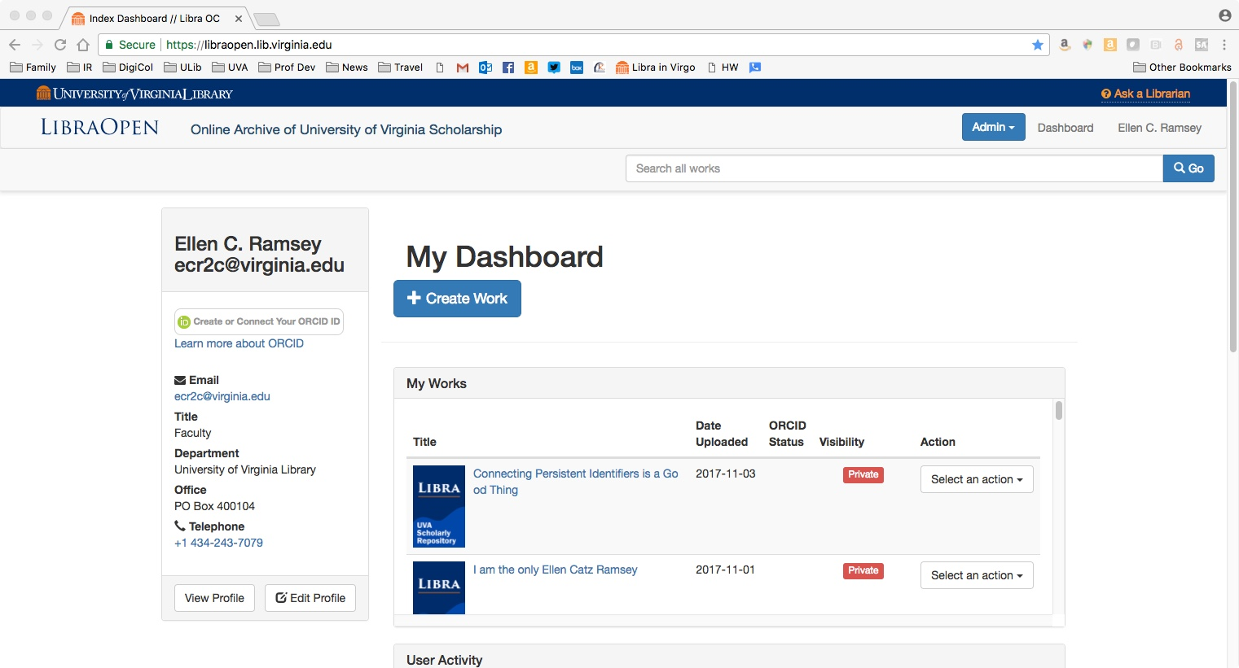

Slide 50
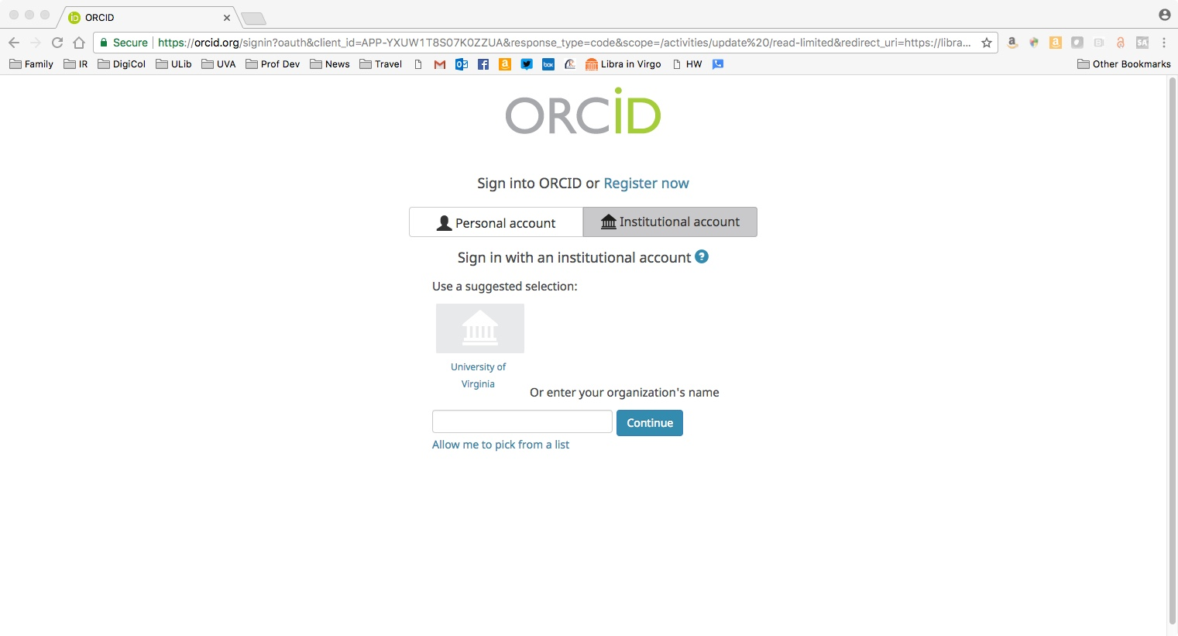

Slide 51
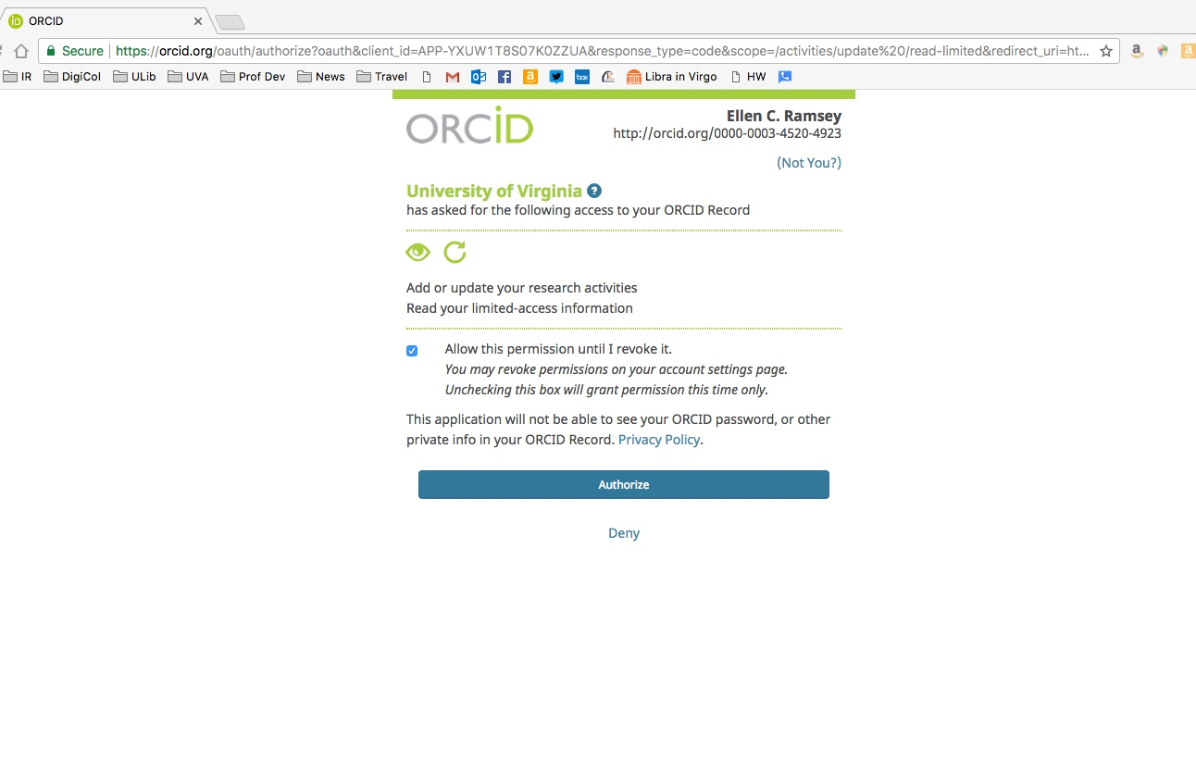

Slide 52
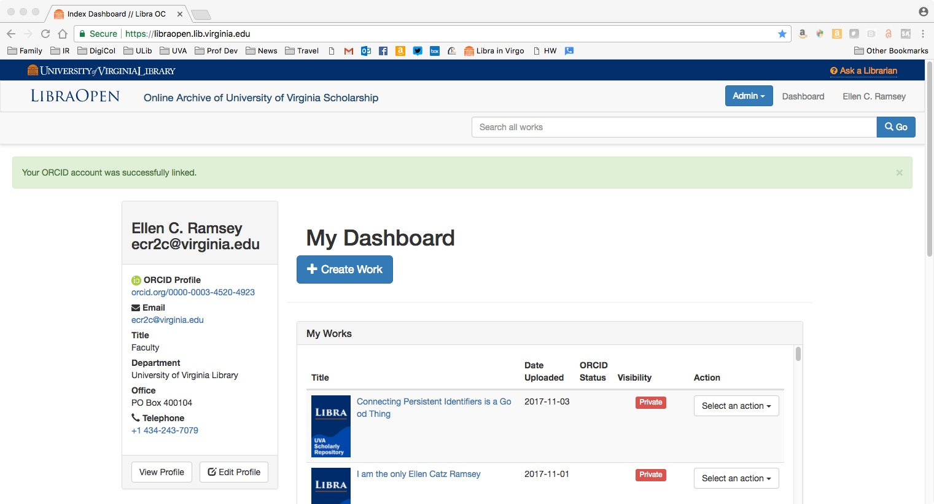

Slide 53
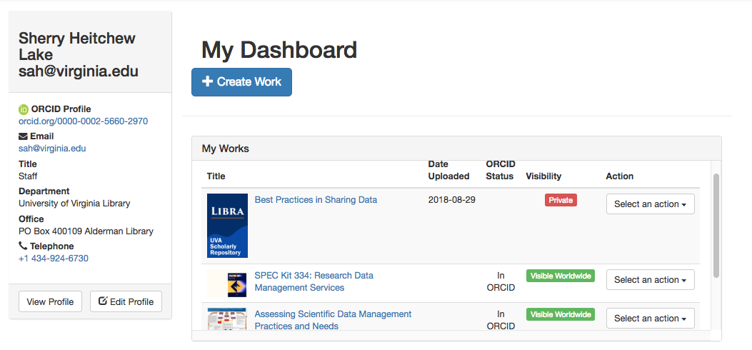

Slide 54
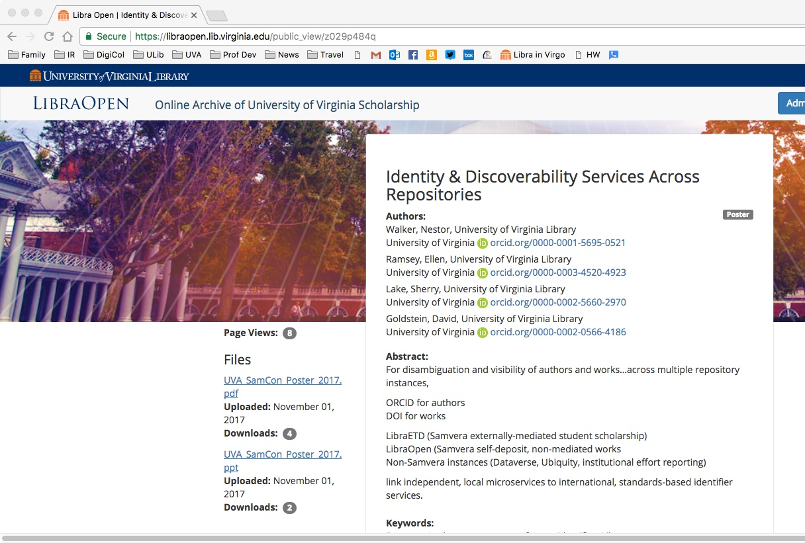

Slide 55
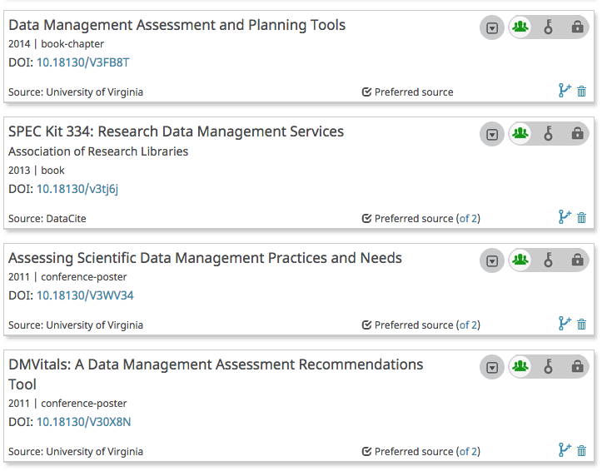

Slide 56
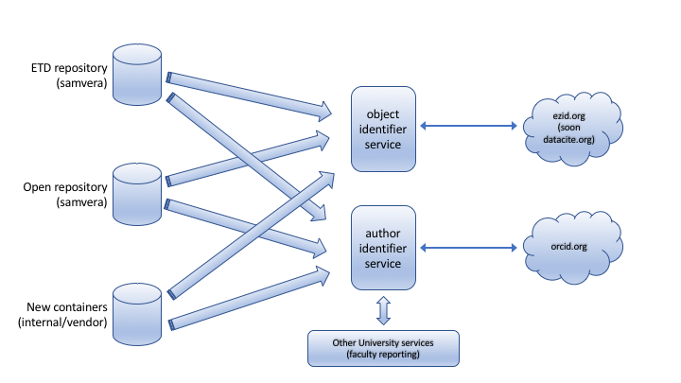
Identity & Discoverability Services Across Repositories
link independent, local microservices
For disambiguation and visibility
of authors and works…
ORCID for authors
DOI for works
across multiple repository instances
LibraETD (Samvera externally-mediated student scholarship)
LibraOpen (Samvera self-deposit, non-mediated works
Non-Samvera instances ????
to international, standards-based identifier services

Slide 57
ORCID US Community Resources
Communication Channels:
Website https://orcid-us.org
Listserv (open to all) http://lyralists.lyrasis.org/mailman/listinfo/orcid-us
Twitter @USconsortium
Members’ Discussion Forum (email orcidus@lyrasis.org to join)

Slide 58
Questions?
Web orcid-us.org
Email orcidus@lyrasis.org

