Slide 1
Peer Review on ScienceOpen
Peer Review Week 10-15 September 2018
@Science_Open @SDawsonBerlin

Slide 2
Can diversity be achieved by openness and integration?
Lichtmaler.at, Linden, Flicker, CCBY-NC-SA

Slide 3
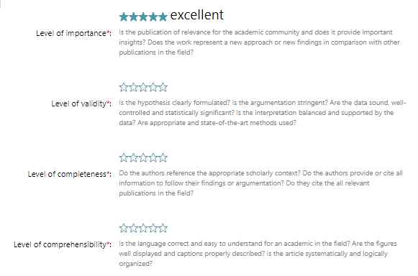
Peer review environment on ScienceOpen
Review
1.5 million preprints
43.5 million articles

Slide 4
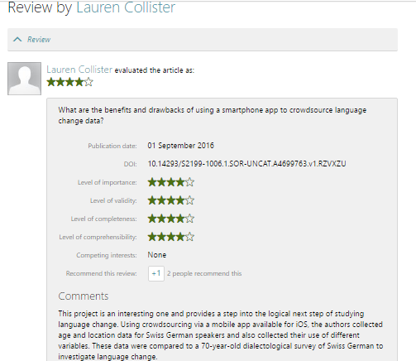
Open post-publication peer review on ScienceOpen / Integration with CrossRef, ORCID

Slide 5
Reviewer requirements: Integration with ORCID
Opening up the process of expert review to any researcher with
5 publications on ORCID
Editor-mediated exceptions for ERCs
Open reviewer invitation function

Slide 6
Post-publication peer review
Article review Book review
Post-publication evaluation
Published authorship
Publication
Reader orientation and context

Slide 7
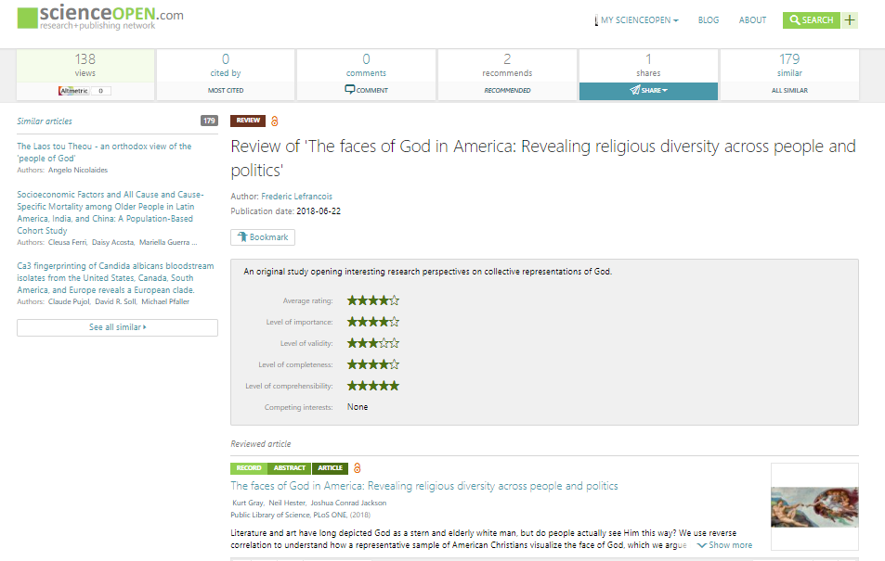
Example on ScienceOpen

Slide 8
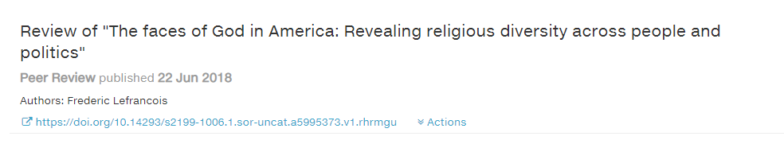
Integration with Crossref
Each review receives a Crossref DOI in the new peer review metadata schema

Slide 9
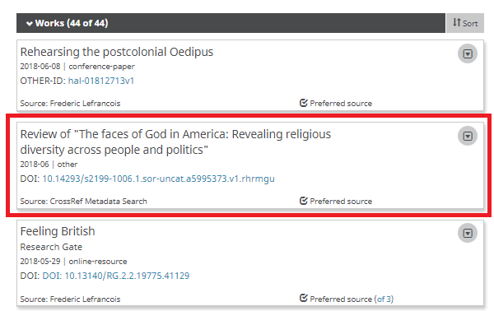
Integration with ORCID

Slide 10
What is the future of peer review?
Gato-Gato-Gato, Flickr CC BY-NC-SA

Slide 11
Rise of pre-print publishing
Rich citation analysis
Aggregation of online attention
Article-level identifiers
Data/code publishing
Megajournals
Post-Publication
Text-/Datamining

Slide 12
Could we use information generated by peer review to learn more about a research topic?
IF
Open review with researcher‘s full publication history
Post-publication evaluation of results
Context
Intepretation
Author/Reviewer reputation systems
THEN

Slide 13
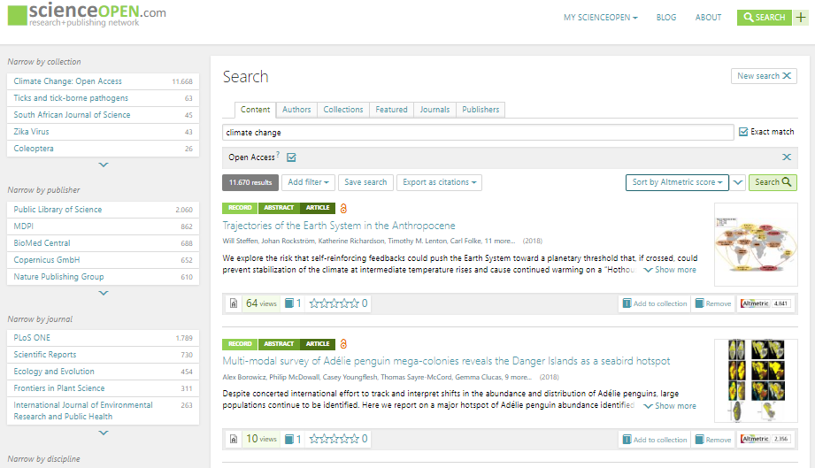
Context-driven search & discovery

Slide 14
We are your team for
As an aggregator of information, ScienceOpen will continue to open up and explore the context of scholarly research to support and recognize peer review in all its forms.
Contact: Stephanie.Dawson@ScienceOpen.com
Twitter: @Science_Open, @SDawsonBerlin
Facebook: www.facebook.com/ScienceOpen

