Slide 1




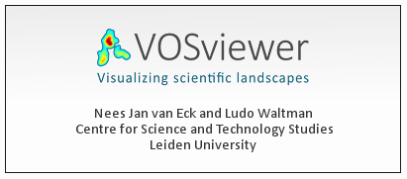

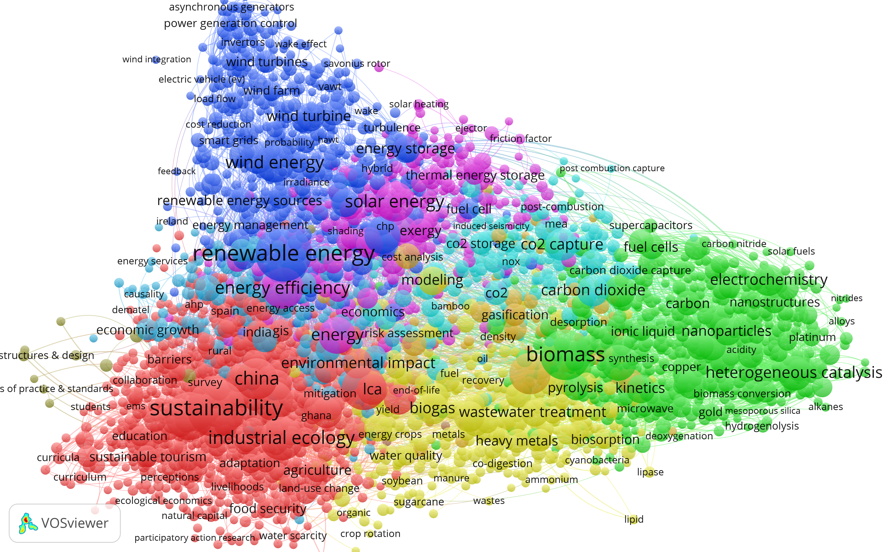
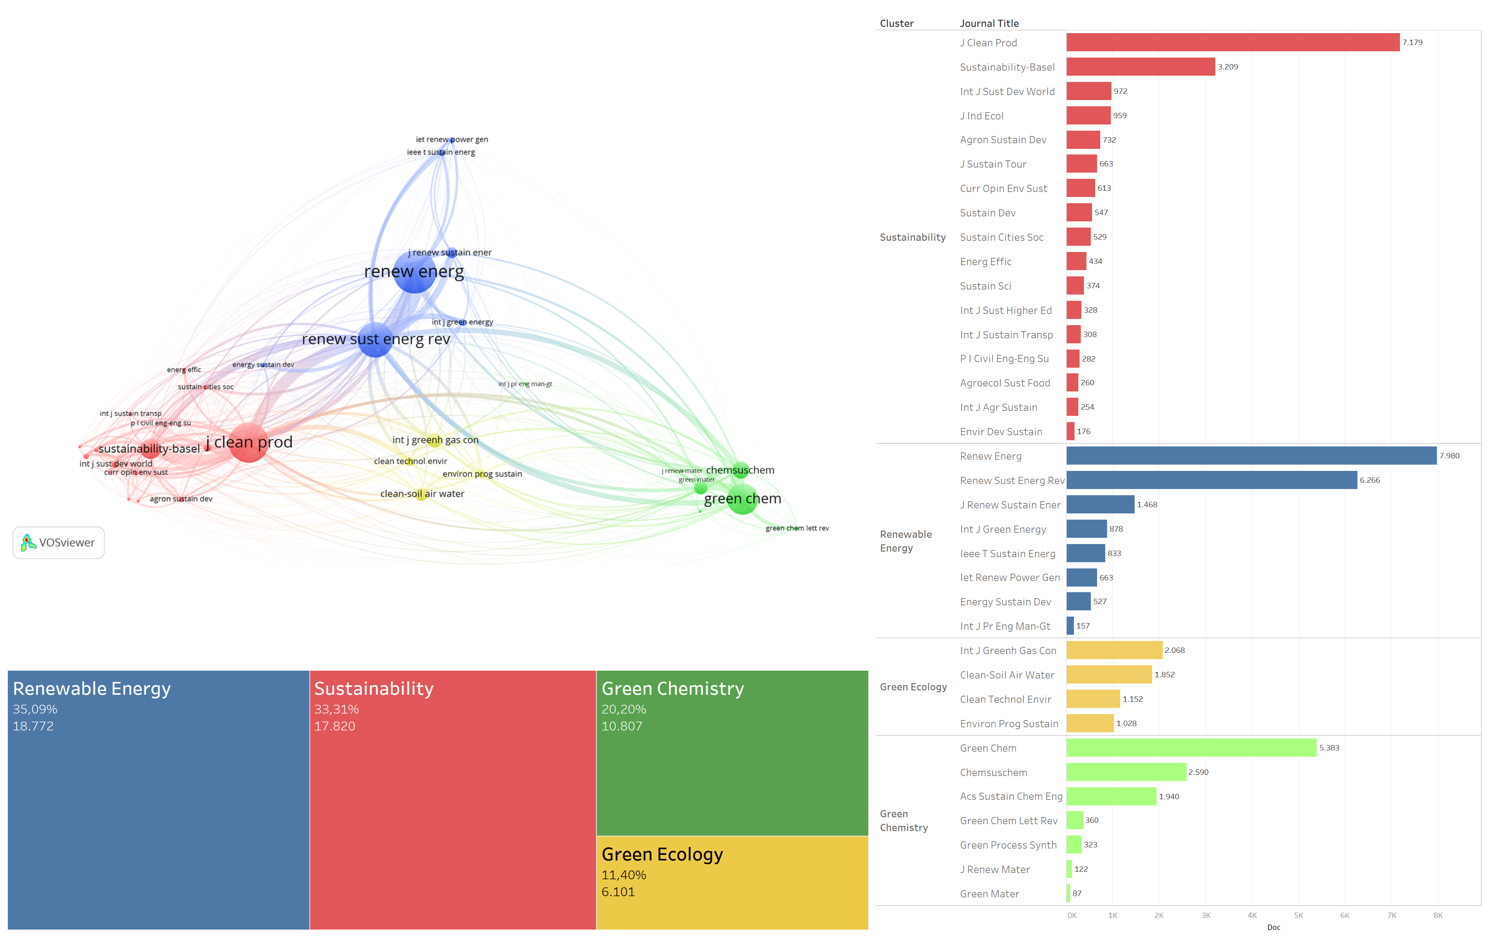
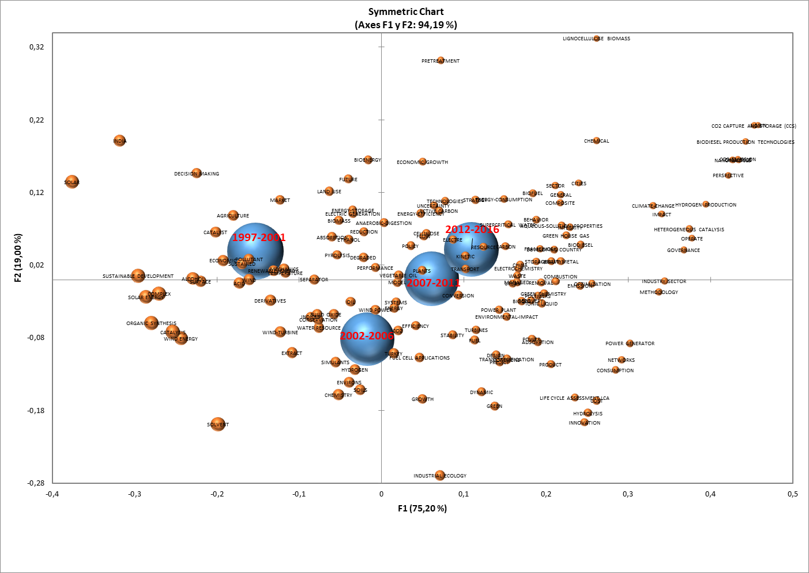
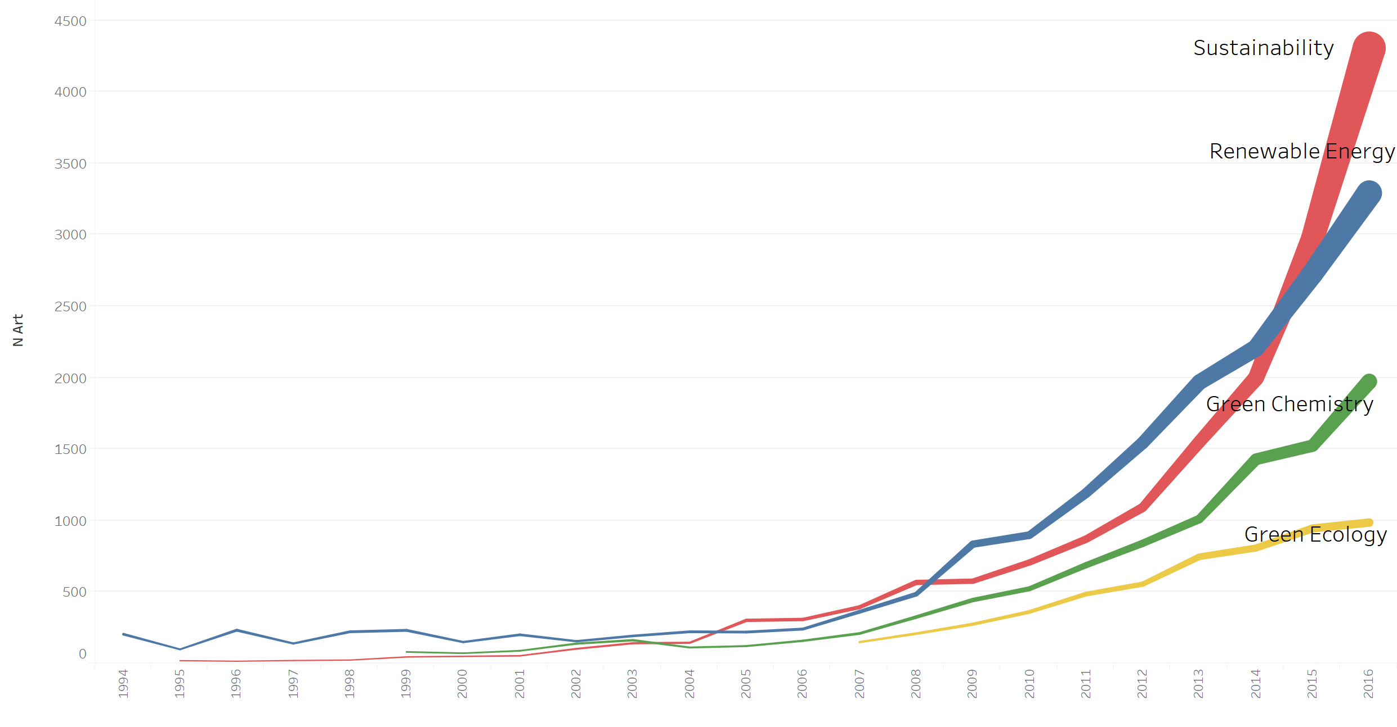
Mapping growth and trends in the category ‘Green and Sustainable Science and Technology’
Introduction
Andrés Pandiella-Dominique; Daniela De Filippo; Núria Bautista-Puig
INAECU Institute (UAM-UC3M), University Carlos III of Madrid (UC3M), SPAIN
Sustainability emerged in the late nineteen-nineties as an alternative to the traditional production model. The emergence and development of a new scientific discipline usually exhibit a recognizable structure and pattern. Authors engaging in the philosophy, history and sociology of science, have identified such dynamics (Kuhn, 1962; Bourdieu, 2003). In the scientometric field, other researches have been published to explain these dynamics (Börner, 2003, Chen 2018). The creation of a new WoS category would attest to the scientific interest generated by certain subjects in the academic community. One of the new subject categories created recently is the ‘Green and Sustainable Science and Technology’ category. The hypothesis defined here assumes that research in the field can be examined based on the contents of the 36 sustainability journals listed under the eponymous category JCR.
Principal aims
Identify the main patterns of evolution of the discipline.
Describe the main characteristics of scientific production in this field.
Analyze what emerging topics have arisen.
Software & sources
Methodology
Growth and development of the discipline
The three indicators used to analyze the growth of scientific production on sustainable S&T are the following:
      Number and proportion of documents per year
      Growth rate
      Cumulative average growth rate (CAGR)
Bibliographic coupling (Kessler, 1963) was used to detect possible sustainable S&T subspecialties so as to inter-relate journals based on shared references and obtain documentary corpora of similar subject areas. Vosviewer (Waltman et al., 2010) software was used to visualize inter-journal relationships.
Subject area specialization
Co-word analysis of keywords was used to identify the subject clusters most commonly addressed in the discipline.
Correspondence analysis was conducted to analyze these subjects over time, inter-relating keywords and years.
Results
The keyword co-word analysis of documents published by journals listed under the WoS category sustainable S&T identified nine clusters, with the constituent terms and their interrelationships (Fig. 4).
Two-thirds of the 49.065 sustainable S&T papers collected from 1994 to 2016 were published after 2012 (Fig. 1).
Figure 4. Co-word analysis of keywords
Figure 1. Scientific growth: 1994-2016
(Orange line = Number of paper per year; blue bars = year-on-year growth; red line = CAGR)
Bibliographic coupling of the journals yielded four subject clusters (Fig. 2): sustainability, renewable energies, green chemistry and green ecology.
Category dynamics were analyzed by correlating the years in which the frequency of appearance was higher (Fig. 5).
Timeline
Figure 2. Structure of WoS category ‘Green and sustainable S&T’
*Earliest papers in sustainability cluster date from 1995 with slow growth in the first 10 years
Figure 5. Correspondence analysis for keywords and years
*Renewable Energy had a small output until 2007 when the growth model underwent abrupt change
Conclusions
*Green chemistry cluster ran parallel to sustainability until 2012
In this study, we intend to reveal in a retrospective way which has been the first steps in the appearance and development of a new discipline. In this sense, the relational structure of the keywords has been shown. In addition, mainstream and emerging subject areas were determined by the grounds of keyword dynamics analysis.
*The first green ecology journals appeared in WoS in 2007
References
Borner, K., Chen, C. M., & Boyack, K. W. (2003). Visualizing knowledge domains. Annual Review of Information Science and Technology, 37, 179-255. doi: 10.1002/aris.1440370106
Bourdieu, Pierre (2003). El oficio de científico. Anagrama. ISBN 9788433961983.
Chen, Chaomei, & Song, M. (2018) Representing Scientific Knowledge: The Role of Uncertainty. Springer.
Kuhn, T. S. (1962). The structure of scientific revolutions (2nd ed.). Chicago, IL University of Chicago press.
Figure 3. Scientific growth by cluster
Acknowledgements
This study was conducted under the project entitled ‘Detection of new research and innovation fronts in energy efficiency. Analysis of knowledge flows in the scientific domain, industry and society’ (ref.: CSO2014-51916-C2-1-R), funded by Spain’s Ministry of the Economy and Competitiveness.

