Slide 1
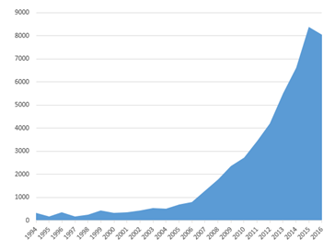
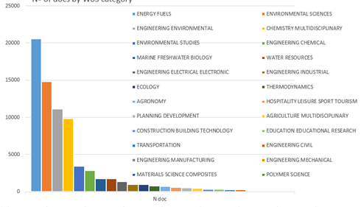
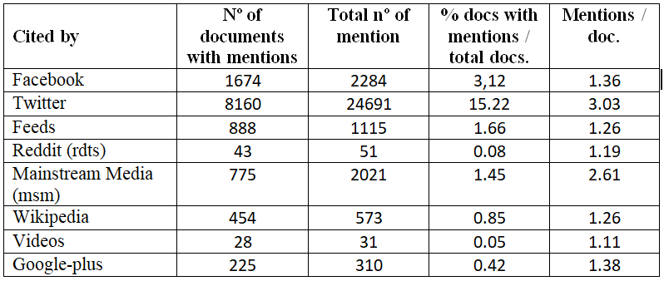
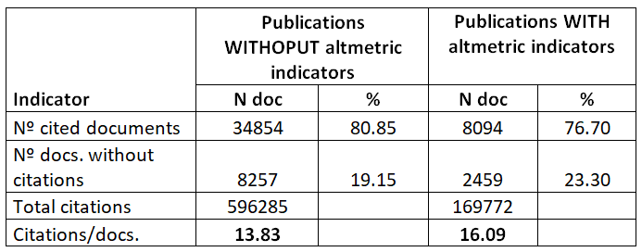
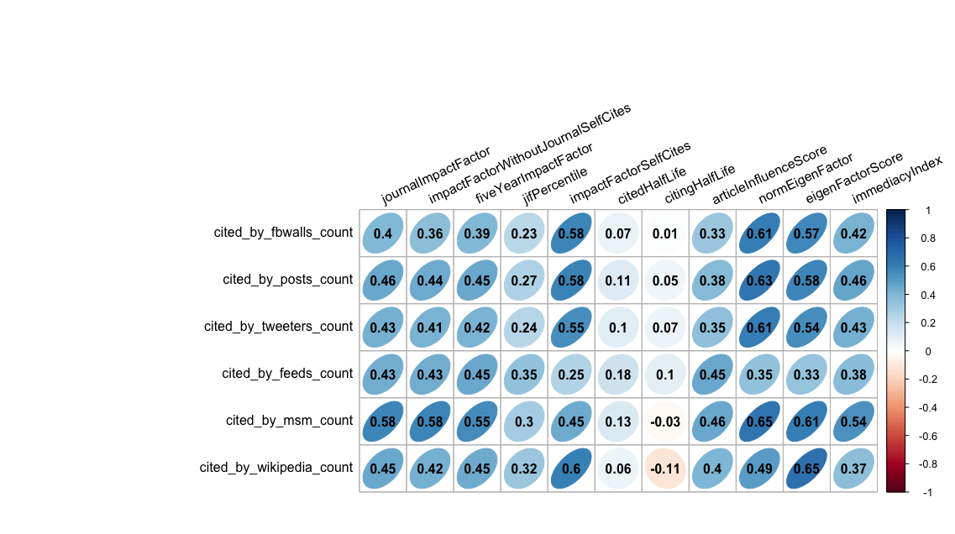
Academic impact and social media presence in Green and Sustainable Science and Technology publications
Daniela De Filippo; Antonio Eleazar Serrano López
Research Institute for Higher Education and Science (INAECU) (UC3M-UAM) (Spain)
Laboratory for Metric Information Studies (LEMI), Department of Library and Information Science, Carlos III University of Madrid (Spain)
INTRODUCTION
OBJECTIVES
Sustainability is one of the topics that has aroused most academic and social interest in recent years. In the scientific field, this interest is evident in the growing number of R&D&i programmes funded by international organizations and the creation of a new subject category in the Journal Citation Report: Green and Sustainable Science and Technology.
To analyze the dynamic of publications in this field.
To detect the presence of scientific publications in social media.
To study if there is a relationship between the academic impact and the social presence of research in this field.
Relationship between bibliometric impact and social media presence
Download of WoS publications in Green and Sustainable Science and Technology
Obtention of the main biblimetrics indicators.
Obtention of altmetrics indicators from ALTMETRIC.COM
METODOLOGY
RESULTS
49 641 docs.
Documents by year
There are documents since 1994.
66% of documents were published since 2012.
The subject categories with the greatest production are Energy Fuels; Engeenering Environmental and Environmental Studies.
Documents by WoS category
97% of documents have DOIs and 20% have been mentioned in social media
Distribution of mentions on social media Academic impact vs social media presence
Correlation between bibliometric and altmetric indicators
CONCLUSIONS
The scientific publication of Green and Sustainable Science and Technology, has a high concentration in the last 5 years.
Around 20% of the documents have altmetric indicators (25% considering the most recent 5 years).
There is a significant correlation between academic impact and social media presence.
Variables such as the Eigen Factor and the Impact Factor show positive and statistically significant correlations with the mentions in social media.
The number of mentions in the mass media also correlates with the traditional impact indicators.
Notes:
Este es el título del proyecto sobre el que voy a hablar en esta presentación

