Slide 1
What Works Clearinghouse Standards in Research Design
Jessica Logan, Ph.D.
Assistant Professor of Education Studies
Quantitative Research, Evaluation, and Measurement
Quantitative Methods Brownbag
8/31/2018
Logan.251@osu.edu

Slide 2
What is the What Works Clearinghouse
The WWC is “a central and trusted source for scientific evidence of what works in education”.
A resource for researchers, practitioners, and policy makers to find information about the effectiveness of curricula or interventions.
Inclusion of an intervention in the WWC is not based on whether the intervention is effective, but whether it was tested in a well-designed causal framework.

Slide 3
Why should you care
Inclusion in WWC is exposure of your intervention idea to a network of researchers, practitioners, and policymakers.
It’s good science. Using these causal research design guidelines gives you a good idea of whether your intervention is working.
IES will now only fund Goal 3 (Effectiveness / ideal conditions) and Goal 4 (Efficacy / large-scale real world implementation) studies if they meet WWC standards

Slide 4
WWC Standards Handbook
Used to determine whether studies are well designed.
  During grant reviews
  During reviews of study write-ups.
WWC only evaluates studies that are:
  Randomized Controlled Trials (RCTs)
  Quasi-Experimental Designs
  Regression Discontinuity Designs
  Single Case Designs

Slide 5
WWC Standards Handbook
Used to determine whether studies are well designed.
  During grant reviews
  During reviews of study write-ups.
WWC only evaluates studies that are:
  Randomized Controlled Trials (RCTs)
  Quasi-Experimental Designs
  Regression Discontinuity Designs
  Single Case Designs

Slide 6
Two types of studies
A Randomized Controlled Trial (RCT):
  Every person must have a non-zero chance of being enrolled in each condition
  Every person must be assigned by chance.
  Because of this, treatment and control groups are equated on expectation
    Characteristics and potential confounds are randomly distributed between groups.
A Quasi-Experimental Design (QED):
  Compare groups that already exist
  Each participant must be a member of only one group
  These will never be equated on expectation

Slide 7
Gradients of approval
WWC provides three different ratings of levels of evidence:
  Meets standards without reservation
  Meets standards with reservations
  Does not meet standards
The guidelines for whether a study meets WWC standards with or without reservation depends on level of random assignment.

Slide 8
Individual Assignment
Individual assignment means you’re interested in evaluating outcomes at the same level as assignment:
  Assign students to conditions and measure student achievement
  Assign teachers to conditions and measure teacher turnover
  Assign schools to conditions and measure percent of HS graduates
The process to determine whether individual assignment studies meet criteria considers:
  Random Assignment
  Sample Attrition
  Baseline Equivalence

Slide 9
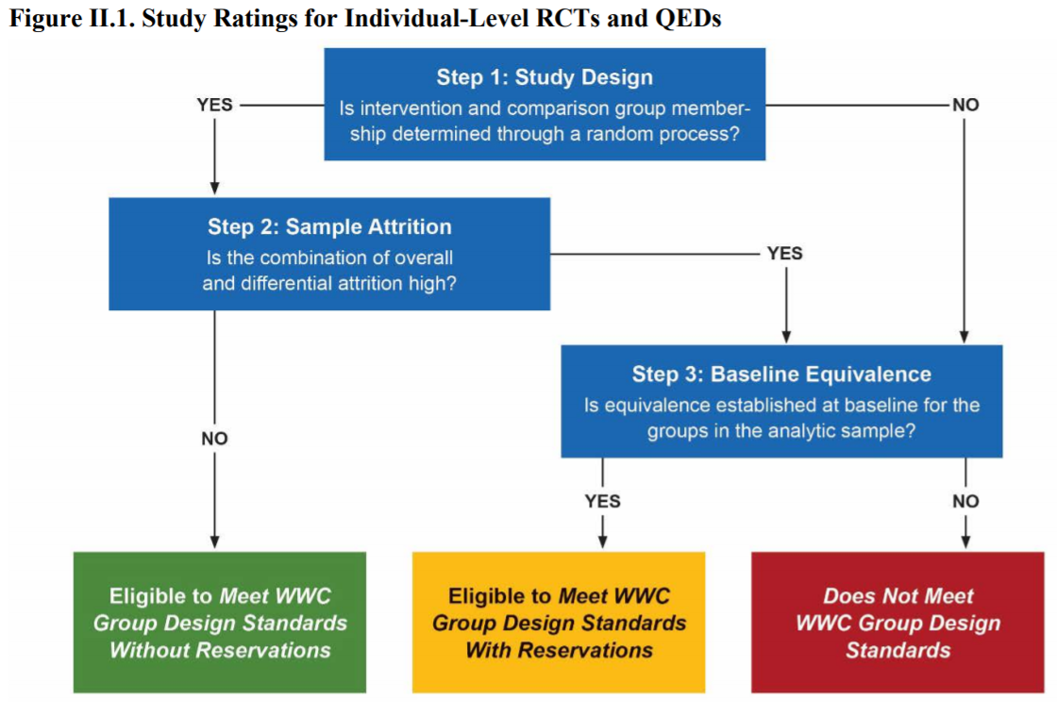
QED
RCT

Slide 10
1. Random Assignment
A Randomized Controlled Trial:
  Every person must have a non-zero chance of being enrolled in each condition
  Every person must be assigned by chance.
  Because of this, treatment and control groups are equated on expectation
    Potential confounds are randomly distributed between groups.
  Eligible to meet WWC standards without reservation
A QED:
  Compare groups that already exist
  Each participant must be a member of only one group
  These will never be equated on expectation
  Can only meet WWC standards with reservation

Slide 11
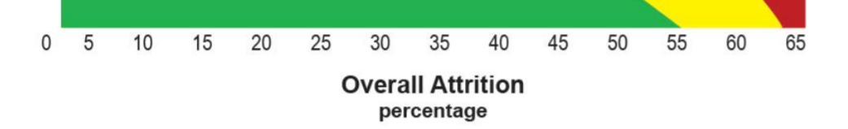
2. Sample Attrition
1) Overall Attrition Rate
  Rules based on Attrition Bias working paper
    Bias of d < .05 considered “tolerable”
2) Differential Attrition rate
  Good: If attrition is related to general loss
    Students move out of the district
    Called “Optimistic” assumption
  Less good: If attrition is related to your intervention.
    Your intervention is hard and makes students skip school to avoid it
    If you (or your reviewer) thinks this is happening, called “cautious” assumption

Slide 12
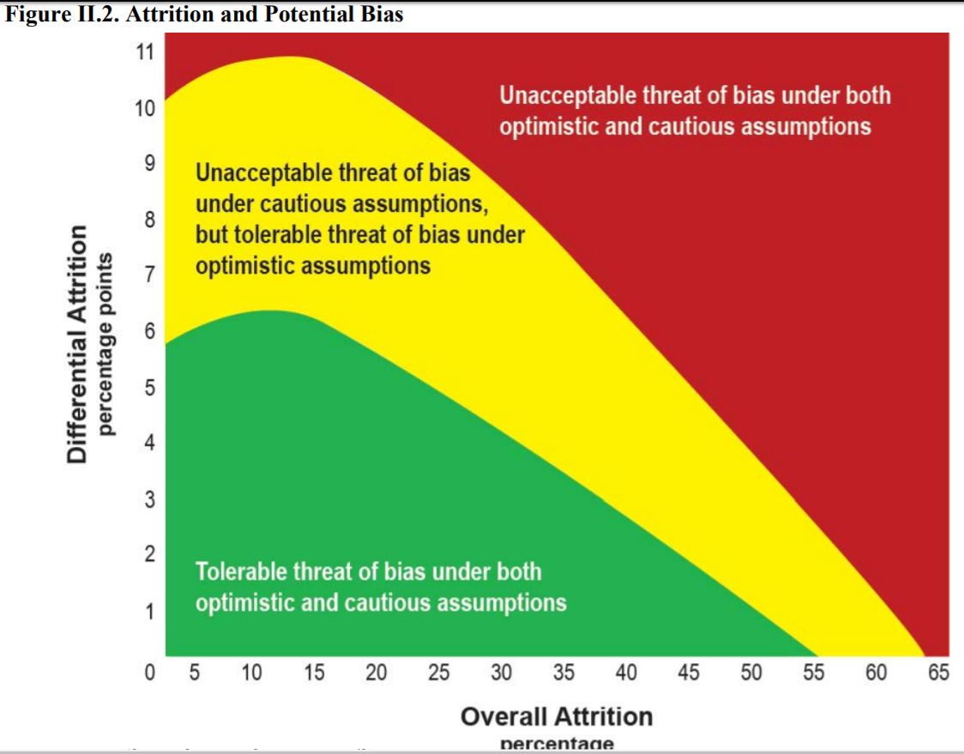
Similar information
In Table II.1

Slide 13
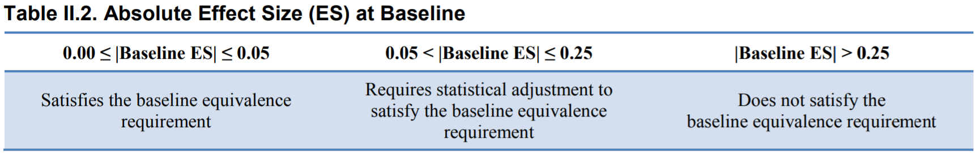
3. Baseline Equivalence
Baseline: Before the intervention is introduced
Equivalence: Bias of d < .05 considered “tolerable”

Slide 14
3. Baseline Equivalence
Baseline equivalence:
  Must be satisfied for each analytic sample and each outcome domain
  Measures used for equivalence must have good reliability
  Must be a true baseline measure (not given after the intervention starts)
  Best to use pre-test to establish equivalence, but when not possible then use demographic characteristics.

Slide 15
QED
RCT

Slide 16
Individual Assignment:
Two additional considerations. The study must…
At least one outcome measure must meet review requirements
  Face validity: Content assessed aligns with the definition
    - e.g., don’t use a reading fluency measure to measure reading accuracy.
  Acceptable Reliability
    Internal consistency (e.g., Cronbach’s alpha) of .50 or higher
    Temporal stability (e.g., pre-post test) of .40 or higher
    Inter-rater reliability (e.g., percent agreement; kappa) of .50 or higher
  Not Overaligned
    Primary outcome can’t be what is explicitly taught
  Outcomes collected in the same manor for treatment and control groups
    - e.g., don’t collect the treatment group first and the control group second.
From WWC V4.0: Chapter IV

Slide 17
Individual Assignment:
Two additional considerations. The study must…
Must be free of confounding factors:
  Intervention or comparison group must have more than one person
  Characteristics of the participants in each group must not differ systematically
    e.g., intervention is all grade 7 and control all grade 6.
    e.g., intervention is English language learners, control all not
  Intervention can not be offered in combination with another intervention
    e.g., intervention is of intervention A, but the treatment group also gets intervention B. The control group gets neither intervention
    The treatment response recored could be A, B or a combination of A and B.
From WWC V4.0: Chapter IV

Slide 18
Group (Cluster-Level) Designs

Slide 19
Group (Cluster-Level) Assignment
In cluster-level assignment studies, you assign a higher-level unit to conditions, then measure outcomes in lower-level units:
  Assign teachers to conditions, measure outcomes for students
  Assign schools to condition, measure outcomes for teachers
Four primary steps to establish quality of group-assignment studies:
  Is it (a) Cluster Randomized with (b) Low Cluster-level attrition
  Bias for cluster entry
  Bias for “nonresponse” of individuals
  Baseline equivalence

Slide 20
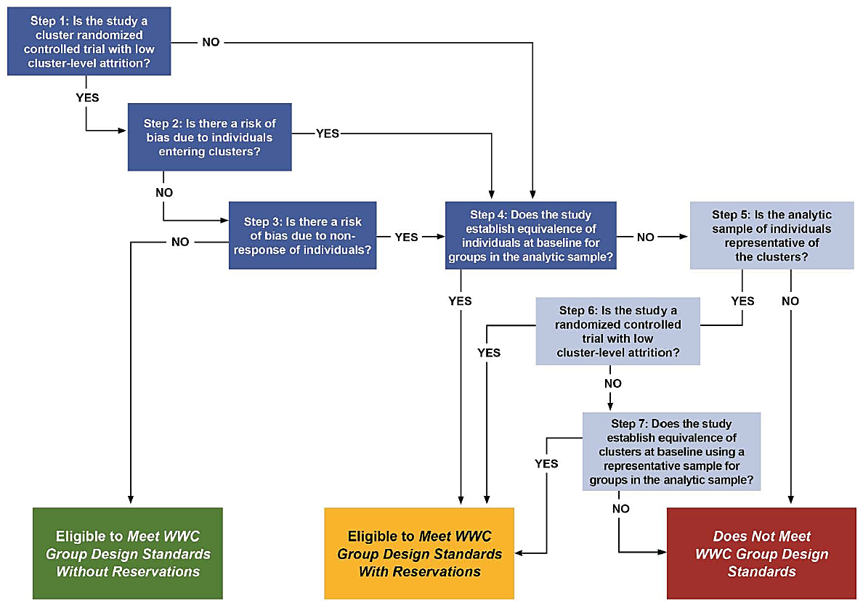
NO
Continues…

Slide 21
1a. Cluster Randomized
1b. Low cluster-level attrition
A) Clusters must be randomly assigned to conditions
  Each cluster has a non-zero probability of being assigned to each condition
  Assignment is by chance
B) Cluster-level attrition must be low
  Cluster-level = level of assignment
  Low = Same definition as individual trials (<55%; < 64%; >64%)
What counts as attrition?
  Cluster-level units who drop out of the study after being randomly assigned.

Slide 22
2. Bias for individuals entering clusters
These individuals are called “Joiners”
Bad because post-random assignment, joiners may not be random.
  Might be joining because they heard this cluster has a cool new intervention.
  Or so they don’t have to do study activities.
How to fix:
  Don’t allow anyone to join clusters late (or at least don’t include them as your analytic sample)
  Allow, but you need really good justification that the joiners will be random.

Slide 23
3. Bias due to individual non-response
Means individual-level attrition
If a cluster left the study (step 1), these individuals don’t count towards individual non-response percentage.
Low attrition = same as previous figures (<55%; < 64%; >64%)
If these are met, then congrats! You meet WWC without reservations!
  If not…

Slide 24
4. Baseline equivalence
Same as before.
If you need to adjust, most effective:
  Use ANCOVA or Gain Scores
    Only when pre/post are measured in the same units
  Use a baseline characteristic that’s correlated at least at .6 with the outcome
If you don’t satisfy the baseline equivalence requirement…

Slide 27
Steps 5-7
These are really only considered if you expect to have very poor response at follow-up.
Basically, a re-examination of the attrition rates (steps 5-6).
If your cluster-level attrition rates are high, you can still save it if you can establish baseline equivalence for a subset of your data.

Slide 28
Missing Data
In every study, you should expect you’ll have some missing data.
Important to document how you will deal with it.
WWC has a few acceptable approaches:

Slide 29
Missing Data: Acceptable approaches
Complete case analysis. Delete incomplete cases.
Regression imputation (must be bootstrapped standard errors)
Maximum Likelihood Estimation
Non-response weights
For all but option A, you need to provide extensive documentation for your choices. (Table II.6).
With your missing data choice documented – demonstrate you still meet WWC standards:

Slide 30
Continued…

Slide 32
Example Writeup
From pending IES grant
Cluster-randomized control trial

Slide 33
What Works Clearinghouse Standards (WWC). We have designed the evaluation to meet WWC standards without reservation (IES, Version 4, 2017).
RCT design with low cluster-level attrition. Per WWC, total attrition is tolerable when at or below 30%. Maximum expected overall attrition in the present study is estimated at 19.5%, based on district teacher turnover rates between school years.
  We will also monitor WWC standards for tolerable differential attrition <5%. We expect differential cluster-level attrition at 1-5% based on a recent three-year IES efficacy study directed by co-investigator (XXX) in this same district. With 105 initial classrooms, only 2 attrited and differential attrition was <1%.

Slide 34
(2) Minimal risk of bias due to individuals entering clusters. Our inclusionary and exclusionary criteria are set prior to study recruitment, therefore minimizing potential introduction of sample bias as such exclusions will not count towards attrition (WWC, p 12). The reference sample for this study will be the original randomized sample (WWC, p 26). Eligibility criteria of focal students requires children to be enrolled in a given classroom prior to random assignment so that potential “joiners” will not be eligible fore participation.
(3) Minimal risk of bias due to individual non-response For child-level differential attrition, previous work by co-investigator XXX found no difference in attrition between groups (7.0% for BAU, 7.2% for Tx; t[827] =0.15, p=.88, Cohen’s d =0.01.)
(4) Establish equivalence of individuals at baseline. We will test for and likely establish baseline equivalence on key outcomes (xxx). As the conditions will be randomized, we have no reason to expect that between-group differences will be observed, and therefore expect to meet WWC standards without reservations.

