Slide 1
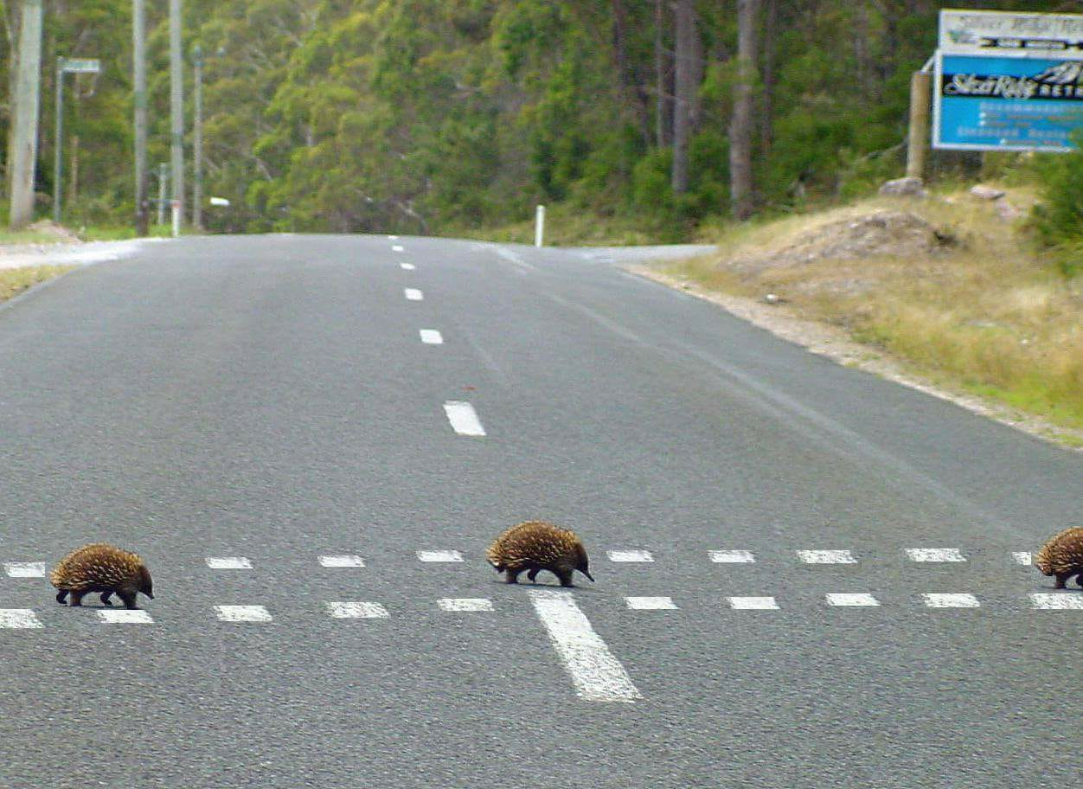
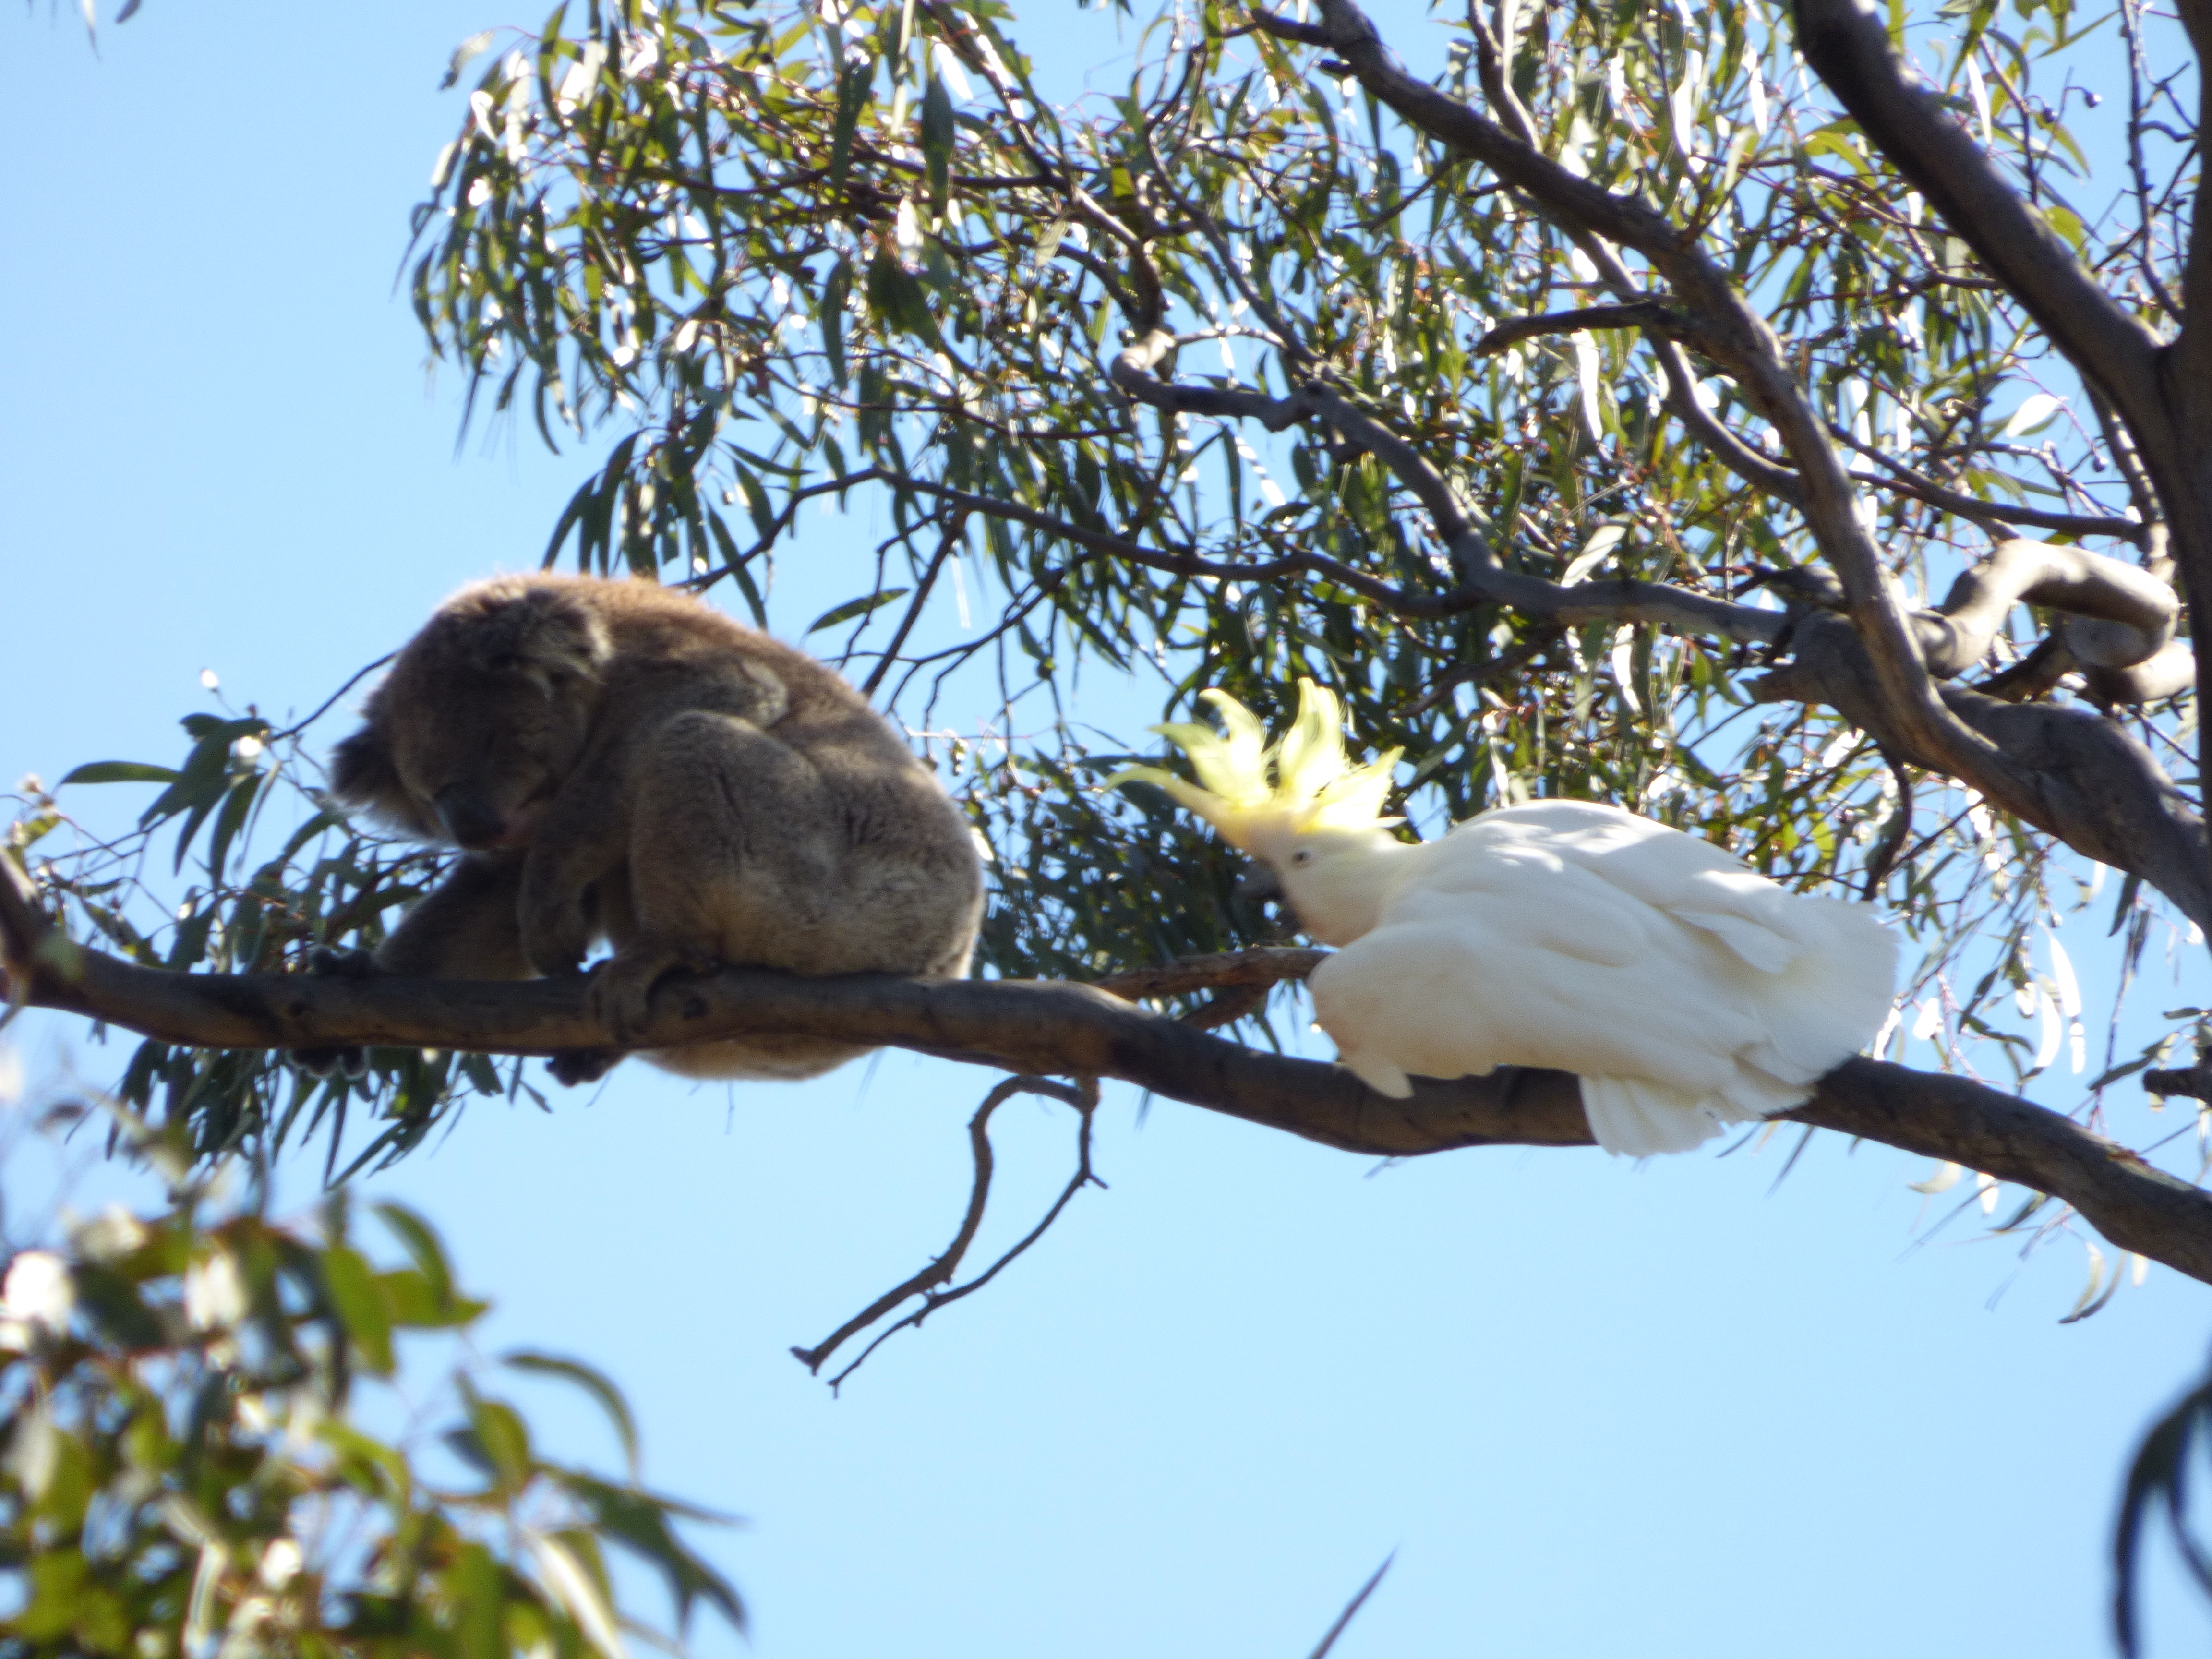
Developing Citizen Science Apps for Conservation Biology
Koala Counter & echidnaCSI
Alan Stenhouse
Centre for Applied Conservation Science, School of Biological Sciences
@alanstenhouse alan.stenhouse@adelaide.edu.au

Slide 2
Development Requirements
@alanstenhouse

Slide 3
Development Platform(s)
University of Adelaide
@alanstenhouse
3

Slide 4
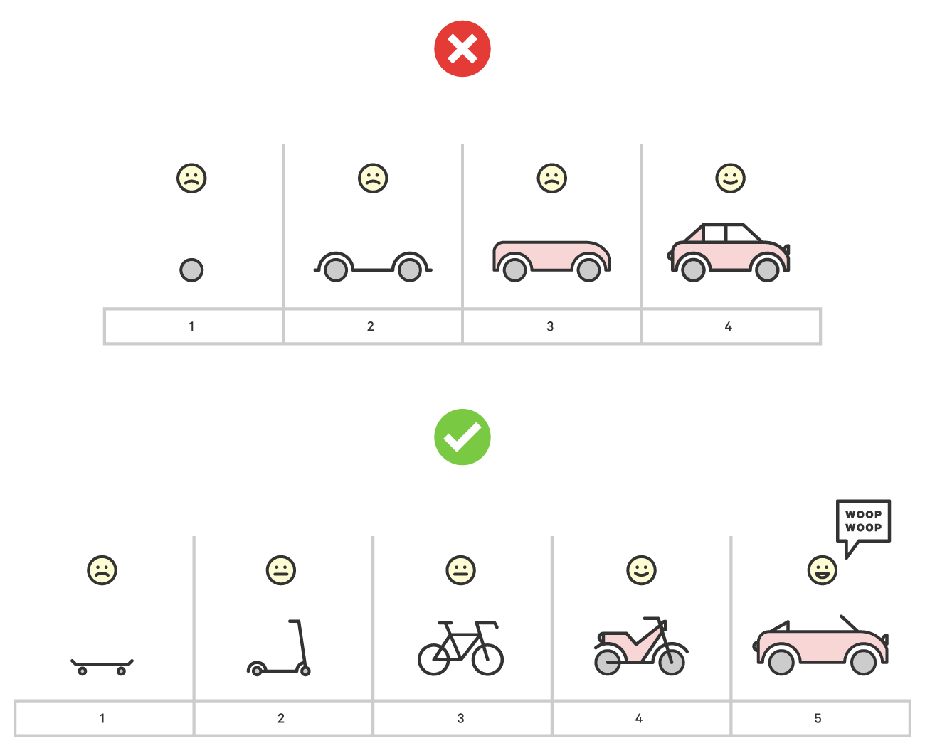
Development Cycle
Minimum Viable Product
@alanstenhouse

Slide 5
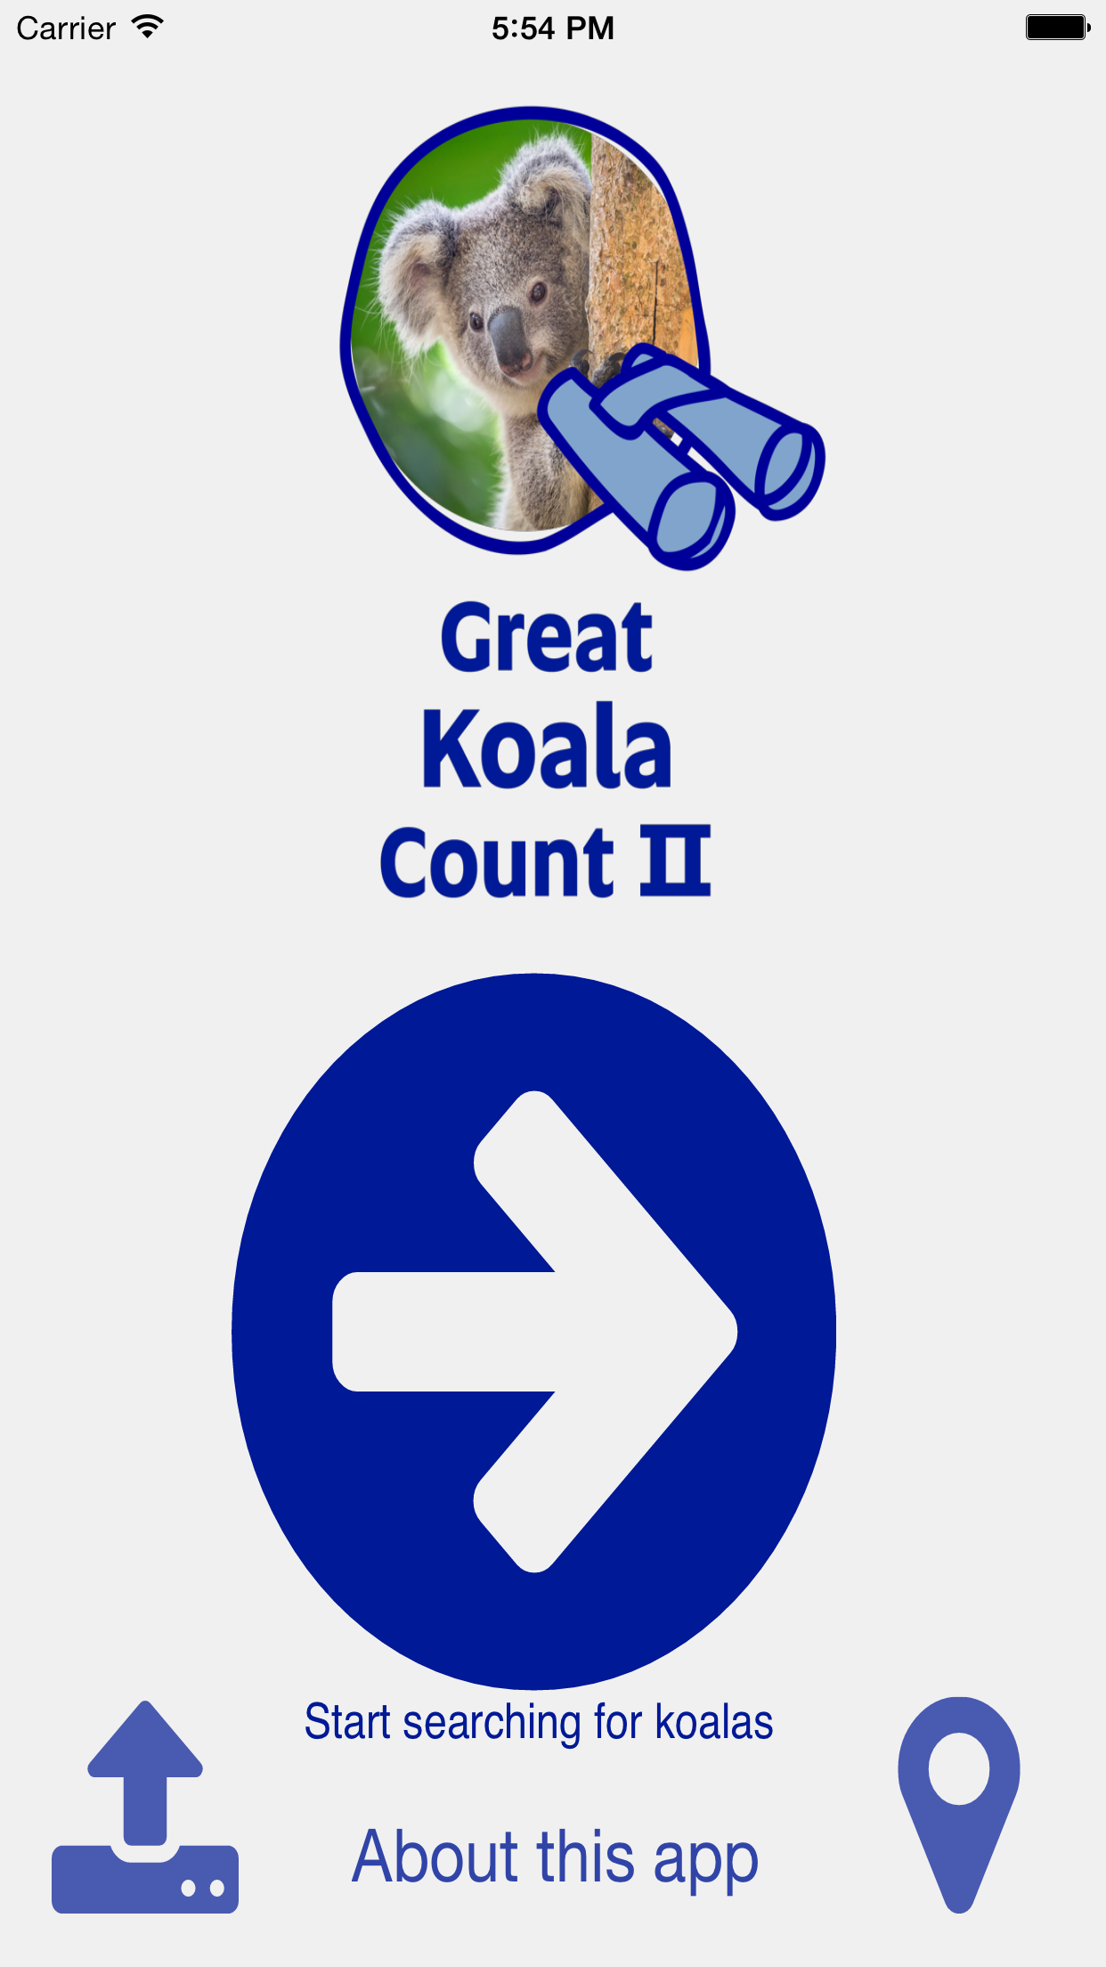
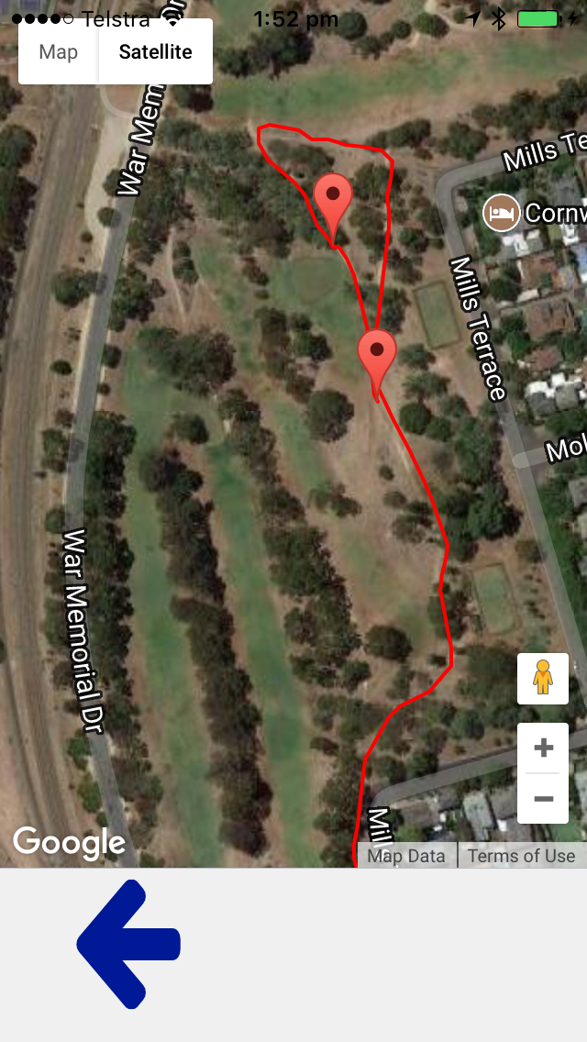
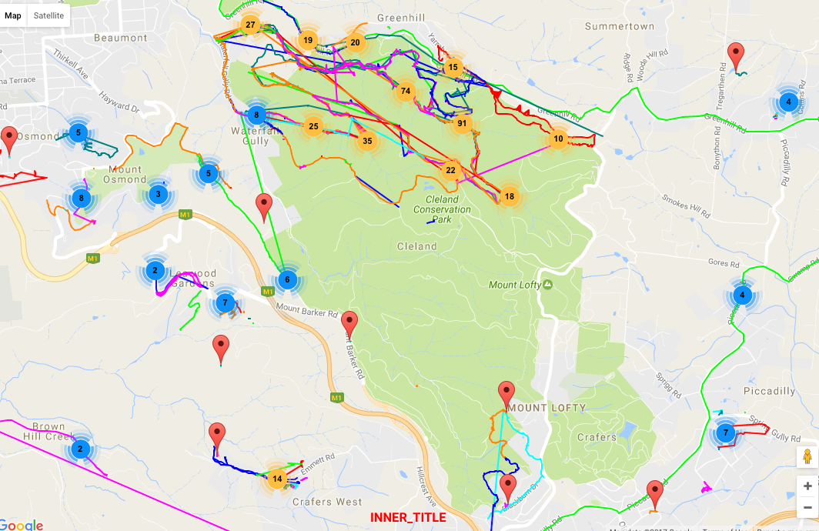
Koala Counter
Recorded user search path
Search effort
Infer species absences
4 months design, development, testing, rollout
Issues
Location services
User training
Collaborator: Dr. Philip Roetman
University of Adelaide
@alanstenhouse
5

Slide 6
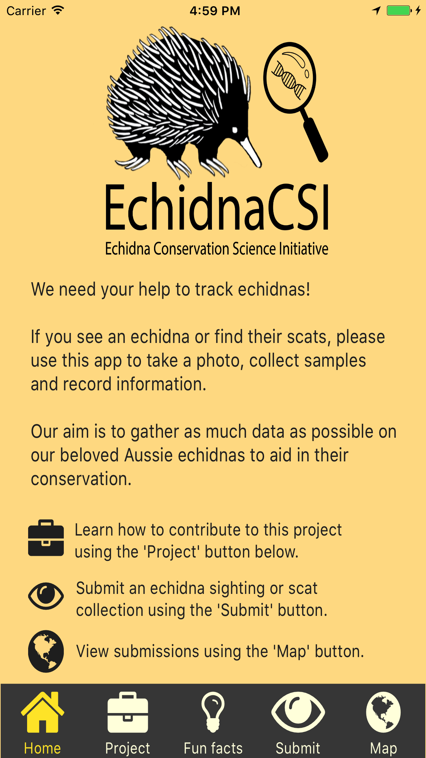
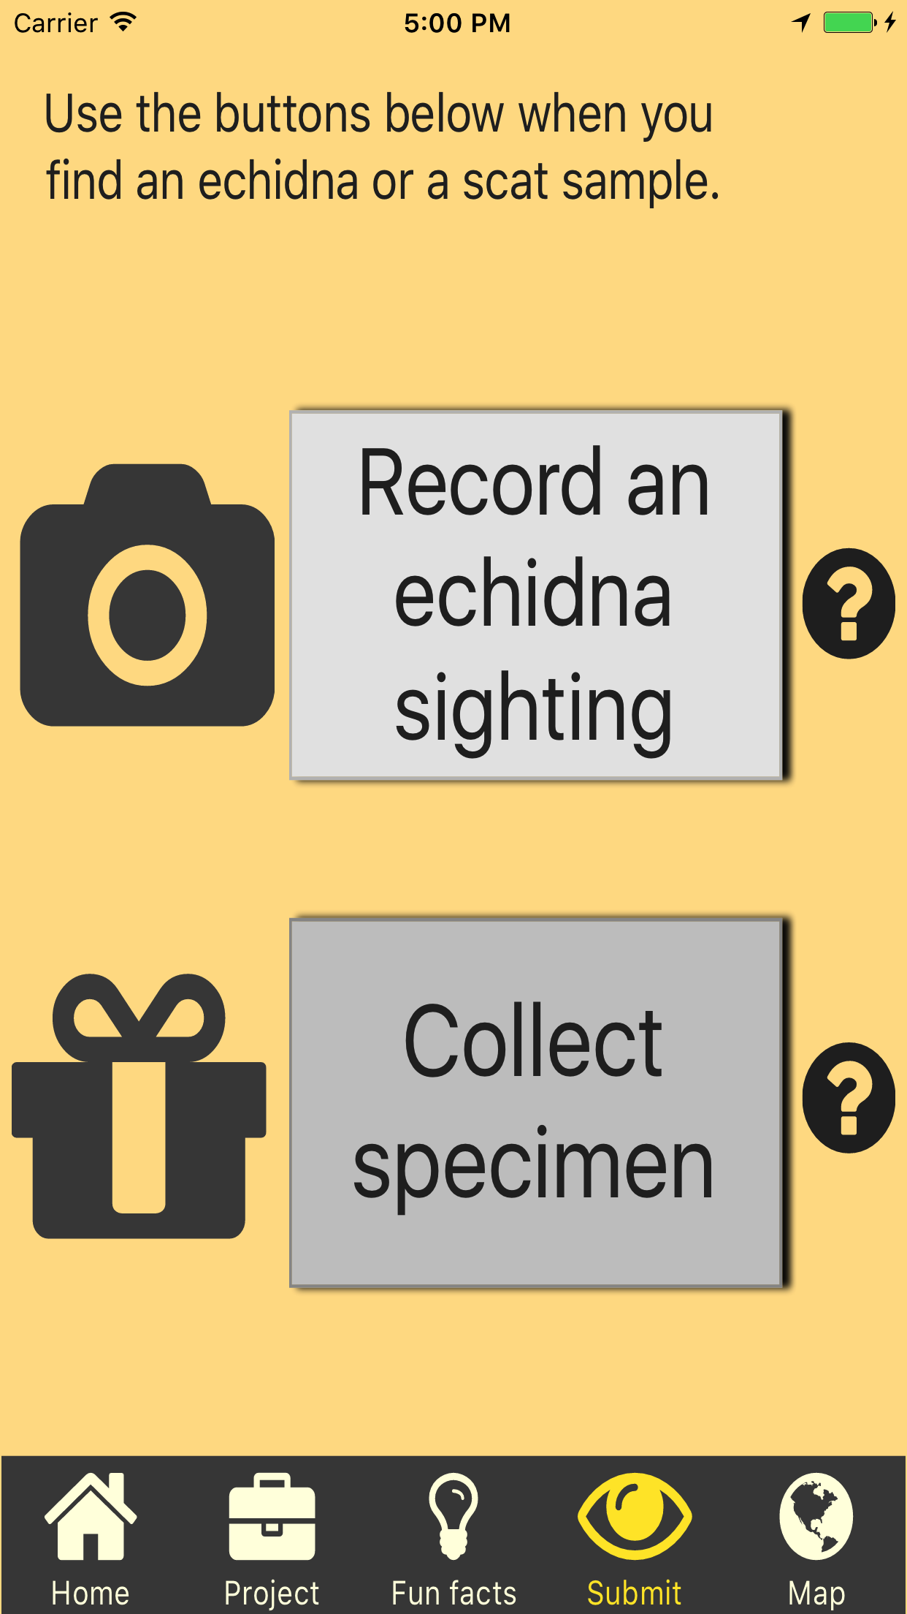
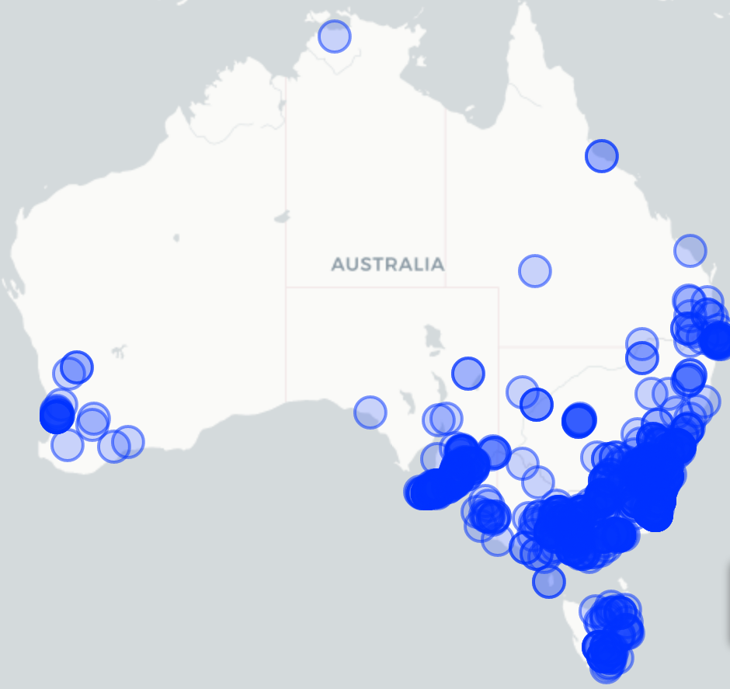
EchidnaCSI
Based on Koala Counter app
ALA / BioCollect integration
2 months design, development, testing, rollout
Noteworthy
Media → Uptake
User registration – Apple change
Collaborators: Tahlia Perry, Prof. Frank Grutzner
@alanstenhouse

Slide 7
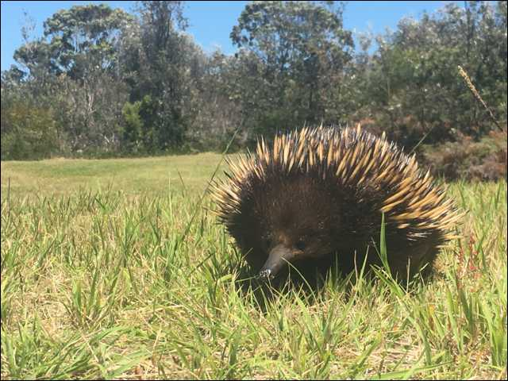
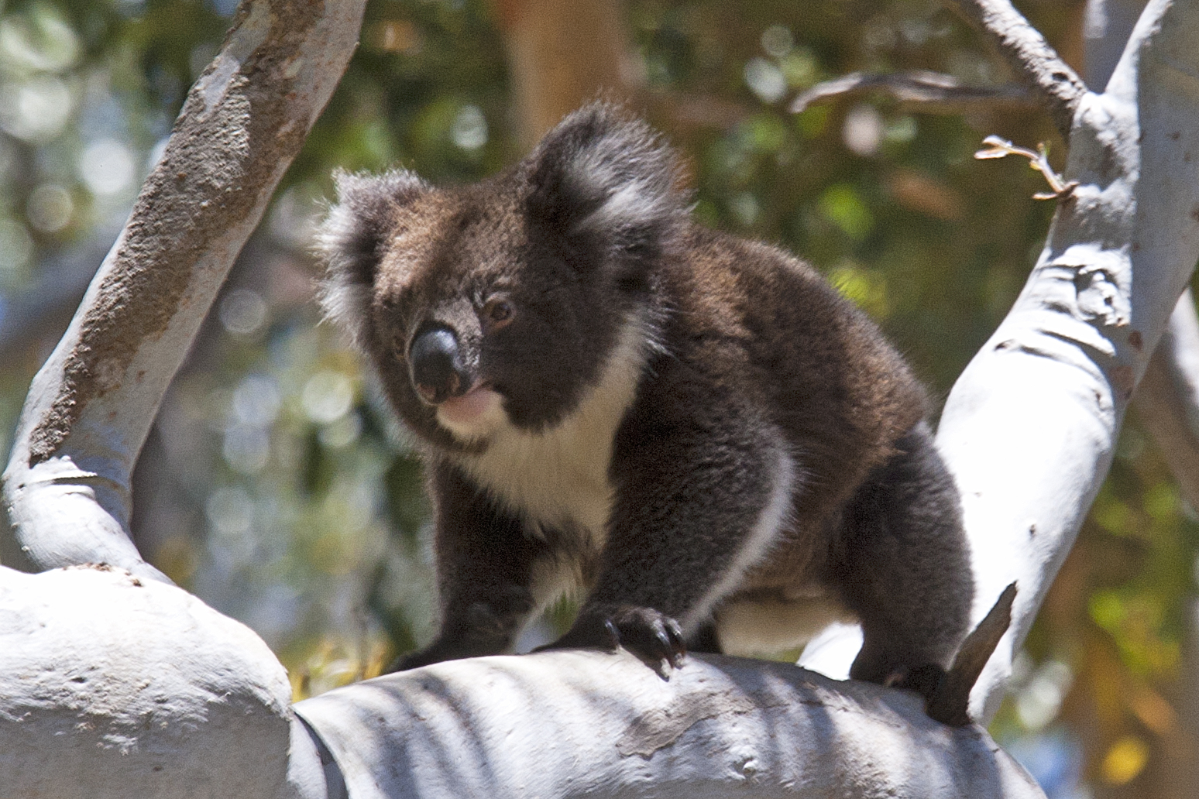
Considerations
Clarity on project requirements - MVP
Partnerships – rewards?
Long-term support?
Can existing tools/apps fulfil requirements?
Integration with other systems?
Development skills range
Tradeoffs
@alanstenhouse

Slide 8
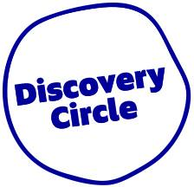
Acknowledgements
Thanks to my PhD supervisors: Prof. Lian Pin Koh and Dr. Philip Roetman
And to my other collaborators, especially Prof. Frank Grutzner & Tahlia Perry
As well as all the enthusiastic contributors to these projects so far!
@alanstenhouse

