Slide 1
Wavelet methods for well-balanced shallow water over topography
James Shaw & Georges Kesserwani (University of Sheffield)
Mohammad Sharifian (University of Tabriz)
MovingMesh2018: Workshop on moving and adaptive meshes for global atmospheric modelling, 3-5 Sep 2018, University of Reading

Slide 2
Overview
Part 1 – James Shaw
Wavelet theory
Quiescent and oscillatory flow simulations
Part 2 – Georges Kesserwani
Transient dam break simulations
Project overview

Slide 3
Why wavelets?
Strong mathematical foundation
Mesh and solution are treated as one
Only one user-specified parameter
Arbitrarily large resolution gaps
Arbitrarily coarse baseline mesh
Preserves accuracy and robust properties of the underlying solver
Cheap to compute

Slide 4
Piecewise-constant Haar wavelet transform
Fine-scale signal
=
Coarse-scale signal
+
Wavelet-encoded details

Slide 5
Piecewise-constant Haar wavelet transform
=
+

Slide 6
Piecewise-constant Haar wavelet transform
=
+
Filter banks

Slide 7
Piecewise-constant Haar wavelet transform
=
+
Filter banks

Slide 8
Haar wavelet inverse transform
=
+

Slide 9
Multiscale Haar wavelet decomposition

Slide 10
Multiscale Haar wavelet decomposition

Slide 11
Multiscale Haar wavelet decomposition

Slide 12
Multiscale Haar wavelet decomposition

Slide 13
Multiscale Haar wavelet decomposition
Bidirectional transform
Locally conservative
Bounded
Mean preserving

Slide 14
Detail coefficient d measures local spectral power
=
+
d ≉ 0
Retain

Slide 15
Detail coefficient d measures local spectral power
=
=
+
+
d ≉ 0
Retain
d ≫ 0
Refine

Slide 16
Detail coefficient d measures local spectral power
=
=
=
+
+
+
d ≉ 0
Retain
d ≫ 0
Refine
d ≈ 0
Coarsen

Slide 17
Adaptivity threshold ε
0
ε
1
Small error
Large error

Slide 18
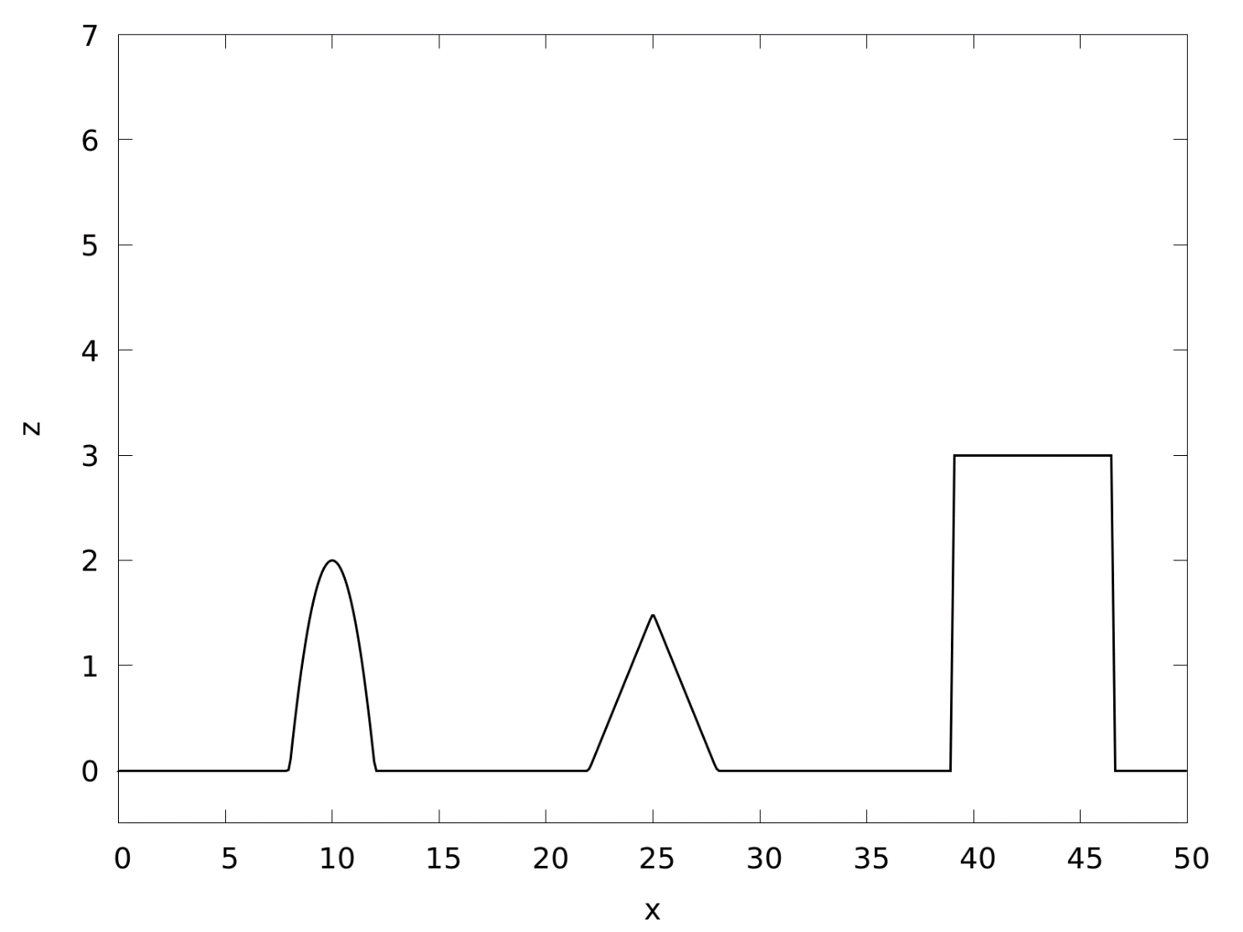
1D idealised topography
Uniform mesh, 512 cells

Slide 19
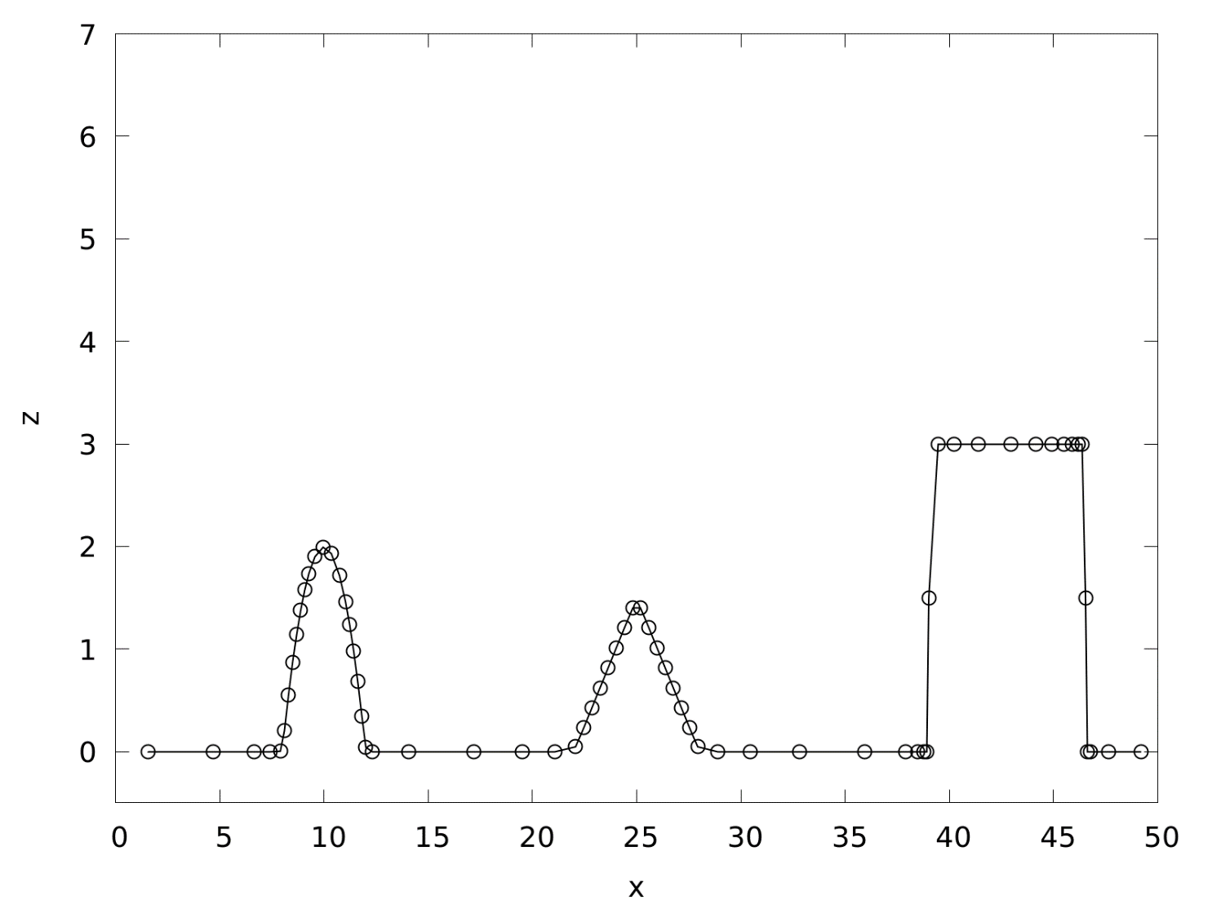
Haar wavelet-based mesh generation
Adaptive mesh, 67 cells, ε=10⁻¹

Slide 20
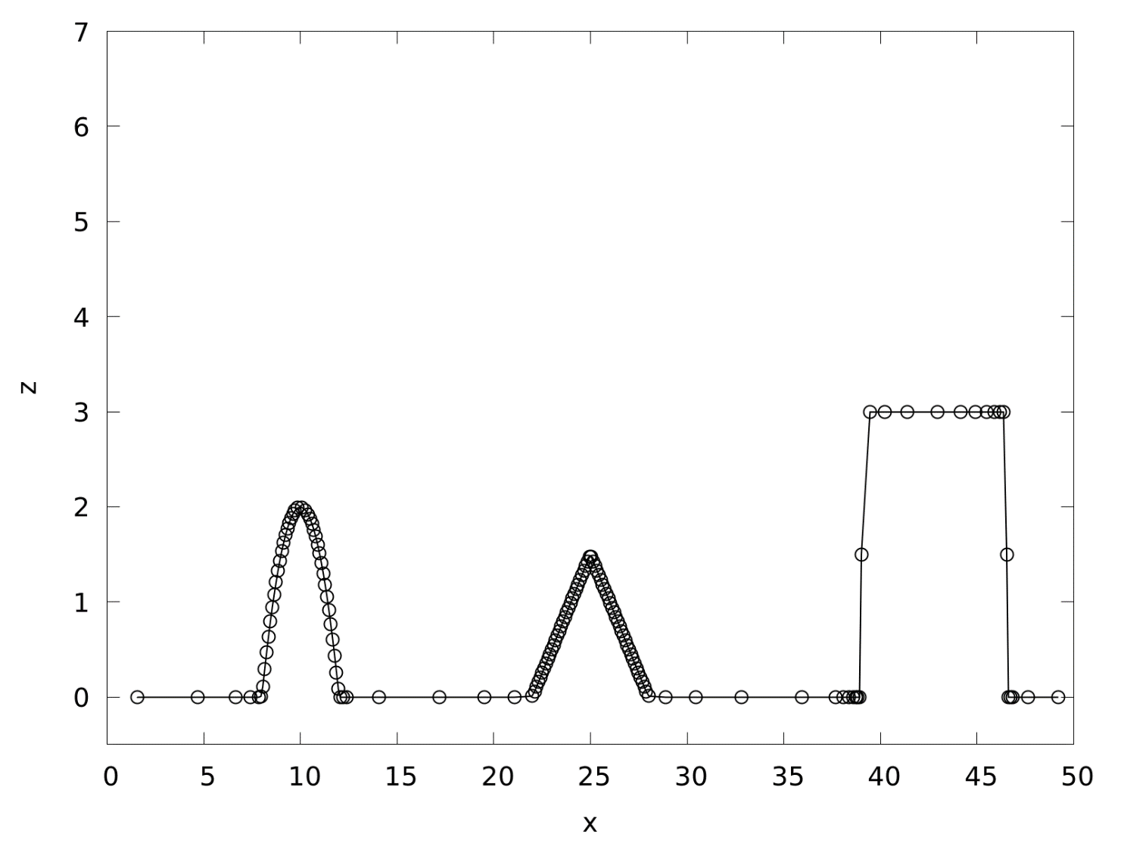
Haar wavelet-based mesh generation
Adaptive mesh, 141 cells, ε=10⁻²

Slide 21
Haar wavelet-based mesh generation
Adaptive mesh, 146 cells, ε=10⁻³

Slide 22
Piecewise-polynomial Alpert multiwavelet transform
=
+
Filter bank matrices

Slide 23
Piecewise-polynomial Alpert multiwavelet transform

Slide 24
Haar wavelet and Alpert multiwavelet adaptivity
Haar wavelets
ε = 10⁻³
Alpert multiwavelets
ε = 10⁻³

Slide 25
Haar wavelet and Alpert multiwavelet adaptivity
Haar wavelets
ε = 10⁻³
Alpert multiwavelets
ε = 10⁻³

Slide 26
Connecting wavelets with a shallow water solver
FV/DG shallow water solver
Shock-capturing
Well-balanced
Wetting/drying

Slide 27
Connecting wavelets with a shallow water solver
FV/DG shallow water solver
Shock-capturing
Well-balanced
Wetting/drying
Wavelet-based multiscale adaptivity
Locally conservative
Bounded

Slide 28
Connecting wavelets with a shallow water solver
FV/DG shallow water solver
Shock-capturing
Well-balanced
Wetting/drying
Wavelet-based multiscale adaptivity
Locally conservative
Bounded
Common piecewise-polynomial basis

Slide 29
Numerical experiments
1D lake-at-rest with topography
2D lake-at-rest with topography
Oscillatory flow in a parabolic bowl
Adaptive methods:
Baseline mesh with a single cell
Maximum refinement level 9, maximum of 2⁹ = 512 cells
Compare:
FV1 (uniform mesh), adaptive Haar-FV (HFV1)
DG2 (uniform mesh), adaptive multiwavelet-DG2 (MWDG2)

Slide 30
Lake-at-rest with topography
0m
50m

Slide 31
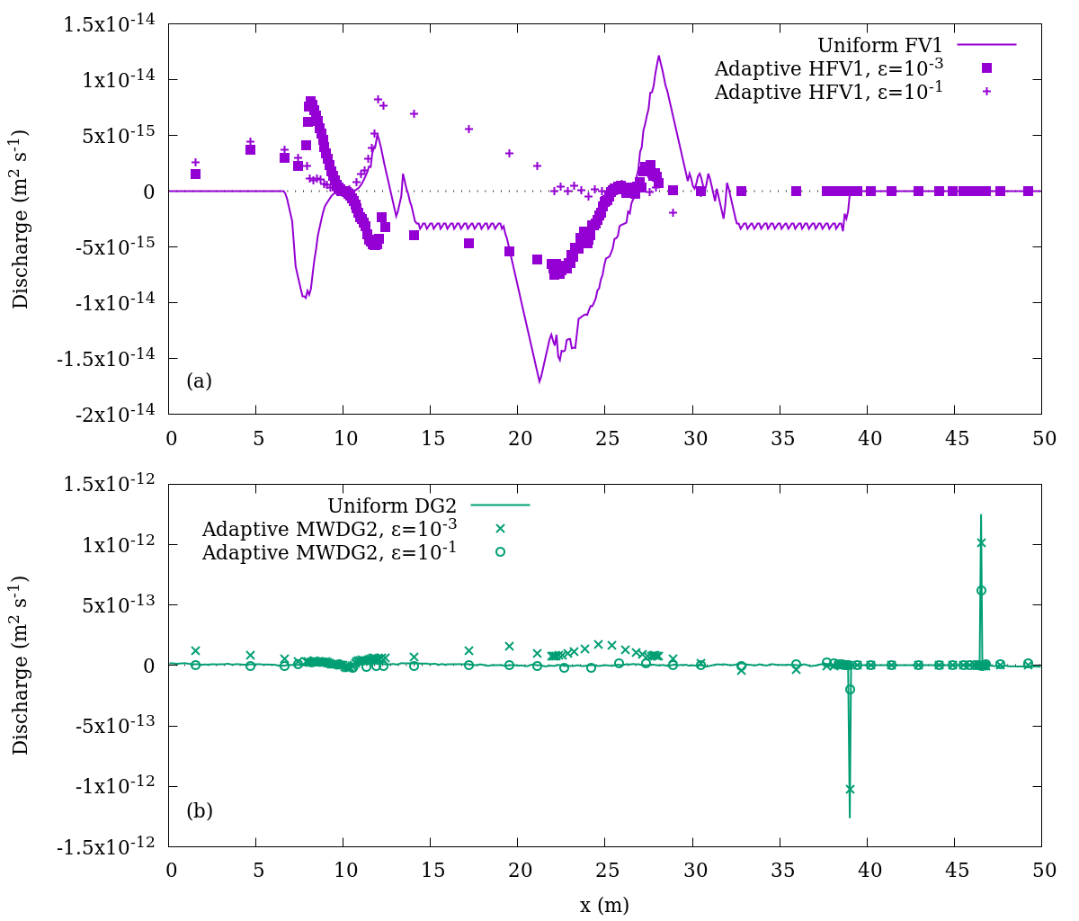
Haar wavelets preserve well-balancing
Uniform FV1 and adaptive HFV1 discharges after 100s (~14000 timesteps)
Discharge = water depth × flow velocity

Slide 32
Alpert multiwavelets preserve well-balancing
Uniform DG2 and adaptive MWDG2 discharges after 100s (~14000 timesteps)
Discharge = water depth × flow velocity

Slide 33
2D multiwavelet-based adaptivity
Discontinuous topography profile with dry, critically dry and wet blocks

Slide 34
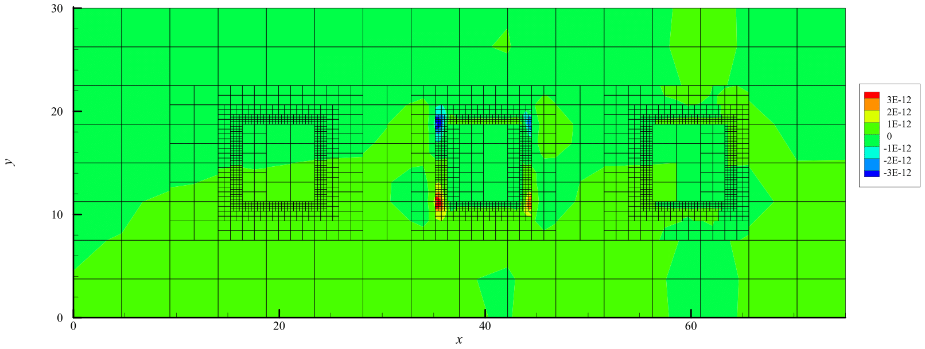
2D multiwavelets preserve well-balancing
MWDG2 discharges after 50s (~3000 timesteps)
𝑥 discharge
𝑦 discharge

Slide 35
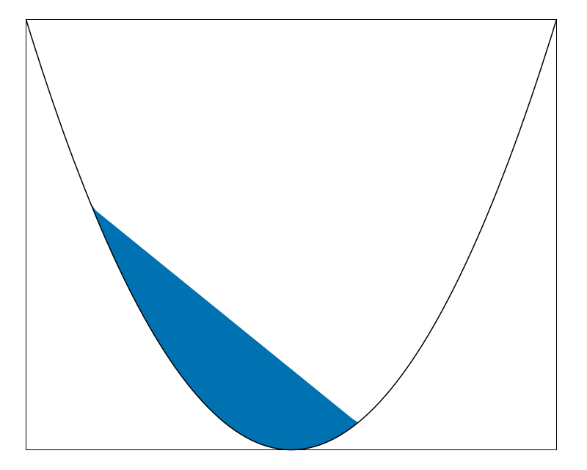
Oscillatory flow in a parabolic bowl

Slide 36
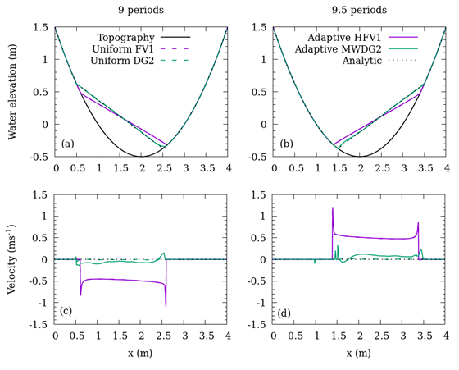
Parabolic bowl solutions

Slide 37
Parabolic bowl solutions

Slide 38
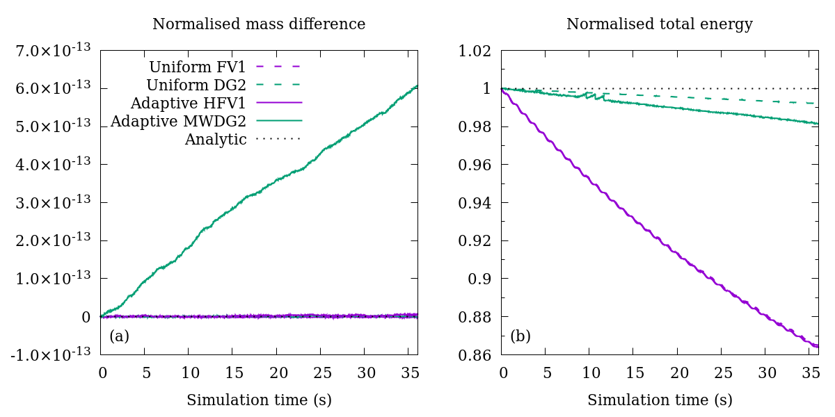
Parabolic bowl mass conservation
18 periods of oscillation

Slide 39
Parabolic bowl energy conservation
18 periods of oscillation

Slide 40
Highlights
Haar wavelets compatible with FV1 (referred to as HFV1)
Alpert multiwavelets compatible with DG (MWDG2)
Contact me: js102@zepler.net, @hertzsprrrung
Slides at doi.org/cs6c

Slide 41
Highlights
Haar wavelets compatible with FV1 (referred to as HFV1)
Alpert multiwavelets compatible with DG (MWDG2)
MWDG2 avoids excessive refinement, better than HFV1
Contact me: js102@zepler.net, @hertzsprrrung
Slides at doi.org/cs6c

Slide 42
Highlights
Haar wavelets compatible with FV1 (referred to as HFV1)
Alpert multiwavelets compatible with DG (MWDG2)
MWDG2 avoids excessive refinement, better than HFV1
Wavelets preserve well-balancing with wetting/drying
Contact me: js102@zepler.net, @hertzsprrrung
Slides at doi.org/cs6c

Slide 43
Highlights
Haar wavelets compatible with FV1 (referred to as HFV1)
Alpert multiwavelets compatible with DG (MWDG2)
MWDG2 avoids excessive refinement, better than HFV1
Wavelets preserve well-balancing with wetting/drying
Wavelets preserve mass and energy conservation
Contact me: js102@zepler.net, @hertzsprrrung
Slides at doi.org/cs6c

