Slide 1
Kfold in Deep Learning
Jesper Dramsch

Slide 2
Supervised Learning
Data
Train
Train
Valid
Test
Test

Slide 3
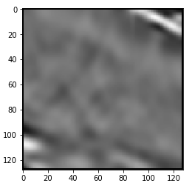
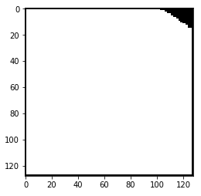
Kaggle TGS Salt Competition - Baseline

Slide 4
Kaggle TGS Salt Competition
Seismic Input
Semantic Segmentation / Seismic Interpretation
Training Set: 4000 Images
Secret Test Set: 18000 Images
Kaggle Evaluation
On secret 33% (6K Images)
Intersection over Union metric
Vanilla Unet
Train: 3600 Images
Test: 400 Images
1 Fold
K-Fold Unet
Train: 3600 x 5
Test: 400 x 5
5 Folds

Slide 5
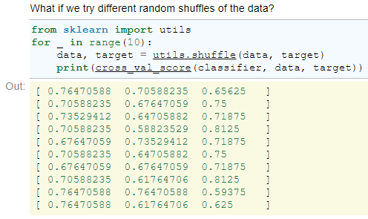
Why not Kfold?
http://gael-varoquaux.info/interpreting_ml_tuto/
Cross-Validation gives spread out measures and depends on sorting:

Slide 6
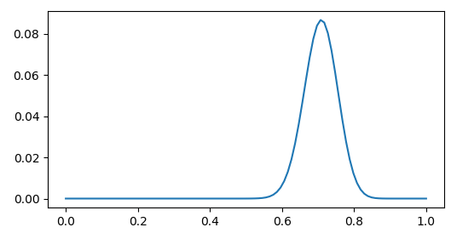
”Fold – Noise” (from Sampling Noise)
Kfold Scores

Slide 7
Scoring:
1-Fold Unet
Validation Score:
68%
Submission Score:
62%
5-Fold Unet
Validation Scores:
66%
67%
68%
71%
77%
Single Submission Score 77% Prediction:
62%
Submission Score Ensemble Prediction:
69%

Slide 8
Thank you!
bit.ly/kaggle-salt

