Slide 1
Welcome!
Delivered by
Supported by

Slide 2
Why we’re here
Understand the basics of research
Representing science for the public – how could we be better at “fact checking”?
Co-research a topic
Improve the AccessLab format

Slide 3
Introductions
Say hi to the person next to you
What do you do?
Anything you’re particularly interested to do today?
#accesslab
@BritSciAssoc
@_foam
@NERCscience

Slide 4
Exercise – Sources of information
5 minute task
On separate pieces of paper, list all the sources of information you would use to find out about what caused this summer’s heatwave
Place your papers on the “trust scale”

Slide 5
Understanding the basics
About BSA, NERC, and FoAM
Why is access to research an issue?
How does research get funded?
How does research get reviewed and published?

Slide 6
https://www.youtube.com/watch?v=t5Qzhi1wJXE

Slide 7
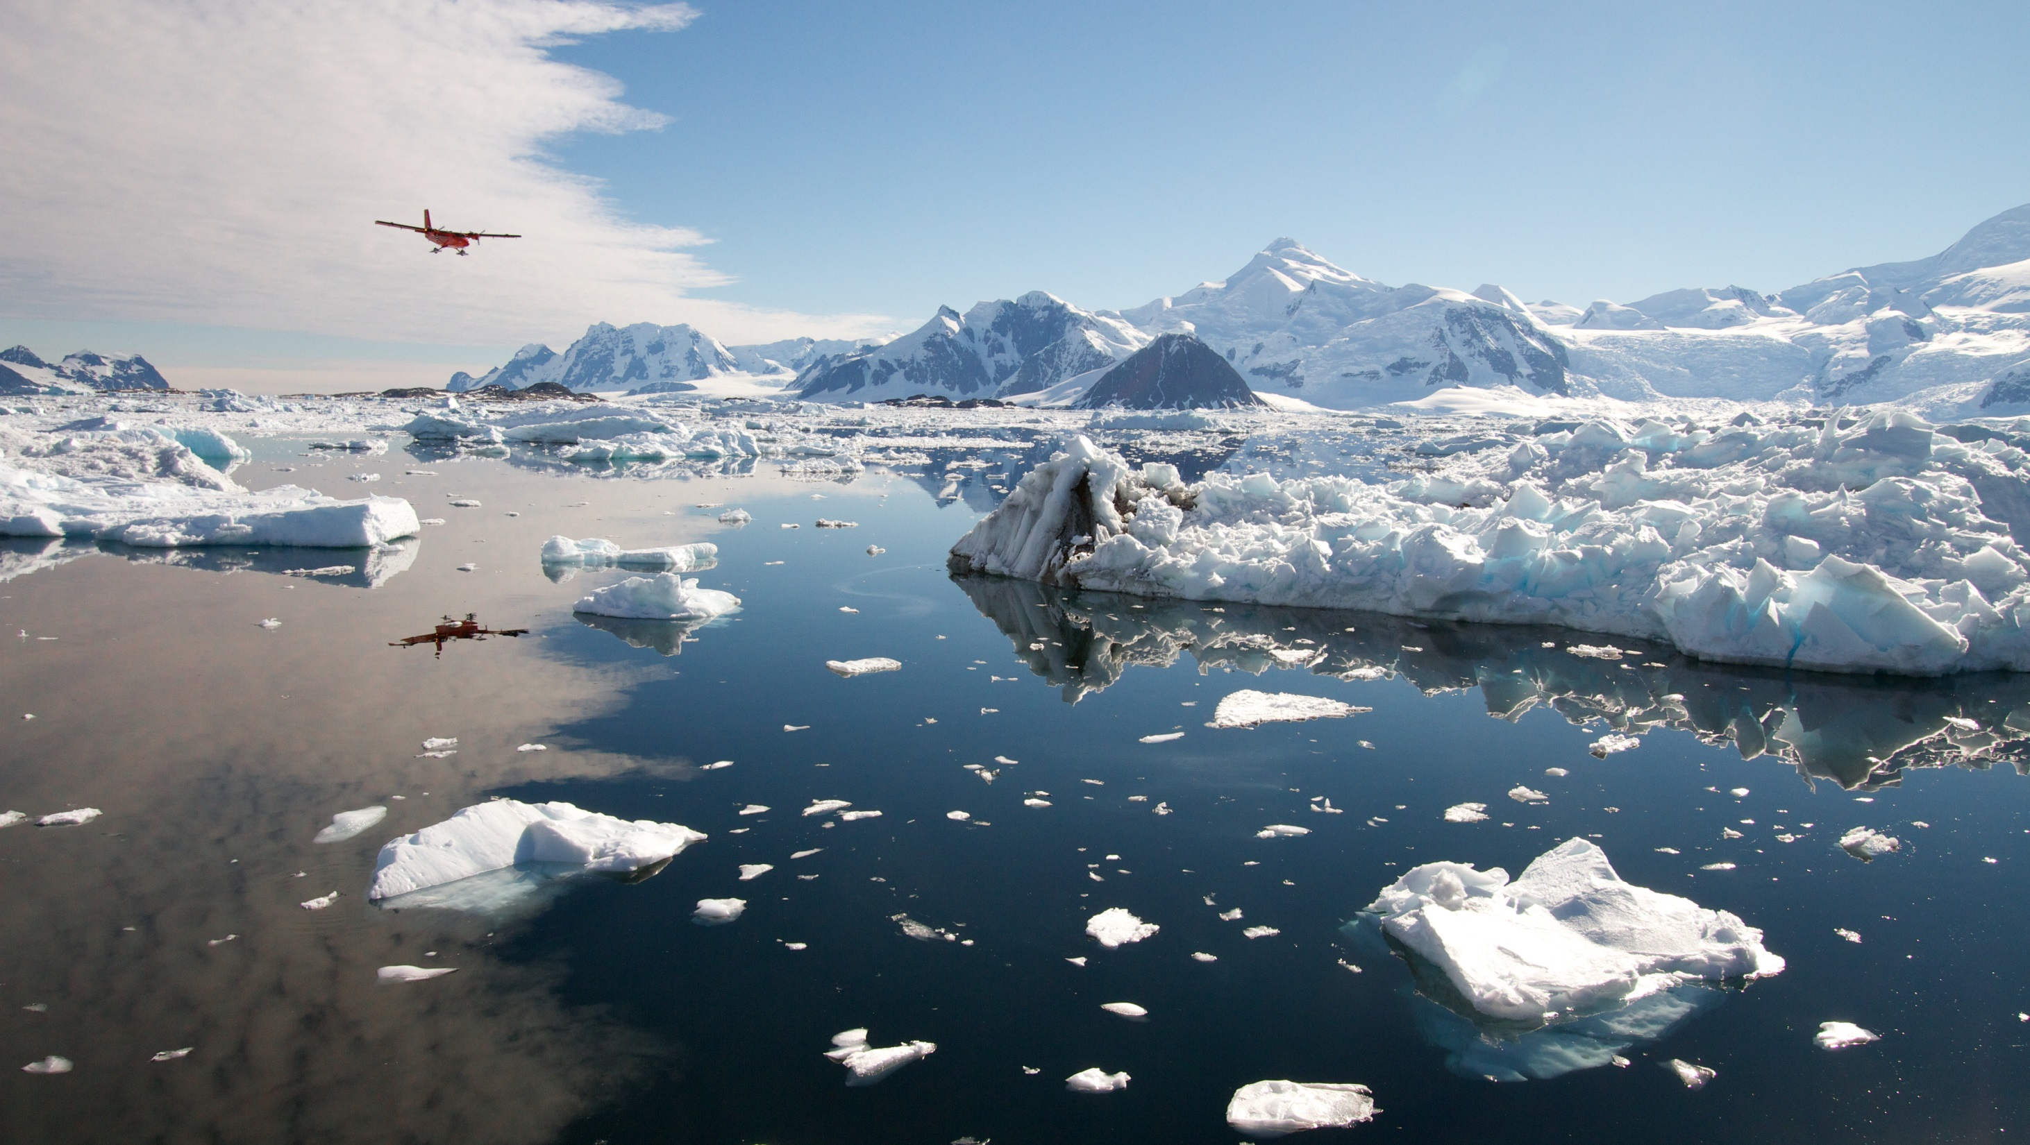
Contents
What is NERC?
Who are NERC?
Why NERC?

Slide 8
Notes:
NERC is the main funder of research into the environment:
from the deep oceans
to the upper atmosphere
from the poles to the equator
Really exciting research tackling societal issues like climate change, how the environment affects our health and our food supply
We are funded by the UK government and part of UKRI, spending public money on:
Science of the oceans (RRS SDA, Boaty)
Science of the ground and below ground (ecology and geology – pollinators, flooding)
Science of the poles (finding out what is happening at the most vulnerable parts of Earth)
Science of the atmosphere (the air we breathe)
NERC is the UK's main organisation for funding and managing research, training and knowledge exchange in the environmental sciences.
Our work covers the full range of atmospheric, Earth, biological, terrestrial and aquatic science, from the deep oceans to the upper atmosphere and from the poles to the equator.
We coordinate some of the world's most exciting research projects, tackling major issues such as climate change, environmental influences on human health, the genetic make-up of life on Earth, and much more.
NERC is part of UK Research & Innovation, a non-departmental public body funded by a grant-in-aid from the UK government.
We invest public money in world-leading science of the environment:
Science of the oceans (RRS SDA, Boaty)
Science of the ground and below ground (ecology and geology)
Science of the poles (finding out what is happening at the most vulnerable parts of Earth)
Science of the atmosphere (the air we breathe)

Slide 9
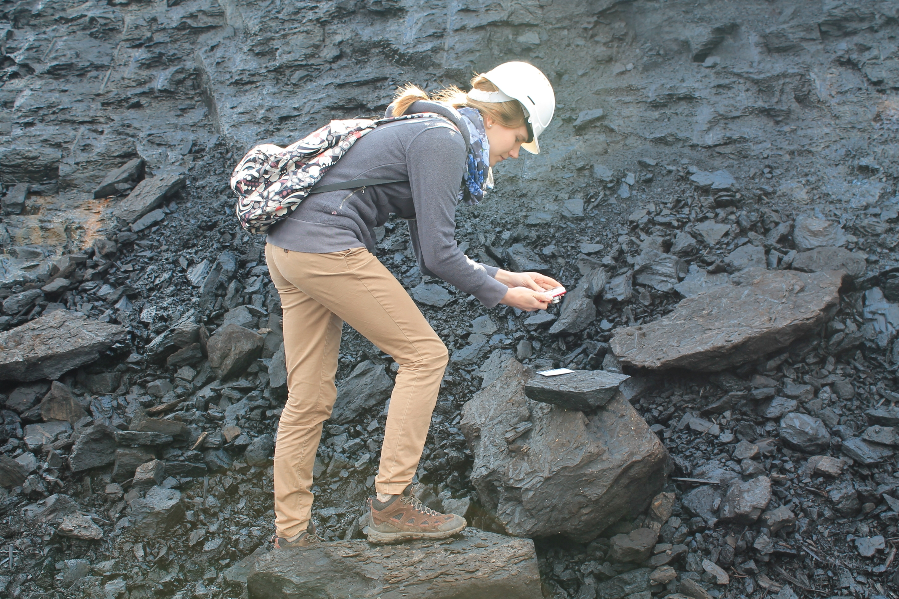
Who is NERC?
Research
People
Infrastructure
3000 researchers
1000 PhD students
4 ships
7 aircraft
6 polar bases
6 data centres
32 community facilities
1000 research projects 60 UK or international programmes
55 universities 20 research institutes

Slide 10
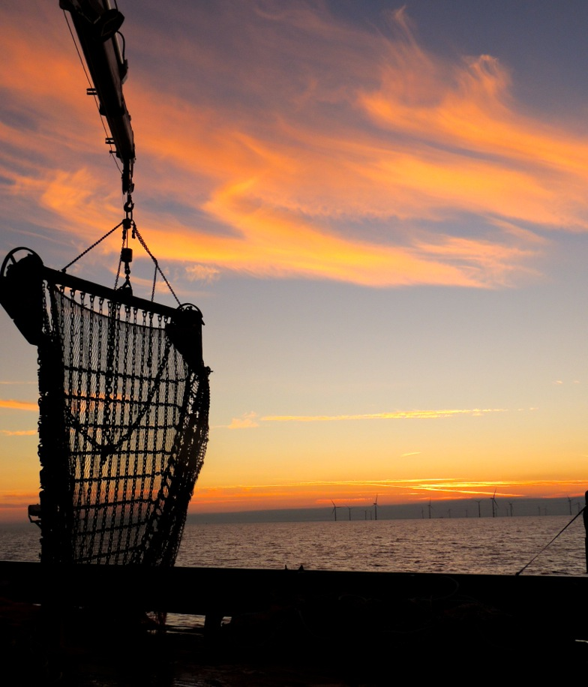
Why NERC?
For example: how we benefit from natural resources
Large, long-term benefits
Productivity and competitiveness
Safer, wealthier and more secure
Impact on economy & society…
Notes:
BRING IMPACT REPORT HARD COPIES AND HOLD UP HERE!
Our impact on economy & society…
Help society to benefit from natural resources, resilience to env hazards and manage environmental change
Generates large, LT economic and social benefits
Drive UK productivity and competitiveness
Whilst building safer, wealthier and more secure world
Katie St John Glew - University of Southampton
Fishing by Sunset. Beautiful skies in the Irish Sea whilst carrying out fisheries stock assessments on board RV Cefas Endeavour, and collecting jellyfish and fish samples for my PhD project to create isotope maps of the UK shelf seas for use in conservation and fisheries management.

Slide 11
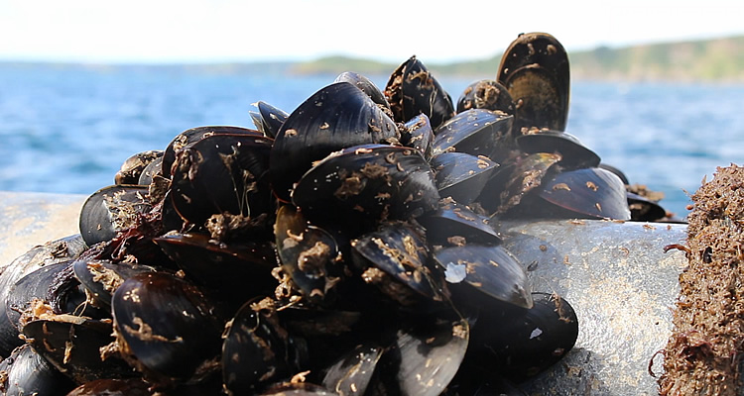
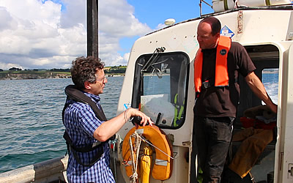
Why NERC example:
What can satellite data do for aquaculture?
Researcher Dr Peter Miller (left) and fisherman Gary Rawle
Notes:
ShellEye project seeks to help shellfish farmers manage threats from harmful algal blooms and E. coli bacteria.
Project works with people like Gary Rawle, a shellfish farmer based around St Austell, owns West Country Mussels of Fowey mussels which end up in restaurants all over the UK.
The project aims to develop a satellite-based forecasting system to help fishermen avoid the worst effects of the algal blooms to protect public health, reduce food waste and contribute to the resilience of the UK food system and bioeconomy.
Dr Peter Miller of PML heads up the ShellEye project and is excited by the potential of satellite data to track algal blooms in real-time, and how these data can then be analysed, simplified and sent to fishermen in the area.

Slide 12
Why NERC example:
£4m
Approx NERC investment 1981-2015
NERC science boosts UK shellfish industry
Britain’s seas are important, and under pressure:
UK households spent £6.3bn on seafood in 2015
Decades of NERC-funded research enabled scientists to:
identify that the use of anti-fouling agents on boats and ships was causing severe harm to shellfish and other marine life
provide the evidence underpinning government bans.
Marine life has now recovered, generating UK benefits worth over £900m:
Alan Lagadu/istockphoto.com
£331m
UK shellfish production benefit
£718m
Wider UK benefits
£141m
Private sector compliance costs
£908m
Net UK benefit
+
-
=
Notes:
Anti-foulant agents prevent organisms such as barnacles and algae attaching to vessel hulls, so improving fuel efficiency and cutting maintenance costs. Tributyltin (TBT) was banned for small vessels in 1987, this was extended to all vessels in 2008.
Based on NERC-commissioned analysis by Deloitte in 2016
More detail in Impacts of NERC science - Cleaner seas (PDF) available at www.nerc.ac.uk/research/impact/casestudies/society/cleaner-seas/
Study report available at www.nerc.ac.uk/about/perform/evaluation/evaluationreports/tributyltin-and-biocides/

Slide 13
FoAM is a networked transdisciplinary lab (UK, BE, NL, SE, Earth)
We are generalists - working across disparate fields – asking ‘what if’?
We are a non-profit and open-source

Slide 14
We work across disciplines designing new ways to improve access to research.
Our tax pays for research, so we should all have access to it.
More diversity of people involved in research makes for better ideas.
Knowledge inequality is a serious matter.

Slide 15
Understanding the basics
Why is access to research an issue?
How does research get funded?
How does research get reviewed and published?

Slide 17
What is AccessLab about?
What should I eat?
Should I be worried about vaccinating my kids?
There’s a vast body of scientific research that could help people in their day-to-day life decisions and work.
Peer-reviewed literature, in scientific journals, is a primary source of information.
We’d like to find ways to help people access this.

Slide 18
Current situation
Global scientific output doubles every 9 years - now ~2.5 million papers/year published in scientific journals.
About 28% of published research is Open Access (~19M papers). The rest is behind paywalls (~£20-100/article).

Slide 20
How we got here
For centuries publishing has been how scholars share their research.
Until relatively recently, this was paid for by sponsors, with peer-review done by research community or uni presses.
During Cold War, research expanded internationally, university sector grew, and funding grew – publishing became highly profitable.
Since 1980s, increased demands for accountability led to a culture of metrics. Academia grew into a ‘prestige economy’ operating on symbolic capital generated by publications.

Slide 21
How we got here
In last 25 years, there’s been a growing divergence between the roles of academic publishing:
Disseminating validated knowledge
Symbolic capital for academic career progression.
Profitable business enterprise – 35-40% profits.
Tax-funded academics do the research, write the papers, make the figures, do the editing roles, do the peer review – all for free, sign over the copyright to publishers who then sell it back to them, typeset.

Slide 22
Change is happening
Awareness that accessibility of research is a serious issue (led by funders).
Awareness that prestige of specific journals is primarily a marketing tactic by the publishers.
Growth of:
Open Access Journals
Non-Profit Journals (incl. Uni Presses)
Various work-arounds to access papers

Slide 23
Universal Declaration of Human Rights, Article 27:
'Everyone has the right freely to share in scientific advancement and its benefits'

Slide 24
Understanding the basics
Why is access to research an issue?
How does research get funded?
How does research get reviewed and published?

Slide 25
Contents
Who funds science and why?
Notes:
10 min overview of scientific funding (who funds the research e.g. tax, industry, charities/trusts etc., how funding bodies decide what to fund, and how scientists decide what to research).

Slide 26
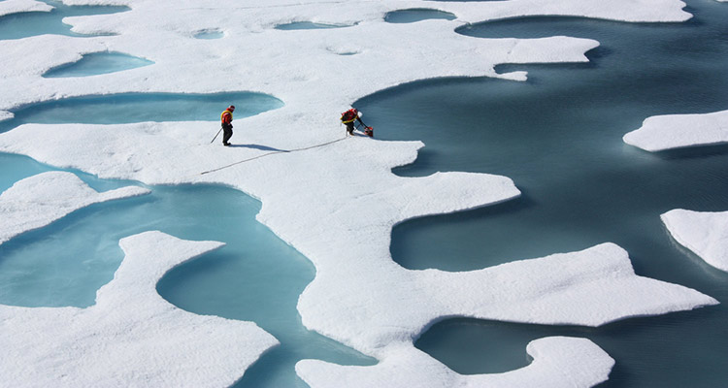
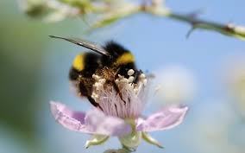
How do we decide what to fund?
‘Discovery science’ (bottom up)
‘Strategic science’ (top down)
Notes:
how funding bodies decide what to fund (blue sky vs strategic etc).
Researchers respond to ‘calls’, which are essentially competitions for funding, by filling in application forms which are assessed
Strategic research – ocean acidification, climate change, air pollution
NERC's strategic research is designed to address major scientific questions that are important for the UK's prosperity and wellbeing in the 21st century - many of them revolving around how we can manage environmental change, make the best use of scarce resources and build resilience to natural hazards. As well as directing funds into important areas of fundamental science, it also supports training and helps to build strong research communities by bringing together academics from different disciplines with potential users of their science.
Discovery science (responsive mode)
Research that is driven by curiosity rather than by a strategic agenda can have enormous benefits far beyond the advancement of knowledge, and often they are least expected. We don't know which projects will eventually make a major impact on our society and economy, but we know some will. NERC is fully committed to supporting this kind of science.

Slide 27
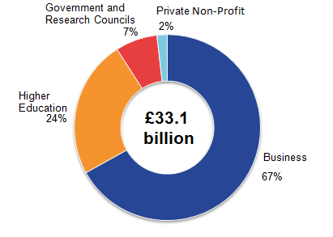
Who funds science (R&D)?
Research & development funding (ONS, 2016)
Alan Lagadu/istockphoto.com
Notes:
ONS Gross domestic expenditure on research and development, UK: 2016 (ref: https://www.ons.gov.uk/economy/governmentpublicsectorandtaxes/researchanddevelopmentexpenditure/bulletins/ukgrossdomesticexpenditureonresearchanddevelopment/2016)
Estimates of research and development performed and funded by:
business enterprise (industry)
higher education
government, research councils (tax)
private non-profit organisations (charities, trusts)

Slide 28
Basic science funding – 2 examples
Government
Charities (e.g. CRUK)
Alan Lagadu/istockphoto.com
Notes:
ONS Gross domestic expenditure on research and development, UK: 2016 (ref: https://www.ons.gov.uk/economy/governmentpublicsectorandtaxes/researchanddevelopmentexpenditure/bulletins/ukgrossdomesticexpenditureonresearchanddevelopment/2016)
Estimates of research and development performed and funded by:
business enterprise (industry)
higher education
government, research councils (tax)
private non-profit organisations (charities, trusts)

Slide 29
How do scientists choose their research?
They follow where the money is…
…or follow their interests!
Notes:
How do scientists decide what to research?
They generally either respond to specific calls for funders’ priorities, or follow their interests and seek funding based on that, or a mixture of both

Slide 30
Hannah King hannah.king@nerc.ac.uk Public Engagement Officer

Slide 31
Understanding the basics
How does research get funded?
Why is access to research an issue?
How does research get reviewed and published?

Slide 32
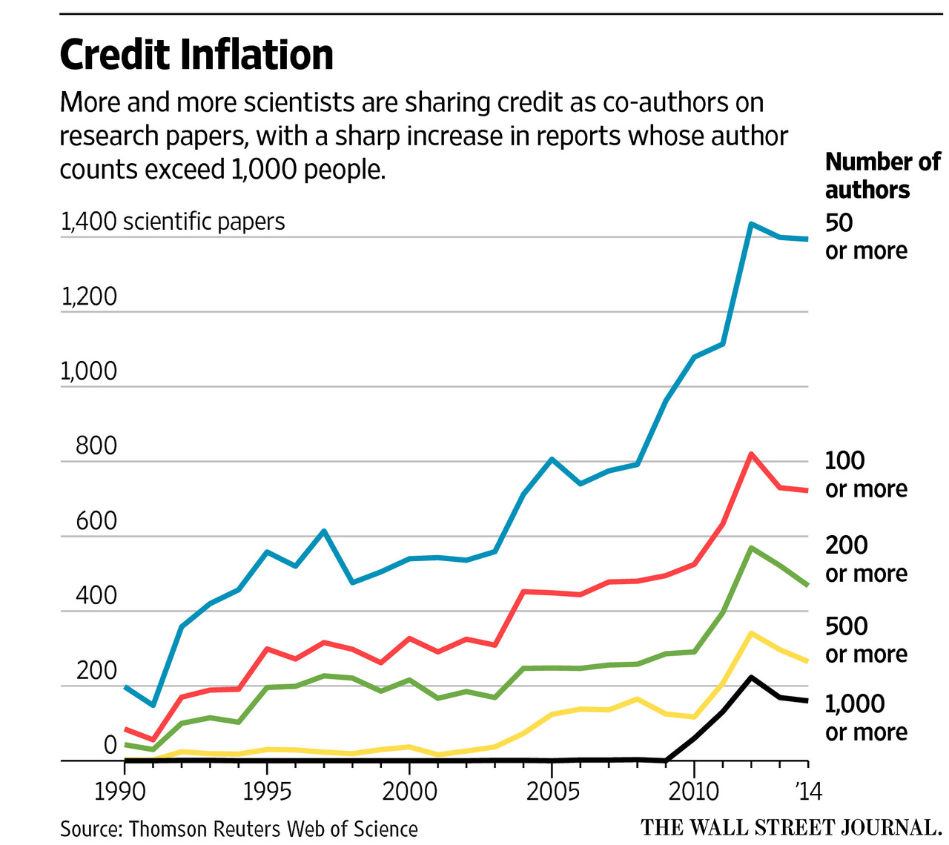
Science is collaborative
When you read a piece of research, it’s very rarely done by one person…
Scientists work in teams of 1-1000!
Notes:
We can see that the increase co-authors is a general trend! Note: this is not about scientists trying to ‘muscle in’ and gain credit (feel free to crop the title on this slide) However, it’s clear that there’s a general trend toward multi-author papers caused by:
- greater collaboration across disciplines
- large international projects
- increased recognition for technical staff
All good things!

Slide 33
The publishing process
Paper submitted
Editor assigned
First decision
Returned to author
50-80%
20-50%
External review
Editorial decision
10-40%
Accepted and published
Revision
Rejection
Notes:
ANIMATED (3 clicks)
- A simplified version of the editorial process for the majority of manuscripts: all this will be covered in more detail later in the module
- The first decision lies with the editor
CLICK
- Sometimes rejected at that stage
CLICK
- After review, the editor will make a decision on whether to reject or revise (it’s very rare for a paper to be published without revision)
CLICK
- There might be another round of review, or the paper might be published after revisions
- Around 10% of the submitted manuscripts are published

Slide 34
How is research assessed?
Research is checked by other scientists working in a similar field – peer review
Scientists do not know who is reviewing their paper
Scientists can suggest reviewers or exclude reviewers (within reason)
There are trials with making peer review more anonymised, or more transparent
Notes:
Single-blinded peer review
Helps prevents bland, timid reviews
Corrects for power imbalance
Reduces opportunities for favor trading
Helps scientists stay friends
Many referees would refuse to review if identified by name
Editors, not referees, take the ultimate responsibility for decisions
Double blind peer review
Referees do not know the identity of the authors: all relevant information is blanked out
Better objectivity by the reviewers: avoids bias based on gender, celebrity, nationality, identity etc.
Difficult to hide author identity (self-citation, conference presentations)
A randomised study published in Journal of the American Medical Assoc./JAMA study in 1998 found no benefit to quality of reviews (n=118; doi:10.1001/jama.280.3.240)
PLoS, the American Physical Society and Nature (Nature 451, 605– 606 (2008)) have abandoned double-blind peer-review trials in the past
Nature Climate Change and Nature Geoscience are still trialling. Uptake quite low (15% Ngeo, 22% NCC), probably because authors had to actively anonymise their paper (e.g. concealing self-citation), which takes time and effort when ready to submit. An editorial at each journal discusses how the trial went.
Open peer review
Low participation
Quality of comments lacking, particularly on technical correctness (“very nice study” etc.)
Transparent peer review
EMBO Journal publishes a ‘review process file’ with each paper, containing all anonymous referee reports, as well as all correspondence between authors and editors
99.85% of reviewers take part with no indication of less-critical reports. More transparency in editorial decisions.

Slide 35
Who are reviewers?
Commonly 2-4 referees chosen by journal editors from a database
They answer two questions:
Do I trust the data?
Why do I care?
Notes:
They look at:
Is the research correct?
How significant is it?
How much will it move the field forward?
They must be:
Minimal bias, no conflict of interest
Timely, fair-minded, constructive
How do the editors choose referees?
The editor’s own knowledge of the field
Publisher peer reviewer databases
The reference list of the paper and related papers
Online literature searches using keywords
Conference pages
The potential referee’s author profile pages can be very helpful to show areas of interest, roles
Suggestions in the cover letter (consider elaborating on how these are used, if you haven’t already)
To become a reviewer: ensure you are accessible (including a website/page with your contact details, details of your research and publications), and be a well-published author yourself. Talking to editors can sometimes help!

Slide 36
What is a review paper?
Longer, more in-depth look at a research area
Discussion of advances over past 2-3 years
Usually:
Commissioned
Written by a senior academic
Contains more images and editorial input
Read by lots of people
Notes:
Authoritative, NOVEL synthesis, summarizing advances from past 2-3 years
Important: not just summarizing, ‘collection of sentences’
You have 5000 words to consider how new data advances our understanding
goes further than discussion sections of primary papers
NOT soapbox
NOT vehicle for pushing own work
Opportunity to consider ‘how do all these findings advance our understanding?

Slide 37
Is all research in journals?
Pre-prints
Research can be put online before review as a “working copy”.
There are hosting platforms organised by subject or by institution
Author copies
Some journals offer authors a link to share their work freely
All articles will have a link to the lead author so you can contact them directly
Remember – authors do not profit from articles!

Slide 38
More questions…
Discuss with the person next to you:
What makes a great research question?
What makes a great story?
Who are your key audiences?

Slide 39
Research to headline
Researchers carry out their project and (usually) submit findings to a journal
University press office keeps an eye out for what researchers are doing
Write a press release (either together, or just press office)

Slide 42
Exaggerations in press releases
Looked at research, press releases (n=462), and associated news stories (n=668).
40% of the press releases contained exaggerated advice
33% contained exaggerated causal claims
36% contained exaggerated inference to humans from research on other animals.
When press releases contained exaggeration, 58%, 81%, and 86% of news stories, contained similar exaggeration, compared with exaggeration rates of 17%, 18%, and 10% in news when the press releases were not exaggerated.
Sumner et al. (2014) The association between exaggeration in health related science news and academic press releases: retrospective observational study. BMJ; 349.

Slide 43
Let’s fact-check!
We’ll go through 7 “key questions” about this story to find the evidence behind the claims

Slide 44
Can you find the original research?

Slide 45
Who did the research?

Slide 46
Who funded the work?
Not funded by a dating app
Not funded by a chain of bars/restaurants/other date location
Not funded by a consumer goods company

Slide 47
How was the work done?
In general, look for:
If the work claims human health implications, was the work done on humans?
How many people/subjects were involved in the study?
If it’s a review paper, is it a “systematic review”?

Slide 48
Did they do what they say they did?
Yes!
Looked at heterosexual users in 4 US cities
Used a standard measure “page rank” to initially determine “desirability”
Looked at variation in age, gender, location, “messaging strategy”
Explained where the results wouldn’t be reliable (e.g. in an “offline” context)

Slide 49
What else has been published?
Importance of physical attractiveness in dating behavior. J. Pers. Soc. Psychol. 4, 508–516 (1966).
CrossRefPubMedWeb of ScienceGoogle Scholar
L. S. Taylor,
A. T. Fiore,
G. A. Mendelsohn,
C. Cheshire
“Out of my league”: A real-world test of the matching hypothesis. Pers. Soc. Psychol. Bull. 37, 942–954 (2011).
CrossRefPubMedWeb of ScienceGoogle Scholar
G. J. Hitsch,
A. Hortaçsu,
D. Ariely
,Matching and sorting in online dating. Am. Econ. Rev. 100, 130–163(2010).
Google Scholar
L. Lee,
G. Loewenstein,
D. Ariely,
J. Hong,
J. Young
If I’m not hot, are you hot or not? Physical-attractiveness evaluations and dating preferences as a function of one’s own attractiveness. Psychol. Sci.19, 669–677 (2008).
CrossRefPubMedWeb of ScienceGoogle Scholar

Slide 50
Can you access the data?

Slide 51
Conclusions from this example
What seems like a silly headline has some decent evidence behind it!
… Mostly!

Slide 52
Media case studies – checklist
Fo.am/accesslab – Media Case study link
20 minute task with the person next to you
Can you find the original research?
Who did the work?
Who funded the work?
How was the work done?
Did they do what they say they did?
What else has been published on the topic?
Can you access the data?

Slide 53
Feedback
Score /10?
Which “fact-checking stage” was most useful?
Anything to add?

Slide 54
Lunch!

Slide 55
Refining your research question
30 minute exercise
Discuss your chosen research topic
Why did you choose it?
What do you know already?
Refine your research question and write it out on the large sheet of paper

Slide 56
Researching the topic
90 minute exercise
(optional)
Write down the sources you find most useful
Write down anything you’d like to share with the group
This is your time – we won’t be asking you to share your findings!

Slide 57
Finishing up
Anything you’d like to share?
Feedback for us
Thank you!!

