Slide 1
Welcome!
Delivered by
Supported by

Slide 2
This afternoon
Why we are doing this
What content we’ll cover
Practical considerations
#accesslab
@_foam
@BritSciAssoc
@NERCscience

Slide 3
Friday
Understand the basics of research
Representing science for the public – how could we be better at “fact checking”?
Co-research a topic
Improve the AccessLab format

Slide 4
Exercise – Sources of information
5 minute task
On separate pieces of paper, list all the sources of information you would use to vote on the final terms of a Brexit deal
Place your papers on the “trust scale”

Slide 5
https://www.youtube.com/watch?v=t5Qzhi1wJXE

Slide 6
FoAM is a networked transdisciplinary lab (UK, BE, NL, SE, Earth)
We are generalists - people who work across disparate fields in an entangled, speculative culture
We are a non-profit organisation
We work open-source

Slide 7
We work across disciplines designing new ways to improve access to research.
Our tax pays for research, so we should all have access to it.
More diversity of people involved in research makes for better ideas.
Knowledge inequality is a serious matter.

Slide 8
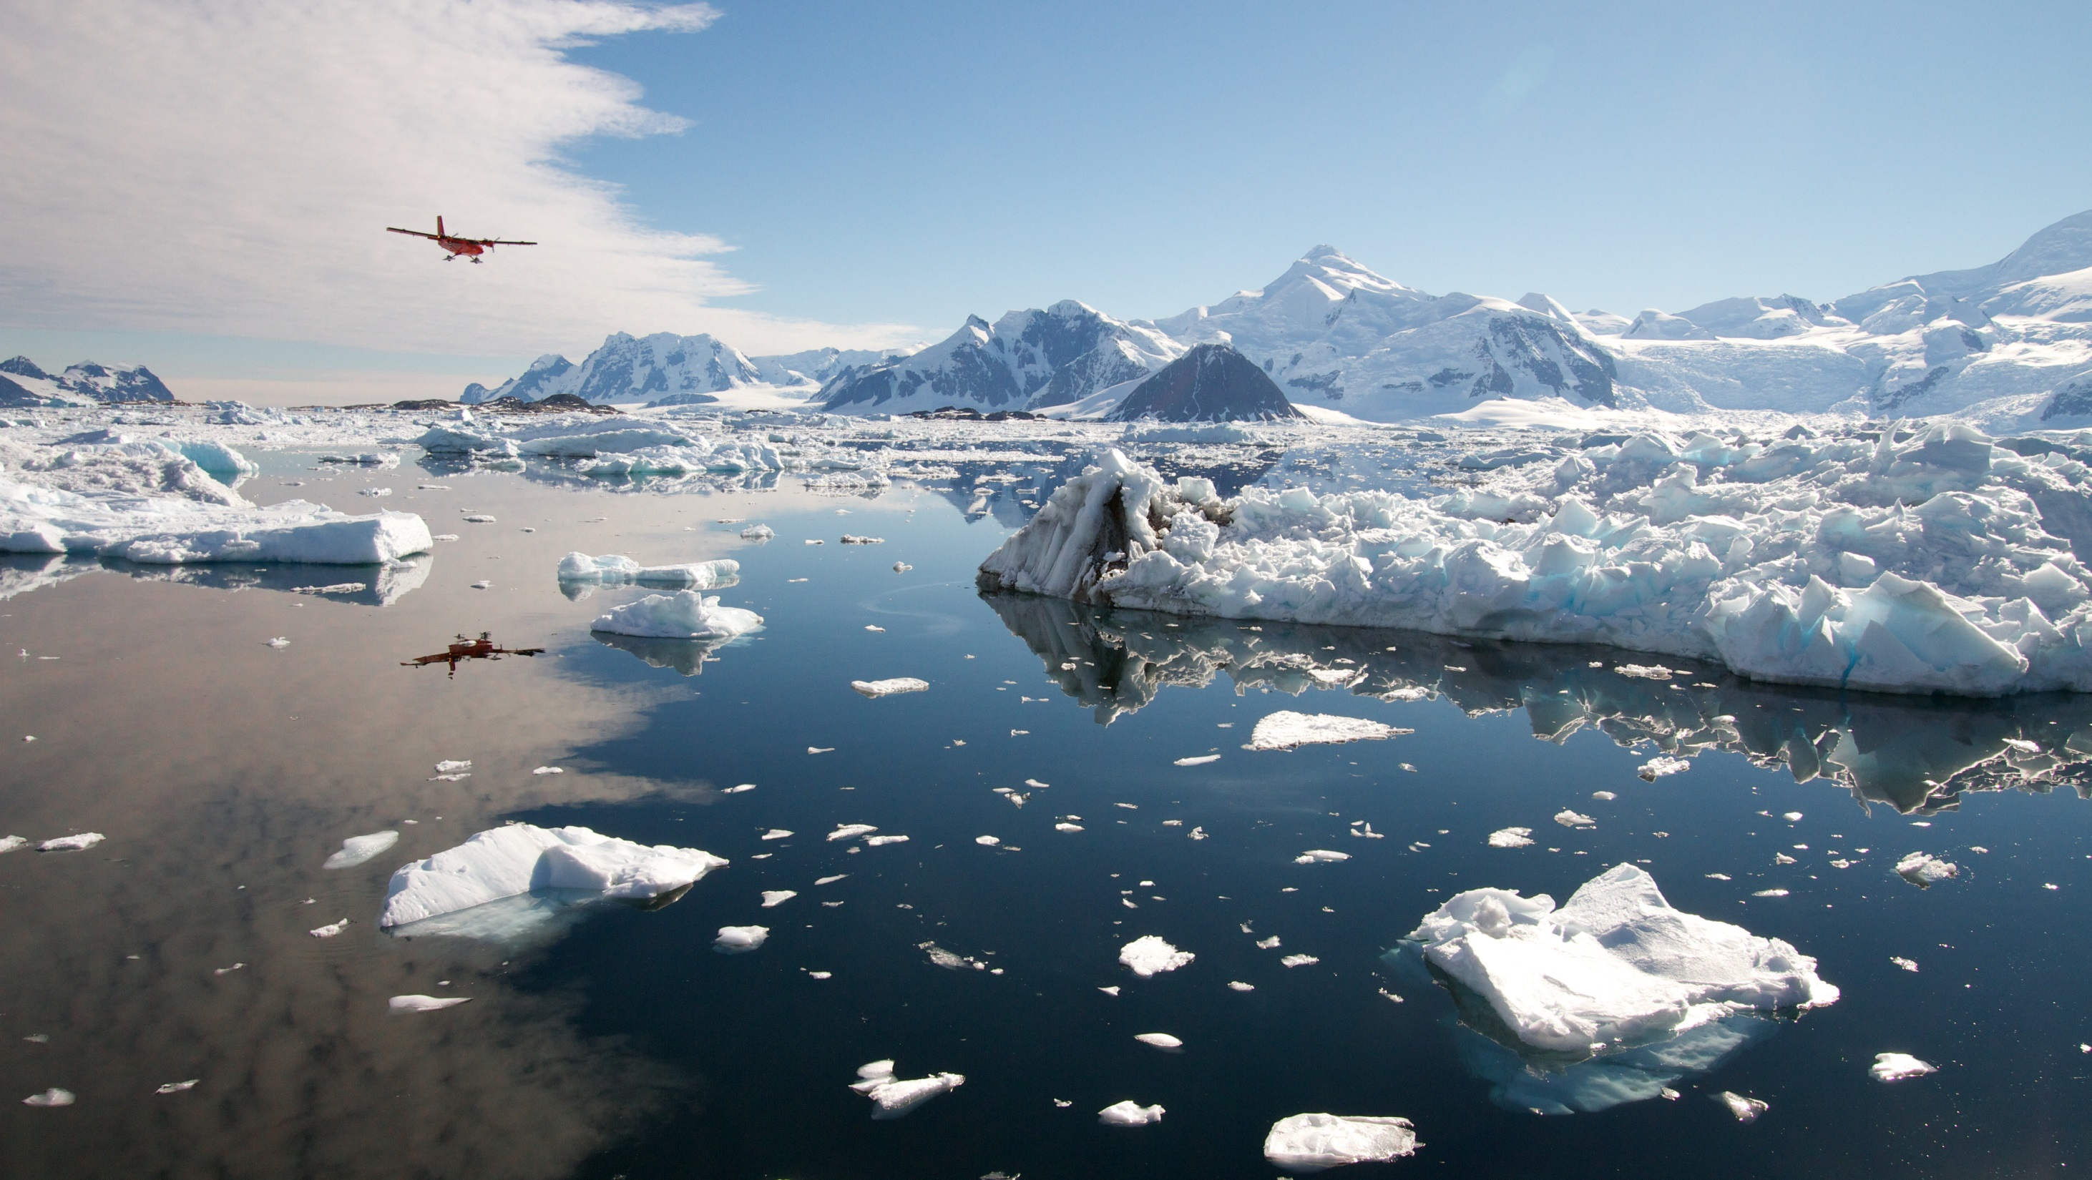
Contents
What is NERC?
Who are NERC?
Why NERC?

Slide 9
Notes:
NERC is the main funder of research into the environment:
from the deep oceans
to the upper atmosphere
from the poles to the equator
Really exciting research tackling societal issues like climate change, how the environment affects our health and our food supply
We are funded by the UK government and part of UKRI, spending public money on:
Science of the oceans (RRS SDA, Boaty)
Science of the ground and below ground (ecology and geology – pollinators, flooding)
Science of the poles (finding out what is happening at the most vulnerable parts of Earth)
Science of the atmosphere (the air we breathe)
NERC is the UK's main organisation for funding and managing research, training and knowledge exchange in the environmental sciences.
Our work covers the full range of atmospheric, Earth, biological, terrestrial and aquatic science, from the deep oceans to the upper atmosphere and from the poles to the equator.
We coordinate some of the world's most exciting research projects, tackling major issues such as climate change, environmental influences on human health, the genetic make-up of life on Earth, and much more.
NERC is part of UK Research & Innovation, a non-departmental public body funded by a grant-in-aid from the UK government.
We invest public money in world-leading science of the environment:
Science of the oceans (RRS SDA, Boaty)
Science of the ground and below ground (ecology and geology)
Science of the poles (finding out what is happening at the most vulnerable parts of Earth)
Science of the atmosphere (the air we breathe)

Slide 10
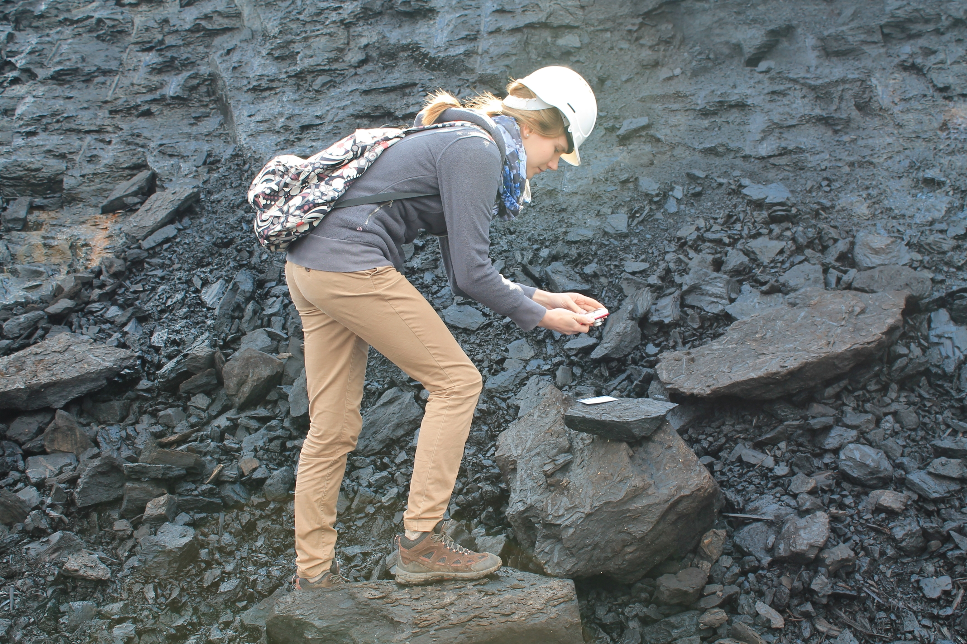
Who is NERC?
Research
People
Infrastructure
3000 researchers
1000 PhD students
4 ships
7 aircraft
6 polar bases
6 data centres
32 community facilities
1000 research projects 60 UK or international programmes
55 universities 20 research institutes

Slide 11
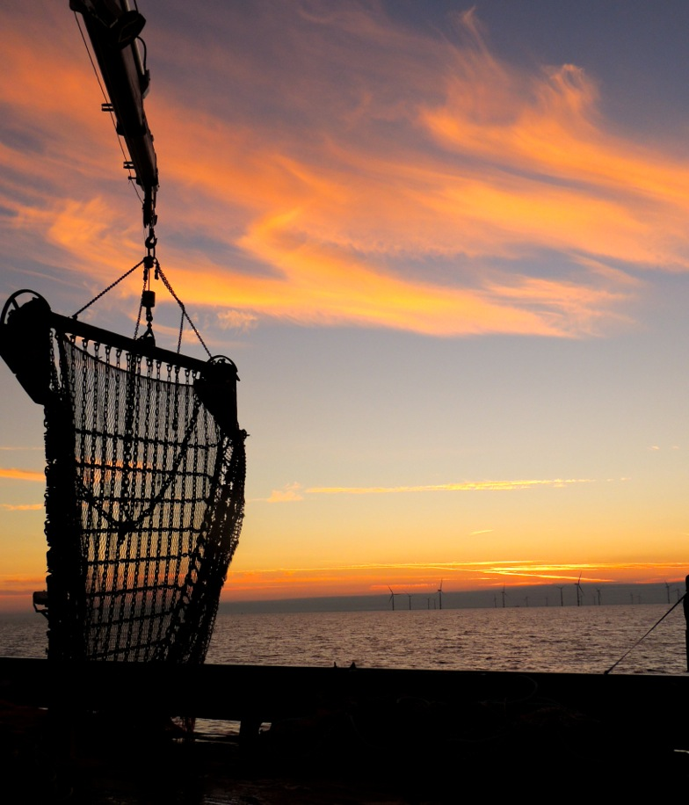
Why NERC?
For example: how we benefit from natural resources
Large, long-term benefits
Productivity and competitiveness
Safer, wealthier and more secure
Impact on economy & society…
Notes:
BRING IMPACT REPORT HARD COPIES AND HOLD UP HERE!
Our impact on economy & society…
Help society to benefit from natural resources, resilience to env hazards and manage environmental change
Generates large, LT economic and social benefits
Drive UK productivity and competitiveness
Whilst building safer, wealthier and more secure world
Katie St John Glew - University of Southampton
Fishing by Sunset. Beautiful skies in the Irish Sea whilst carrying out fisheries stock assessments on board RV Cefas Endeavour, and collecting jellyfish and fish samples for my PhD project to create isotope maps of the UK shelf seas for use in conservation and fisheries management.

Slide 12
Why AccessLab?

Slide 13
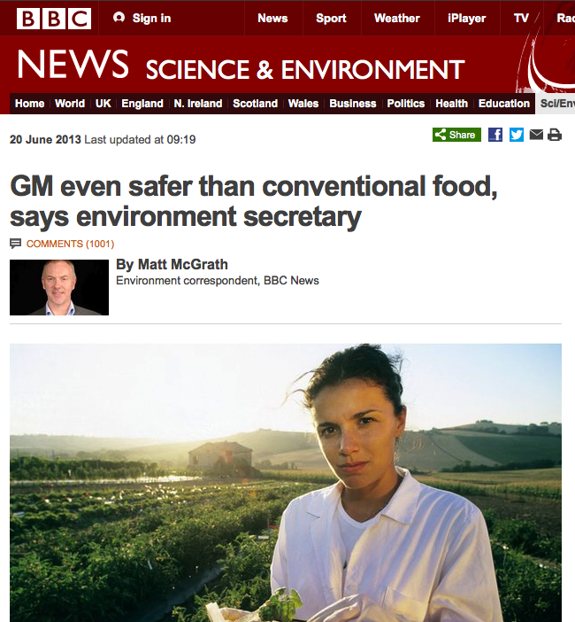
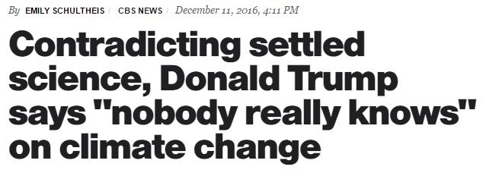
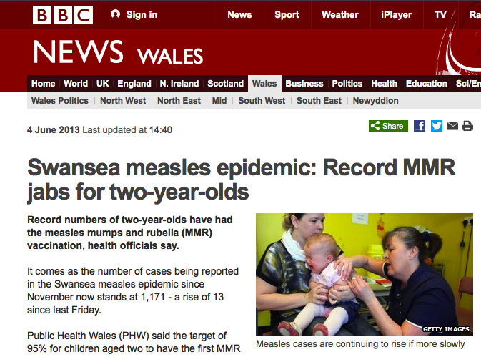
Sources of information…

Slide 14
Public Attitudes to Science – Dept for Business, Innovation and Skills, Ipsos Mori, British Science Association

Slide 15
The challenge
To make use of scientific research, you need to know:
That it exists
How to find it
How to read an interpret it
You have this knowledge!
And this access!
And these skills!

Slide 16
Exercise – Research to benefit the world
2 minute task
What is the most important question/topic of our time that scientific research could offer something towards?
20 minute task
Work in pairs to choose 3-5 seminal papers on your topic
Write them on your big sheet

Slide 17
Break!

Slide 18
Exercise – Finding and judging research
Part 1
On separate pieces of paper, list all the places you could find scientific information/research papers
Part 2
On separate pieces of paper, list all the ways you could judge the reliability of scientific information/research papers

Slide 19
Exercise – Finding and judging research
Place your papers on a scale:
How easy is it to use for someone with no research background?
How reliable is the approach?
Think about:
What prior knowledge is needed
How the information is organised

Slide 20
Things to remember
They have taken time out of their jobs to attend the workshop
AccessLab is a skills exchange, not a transfer of knowledge
There might be different views and approaches – you can definitely learn from this!
There are good reasons why people might not 100% trust science or scientists – don’t shy away from this!

Slide 21
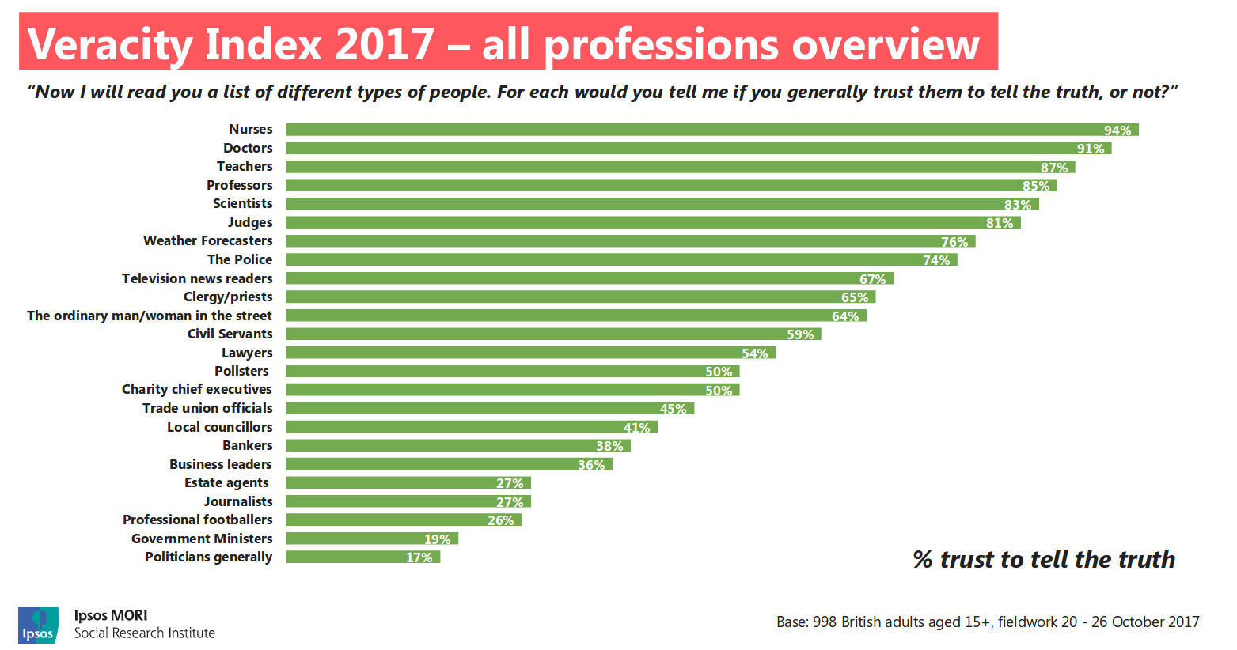

Slide 22
And finally…
We all know that science has huge positives to offer - we need to help people to access these
Think about what the ideal workshop would look like – you are the people who could roll this model out → 25 JAN 2019!

