Slide 1
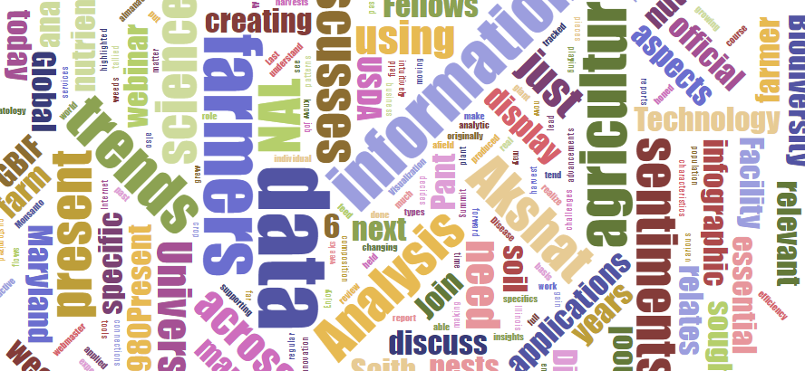
Data Science & Agriculture
Shivam Saith
Akshat Pant
US Department of Agriculture
National Agricultural Library
22 May 2018

Slide 2
Gap Assessment of Accessible Agrobiodiversity Data using GBIF and the NAL Thesaurus
Developed by: Akshat Pant
Advised by: Cynthia Parr, Adam Kriesberg

Slide 3
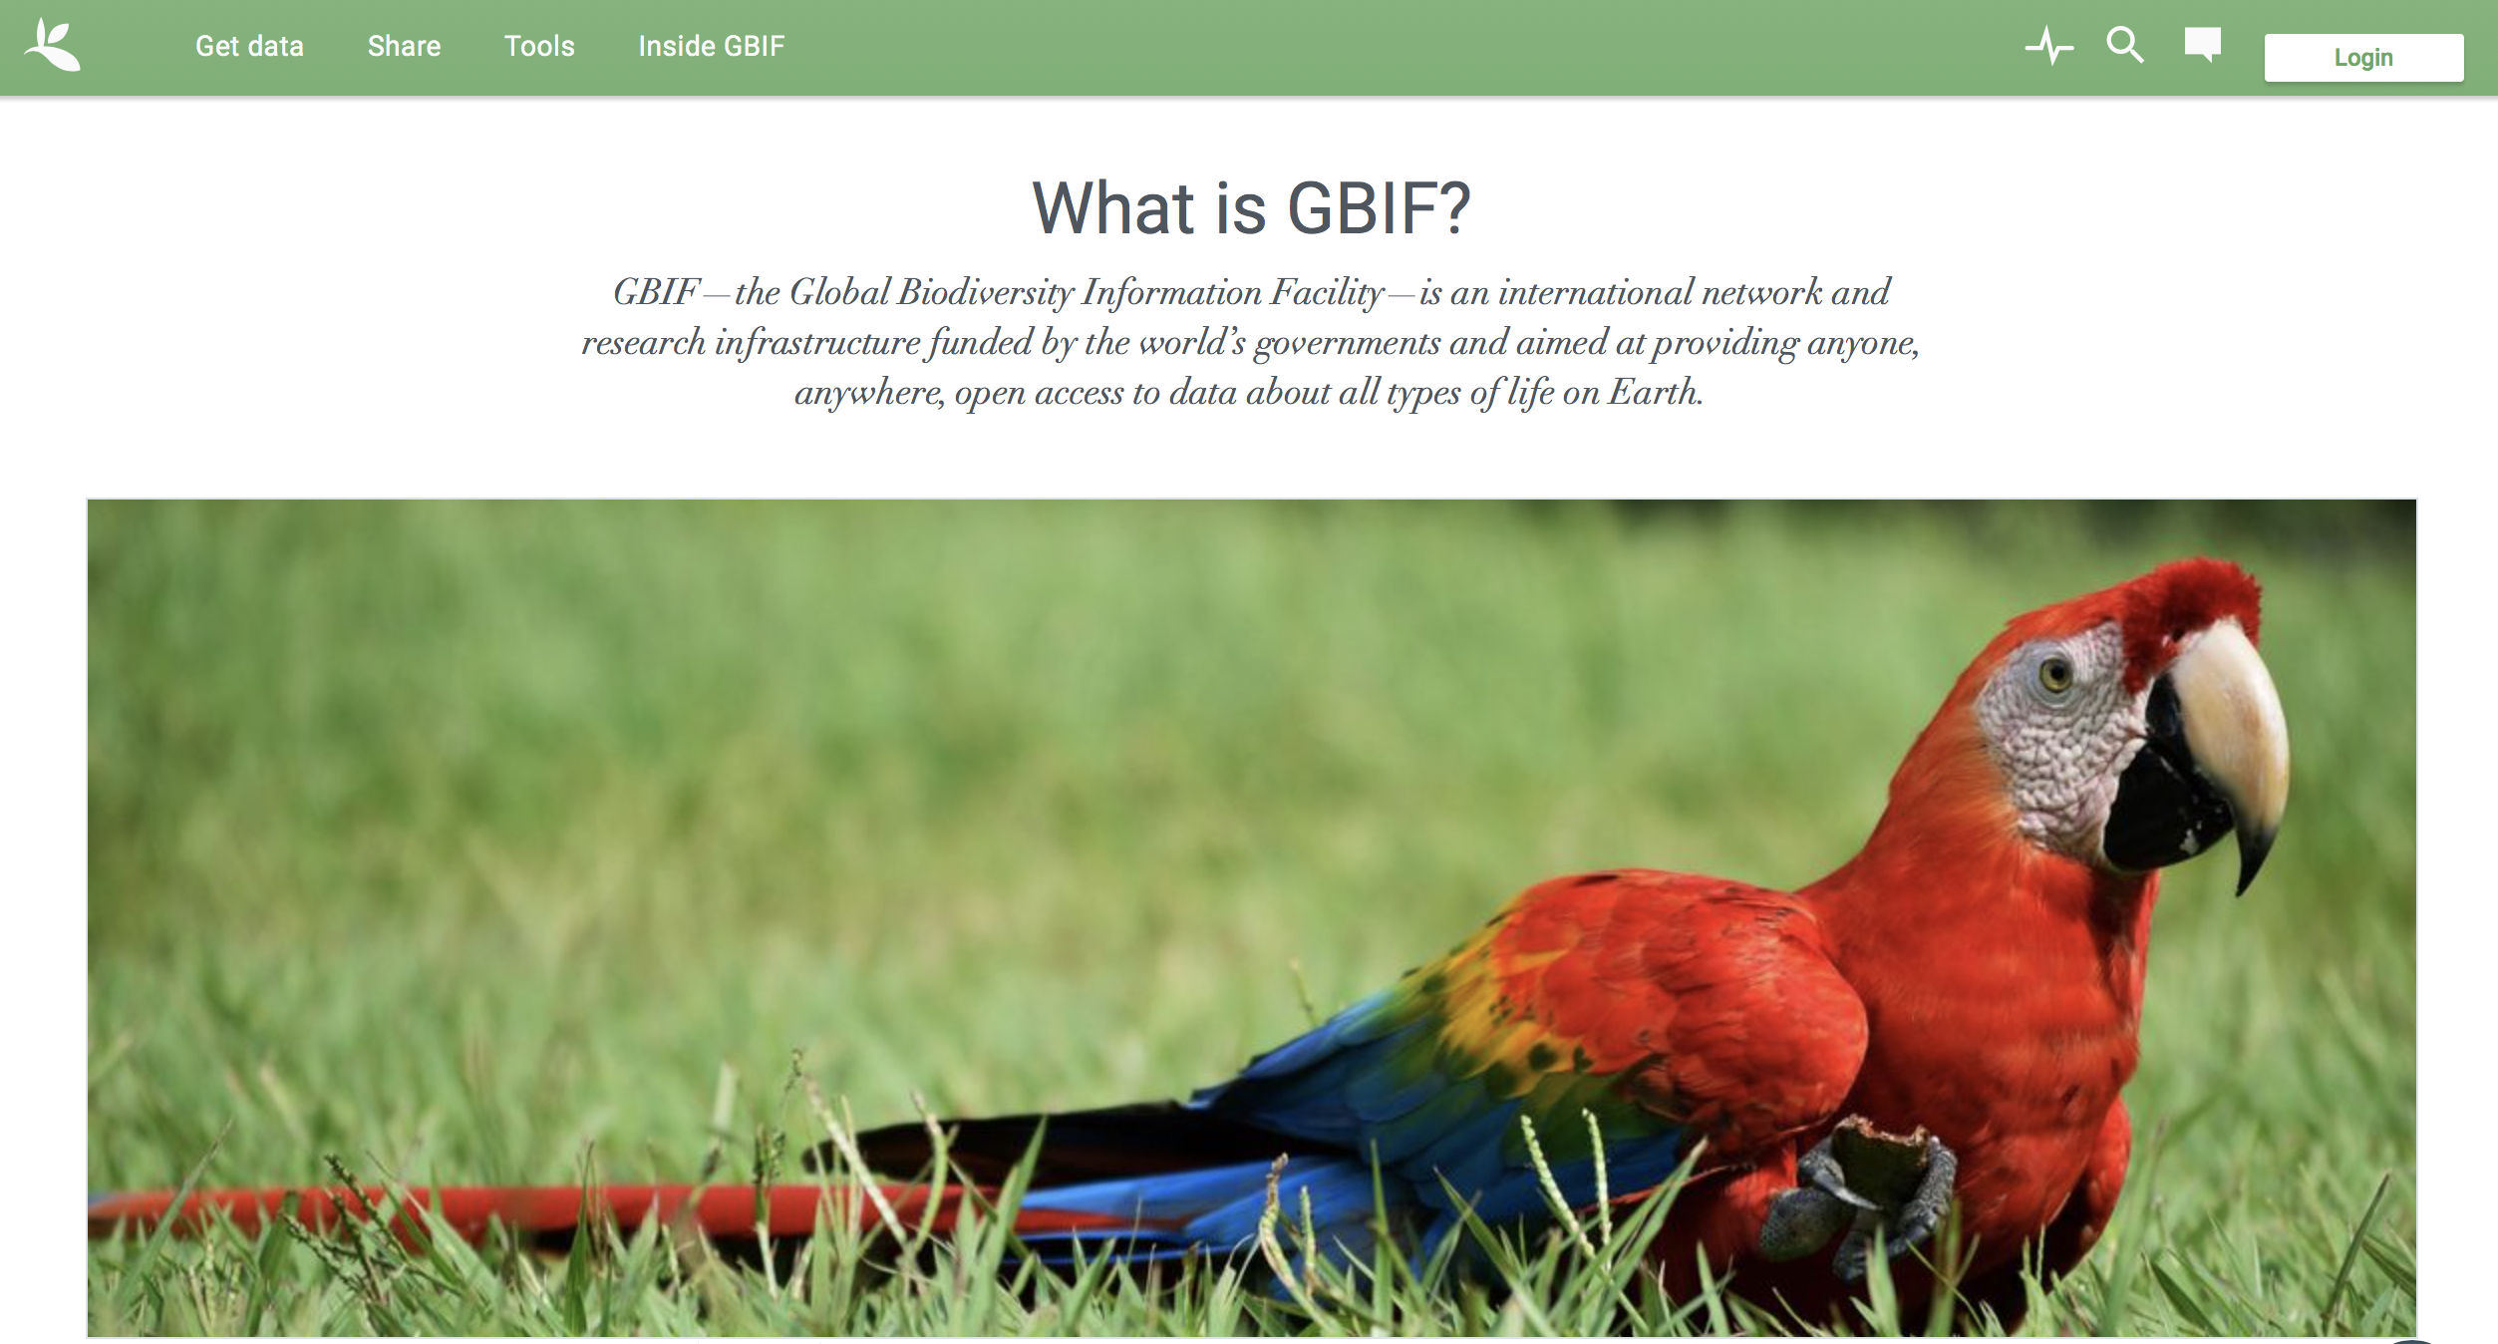
Global Biodiversity Information Facility (https://www.gbif.org)
International network and research infrastructure
Open access to data about all types of life on Earth
Information about where and when species have been recorded: occurrences such as museum specimens and citizen science observations
Includes some limited agricultural data such as germplasm records
Metadata like genus, species, family, scientific name, decimal latitude, decimal longitude, year and more.

Slide 5
GBIF provides metrics on their overall corpus

Slide 6
NAL Thesaurus
https://agclass.nal.usda.gov/
Online vocabulary tools
First released by the National Agricultural Library in 2002
In-depth coverage of agriculture, biology and related disciplines
Used to index scholarly articles
Contains over 135,000 terms
Examples: Tillage, Zea mays, carbon nitrogen ratio
Fields like broader term (parent), narrower term (child), RDF format, persistent URI
Notes:
The Thesaurus and Glossary are online vocabulary tools of agricultural terms in English and Spanish and are cooperatively produced by the National Agricultural Library, USDA, and the Inter-American Institute for Cooperation on Agriculture as well as other Latin American agricultural institutions belonging to the Agriculture Information and Documentation Service of the Americas (SIDALC).
The Agricultural Thesaurus and Glossarywere first released by the National Agricultural Library in 2002. In 2007, NAL and the Inter-American Institute for Cooperation on Agriculture (IICA) collaborated to develop the Spanish version of the NAL Agricultural Thesaurus. In depth coverage of agriculture, biology and related disciplines. Contains over 135,000 terms.
Data like taxonomic rank, broader term (parent), narrower term (children), Rdf/XML format, persistant uri (links to that organisms webpage.)

Slide 7
Scientific names in NAL Thesaurus will represent “agriculturally relevant organisms”
Over 50,000 of the 135,000 NALT terms are organism names
These are a subset of the overall organisms in the world
Names are included in NALT if:
Many hits on AGRICOLA (millions of citations relating to the field of agriculture)
Sometimes entire groups are included if some members of the group have high numbers of hits in AGRICOLA
We focus on ~22,000 species-level names to keep the analysis manageable and also because above that level is too broad

Slide 8
Goals
Get some descriptive statistics about Agrobiodiversity Data (AgData) in GBIF
Create visualizations to view occurrence trends of the GBIF corpus and AgData in GBIF to determine gaps or biases
Provide examples of and code for how agricultural researchers can work with GBIF data

Slide 9
Questions
1. How many different species in NALT have occurrences in GBIF?
2. Which are the most and least common agricultural species in GBIF?
3. What is the temporal trend of the occurrences in the overall GBIF corpus?
4. How does it compare to the temporal trend of agriculturally relevant occurrence data?
5. What is the geographic distribution of the overall GBIF corpus compared to the geographic distribution of ag relevant occurrences?
Notes:
How many different species in NALT have occurrences in GBIF (% of the total NALT sample, % of total GBIF species)
Which are the most common agricultural species in GBIF? (Which have the most occurrences? How many have only a small count?)

Slide 10
Technologies Used
Python was used for all the data analysis
Jupyter notebook run through Anaconda
Tableau was used to create visualizations
Packages used are pandas, requests and more
Pandas is used for data manipulation in python
Requests and json libraries used to interact with the GBIF API

Slide 11
94 percent of species in the NAL Thesaurus have occurrence records in GBIF
NALT
GBIF
Each species in NALT has 18855 occurrence records in GBIF on average

Slide 12
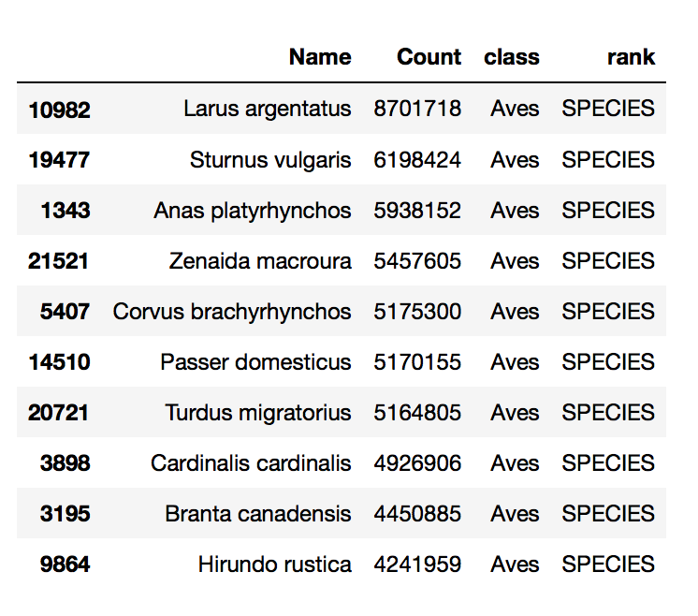
The most common agricultural species in GBIF are all birds
Each species in NALT has 18855 occurrence records in GBIF on average
Notes:
Challenges: Using api with nalt names (used exception handling

Slide 13
The least common agricultural species in GBIF are insects and microbes

Slide 14
Most of the occurrence counts are in the range 1-1000 followed by 1001-2000

Slide 15
Occurrence data in the overall GBIF corpus is increasing exponentially over time
Notes:
Explain about the logarithmic axis. How it translates to exponential increase.
Reason could be technological advances and increased accessibility of image capturing devices, increase in accessibility of different regions of earth.

Slide 16
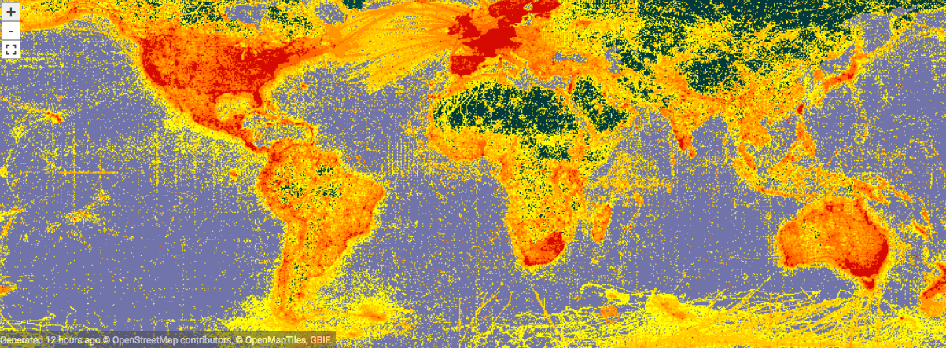
Challenges for remaining analyses
Need to adjust for the GBIF bias in bird citizen science
Need to improve queries so the results have effective latitude and longitude data
Need to decide on a good way to show the geospatial differences OR
Need to visualize the AgData in a similar way to the overall GBIF corpus
Notes:
Challenges: Getting the lat long values. Unusual format of the csv download from gbif.

Slide 17
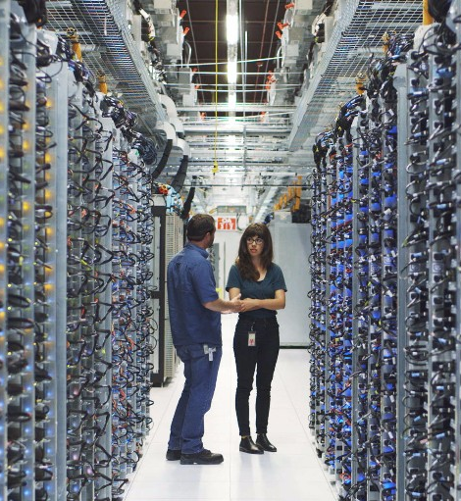
SCINet
Further analyses will be computationally intensive and so I plan to take advantage of Agriculture Research Service’s high performance computing platform called SCINet
This is a high performance computing infrastructure for ARS researchers
Designed to enable large-scale computing and large-scale storage

Slide 18
Conclusion
Most of the species in NAL Thesaurus have occurrence data in GBIF
Most of the species have vey little data
Occurrence records of GBIF corpus have increased exponentially with time
Python is a versatile language, suitable for both web scraping and data analysis.
This approach is going to be useful in answering the remaining questions and will provide some guidance for people interested in using GBIF for agricultural analysis.
It will also highlight where data are missing from GBIF: gaps may be filled by indexing data from agricultural records or by accounting for biases
Future work can include below species occurrence like particular cultivars or varieties.

