Slide 1
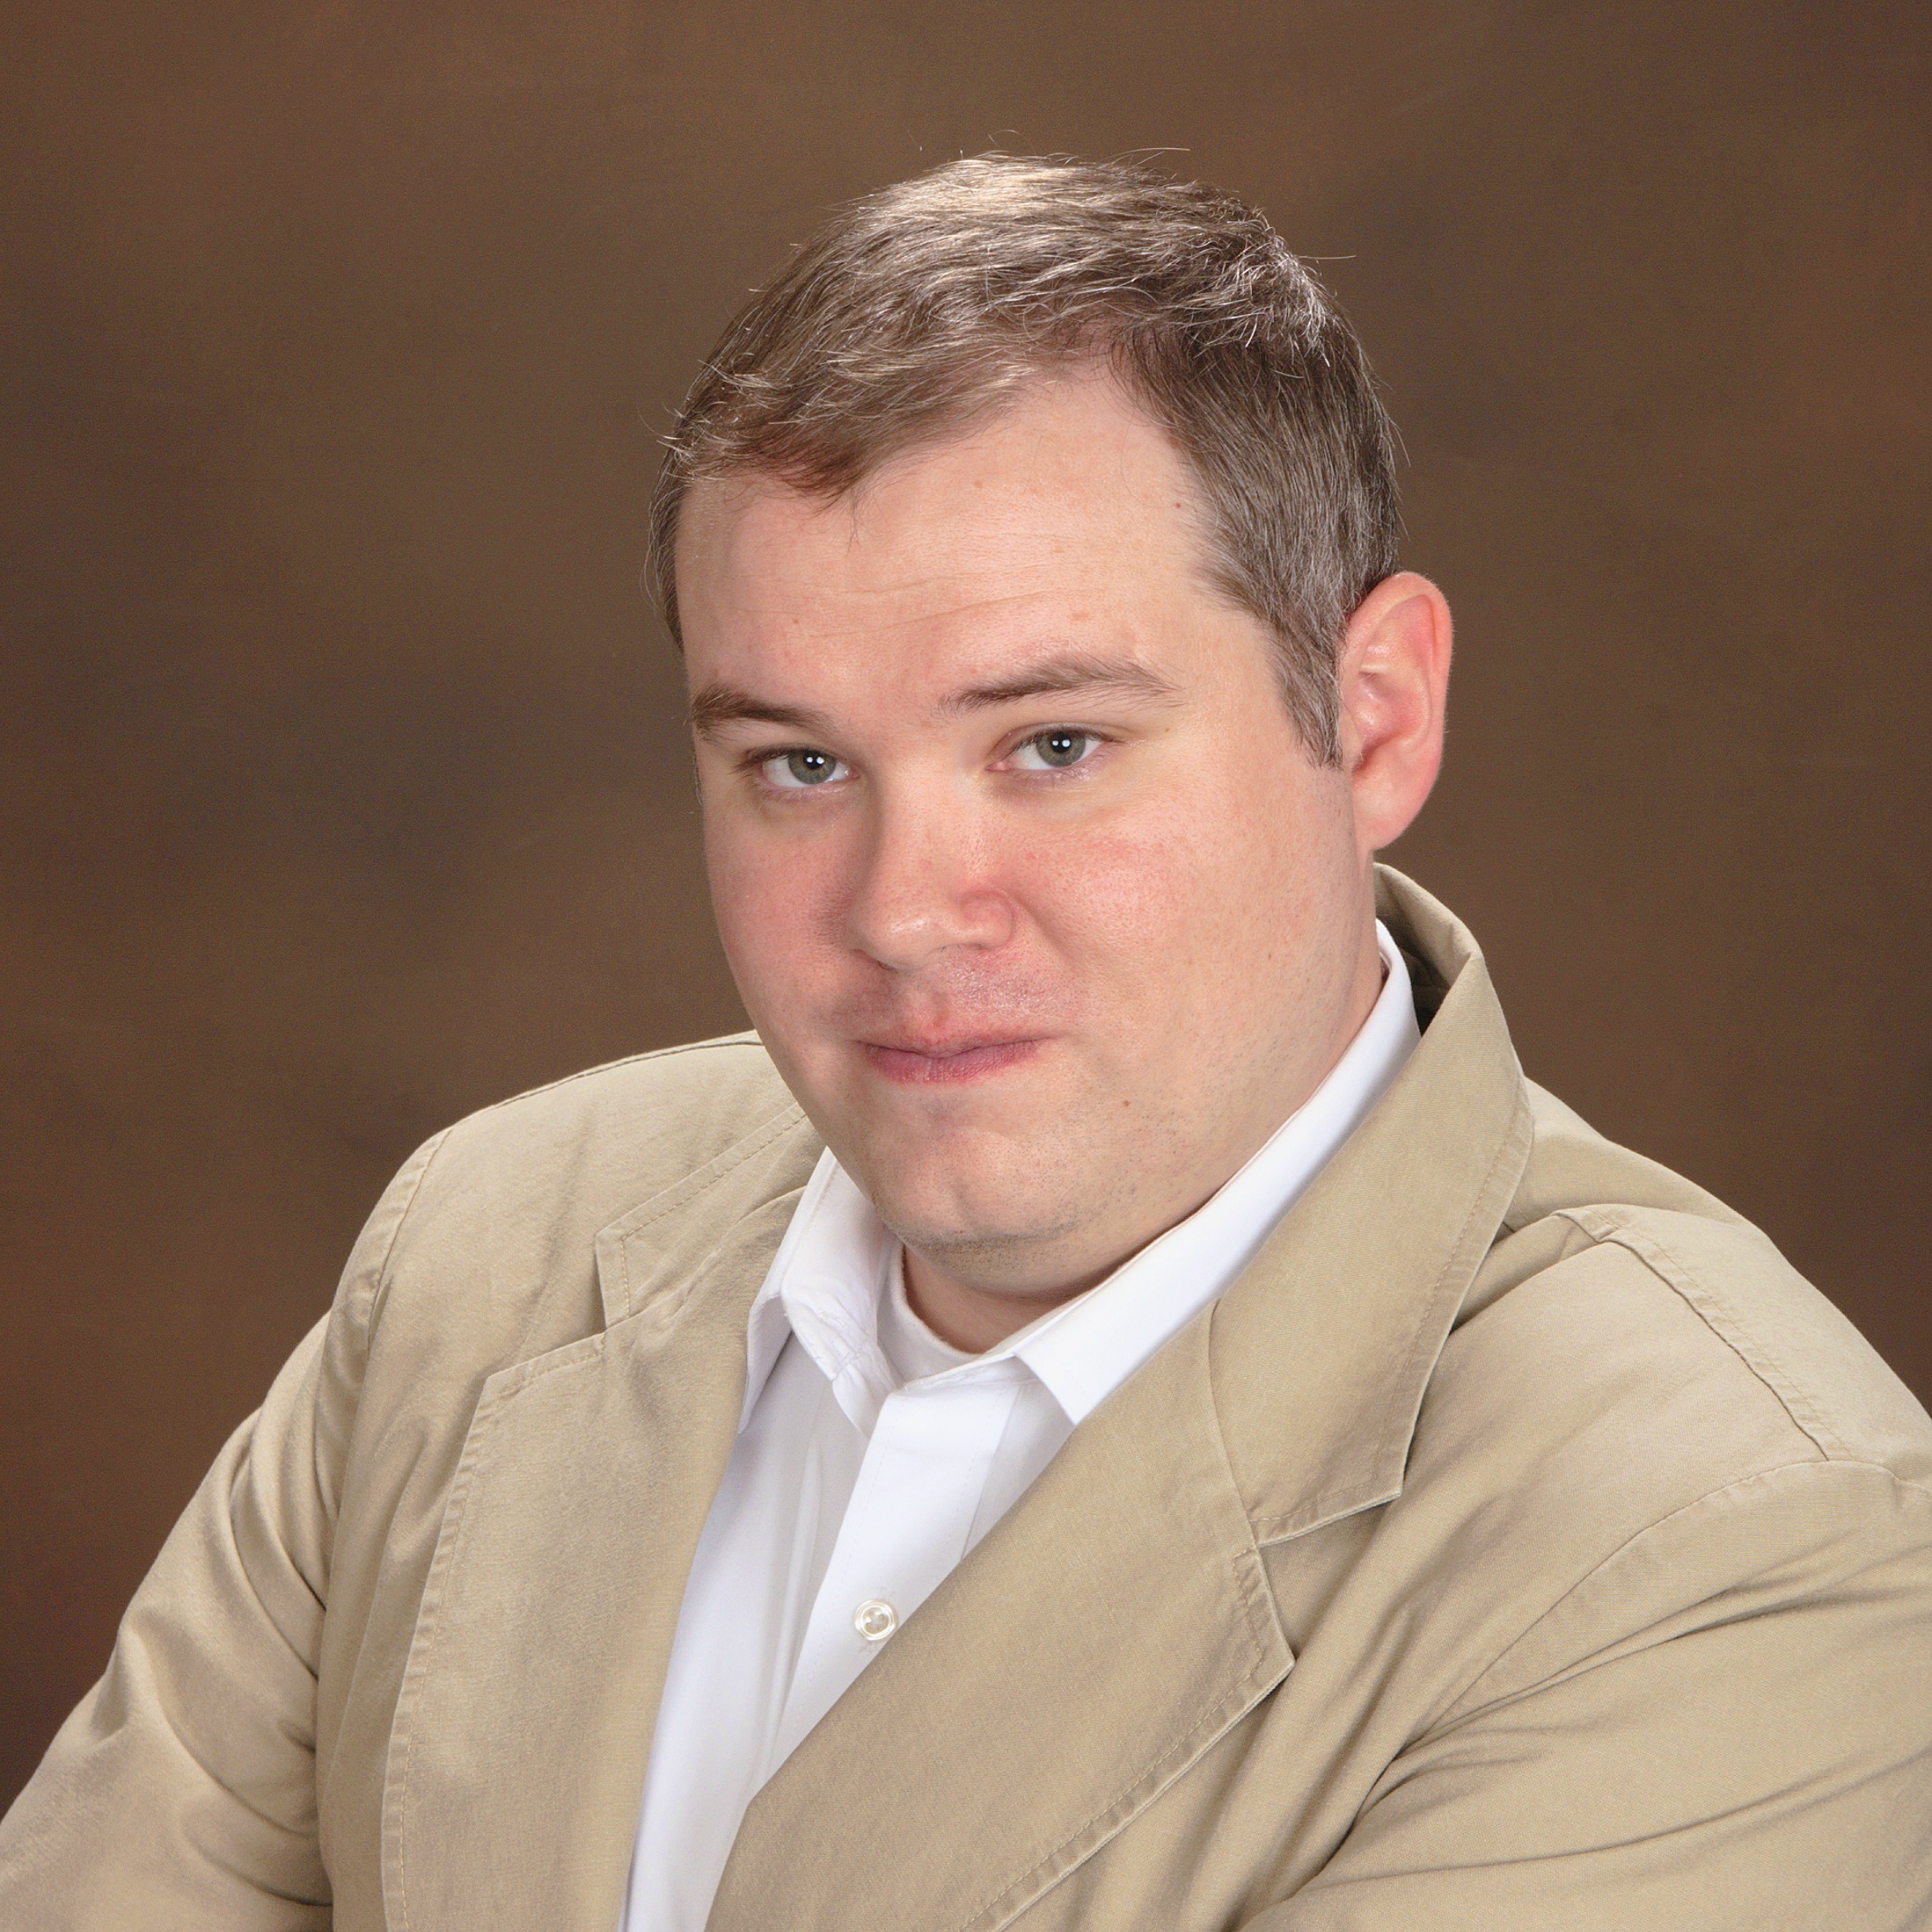
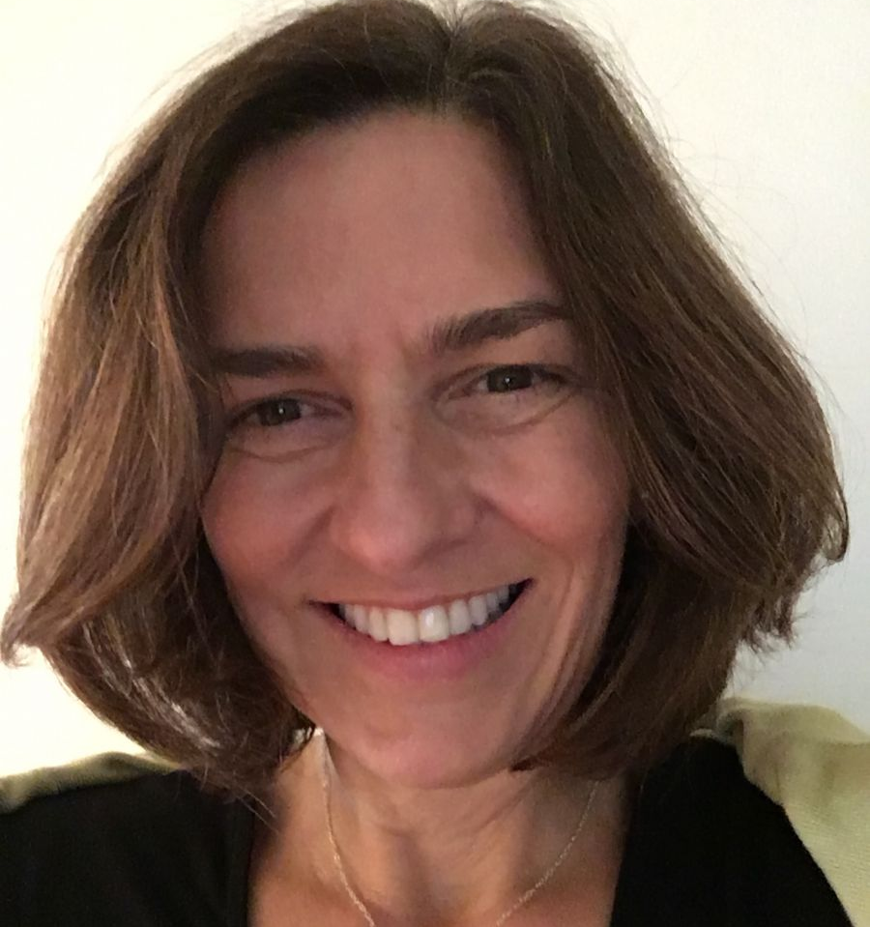
SPEAKERS
Eric Olson
Membership Specialist, North America
https://orcid.org/0000-0002-5989-8244
ANA VERA WYNNE
Community Manager, North America
https://orcid.org/0000-0002-9810-2894
ORCID: Enter Once | Reuse Often
What does this mean to Research Institutions?
ORCID Webinar | july, 2018
Notes:
I am Laura Paglione, the Director of Strategic Initiatives at ORCID, and I welcome you to this webinar. Also here is my colleague, Eric Olson from ORCID’s community engagement team.
The information that we have prepared for today is primarily geared toward US-based research institutions that are not currently ORCID members. While we know that some of you are not from this audience, most of the information that we’ll share is general enough to apply to any organization. In addition, we will have time for Q&A at the end for anything that isn’t covered. Finally, we both will be available to set up follow up sessions with anyone who may have questions specific to their organization, or who want to continue the conversation.
Some housekeeping
we will NOT be recording this session, though we will be doing this webinar again next week, and in the future.
These slides will be available at the conclusion of this webinar – you will receive an email that will include a link to the slides.
Everyone’s microphone is muted during the presentation, though you are welcome to type questions into the chat window at any time, or please feel free to click on the button in your console to raise your hand, and we can unmute you so that you can ask your question.
In addition to the Q&A session at the end, we will pause throughout the presentation to answer questions that have come up so far.
We’ll be spending the next 40 min or so talking about ORCID and how ORCID’s offerings can help address some challenges that research institutions often face. We’ll also talk about new initiatives that national funders, including the US National Institutes of Health, are undertaking as early as next month, and how they may impact research institutions. We’ll wrap things up with information about ORCID membership, and the benefits that both ORCID members and non members enjoy.
Though, before we get into all of that, Eric and I thought it would be a good idea to learn a bit more about the challenges that you face.
[GOTOWEBINAR POLL #1: Which of the following challenges does your institution face? (check all that apply)
We have research information in many different systems
It is difficult to collect/track faculty research activities
We want to understand more about what alumni are doing
Research tracking/impact is increasingly important
We are concerned about inaccurate inst. affiliation claims]
Display results – provide comment about how the webinar will provide insight of how ORCID can help.

Slide 2
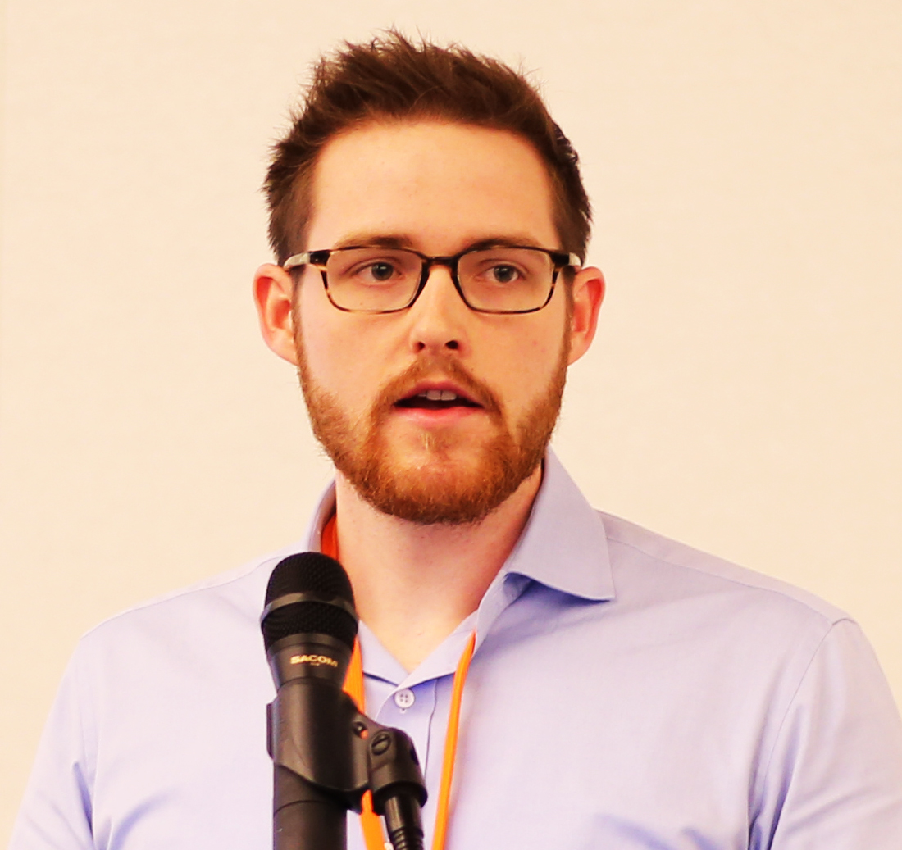
Guests
KIMBERLY KOWAL
Associate University Librarian, Digital Initiatives & Services
https://orcid.org/0000-0003-4659-2307
JOHN O’CONNOR
eScholarship Repository Librarian
https://orcid.org/0000-0002-0150-2083
ORCID at boston college
ORCID Webinar | july, 2018
Notes:
I am Laura Paglione, the Director of Strategic Initiatives at ORCID, and I welcome you to this webinar. Also here is my colleague, Eric Olson from ORCID’s community engagement team.
The information that we have prepared for today is primarily geared toward US-based research institutions that are not currently ORCID members. While we know that some of you are not from this audience, most of the information that we’ll share is general enough to apply to any organization. In addition, we will have time for Q&A at the end for anything that isn’t covered. Finally, we both will be available to set up follow up sessions with anyone who may have questions specific to their organization, or who want to continue the conversation.
Some housekeeping
we will NOT be recording this session, though we will be doing this webinar again next week, and in the future.
These slides will be available at the conclusion of this webinar – you will receive an email that will include a link to the slides.
Everyone’s microphone is muted during the presentation, though you are welcome to type questions into the chat window at any time, or please feel free to click on the button in your console to raise your hand, and we can unmute you so that you can ask your question.
In addition to the Q&A session at the end, we will pause throughout the presentation to answer questions that have come up so far.
We’ll be spending the next 40 min or so talking about ORCID and how ORCID’s offerings can help address some challenges that research institutions often face. We’ll also talk about new initiatives that national funders, including the US National Institutes of Health, are undertaking as early as next month, and how they may impact research institutions. We’ll wrap things up with information about ORCID membership, and the benefits that both ORCID members and non members enjoy.
Though, before we get into all of that, Eric and I thought it would be a good idea to learn a bit more about the challenges that you face.
[GOTOWEBINAR POLL #1: Which of the following challenges does your institution face? (check all that apply)
We have research information in many different systems
It is difficult to collect/track faculty research activities
We want to understand more about what alumni are doing
Research tracking/impact is increasingly important
We are concerned about inaccurate inst. affiliation claims]
Display results – provide comment about how the webinar will provide insight of how ORCID can help.

Slide 3
OUR AGENDA
What and who is ORCID?
ORCID at Boston College
ORCID for research institutions
Connecting to ORCID
ORCID Consortia
Q & A

Slide 4
Names are messy!

Slide 5
Pids for people, places, & things
Coming soon…
Onyar!

Slide 6
What is ORCID?
Notes:
Before we get ahead of ourselves, let’s back up for a moment and talk about ORCID in general.

Slide 7
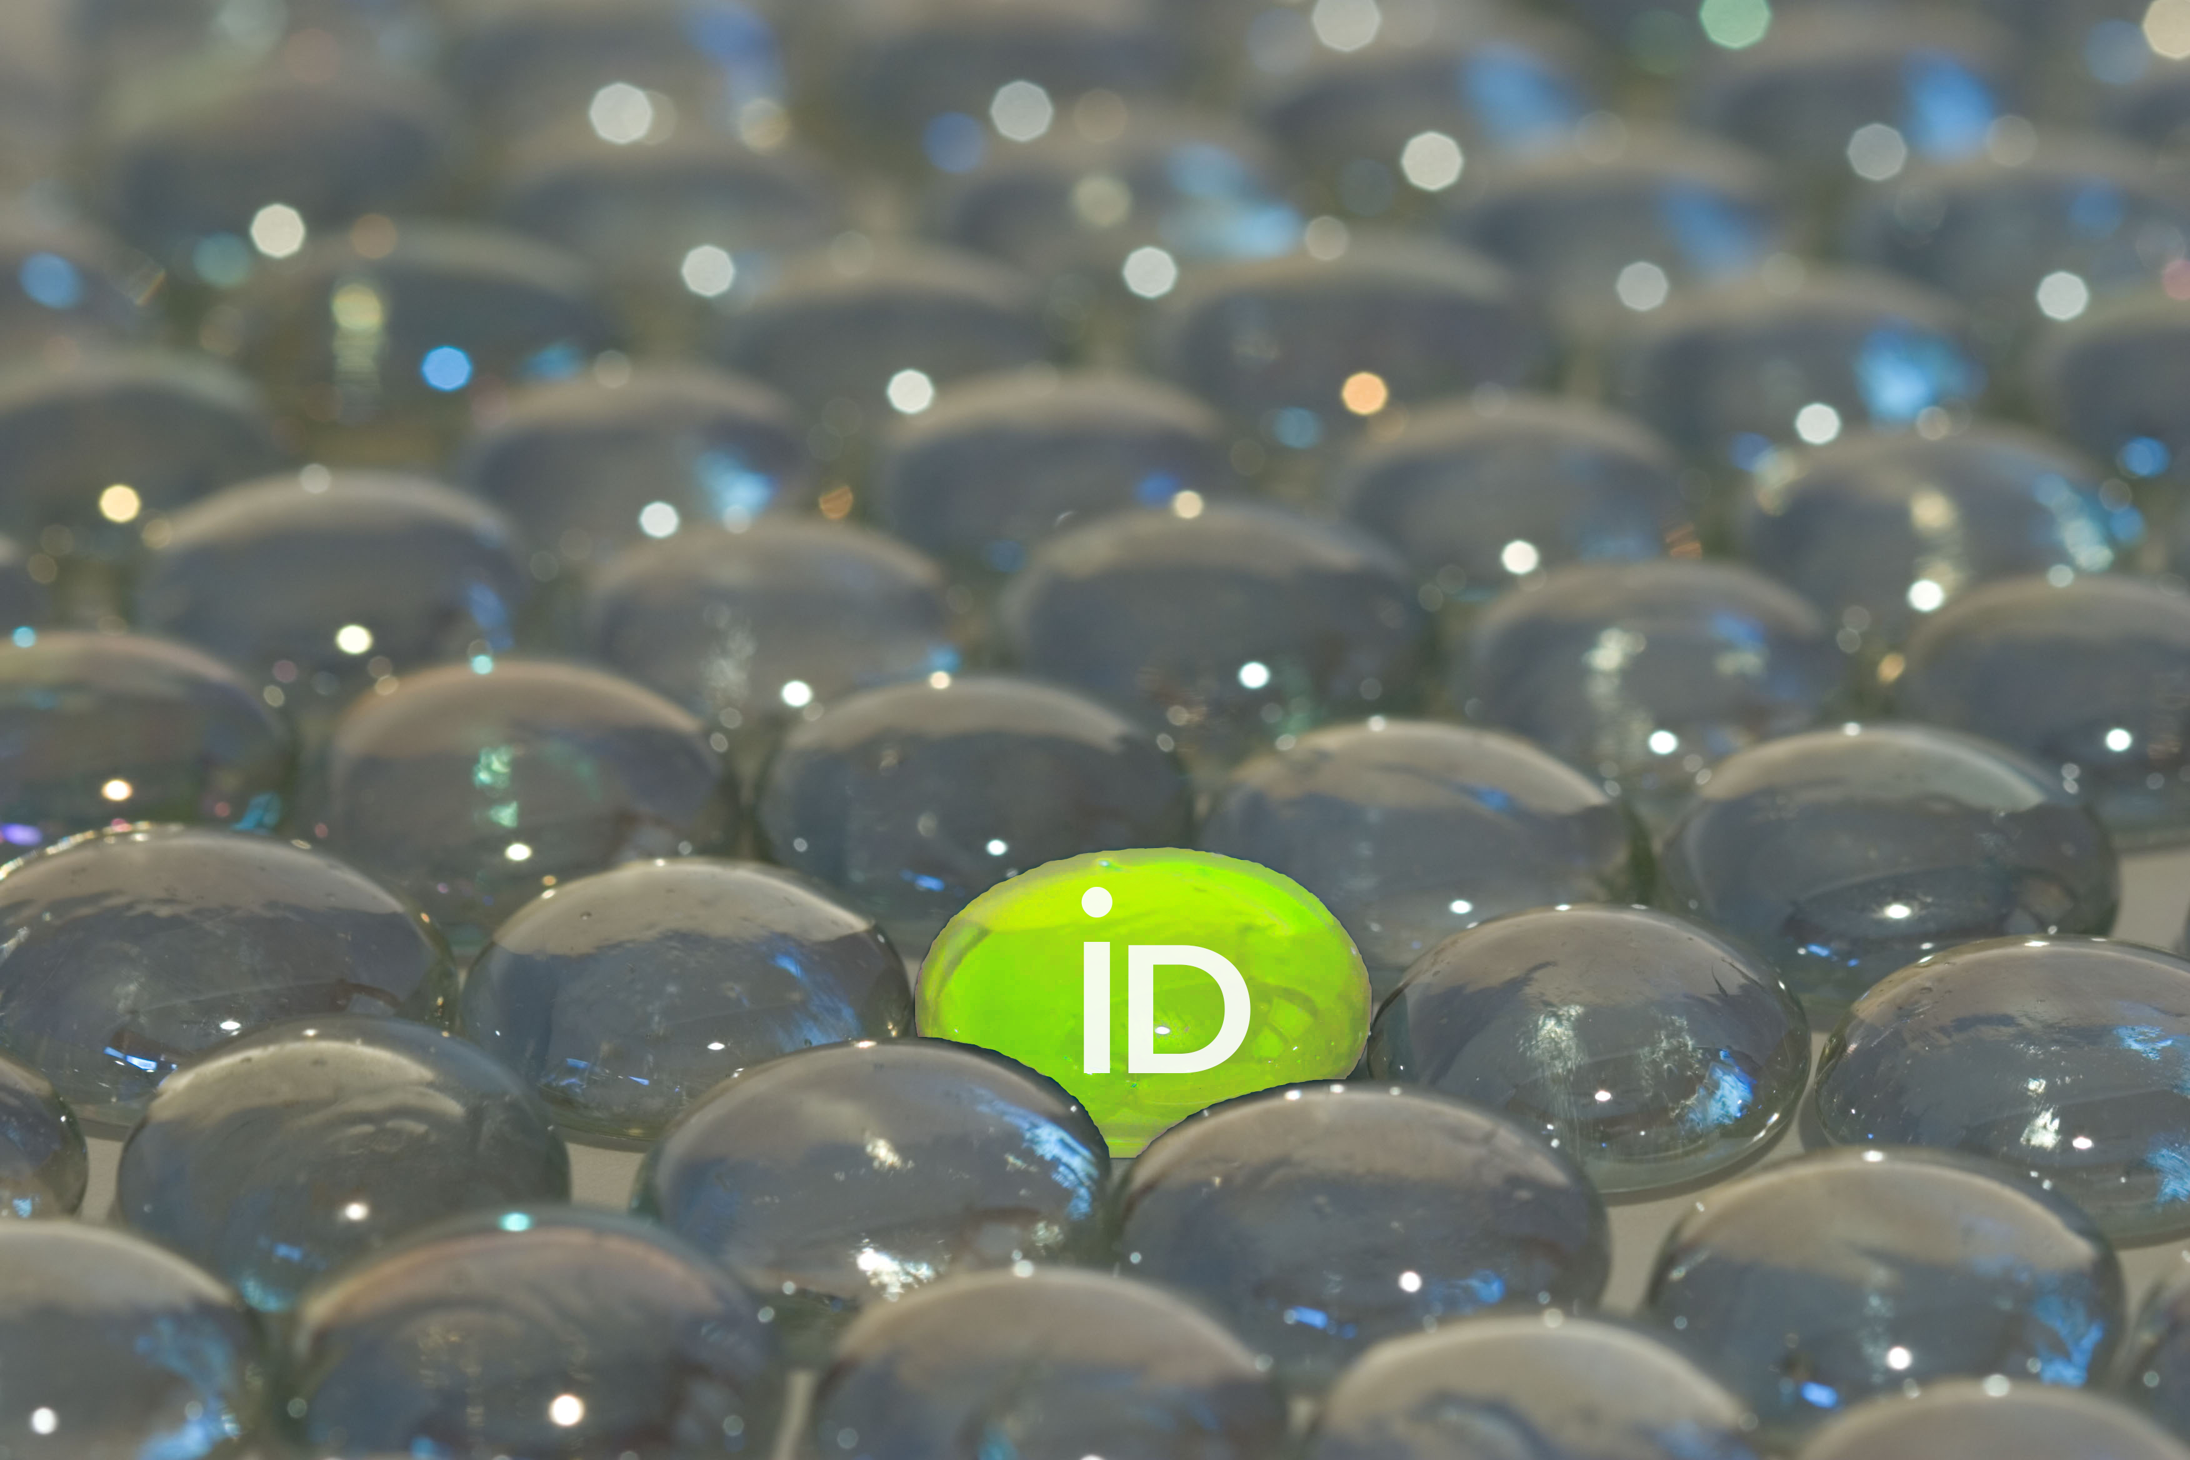
What is ORCID?
An identifier for researchers
A registry
A set of standard procedures (APIs) for connecting researchers to their affiliations and activities
A committed community building connectors
An international-scale open research effort
Notes:
ORCID is many things
We are an identifier for researchers. This 16-character identifier can be used by researchers and scholars with their name to uniquely identify them. It is free and easy to get, and stays with the person throughout his or her career. Throughout this presentation we will refer to the identifier as the ORCID iD, which is our preference, though occasionally you may hear people talk about the identifier as the “ORCID”
ORCID is a registry. We provide an online registry for researchers to obtain an ORCID iD. The registry also stores an ORCID record which includes references to activities associated with the individual’s ORCID iD, such as a grant award, a publication, a data set or a research institution affiliation. The use of the registry is also free to individuals, and there they are able to control the visibility and access to the information associated to their iD.
ORCID is a set of standard procedures, or APIs) for connecting researchers to their affiliations and activities. I mentioned the ORCID record that is contained in the registry with the iD. This record is generally populated by ORCID members using these standard procedures or APIs. This approach enables automated, machine-to-machine additions and updates of important research activity and affiliation information.
ORCID is a committed community that is building connectors. The machine-to-machine additions and updates are made possible through “connectors” that are built by member organizations and the system vendors that they use. With explicit consent from the individual researchers and scholars, the ORCID community is building a connected web of trusted information that can be reliably exchanged.
ORCID is an international-scale open research effort. We accomplish all of these things through collaboration among the international research community of individuals and organizations. Researchers enable this information flow, allowing for global exchange of information regardless of where they are and who they collaborate with.

Slide 8
WHY PERSISTENT IDs?
Challenges for the individual:
Multiple profile systems
Manual data entry
Administrative burden
No control of personal data
Name ambiguity
Recognition/credit
Challenges for the organisations:
Name ambiguity
Trust in metadata
Reporting latency
Silo systems
Return on investment
Discoverability

Slide 9
9
Notes:
In general, ORCID’s vision is a world where all who participate in research, scholarship and innovation and uniquely identified and connected to their contributions and affiliations across time, disciplines, and borders.

Slide 10
These connections matter because research progress, programs, and careers and based on the communication of ideas.
The connections are made possible by a network of partners working together with the purpose of improving how we share research information.

Slide 11
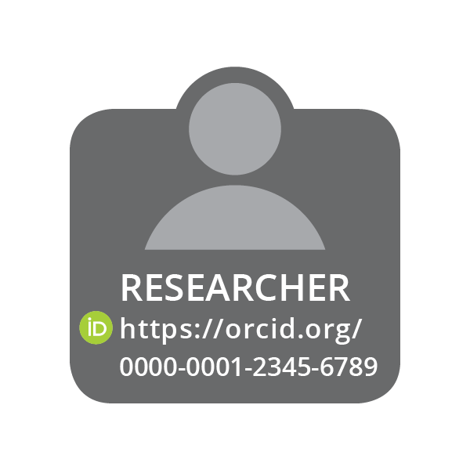
Cross-sector Partner Network
PUBLISHER
&
REPOSITORY
Assert authorship & data contributions
EMPLOYER
Assert faculty or staff affiliation
CONNECT
COLLECT
COLLECT
CONNECT
COLLECT
CONNECT
FUNDER
&
FACILITATOR
Assert grant, facilities, and equipment award

Slide 12
Sector ACTIONs
Trust and Assertion are key
Funders: COLLECT iDs at grant submission and review; DISPLAY with award; CONNECT grant IDs to researcher record; SYNCH updates
Universities/Organizations: COLLECT iDs for new staff and students, at thesis submission, in faculty profile systems; DISPLAY affiliation IDs; CONNECT organization iDs (education/employment); SYNCH updates
Publishers and Repositories: COLLECT iDs for authors, contributors, and reviewers; DISPLAY iD with work; CONNECT paper, dataset, review IDs; SYNCH updates
Note: ORCID stores paper metadata and pointers to them, We do not store papers.

Slide 13
Who is using ORCID?
~5m registrants
~900 organizational members
78% research institutions
50% Europe, 27% US/Canada
17 national consortia
43 countries
Over 560 live integrations
https://orcid.org/statistics
Notes:
Can get updated stats on our webpage https://orcid.org/statistics
Can get integration info from the website https://orcid.org/members or ask us directly

Slide 14
What are they using Orcid for?
~ 2m iDs with external identifiers
Person, organization, funding, works, peer review
2.5m+ education affiliations
31m+ works
12m+ unique DOIs
~1m works added via auto-update
~0.5m funding activities
~0.25m peer review activities
https://orcid.org/statistics
Notes:
Can get updated stats on our webpage https://orcid.org/statistics
Can get integration info from the website https://orcid.org/members or ask us directly

Slide 15
How does orcid work?
This is an example from the Environmental Molecular Sciences Laboratory. This is Phase 1 of a workflow that will allow them to assert the use of their facilities to researchers’ ORCID records. However, these first steps will be very similar for your systems.
Link

Slide 16
integration benefits
A robust ORCID integration brings many advantages:
More transparency and easier sharing
Researchers spend less time spent inputting information
Administrators spend less time verifying and checking information
Improved information quality and reliability

Slide 17
ORCID @ Boston College
Notes:
Before we get ahead of ourselves, let’s back up for a moment and talk about ORCID in general.

Slide 18
Boston College is a consortial member of ORCID (through NERL)
Integrations:
BC Create or Connect application
Faculty180 annual report software
eScholarship@BC
Lessons learned
Other possibilities
Notes:
One way to convince admin to pay for membership was because we needed access to API and that was only way to do so

Slide 19
BC Create or Connect application
University HR system (PeopleSoft)
Writing employment to ORCID profile
Writing ORCID to faculty profile

Slide 20
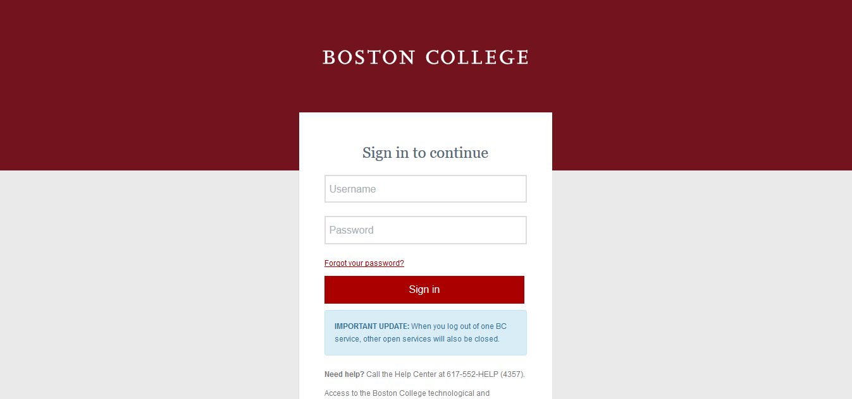

Slide 21
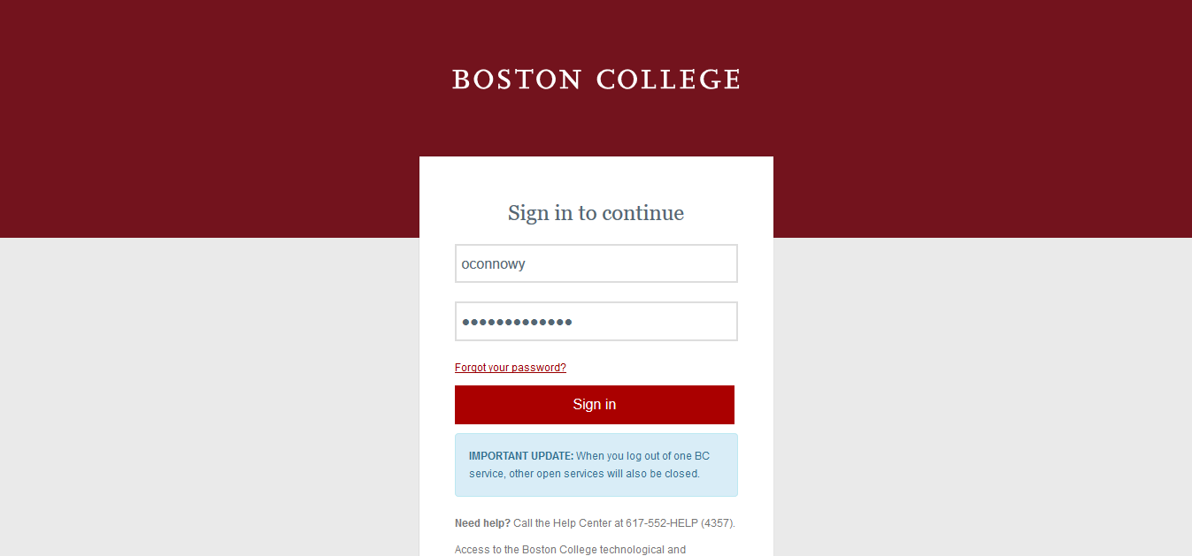

Slide 22
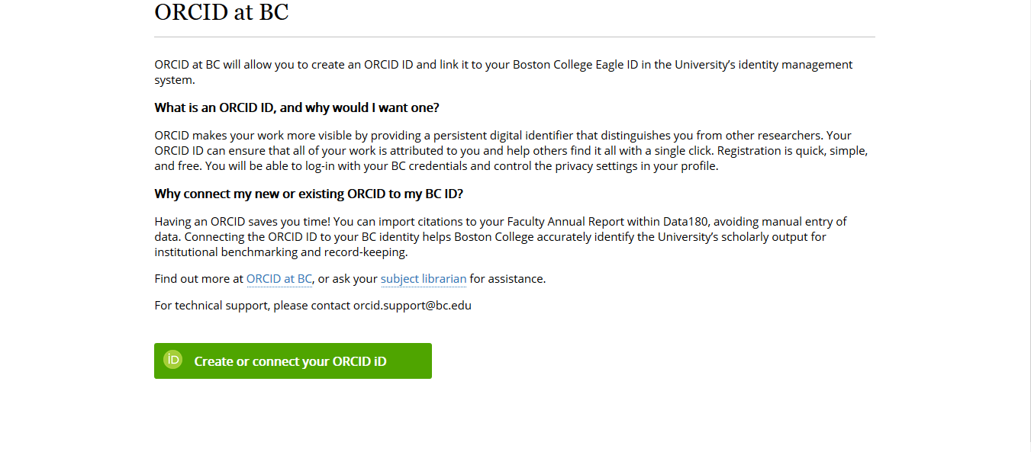

Slide 23
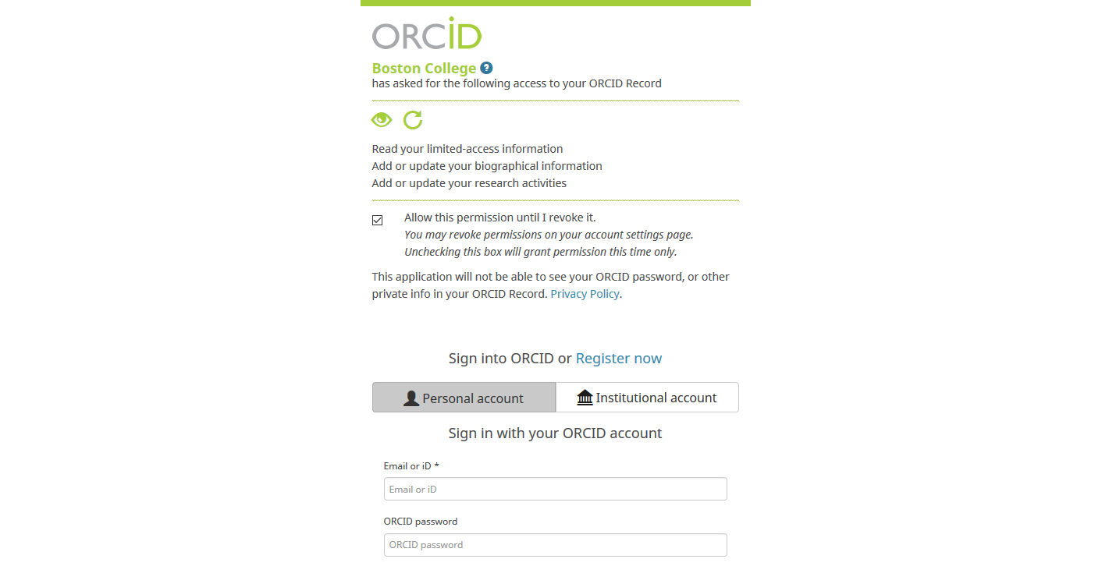

Slide 24
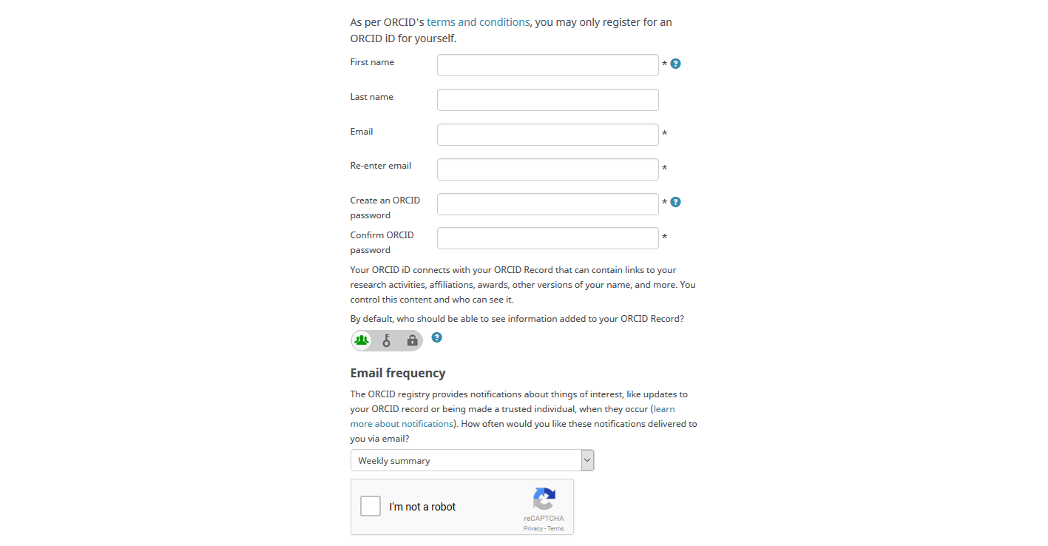

Slide 25
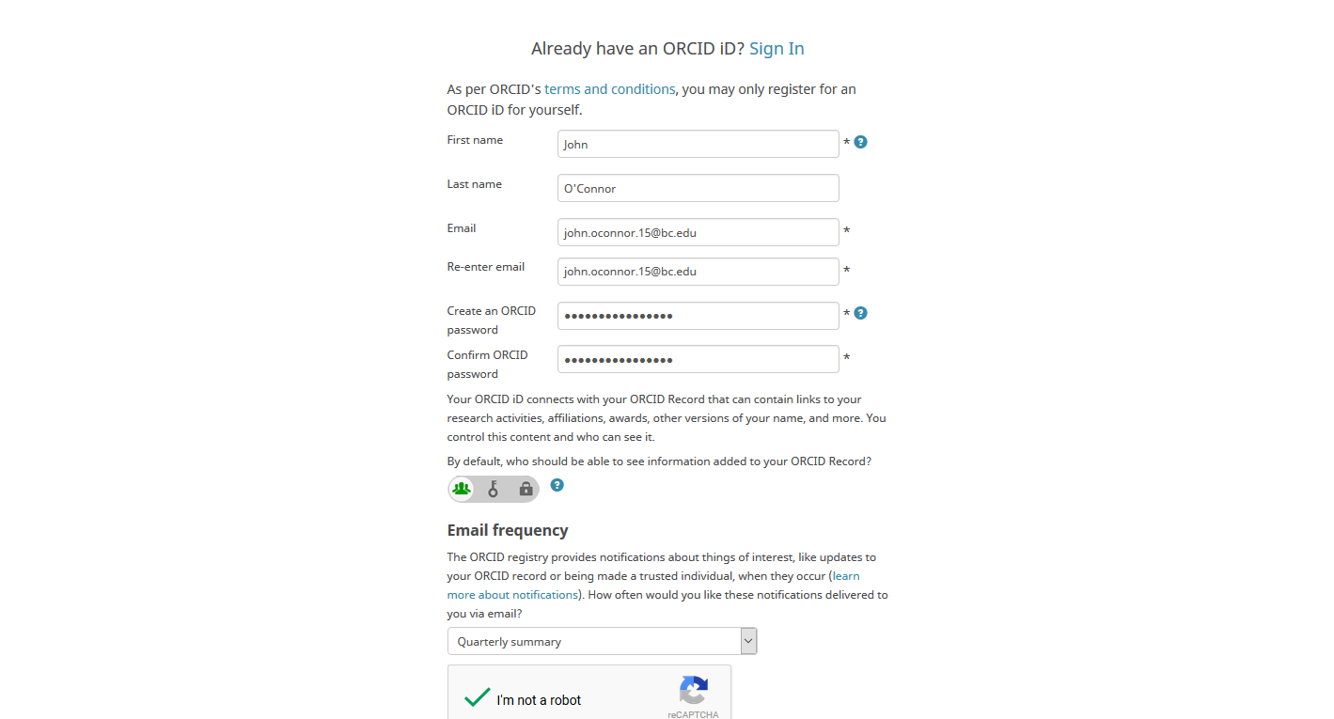

Slide 26
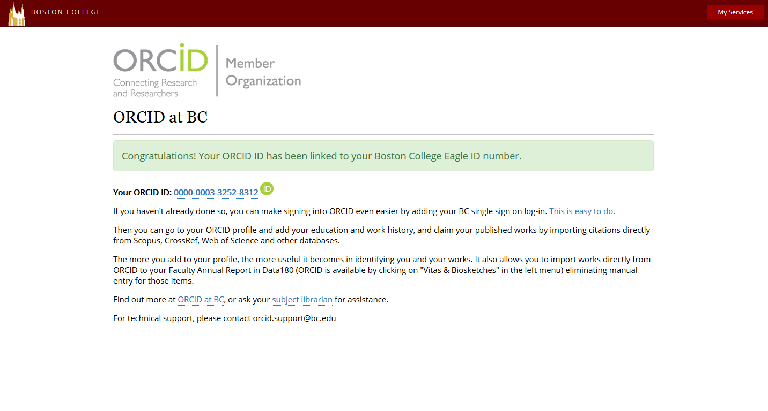

Slide 27
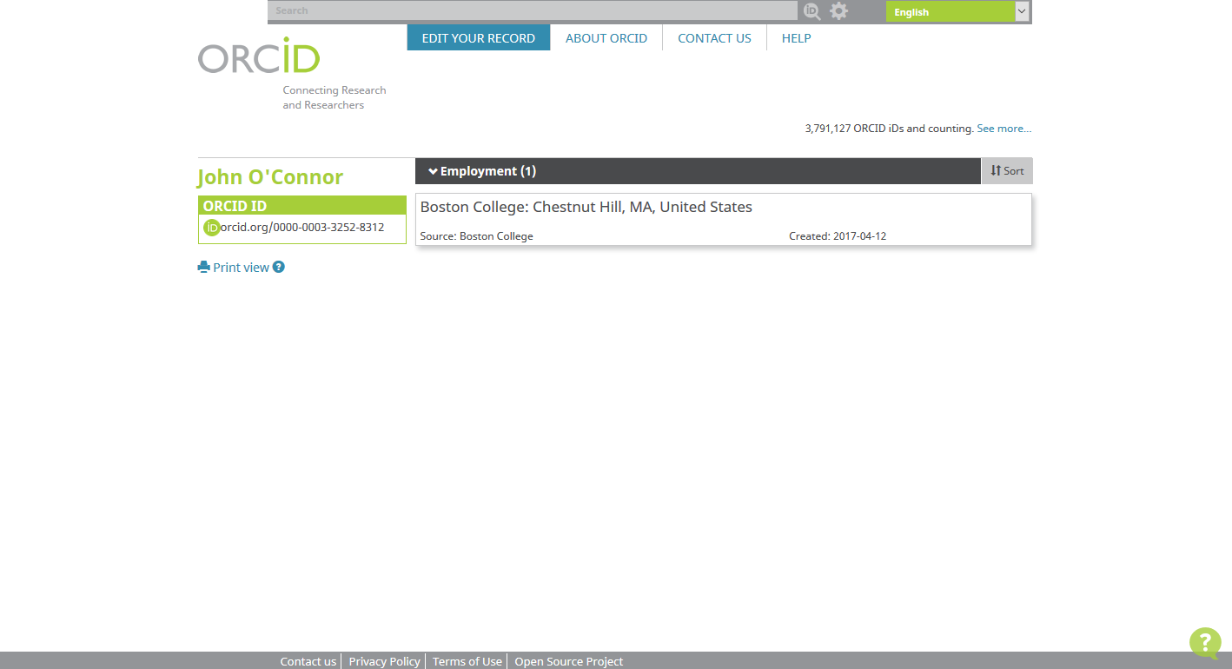

Slide 28
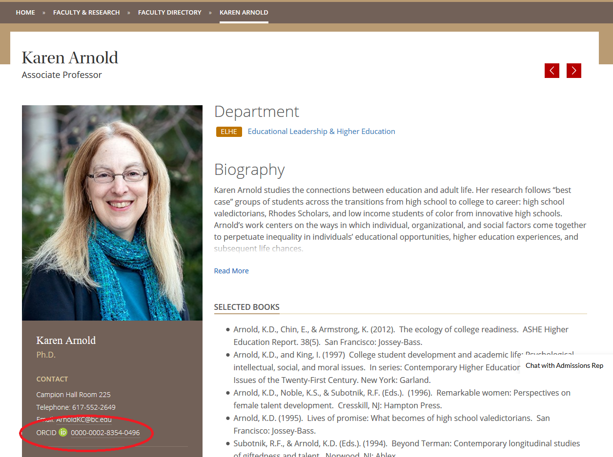

Slide 29
Faculty180 annual report software

Slide 30
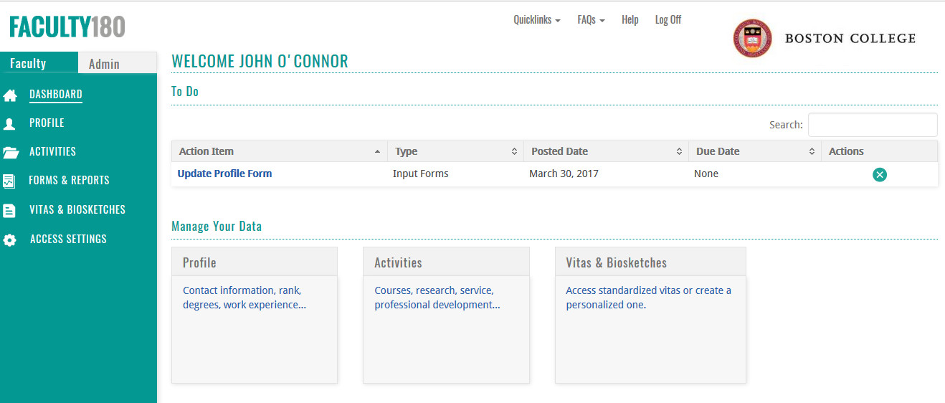

Slide 31
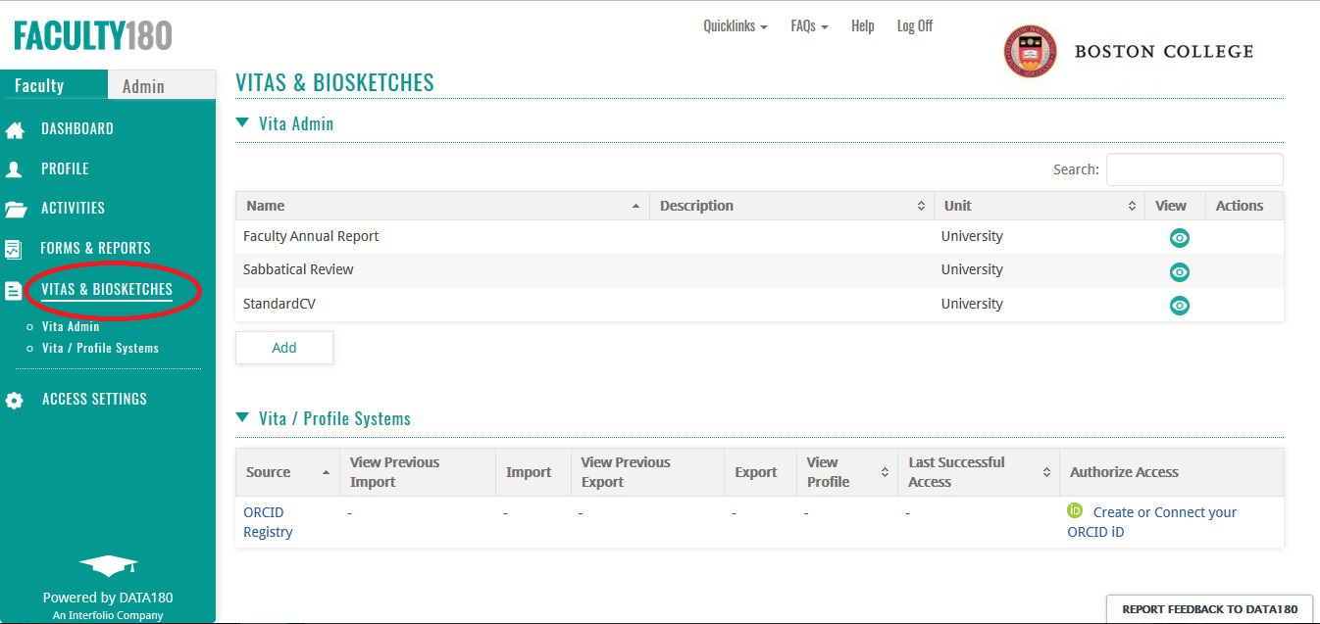

Slide 32
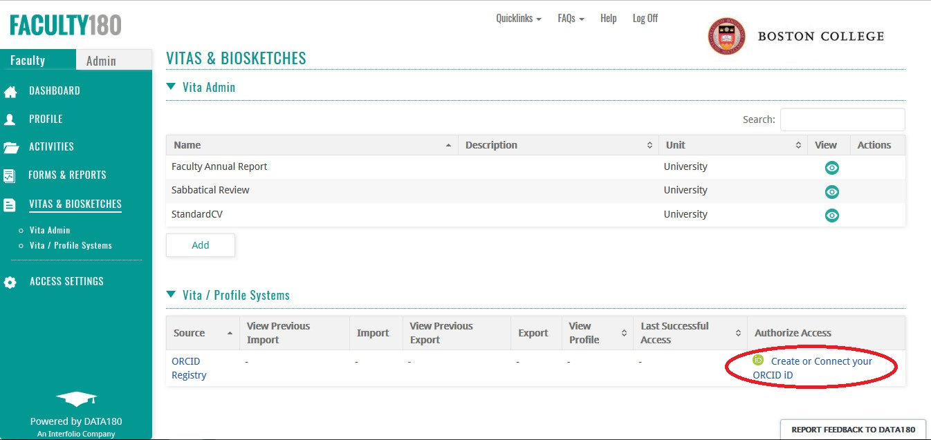

Slide 33
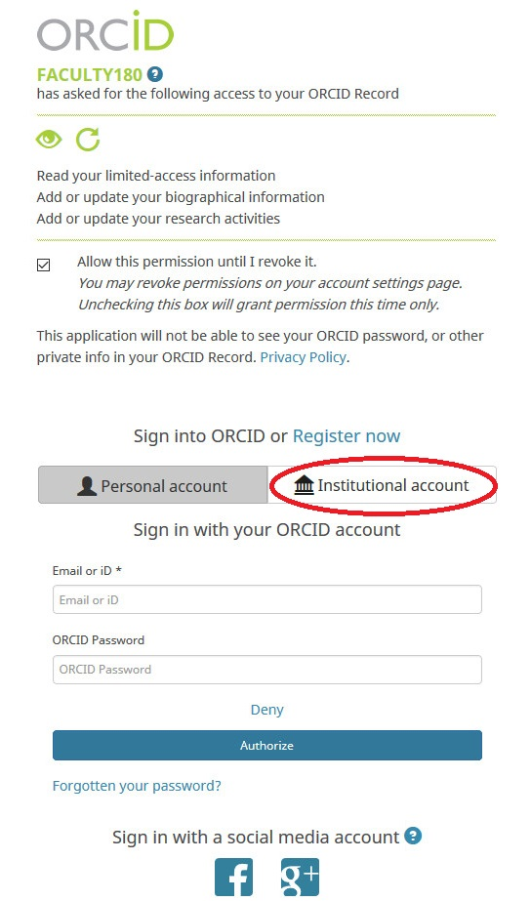

Slide 34
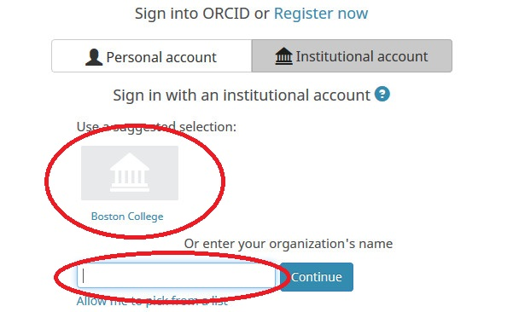

Slide 35
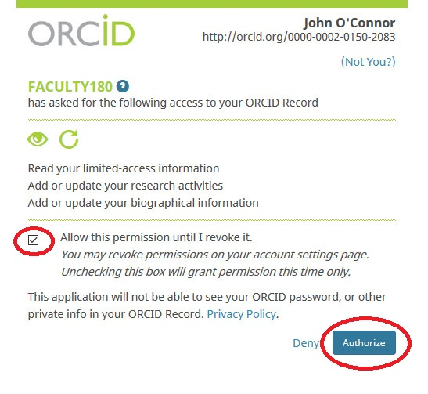

Slide 36
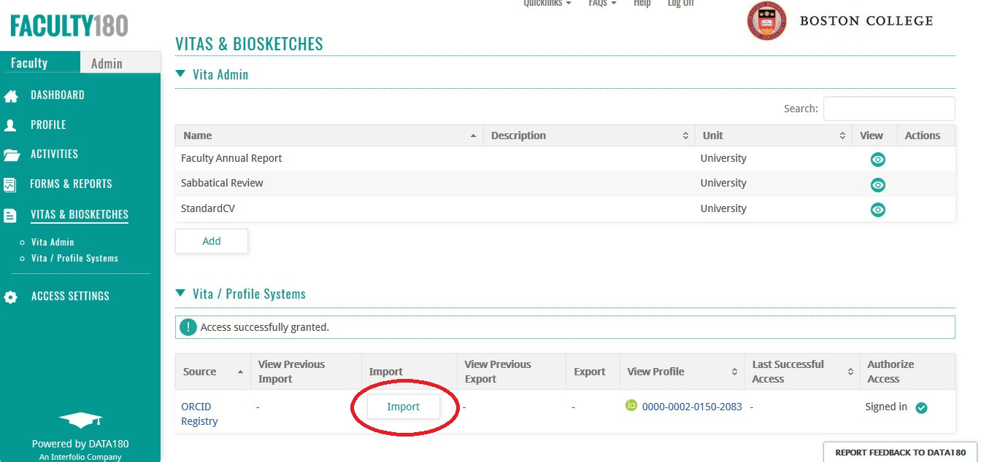

Slide 37
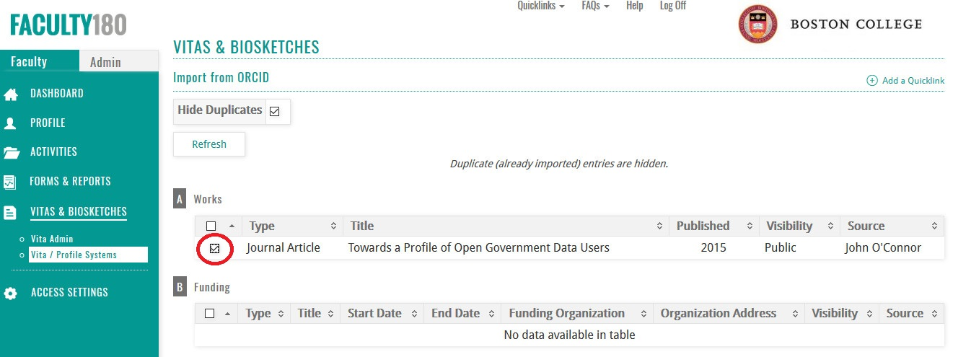

Slide 38
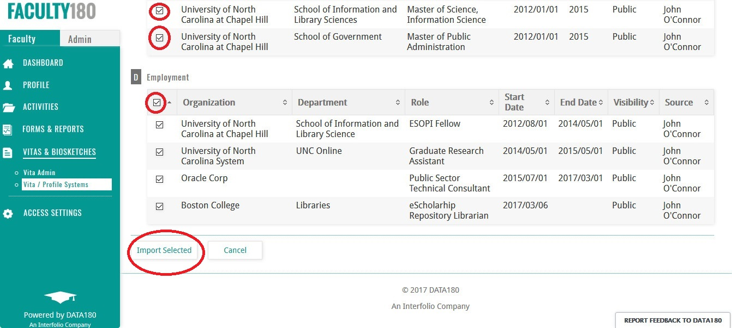

Slide 39
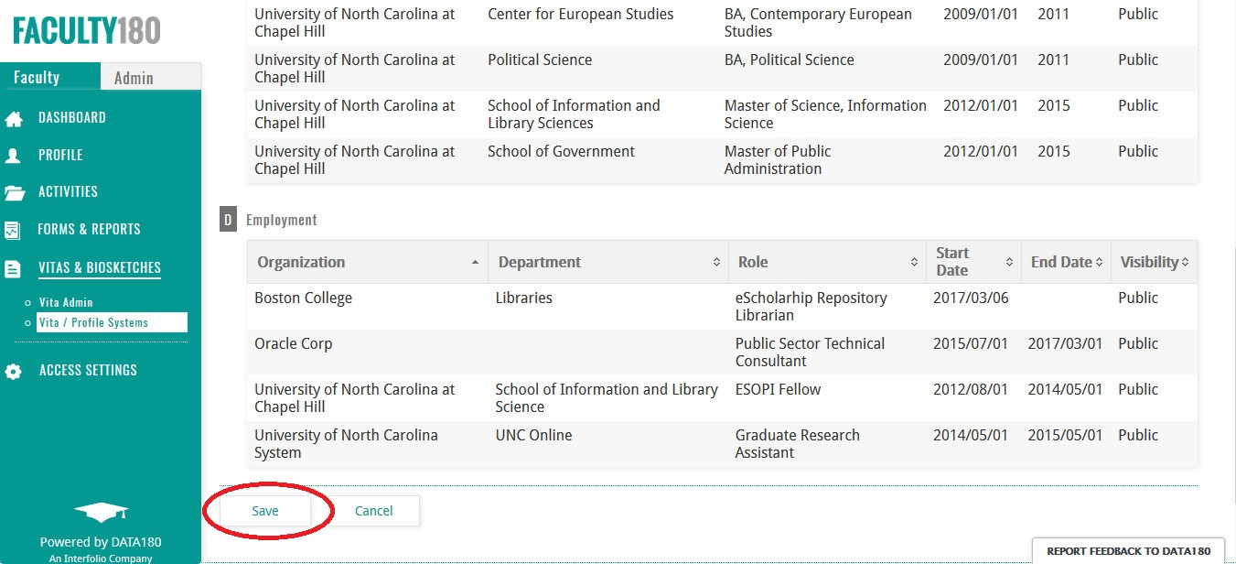

Slide 40
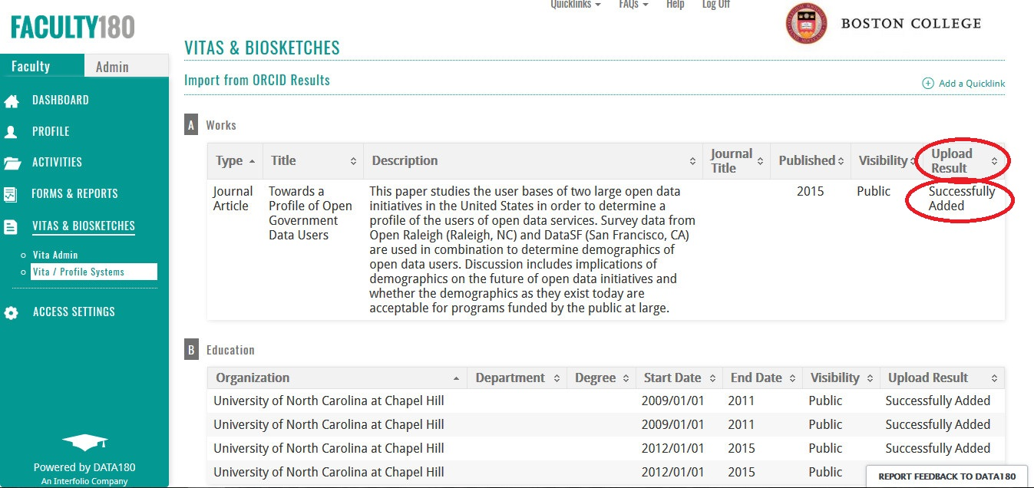

Slide 41
eScholarship@BC

Slide 42
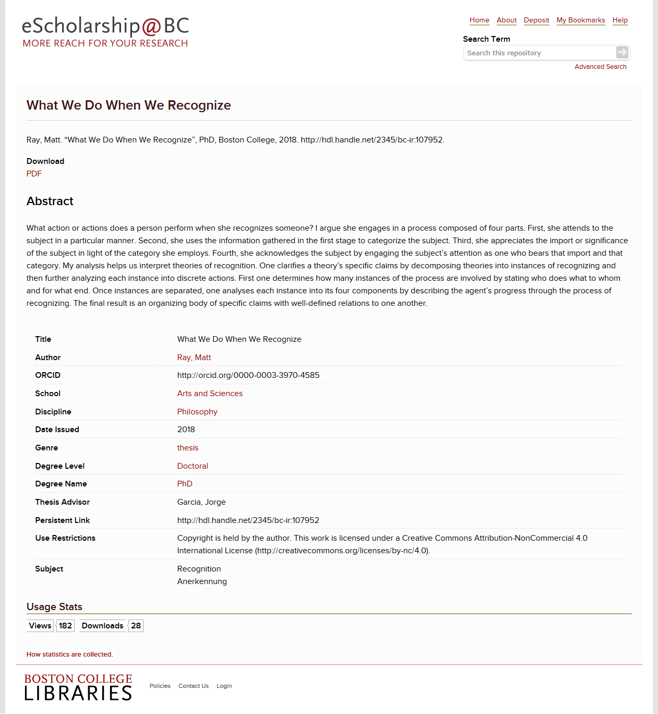

Slide 43
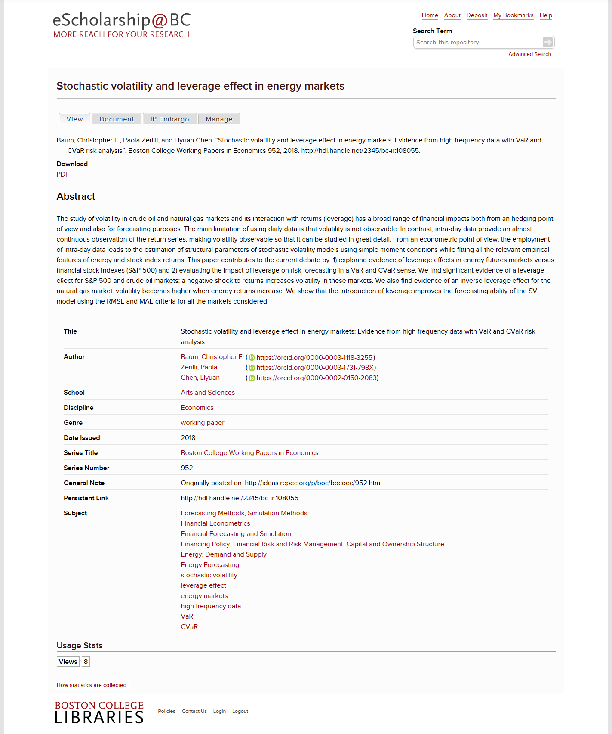

Slide 44
Lessons Learned
Get buy-in from ITS early in the process
Create a reporting database from the beginning
The adoption curve flattens out quickly
Have at least one carrot
Departmental liaisons have been critical
ORCID is better for some disciplines than others
Focus on those
“Yes, you can fill out your ORCID profile using Google Scholar in just a few clicks.”

Slide 45
Other Possibilities
BC departmental faculty profile information population
Using ORCID for departmental reporting
Integration with Office for Sponsored Programs

Slide 46
libguides.bc.edu/orcid
John O’Connor
john.oconnor.15@bc.edu

Slide 47
ORCID and Research Institutions
Why should research institutions care about ORCID?
Notes:
So, you are all from research institutions. Why should you care about ORCID?
Bring back in references to the earlier poll

Slide 48
Key Benefits for Research Institutions
Reliable connections
International scope
Pre-populate forms
Alumni updates
Machines do the work
Obtain consent to use data
Researchers support ORCID
PHOTO: mallow sundae by jennie collbran
CC BY-NC-ND 2.0 https://flic.kr/p/2HFwFT
Notes:
Research institutions can develop trustworthy & reliable connections, which provide several benefits as describe here. In the next slides we’ll go over each.

Slide 49
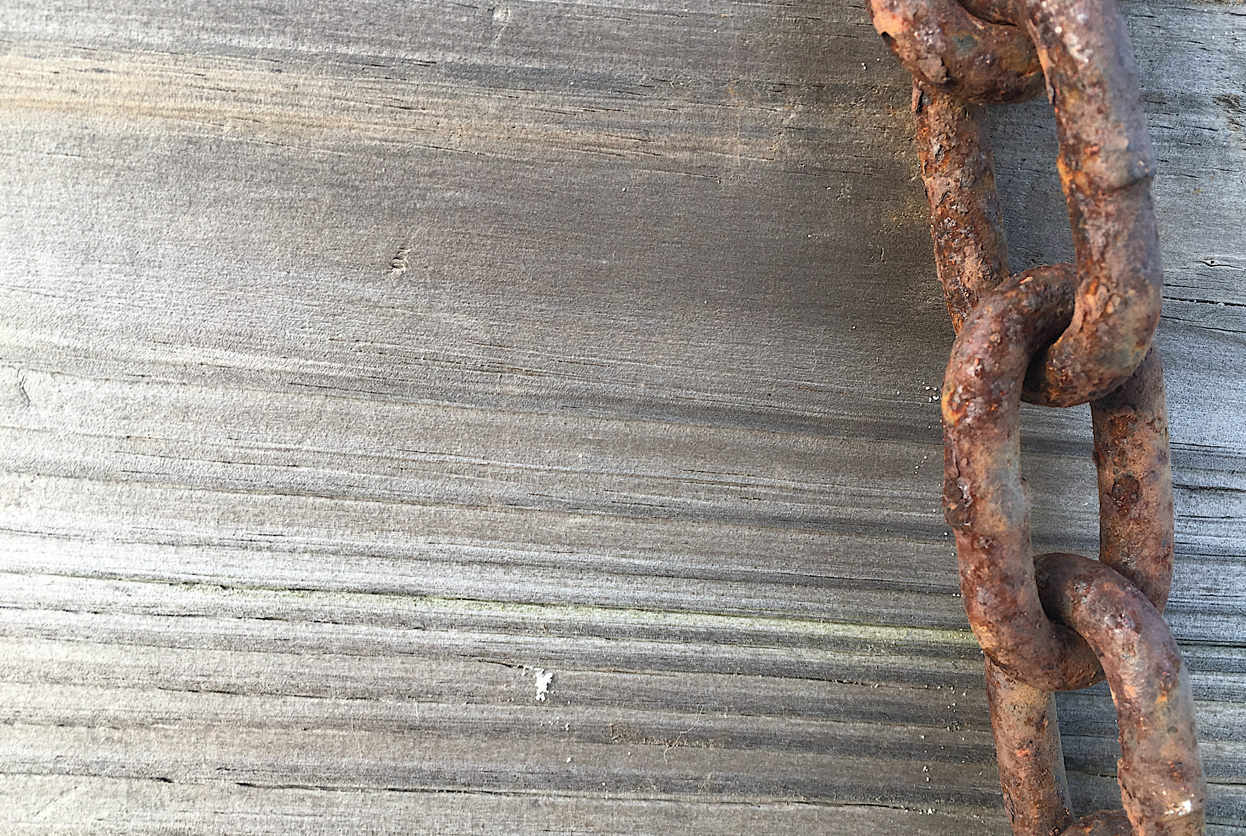
Reliable Connections
Control how your organization name is expressed in systems your researchers use
Include unique organization identifier
CONNECT authoritative affiliation information to researcher records
PHOTO: Linked by NAS Alan Levine CC0 https://flic.kr/p/VKfww6
Notes:
Reliable connections to your institution
Create unambiguous links between your institution and the people and activities associated with it. As in the story we told with the circle diagram, your research institution can CONNECT authoritative affiliation information into your researcher’s records. This action provides three key benefits
You can control how your institution’s name is expressed, and when this information is COLLECTED by other systems with the researcher’s permission, your preferred name is shared as well.
You can include a unique identifier for your institution, making it easier to tie research activities and affiliations back to your institution even when the information is stored in other systems.
You can explicitly assert authoritative connections between your institution and the people that perform research at and are educated by your institution.

Slide 50
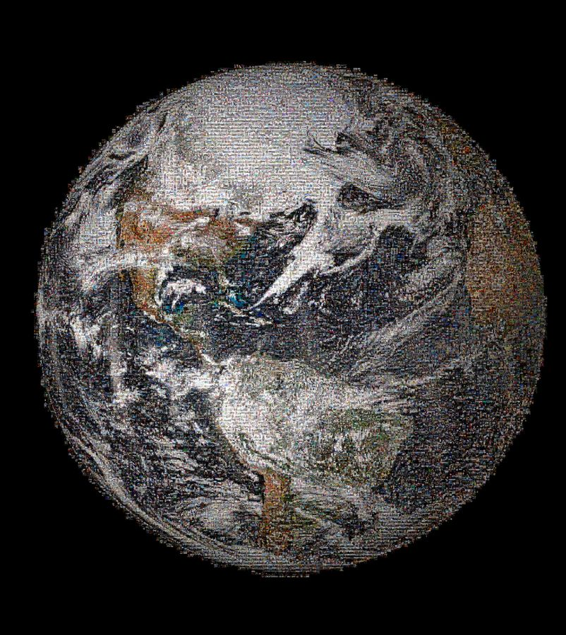
International Scope
Benefit from a broadly-used, reliable, and mobile identifier for your faculty, staff, students, and alumni
PHOTO: The Making of NASA's Global Selfie: 100+ Countries, Thousands of Photos by NAS Goddard Space Flight CC 2.0 https://flic.kr/p/nqjkaJ
Notes:
With researchers in nearly every country and member system connectors around the globe, your institution benefits from a broadly-used, reliable and mobile identifier for your faculty, staff, students and alumni

Slide 51
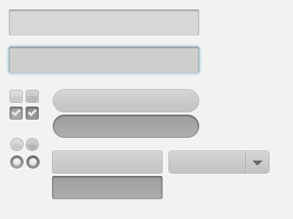
Pre-populate Forms
Receive real-time notifications about research activities, avoiding after-the- fact reporting and form-fatigue
PHOTO: Custom form elements.by Mårten Björk CC BY 2.0 https://flic.kr/p/86cM6z
Notes:
As we mentioned before, the US NIH and other funders will be using he ability to COLLECT information from ORCID to pre-populate application forms and eventually reduce granting reporting burdens when research outcomes are published. They are also CONNECTING award information to records to increase transparency of this information, and enable others to COLLECT it from ORCID records.

Slide 52
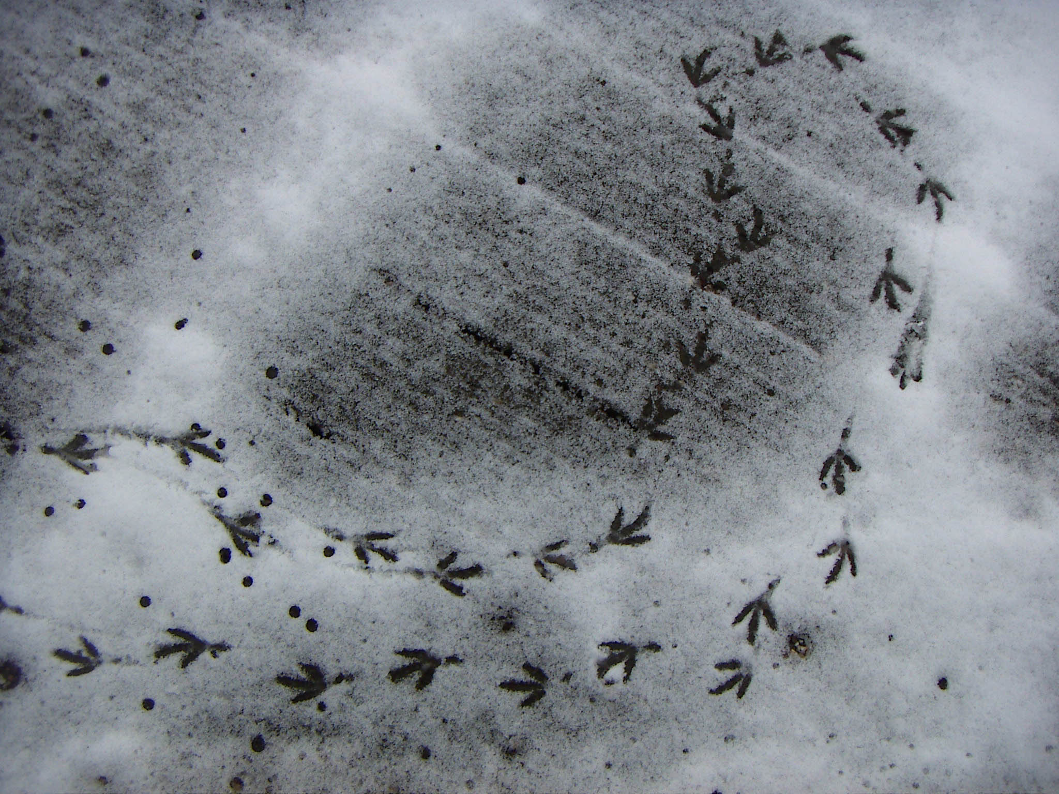
Alumni updates
Gain insights about former faculty, staff and students.
Automatically be alerted to new contributions – publications, grants and awards, affiliations and more!
PHOTO: Footprints by Holly Gramazio CC BY-NC 2.0 https://flic.kr/p/yvVMz
Notes:
Permissions to COLLECT information from ORCID records persist until the researcher revokes these permissions. As a result, these permissions can last beyond your formal relationship with the individual. This means that you can gain insights about former faculty, staff and students even after they leave your campus. Your systems can automatically be notified about scholarly activities performed by both your current and future researchers

Slide 53
Machines do the work
Do all of these activities efficiently and at low cost through machine-to-machine communications using ORCID’s reliable platform
PHOTO: machine by Eugen Stoll CC BY 2.0 https://flic.kr/p/5c8cz
Notes:
Go through slide quickly

Slide 54
Data with consent
Current trends and regulations are putting individuals at the center of their data use.
Strengthen trust and confidence by sharing through ORCID’s permission model
PHOTO: HELLO, my name is... By thomas stein CC BY-SA 2.0 https://flic.kr/p/4qijZc
Notes:
Go through slide quickly

Slide 55
Automatic updates by Machines w/ Consent
Time to report!
Need info for a form!
New publication!
New position!
Updated grant!
TRIGGERS
Yes!
ORCID Record
Do you have permission to do what you want to do?
Read the record or CONNECT the new or updated information
No
Researchers control the visibility of their information
COLLECT permission; store iD and “token”
Notes:
Similar to the circle diagram that we showed earlier, part of the “magic” of the information flow is that information can flow freely across systems via the ORCID platform. Some of this information flow may be triggered by workflows that you have internally. For example, “It’s time to report” or “need info for a form!”. These triggers will initiate your systems to reach out to the ORCID record to COLLECT the most recent information from the ORCID record, with the researcher’s permission.
In other situations another organization's workflows may trigger information to be put into the ORCID record. These triggers may be “Updated grant”, or “New publication!” These triggers would generating update notifications to your institution, enabling you to do real-time COLLECTION of information if desired.
Regardless, the researcher has control over this information, can can set the visibility of each item on his or her record according to three settings – visible to everyone, visible to only those I trust (who have my permission), and visible only to the researcher.

Slide 56
Researchers support ORCID
Per our 2017 community survey, respondents strongly agree that an ORCID iD is essential for researchers
85.9% of respondents believe requiring the use of ORCID iDs is beneficial to the global research community
PHOTO: High Five Panda By Mark Dumont CC BY 2.0 https://flic.kr/p/ipWWpK
Notes:
We sometimes hear from institutions that they are concerned researchers will push back about the use of iDs. There are a growing number of publishers and funders whoa re requiring iDs. We conducted a survey of researchers – both those with and without iDs. We found strong support for them. In fact 85.9% of respondents believe that requiring the use of ORCID iDs is beneficial to the global community.

Slide 57
Why should we use this?
Researchers can easily share their affiliations, contributions, and resources used (Researcher value added)
Transparent assertions are created in a robust machine and human readable manner and with researcher permission (Community value added)
Assertions underpin an open graph of connections between people, places, and things, enabling tracking and reporting through article and/or ORCID record metadata (Institution/project value added)

Slide 58
Connecting to ORCID
Notes:
And, connecting to ORCID couldn’t be easier.
Many systems that research institutions already use have incorporated ORCID connections into their products. Taking advantage of these connections can be as simple as typing in a system ID and secret code that you get from ORCID.
Let’s take a look at some of the vendor systems that already have support for ORCID.

Slide 59
CRIS Systems
Configure your vendor system!
Converis
Elements
Faculty 180
IRMA
Pivot
Pure
DSpace CRIS
Vivo
Digital Measures

Slide 60
Repository systems
Configure your vendor system!
DSpace
ePrints
Hydra/Fedora

Slide 61
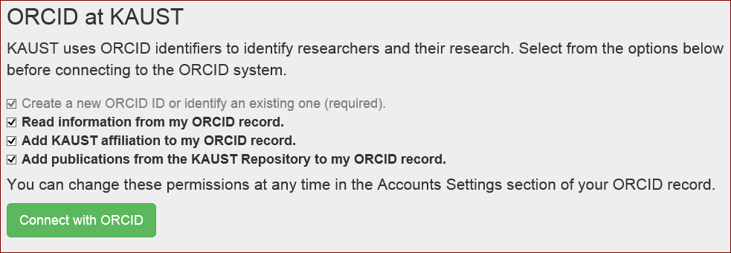
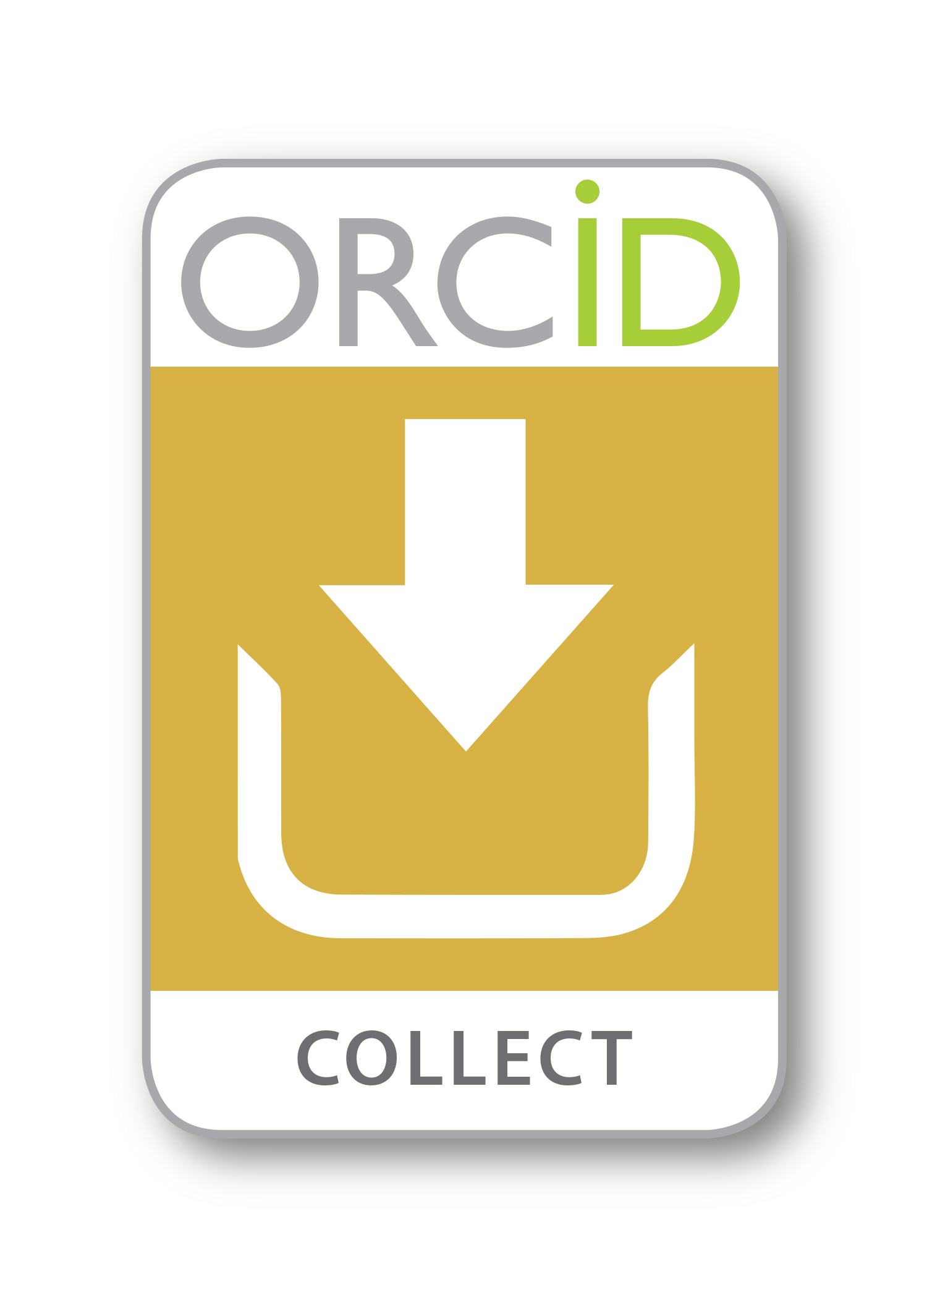
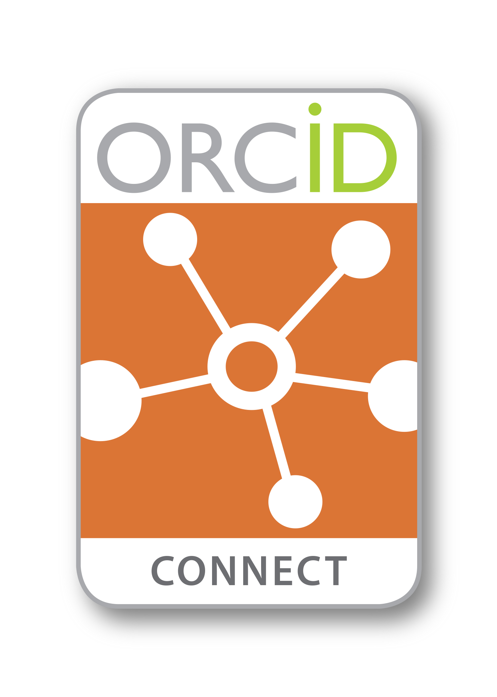
An example
Custom DSpace integration
KAUST COLLECTS permissions
CONNECTS works in IR to the ORCID record
CONNECTS KAUST affiliation to the ORCID record
Track ORCID uptake via dashboard

Slide 62
Custom System Connectors
Build something to suit your needs
Fully accessible API
Embedded permission protocol to COLLECT permissions
Ability to read and write to records to CONNECT information to records
Automatic notifications when changes occur to SYNC systems (premium membership)

Slide 63
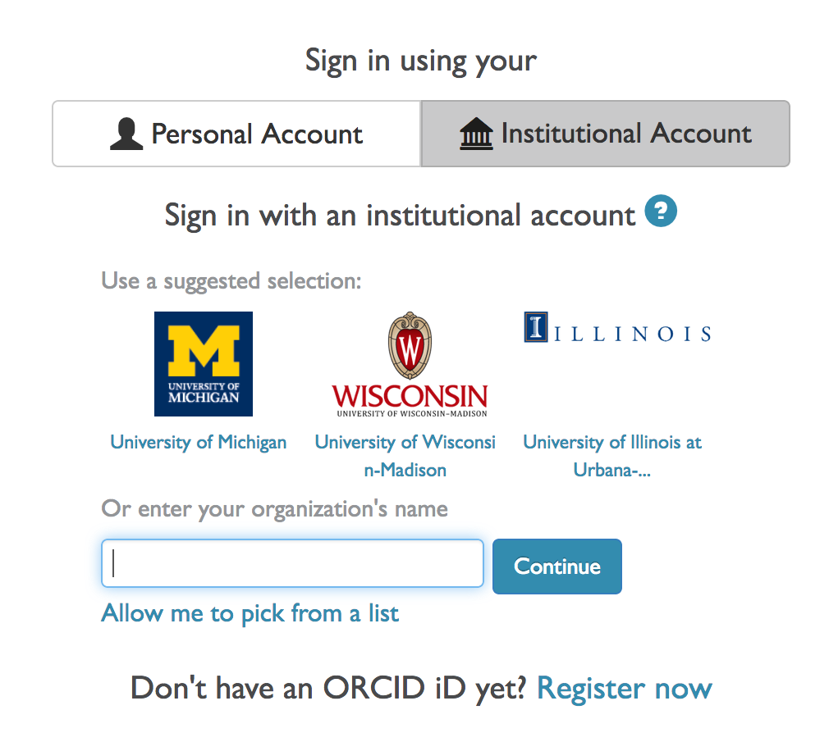
Institution Sign in
https://orcid.org/about/membership
Notes:
You can sign in with your existing institution credentials. This works for over 5000 institutions globally with no extra work from them. If it doesn’t work for your institution, contact us and we will work out why, and try to resolve it.

Slide 64
About Consortia

Slide 65
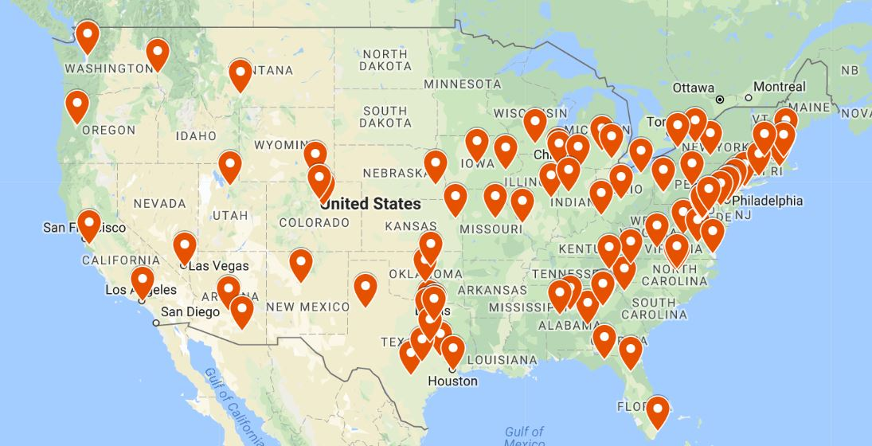
ORCID US Community
NERL
GWLA (ASERL)
Big Ten
LYRASIS
Combined to form a unique US inter-consortial partnership, beginning January 2018

Slide 66
ORCID US Community
97 universities and 1 research center
Includes majority of top 100 US research institutions
Number of live integrations: 86 integrations launched or nearing completion

Slide 67
ORCID-CANADA
ORCID-CA Consortium Formed in 2016
35 members: 32 universities, 2 hospitals, 1 government institution
8 integrations in pre-launch or completed

Slide 68
ORCID Consortia
Institutions can join ORCID at the premium membership tier at a reduced rate ($4,300 vs $20,600)
By joining, institutions will have access to the new dedicated staff position for the US to assist with ORCID integration. Her focus is entirely on these members.
Support for collaboration with colleagues
Community-based researcher engagement
This is an opportunity to help shape the vision and priorities of a budding community!

Slide 69
Open floor
Many thanks to Kimberly and John!
Questions or thoughts about the ORCID mission, integrations, or membership?
You can use the gotomeeting chat box, which appears on the bottom of the tool panel.

Slide 70
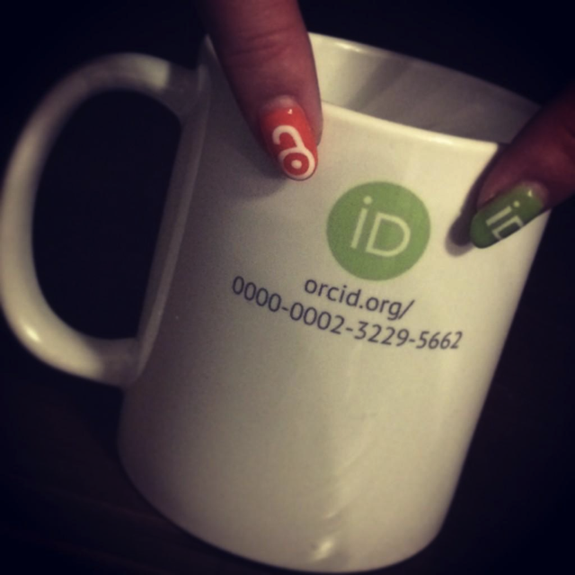
Thanks!
For more information on upcoming
ORCID events and webinars, visit
https://orcid.org/about/events
Eric Olson
ANA VERA WYNNE
Community Manager, North America
https://orcid.org/0000-0002-9810-2894
a.wynne@orcid.org
Membership Specialist, North America
http://orcid.org/0000-0002-5989-8244 e.olson@orcid.org

