Slide 1
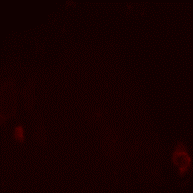
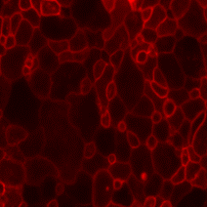
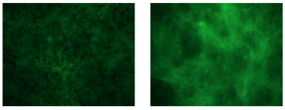
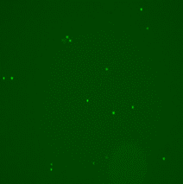
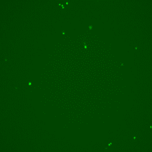
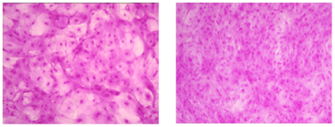
Figure 1
Monolayer Cells
Monolayer Cells
Stratified Cells
A
Fluorescein
B
ANXA5 binding
C
Fluorescein
Unstressed
Stressed
Unstressed
Stressed
Unstressed Stressed
X10
Rose Bengal
TUNEL
Rose Bengal
Unstressed
Stressed
Unstressed
Stressed
X4
Unstressed Stressed
x10
X4
Notes:
On B – what is the correct magnification?

Slide 2
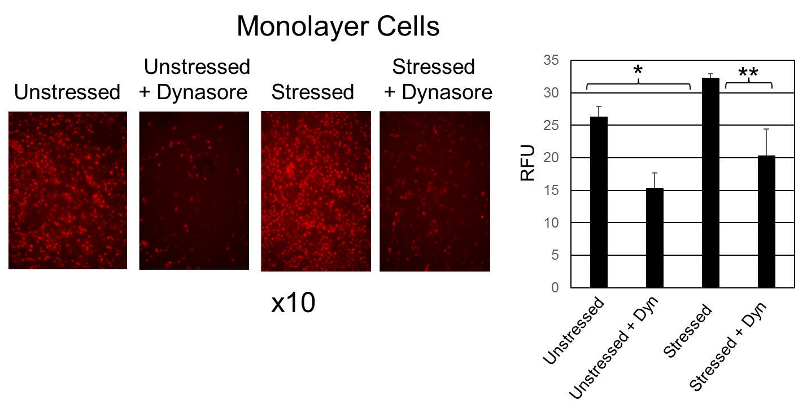
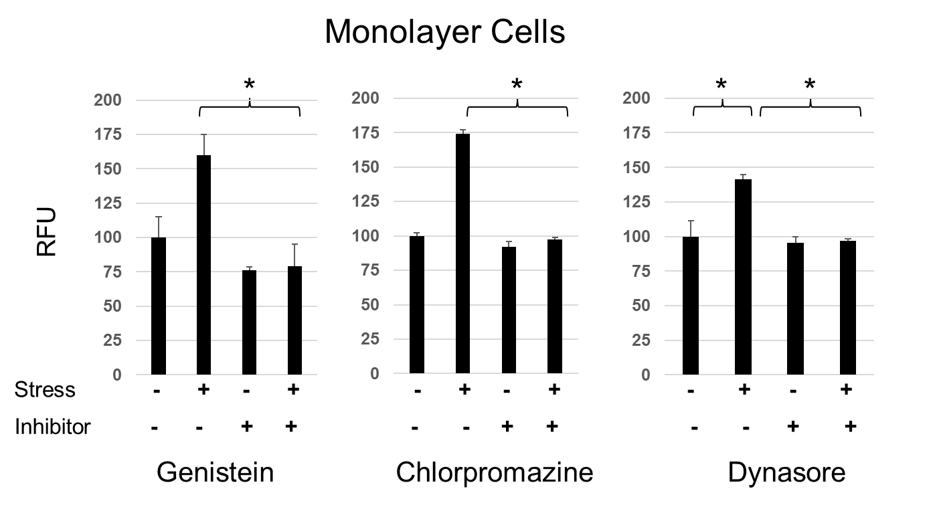
Figure 2
A
B

Slide 3
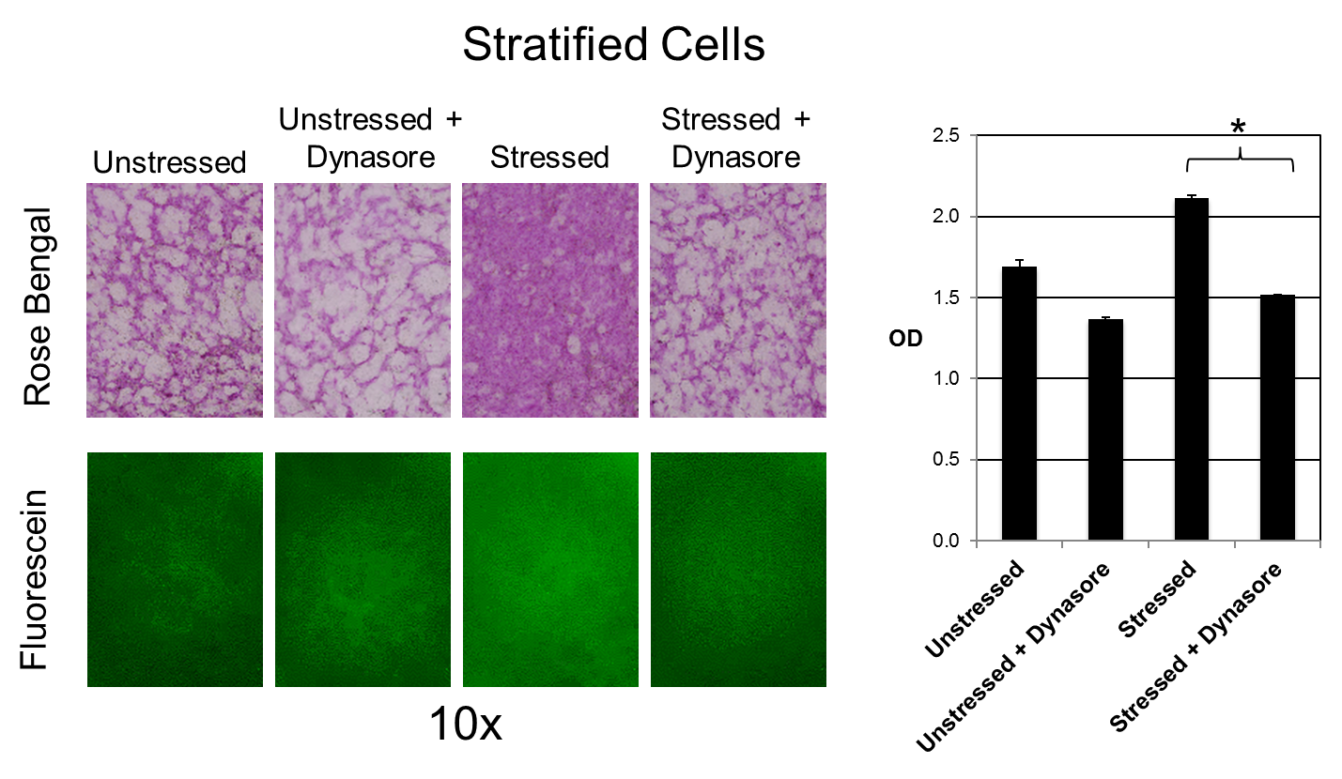
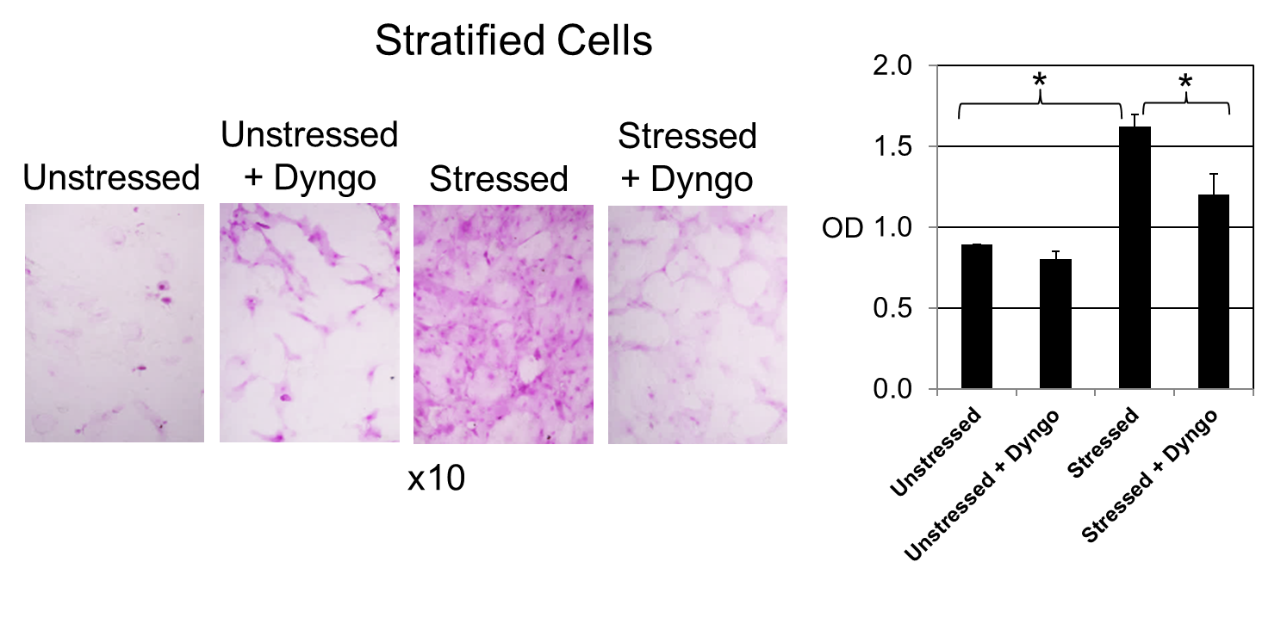
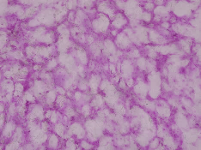
Figure 3
Stratified Cells
C
A
TF Uptake
Unstressed
x10
Stressed
Stratified Cells
B
D
Unstressed + Stressed +
Unstressed Genistein Stressed Genistein
Unstressed + Stressed +
Unstressed Chlorpromazine Stressed Chlorpromazine
x10

Slide 4
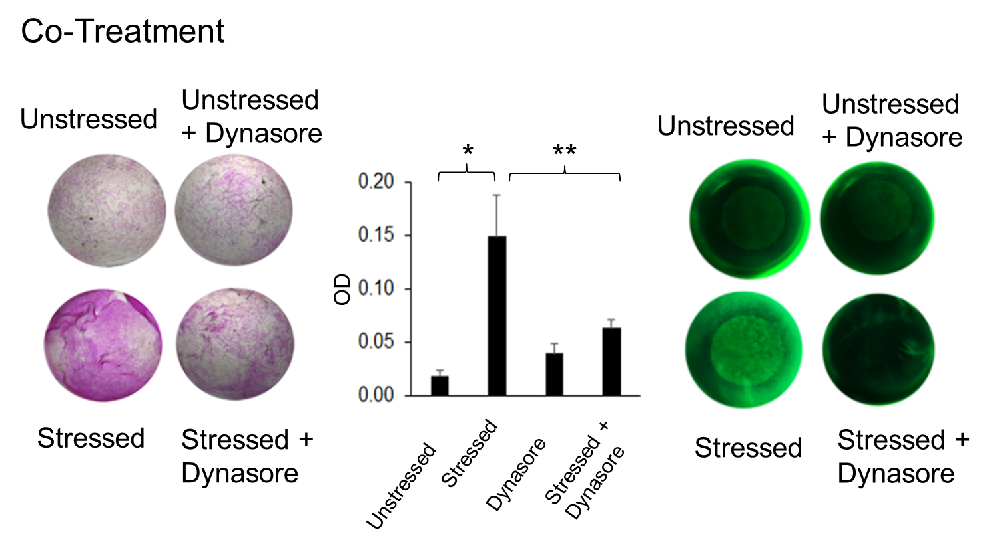
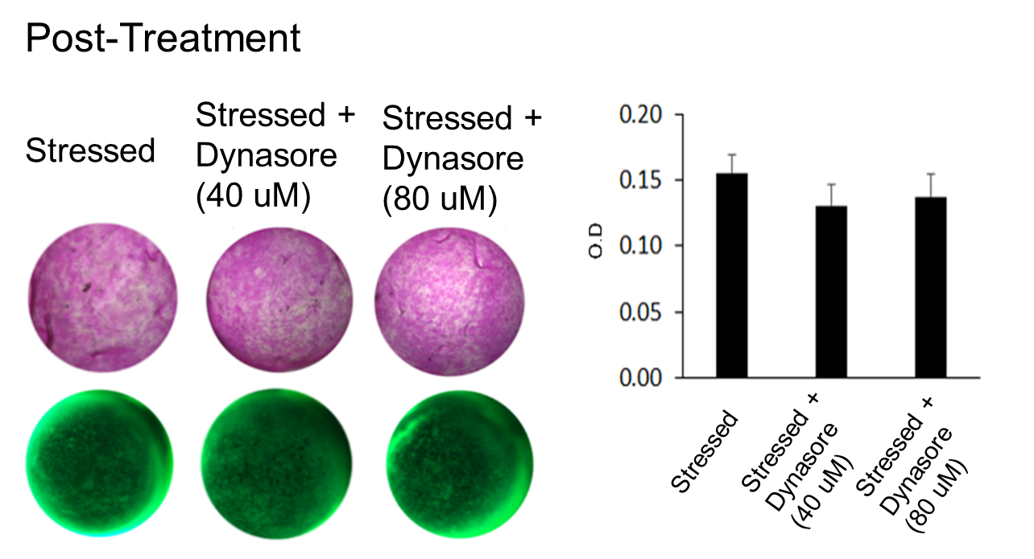
Figure 4
A
B

Slide 5
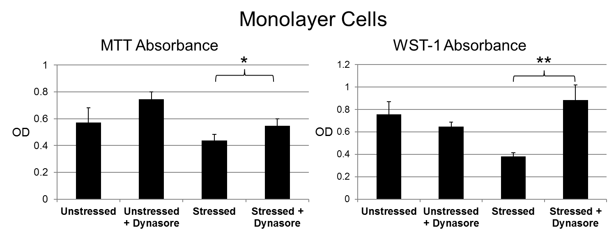
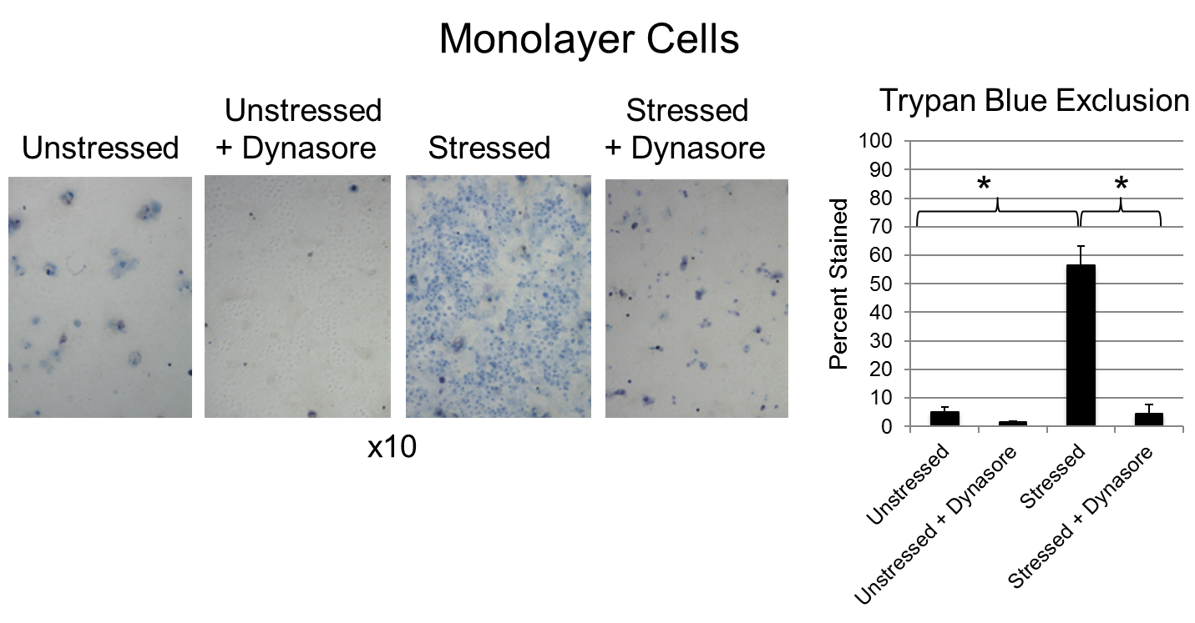
Figure 5
A
B

Slide 6
Figure 6
Stratified Cells
A
Unstressed Stressed
Unstressed + Dynasore Stressed + Dynasore
x10
B
Set 1 Set 2
Stressed - + - + - + - +
Dynasore - - + + - - + +
LGALS3
Standard
Size
(bp)
300-
200-
Medium
Control
Conditioned Media
Notes:
Glycocalyx Protection Assay - Stratified Culture – Jacalin Staining
Stratified HCLE cells in a 24-well plate were exposed to the various chemicals shown above for 3 hours. Afterwards the chemicals were removed and cells were fixed with 100% MeOH. Cells were then incubated in 1% BSA for 30 minutes, followed by an hour staining with fluorescein-conjugated Jacalin (1:100 dilution). Cells were then mounted with PI and a coverslip was placed on top before being viewed under the microscope. 10/4/2017

