Slide 1
Cumulus:
NASA Archives in the Cloud
2018 ESIP Summer Meeting
Lauren Frederick
Cumulus Lead
lauren@element84.com
Patrick Quinn
Cumulus Architect
patrick@element84.com
And the Cumulus team:
Katie Baynes, Dana Shum, Darla Werner, Taylor Wright, Aimee Barciauskas, Alireza Jazayeri, Jacob Cambell, Jenny Liu, Menno Van Diermen, Jonathan Kovarik, Katie Kelly, Marc Huffnagle, and Matt Savoie
This work was supported by NASA/GSFC under Raytheon Co. contract number NNG15HZ39C.
This document does not contain technology or Technical Data controlled under either the U.S. International Traffic in Arms Regulations or the U.S. Export Administration Regulations.

Slide 2
BACKGROUND:
DAACS IN THE CLOUD
Notes:
What is a DAAC?
Distributed Active Archive Center
where data is processed, documented, archived, and distributed
There are 12 DAACs throughout the United States

Slide 3
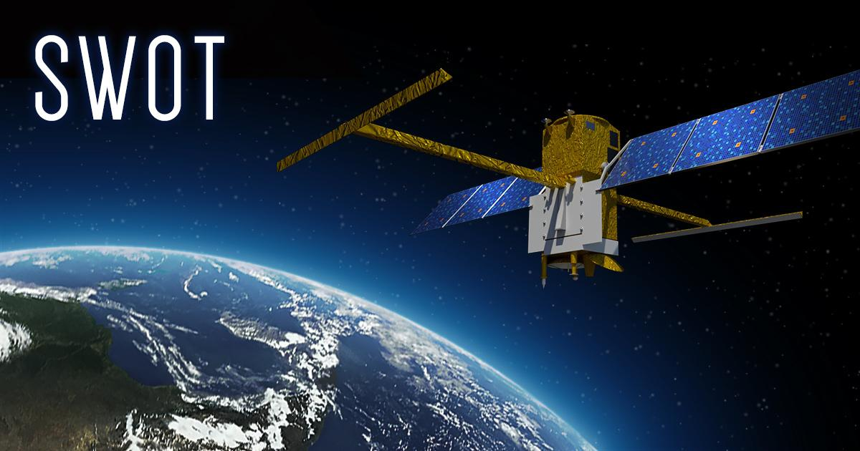
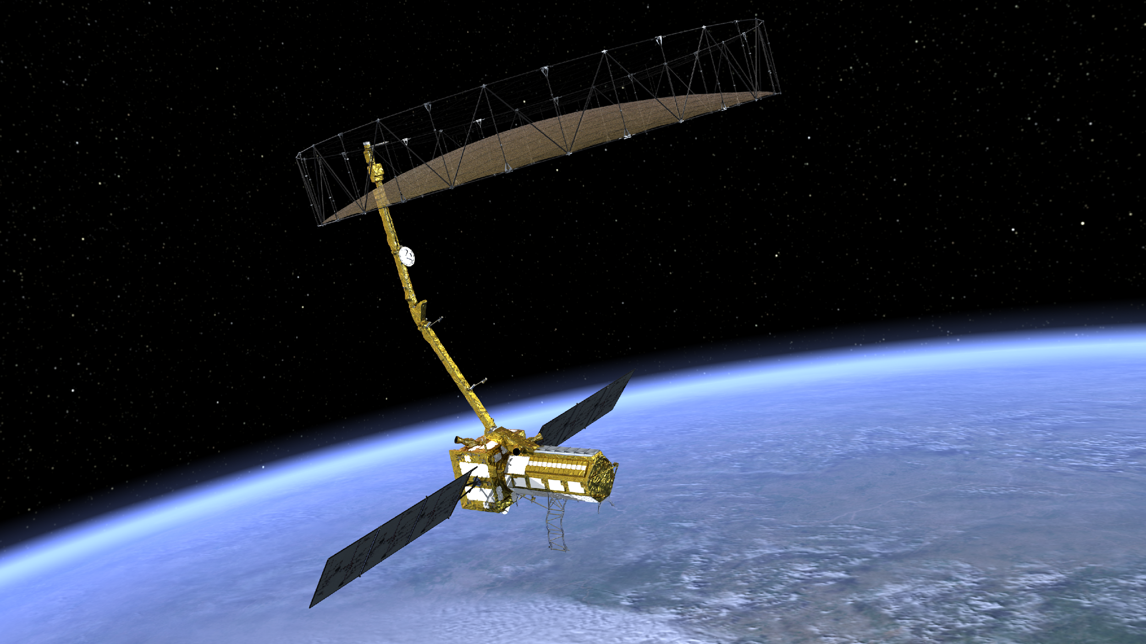
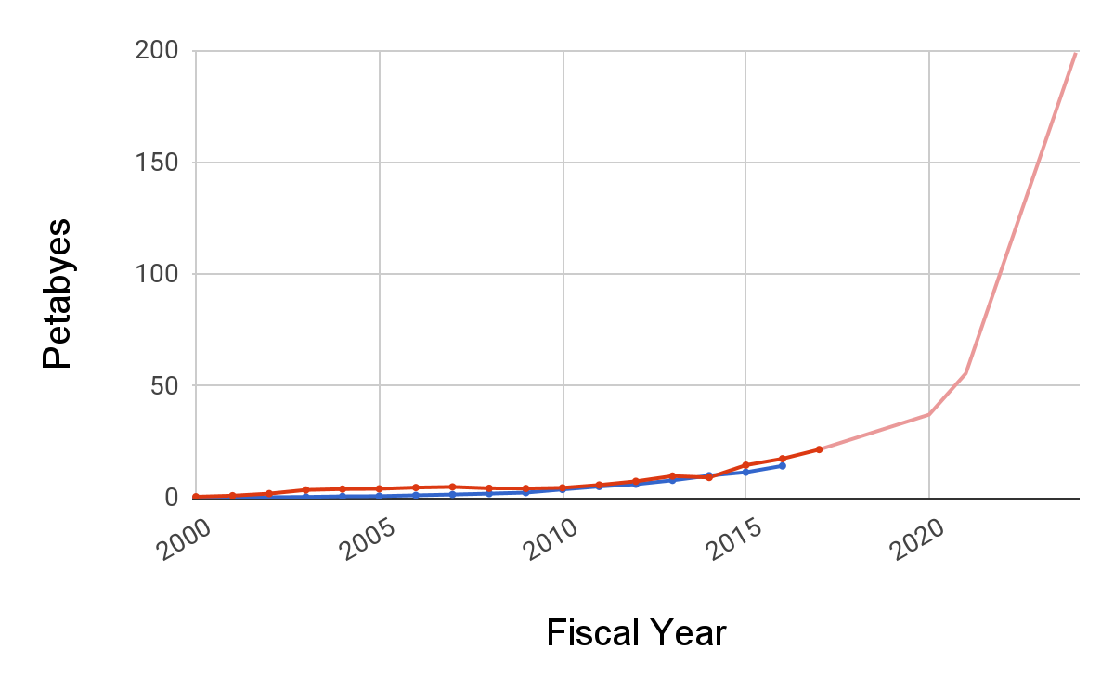
Why DAACs in the Cloud?
+
=
Notes:
Cloud is generally scalable, highly available, and cost-effective.
With 2 big missions, NISAR and SWOT coming up, the amount of data coming in is going to increase exponentially.
Archive now approx 21 PB going to 200+ PB in the next 5 years.
Not only more granule files, but granule files are larger, forcing us to re-think how we store and work with data. It’s not practical to download terrabytes of data to perform simple processing.
______________
ASF, CMR, (not SWOT/NISAR, both bringing in SAR data) spell out acronyms

Slide 4
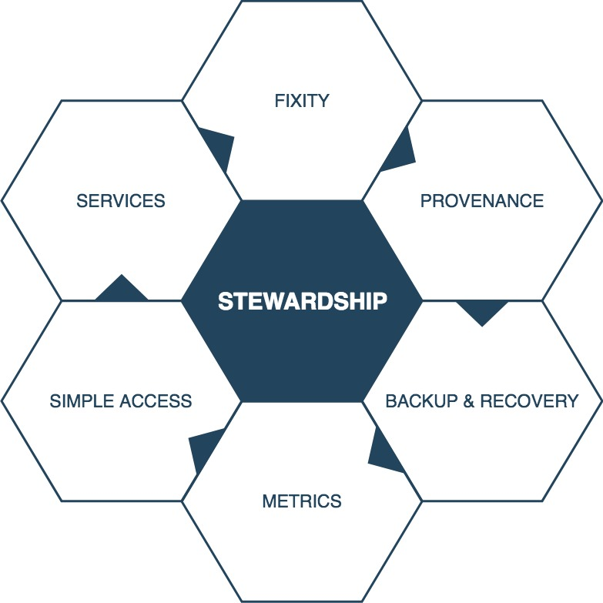
Science Archives in the Cloud
Notes:
Not just an S3 bucket, science data from billion-dollar missions that is irreplaceable and valuable
What does it mean to have a science archive in the cloud?
Be good stewards of the data:
Know that the data is correct
Know where the data is - as we move data update the systems
Keep the data safe
Make the data available to users
Provide services (processing, organization) and metrics

Slide 5
CUMULUS:
NASA ARCHIVES IN THE CLOUD
Notes:
How Cumulus is solving the problem of putting a full-fledged archive in the cloud

Slide 6
What Is Cumulus?
Cumulus allows DAACs to ingest, archive, manage, and distribute data products, all within the cloud.
Cumulus is designed to be extensible and configurable, providing support for all DAACs while maximizing reuse and shareability.
Notes:
Cumulus is a common set of code and services.
Cumulus provides the DAACs a leg up to get into the cloud and gives the DAACs control to maintain stewardship.
Cumulus is designed to be configurable and reusable, promoting sharing amongst the DAACs.
Cumulus is open source to further promote collaboration and Cumulus node.js tasks and packages are publicly available on the node package manager (NPM), making it easy to install Cumulus

Slide 7
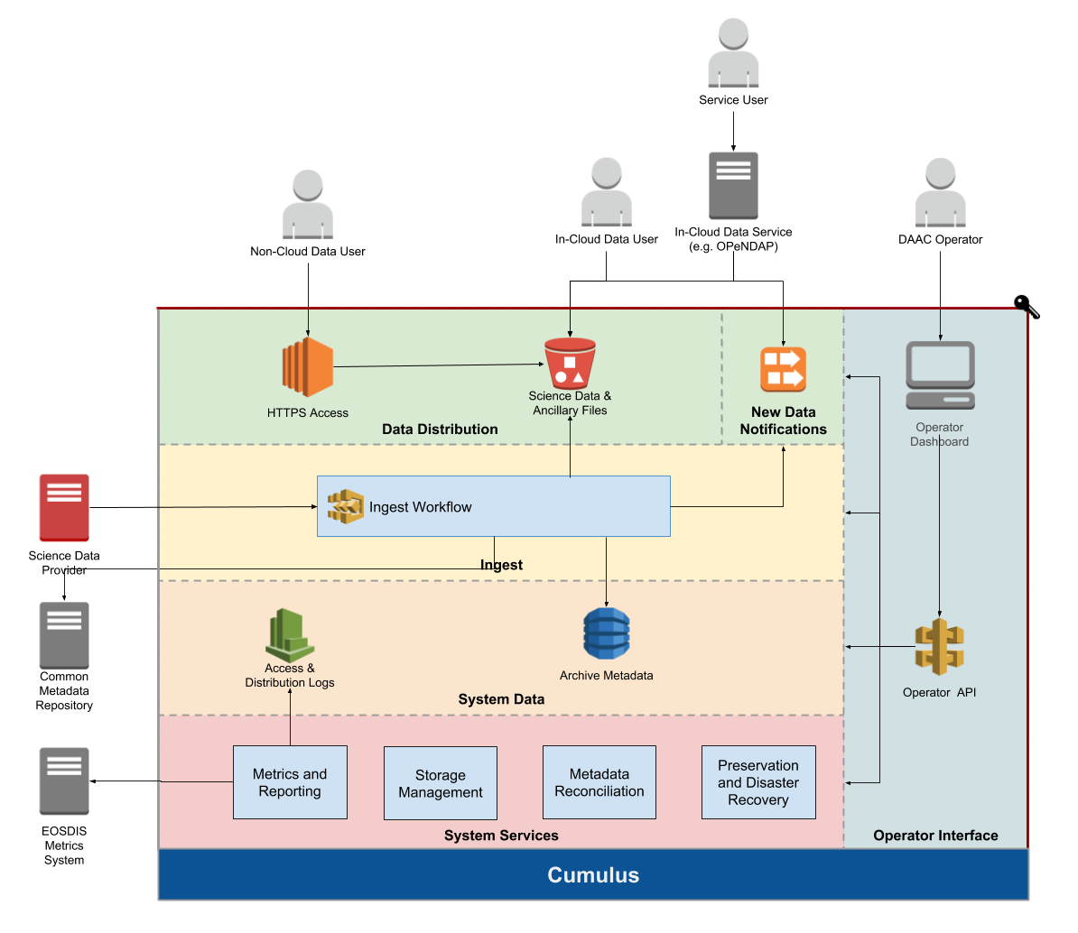
Notes:
Overview of Cumulus, the services provided, and how end users interact with the system
We use AWS as our cloud solution - data is stored in S3 buckets
Ingest Layer:
Cumulus workflow configured to Ingest
Science data provider triggers workflow - can be configured to trigger on schedule or when there is new data. Workflows can trigger other workflows.
Ingested data gets archived and can write to the CMR
Distribution layer - how the data is accessed
Distribution endpoint behind Earthdata Login
Direct S3 Access
Services running on Cumulus:
Reconciliation
Backup
Metrics - reports to EMS nightly
Operators
Operator dashboard
manage providers, collections, configuration, and rules
Talks to all layers via the operator API
Behind ED login

Slide 8
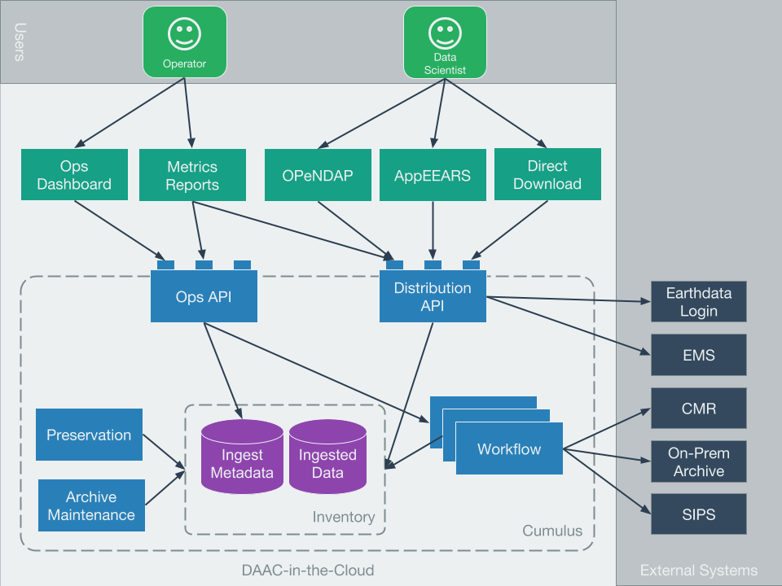
Notes:
What are the pieces needed to accomplish the goal?
Cumulus is the foundation of a DAAC in the Cloud
Big diagram
Ingest (workflows w/ processing, CMR, etc)
Distribution
Reporting / ops tools
Flexibility for DAACs to do their thing
Probably a lot of content here
DAAC in the cloud components
interfaces to services
authentication

Slide 9
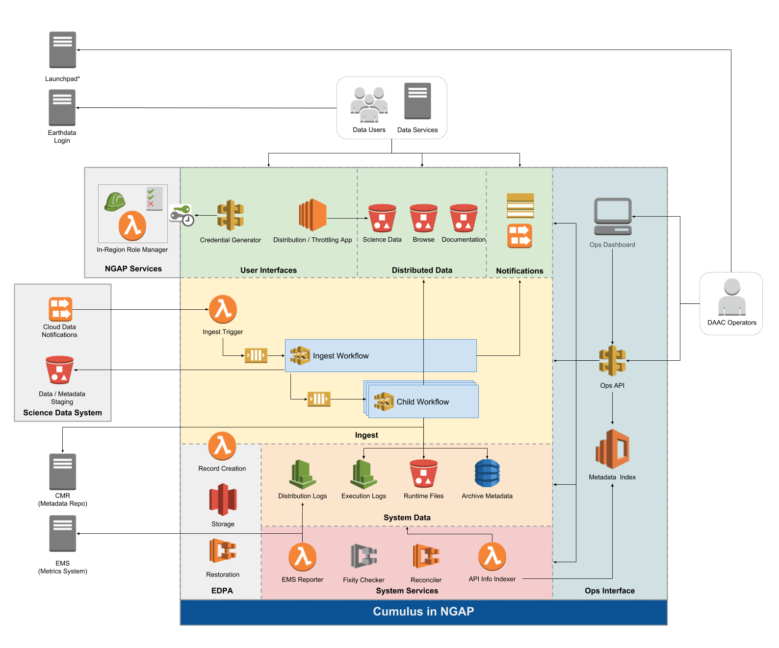
Notes:
Note to reviewer: It is likely we will expand this into several slides which zoom into a particular part of this diagram to explain it. We won’t be adding any content or significantly altering the presentation, but would be splitting this content among several slides to make it more digestible
Mention AWS

Slide 10
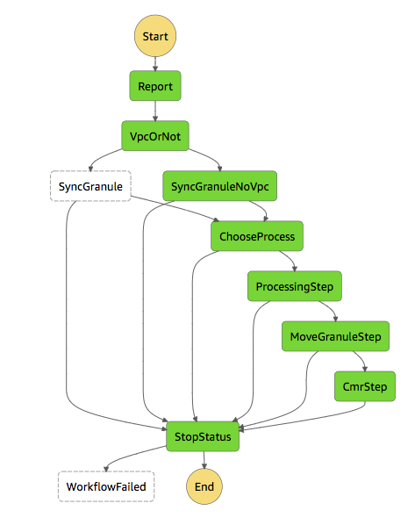
Flexible, Configurable
Notes:
Remove?
Specify a state machine that defines how data is ingested
Configuring workflows - common steps and custom steps
operators can use for visibility and troubleshooting
Bucket configuration

Slide 11
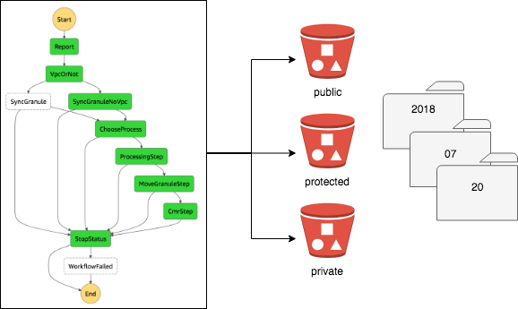
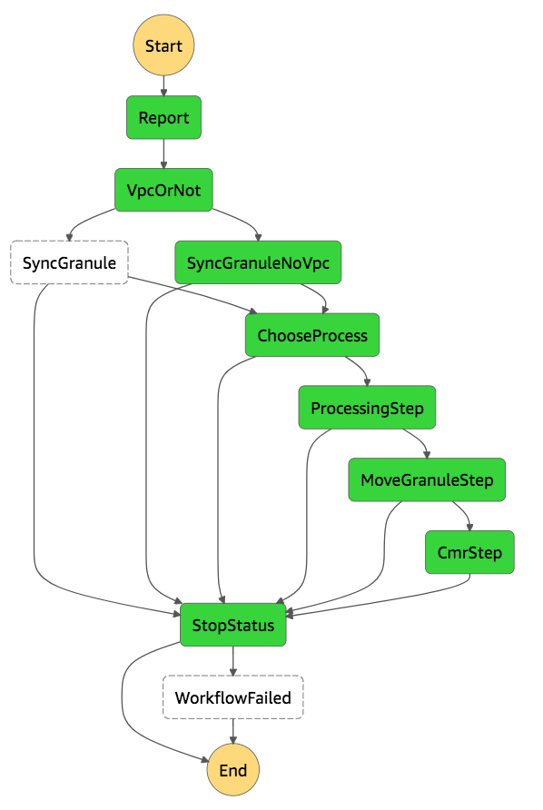
Flexible, Configurable
Notes:
Template ingest workflow
Processing step creates the CMR metadata

Slide 12
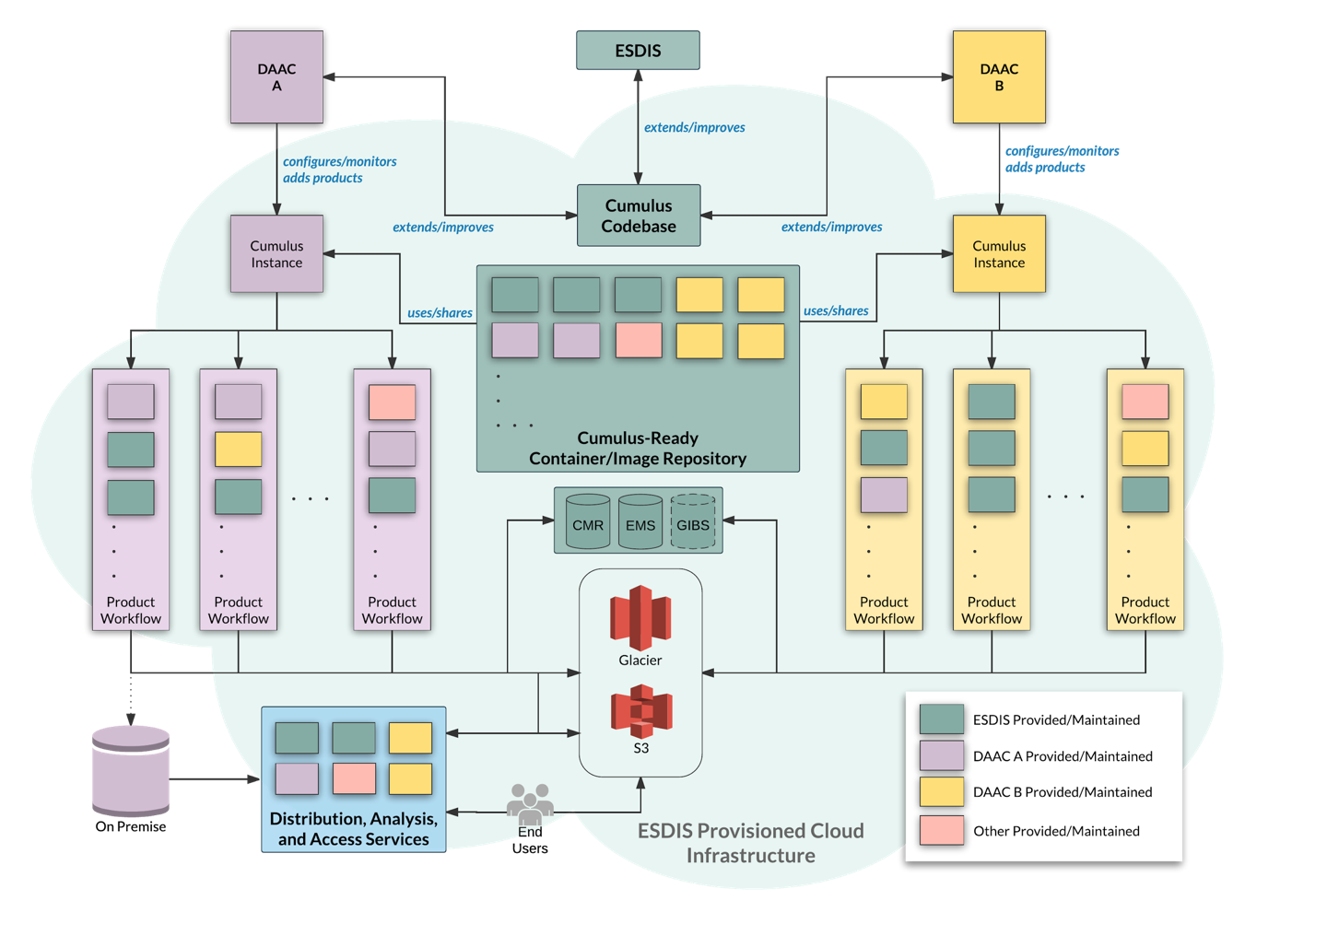
Notes:
Diagram of how Cumulus is deployed and used by multiple DAACs
Both DAACs are deployed the same way and use Cumulus workflow components and Cumulus services, but they have their own instance of Cumulus
Cumulus core has common components available and versioned
DAACs create workflows to discover, process, and archive data using custom DAAC-specific components, Cumulus core components, and components from other DAACs
_______________________________________________________
What is this that I am looking at - diagram of how Cumulus is deployed and used by multiple DAACs
left - deployment of one daac
Start at the highest level
Workflow
New diagram:
Using AWS S3 Cloud Object store - makes it available to the next tier of services
New slide:
GIBS - MRF file optimized for cloud object stores (cloud-ready format)
Very different in how they are processing, sharing common components, use the same operators tools, deployed in similar ways.

Slide 13
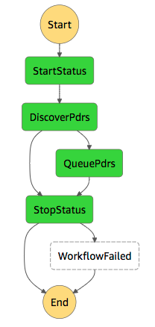
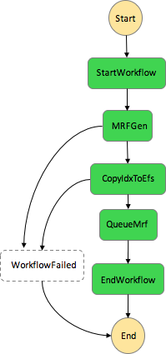
Flexible, Configurable
GIBS Discover and Queue PDRs Workflow
GIBS Workflow to Generate and Queue MRFs
Notes:
Left is a GIBS Discover and Queue PDRs workflow made up entirely of Cumulus Core components
On the right is a GIBS workflow in a Cumulus deployment generating and queueing an MRF file - which is a file optimized for cloud storage.
Completely different in how it processes files than the previous slide, but deployed in the same way, use the same operator tools

Slide 14
WHAT IT MEANS FOR USERS

Slide 15
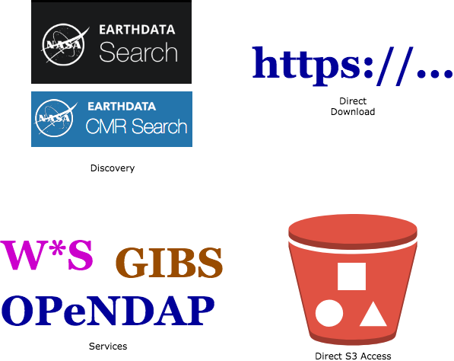
The Same, Only Better

Slide 16
Direct S3 Access?
But what about unbounded egress?
How does this tie back to Earthdata Login?

Slide 17
Direct S3 Access!
Credential Dispenser
Earthdata Login
(OAuth)
Science User
Or Service
Read-Only In-Region Access Keys
Direct S3 Access
Science User
Or Service
Science Data
Read-Only In-Region Access Keys
Notes:
Unbounded egress - allow in-region access only
Fast and cost-effective solution for everyone
ED Login:
Credential dispenser API
Challenges that we have not yet solved
How to enforce CMR-level ACLs with S3 direct access - policies need to be created by a person
____________
How this works for the user - hit endpoint that logs you in to ED login and dispenses temporary S3 access credentials. Distribution links back to ED login for metrics.
Key point: talk about the user experience. What is this bringing to users? Show curl command.
Spin up compute resources in AWS and get high bandwidth, scalable access to computation near the data
What if you’re not in region?
Spell out more that we cannot have unbounded costs anywhere. Cost control.
HTTP access to everyone, potential range reads so you don’t need to get the entire file
Option to allow access across the internet and then could shut off if costs get out of control, or shut off for particular users who are over-using or abusing.
Fast access to compute in the cloud

Slide 18
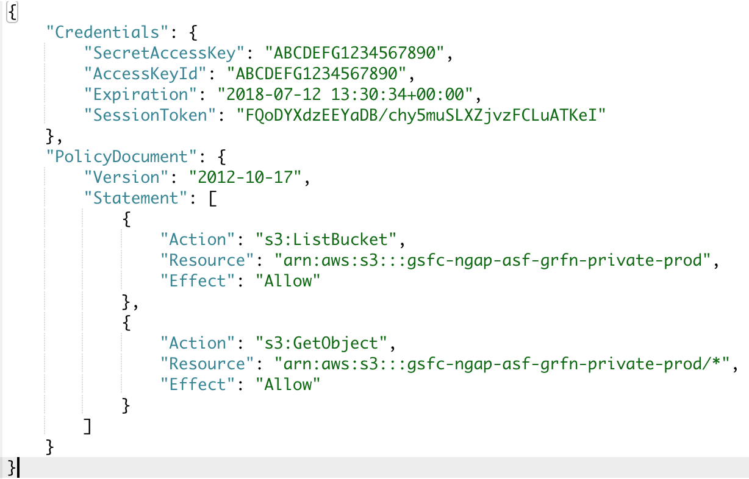
Direct S3 Access!
https://cumulus.com/s3credentials

Slide 19
Free and Open Access
Check us out on github!
https://github.com/nasa
Packages on NPM
https://www.npmjs.com/org/cumulus
Docker Hub
https://hub.docker.com/u/cumuluss/
Notes:
NOTE FOR Reviewer: The URL will change to one or more NASA GitHub URLs
Under active development now, we invite you to pull the code or libraries, check out our documentation

Slide 20
QUESTIONS?

Slide 21
Thank You!
Lauren Frederick
lauren@element84.com

Slide 22
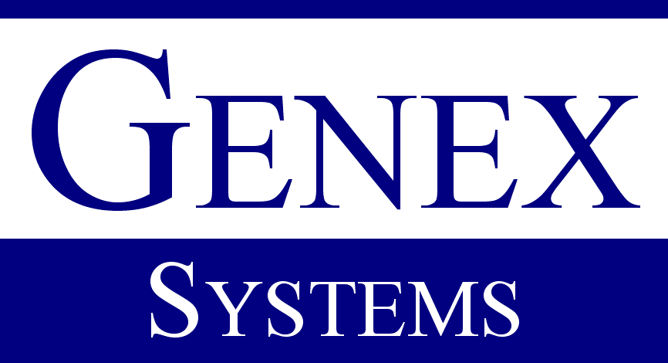
This work was supported by NASA/GSFC under Raytheon Co. contract number NNG15HZ39C.
in partnership with

