Slide 1
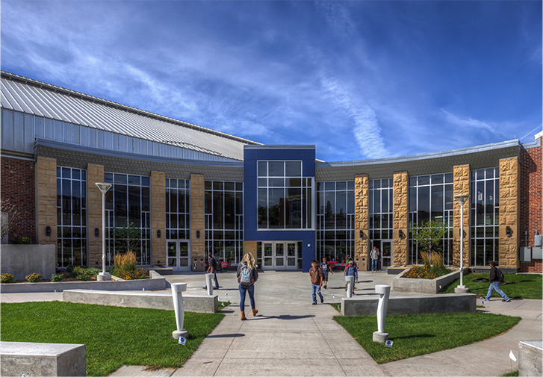
Robot Integrations in the Home and Workplace from an Assistive Technology Perspective
Dr. Devin R. Berg
Robert F. Cervenka School of Engineering
UNIVERSITY OF WISCONSIN-STOUT Learn more at www.uwstout.edu

Slide 2
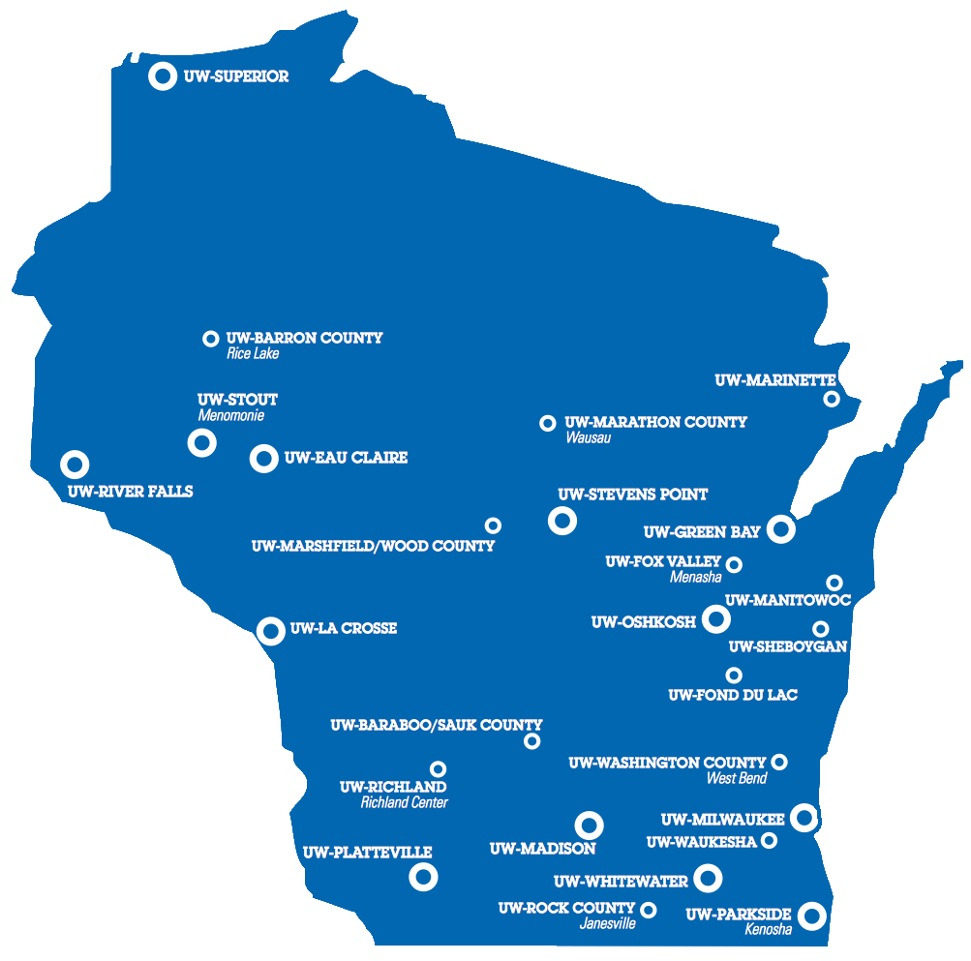
THE UW SYSTEM
UNIVERSITY OF WISCONSIN-STOUT Learn more at www.uwstout.edu

Slide 3
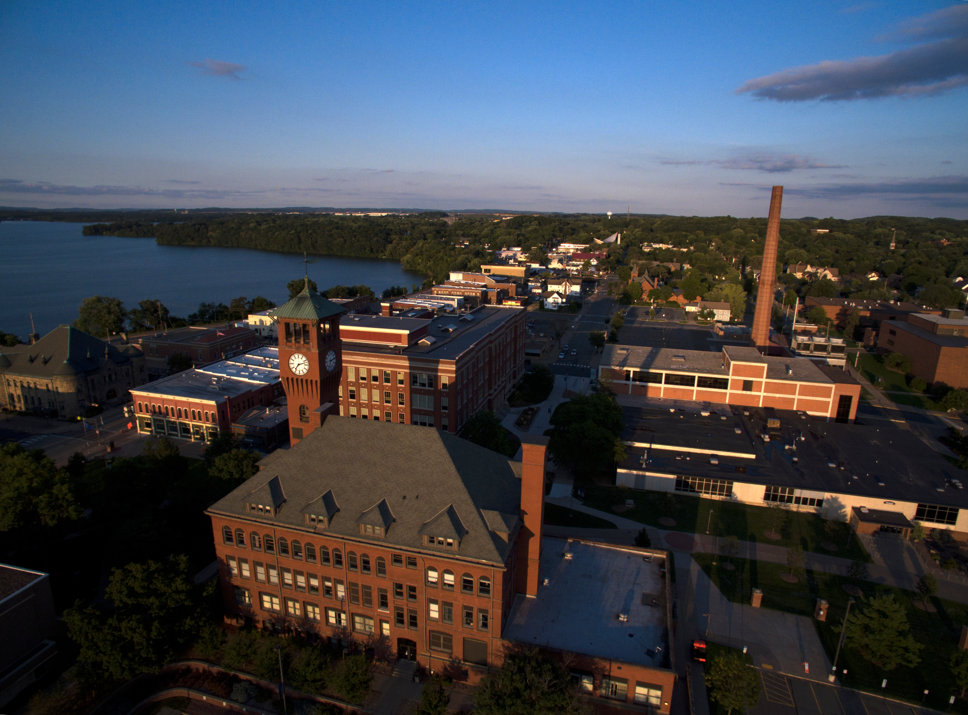
UW - STOUT
Notes:
Smithsonian Magazine has ranked Menomonie as one of the best towns in America. The Menomonie community offers a nice mix of many thriving businesses, larger chain retailers and restaurants, as well as recreational offerings such a skate park and a water park. Menomonie is also surrounded by beautiful scenic trails along the Red Cedar River.

Slide 4
UW-STOUT’S POLYTECHNIC DESIGNATION
POLYTECHNIC SCHOOLS ARE CAREER-FOCUSED UNDERGRADUATE AND GRADUATE UNIVERSITIES THAT COMBINE APPLIED LEARNING WITH A LIBERAL ARTS EDUCATION.
Notes:
UW Stout was given our designation as “Wisconsin’s Polytechnic University” in 2007 by the UW Board of Regents. This designation is only applicable to about 3% of universities in the U.S. and includes other polytechnic peers such as Cal Poly, Michigan Tech, and MIT. The definition of a polytechnic is defined as…(click to present the definition) At Stout we further define our designation with three tenants (click again to present and discuss the 3 tenants.)

Slide 5
Business and Industry Ties
DISCOVERY CENTER
FAB LAB & MOC
The Discovery Center facilitates over 50 industry projects which also engage over 150 students annually
Our FabLab, an open source digital fabrication workshop originated by MIT, logs over 2,500 total hours of machine time annually by students, staff, business, industry and community. Manufacturing Outreach Center (MOC) reported nearly $20 million in new/retained sales, cost and investments
OVER 300
COLLABORATIVE PROJECTS
CAREER CONFERENCES
Stout Technology & Business Park
600⁺
Employers attend each of Stout’s career conferences – two of the largest in the Midwest
A university-affiliated, mixed-use technology, 403
acre business park community is open to industrial, commercial, business and educational owners to reap the benefits of Stout’s commitment to business and industry
UNIVERSITY OF WISCONSIN-STOUT Learn more at www.uwstout.edu

Slide 6
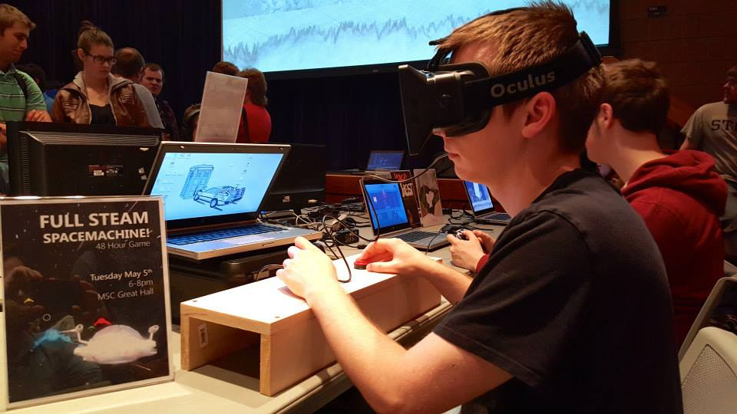
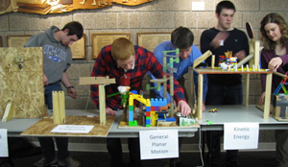
Hands on
CELEBRATIONS OF THE POLYTECHNIC EXPERIENCE
STEM EXPO
GAME LAUNCH
Engineering day
LABORATORY RICH ENVIRONMENT
OVER 70 Student focused labs in the college
29 LABORATORIES in Engineering
UNIVERSITY OF WISCONSIN-STOUT Learn more at www.uwstout.edu

Slide 7
STEM Programs
SCIENCE
Applied Biochemistry and Molecular Biology
Applied Science
Environmental Science
PSM Conservation Biology
ENGINEERING
Robert F. Cervenka School of Engineering
Computer & Electrical Engineering
Manufacturing Engineering
Mechanical Engineering
Plastics Engineering
MS Manufacturing Engineering
Engineering Technology
TECHNOLOGY
Packaging
Construction
MS Construction Management
MATHEMATICS
Applied Math and Computer Science
Game Design and Mobile Applications PSM Industrial and Applied Math
UNIVERSITY OF WISCONSIN-STOUT Learn more at www.uwstout.edu

Slide 8
ROBOT HUMAN INTERACTIONS
(source)

Slide 9
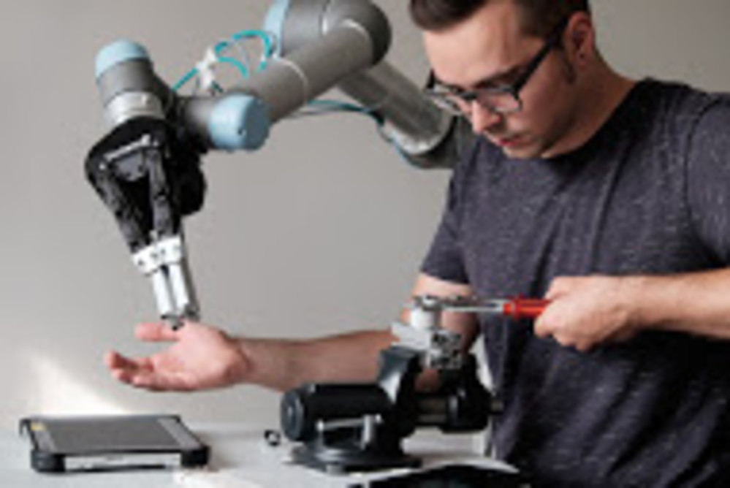
ROBOT HUMAN INTERACTIONS
(source)
(source)
Notes:
Force limiting, visioning, position sensing

Slide 10
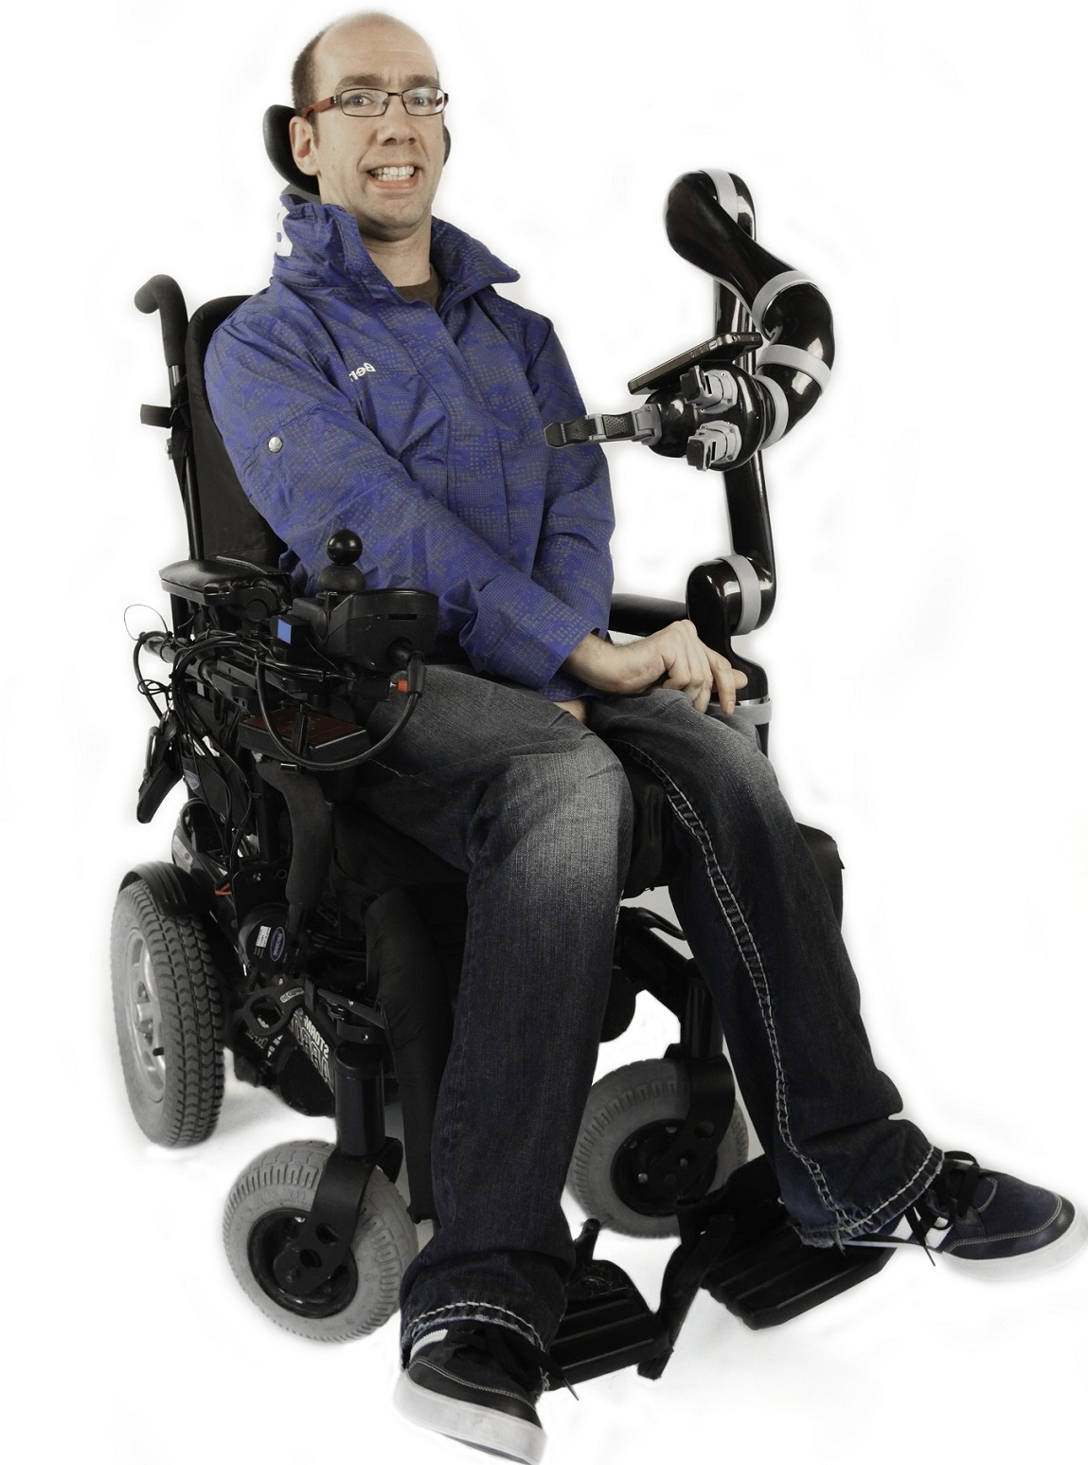
ROBOT HUMAN INTERACTIONS
(source)
(source)
Notes:
Low mass, prescribed safety zones

Slide 11
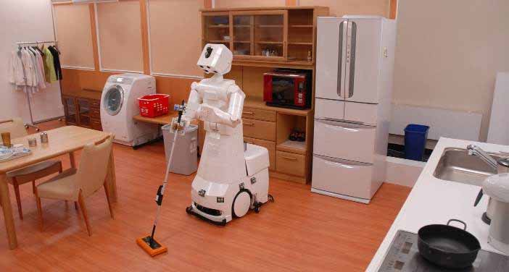
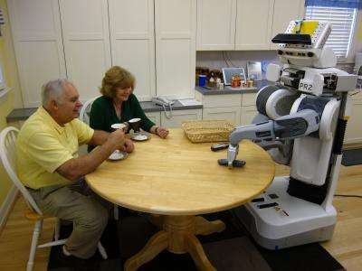
ROBOT HUMAN INTERACTIONS
(source)
(source)

Slide 12
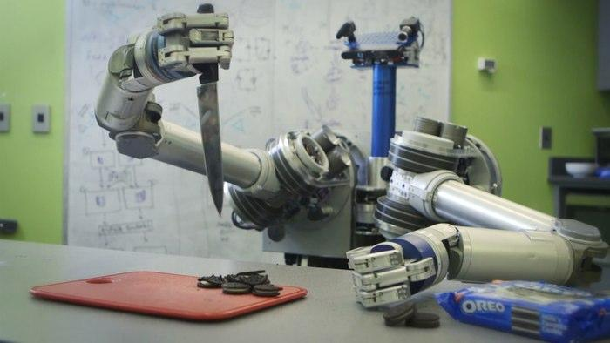
ROBOT HUMAN INTERACTIONS
(source)

Slide 13
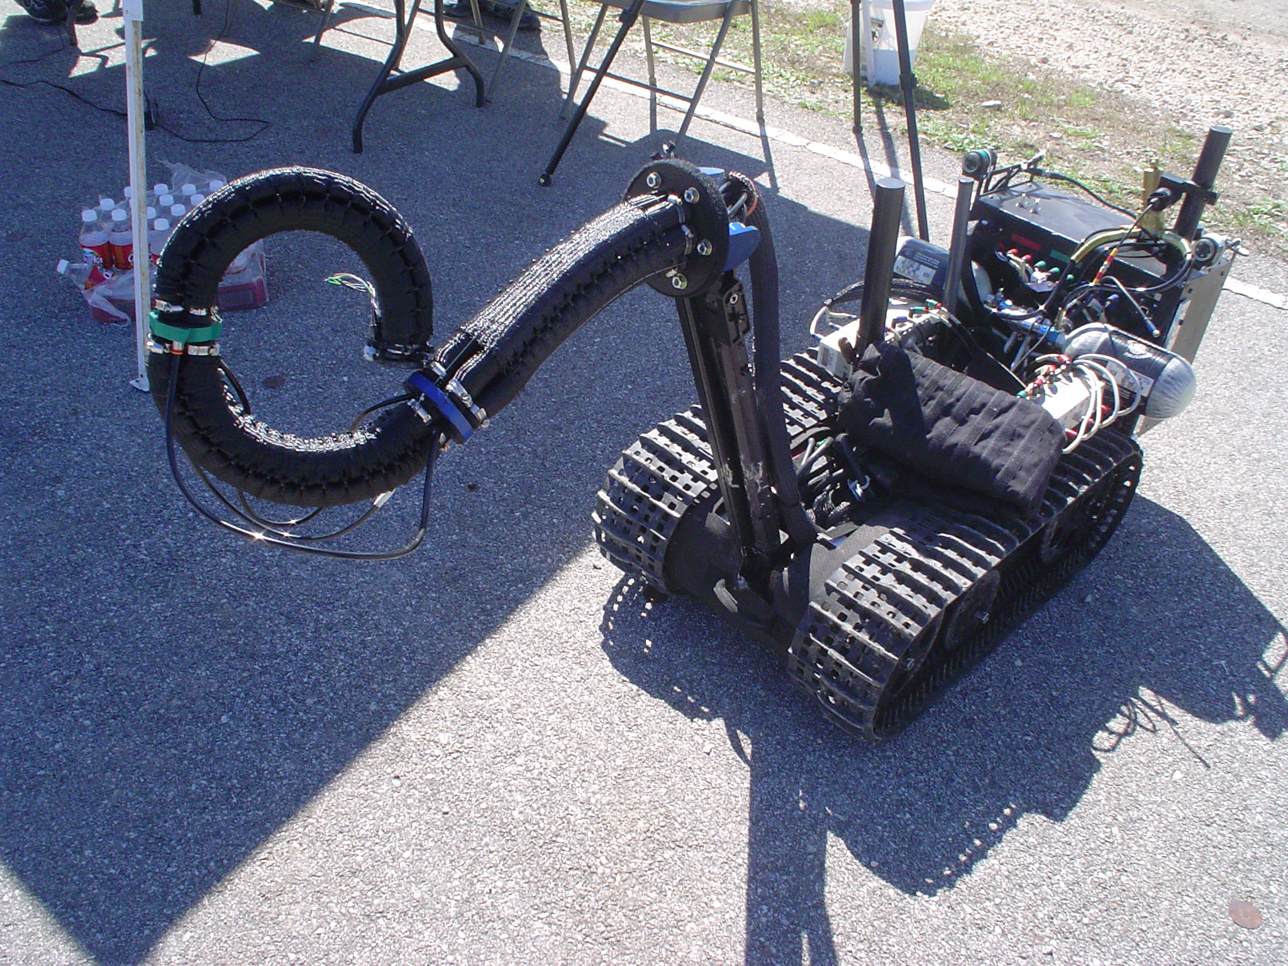
WHAT ABOUT CONTINUUM ROBOTS?
(source)

Slide 14
WHAT ABOUT CONTINUUM ROBOTS?
(source)

Slide 15
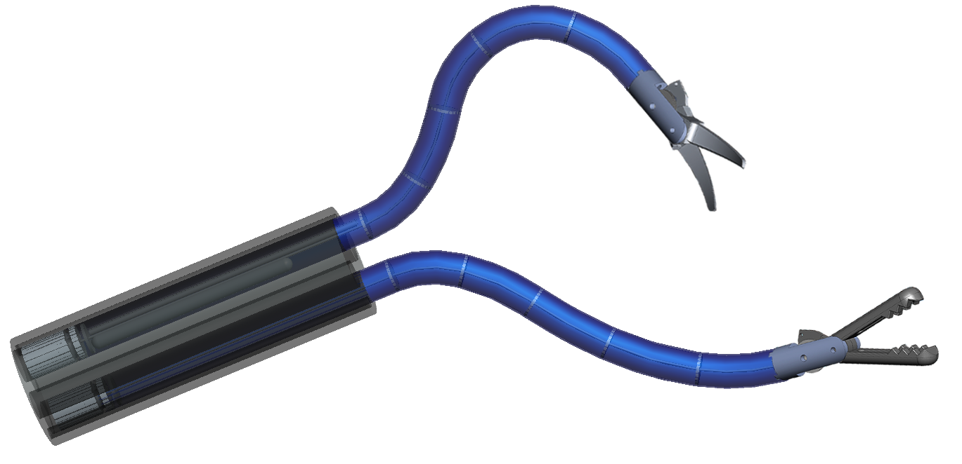
MY DISSERTATION WORK
Natural orifice abdominal access
Fluid-powered continuum manipulator
(source)

Slide 16
AN NSF REU GRANT

Slide 17
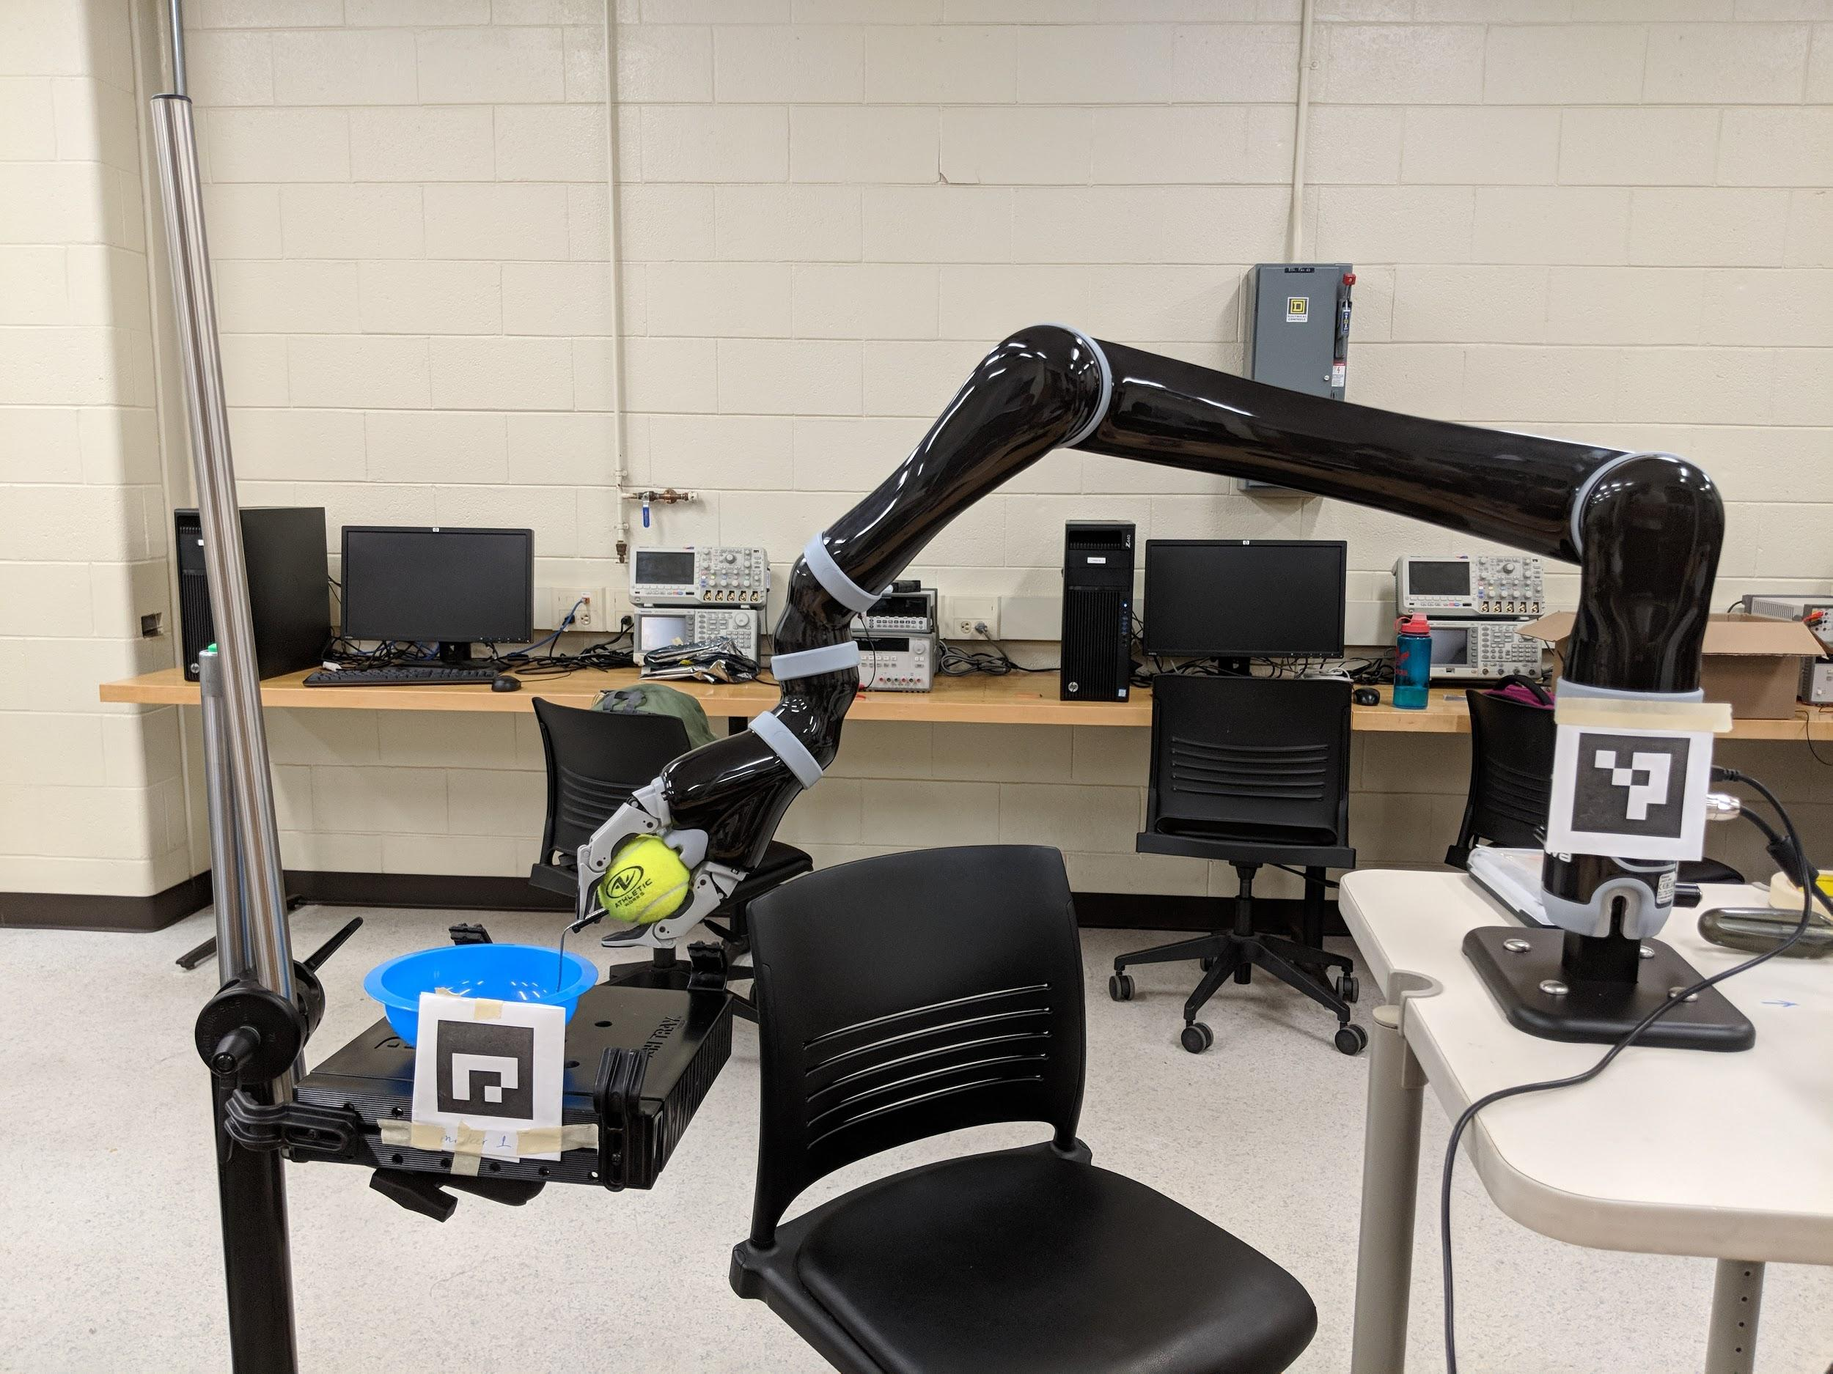
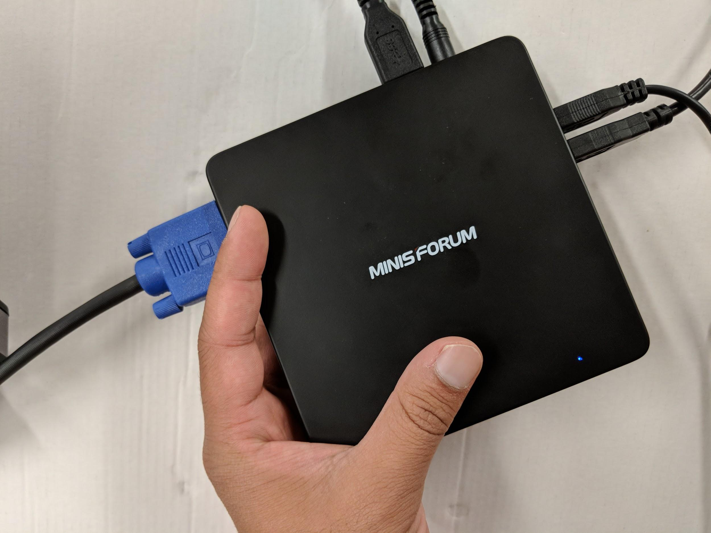
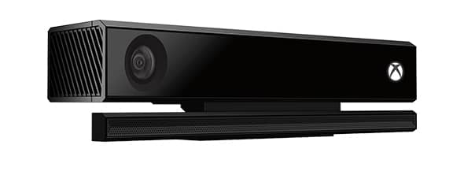
ONGOING WORK WITH A RIGID ARM
Uses Microsoft Kinect for image capture and processing
Coupled with voice commands
Notes:
Kinova JACO 2, Kinect V2, MinisForum Z83-F ($160)

Slide 18
ONGOING WORK WITH A RIGID ARM
Uses Microsoft Kinect for image capture and processing
Coupled with voice commands
Notes:
Facial recognition library gives several trackable parameters, AR markers give position and orientation

Slide 19
ONGOING WORK WITH A RIGID ARM
(Credit: Erin Louwagie, Haiming Lou, Robert Munoz, Dr. Wei Shi)
(source)

Slide 20
ONGOING WORK WITH A RIGID ARM
(Credit: Sujay Bajracharya, Derek Belsky, Bel Klave, Dr. Cheng Liu)
(source)

Slide 21
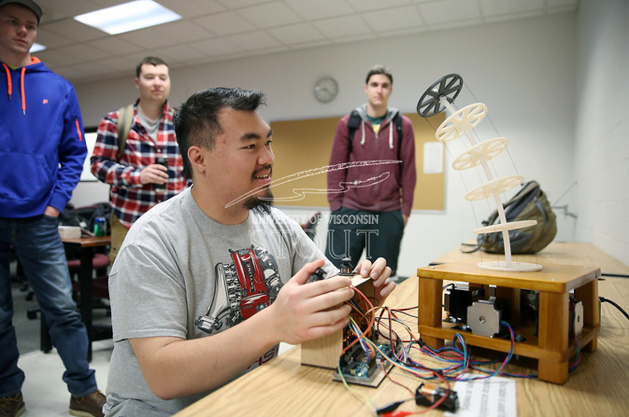
A CONTINUUM ALTERNATIVE
(Credit: Derek Hartmon, Tswjyeej Her,
Joshua Lemke, Daniel Vandenberg)
(source)

Slide 22
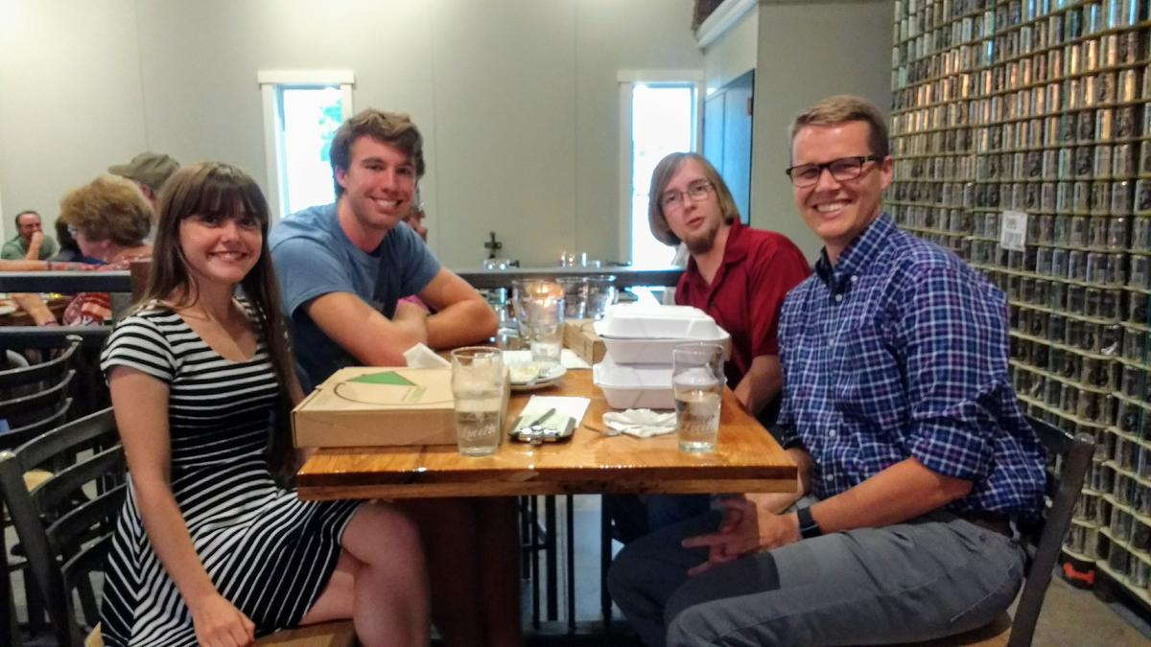
A CONTINUUM ALTERNATIVE
(Credit: Ryan Coulson, Max Kirkpatrick, Megan Robinson)
(source)
Notes:
$550 in component cost

Slide 23
USER TESTING
Dual-Joystick
Single-Joystick Segmented
3 Modes
Single-Joystick Compensative
2 Modes
Re-centering
Slack removal
(source)

Slide 24
USER TESTING: ROUND ONE
A simple task:
Determine control scheme effectiveness
Controlled for age and gaming experience
Qualitative feedback
Compensative method preferred
(source)

Slide 25
USER TESTING: ROUND TWO
Complicated tasks:
Determine improvement through practice
(source)

Slide 26
USER TESTING: ROUND TWO
Improvement shown in short time with robot
(source)

Slide 27
A CONTINUUM ALTERNATIVE
(source)

Slide 28
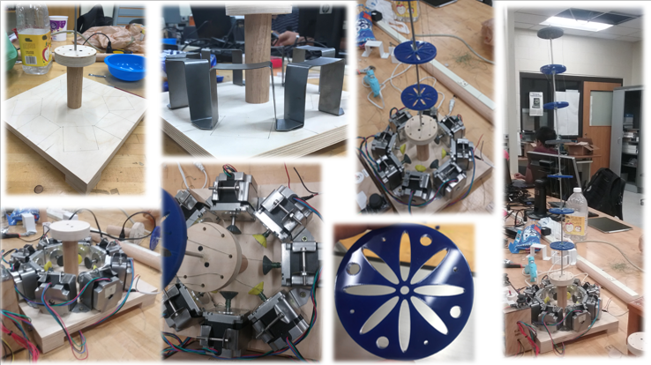
RECENT PROGRESS
(source)
(Credit: Samantha Metevier, Kayla Sneller, Emily Swanson)
Notes:
Goals: to address issues with previous iterations such as backbone instability, ease of use, manipulator control

Slide 29
GOALS OF MANIPULATOR PROJECT
Develop a relatively low-cost arm based upon premise of inherent safety
Intuitive user control
Relatively simple construction
Potential as open-source platform for user development

Slide 30
THANKS!

