Slide 1
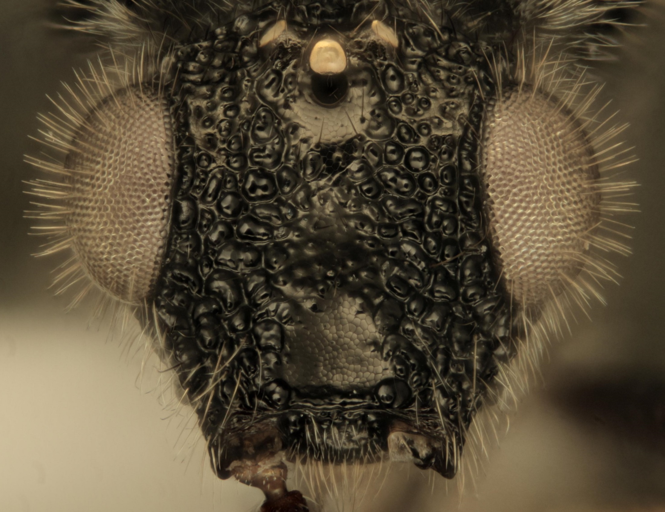
Mysteries of Megaspilidae: Conostigmus spp. (Hymenoptera: Megaspilidae) of the Nearctic
Carolyn Trietsch
István Mikó
Andrew R. Deans
The Pennsylvania State University

Slide 2
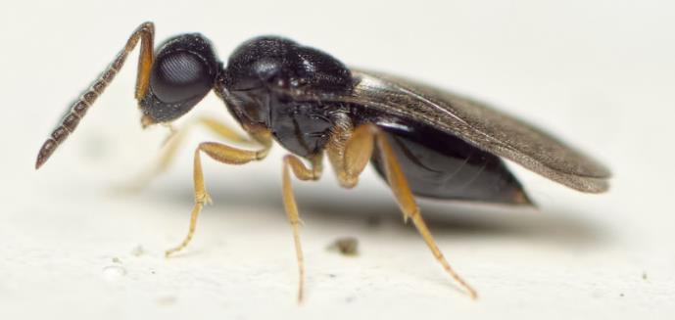
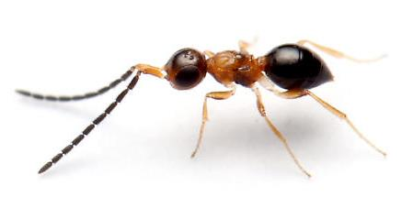
Ceraphronoidea
Megaspilidae
Ceraphronidae
Photo by Pierre Bornand

Slide 3
Conostigmus Dahlbom 1858
169 spp. worldwide
32 spp. in North America (north of Mexico), but never revised
Objectives
Revise Nearctic Conostigmus using morphological and molecular data
Create a key to Nearctic species
Johnson & Musetti (2004)

Slide 4
Materials & Methods
Borrowed over 800 Conostigmus specimens from 13 museums and collections

Slide 5
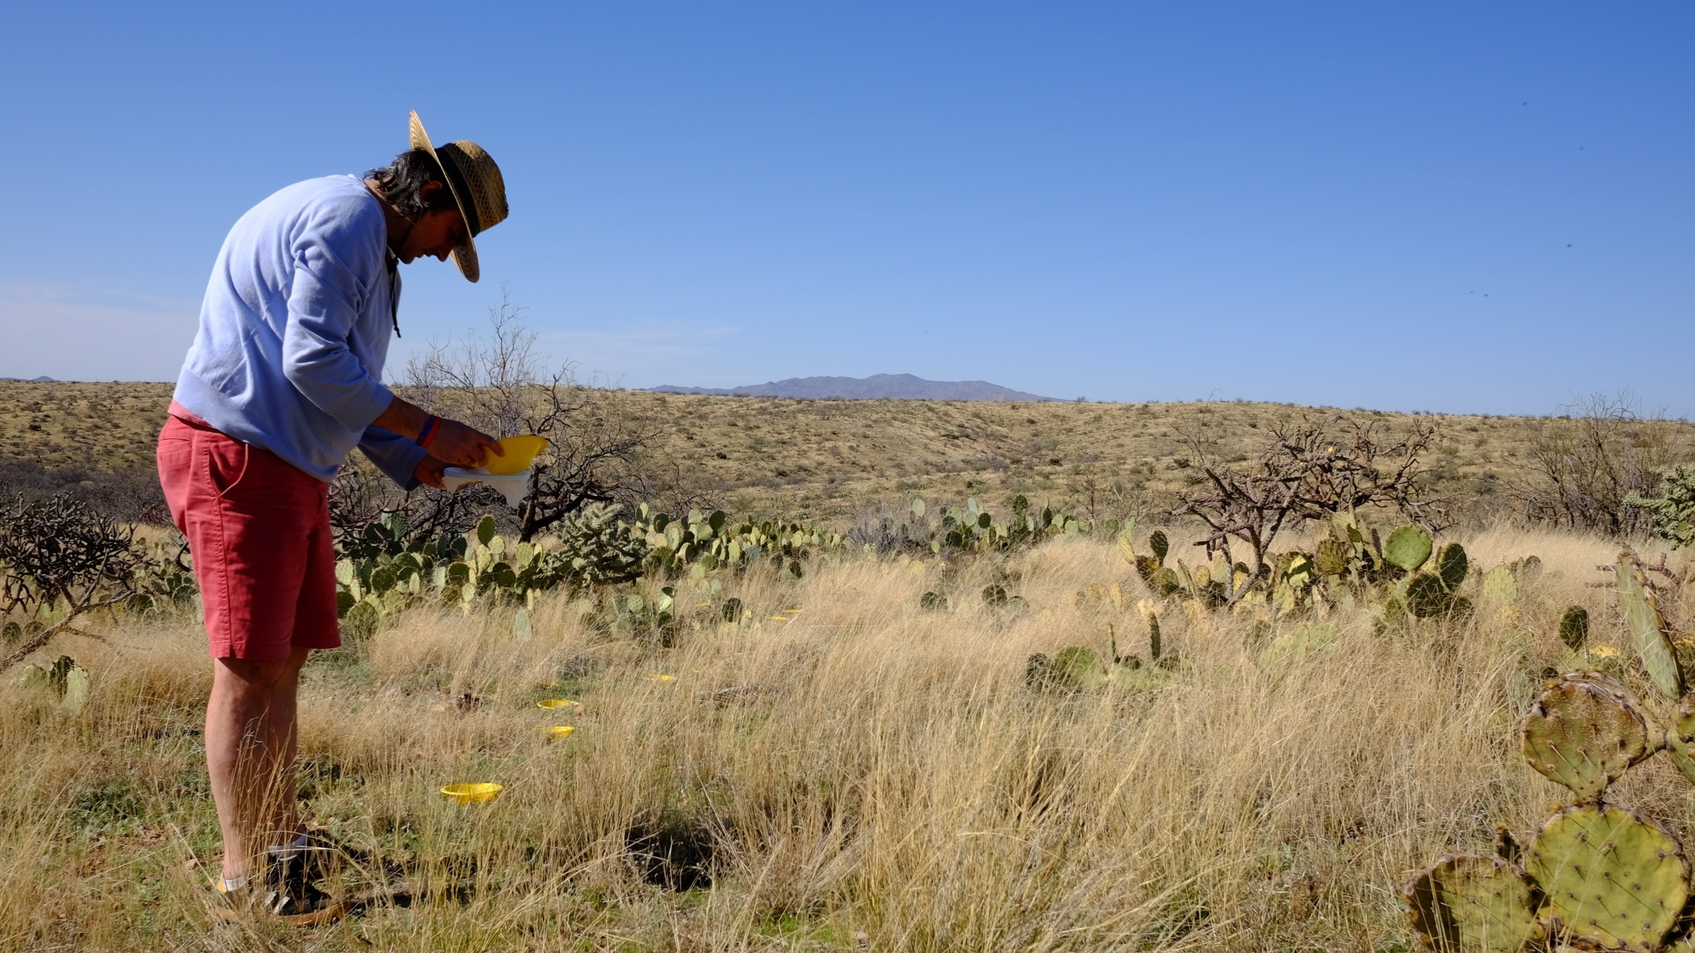
Sampling in: AZ, CT, MA, NC, NJ, NY, PA, UT

Slide 6
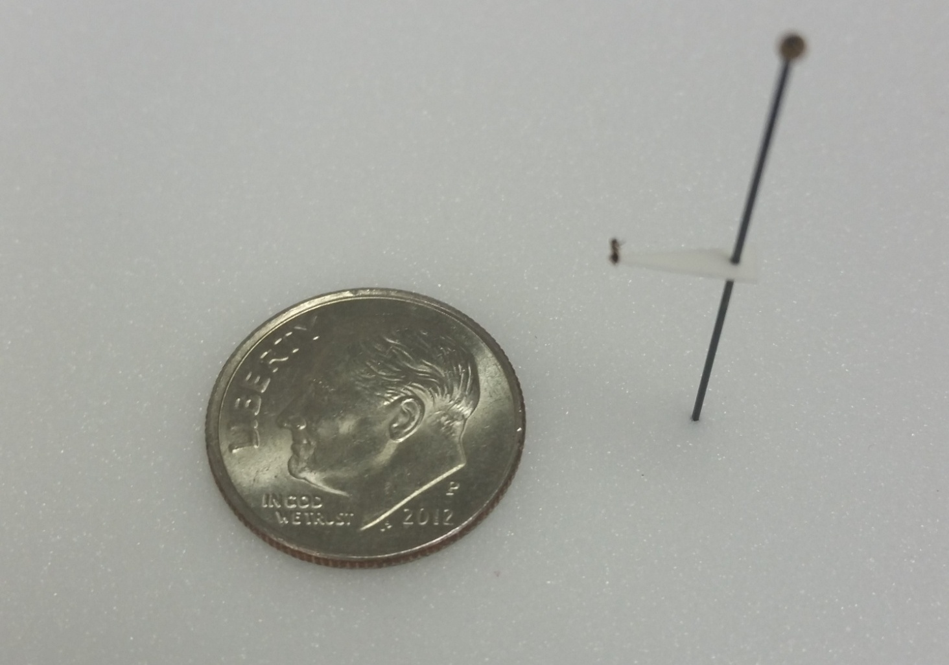
Morphological Approach

Slide 7
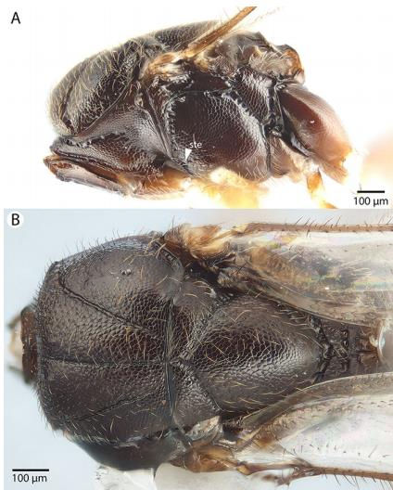
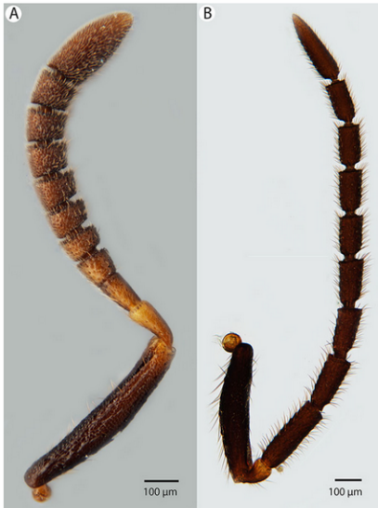
Morphological Approach
Mikó et al. (2017)

Slide 8
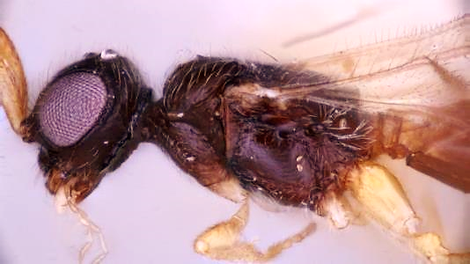
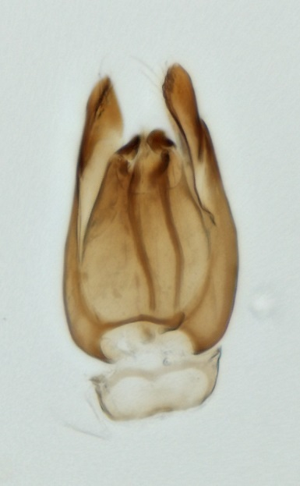
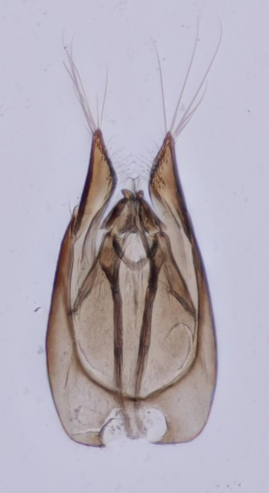
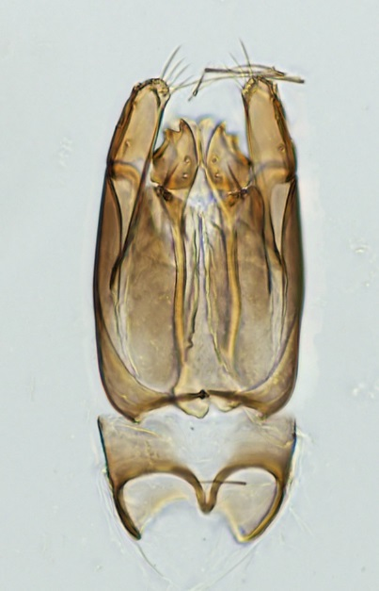
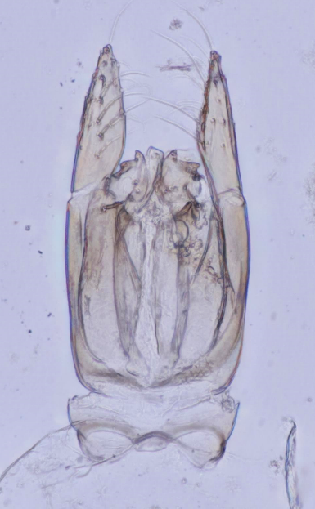
C. sp. C7C
C. sp. C7A
C. sp. C7D
C. sp. C7E
C. sp. C7G
This presentation is not issued for purposes of zoological nomenclature, and is not published within the meaning of the Code.

Slide 9
Results
Morphological Data
39 species concepts (so far!)
32 species known in Nearctic
New to science?
Molecular Data
Mitochondrial CO1, nuclear 28S and 16S
Very difficult!
No previous Conostigmus CO1 primers

Slide 10
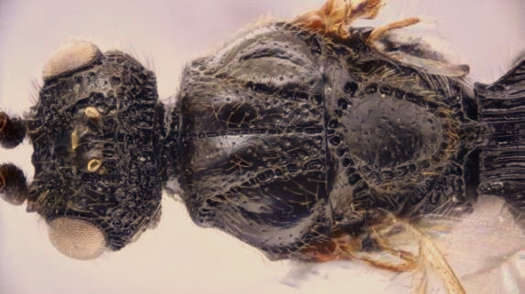
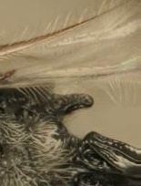
Conostigmus ballescoracas
Megaspilus sp.

Slide 11
Mikó et al. (2013)

Slide 12
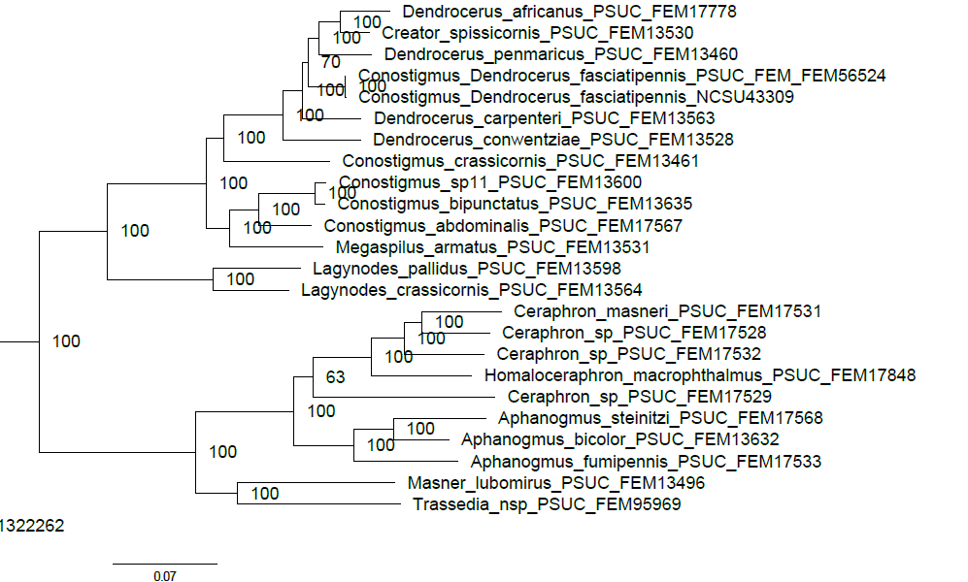
Preliminary UCE Results
V
Blaimer et al. (in prep.), Smithsonian (NMNH)

Slide 13
Mikó et al. (in prep.)

Slide 14
Mikó et al. (in prep.)

Slide 15
Conclusions
UCEs and Synchrotron based micro-CT are valuable for studying Ceraphronoidea
Megaspilus and Conostigmus likely represent the same genus
Future directions
Finish Nearctic revision of Conostigmus
Investigate higher level phylogeny of Ceraphronoidea

Slide 16
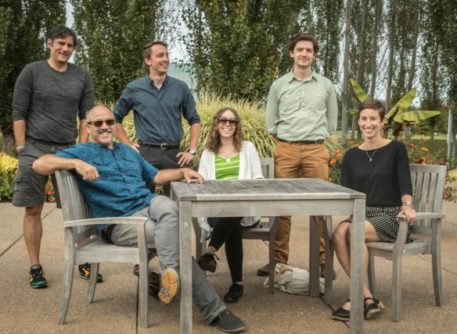
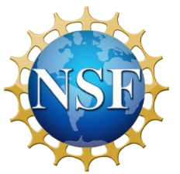
Acknowledgments
Special thanks to Thomas van de Kamp and the researchers at the Karlsruhe Institute of Technology (KIT), Bonnie Blaimer and the researchers at the Smithsonian National Museum of Natural History, Lubomir Masner, Michael J. Sharkey, Luciana Musetti, Matt Bertone, Shawn Clark, Matt Yoder, Missy Hazen, members of the Deans lab, members of the Hines lab, and all the rest!
This material is based upon work supported by the U. S. National Science Foundation, under Grant Numbers DBI-1356381 and DEB-1353252. Any opinions, findings, and conclusions or recommendations expressed in this material are those of the authors and do not necessarily reflect the views of the National Science Foundation.

