Slide 1
Using VIVO for a Research Intelligence System
VIVO Conference * June 8, 2018
Tom Cramer Peter Mangiafico
Assistant University Librarian Product Manager
@tcramer @peetucket

Slide 2
What is Stanford’s research output?

Slide 3
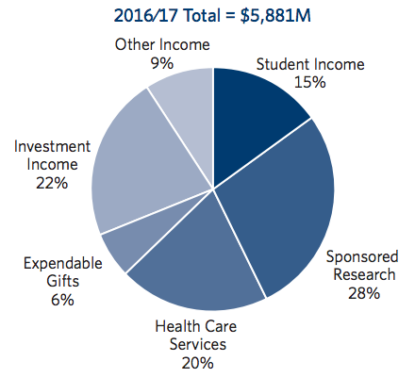
Stanford Statistics
University Revenue
2,180 faculty members
9,304 graduate students
7,032 undergraduates
6,000+ sponsored projects
18 independent labs, centers & institutes
$94 million from 779 licensed technologies
141 new licenses in 2015-16
$1.6 billion research budget
http://facts.stanford.edu/pdf/StanfordFacts_2017.pdf
https://web.stanford.edu/dept/pres-provost/budget/plans/BudgetBookFY17.pdf

Slide 4
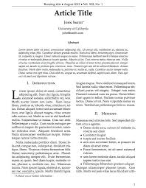
Stanford Knows…
WHO
HOW
WHAT

Slide 5
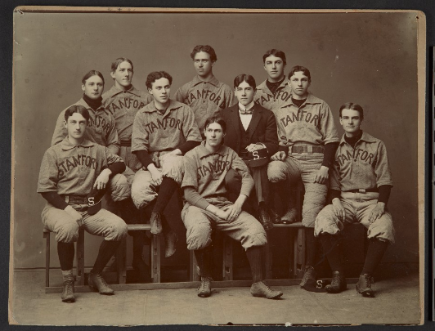
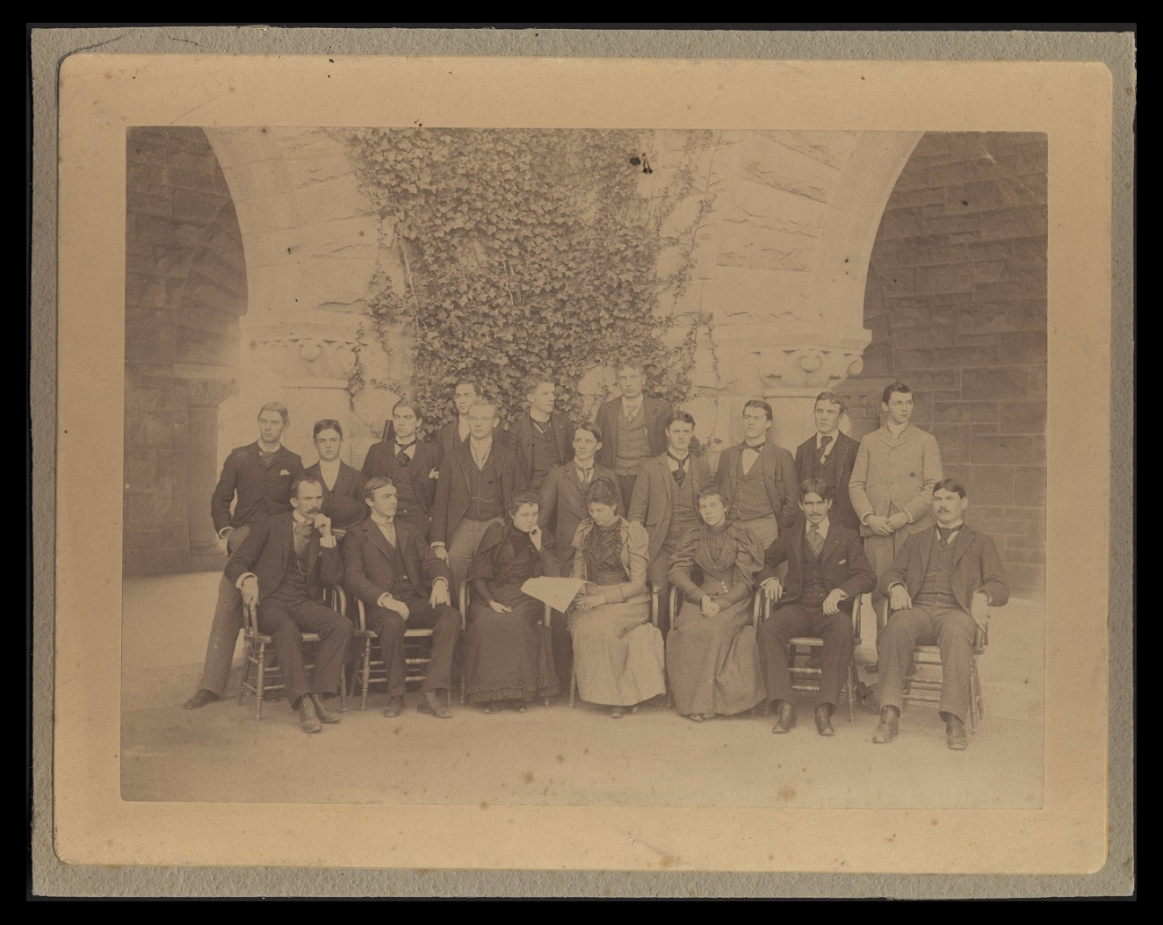
Stanford Baseball Team, undated
Staff of The Stanford Daily in 1926
https://purl.stanford.edu/qx454wd5357
https://purl.stanford.edu/zt289hb8261
A baseball team with
the line up and
schedule,
personal stats,
but no team scores?
A newspaper with
Staff, articles and daily readers,
but that doesn’t track circulation or keep any back issues?

Slide 6
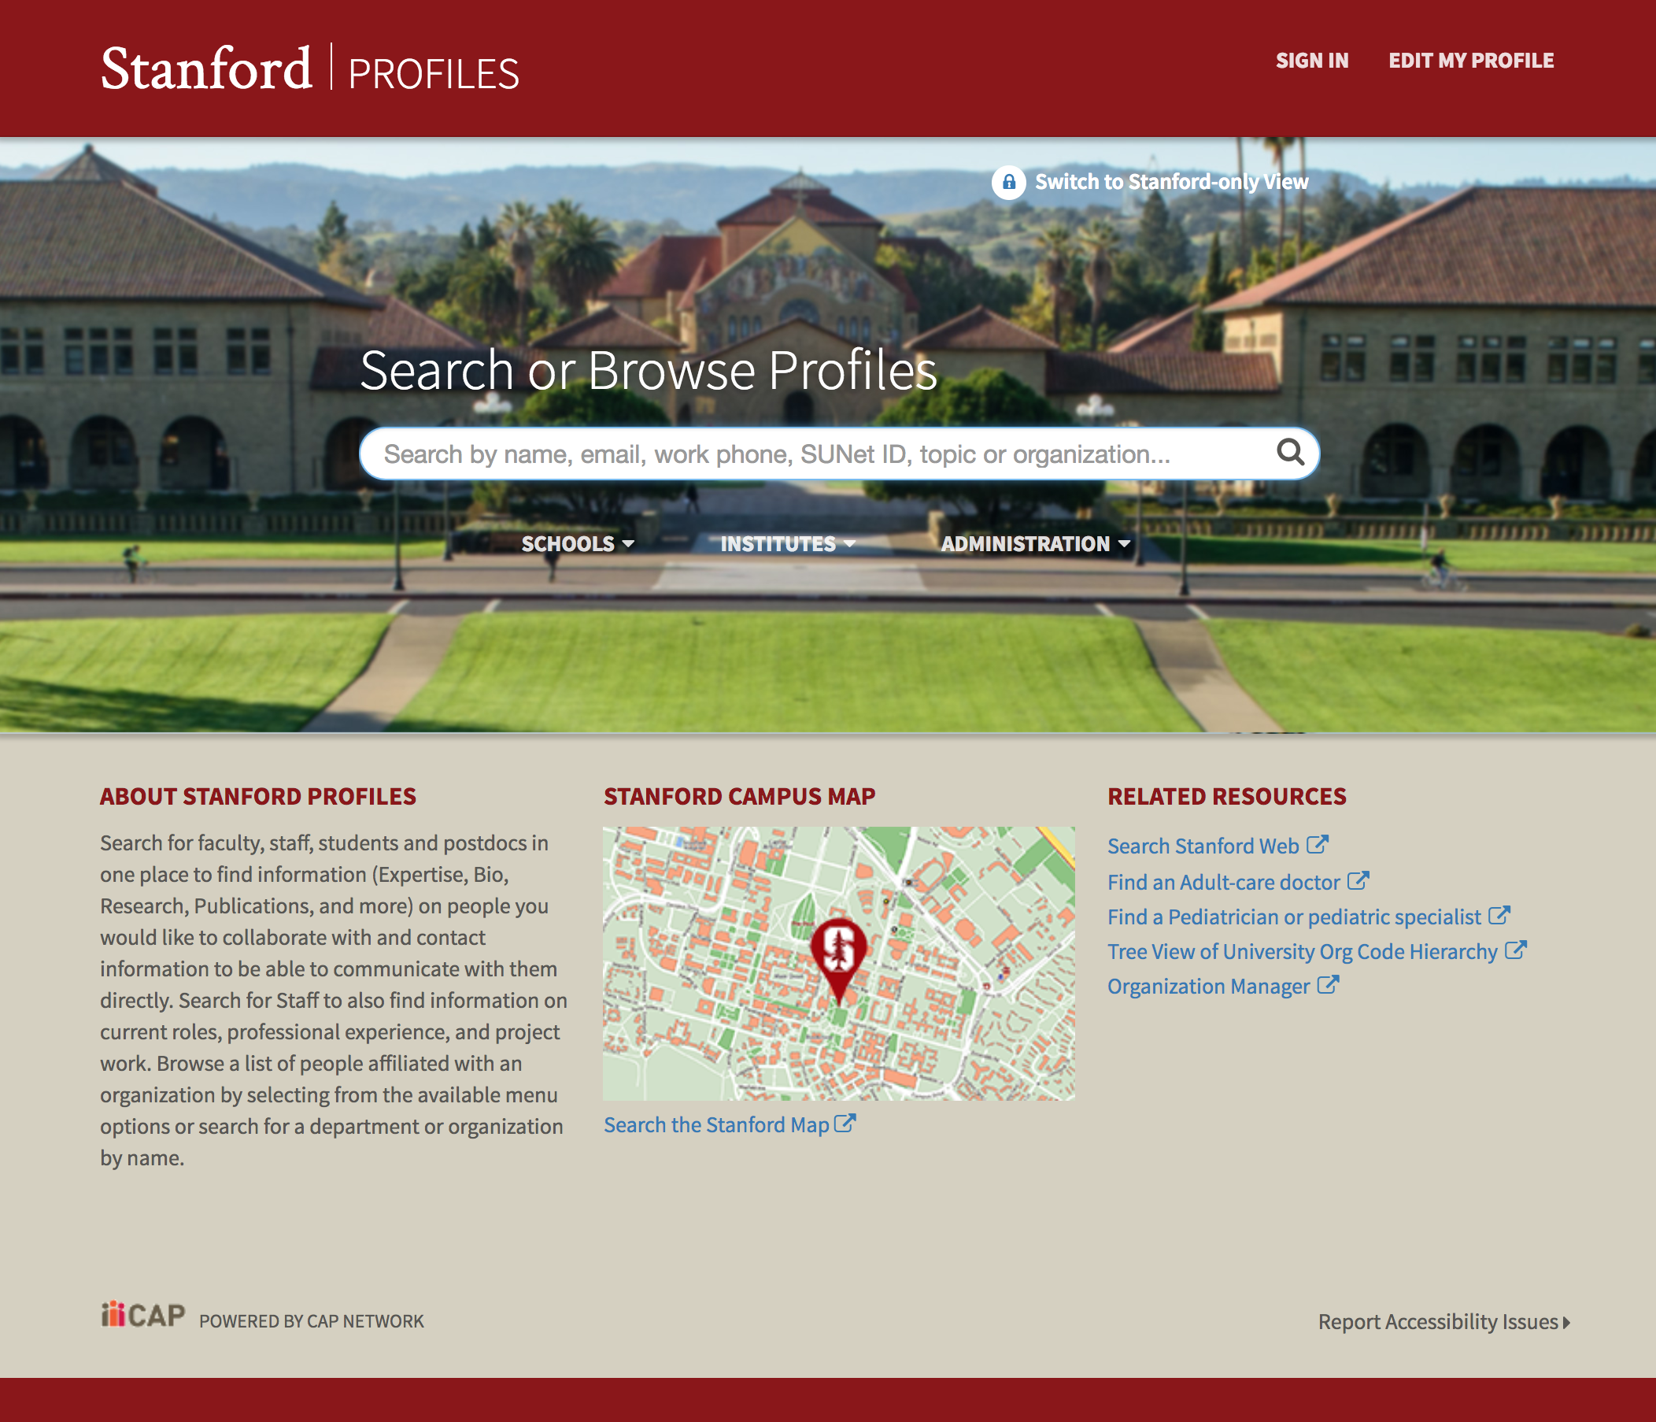
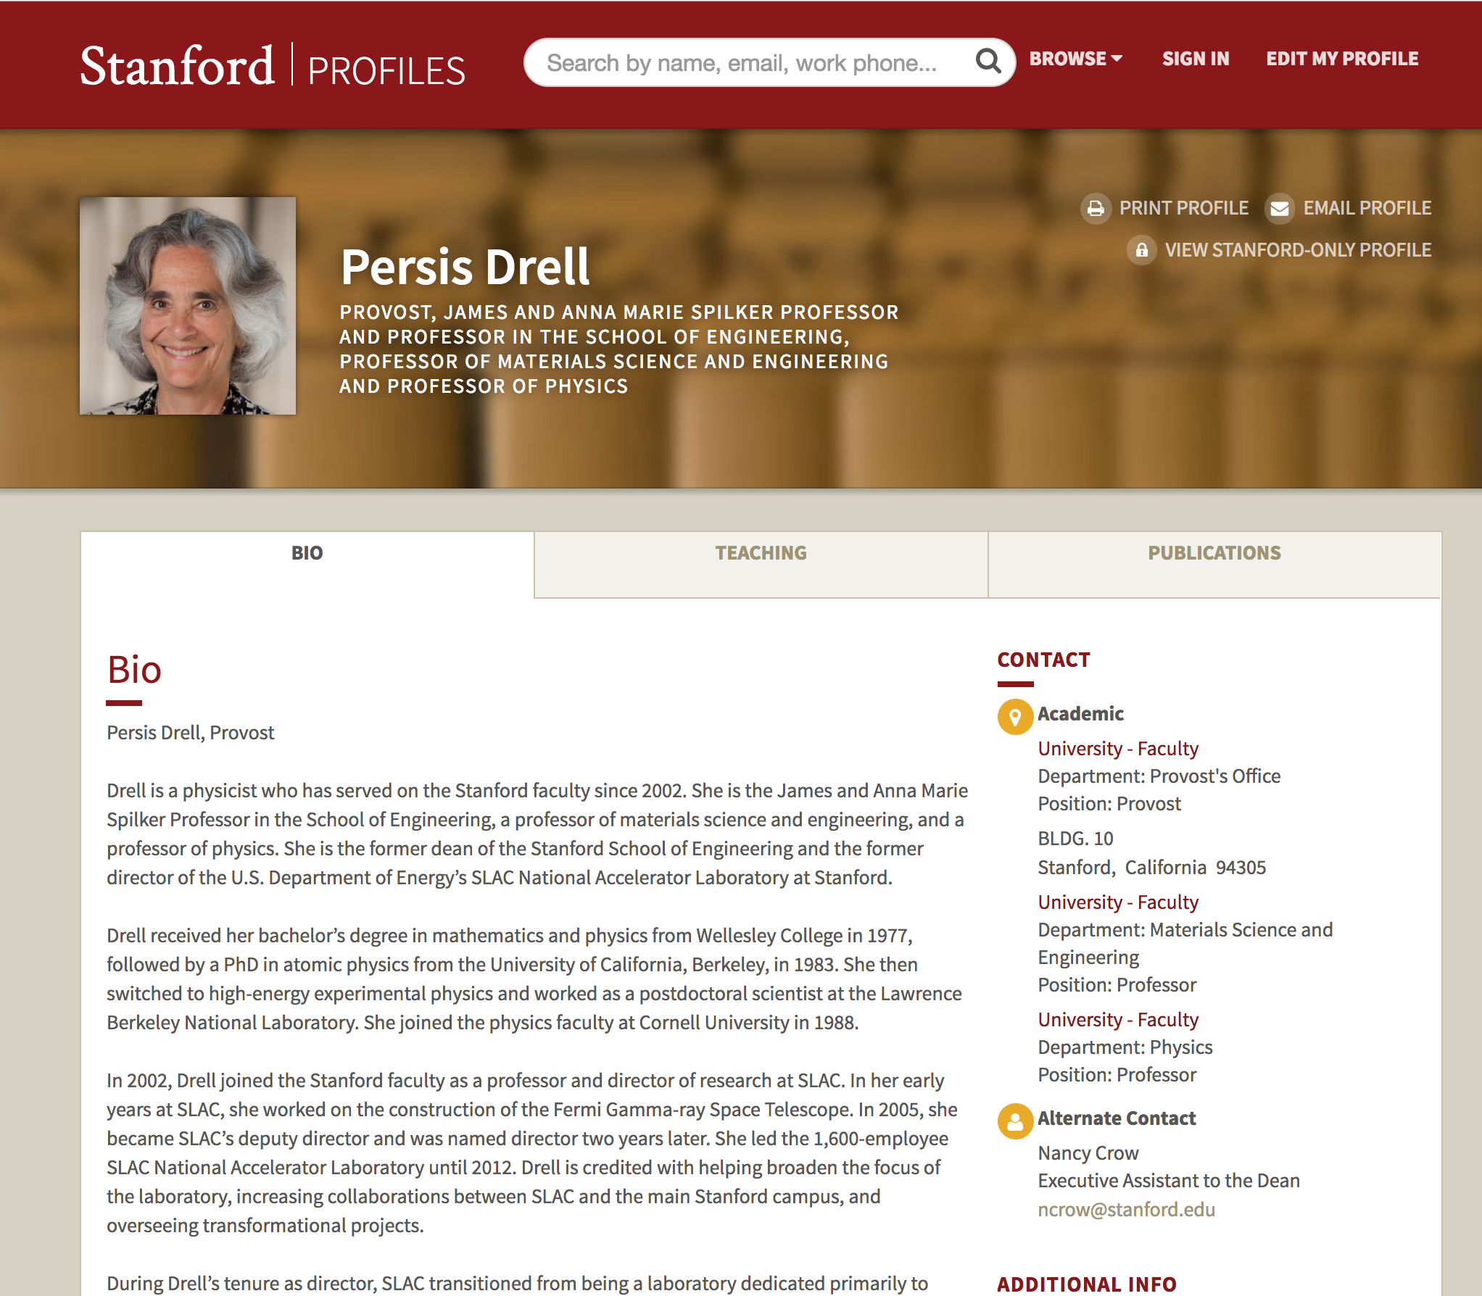
(not based on VIVO)
Profiles.stanford.edu

Slide 7
Knowing the What Increasingly Matters
General awareness
Reporting
Demonstrating impact
Trend analysis
Rapid response
Compliance with mandates & policies
Research networking / enabling collaborations

Slide 8
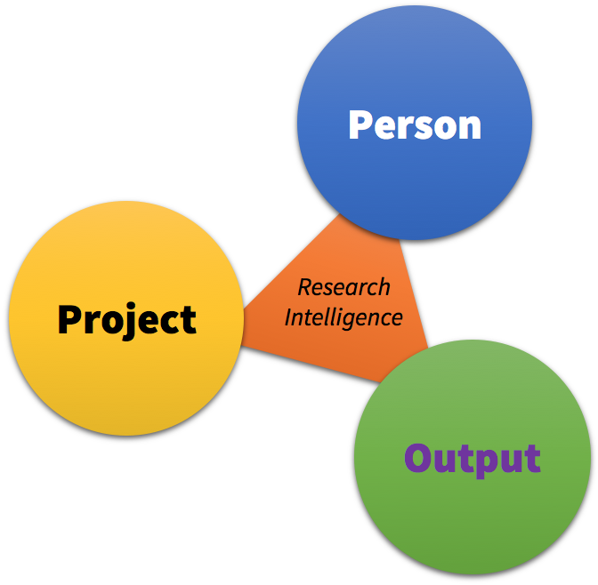
Flavors of Research Intelligence Systems
RIM (Research Information Management)
CRIS (Current Research Information System)
RNS (Research Networking System)
RPS (Research Profiling System)
FAR (Faculty Activity Reporting)
Research Analytics
Research Evaluation
Profiles systems
See Bryant, Rebecca, et al.; 2017. Research Information Management: Defining RIM and the Library’s Role. Dublin, OH: OCLC Research. doi:10.25333/C3NK88

Slide 9
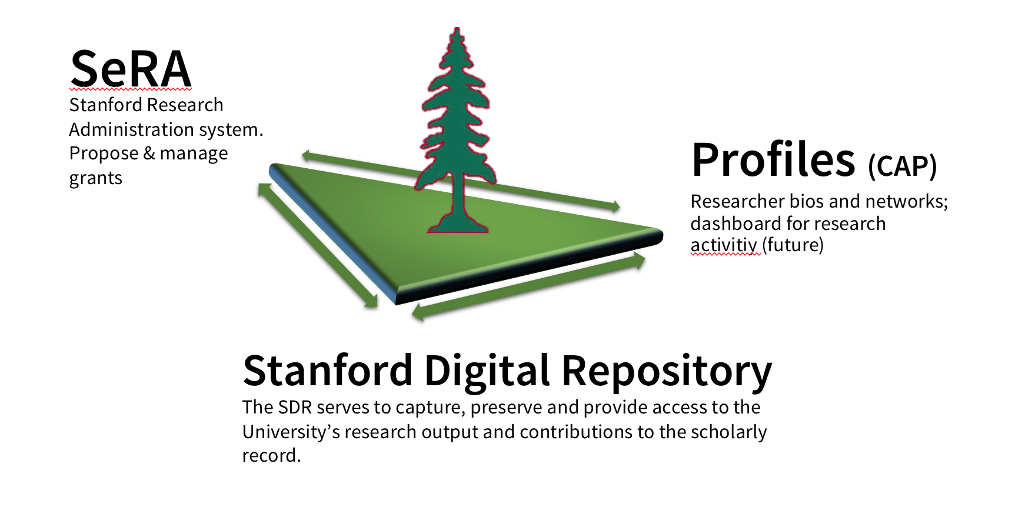
Stanford’s “Research Core”

Slide 10
RIE: Research Information Ecosystem
Who: Dean of Research + Libraries + Office of Research Administration + University IT
Objective: Enhance faculty research & scholarship at Stanford
How:
Open, internal data exchange
Reduce data friction & reentry
Increase creative & analytic opportunities
Leverage data already in the University

Slide 11
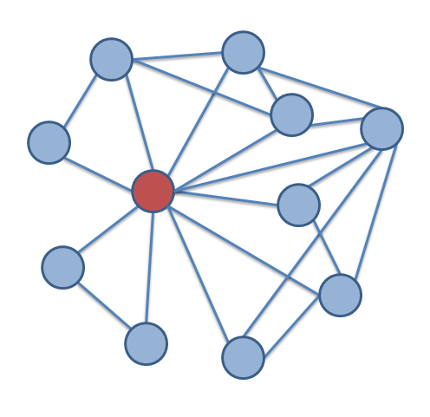
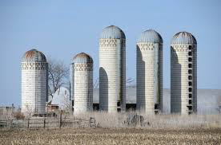
From “Cylinders of Excellence” to a Network

Slide 12
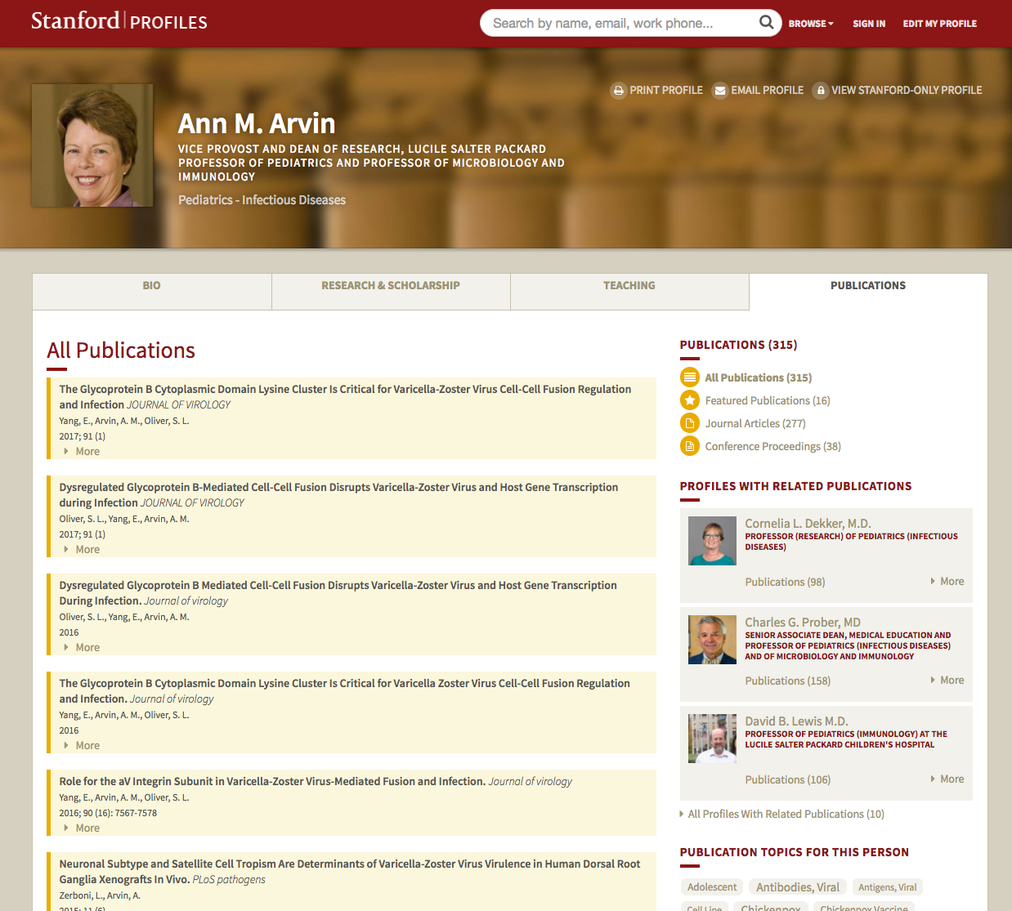
Example 1: Publication Data + Profiles
Publication data harvested and managed by
the Libraries
Direct link to full text and data sets in the SDR (potential development)

Slide 13
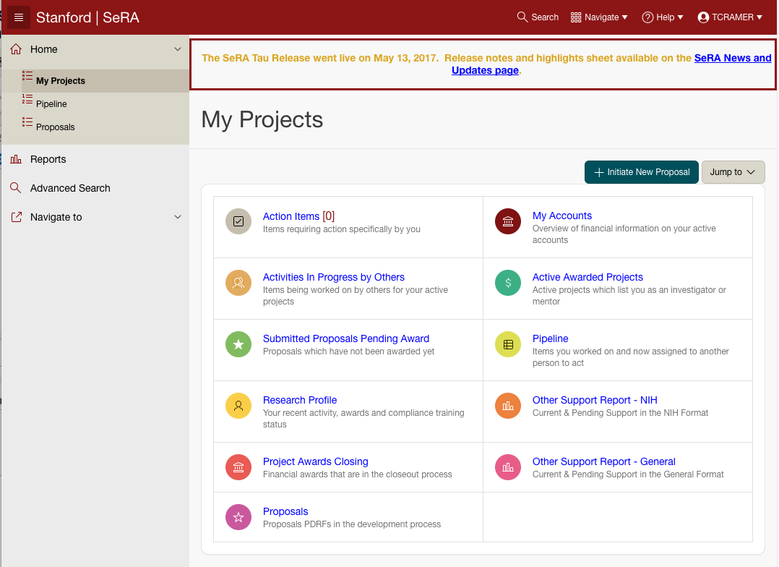
Example 2: SeRA + SDR
Ticklers to deposit research data / articles / reports to SDR for preservation & access (and grant compliance)
Intelligence on upcoming grants with data management requirements

Slide 14
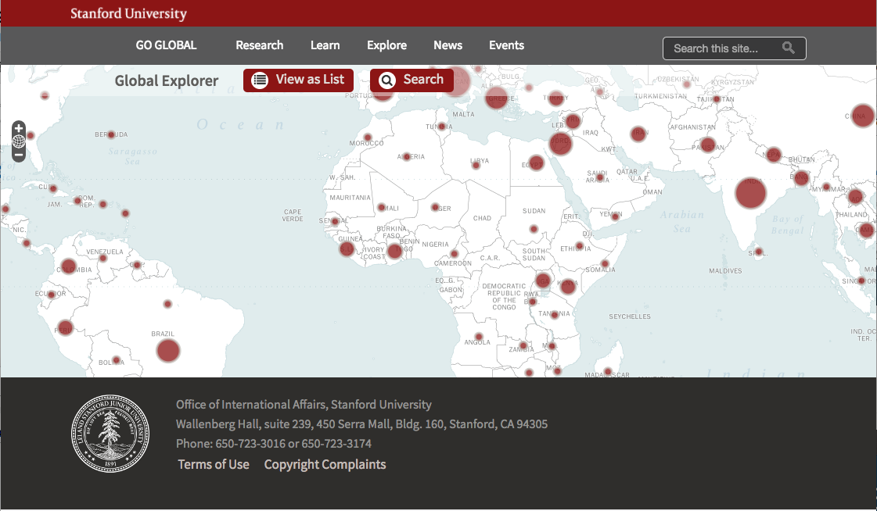
Example 3: Research GeoData to GoGlobal
Stanford’s Office of International Affairs tracks, promotes & facilitates Stanford’s engagement in countries across the world.

Slide 15
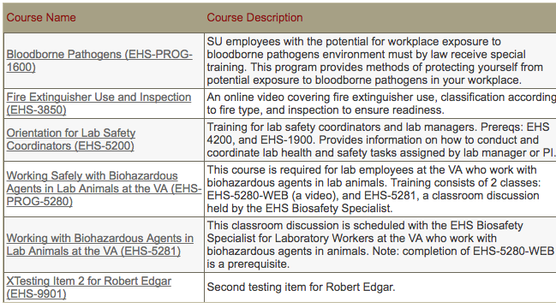
Example 4: SeRA, STARS, and EH&S
EH&S Environmental Health & Safety
SeRA Research Administration
STARS Training System

Slide 16
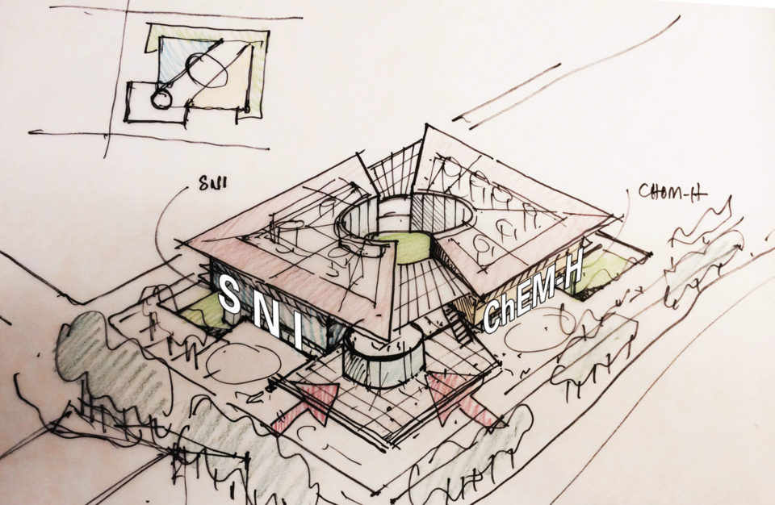
Example 5: Space Planning
Planning office & lab allocation based on collaboration data extracted from RIALTO and Profiles.
SNI & Chem-H Designed to innovatively co-locate two emerging research institutes – Stanford Neurosciences Institute and Stanford Chemistry, Engineering Medicine and Human Health (ChEM-H)

Slide 17
Q: What is Stanford’s Research Output?
Stanford is a research enterprise.
SeRA manages grants administration. Profiles & PeopleSoft manage person information.
SDR holds digital assets (but not all research artifacts).
Where & how do we track the University’s research output?

Slide 18
Q: What is Stanford’s Research Output?
Stanford is a research enterprise.
SeRA manages grants administration. Profiles & PeopleSoft manage person information.
SDR holds digital assets (but not all research artifacts).
Where & how do we track the University’s research output?
A:

Slide 19
RIALTO is being developed by SUL
As a database, it captures and relates information on research artifacts (articles, data and more), research activities (grants/projects), and the people and groups who do them.
As a web application, it provides intelligence and reporting on Stanford’s research activities and output.
Through its integration to other campus systems (e.g., Profiles, SeRA, SDR, etc.), it produces and consumes information vital to Stanford’s research core systems.
Through its campus APIs, it supports visualizations and data mining for special purpose and ad hoc needs.
Through linked data, it is Stanford’s face to the Web of Data.

Slide 20
RIALTO
Funding Agencies
Stanford Profiles
External Repos
Relate
RIALTO
Stanford Digital Repository
Publishers
Report
Reuse
SeRA
Web of data
Identifier Services (ORCID, ISNI)
Notes:
Market developing to aggregate, relate, report & analyze data across systems & lifecycle.

Slide 21
Emerging Verticals
Point Solutions of Note:
Academia.edu
Research Gate
ORCID
CrossRef
Google Scholar
Clarivate
Elsevier
Digital Science
Open stack
Discovery
Web of Science
Scopus
Reference Management
Mendeley
(ReadCube)
Open Science Framework
Social Networking
(FigShare)
Profiles
WoS Profiles
Expert Finder
VIVO
Publications / Citations
SHARE
Evaluation / Analysis
InCites
SciVal
Symplectic Elements
CRIS
Converis
Pure
Funding Opportunities
Dimensions
Digital Repository
Mendeley Data / SSRN
FigShare
Zenodo

Slide 22
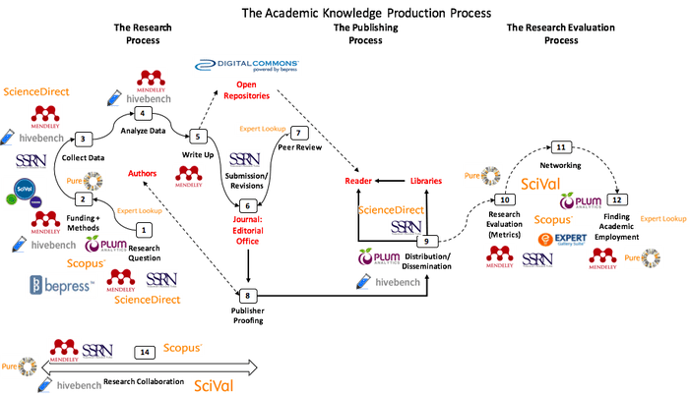
Posada & Chen: Elsevier’s Growing Position
http://knowledgegap.org/index.php/sub-projects/rent-seeking-and-financialization-of-the-academic-publishing-industry/preliminary-findings/
Notes:
“Elsevier has recently rebranded itself from an academic content provider to an “Information Analytics Company””
” However, as big publishers move towards openness they have also been redirecting their business strategies towards the acquisition of scholarly infrastructure, the tools and services that underpin the scholarly research life cycle, many of which are geared towards data analytics. ”

Slide 23
Use Cases and System Architecture

Slide 24
Uses cases...use cases...use cases!

Slide 25
Case Study: Fostering International Research
“ I was at a meeting for the Academy of Sciences recently about ‘barriers to international research,’ and multiple faculty members stated wistfully that it would be amazing if we could map, or at least count, the international co-authors of Stanford authors as a case for how important international researchers are to Stanford.
“Do you think it would be possible to design a RIALTO query that could surface co-authors from non-US institutions?”

Slide 26
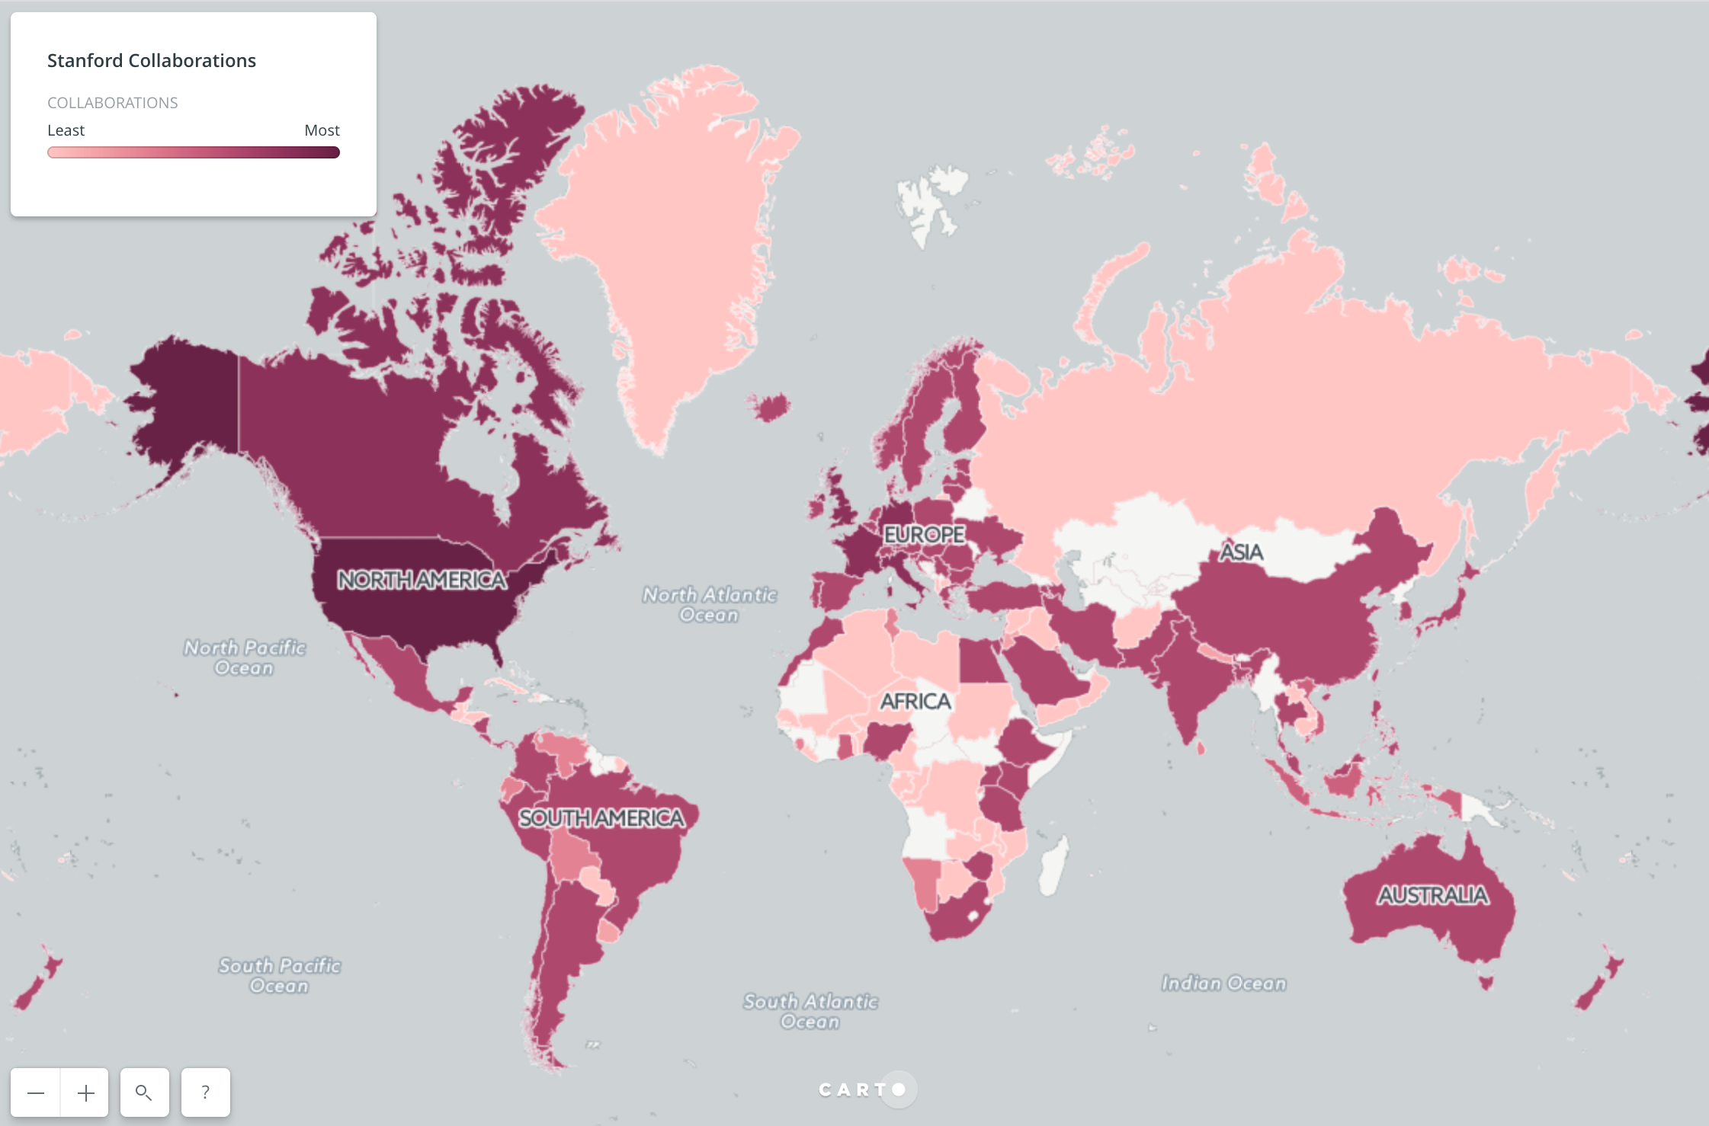
After some manual queries...
Holy... Peter, I've been waiting 6 yrs for what you did in less than a week! This is the richest data set about our global research footprint that we have ever produced, bar none.

Slide 27
Research Intelligence: Sample Stories from Stanford
As a university administrator, I need to understand the impact of cross-disciplinary institutions on research impact so I can assess their ROI
As the Director of the Office of International Affairs, I need to be able to map faculty members' international co-authors by institution so that I can make strategic decisions about potential university-wide partnerships.
As a university administrator, I want to measure the impact of research on student publications so that I can understand which faculty members and granting agencies produce the most student publications
As a university administrator, I need to know which publications resulted from which grants so that I can fulfill reporting requirements to funding agencies
As a department administrator, I need to know how many publications are being produced by each department so that I can report this information
As a subject or data librarian, I want to be able to track incoming awarded grants so that I can talk to researchers about their data preservation and resource needs
As an administrator, I need to understand how the use of building resources and assignments to rooms affects productivity and output

Slide 28
Proposed RIALTO Architecture
Data Pipeline harvests from multiple known sources, transforms & enhances source data, then loads into the RIALTO canonical datastore.
Canonical Datastore allows scalable ingest, exposure, schema evolution, & complex relationship querying between managed entities as well as real-time population of downstream datastores (e.g., representations for web app usage);
Web Application exposes visualizations, reports, & landing pages for RIALTO entities sufficient to satisfy the collated requirements below.

Slide 29
Proposed RIALTO Architecture
Web of Science API
Stanford Profiles API
Other Data Sources?
Harvest Source Data Dump / Batch Load
Dimensions API?
Data Pipeline
Harvest: Pull in & cache data from APIs, Batch loads, other sources
Normalize: String clean-up, field mappings to IR, validation for data shapes
Merge: Overwrite existing data where it is updated, create new otherwise, perform reconciliation
Enhance: Reconcile externally, pull in other data possibly
Publish: Load new data into store of record, notify systems of changes
SDR (later)
Canonical Datastore
Web App
Publishes RIALTO resource pages
Display results of queries on data
Generate visualizations
Creates Pages based on data profiles
GUI
Entity Pages datastore
Viz API
Realtime viz & reports
Visualization datastore
Graph => UI data translations
RIALTO external publishing API (later)

Slide 30
Tech Selections
Data Pipeline: Traject/Plus
https://github.com/traject/traject
Canonical Datastore: Vitro with Jena
https://vivoweb.org/info/about-vitro
Web App: Ruby on Rails with Blacklight https://github.com/projectblacklight/blacklight

Slide 31
RIALTO and VIVO
Our knowledgebase: https://github.com/sul-dlss/rialto/wiki
Actual code lives in various other github repos
Performing enumeration, evaluation and performance metrics for various data ingest options to see what works at scale
https://github.com/sul-dlss/rialto/wiki/Vitro-Data-Ingest-Options
https://github.com/sul-dlss/rialto/wiki/Performance-Assessment
Not used as a profiles system, though entity pages may be useful to view aggregated data

Slide 32
Topics for Community Engagement
What are your experiences with using the VIVO stack for data aggregation and analytics?
What are your experiences in loading a large amount of data into the VIVO stack (one time and incrementally)?
What are your experiences in running arbitrary queries against the aggregated data?
What front-end technologies are you using to augment the VIVO UI for analytics purposes?
How can we onboard new developers to the VIVO tech stack more efficiently?

