Slide 1
NRAQC
NEAR REAL-TIME AUTONOMOUS QUALITY CONTROL SOFTWARE FOR THE NEVADA RESEARCH DATA CENTER
Presented By:
Connor Scully-Allison (ESIP Student Fellow)

Slide 2
Overview
Introduction
The problem of Invalid Data
The solution for Invalid Data
NRAQC Details
FAIR Data Practices
Challenges and Future Work

Slide 3
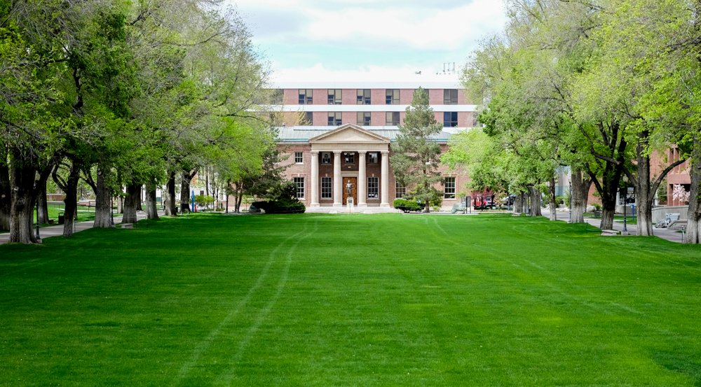
About the Presenter
Master’s Student at University of Nevada, Reno
Dept. Computer Science
Research Interests Include:
Data Science
Interdisciplinary Scientific Software Development
Human Computer Interaction

Slide 4
Nevada Research Data Center (NRDC)
NSF Funded
We primarily build software to support the needs of several in-situ deployments across rural Nevada
Ingests over 100,000 data points per day
Currently managing over 3bn data points collected over the last 10 years
“Big” Data

Slide 5
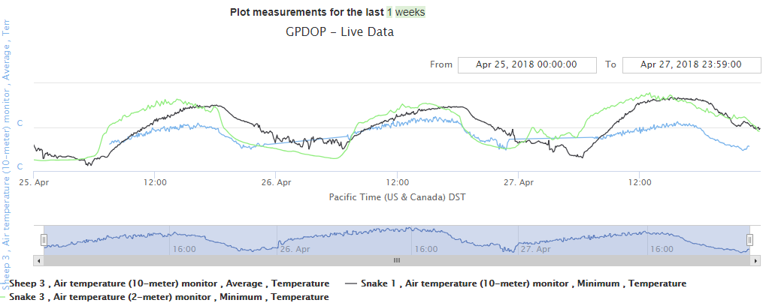
The Data We Manage
Time series environmental data from 13 sites across nevada

Slide 6
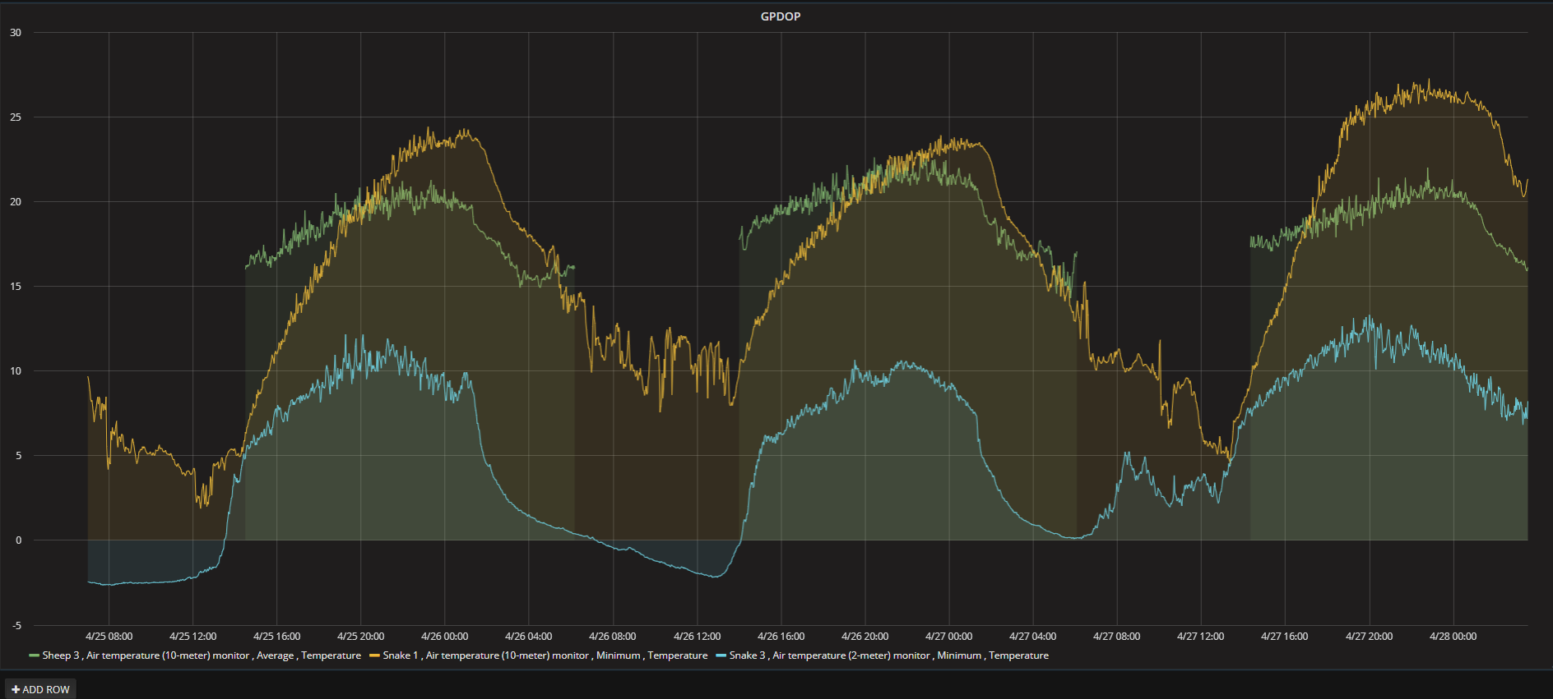
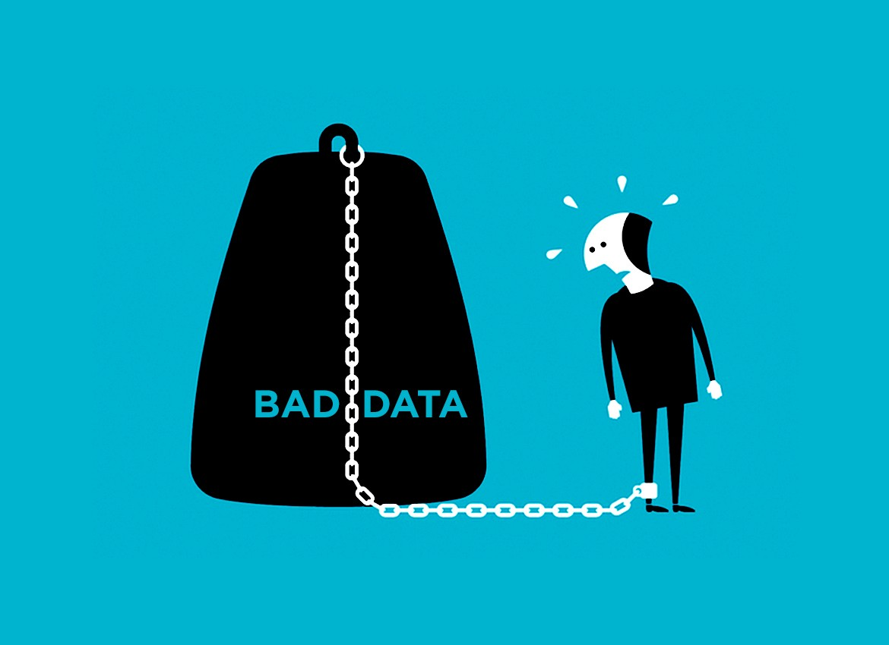
Invalid Data?
What is invalid data?
Data Logged Erroneously
Missing Data
Why is it problematic?
Data Analytics
Data as a Product
The current model (for the NRDC)

Slide 7
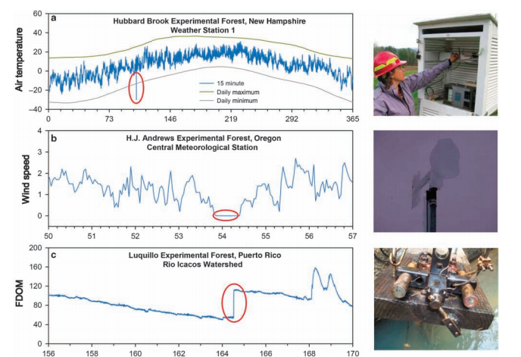
Specific problems in Streaming Data
Some specific failure points for data
Out of Bounds
Repeated Measurements
Slope Errors

Slide 8
More Specific Problems
More Specific Places Data Can go Bad
Missing Data Values
Spatial Consistency
Between Similar Sensors Close To One Another

Slide 9
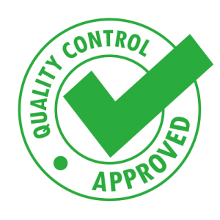
The Solution For Invalid Data
Quality Assurance and Quality Control
The Former is dependent on humans
Repairing, Maintaining and Documenting
The latter can be Automated
And that’s where this software comes in . . .

Slide 10
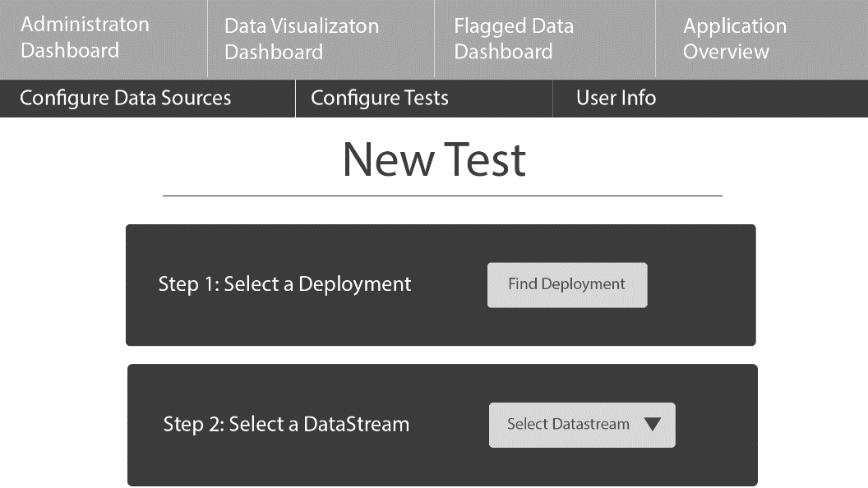
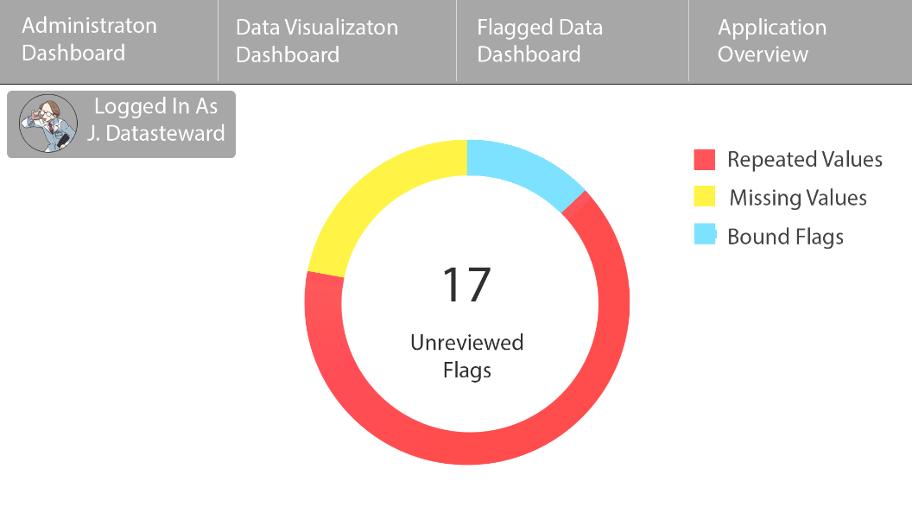
What is NRAQC?
A web application that:
Autonomously flags streaming sensor data in near real time
Provides a means for Data Stewards to Create and Configure Tests
Provides Data Visualization tools to view Flagged Data
Provides tools for human-assisted flagging of data
And much much more!

Slide 11
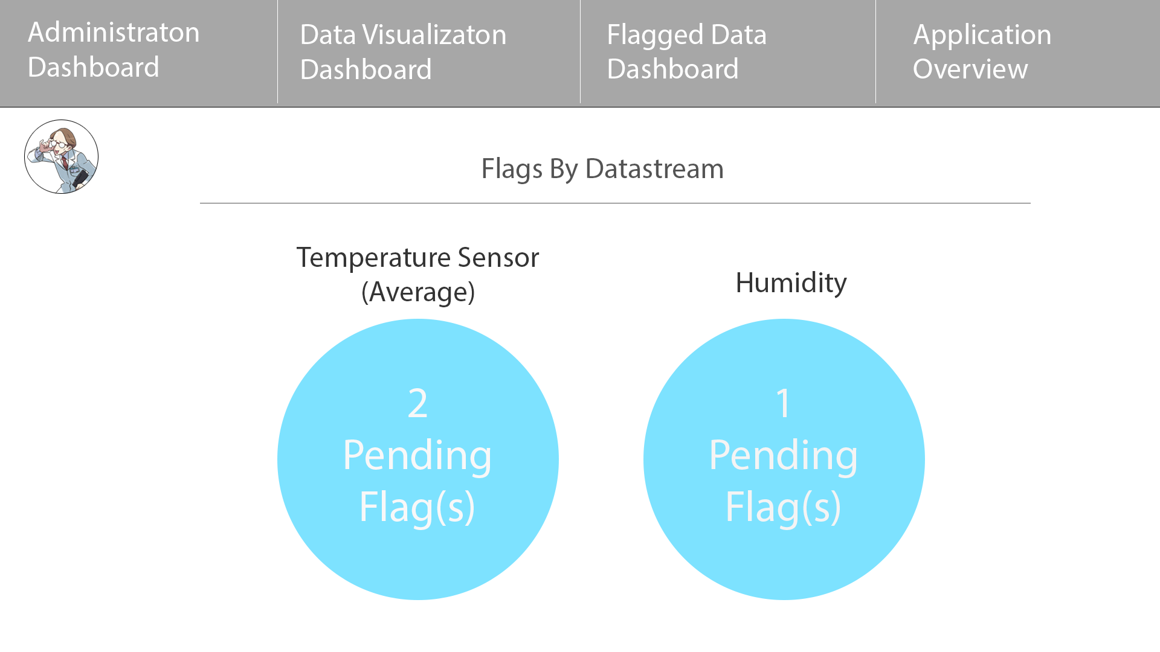

Slide 12
Microservice Architecture

Slide 13
NRAQC Backend - How does it work?
Pipeline Architecture
DP
90
90
DP
90
90
DP
90

Slide 14
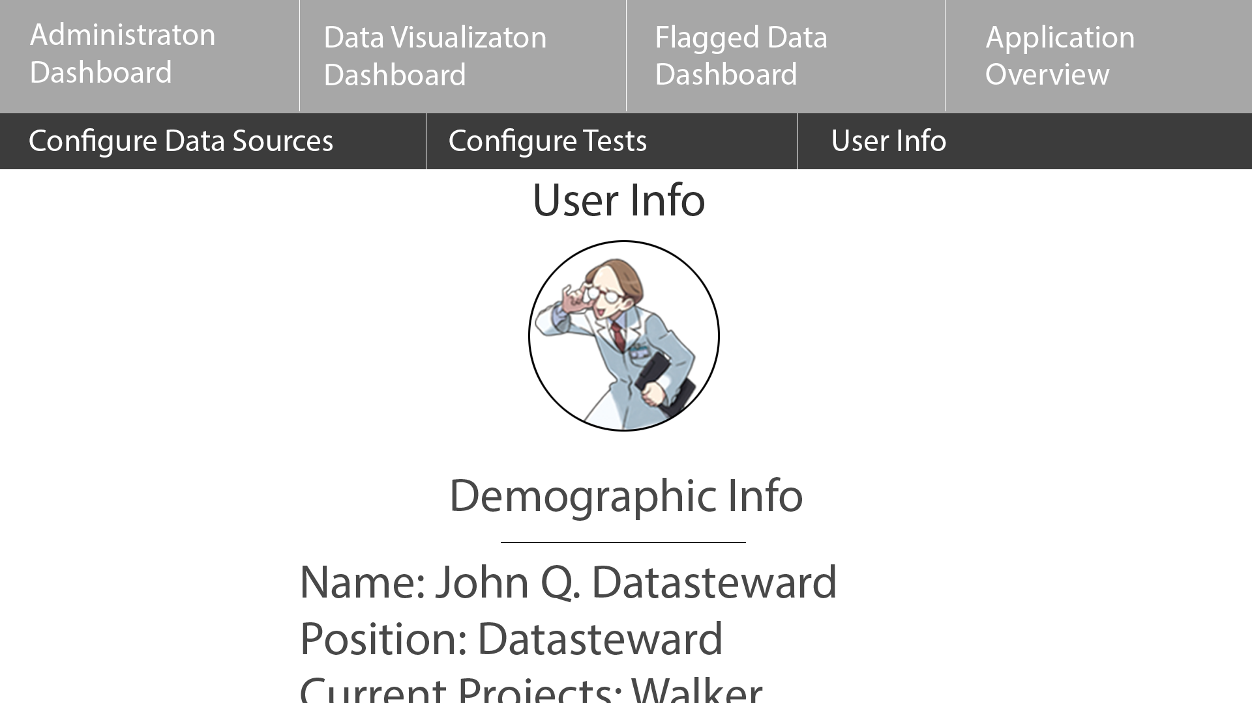
The Pretty Parts
Primary Workflow
Configuration
Data Visualization

Slide 15
Broader Impacts
What does this autonomous quality control software mean for my Indiscipinary colleagues at ESIP and beyond?

Slide 16
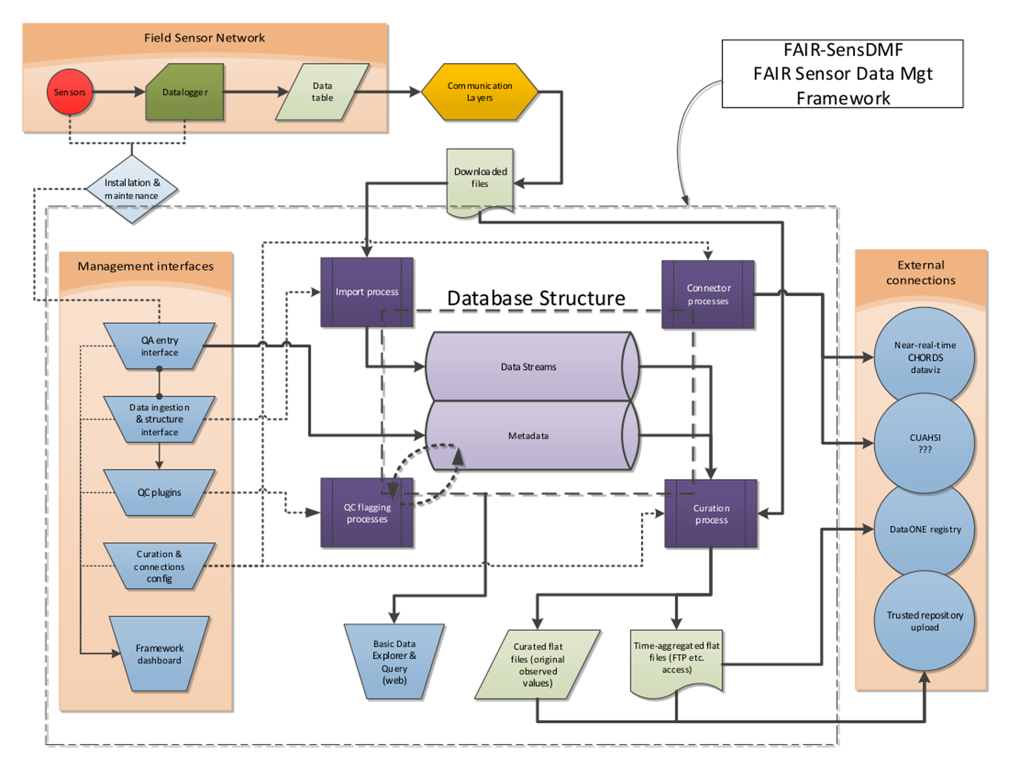

Slide 17
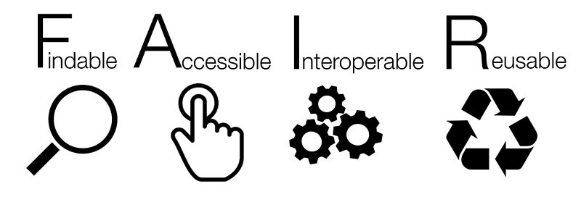
FAIR Data Practices
Autonomous QC - Crucial to producing usable data
QC Metadata
Fundamentally machine readable
Designed inter-operable
Enhances re-usability
Slows data quality degradation

Slide 18
FAIR Data Practices
Increased accessibility to QC-related metadata
What data was flagged, when was it flagged and for what reason
A complete data product

Slide 19
Challenges and Future Work
Generalizability and Configurability
Architectural redesign
Containerization
Filling the Holes
Data Imputation with Machine Learning
Advanced Automation
Leveraging Existing Flags for Classification

Slide 20
Thesis Impacts
Connor
This is my Thesis
Therefore Literally Everything
Vinh
Microservice Architecture Validation
Level 2 Requirements
Multiple projects on one service discovery
Health Monitoring
Service Call History

Slide 21
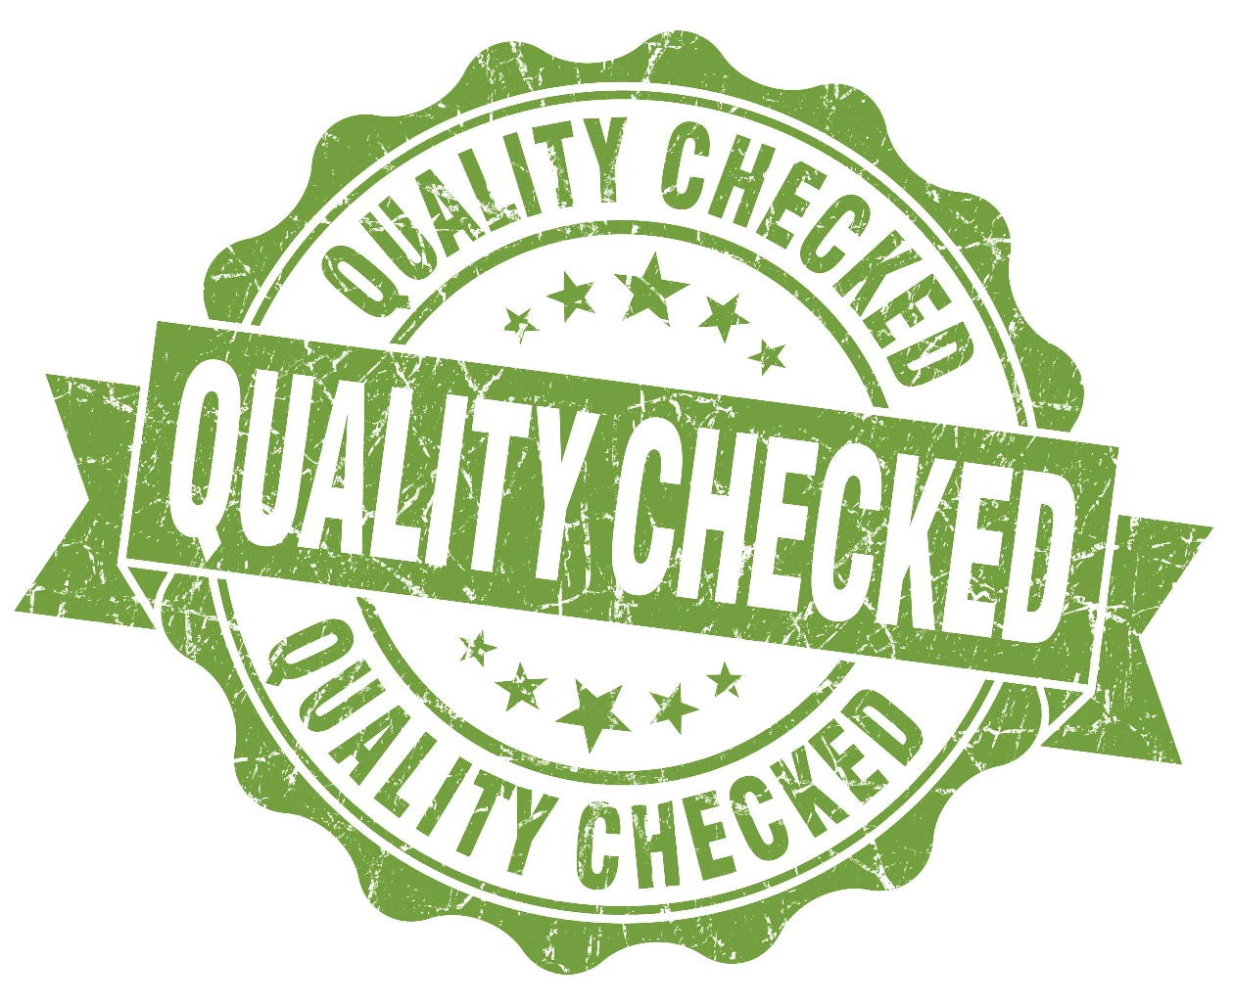
Future Work
Future Work
Make the UI as good looking as the mockups
Provide Functionality for User Assisted Manual QC
Interface with other Data Visualization software
Containerize Software
Publication(s)

Slide 22
Thank You
Any Questions or Comments?

