Slide 1
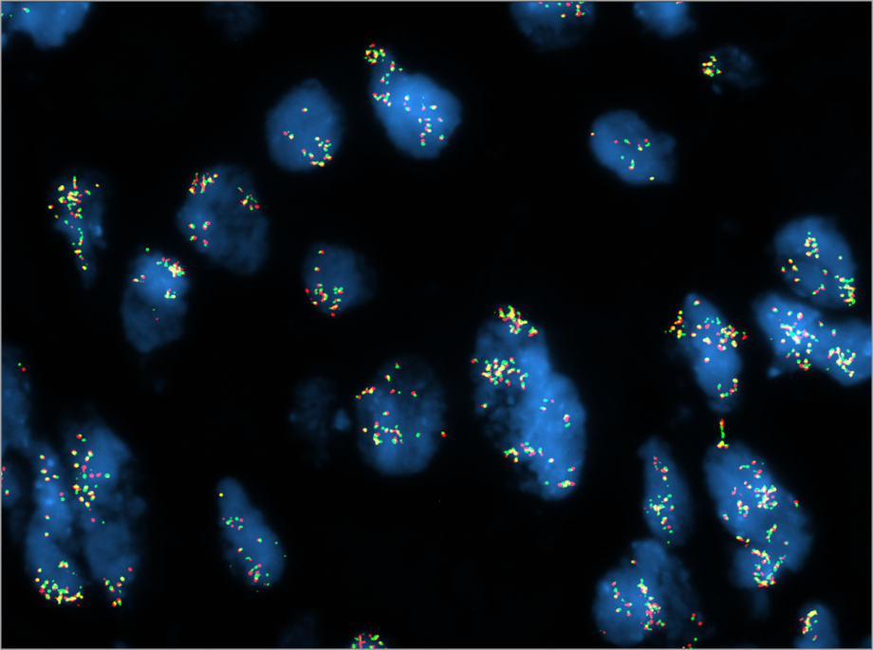
TNBC-11
A
C
2.0N
3.9N
B
Chromosome 9
+
Log₂ratio
0
-
Barrett et al., Supplemental Figure 4

