Slide 1
Linked Open Data for Scholarship: The VIVO Experience
Michael Conlon, PhD
VIVO Project Director
Emeritus Faculty Member
University of Florida

Slide 2
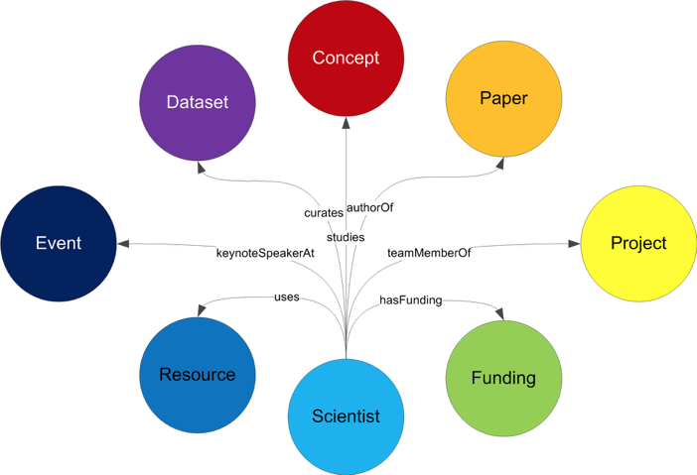
Conceptual

Slide 3
Data
Paper/
Scholarly Work
Person:Paper
authorOf, hasAuthor
Person:Grant
fundedBy, funds
Person:Resource
userOf, hasUser
Person:Data
creatorOf, hasCreator
curatorOf, hasCurator
userOf, hasUser
Person
Funding/
Project
Resource

Slide 4
What is VIVO
VIVO is an open source, semantic web application for representing, showcasing, and studying scholarship
VIVO uses a collection of ontologies to represent scholarship
VIVO produces linked data that is readily shared and recombined
VIVO is member-supported project
VIVO is in use at over 150 institutions in 27 countries, representing more than 200,000 scholars and 2 million works.

Slide 5
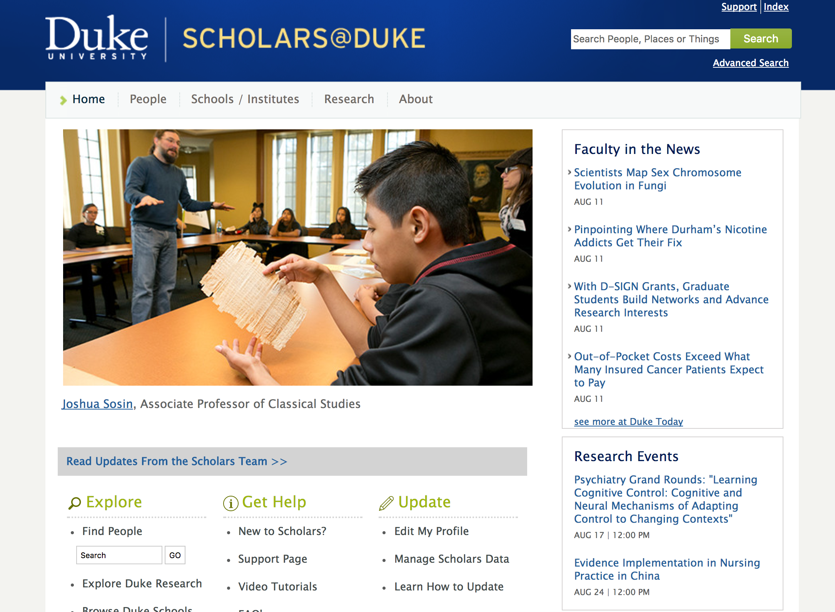

Slide 6
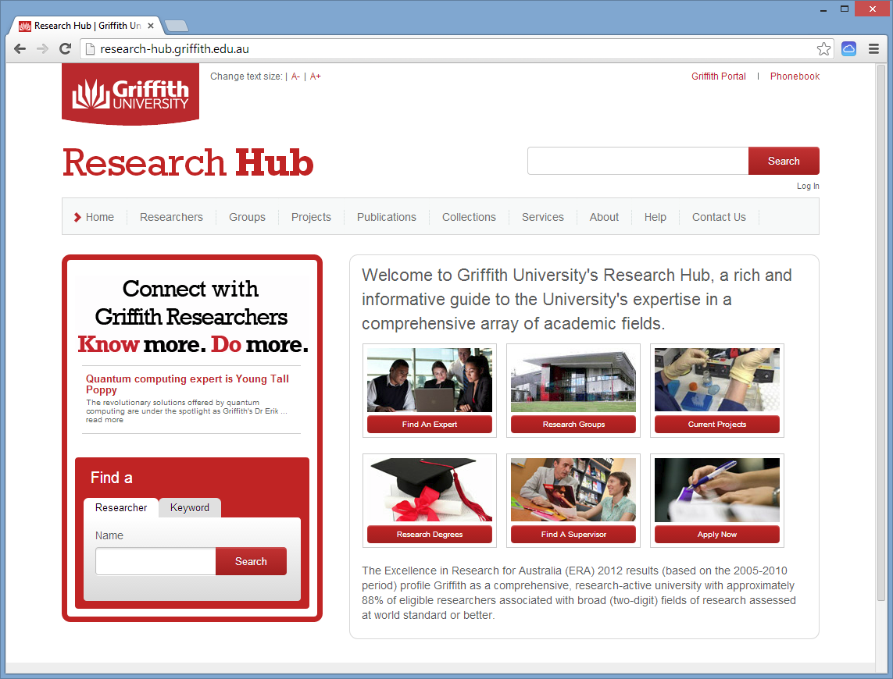

Slide 7
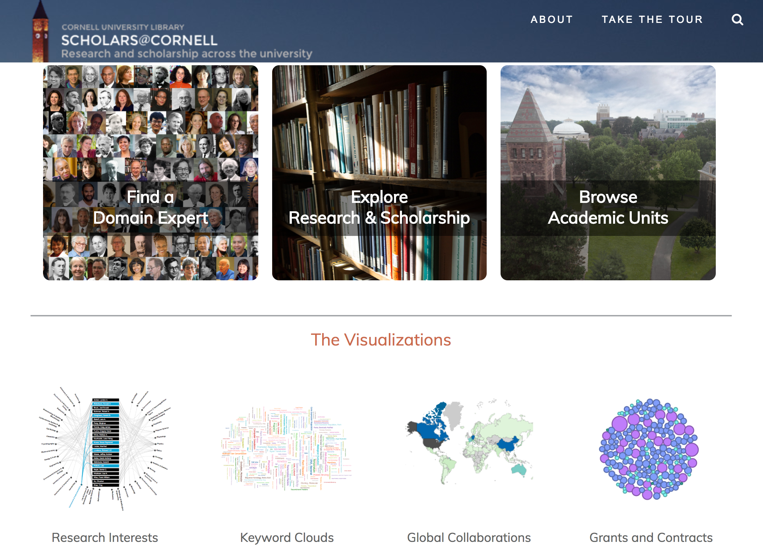

Slide 8
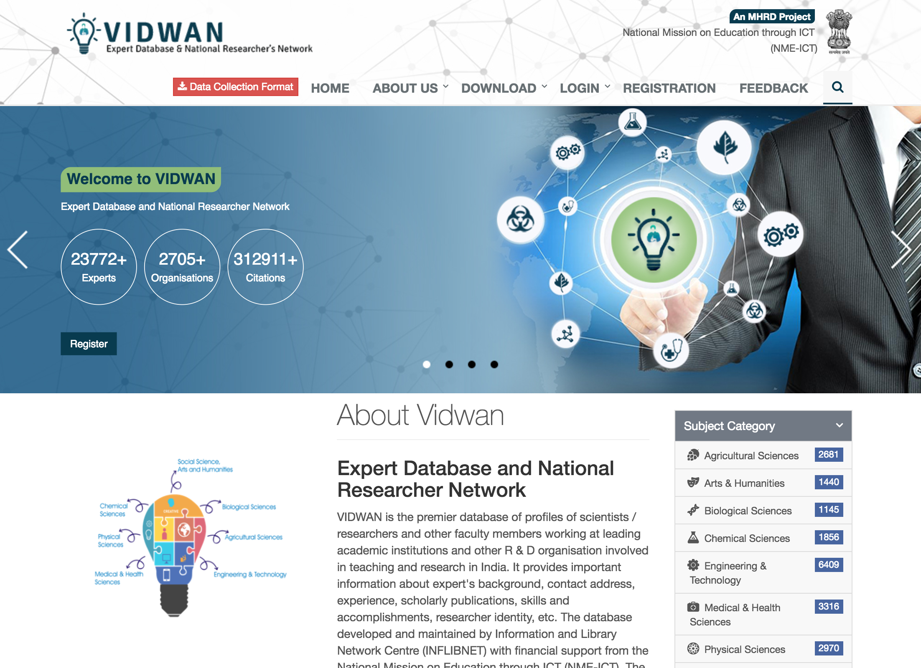

Slide 9
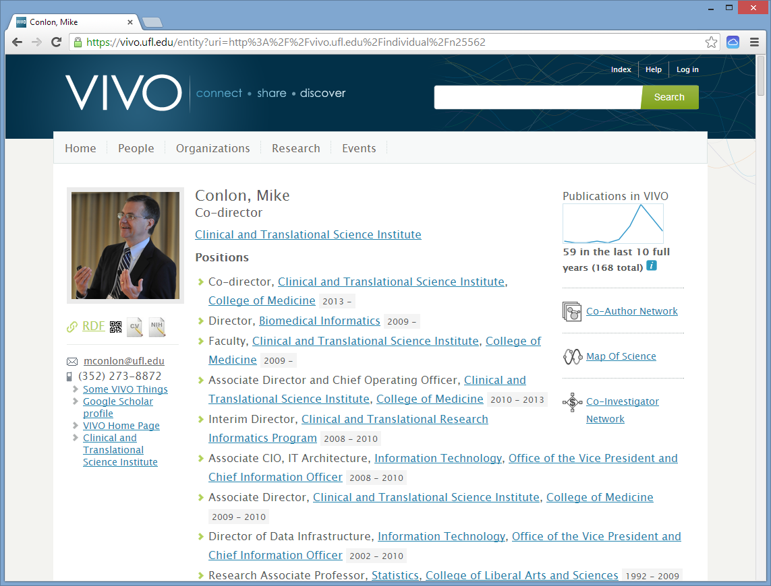

Slide 10
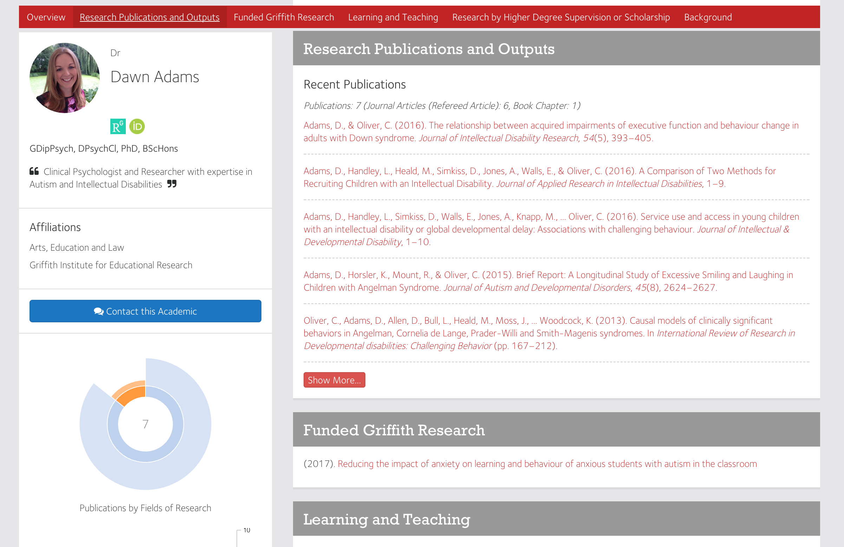

Slide 11
VIVO integrates and reuses institutional data
Reports
Organization
Expert
Finding
People
VIVO
Projects
Portfolio/
Vitae
Papers, Books Datasets, Software
Network
Analysis
Teaching
Service
Adhoc
Queries
Visualizations

Slide 12
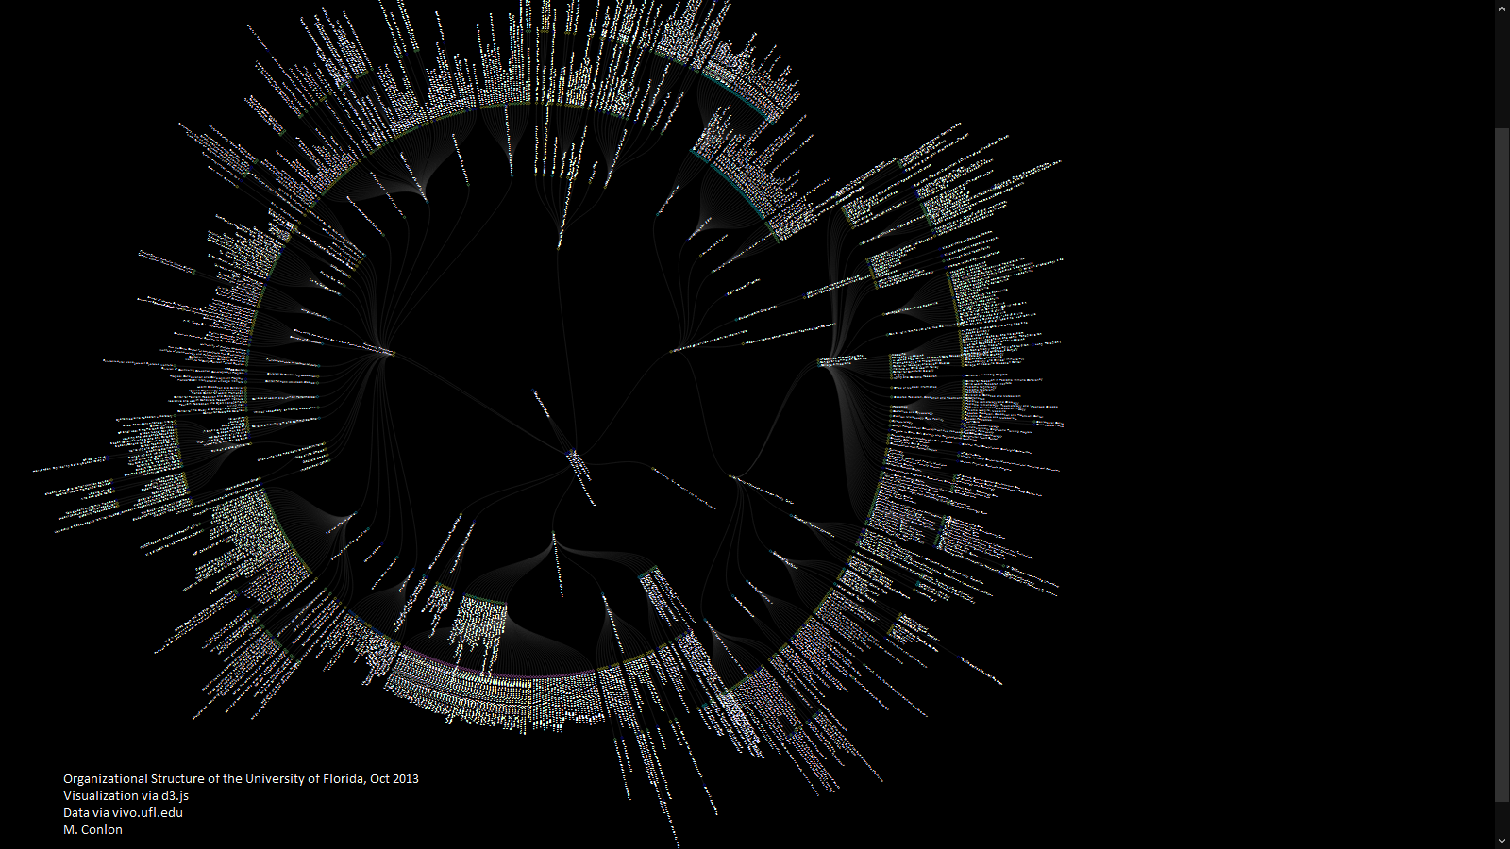
data visualization

Slide 13
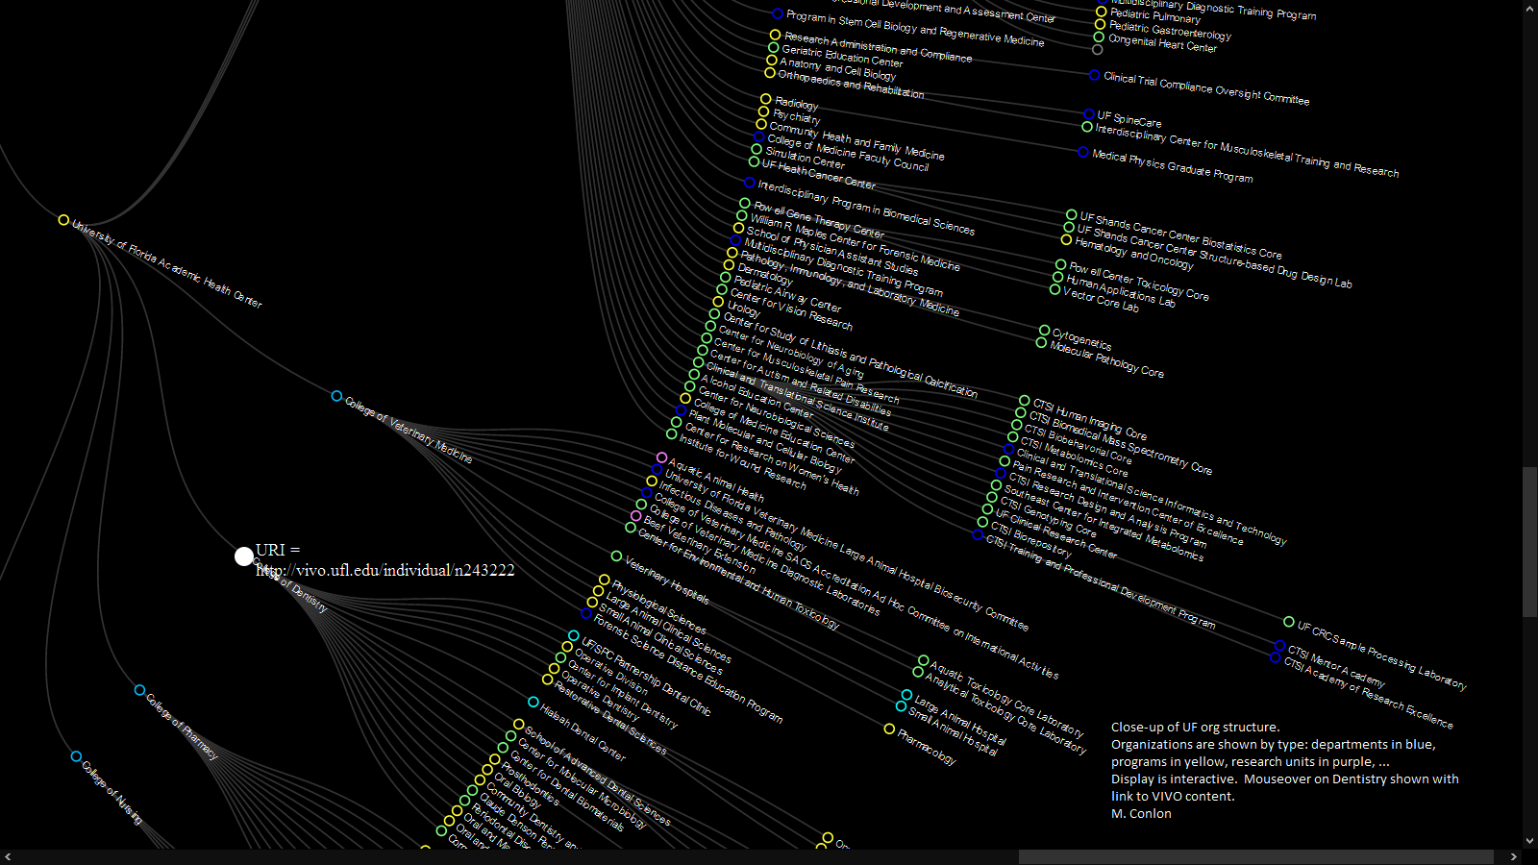
visualization via d3.js data via vivo.ufl.edu

Slide 14
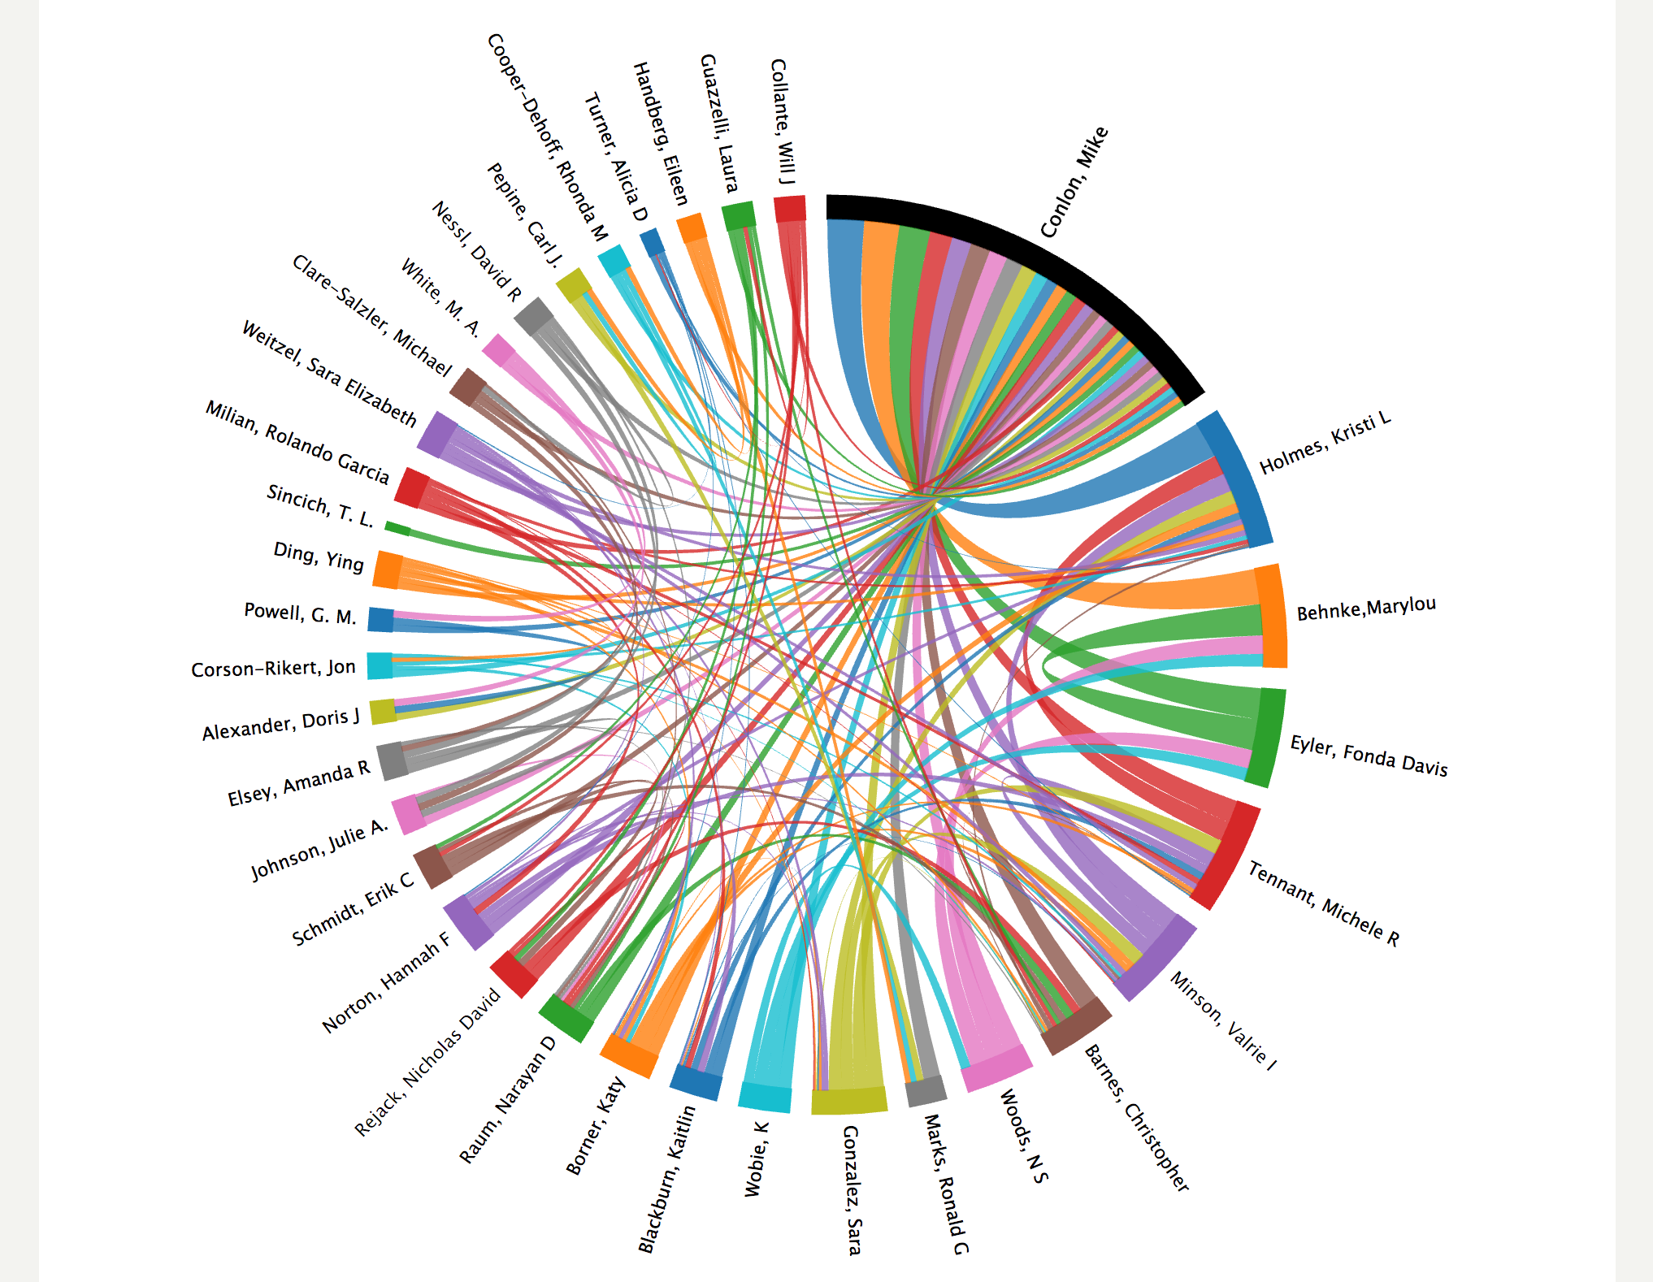

Slide 15
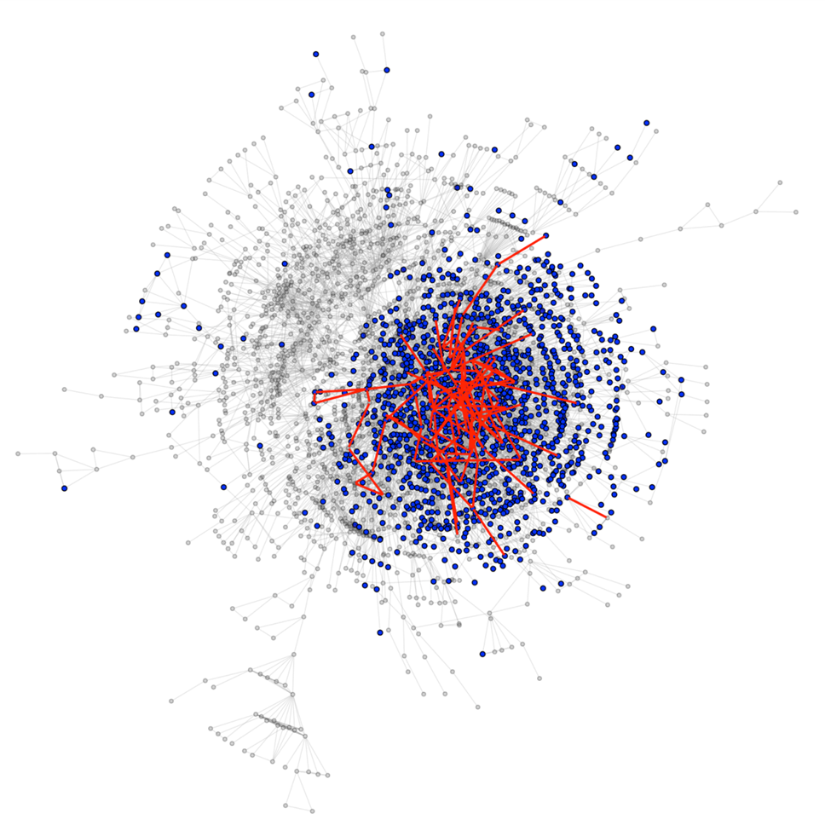
Impact of Pilot Funding on University Social Network Chris McCarty, Raffaele Vacca
Co-author network of the University of Florida, 2013.
Health Center Faculty in blue. Pilot awardees and new
connections in red.

Slide 16
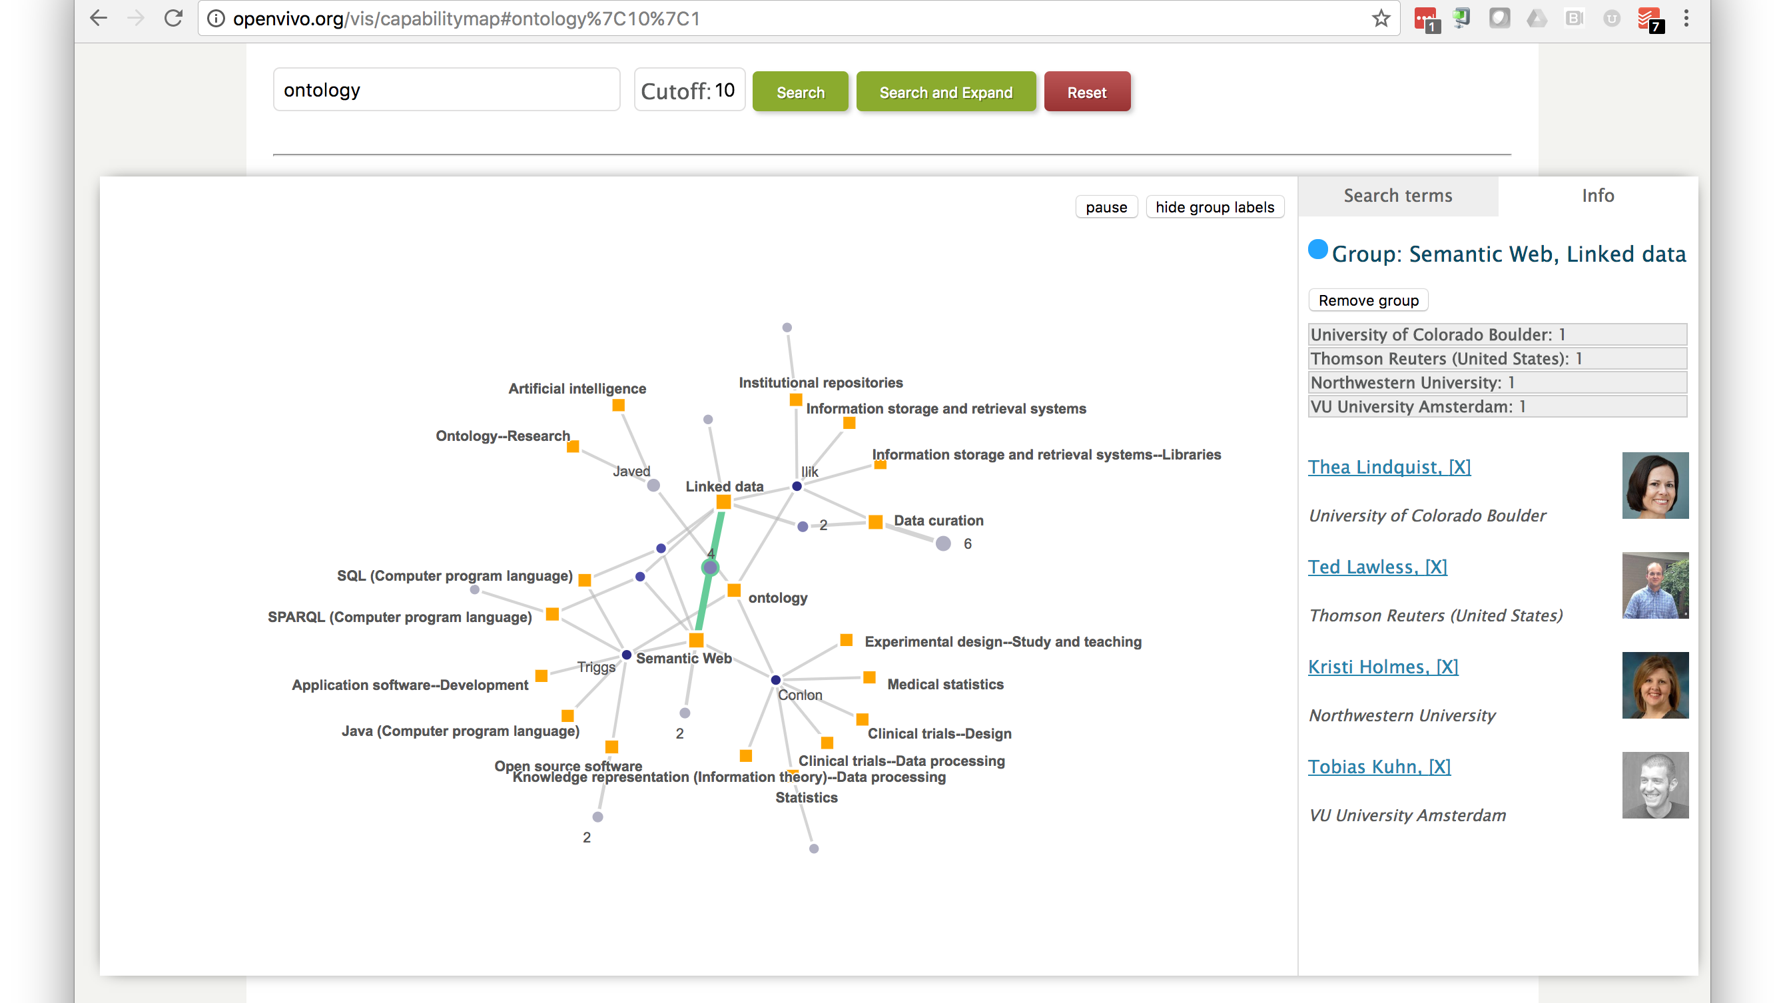

Slide 17
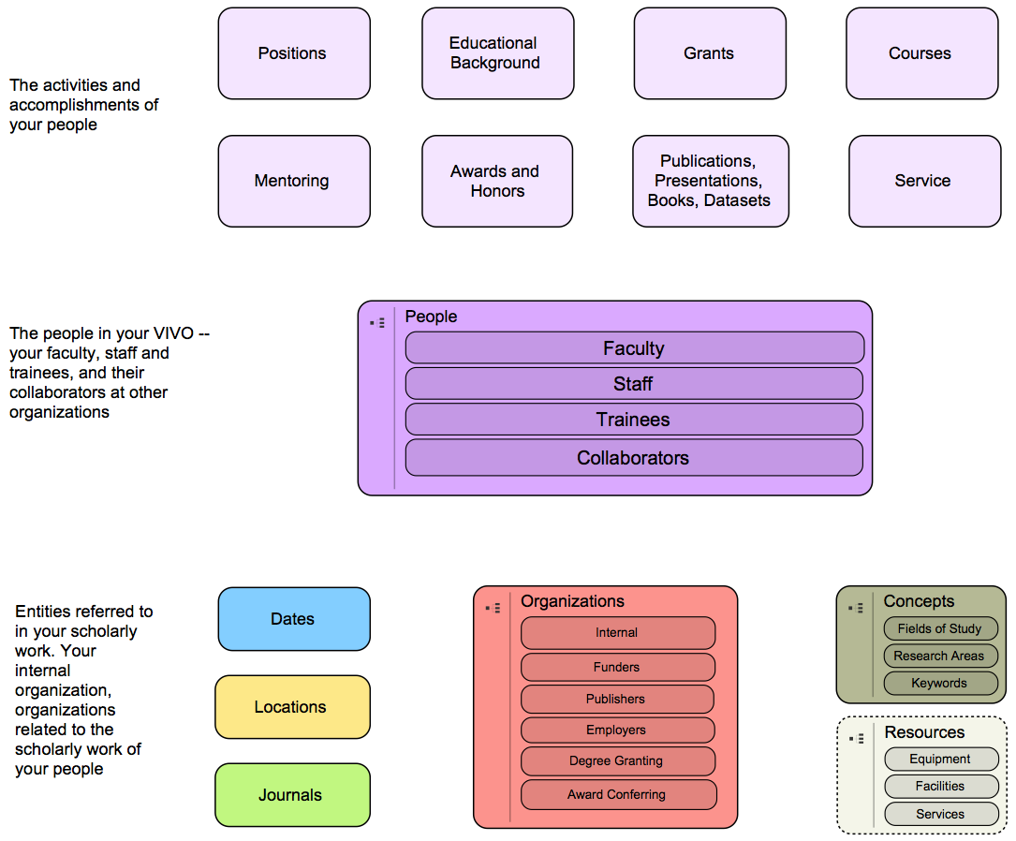
Domains of Representation

Slide 18
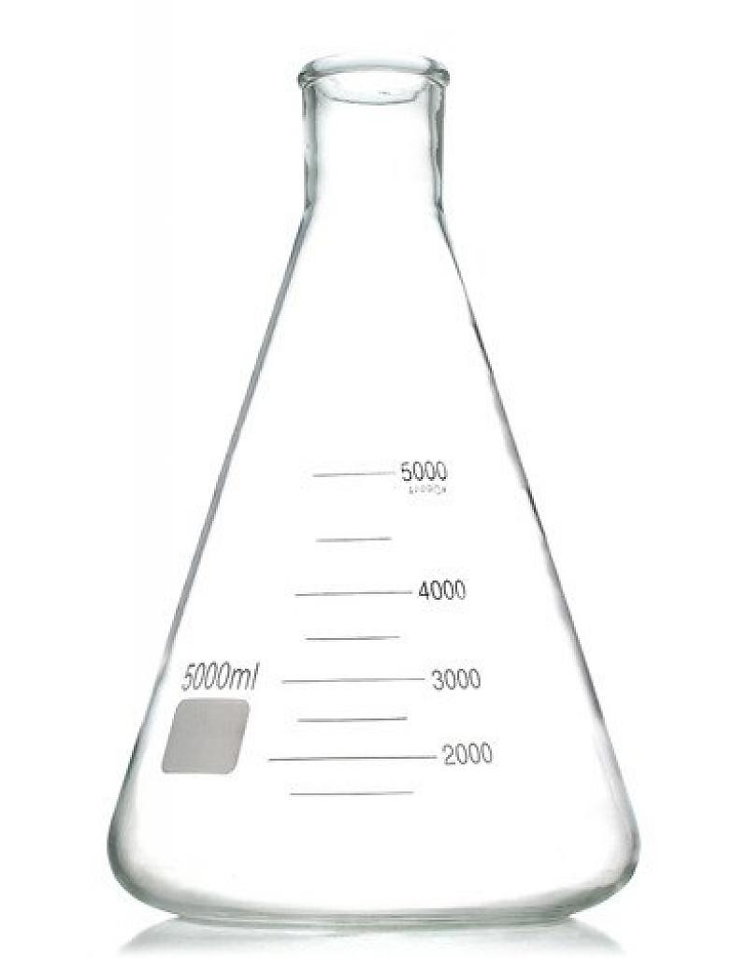
College
Department
“Is a”
“Is a”
Thing 1
Thing 2
“Part of”
“name”
“name”
“College of Science”
“Department of Chemistry”

Slide 19
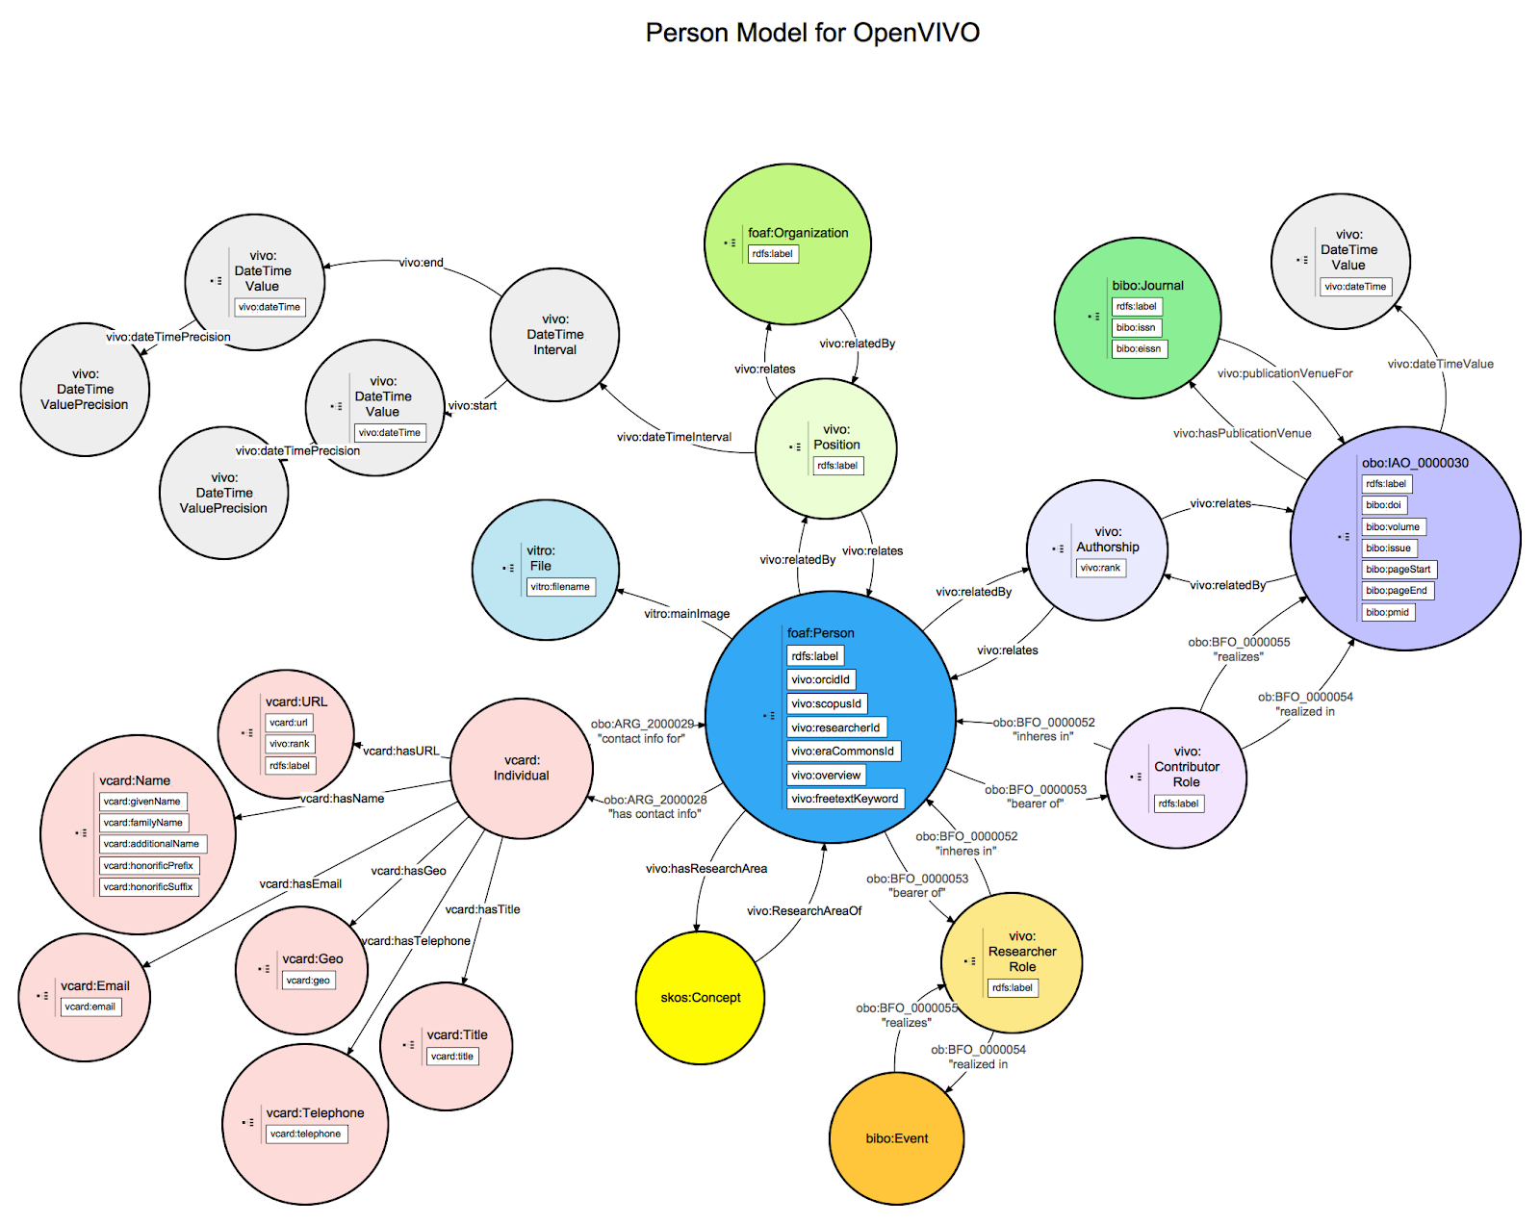

Slide 20
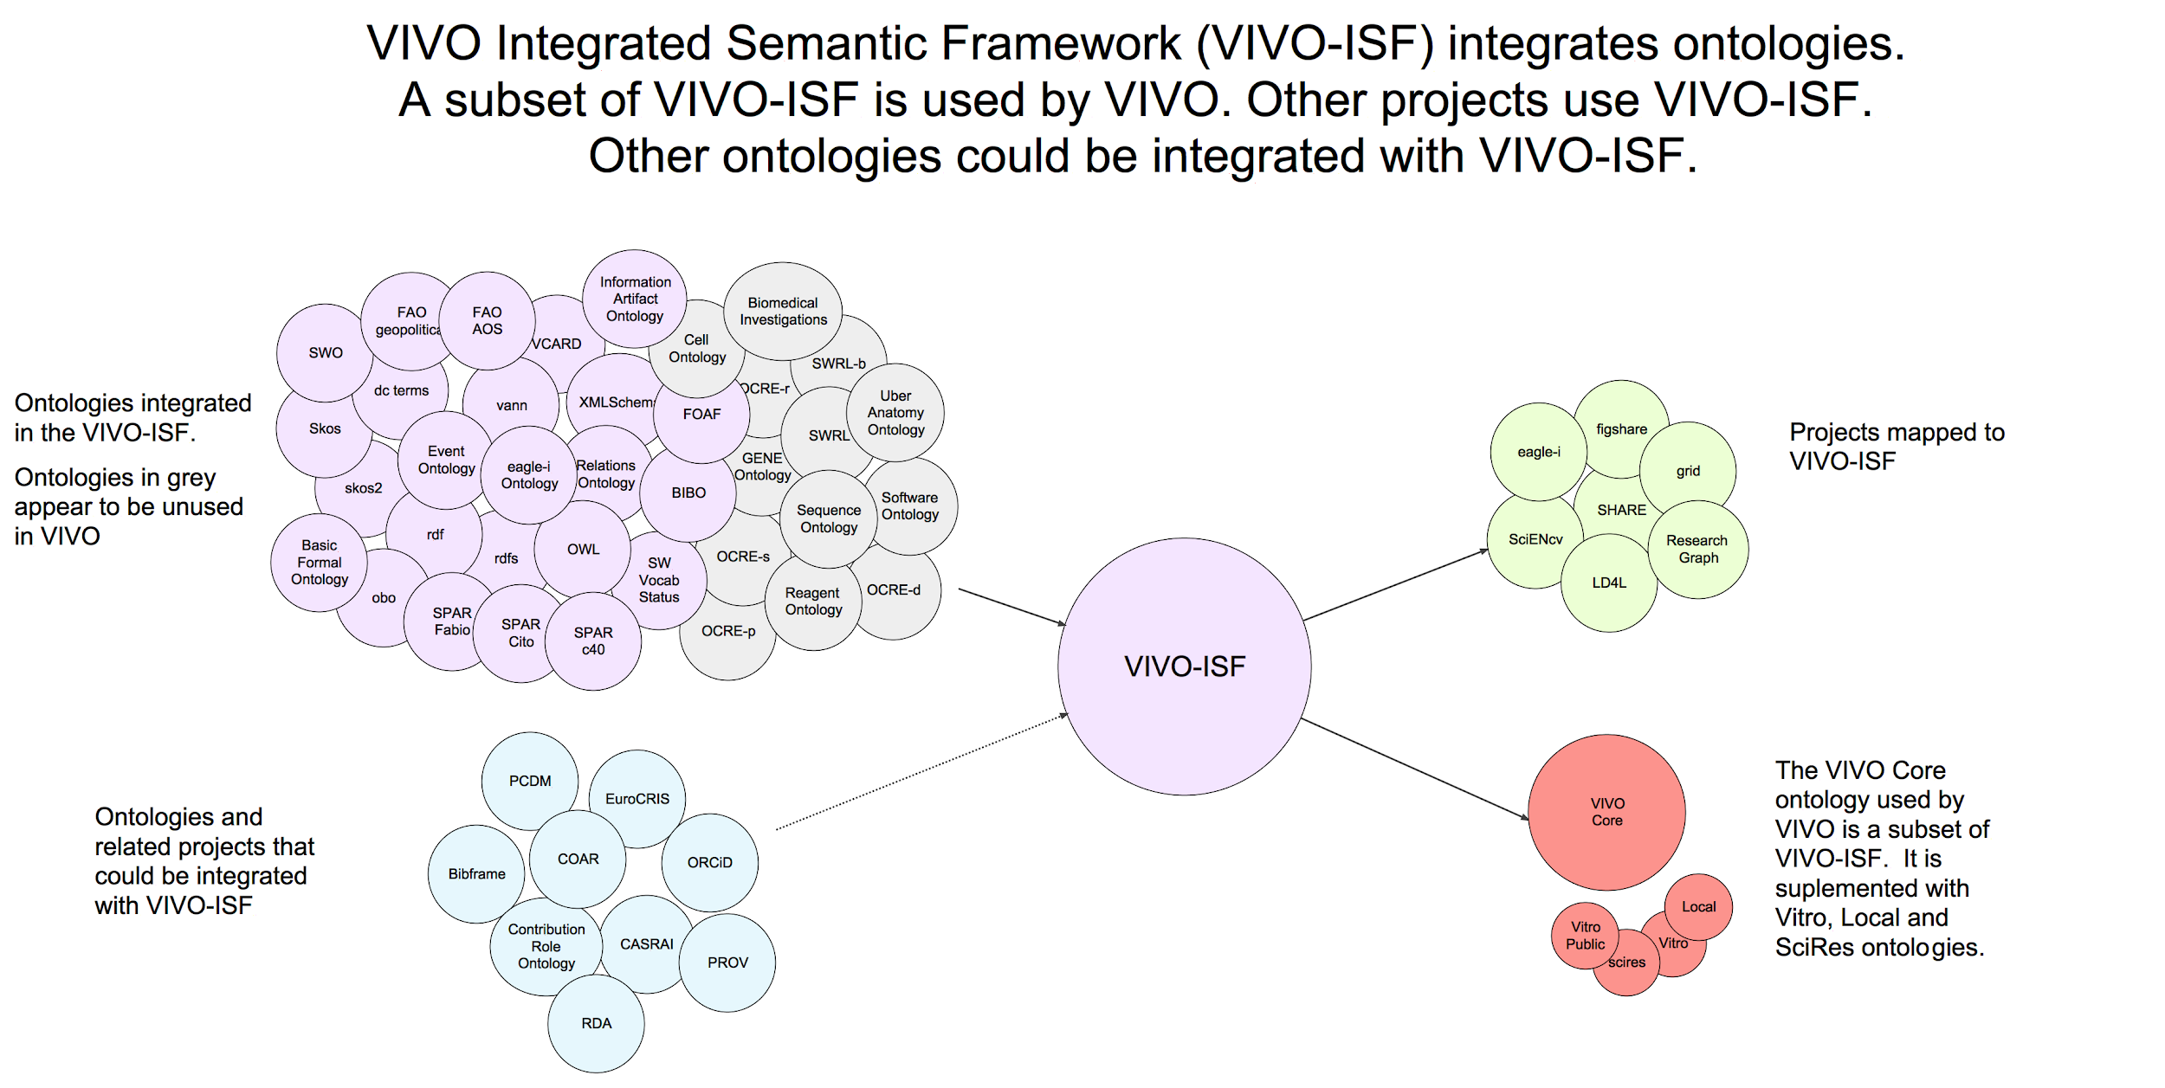

Slide 21
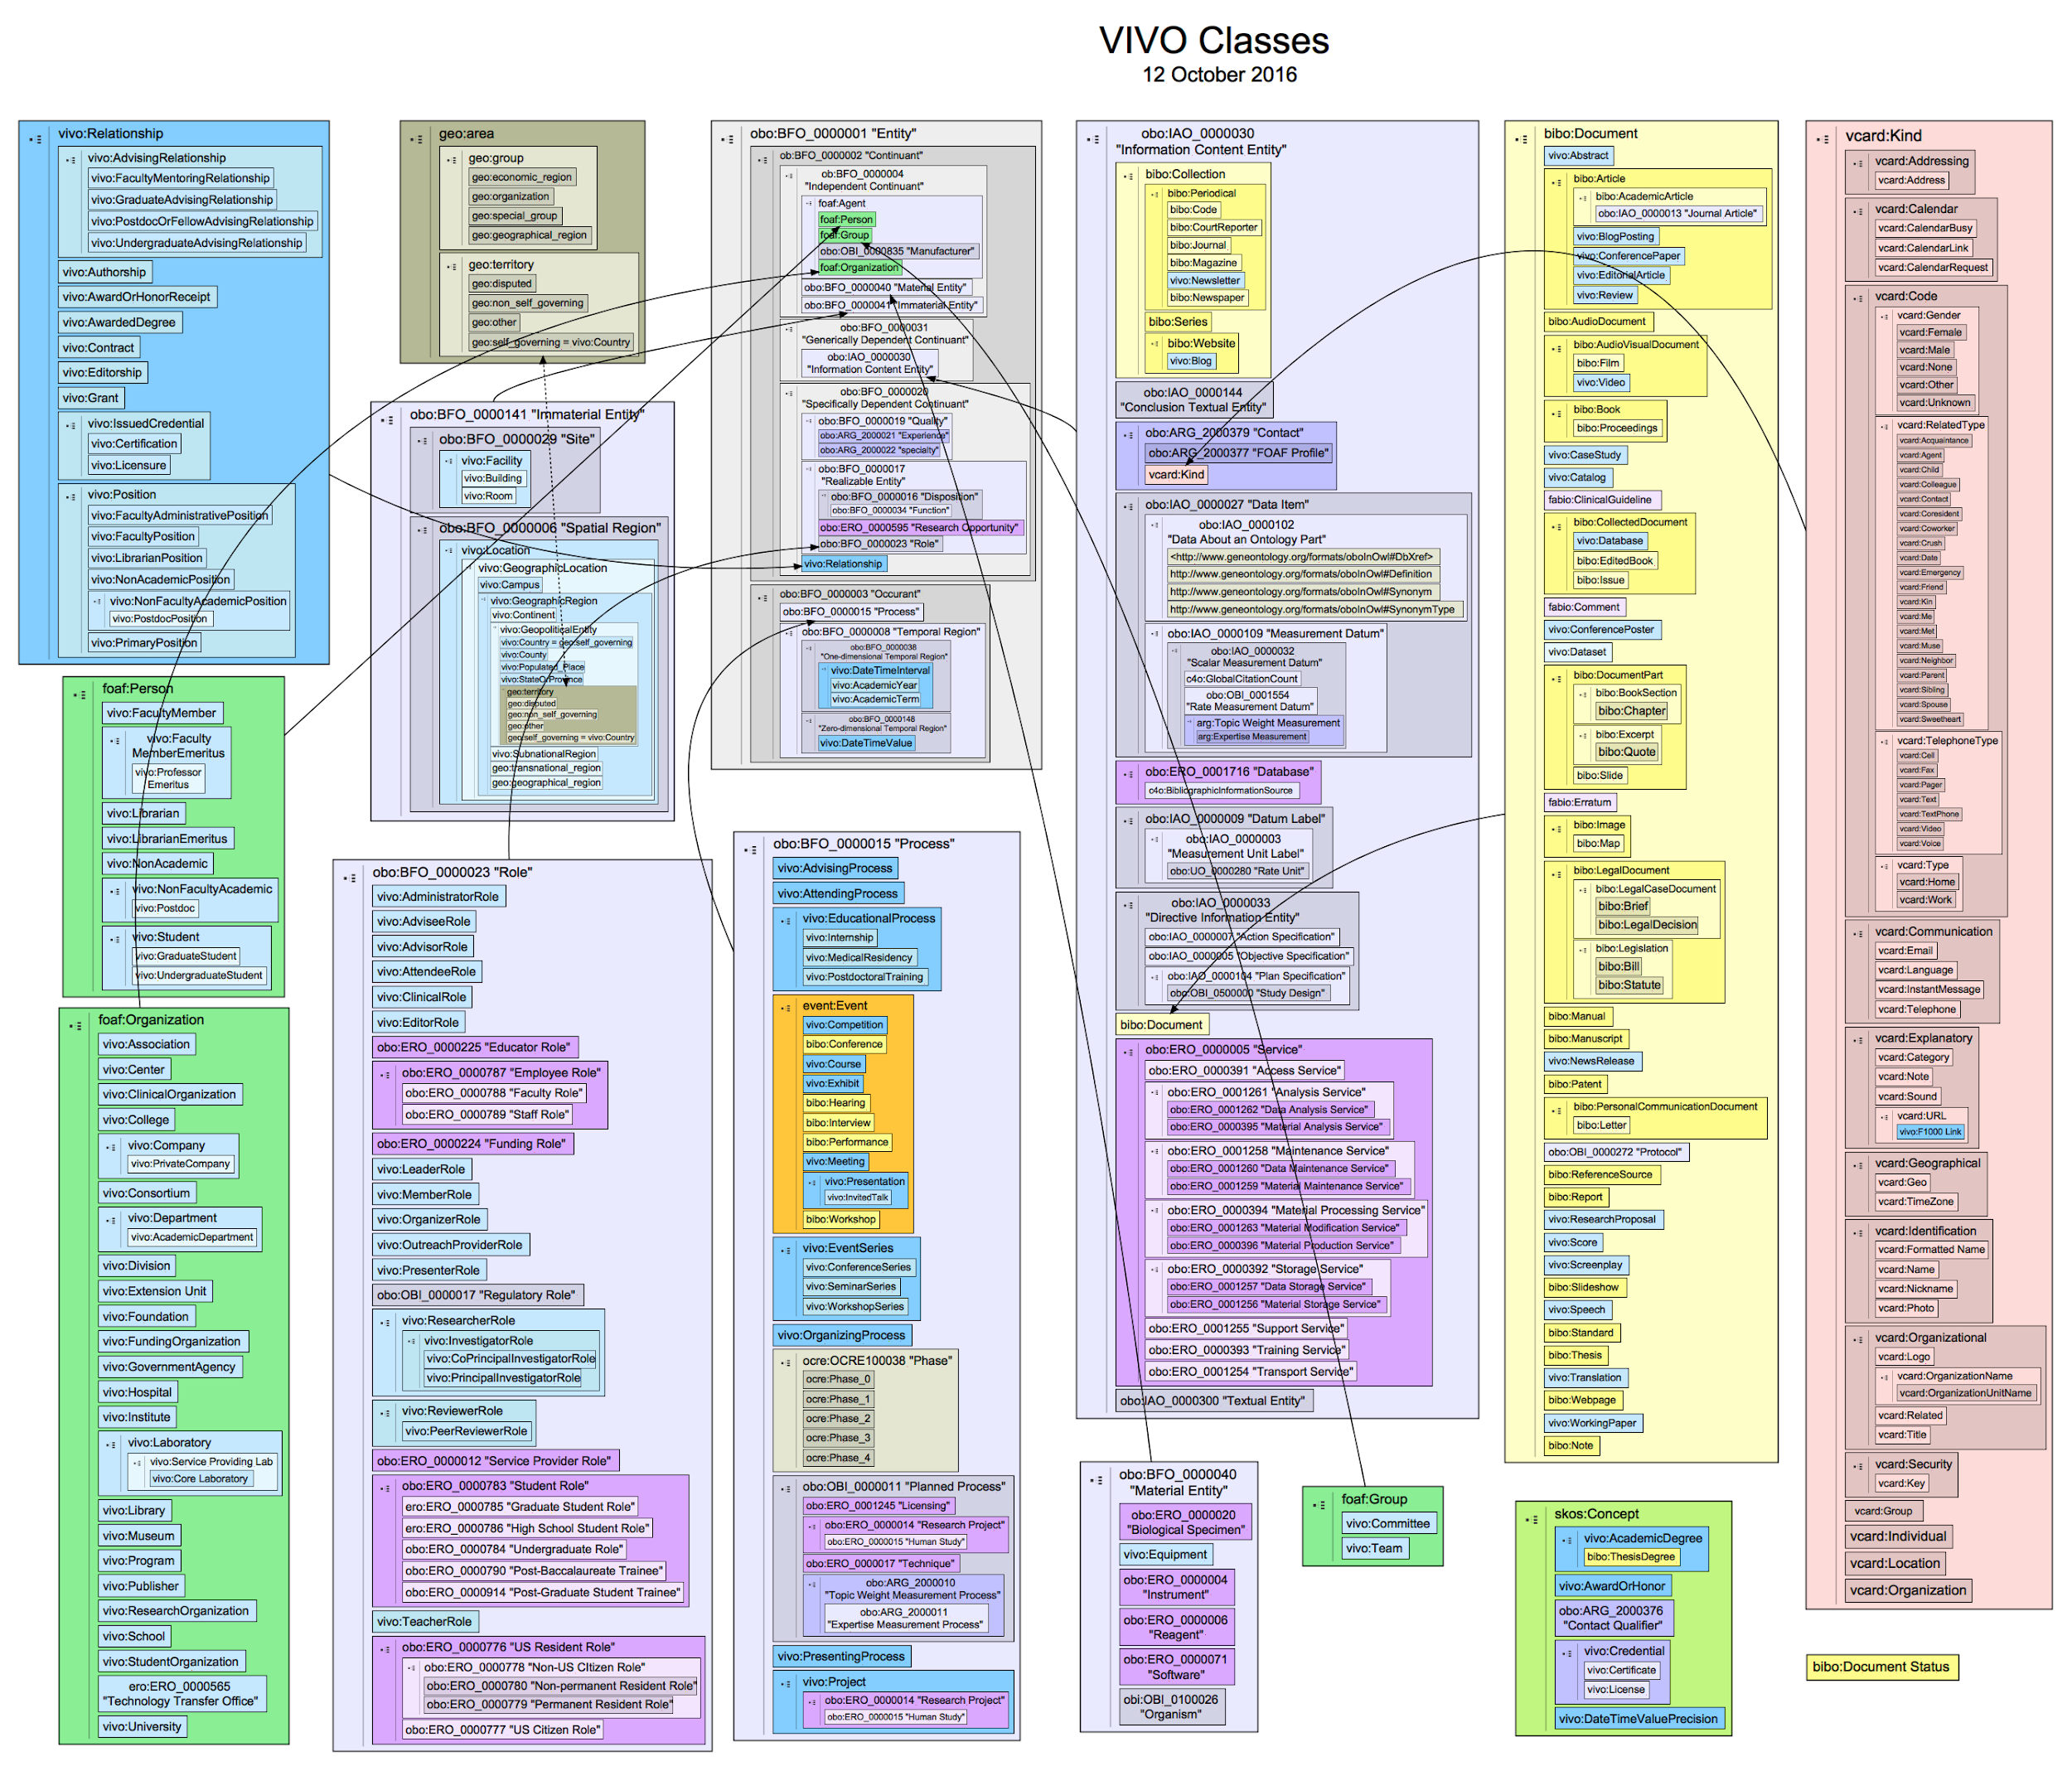
418
Classes
199
Object
Properties
219
Datatype
Properties
14 Individuals

Slide 22
Issue: The Middle Ground
Above VIVO (more abstract) is the Basic Formal Ontology
Below VIVO (more specific) are domain specific ontologies and vocabularies (clinical trials, agriculture, humanities, cultural heritage, …)
Most ontologies “below” VIVO introduce their own “middle concepts” — person, paper, project — these must be “reconciled” with VIVO. This is fundamental collaborative work across projects

Slide 23
Issue: Missing Ontologies
To represent scholarship, VIVO must represent detail that is best defined by authoritative sources
Example: Academic Degrees
VIVO supports its own vocabulary of 173 academic degrees (because the world doesn’t have one)
Example: Research Areas
Many vocabularies exist for expressing research areas of faculty members. What might be “useful” for faculty to find people working in related areas? OpenVIVO uses FAST (Faceted Application of Subject Terminology) from OCLC (Online Computer Library Center).
Example: Contribution Ontology
The contribution ontology developed by the Force16 Attribution Work Group, VIVO Project, and OpenRIF is new. It will need to be refined based on experience and further analysis

Slide 24
Issue: Managing Ontological Change
Many institutions and projects use VIVO (~150) and the VIVO-ISF ontology (another 250?)
VIVO needs a process for updating ontologies it uses, and updating its data and interfaces to use updated ontologies
But many sites depend on the ontology to retrieve data from VIVO and other systems to web sites, software, and reports
What changes have minimal to no impact? Which do not? How to propose change? Govern change? Implement change?

Slide 25
Systems producing VIVO Data for Scholarship
VIVO sites, including OpenVIVO, Cambridge, Duke, Cornell, IICA, InflibNet, APA, TIB Hannover, and 150 others in 26 countries
SCOPUS, Web of Science, Dimensions, Pubmed, ORCiD, ResearchGraph, figshare, GRiD
Harvard Profiles, Elsevier PURE, Symplectic Elements
Local systems producing VIVO data from other systems
Tools for producing VIVO Data for Scholarship
Karma
The VIVO Pump
The VIVO Harvester
Many other local, open source tools

Slide 26
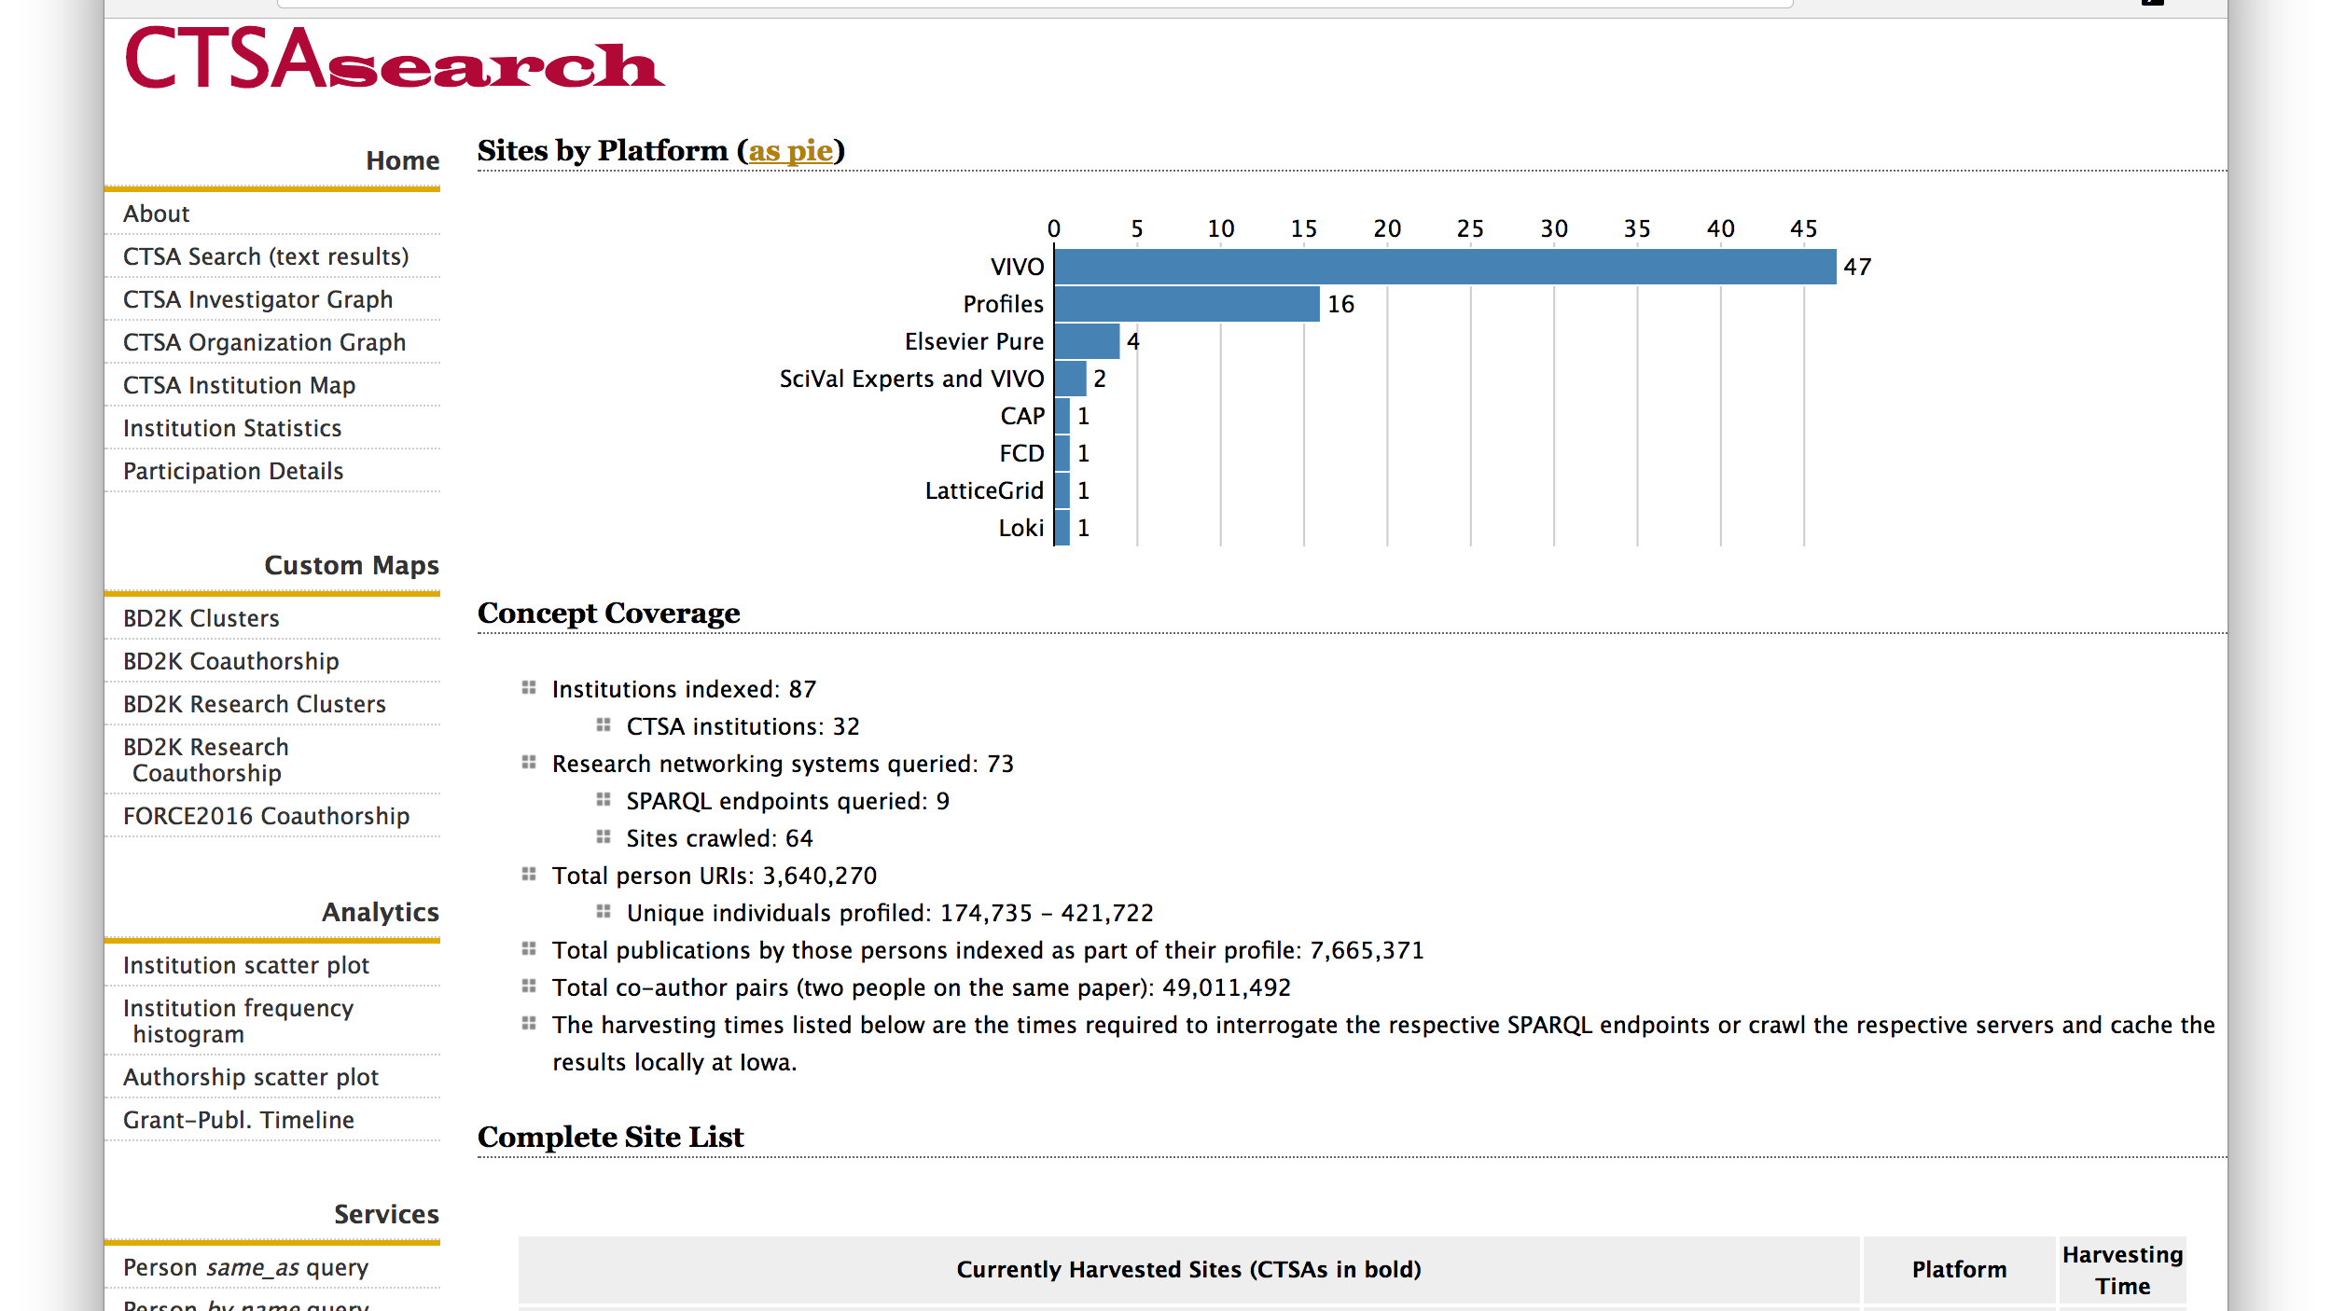

Slide 27
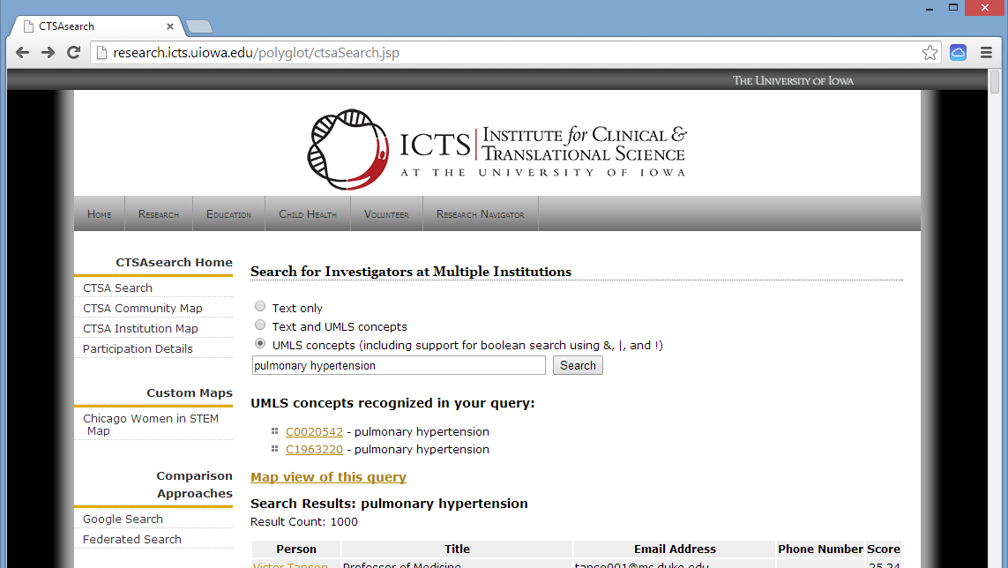

Slide 28
VIVO Data Issues
Semantic web approach is new for many universities
Locating, identifying, and disambiguating researchers and their works can be difficult
Shortcomings in the data may lead to unwillingness to make data available

Slide 29
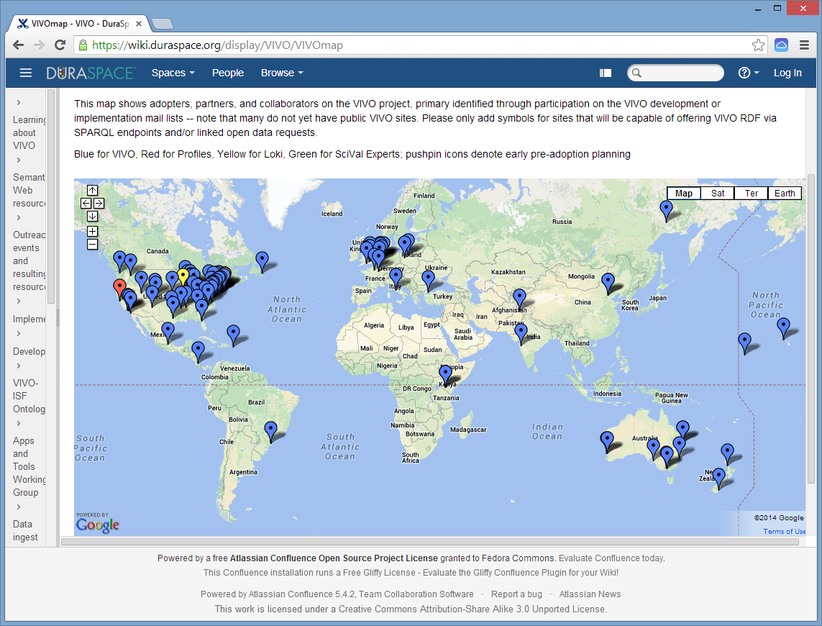

Slide 30
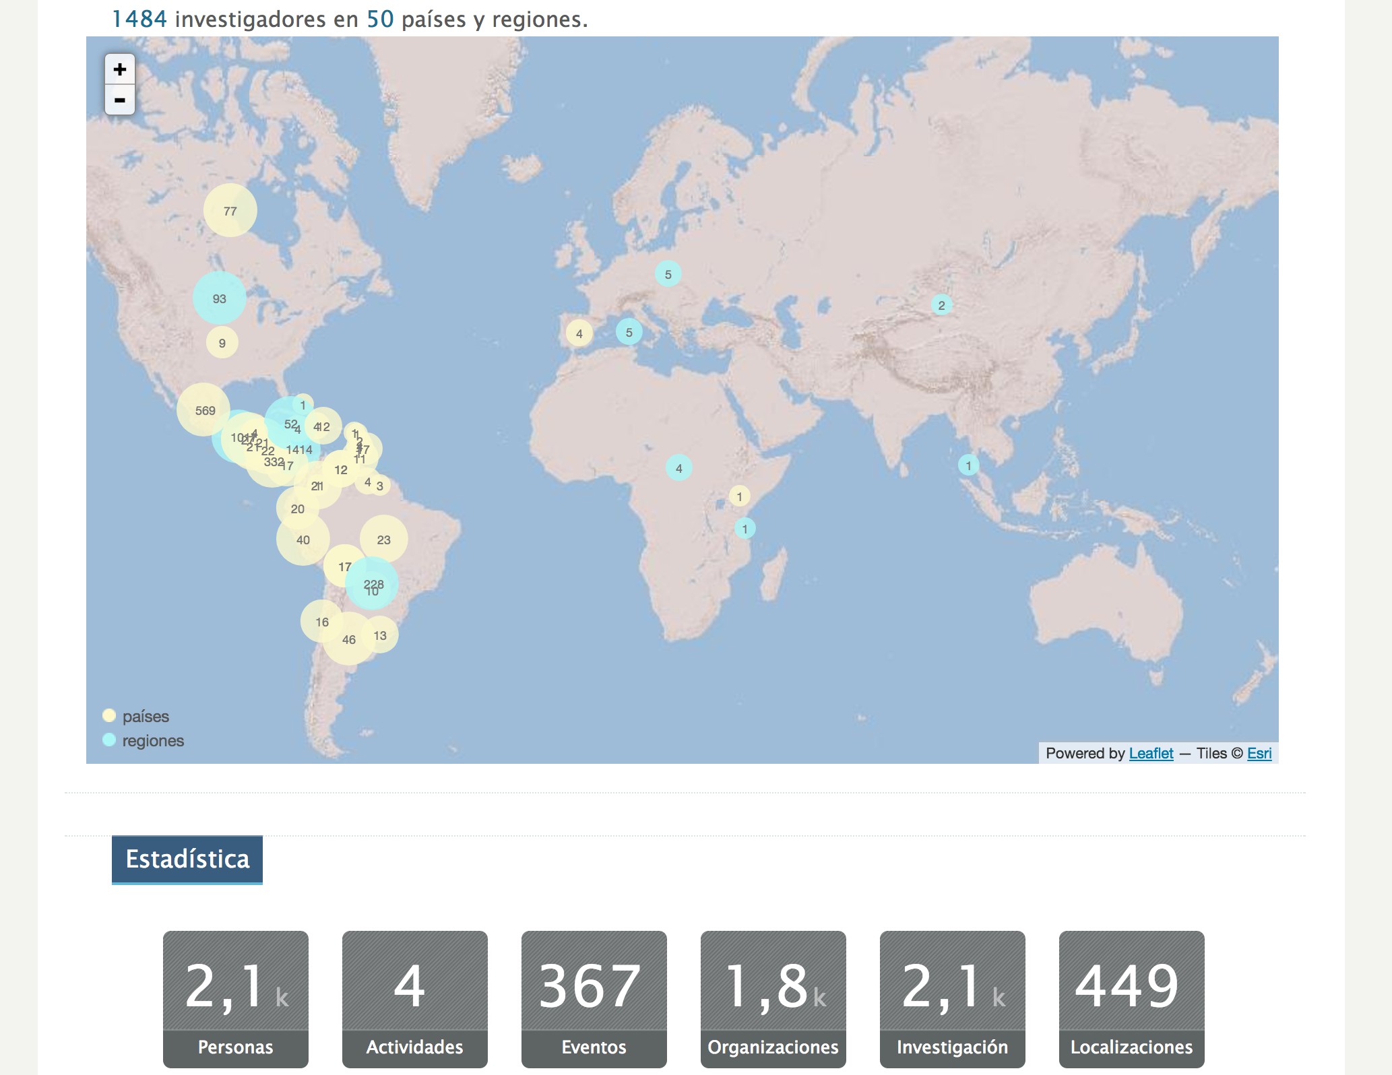
Inter-American Institute for Cooperation on Agriculture

Slide 31
Current VIVO Projects
Internationalization – German, Spanish, Mandarin, French, English
Product Evolution – new presentation layer
Combine – collect and disambiguate world and local data for VIVO
VIVO and Blockchain – using an open blockchain to store VIVO assertions
RIALTO – Stanford University research information
Deff Opera – research analytics
Research Graph – data augmentation
Research Management Information ontology for VIVO
CERIF to VIVO – convert CRIS data to VIVO
CD2H – expand person roles in scholarship
Metabolomics – domain coordinating center and repository
Ontology Improvement – clean-up, clinical trials, humanities

Slide 32
VIVO Members

Slide 33
Getting Started
VIVO GitHub https://github.com/vivo-project
VIVO Conference http://vivoconference.org, Europe Fall 2019

