Slide 1
The roer4d open data initiative building the empirical base
Thomas King

Slide 2
Introduction to ROER4D
ROER4D – Research on Open Educational Resources for Development project
18 sub-projects, across 26 countries in the Global South from Chile to Mongolia, with 100 researchers, supported by a Network Hub team based in the University of Cape Town and Wawasan Open University.
Datasets in multiple languages (English, Spanish, Mongolian)
Mostly mixed-methods data (mix of quantitative and qualitative)
ROER4D Open Data Initiative: supporting interested sub-projects in sharing their data openly
Notes:
The ROER4D project, conceived in 2012 and running from 2013 to the end of 2017, was explicitly scoped with an ambition to conduct Open Research inasmuch as that proved viable and valuable. An early ambition mentioned in the scoping document was the desire to share data openly, but this process was not begun until 2015 with the elevation of Curation and Dissemination as a core project objective and the subsequent launch of the Open Data Initiative.

Slide 3
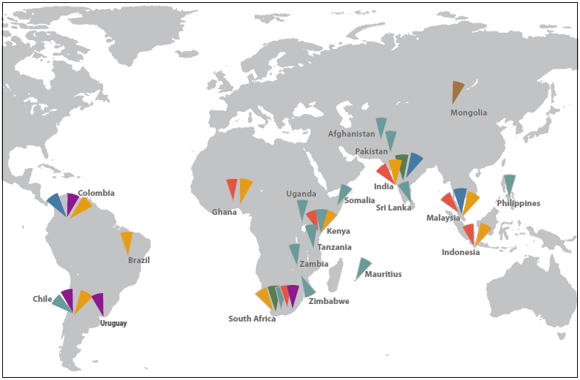
Notes:
The graphic above shows where the ROER4D sub-projects were located and where they conducted their research activities. The research participants included high-school (secondary) and university (tertiary) students, teachers in secondary and tertiary education, government officials, and members of NGOs,.

Slide 4
Why should researchers share data?
ROER4D motivations:
Build the empirical base for future research
Coherent with our generally ‘open’ approach – publishing open access outputs, actively communicating with audiences and stakeholders, etc.
International trends
Many research funders now require some sort of data-sharing activity or plan
Improve rigour
Sharing data openly demands that the dataset is well described and organised
Increased scrutiny of the dataset often leads to more refined analysis
Notes:
While there are potential and real benefits to civil society and government from sharing Open Data, there is also a case to be made for the individual benefits accruing to researchers from sharing their data. Open data sharing is increasingly being mandated by funder institutions, particularly large national and regional funders in the Global North, and so familiarising oneself with open data principles and sharing data openly is good practice for those interested in applying to these funders. Finally, and significantly, the process of preparing one’s data for open sharing necessitates deep and thorough data sophistication, through improvement of the microdata and/or metadata.

Slide 5
When should data not be shared?
When the data contains disclosive (identifying) information about research participants
Particularly at-risk groups, such as disadvantaged minority groups, children, displaced and refugee groups, and/or data relating to those groups
When the data is of poor quality, contains errors, badly described, etc.
When publication agreements/patent process requires non-publication data for a certain period

Slide 6
Open Data Initiative: Recruiting participants
Emphasising social justice through sharing
Sharing open data allows for latitudinal studies using data from multiple sites
Emphasising personal reputation
Sharing open data as a means of building one’s personal profile as a researcher
Emphasising rigour
Sharing data openly enhances the quality of the research
Notes:
As the Open Data Initiative was a voluntary activity (not mandated in the original project scoping), participants had to be persuaded to participate. The three primary methods used to encourage participation were through:
1) An appeal to the project’s overall Open Research agenda, by emphasising the value of Open Data for future studies and potentially latitudinal research 2) An appeal to the benefits accruing to contributors’ personal reputation, through the production of a citable research object (an open dataset) 3) An emphasis on the rigour-enhancement inherent in preparing a dataset for open sharing.
As the project was conceived with an explicit open agenda, much of the first strategy was implicit in the project’s general Open Research orientation. The second emphasis (personal reputation) relied on the standard practice of measuring citations as a means of measuring an academic’s public profile. Finally, the third strategy highlighted the Open Data sharing process as serving the core academic principle of ethical, rigorous research practice.

Slide 7
Preparing data for publication

Slide 8
Terms and definitions
TERM | DEFINITION
Microdata (aka Unit Record Data) | The information that underlies a research project’s analysis (i.e. the ‘thing’)
Metadata | Data that describes a file or record on a database (for example, keywords, author fields, ISBNs, DOIs)
Research Data Management (RDM) | Overall term for how individuals/projects/institutions manage their data
Data Management Plan (DMP) | Outlines an individual or project’s strategy around all aspects of data management
Curation | Organising, storing/archiving and describing data to ensure & control its long-term accessibility and usability. May include collating/concatenating from other sources
De-identification | Removing, eliding or replacing pieces of information that reveal research participants’ (possibly also referents’) identity
Anonymity | Personal details (identifiers) are not gathered
Confidentiality | Personal details (identifiers) are not shared
Curation platform | An on-premises or cloud-based storage space that contains metadata capabilities, Search Engine Optimisation, and backup capabilities
Notes:
Difference between anonymity and confidentiality: an anonymous survey contains no questions about personal identifiers; a confidential survey does contain these questions, but will not share/publish them.

Slide 9
Refine data
Collect data
Verification, validation
Ethics clearance, methodology, instruments
Organise data
Formats, naming conventions
Research Data Management
Share data
Store data
De-identification, publishing, open data
Backup, archive, on-site storage, cloud storage
Document data
Metadata, dataset description
Curation layer
Notes:
In the networked model of the ROER4D project, the Curation and Dissemination team were not involved in the gathering and validation of data, but supported the sub-projects in processing and organising their data for long-term curation and storage, and in some cases for publication and sharing as Open Data. Due to contractual requirements, the Network Hub

Slide 10
The two pillars of Open Data sharing
Research Data Management & Open Data sharing
Consensual
ethical
legal
Comprehensible
coherent
valuable
Notes:
There are two competing influences on Open Data sharing, namely the ethical imperative – the requirement to actively inform research participants of the Open Data process and protect them from potential negative consequences – and ensuring the integrity and value of the shared dataset by not removing so much content that the final product is incomprehensible or so sparse as to lack value.

Slide 11
The de-identification balancing act
First, do no harm
Remove as much as needed to ensure the confidentiality or anonymity of the research participants.
Ensure that all ethical and consent processes have been adhered to.
Don’t go overboard
Remove as little as is ethical to ensure the richness of the data.
Take the unit of analysis as the guide – de-identify up to the Unit of Analysis.
E.g: If Study X compares two universities, you can safely remove all identifiers lower than the university affiliation.
HOWEVER
Your data may be useful to others. The purpose of de-identification is to preserve confidentiality – don’t de-identify for the sake of it
Notes:
While ethical considerations and the protection of research participants must come first, part of the value of Open Data lies in part in the ability of other researchers to mine datasets according to different conceptual and analytical frameworks. In such instances, a de-identification approach that only retains such content as supports the original study’s analysis limits the reusability, and thus the value of the dataset.

Slide 12
ROER4D data interrogation process
2.
Coherence Format & layout
3.
Editing
Fix typos & identify anomalous data
READ DATA
1.
4.
Validation
Identify and account for missing data
5.
De-identifying
Remove identifiers
Notes:
The ROER4D Network Hub conceives of data publishing as a ‘data interrogation’ process that may result in published Open Data, but still provides value even if the decision is made not to publish. The data interrogation process relies on frequently returning to read the original data in between coherence checking, editorial work, validation and verification activity, and finally de-identification. This process helps surface issues, particularly indirect identifiers, that are particularly relevant and prevalent in qualitative data.

Slide 13
Qualitative de-identification
De-identification located in the same ecosystem as data cleaning and data validation – no clear line between data improvement and de-identification
Cleaning up typos
Standardising presentation and layout
Identifying unanswered questions (or additional questions), mislabelled responses, etc.
Much of these also apply to quantitative data
Articulation of principles in RDM and description of these processes included in metadata

Slide 14
ROER4D de-identification process
First-level de-identification by researcher
Removal of direct identifiers (names of people/institutions/companies, ID numbers, etc.)
Important to ensure that raw data is not shared
Second-level de-identification by C&D team to catch remaining direct identifiers
In-depth sweep of the text to identify indirect identifiers
Meticulous, thorough, repeated reading of the text
(which ties back to general data enhancement)
Notes:
In quantitative data, disclosive information is typically isolated to specific variables or data values that can be identified and removed automatically. In qualitative data however the interplay between otherwise nondisclosive information or insights may potentially be disclosive. Therefore, more attention must be paid to identifying and removing, eliding or obfuscating these indirect identifiers, which may only be recognisable after repeated passes of the data.

Slide 15
Qualitative de-identification example
Raw data
Well my name is Susan Tsvangirai, and I’m the Head of the Anthropology department at the University of Zimbabwe. I first started getting involved in publishing my data – see I’m the only person in the country who works on human ecologies, well it’s me and Ishaan at Wits, but I’m the only one locally, and I started out using the institutional repository but it didn’t really work. It kept timing out when I tried to upload resources. So I switched the Zenodo which was fine but it felt a little bit sterile…
Cleaned/processed data
Well my name is [redacted], and I’m the Head of [my] department at the University of Zimbabwe. I first started getting involved in publishing my data – see I’m the only person in the country who works [in my area], well it’s me and [a colleague] at Wits, but I’m the only one locally, and I started out using the institutional repository but it didn’t really work. It kept timing out when I tried to upload resources. So I switched the Zenodo which was fine but it felt a little bit sterile…
Notes:
The above is an excerpt from a fictional qualitative dataset with the disclosive information indicated in red. The bold text indicates an indirect identifier that, in combination with the directly disclosive information, becomes disclosive itself. The second paragraph serves as an example of one way of de-identifying this excerpt.

Slide 16
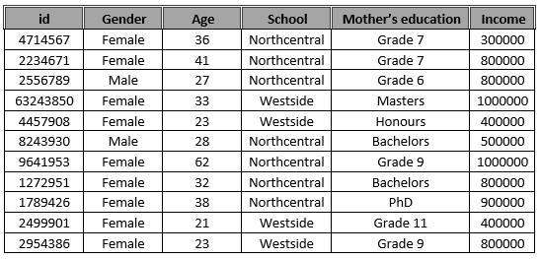
Quantitative de-identification example

Slide 17
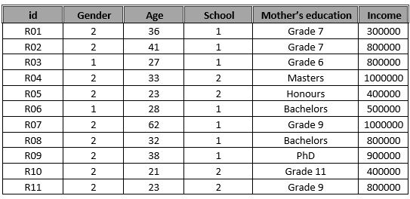
Quantitative de-identification example

Slide 18
Resources required
e-Infrastructure
Software – MS Office/Open Office
Platforms – large number of free data platforms, e.g. Zenodo, FigShare
Competencies
Familiarity with open licensing
De-identification skills
Time – and lots of it!

Slide 19
Challenges
Data collected in multiple languages
De-identification (particularly in qualitative data) far more difficult – greater reliance on the researcher to identify disclosive information
Post-hoc consent process
Departments merge or close, participants retire or disappear
Data collected by multiple researchers
Different collection strategies, adherence to interview schedules, use/non-use of clarifying questions, etc.
Notes:
As a networked project ROER4D covered a vast area with different linguistic and cultural norms, and contained sub-projects with different research methodologies. This introduced complexity into the data cleaning process, made even more complicated by the fact that the Open Data Initiative had not formed part of the original scoping and therefore in some cases research participants had to be recontacted in order to gain consent for their data to be shared.

Slide 20
Ways forward: Creating a RDM
Consider research data management (and publication/sharing) as an integral part of research project scoping
Employ an online DMP tool to create an RDM in early stage of project development
Consult and update RDM regularly
Set aside time/resources specifically for data management and publication

Slide 21
Ways forward: ‘Open by design’
Write/help researchers write consent forms! Particularly for open data sharing.
‘Red flag’ clauses abound in template consent forms, including:
“will be used for research purposes only”
“data will be destroyed after use”
“only researchers will have access to the data”
More open consent forms allow for data sharing but do not mandate it.

