Slide 1
Modeling genetically-induced dependence in studies of families and “unrelated” individuals
Habib Ganjgahi
PhD
Statistics Department, University of Oxford
habib.ganjgahi@stats.ox.ac.uk

Slide 2
Contents
Nuisance:
  Covariate inference in presence of familial dependence
Interest:
  Heritability of high dimensional neuroimaging phenotypes
  GWA of high dimensional neuroimaging phenotypes

Slide 3
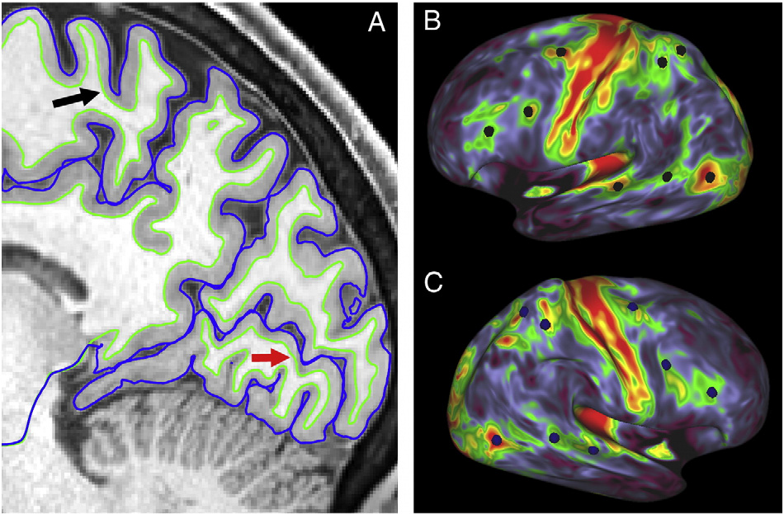
Human Connectome Project http://www.humanconnectome.org
1,200 subjects
  Extended Twin Design
Cutting edge MRI
  Structural MRI
  Functional MRI, Task & Rest
  Diffusion MRI
Extensive testing
  478 variables
  Subject Information
  Health & Family History
  Cognitive
Van Essen et al. (2013). The WU-Minn Human Connectome Project:
An overview. NeuroImage, 80, 62–79.

Slide 4
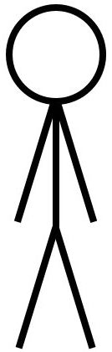
Familial Dependence
subj 1
subj 2
Complex dependence: Kinship matrix
SNP 1
SNP2
SNP 3
.
.
SNP M
0 1
2 1
0 2
1
correlation
An Example of HCP design
Genetic relationship matrix (GRM) from unrelated individuals
Notes:
The number of neuroimaging studies that use related individuals is growing, the most notable example is perhaps the Human Connectome Project (HCP). The HCP uses an extended twin design, and is a special case of general pedigree design that seeks to collect large families.
Even with putatively unrelated individuals, large studies like the UK Biobank have varying levels of relatedness due to mixtures of ethnic populations or unreported ”cryptic” relatedness.

Slide 5
Motivation
Null simulation error rate
Linear model:
  Independence assumed
Null Simulation
  HCP S1200 kinship
  20000 realizations
  Mixed heritability:
    0.2, 0.4, 0.6, 0.8
FPRs:
  5%: (0.0470, 0.0530)
  1%: (0.0486, 0.0514)
  0.01%: (0.0496, 0.0504)
Notes:
In the context of general linear model (GLM), the dependence among individuals violates the usual assumption of independence; ignoring this dependence may lead to spurious findings.

Slide 6
Motivation: Real HCP Data
Linear mixed effect model (LMM)
195 Freesurfer phenotypes from HCP S1200
OLS: Excessive false positive rate
Notes:
Linear mixed effect models (LMM) are the standard statistical practice for covariate inference in presence of family relatedness. In these models, the test statistics for the covariate effect, takes into account component of trait variance that is explained by kinship matrix, hence provide valid inference for covariate effect.
However, linear mixed effect models rely on numerical methods for parameter estimation and inference which are computationally intensive, prone to convergence failure and make extensive model assumptions.

Slide 7
Linear Mixed Effect Challenges
Imaging Software’s: FSL, SPM, Freesurfer
  No kinship
Quantitative Genetics: Solar, FaST-LMM, etc
  Spatial statistics:
    cluster size or TFCE inferences
    Multiple testing correction
  Scalability:
    Numerical methods for parameters estimation and inference
    Prone to convergence failure
    Parametric inference is only valid asymptotically

Slide 8
Covariate Inference: kinship as Nuisance
R package Lmekin:
  LMM: Best statistical practice
  Parameter estimation and inference: optimized likelihood function
  Intractable for mass univariate approach
PALM¹:
  Implicitly models the family relatedness by permuting the data within exchangeable blocks
  FWE corrected spatial statistics P-values
NINGA²/solar eclipse³:
  Approximate solution for LMM maximum likelihood
Winkler., et al. 2014., doi: 10.1016/j.neuroimage.2014.01.060
Ganjgahi., et al., 2017., doi: 10.1101/179150 (Appear in Nature Communications)
http://solar-eclipse-genetics.org/

Slide 9
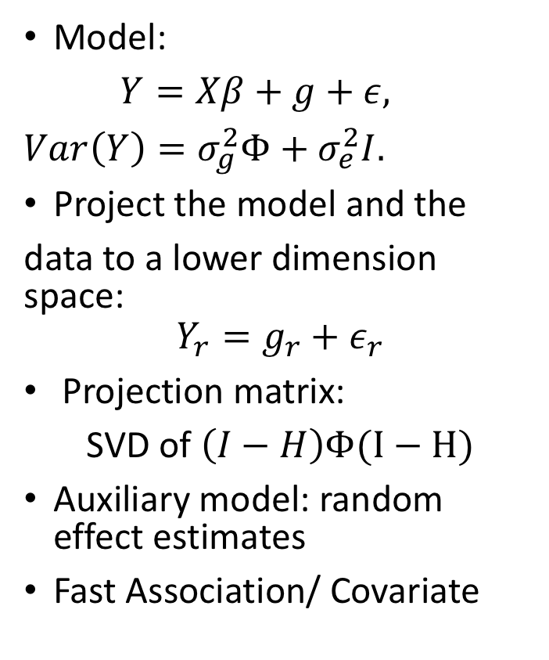
NINGA
Model:
$Y=Xβ+g+ε,$
$Var\left(Y\right)=σ_{g}^{2}Φ+σ_{e}^{2}I.$
Project the model and the
data to a lower dimension space:
$$Y_{r}=g_{r}+ε_{r}$$
Projection matrix:
SVD of $\left(I−H\right)Φ(I−H)$
Auxiliary model: random effect estimates
Fast Association/ Covariate
Ganjgahi., et al. 2015, doi: 10.1016/j.neuroimage.2015.03.005
Ganjgahi., et al., 2017., doi: 10.1101/179150 (Appear in Nature Communications)

Slide 10
Covariate Inference: Kinship as Nuisance
SIMULATION BASED ON S1200 HCP kinship
5000 realizations for each level of heritability
Ignoring kinship (OLS) increases false positive rate
Null simulations
Power simulations

Slide 11
An example from HCP
Y: Cortical thickness
  68 regions
X: Reading ability
Adjusted for age and gender
All S1200 HCP subjects
NINGA, PALM similar
NINGA Slightly more powerful
Notes:
Real data analysis, reading ability correlation with cortical thickness of 68 region of interests adjusted for age and gender effects using S1200 HCP subjects. Each figure compares different packages including parametric P-values from lmekin, and permutaton based P-values from NINGA and PALM where dots represent -log P-values. The Uncorrected P-values from all different packages look similar where NINGA and lmekin show good concordance. Also, FWE corrected P-values from PALM and NINGA are comparable where NINGA is more powerful. None of the 68 tests passed the PALM’s FWE threshold. However, 2 tests passed NINGA’s permutation based FWE

Slide 12
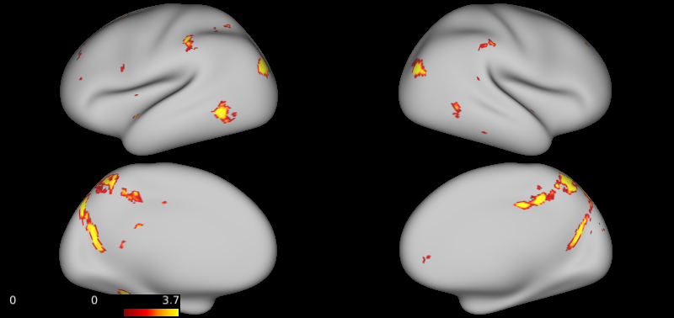
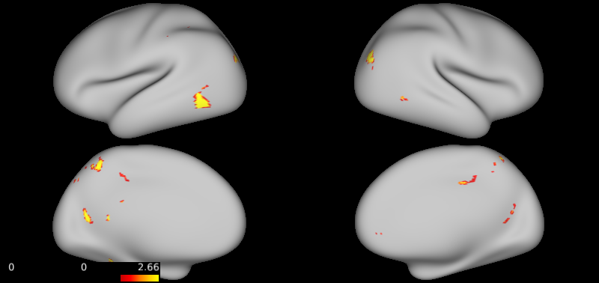
An example from HCP
Y: Cortical thickness of 60k vertices
X: Reading ability correlation
Adjusted for age and gender
All S1200 HCP subjects
NINGA: 2 hours 5000 permutations
PALM: 5 hours 5000 permutations
Results are similar, NINGA is slightly powerful
  NINGA uses approximate ML solution
NINGA
PALM
-log FWE P-values

Slide 13
Contents
Nuisance:
  Covariate inference in presence of familial dependence
Interest:
  Heritability of high dimensional neuroimaging phenotypes
  GWA of high dimensional neuroimaging phenotypes

Slide 14
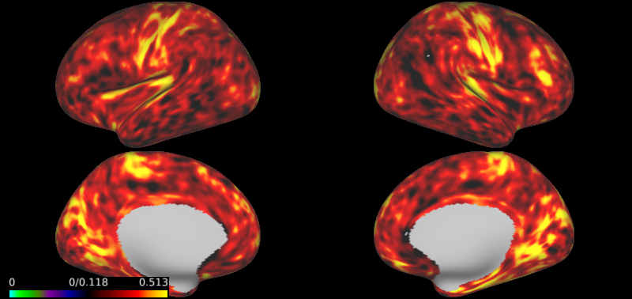
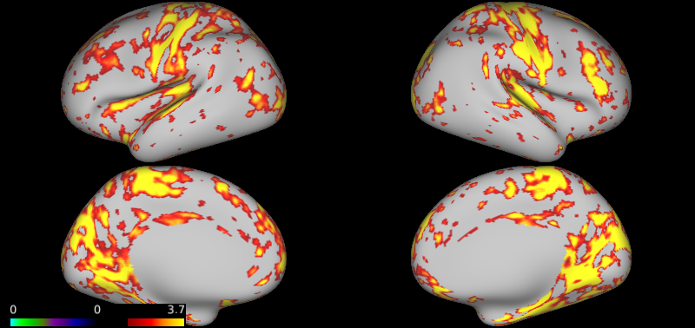
Heritability of Neuroimaging phenotypes
HCP S1200 Cortical thickness vertex-wise heritability map
Tools: Solar, OpenMX
Estimation and inference:
  Numerical methods
  Conservative (Ganjgahi 2015)
NINGA:
Heritability estimate 60k vertices:
  Solar: 4 hours
  NINGA: 1.4 sec
  5000 permutations 2 hours
Vertex-wise analysis: -log FWE P-values

Slide 15
Heritability GRM
TBSS FA of 42 ROIs
  331 unrelated subjects¹
  54% healthy individual (175 control/155 schizophrenic)
  Mean age of 39.12 (SD= 14.9)
  50% male
GRM Heritability
1. Kochunov., et al. doi: 10.1002/hbm.23336

Slide 16
Genome wide Association
LMM using GRM for unrelated subjects GWA
Tools:
  FaST-LMM, Solar, EMMAX, GenAbel
  Scalability
FaST-LMM: fastest implementation
Running time of parametric association testing on 22 ROIs and 1.5 M SNPs
  FaST-LMM: 756 mins
  NINGA: 2 min
 | Random Effect Estimation | Association
FaST-LMM | O(N³+INV) | O(SPN ²V)
NINGA | O(N³+NV) | O(SNV )
N: # subjects,
V: # image elements,
S: # SNPs,
I: # average iteration.

Slide 17
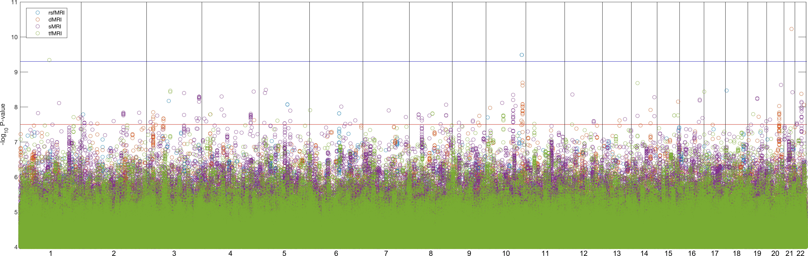
HCP GWA
GWA results for
  2,014 HCP imaging phenotypes
  9,828,572 SNPs
  All S1200 HCP
1000 permutations took 10 hours
5% FWE Threshold
Usual GWA P-value
Notes:
GWAS results for 2,014 phenotypes and all 9,828,572 SNPs where each dot represents maximum −log10 P-values per SNP between different imaging modalities. 294 SNPs passed the usual GWA P-value corrected for number of SNPs being tested. Top hits include associations for TBSS FA, Netmat edges and tfMRI acti- vations. Among 19.8 billion tests, 3 passed the FWE threshold for all SNPs and ROIs. Upper (blue) line is 5% FWE threshold −log10 P threshold (9.4), and lower (red) threshold is usual GWA threshold of 7.5 −log10 P

Slide 18
Conclusion
Poster 1545
Covariate inference
  Accommodate Kinship
NINGA:
  Computationally efficient LMM
  Heritability
  GWAS
  FWE P-values
Thank you for your attention
habib.ganjgahi@stats.ox.ac.uk
NINGA: http://nisox.org/software/ninga/

