Slide 1
More Than Top Down or Bottom Up: Fostering Software Engineering Best Practice in Diverse Groups https://doi.org/10.6084/m9.figshare.6731696 3rd July 2018, PASC2018, Basel Neil Chue Hong (@npch), Software Sustainability Institute ORCID: 0000-0002-8876-7606 | N.ChueHong@software.ac.uk
Supported by
Project funding from
Slides licensed under CC-BY where indicated:
Notes:
We often think of practice being driven by grass-roots change (encouraging participation) or clear leadership (providing direction). In reality, successful application of best practice requires both, particularly in the diverse communities where research software is developed and used. Over the last five years, significant changes related to research software have taken place from training initiatives like Software Carpentry, to the recognition of the role of the Research Software Engineer, to the development and adoption of community guidelines and practices. My talk will look at how each of these is related, and how the drive towards reproducibility, FAIR research outputs, and open science is having an effect on the way that software development is being done in research teams.

Slide 2
Best practice is HARD
It’s not easy to understand how to produce good software
One size doesn’t always fit all
Best practice requires more than just one person ”buying in” to become widely adopted

Slide 3
Software Sustainability Institute
A national facility for cultivating better, more sustainable, research software to enable world-class research
Software reaches boundaries in its development cycle that prevent improvement, growth and adoption
Providing the expertise and services needed to negotiate to the next stage
Developing the policy and tools to support the community developing and using research software
Supported by EPSRC Grant EP/H043160/1 + EPSRC/ESRC/BBSRC grant EP/N006410/1
Notes:
The Software Sustainability Institute can help with: software reviews and refactoring, collaborations to develop your project, guidance and best practice on software development, project management, community building, publicity and more…
Drawing on pool of specialists to drive the continued improvement and impact of research software developed by and for researchers
Providing services for research software users and developers
Developing research community interactions and capacity
Promoting research software best practice and capability

Slide 4
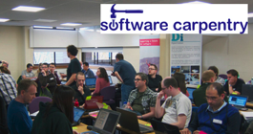
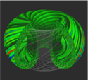
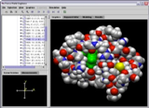
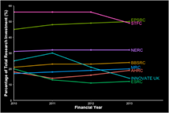
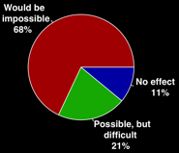
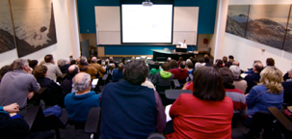
Software
Training
Helping the community to develop software that meets the needs of reliable, reproducible, and reusable research
Delivering essential software skills to researchers via CDTs, institutions & doctoral schools
Outreach
Exploiting our platform to enable engagement, delivery & uptake
Collecting evidence on the community’s software use & sharing with stakeholders
Bringing together the right people to understand and address topical issues
Policy
Community

Slide 5
About this talk
Why software best practice is important
Ubiquity of software; Reproducibility crisis; Careers
What’s already happening
Changes in Policy; Carpentries; Research Software Engineers; Community Guidelines
What the next challenges are
Lack of resources; Belief in research commons

Slide 6
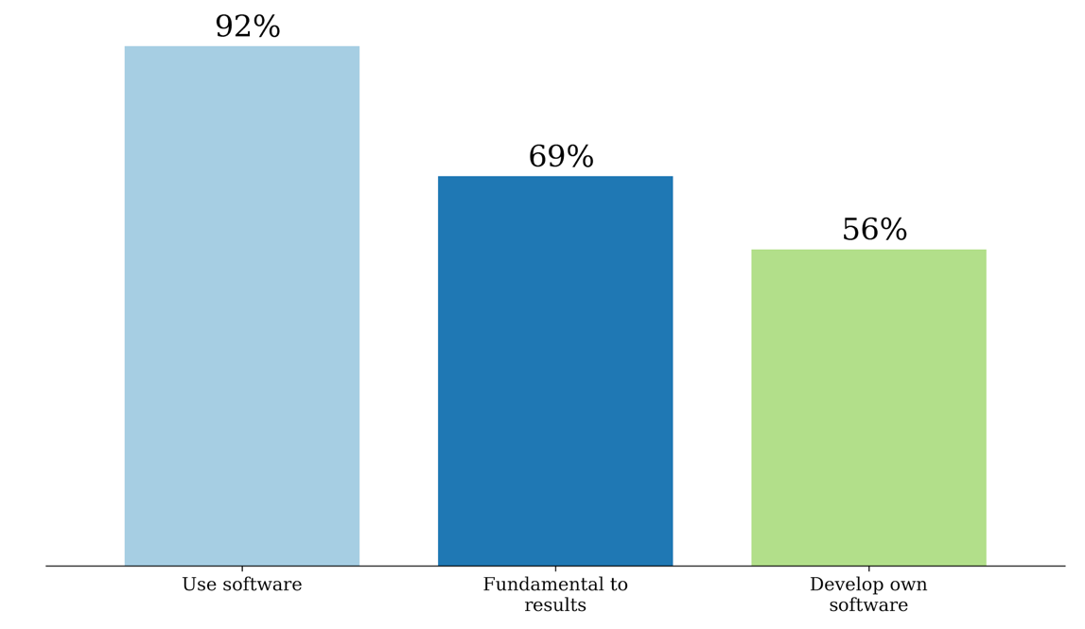
UK software survey 2014
S.J. Hettrick et al, UK Research Software Survey 2014
​DOI:10.5281/zenodo.1183562.
Notes:
417 responses across 15 Russell Group universities. Can’t re-run the analysis because people did not like being cold-called.
https://www.software.ac.uk/blog/2016-09-12-its-impossible-conduct-research-without-software-say-7-out-10-uk-researchers
RCs invested around £4.7 billion a year, which means £3.2 billion (69%) is at risk.
https://www.gov.uk/government/uploads/system/uploads/attachment_data/file/505308/bis-16-160-allocation-science-research-funding-2016-17-2019-20.pdf
Industrial strategy aims to spend 2.4% of GDP on research and development (equivalent to £480 billion in 2017). 69% of that is £380 billion.

Slide 7
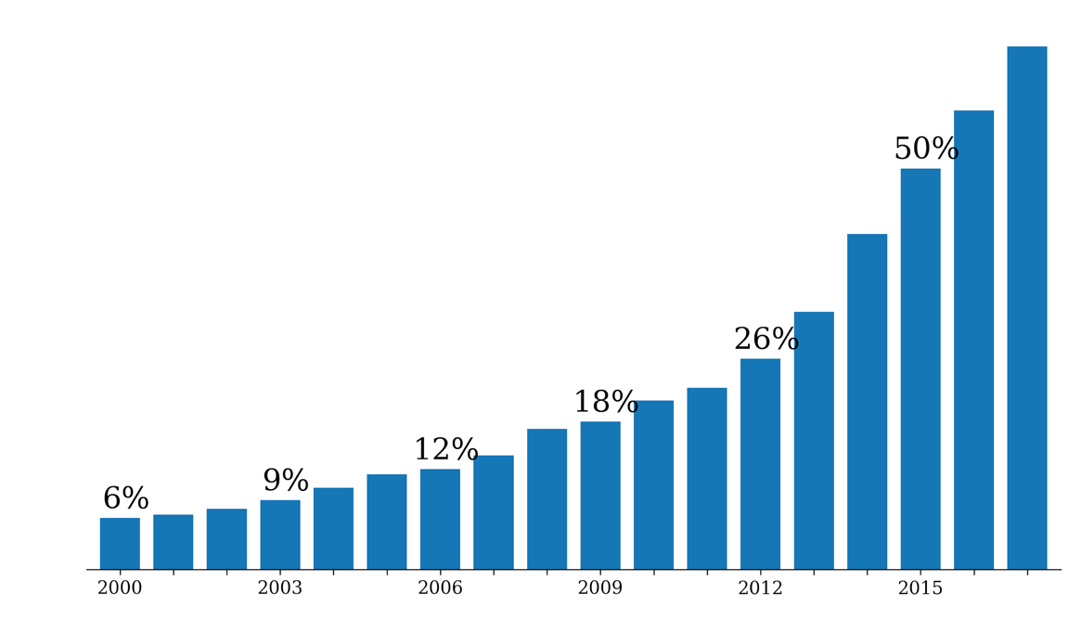
Software in research papers
65%
Searched Eprints repositories from 31 UK institutions ~ 600k papers
Displayed the percentage of papers found to have software-related terms against all papers in the repository.
2017
Notes:
It’s really difficult to assess an unbiased way of identifying the importance of software in research.
Eprints is a digital repository which many institutions are mandating their researchers to use.
We searched Eprints repositories from 31 UK institutions (~ 600k papers) for terms indicating that the results in the publication relied on the use of software at some stage of the research. This graph displays the percentage of papers found to have software-related terms against all papers in the repository submitted in that year. Not only has the number of papers submitted been rising, but the percentage dependent on software has also been rising dramatically.

Slide 8
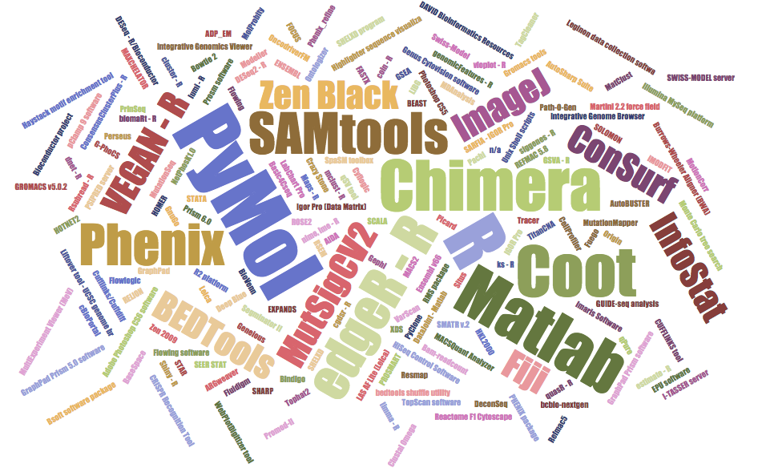
Software in nature
Nangia and Katz: https://arxiv.org/pdf/1706.06527.pdf
Notes:
Study by Nangia and Katz
https://arxiv.org/pdf/1706.06527.pdf
January – March 2016, 173 pieces of software mentioned
32 of 40 papers mention software
6 packages mentioned in 4 or more papers: Pymol, R, Chimera, Coot, Matlab, PHENIX
26 packages mentioned in 2 or more papers
Note that R packages feature heavily, along with visualisation tools

Slide 9
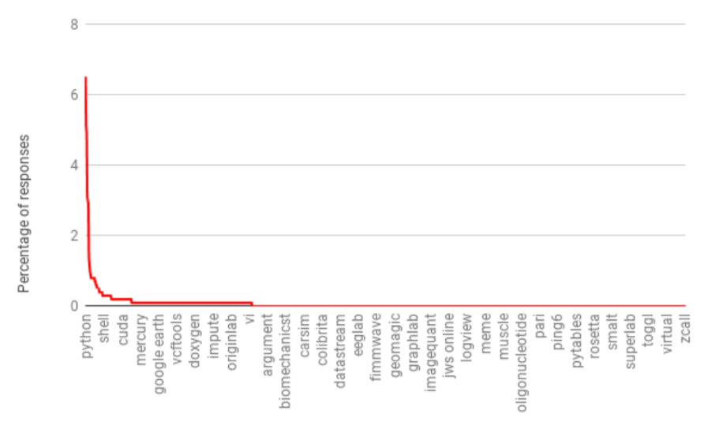
Long, long, long tail
“What software do you use in your research?”
2958 responses (2014–16, 1261 participants)
>10: 35 packages
>1: 304 packages
1: 2654 packages
Python, Matlab, R SPSS, Excel top packages
http://doi.org/10.5281/zenodo.60276
Slide courtesy of Simon Hettrick

Slide 10
Growth in a time of debt
Can you spot the mistake?
“All I can hope is that future historians note that one of the core empirical points providing the intellectual foundation for the global move to austerity in the early 2010s was based on someone accidentally not updating a row formula in Excel” – Mike Konczal
Reinhart, Carmen M.; Rogoff, Kenneth S. (2010). "Growth in a Time of Debt". American Economic Review. 100 (2): 573–78. doi:10.1257/aer.100.2.573
https://qz.com/75035/fixing-this-excel-error-transforms-high-debt-countries-from-recession-to-growth/
http://www.nytimes.com/2013/04/26/opinion/debt-growth-and-the-austerity-debate.html
https://www.bloomberg.com/news/articles/2013-04-18/faq-reinhart-rogoff-and-the-excel-error-that-changed-history

Slide 11
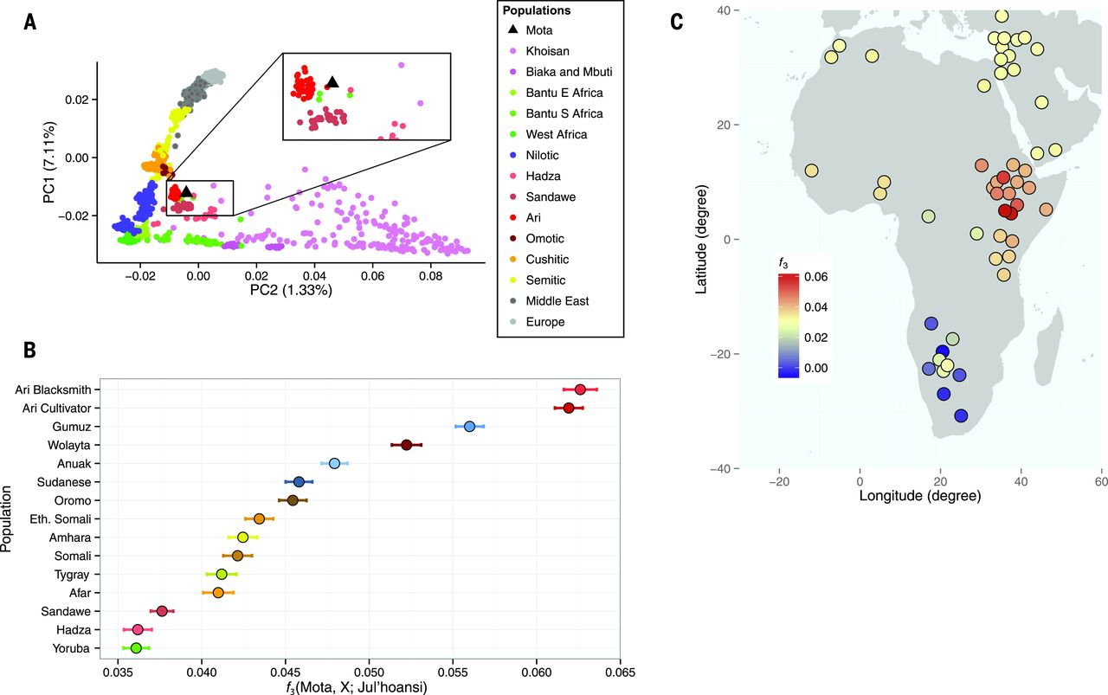
Llorente et al. Science, 350, 6262
doi:10.1126/science.aad2879
The results presented in the Report “Ancient Ethiopian genome reveals extensive Eurasian admixture throughout the African continent“ were affected by a bioinformatics error
https://www.nature.com/news/error-found-in-study-of-first-ancient-african-genome-1.19258
Notes:
One of the conclusions of a report published last year suggested a large migration of Eurasians back into Africa. However it turned out that this was due to an error in the bioinformatics pipeline wrongly discarding data.
In this case, this is a case of good science – the methodology was published, the data was available (http://africangenome.org/index.php/African_genome_ftp though not licensed) and the authors issued an erratum when the mistake was found.
The results presented in the Report “Ancient Ethiopian genome reveals extensive Eurasian admixture throughout the African continent“ were affected by a bioinformatics error. A script necessary to convert the input produced by samtools v0.1.19 to be compatible with PLINK was not run when merging the ancient genome, Mota, with the contemporary populations SNP panel, leading to homozygote positions to the human reference genome being dropped as missing data (the analysis of admixture with Neanderthals and Denisovans was not affected). When those positions were included, 255,922 SNP out of 256,540 from the contemporary reference panel could be called in Mota. The conclusion of a large migration into East Africa from Western Eurasia, and more precisely from a source genetically close to the early Neolithic farmers, is not affected. However, the geographic extent of the genetic impact of this migration was overestimated: the Western Eurasian backflow mostly affected East Africa and only a few Sub-Saharan populations; the Yoruba and Mbuti do not show higher levels of Western Eurasian ancestry compared to Mota.
We thank Pontus Skoglund and David Reich for letting us know about this problem.

Slide 12
When things go wrong
64 bit floating point number
10101010
10101010
10101010
10101010
10101010
10101010
10101010
10101010
10101010
10101010
10101010
10101010
10101010
10101010
10101010
10101010
16 bit signed integer
11111111
00000000
00001111
11110000
00110011
11001100
00001111
11110000
“nozzle deflections were commanded by the ... software on the basis of data transmitted by the active Inertial Reference System (SRI 2) ... Part of these data ... did not contain proper flight data, but ... was interpreted as flight data.”
“SRI 2 did not send correct attitude data ... due to a software exception”
“software exception was caused during execution of a data conversion from 64-bit floating point to 16-bit signed integer value”
ARIANE 5 Flight 501 Failure, Report by the Inquiry Board, 19 July 1996
http://www.esa.int/For_Media/Press_Releases/Ariane_501_-_Presentation_of_Inquiry_Board_report
Cost of this bug: US$370 million
http://www.esa.int/spaceinimages/Images/2009/09/Explosion_of_first_Ariane_5_flight_June_4_1996

Slide 13
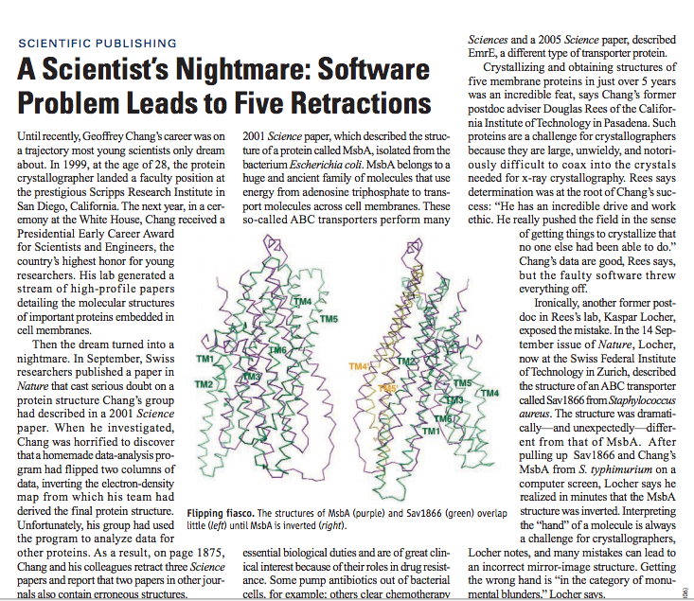
“Chang’s data are good… but the faulty software threw everything off”
http://science.sciencemag.org/ content/314/5807/1856.full
“a homemade data-analysis program had flipped two columns”
Notes:
http://science.sciencemag.org/content/314/5807/1856.full

Slide 14
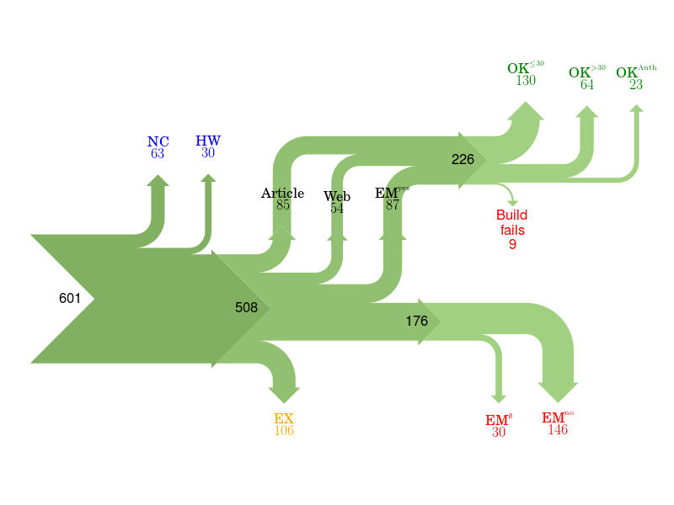
Of 601 papers in ACM Computer Science journals and proceedings, only 85 provided a link to software.
For 176 the software could not be obtained.
Collberg, Proebsting, Warren, University of Arizona TR 14-04, 2015
http://reproducibility.cs.arizona.edu/v2/RepeatabilityTR.pdf
Notes:
NC Paper excluded due to results not being backed by code.
HW Paper excluded due to replication requiring special hardware.
EX Paper excluded due to overlapping author lists.
EMno Author responds that the code cannot be provided.
EMØ Author does not respond to email request within 2 months.
Article Code is found from link in the article itself.
Web Code is found from a web search.
EMyes Code is provided by author after email request.
OK≤30 We succeed in building the system in ≤30 minutes.
OK>30 We succeed in building the system in >30 minutes.
OK>Author We fail to build, but the author says the code builds with reasonable effort.
Fails We fail to build, and the author doesn't respond to survey or says code may have problems building.

Slide 15
Culture change is hard
In 2011 Science changed its editorial policies:
“We require that all computer code used for modeling and/or data analysis that is not commercially available be deposited in a publicly accessible repository upon publication.”
“After publication, all reasonable requests for data, code, or materials must be fulfilled.”
Stodden, Seiler, Ma. An empirical analysis of journal policy effectiveness for computational reproducibility
https://doi.org/10.1073/pnas.1708290115
Notes:
https://doi.org/10.1073/pnas.1708290115
http://www.sciencemag.org/authors/science-journals-editorial-policies
Implemented February 11, 2011.

Slide 16
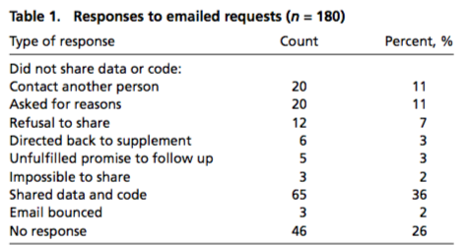
Culture change is hard
Stodden, Seiler, Ma. An empirical analysis of journal policy effectiveness for computational reproducibility
https://doi.org/10.1073/pnas.1708290115
Notes:
https://doi.org/10.1073/pnas.1708290115
http://www.sciencemag.org/authors/science-journals-editorial-policies
Implemented February 11, 2011.

Slide 17
Culture change is hard
“There appeared to be some confusion among authors, some of whom seemed to be unaware of Science’s data and code sharing requirement. We can most easily demonstrate this with some anonymized author responses that highlight some of the barriers to sharing they perceived:”
Stodden, Seiler, Ma. An empirical analysis of journal policy effectiveness for computational reproducibility
https://doi.org/10.1073/pnas.1708290115
Notes:
https://doi.org/10.1073/pnas.1708290115
http://www.sciencemag.org/authors/science-journals-editorial-policies
Implemented February 11, 2011.

Slide 18
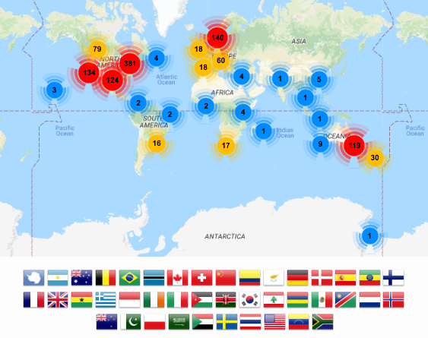
Foundational skills for researchers
Basic lab skills for scientific computing; researchers can do more in less time and with less pain.
Basic concepts, skills and tools for working more effectively with data.
Open source learning, “Train the trainers”

Slide 19
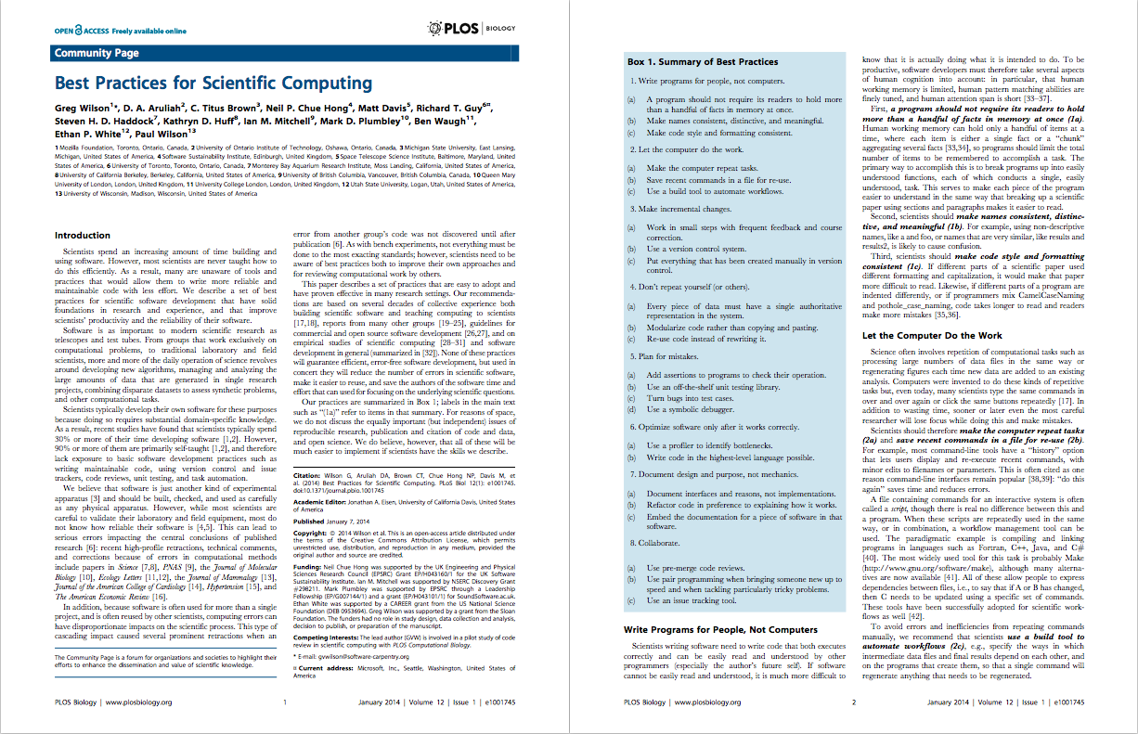
Best Practices for Scientific Computing: https://doi.org/10.1371/journal.pbio.1001745

Slide 20
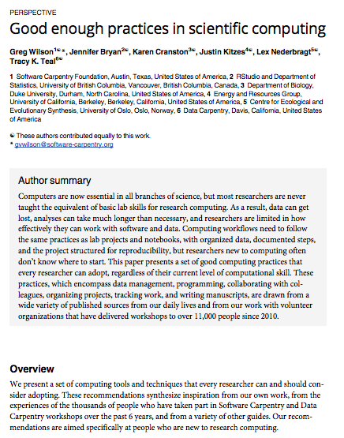
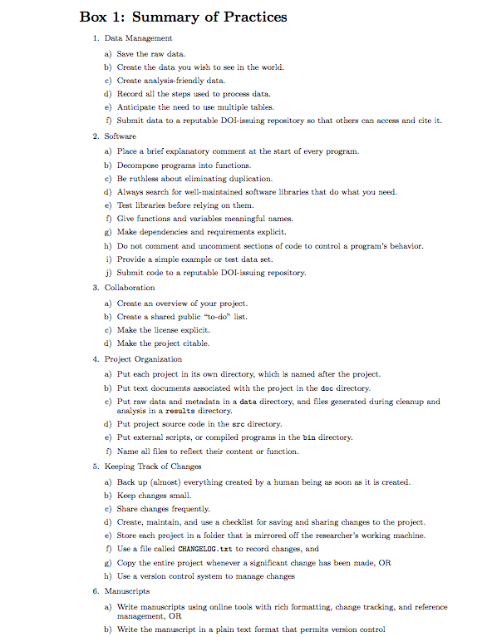
Good Enough Practices in Scientific Computing: https://doi.org/10.1371/journal.pcbi.1005510
Notes:
Good Enough Practices in Scientific Computing: https://doi.org/10.1371/journal.pcbi.1005510

Slide 21
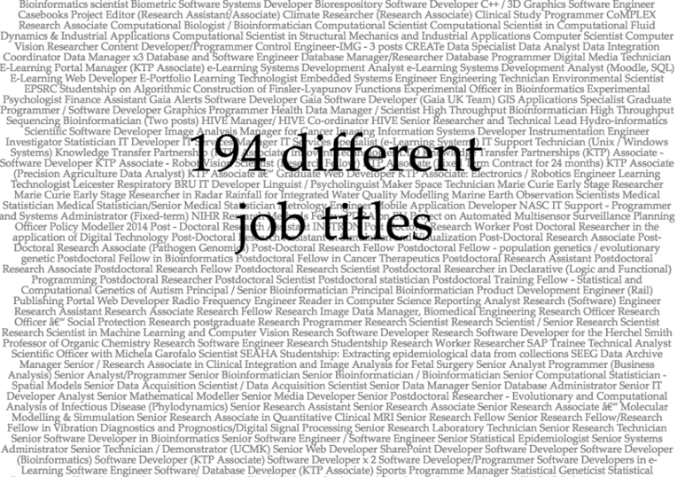
What about careers?
jobs.ac.uk
10,000 jobs assessed
~400 related to software development (4%)
Slide courtesy of Simon Hettrick

Slide 22
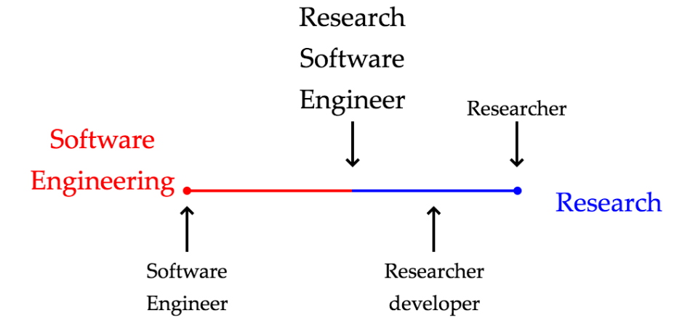
A new name is born
Slide courtesy of Simon Hettrick

Slide 23
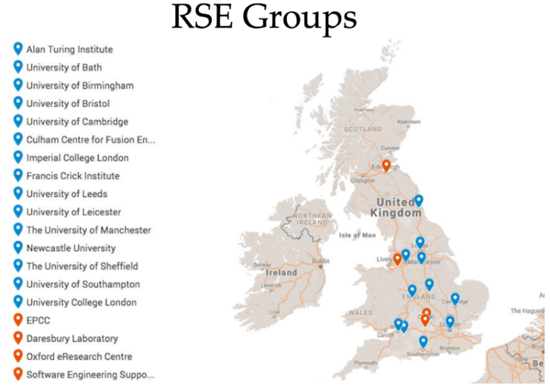
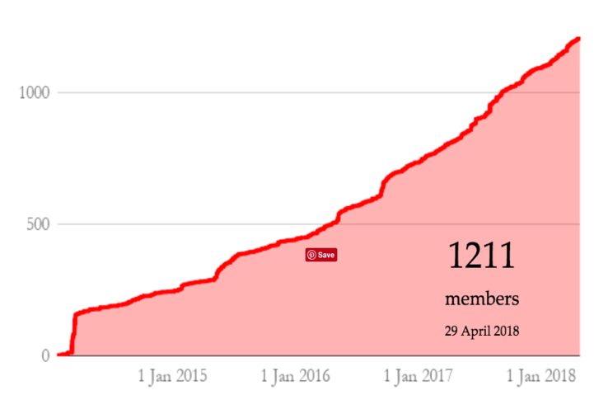
Growth of RSE Community
Slide courtesy of Simon Hettrick

Slide 24
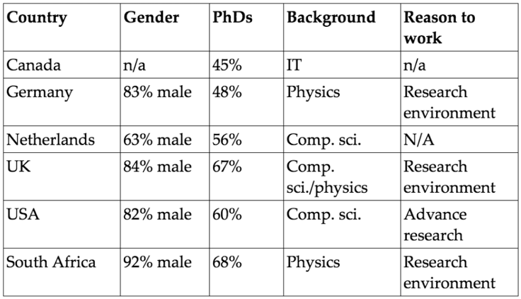
RSEs are worldwide
Wants to work in a research environment
Wants to advance research
Wants to develop software
github.com/softwaresaved/international-survey/tree/master/analysis
Slide courtesy of Simon Hettrick

Slide 25
Guides are popular
Software Evaluation Guide (over 65k unique visits)
Choosing a repository for your software project (over 50k unique visits)
How to cite and describe software (over 25k unique visits)
Developing maintainable software (over 25k unique visits)
In which journals should I publish my software (over 22k unique visits)
But on their own, they don’t ensure adoption of good practice

Slide 26
DLR Initiative
https://doi.org/10.6084/m9.figshare.5331703.v2
Carina Haupt and Tobias Schlauch

Slide 27
https://doi.org/10.6084/m9.figshare.5331703.v2
Carina Haupt and Tobias Schlauch

Slide 28
https://doi.org/10.6084/m9.figshare.5331703.v2
Carina Haupt and Tobias Schlauch

Slide 29
Community standards
ESIP (Earth Sciences): https://esipfed.github.io/Software-Assessment-Guidelines/
CLARIAH (Arts and Humanities): https://github.com/CLARIAH/software-quality-guidelines
IPOL (Image Processing): https://tools.ipol.im/wiki/ref/software_guidelines/
ELIXIR (Life Sciences): https://www.ncbi.nlm.nih.gov/pmc/articles/PMC5490478/

Slide 30
Software Development Best Practices for Life Sciences
Goal:
Define procedures to improve quality and sustainability of software development that could be adopted by ELIXIR and other biomedical Research Infrastructures
Series of workshops (lightning talks, facilitated sessions)
Agree practices
Build community
Create policy
Develop guidance
Outputs
“Four simple recommendations” paper
“Top 10 Metrics” paper
Training course (in development)
Endorsement by community
Repo: https://github.com/SoftDev4Research/
1. Develop publicly accessible open source code from day one
2. Make software easy to discover by providing software metadata via a popular community registry
3. Adopt a license and comply with the licence of third-party dependencies
4. Have a clear and transparent contribution, governance and communication processes

Slide 31
Research Software Workflow
describe
develop ➔ share ➔ preserve
Developed and versioned using code repository
Published via code repository
or website
Deposited in digital repository with paper / for preservation

Slide 32
LIGO Example
LIGO Paper:
http://journals.aps.org/prl/abstract/10.1103/PhysRevLett.116.061102
LIGO Notebook:
https://losc.ligo.org/s/events/GW150914/GW150914_tutorial.ipynb
Notes:
LIGO Paper:
http://journals.aps.org/prl/abstract/10.1103/PhysRevLett.116.061102
LIGO Notebook:
https://losc.ligo.org/s/events/GW150914/GW150914_tutorial.ipynb

Slide 33
“Perceived” importance
“It has been said … that writing a large piece of software is akin to building infrastructure such as a telescope rather than a creditable scientific contribution…”
“software development [is] often discounted in the scientific community, and programming is treated as something to spend as little time on as possible”
“Serious scientists are not expected to carefully test code, let alone document it, in the same way they are trained to properly use other tools or document their experiments”
Stodden, V., Bailey, D. H., Borwein, J., LeVeque, R.J., Rider, W., Stein, W. “Setting the Default to Reproducible Reproducibility in Computational and Experimental Mathematics”, ICERM 2013, February 2013.

Slide 34
Victoria Stodden, AMP 2011 http://www.stodden.net/AMP2011/,
Special Issue Reproducible Research Computing in Science and Engineering July/August 2012, 14(4)
Howison and Herbsleb (2013) "Incentives and Integration In Scientific Software Production" CSCW 2013.
Notes:
Victoria Stodden, AMP 2011 http://www.stodden.net/AMP2011/,
Special Issue Reproducible Research Computing in Science and Engineering July/August 2012, 14(4)
Howison and Herbsleb (2013) "Incentives and Integration In Scientific Software Production" CSCW 2013.

Slide 35
Sharing is key to reproducibility
Improves transparency
Improves understanding
Elimination of errors
Encourages collaboration
Easier on-ramping
Improves trust
“Deep intellectual contributions now encoded only in software" – Stodden
“Scholarship is the full software environment, code and data, that produced the result” - Claerbout

Slide 36
It’s still all about reputation
“This particular project was something I wrote a couple years ago to help me out with a workflow… I’d put it up on Github, so that others could potentially use it or use the code. So I went to see what people were saying about this project. It seemed liked I’d done something fundamentally wrong, so stupid that it flabbergasts someone... So of course I start sobbing. Then I see these people’s follower count, and I sob harder. I can’t help but think of potential future employers that are no longer potential.”
http://www.software.ac.uk/blog/2013-01-25-haters-gonna- hate-why-you-shouldnt-be-ashamed-releasing-your-code

Slide 37
It’s impossible to do this on your own

Slide 38
Communities of Practice
Domain: A domain of knowledge creates common ground, inspires members to participate, guides their learning and gives meaning to their actions
Community: The notion of a community creates the social fabric for that learning. A strong community fosters interactions and encourages a willingness to share ideas.
Practice: While the domain provides the general area of interest for the community, the practice is the specific focus around which the community develops, shares and maintains its core of knowledge.
Wenger, Etienne; McDermott, Richard; Snyder, William M. (2002). Cultivating Communities of Practice (Hardcover). Harvard Business Press; 1 edition. ISBN 978-1-57851-330-7.

Slide 39
Cultivating successful CoPs
Design the community to evolve naturally
Create opportunities for open dialog within and with outside perspectives
Welcome and allow different levels of participation
Develop both public and private community spaces
Focus on the value of the community
Combine familiarity and excitement
Find and nurture a regular rhythm for the community
Wenger, Etienne; McDermott, Richard; Snyder, William M. (2002). Cultivating Communities of Practice (Hardcover). Harvard Business Press; 1 edition. ISBN 978-1-57851-330-7.

Slide 40
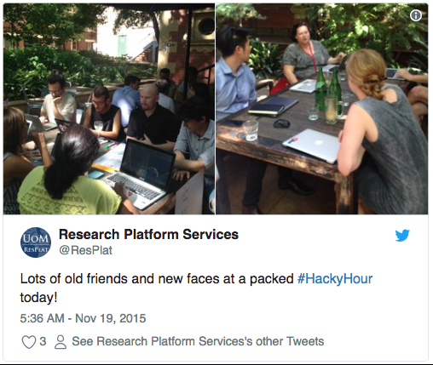
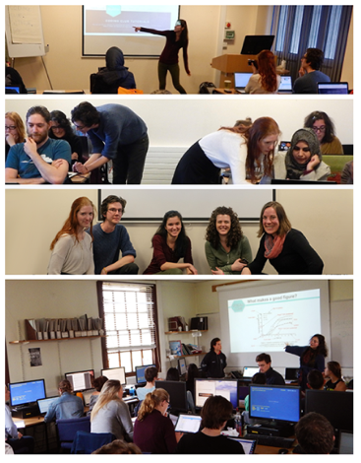
Examples of CoPs
https://cookbook.carpentries.org/
https://ourcodingclub.github.io/
Sheffield Astrophysics Code Review Club https://www.software.ac.uk/index.php/blog/ 2018-05-18-code-review-academia
http://melbourne.resbaz.edu.au/HackyHour
http://collections.plos.org/ ten-simple-rules

Slide 41
Summary
Increasing amounts of research software, increasing understanding of good practice
Challenge is that research does not incentivize good practice
So bottom-up training and top-down policies don’t work on their own
Success has come from supporting formation of communities of practice, and sharing materials
But this takes effort and goodwill

Slide 42
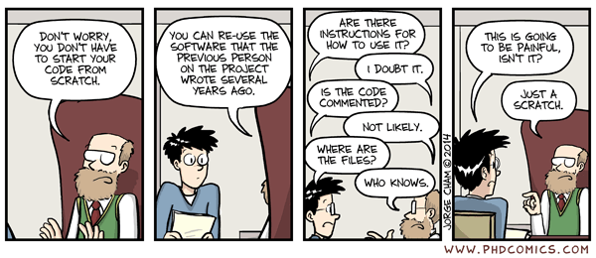
This is still going to be painful
Piled Higher and Deeper" by Jorge Cham www.phdcomics.com
http://phdcomics.com/comics.php?f=1689

Slide 43
Find out more about the SSI
Community Engagement (Lead: Shoaib Sufi)
Fellowship Programme & Events and Workshops
Consultancy (Lead: Steve Crouch)
Open Call for Projects / Collaborations
Online Software Evaluation & Software Management Planning
Policy and Publicity (Lead: Simon Hettrick)
Case Studies / Policy Campaigns
Software and Research Blog
Training (Lead: Aleksandra Nenadic)
Software Carpentry and Data Carpentry
Guides and Top Tips
Journal of Open Research Software (Editor: Neil Chue Hong)
Collaboration between universities of Edinburgh, Manchester, Oxford and Southampton Supported by EPSRC Grant EP/H043160/1 + EPSRC/ESRC/BBSRC grant EP/N006410/1

Slide 44
Acknowledgements
The SSI team/alumni:
Aleksandra Nenadic
Aleksandra Pawlik
Alexander Hay
Arno Proeme
Carole Goble
Claire Wyatt
Clem Hadfield
Dave De Roure
Devasena Prasad
Giacomo Peru
Graeme Smith
Iain Emsley
James Graham
John Robinson
Les Carr
Malcolm Atkinson
Malcolm Illingworth
Mario Antonioletti
Mark Parsons
Mike Jackson
Olivier Philippe
Priyanka Singh
Raniere Silva
Rob Baxter
Robin Wilson
Shoaib Sufi
Simon Hettrick
Stephen Crouch
Tim Parkinson
Toni Collis
Plus the SSI Fellows and RSE community
Scientific software:
Dan Katz
Heather Piowowar
James Howison
Jeff Carver
Jennifer Schopf
Kaitlin Thaney
Martin Fenner
Victoria Stodden
WSSSPE community
Software/Data Carpentry
Greg Wilson
Jonah Duckles
Tracy Teal
Instructor Community
Supported by EPSRC Grant EP/H043160/1 + EPSRC/ESRC/BBSRC grant EP/N006410/1

Slide 45
Software Sustainability Institute
A national facility for cultivating better, more sustainable, research software to enable world-class research
Software reaches boundaries in its development cycle that prevent improvement, growth and adoption
Providing the expertise and services needed to negotiate to the next stage
Developing the policy and tools to support the community developing and using research software
Supported by EPSRC Grant EP/H043160/1 + EPSRC/ESRC/BBSRC grant EP/N006410/1
Notes:
The Software Sustainability Institute can help with: software reviews and refactoring, collaborations to develop your project, guidance and best practice on software development, project management, community building, publicity and more…
Drawing on pool of specialists to drive the continued improvement and impact of research software developed by and for researchers
Providing services for research software users and developers
Developing research community interactions and capacity
Promoting research software best practice and capability

Slide 46
Software
Training
Helping the community to develop software that meets the needs of reliable, reproducible, and reusable research
Delivering essential software skills to researchers via CDTs, institutions & doctoral schools
Outreach
Exploiting our platform to enable engagement, delivery & uptake
Collecting evidence on the community’s software use & sharing with stakeholders
Bringing together the right people to understand and address topical issues
Policy
Community

Slide 47
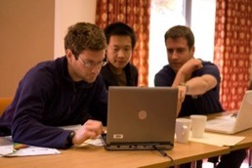
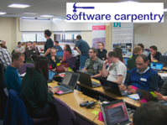
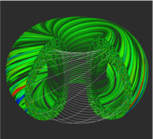
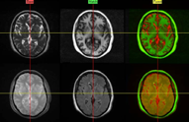
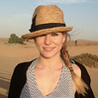
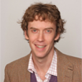
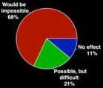
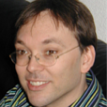
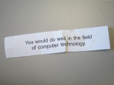
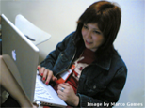
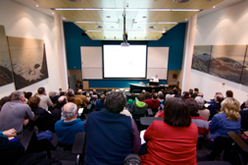
Software
Training
Advice
Courses
35+ UK SWC workshops
1000+ learners
Consultancy
50+ projects
130+ evaluations
4 surgeries
Guides
Outreach
80+ guides
50,000 readers
Website & blog
150+ contributed articles
20,000 unique visitors per month
3,000 Twitter followers
Research
740 researchers 50,000 grants analysed
Campaigns
Workshops
Fellowship
61 domain ambassadors
300+ RSEs engaged
2100 signatures
13 issues highlighted
Policy
Community
20+ workshops organised

