Slide 1
ADAPTIVE MULTISCALE SHALLOW FLOW MODEL A wavelet-based formulation Georges Kesserwani¹ / Mohammad K Sharifian² / James Shaw³ ¹ University of Sheffield, g.kesserwani@shef.ac.uk ² University of Tabriz, m.sharifian@tabrizu.ac.ir ³ University of Sheffield, js102@zepler.net

Slide 2
Large spatial domain
Adaptive multiscale modelling
Fine mesh spacing
Computational efficiency

Slide 3
Challenges facing adaptive multiscale models
Must adapt both mesh and numerical solution
Avoid too many tuneable parameters
Avoid complex, heuristic adaptivity decision-making
Preserve robustness and accuracy of underlying model
Notes:
Don’t want user-defined parameters that need tuning differently for different test case

Slide 4
Wavelet-based adaptive modelling
Wavelets adapt mesh and solution simultaneously
Single tuneable parameter to control adaptivity error
Wavelets directly control coarsening/refinement decisions
Must adapt both mesh and numerical solution
Avoid too many tuneable parameters
Avoid complex, heuristic adaptivity decision-making
Preserve robustness and accuracy of underlying model
Notes:
Don’t want user-defined parameters that need tuning differently for different test case

Slide 5
Wavelets encode detail lost through coarsening
Fine-scale signal
=
Coarse-scale signal
+
Wavelet-encoded details

Slide 6
Multiscale Haar wavelet decomposition
Notes:
Note that Haar wavelets are piecewise constant, so they are directly compatible with finite volume basis

Slide 7
Multiscale Haar wavelet decomposition
Notes:
Note that Haar wavelets are piecewise constant, so they are directly compatible with finite volume basis

Slide 8
Multiscale Haar wavelet decomposition
Notes:
Note that Haar wavelets are piecewise constant, so they are directly compatible with finite volume basis

Slide 9
Multiscale Haar wavelet decomposition
Notes:
Note that Haar wavelets are piecewise constant, so they are directly compatible with finite volume basis

Slide 10
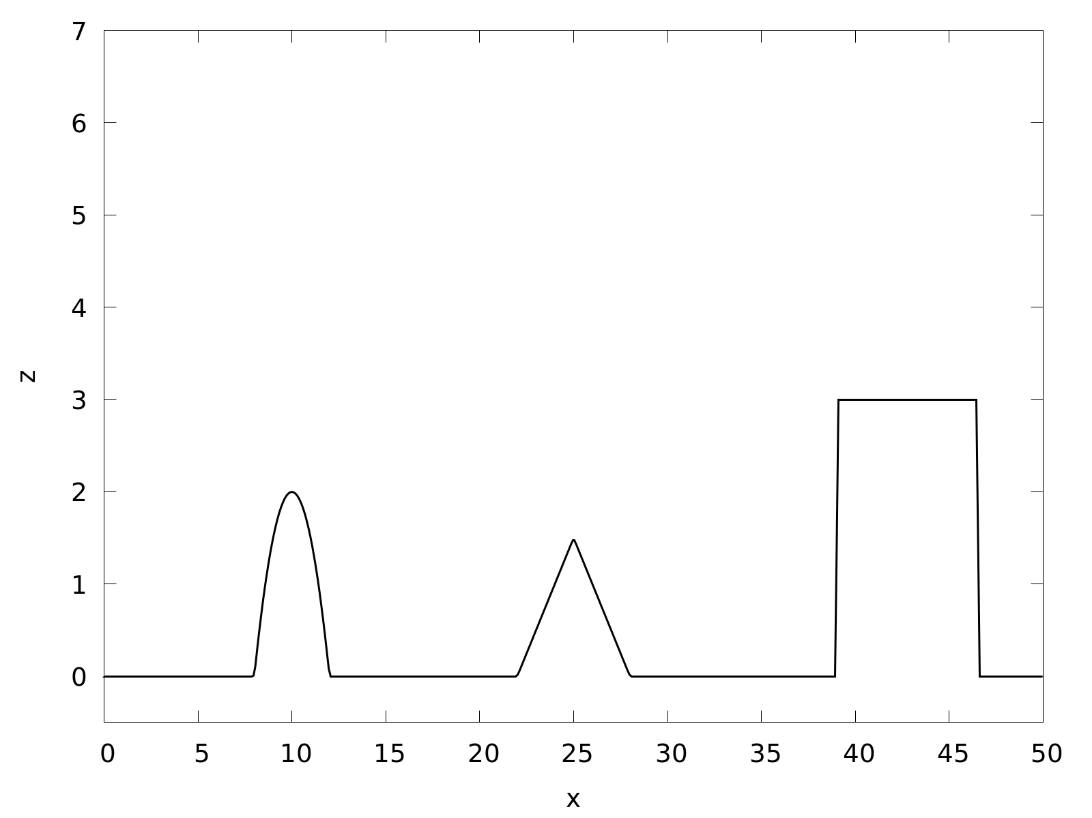
1D idealised topography
Uniform mesh, 512 cells

Slide 11
Adaptivity error threshold parameter, ε
0
ε
1
Small error
Large error

Slide 12
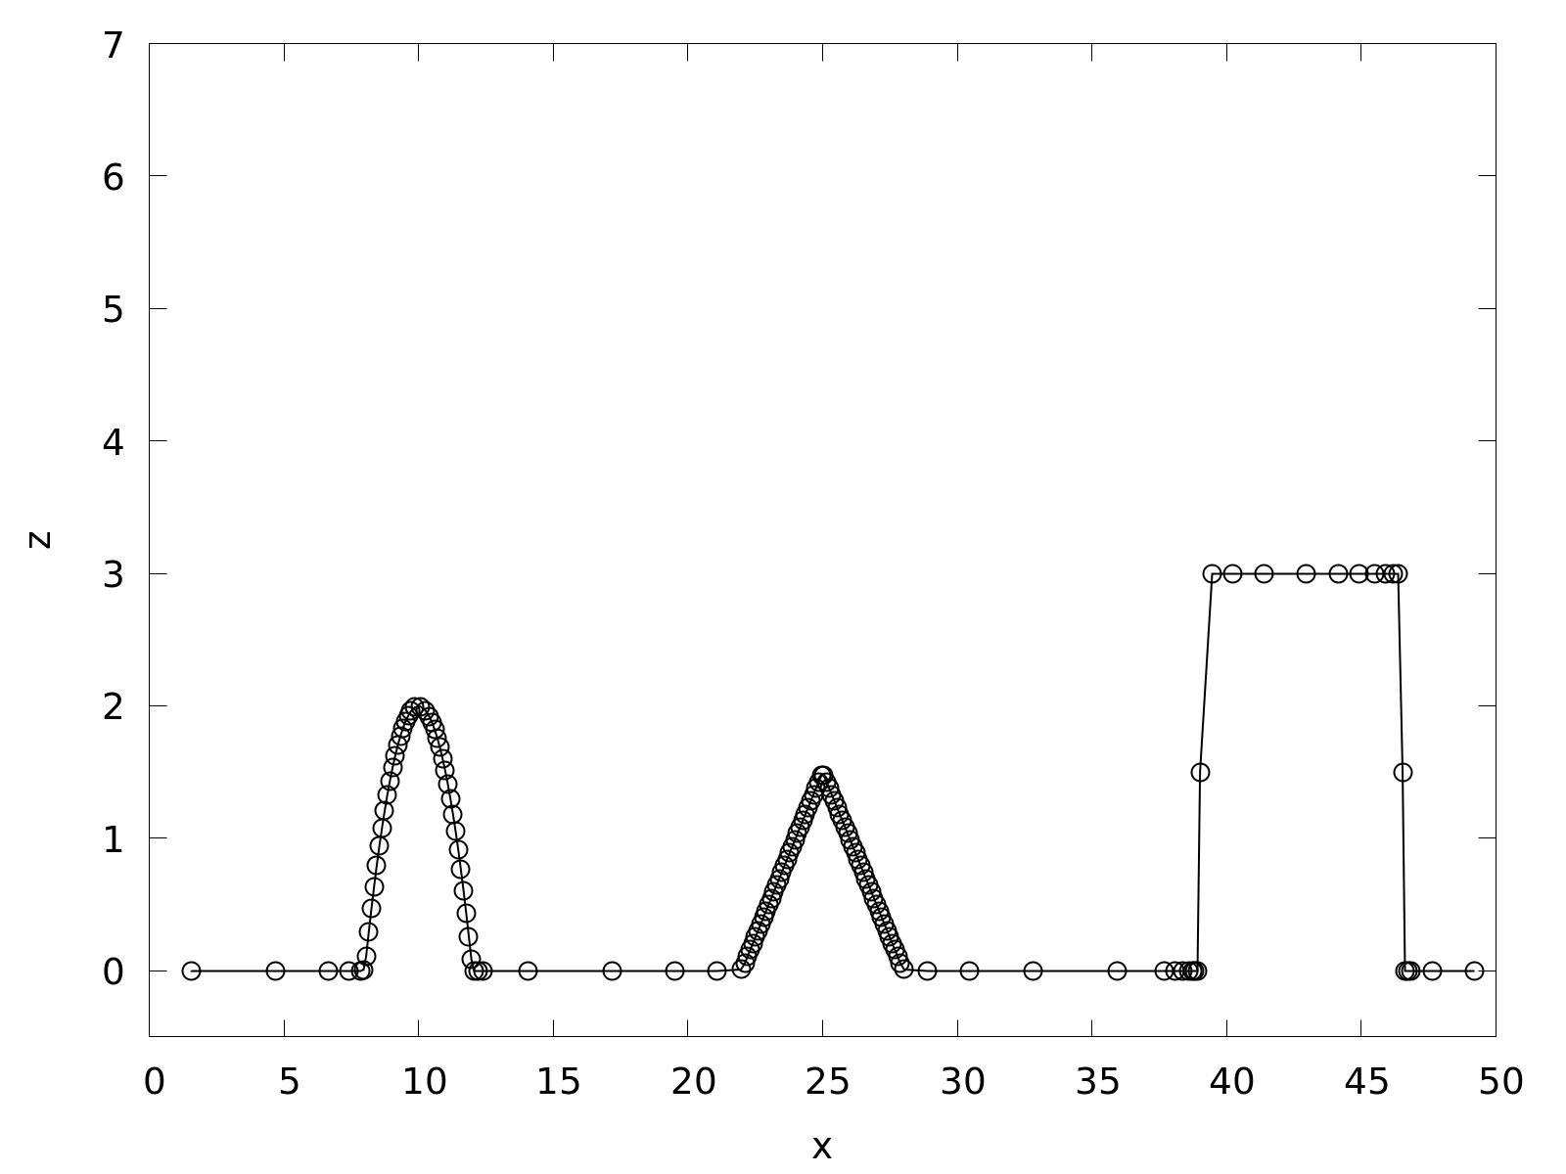
Wavelet-based mesh generation
Adaptive mesh, 141 cells, ε=10⁻²

Slide 13
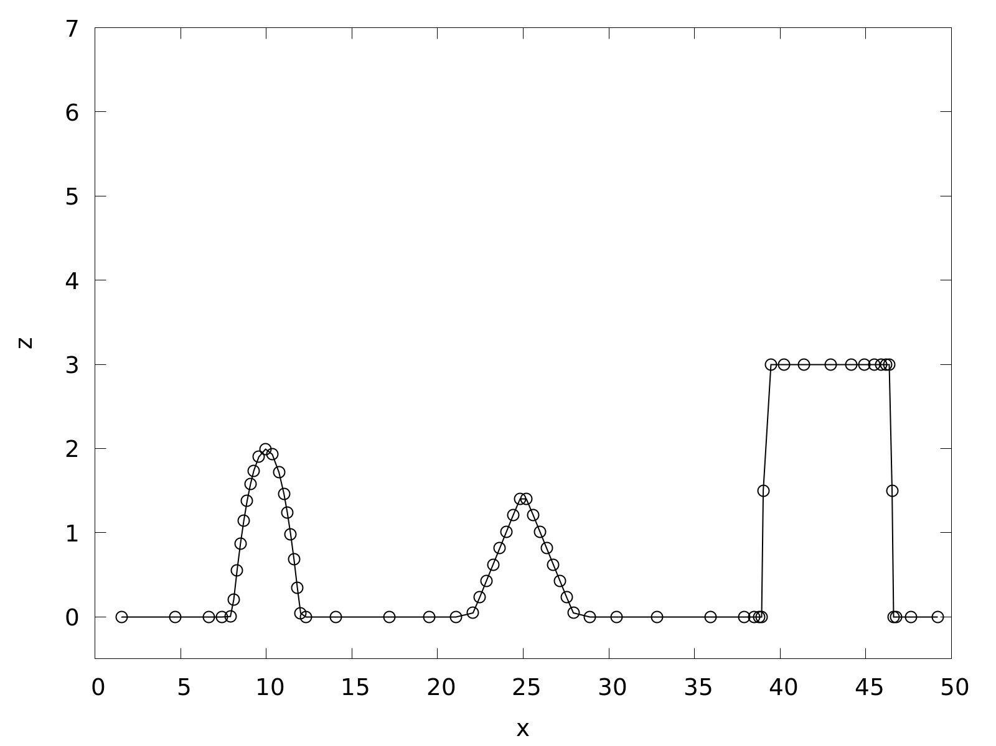
Wavelet-based mesh generation
Adaptive mesh, 67 cells, ε=10⁻¹

Slide 14
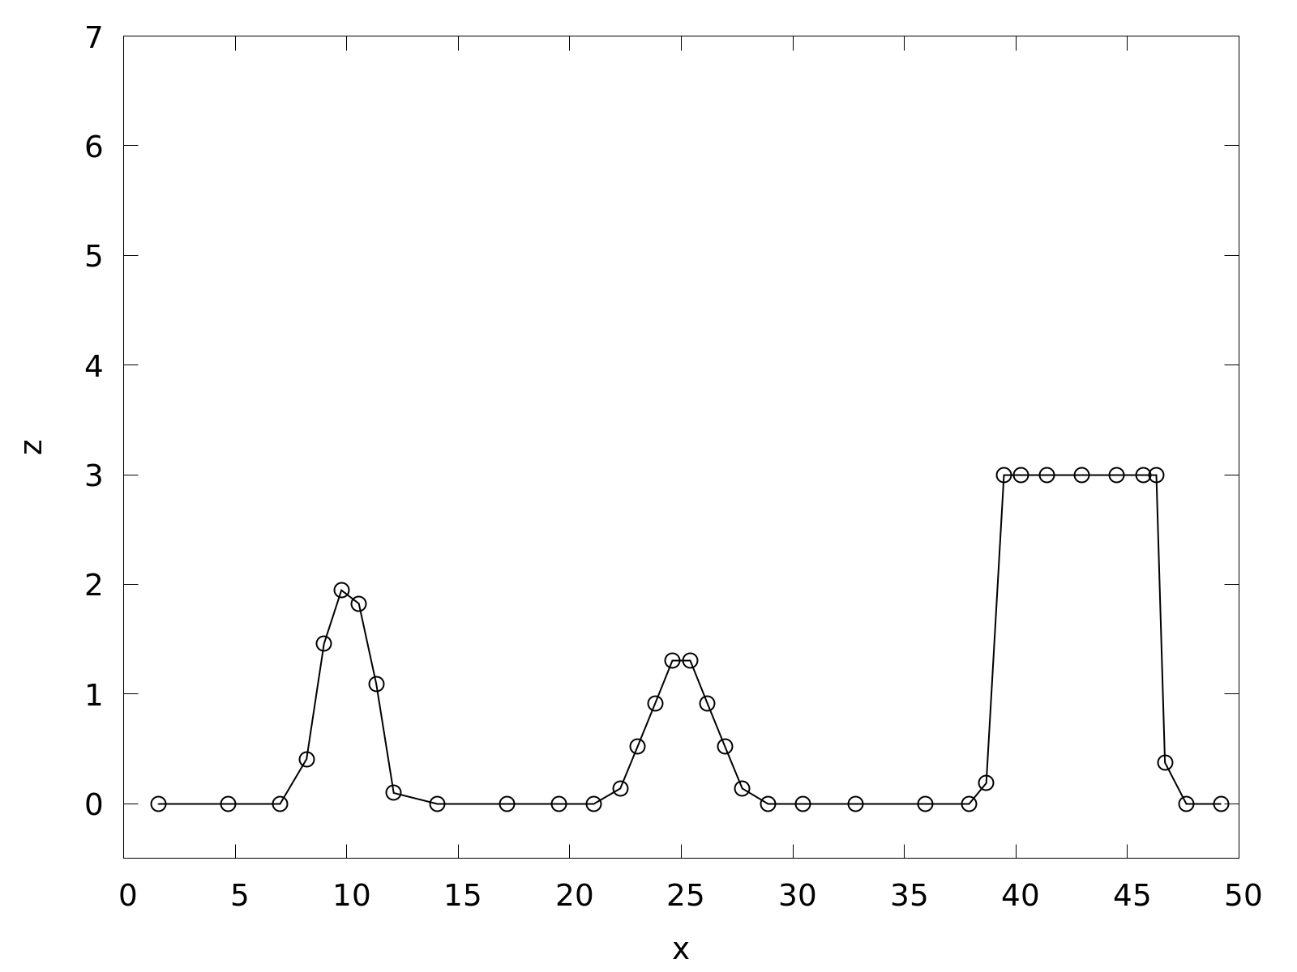
Wavelet-based mesh generation
Adaptive mesh, 37 cells, ε=1

Slide 15
Shallow flow modelling with wavelet-based adaptivity
Finite volume shallow flow solver
Shock-capturing
Well-balanced
Wetting/drying

Slide 16
Shallow flow modelling with wavelet-based adaptivity
Finite volume shallow flow solver
Shock-capturing
Well-balanced
Wetting/drying
Haar wavelet-based multiscale adaptivity
Mass conserving
Bounded

Slide 17
Shallow flow modelling with wavelet-based adaptivity
Finite volume shallow flow solver
Shock-capturing
Well-balanced
Wetting/drying
Haar wavelet-based multiscale adaptivity
Mass conserving
Bounded
Common piecewise-constant basis

Slide 18
1D shallow flow experiments
Lake-at-rest with topography
Dam break with shock wave

Slide 19
Lake-at-rest with wet/dry zones
0 m
50 m

Slide 20
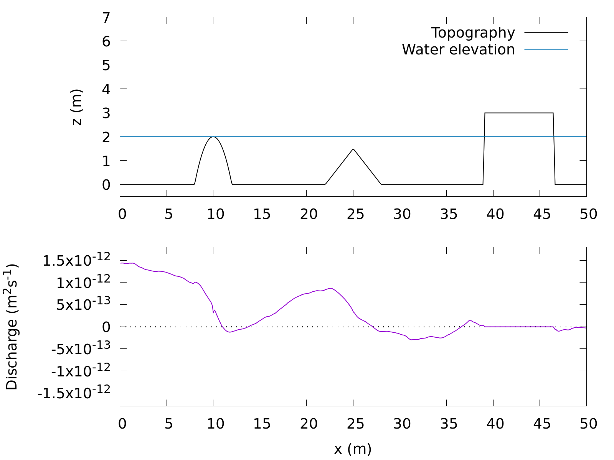
Lake-at-rest after t=100s (~14 000 timesteps)
Uniform solution, 512 cells

Slide 21
Lake-at-rest after t=100s (~14 000 timesteps)
Uniform solution, 512 cells

Slide 22
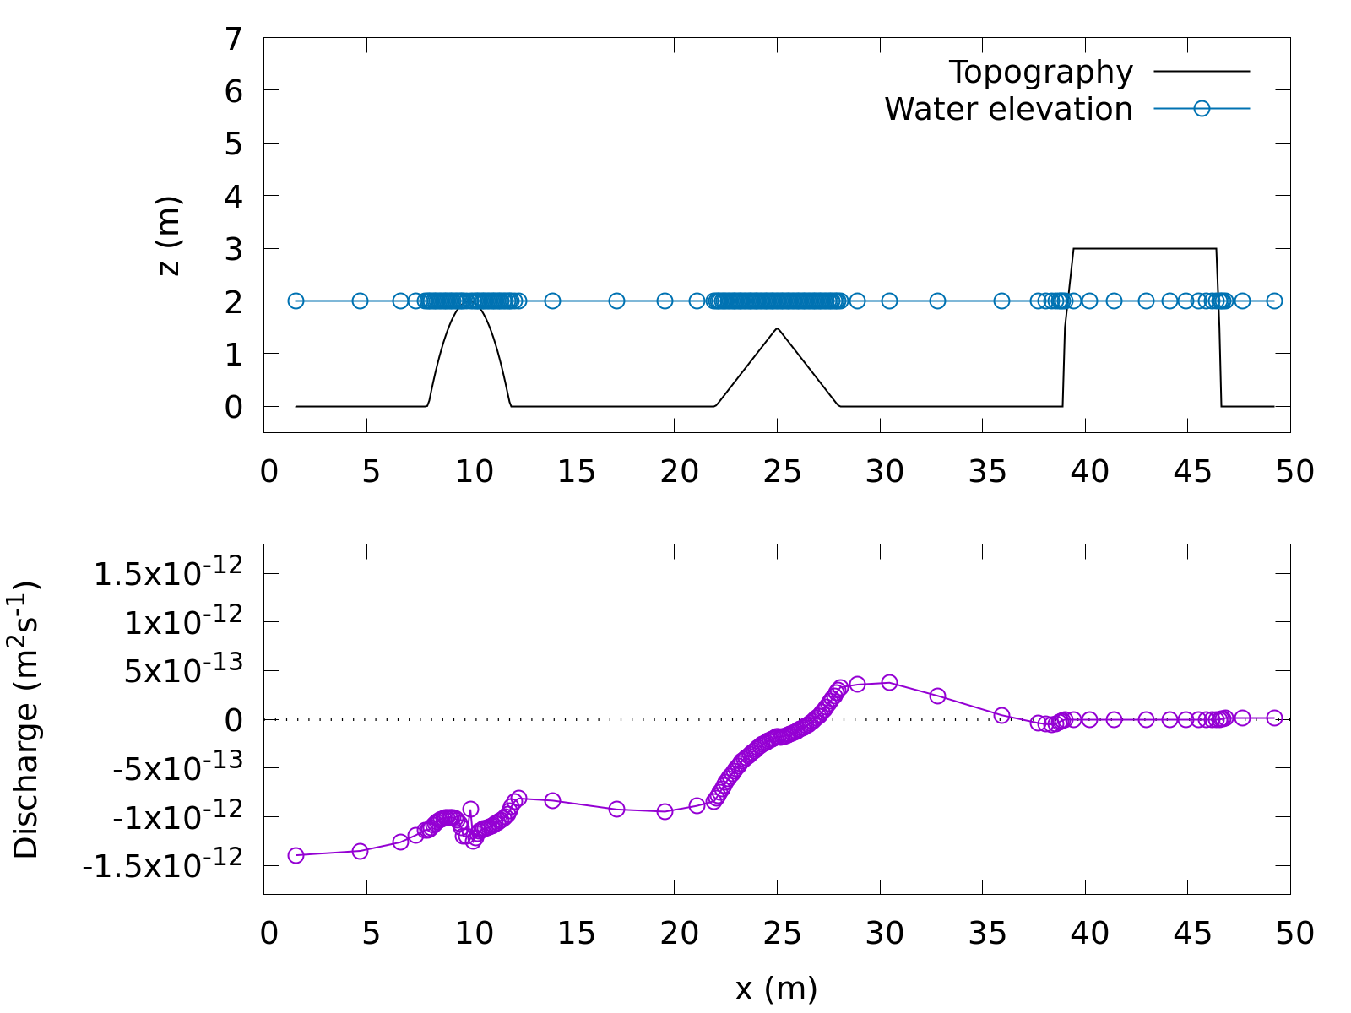
Wavelets preserve well-balancing with wetting and drying
Adaptive solution, 144 cells, ε=10⁻²

Slide 23
Dam break initial condition

Slide 24
Dam break at t=2.5s

Slide 25
Dam break at t=2.5s

Slide 26
Dam break at t=2.5s

Slide 27
Dam break at t=2.5s

Slide 28
Dam break at t=2.5s

Slide 29
Adaptive solution preserves accuracy

Slide 30
Dam break at t=40s

Slide 31
Adaptive mesh has just one cell by t=40s

Slide 32
Adaptive solution is 4× faster than uniform solution
 | Total timesteps | Total elements | Wall clock time
Uniform solution | 11578 | 5927936 | 1.2s
Adaptive solution, ‎ε=10⁻³ | 3380 | 382453 | 0.3s
Obtained at t=40s

Slide 33
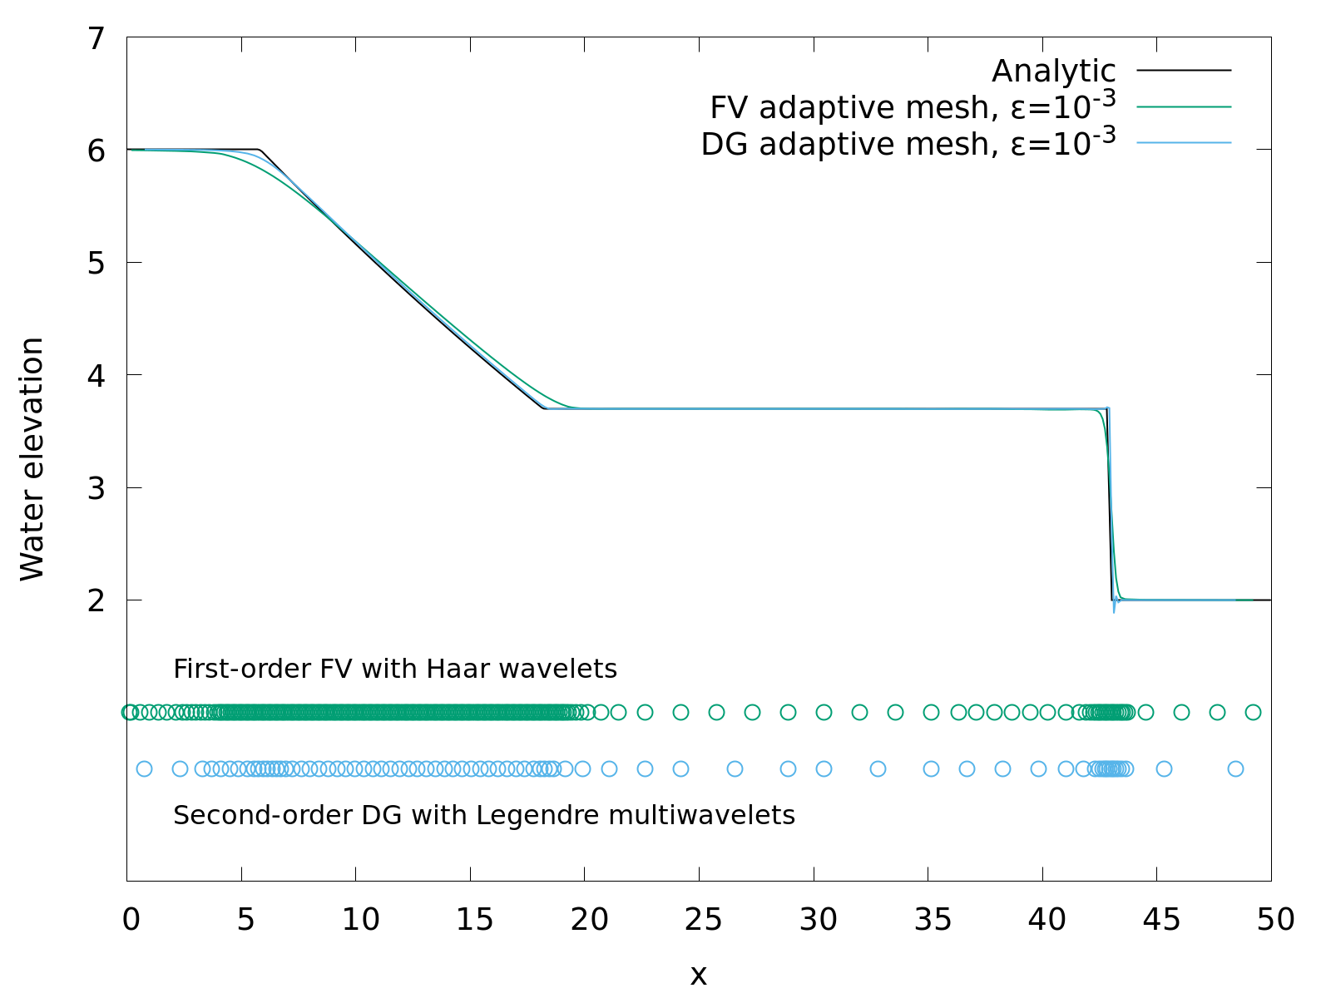
1D Discontinuous Galerkin with multiwavelet-based adaptivity

Slide 34
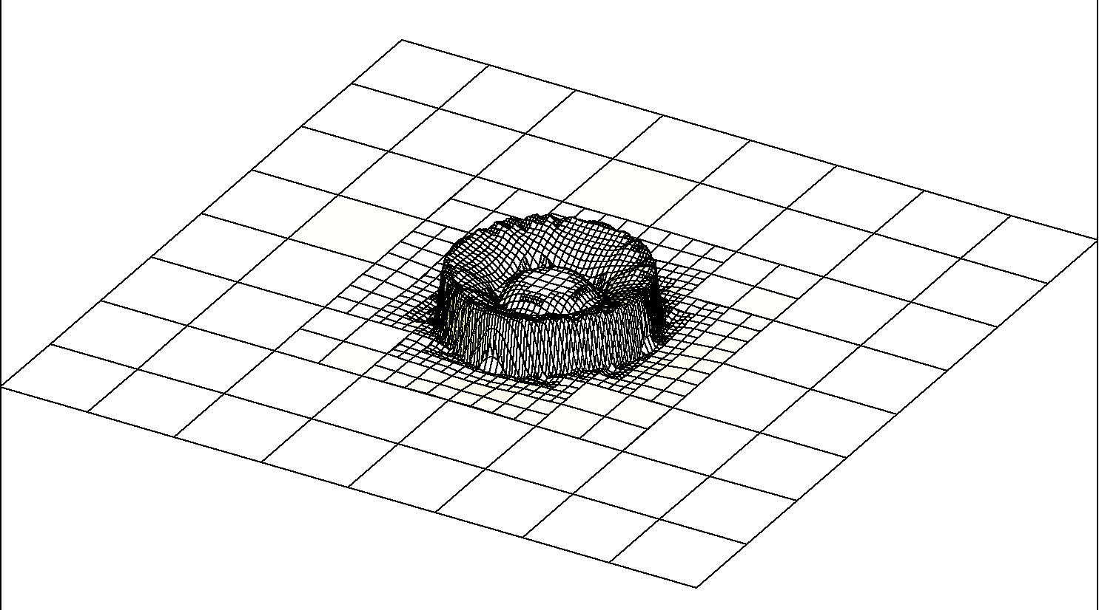
2D Discontinuous Galerkin with multiwavelet-based adaptivity
Radial dam break, t=0.7s

Slide 35
Stochastic modelling for uncertainty quantification
Polynomial chaos
Topographic uncertainty
Uncertainty quantification
Stochastic DG shallow flow model
Wetting/drying
Wavelet-based adaptivity

Slide 36
Highlights of wavelet-based adaptivity
Observed 4× speed-up with negligible loss of accuracy
Robust well-balancing with wetting/drying preserved
Single parameter to directly control adaptivity error
Unlimited coarsening down to a single cell
Arbitrarily large resolution gaps permitted
Contact me: js102@zepler.net, @hertzsprrrung
Slides at doi.org/crmq

