Slide 1
Research Software: what do you need to know? https://doi.org/10.6084/m9.figshare.6715928 29th June 2018, Met Office, Exeter Neil Chue Hong (@npch), Software Sustainability Institute ORCID: 0000-0002-8876-7606 | N.ChueHong@software.ac.uk
Supported by
Project funding from
Slides licensed under CC-BY where indicated:

Slide 2
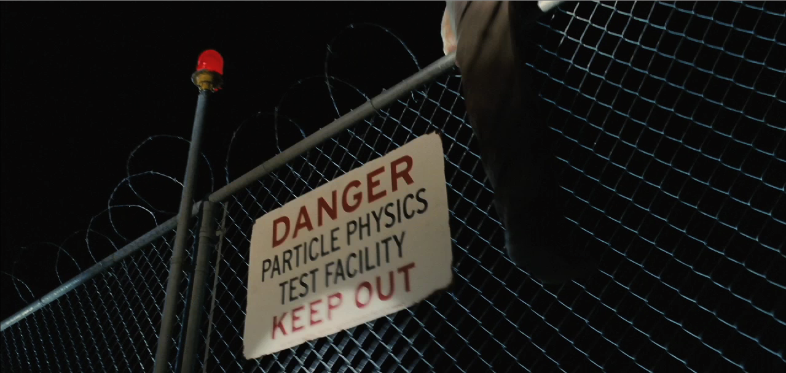
Who am I?
”Particle Physics Test Facility” by Zach Tirell
Graduated in Physics
Worked in technology transfer
Developer and manager on open source scientific software projects
Started the Software Sustainability Institute based on what I experienced
Notes:
Photo credits:
”Particle Physics Test Facility” by Zach Tirell under CC BY-SA https://www.flickr.com/photos/tirrell/296453918

Slide 3
Who am I?
“Flock of Birds” by Eugene Zemlyanskiy
Notes:
“Flock of Birds” by Eugene Zemlyanskiy is licensed under CC BY 2.0

Slide 4
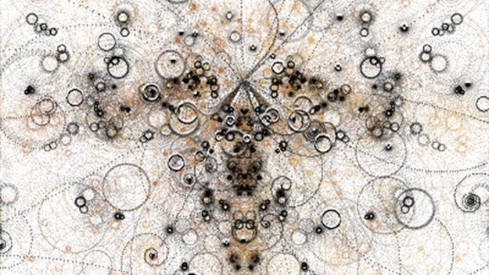
Who am I?
“Simulated Bubble Chamber” by Erik Charlton
Notes:
“Simulated Bubble Chamber” by Erik Charlton is licensed under CC BY

Slide 5
Who am I?
Doi: 10.1007/s12145-008-0012-5
Notes:
Image from https://link.springer.com/article/10.1007/s12145-008-0012-5

Slide 6
Who am I?
Photo courtesy of Edinburgh International Film Festival
Notes:
Photo courtesy of Edinburgh International Film Festival

Slide 7
Software Sustainability Institute
A national facility for cultivating better, more sustainable, research software to enable world-class research
Software reaches boundaries in its development cycle that prevent improvement, growth and adoption
Providing the expertise and services needed to negotiate to the next stage
Developing the policy and tools to support the community developing and using research software
Supported by EPSRC Grant EP/H043160/1 + EPSRC/ESRC/BBSRC grant EP/N006410/1
Notes:
The Software Sustainability Institute can help with: software reviews and refactoring, collaborations to develop your project, guidance and best practice on software development, project management, community building, publicity and more…
Drawing on pool of specialists to drive the continued improvement and impact of research software developed by and for researchers
Providing services for research software users and developers
Developing research community interactions and capacity
Promoting research software best practice and capability

Slide 8
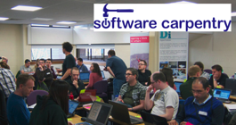
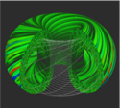
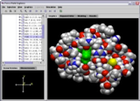
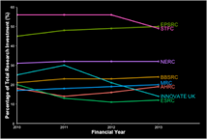
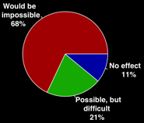
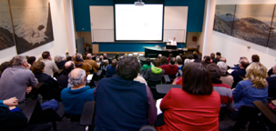
Software
Training
Helping the community to develop software that meets the needs of reliable, reproducible, and reusable research
Delivering essential software skills to researchers via CDTs, institutions & doctoral schools
Outreach
Exploiting our platform to enable engagement, delivery & uptake
Collecting evidence on the community’s software use & sharing with stakeholders
Bringing together the right people to understand and address topical issues
Policy
Community

Slide 9
About this lecture
Beyond software carpentry
It won’t teach you everything
But it will introduce you to useful topics
Process and politics, rather than programming
Mixture of presentation and discussion
Be prepared to talk to each other!

Slide 10
Identifying good practice
It’s not easy to understand how to write good code
However you probably know more than you think
What else do you need to know?

Slide 11
Identifying good practice
Split into pairs / threes
Brainstorm practices that improve the process of software development in a research context
We’ll do this for five minutes then discuss

Slide 12
What’s good practice?
What things do you think are most important?
Were there things that were unexpected?
Are any things which are easier to implement than others?
Do you think any things are more effective than others?

Slide 13
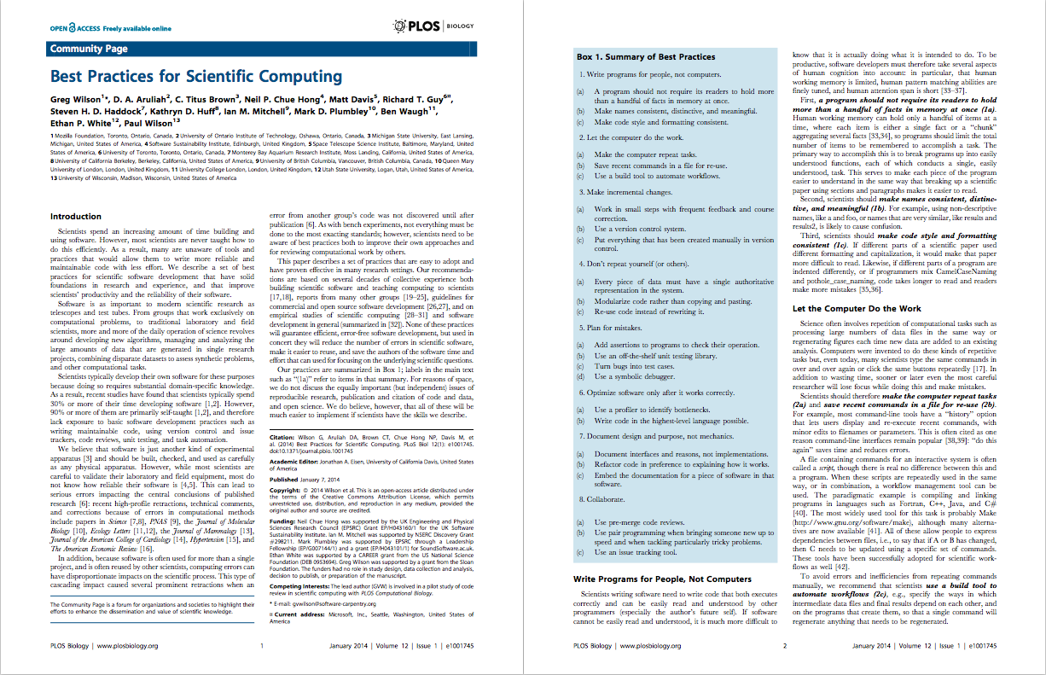
Best Practices for Scientific Computing: https://doi.org/10.1371/journal.pbio.1001745

Slide 14
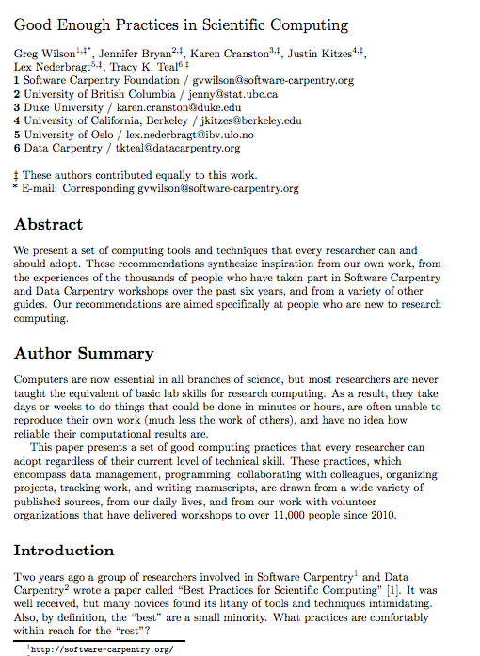
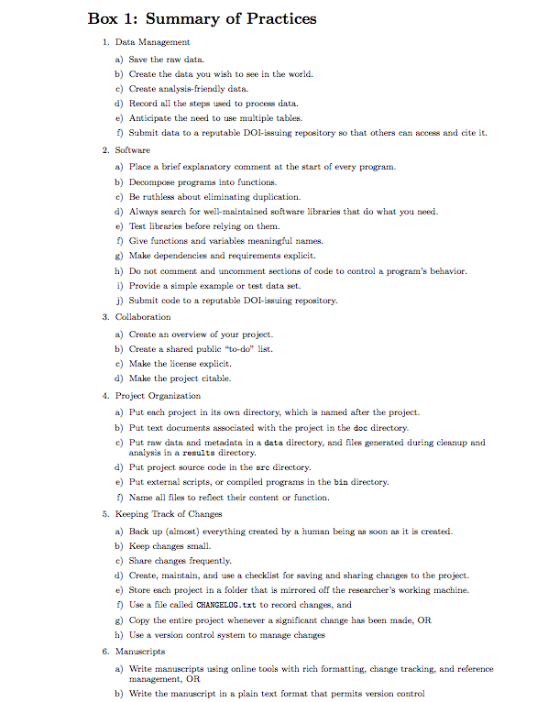
Good Enough Practices in Scientific Computing: https://doi.org/10.1371/journal.pcbi.1005510
Notes:
Good Enough Practices in Scientific Computing: https://doi.org/10.1371/journal.pcbi.1005510

Slide 15
Community standards
ESIP (Earth Sciences): https://esipfed.github.io/Software-Assessment-Guidelines/
CLARIAH (Arts and Humanities): https://github.com/CLARIAH/software-quality-guidelines
IPOL (Image Processing): https://tools.ipol.im/wiki/ref/software_guidelines/
ELIXIR (Life Sciences): https://www.ncbi.nlm.nih.gov/pmc/articles/PMC5490478/
Your community here?

Slide 16
Why is this important?

Slide 17
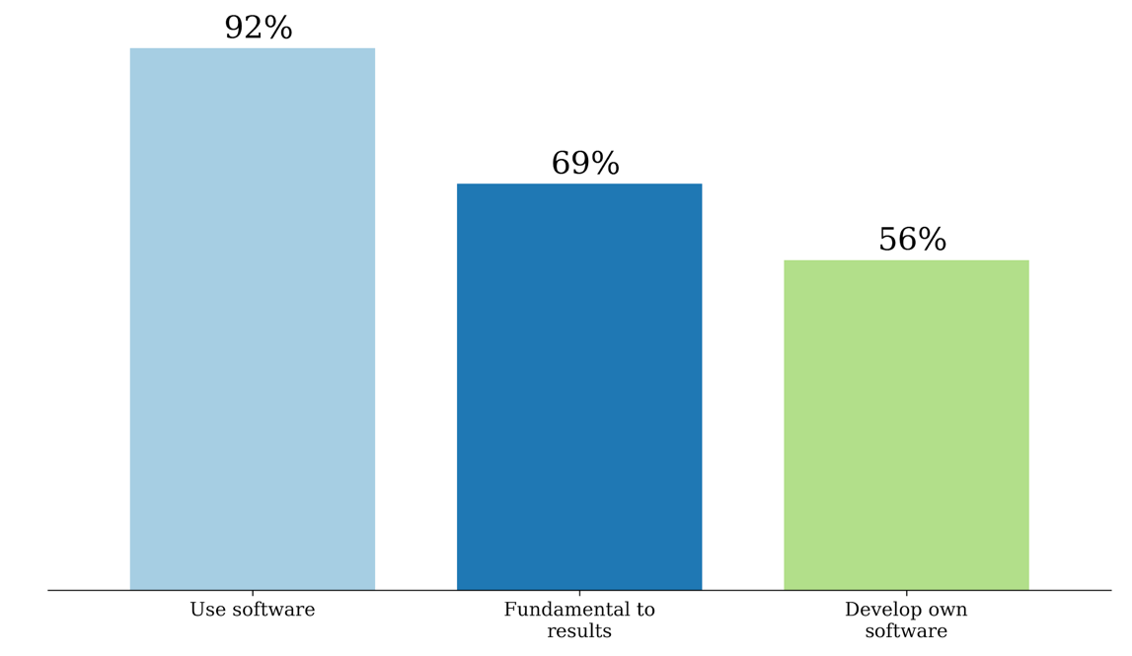
UK software survey 2014
S.J. Hettrick et al, UK Research Software Survey 2014
​DOI:10.5281/zenodo.1183562.
Notes:
417 responses across 15 Russell Group universities. Can’t re-run the analysis because people did not like being cold-called.
https://www.software.ac.uk/blog/2016-09-12-its-impossible-conduct-research-without-software-say-7-out-10-uk-researchers
RCs invested around £4.7 billion a year, which means £3.2 billion (69%) is at risk.
https://www.gov.uk/government/uploads/system/uploads/attachment_data/file/505308/bis-16-160-allocation-science-research-funding-2016-17-2019-20.pdf
Industrial strategy aims to spend 2.4% of GDP on research and development (equivalent to £480 billion in 2017). 69% of that is £380 billion.

Slide 18
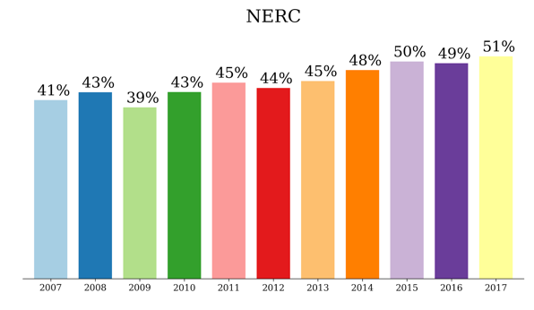
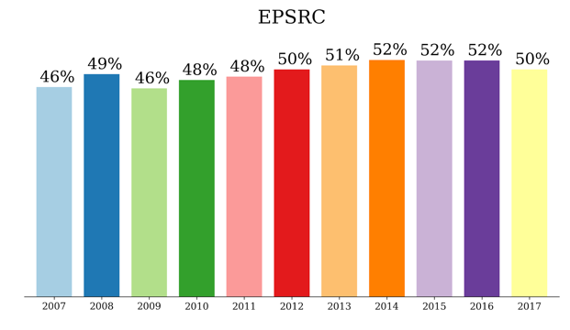
Research relies on software
Funded research reported through Gateway to Research that indicates it relies on software
Average
45%
Average
50%

Slide 19
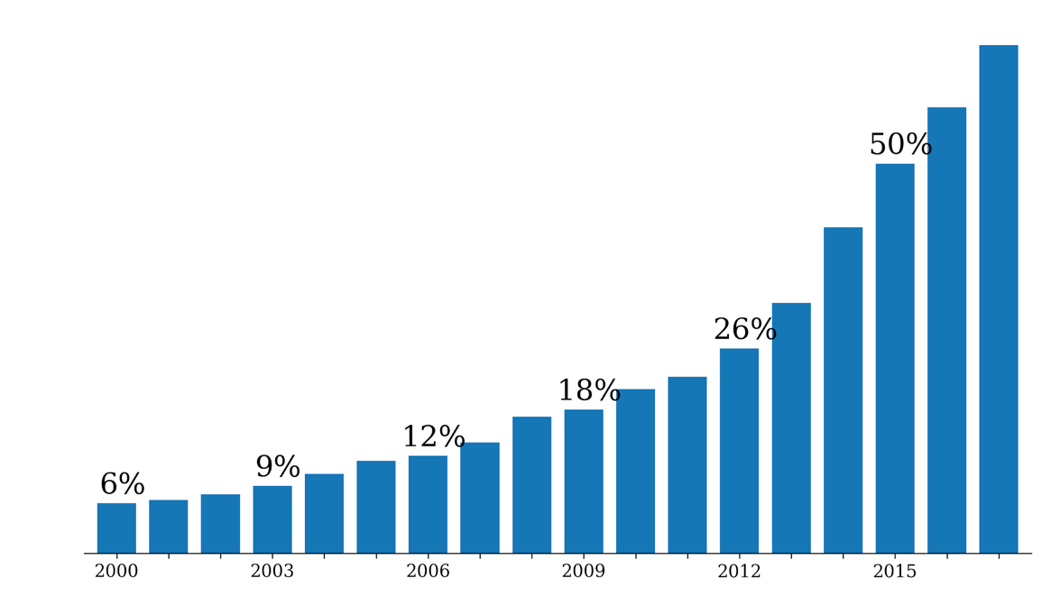
Software in research papers
65%
Searched Eprints repositories from 31 UK institutions ~ 600k papers
Displayed the percentage of papers found to have software-related terms against all papers in the repository.
2017
Notes:
It’s really difficult to assess an unbiased way of identifying the importance of software in research.
Eprints is a digital repository which many institutions are mandating their researchers to use.
We searched Eprints repositories from 31 UK institutions (~ 600k papers) for terms indicating that the results in the publication relied on the use of software at some stage of the research. This graph displays the percentage of papers found to have software-related terms against all papers in the repository submitted in that year. Not only has the number of papers submitted been rising, but the percentage dependent on software has also been rising dramatically.

Slide 20
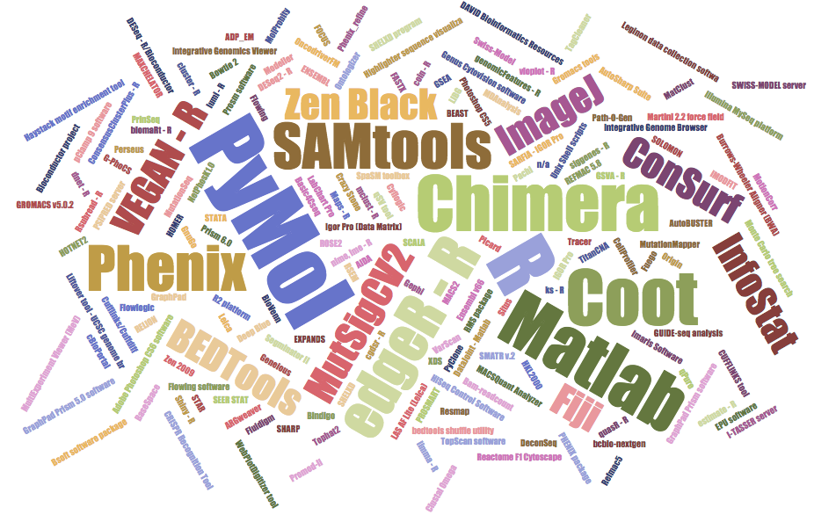
Software in nature
Nangia and Katz: https://arxiv.org/pdf/1706.06527.pdf
Notes:
Study by Nangia and Katz
https://arxiv.org/pdf/1706.06527.pdf
January – March 2016, 173 pieces of software mentioned
32 of 40 papers mention software
6 packages mentioned in 4 or more papers: Pymol, R, Chimera, Coot, Matlab, PHENIX
26 packages mentioned in 2 or more papers
Note that R packages feature heavily, along with visualisation tools

Slide 21
“Perceived” importance
“It has been said … that writing a large piece of software is akin to building infrastructure such as a telescope rather than a creditable scientific contribution…”
“software development [is] often discounted in the scientific community, and programming is treated as something to spend as little time on as possible”
“Serious scientists are not expected to carefully test code, let alone document it, in the same way they are trained to properly use other tools or document their experiments”
Stodden, V., Bailey, D. H., Borwein, J., LeVeque, R.J., Rider, W., Stein, W. “Setting the Default to Reproducible Reproducibility in Computational and Experimental Mathematics”, ICERM 2013, February 2013.

Slide 22
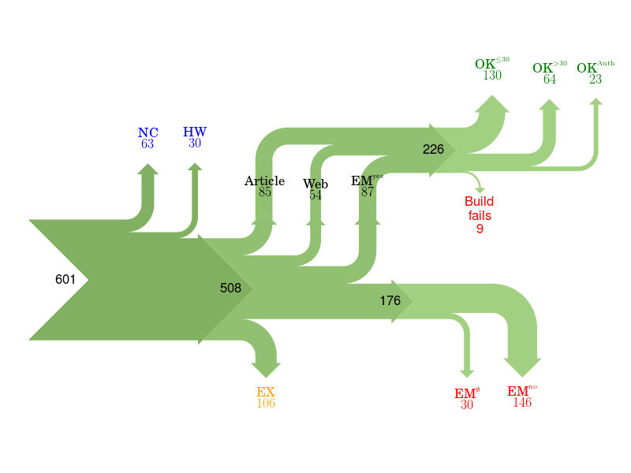
Of 601 papers in ACM Computer Science journals and proceedings, only 85 provided a link to software.
For 176 the software could not be obtained.
Collberg, Proebsting, Warren, University of Arizona TR 14-04, 2015
http://reproducibility.cs.arizona.edu/v2/RepeatabilityTR.pdf
Notes:
NC Paper excluded due to results not being backed by code.
HW Paper excluded due to replication requiring special hardware.
EX Paper excluded due to overlapping author lists.
EMno Author responds that the code cannot be provided.
EMØ Author does not respond to email request within 2 months.
Article Code is found from link in the article itself.
Web Code is found from a web search.
EMyes Code is provided by author after email request.
OK≤30 We succeed in building the system in ≤30 minutes.
OK>30 We succeed in building the system in >30 minutes.
OK>Author We fail to build, but the author says the code builds with reasonable effort.
Fails We fail to build, and the author doesn't respond to survey or says code may have problems building.

Slide 23
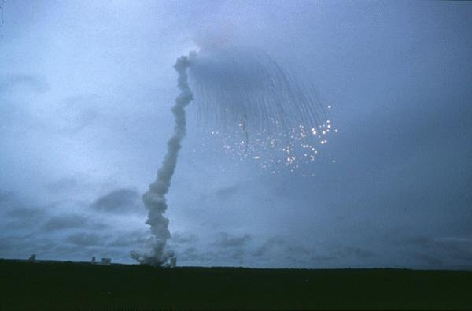
When things go wrong
64 bit floating point number
10101010
10101010
10101010
10101010
10101010
10101010
10101010
10101010
10101010
10101010
10101010
10101010
10101010
10101010
10101010
10101010
16 bit signed integer
11111111
00000000
00001111
11110000
00110011
11001100
00001111
11110000
“nozzle deflections were commanded by the ... software on the basis of data transmitted by the active Inertial Reference System (SRI 2) ... Part of these data ... did not contain proper flight data, but ... was interpreted as flight data.”
“SRI 2 did not send correct attitude data ... due to a software exception”
“software exception was caused during execution of a data conversion from 64-bit floating point to 16-bit signed integer value”
ARIANE 5 Flight 501 Failure, Report by the Inquiry Board, 19 July 1996
http://www.esa.int/For_Media/Press_Releases/Ariane_501_-_Presentation_of_Inquiry_Board_report
Cost of this bug: US$370 million
http://www.esa.int/spaceinimages/Images/2009/09/Explosion_of_first_Ariane_5_flight_June_4_1996

Slide 24
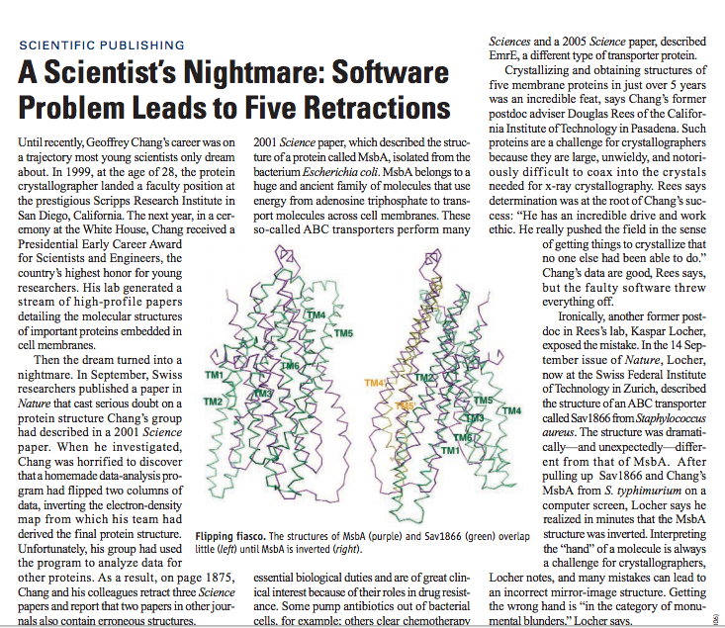
“Chang’s data are good… but the faulty software threw everything off”
http://science.sciencemag.org/ content/314/5807/1856.full
“a homemade data-analysis program had flipped two columns”
Notes:
http://science.sciencemag.org/content/314/5807/1856.full

Slide 25
Growth in a time of debt
Can you spot the mistake?
“All I can hope is that future historians note that one of the core empirical points providing the intellectual foundation for the global move to austerity in the early 2010s was based on someone accidentally not updating a row formula in Excel” – Mike Konczal
Reinhart, Carmen M.; Rogoff, Kenneth S. (2010). "Growth in a Time of Debt". American Economic Review. 100 (2): 573–78. doi:10.1257/aer.100.2.573
https://qz.com/75035/fixing-this-excel-error-transforms-high-debt-countries-from-recession-to-growth/
http://www.nytimes.com/2013/04/26/opinion/debt-growth-and-the-austerity-debate.html
https://www.bloomberg.com/news/articles/2013-04-18/faq-reinhart-rogoff-and-the-excel-error-that-changed-history

Slide 26
“All I can hope is that future historians note that one of the core empirical points providing the intellectual foundation for the global move to austerity in the early 2010s was based on someone accidentally not updating a row formula in Excel”
– Mike Konczal
https://www.bloomberg.com/news/articles/2013-04-18/faq-reinhart-rogoff-and-the-excel-error-that-changed-history
Notes:
https://www.bloomberg.com/news/articles/2013-04-18/faq-reinhart-rogoff-and-the-excel-error-that-changed-history

Slide 27
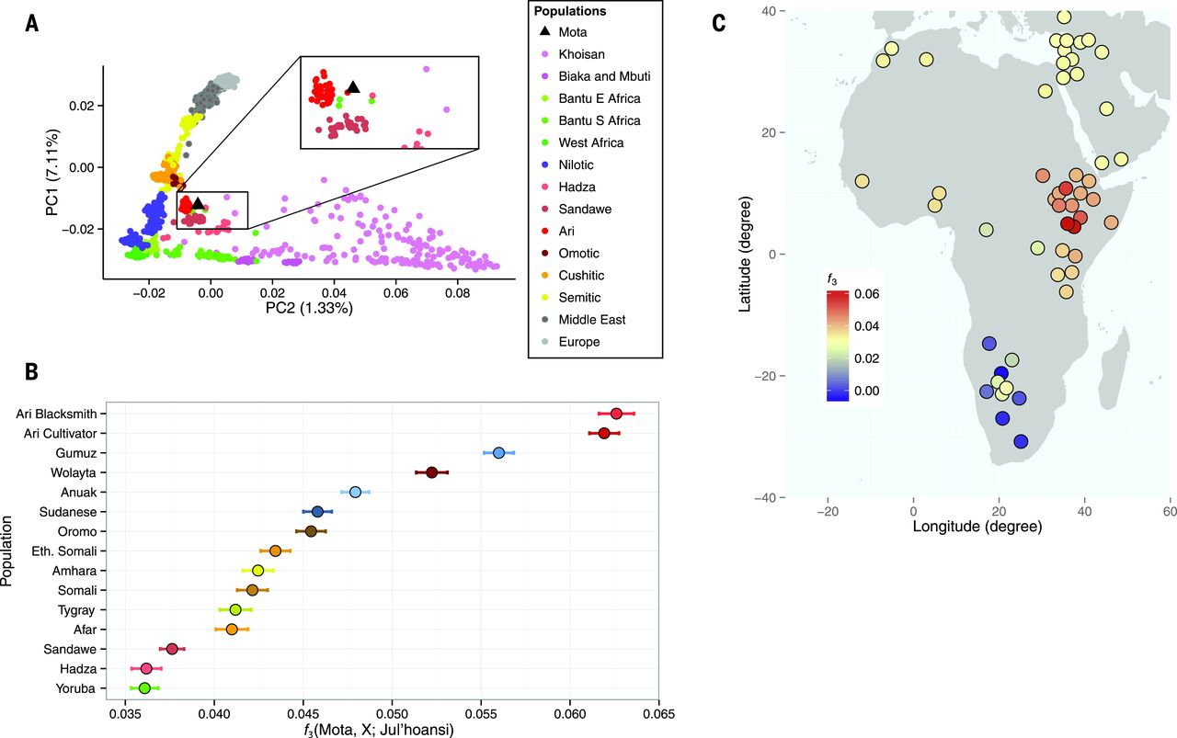
Llorente et al. Science, 350, 6262
doi:10.1126/science.aad2879
The results presented in the Report “Ancient Ethiopian genome reveals extensive Eurasian admixture throughout the African continent“ were affected by a bioinformatics error
https://www.nature.com/news/error-found-in-study-of-first-ancient-african-genome-1.19258
Notes:
One of the conclusions of a report published last year suggested a large migration of Eurasians back into Africa. However it turned out that this was due to an error in the bioinformatics pipeline wrongly discarding data.
In this case, this is a case of good science – the methodology was published, the data was available (http://africangenome.org/index.php/African_genome_ftp though not licensed) and the authors issued an erratum when the mistake was found.
The results presented in the Report “Ancient Ethiopian genome reveals extensive Eurasian admixture throughout the African continent“ were affected by a bioinformatics error. A script necessary to convert the input produced by samtools v0.1.19 to be compatible with PLINK was not run when merging the ancient genome, Mota, with the contemporary populations SNP panel, leading to homozygote positions to the human reference genome being dropped as missing data (the analysis of admixture with Neanderthals and Denisovans was not affected). When those positions were included, 255,922 SNP out of 256,540 from the contemporary reference panel could be called in Mota. The conclusion of a large migration into East Africa from Western Eurasia, and more precisely from a source genetically close to the early Neolithic farmers, is not affected. However, the geographic extent of the genetic impact of this migration was overestimated: the Western Eurasian backflow mostly affected East Africa and only a few Sub-Saharan populations; the Yoruba and Mbuti do not show higher levels of Western Eurasian ancestry compared to Mota.
We thank Pontus Skoglund and David Reich for letting us know about this problem.

Slide 28
If software is so important, why do researchers find it so difficult?

Slide 29
Victoria Stodden, AMP 2011 http://www.stodden.net/AMP2011/,
Special Issue Reproducible Research Computing in Science and Engineering July/August 2012, 14(4)
Howison and Herbsleb (2013) "Incentives and Integration In Scientific Software Production" CSCW 2013.
Notes:
Victoria Stodden, AMP 2011 http://www.stodden.net/AMP2011/,
Special Issue Reproducible Research Computing in Science and Engineering July/August 2012, 14(4)
Howison and Herbsleb (2013) "Incentives and Integration In Scientific Software Production" CSCW 2013.

Slide 30
It’s still all about reputation
“This particular project was something I wrote a couple years ago to help me out with a workflow… I’d put it up on Github, so that others could potentially use it or use the code. So I went to see what people were saying about this project. It seemed liked I’d done something fundamentally wrong, so stupid that it flabbergasts someone... So of course I start sobbing. Then I see these people’s follower count, and I sob harder. I can’t help but think of potential future employers that are no longer potential.”
http://www.software.ac.uk/blog/2013-01-25-haters-gonna- hate-why-you-shouldnt-be-ashamed-releasing-your-code

Slide 31
And culture change is hard
In 2011 Science changed its editorial policies:
“We require that all computer code used for modeling and/or data analysis that is not commercially available be deposited in a publicly accessible repository upon publication.”
“After publication, all reasonable requests for data, code, or materials must be fulfilled.”
Stodden, Seiler, Ma. An empirical analysis of journal policy effectiveness for computational reproducibility
https://doi.org/10.1073/pnas.1708290115
Notes:
https://doi.org/10.1073/pnas.1708290115
http://www.sciencemag.org/authors/science-journals-editorial-policies
Implemented February 11, 2011.

Slide 32
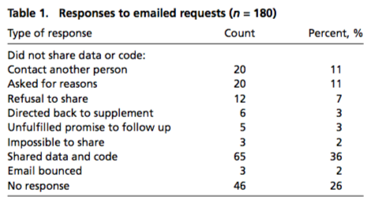
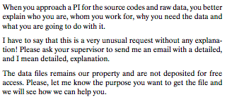
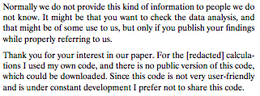
And culture change is hard
Stodden, Seiler, Ma. An empirical analysis of journal policy effectiveness for computational reproducibility
https://doi.org/10.1073/pnas.1708290115
Notes:
https://doi.org/10.1073/pnas.1708290115
http://www.sciencemag.org/authors/science-journals-editorial-policies
Implemented February 11, 2011.

Slide 33
And culture change is hard
“There appeared to be some confusion among authors, some of whom seemed to be unaware of Science’s data and code sharing requirement. We can most easily demonstrate this with some anonymized author responses that highlight some of the barriers to sharing they perceived:”
Stodden, Seiler, Ma. An empirical analysis of journal policy effectiveness for computational reproducibility
https://doi.org/10.1073/pnas.1708290115
Notes:
https://doi.org/10.1073/pnas.1708290115
http://www.sciencemag.org/authors/science-journals-editorial-policies
Implemented February 11, 2011.

Slide 34
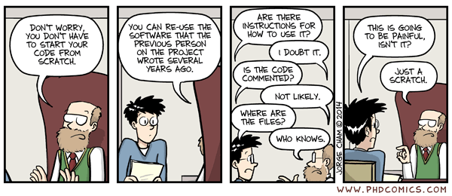
Legacy code
Piled Higher and Deeper" by Jorge Cham www.phdcomics.com
Everything is legacy code – just wait a few months!
http://phdcomics.com/comics.php?f=1689

Slide 35
Croucher’s Law I can be an idiot and will make mistakes You are no different! Corollary: Even when you’re an expert programmer
http://mikecroucher.
github.io/MLPM_talk/

Slide 36
Good enough practices to please your future self

Slide 37
Good Enough Practices - Data
Data – play FAIR:
Save and backup raw data
Create analysis-friendly data
Record your processing steps
Anticipate the need to use multiple tables, and use a unique identifier for each record
Submit data to a repository and get a DOI

Slide 38
Good Enough Practices - Software
Use version control
Document for your future self
Learn to be modular
Make it accessible in the future; choose a license
Get a colleague to try using it
Ask a collaborator to contribute and give feedback
Notes:
Document for your future self:
Brief descriptive comment at the start of your code
Provide a simple example or test data set
Give functions and variables meaningful names
Make dependencies and requirements explicit
Learn to be modular
Break programs into functions
Don’t duplicate functionality
Search for well-maintained libraries that do what you need
Make it accessible in the future
Make the license explicit
Keep track of changes
Submit code to a reputable DOI-issuing repository

Slide 39
Good Enough Practices - Software
Use version control
Document for your future self
Learn to be modular
Make it accessible in the future; choose a license
Get a colleague to try using it
Ask a collaborator to contribute and give feedback
Notes:
Document for your future self:
Brief descriptive comment at the start of your code
Provide a simple example or test data set
Give functions and variables meaningful names
Make dependencies and requirements explicit
Learn to be modular
Break programs into functions
Don’t duplicate functionality
Search for well-maintained libraries that do what you need
Make it accessible in the future
Make the license explicit
Keep track of changes
Submit code to a reputable DOI-issuing repository

Slide 40
Writing for strangers
“In pursuing full reproducibility, we fundamen- tally produce code for strangers to use. Although it might seem unnatural to help strangers—and reluctance to do so certainly impedes the spread of reproducible research—our term stranger really means anyone who doesn’t possess our current short-term memory and experiences.” – David Donoho
Notes:
M. Shahram, V. Stodden, D. L. Donoho, A. Maleki and I. U. Rahman, "Reproducible Research in Computational Harmonic Analysis," in Computing in Science & Engineering, vol. 11, no. , pp. 8-18, 2009. doi:10.1109/MCSE.2009.15

Slide 41
Definition of a stranger
Anyone not in possession of the authors current short-term memory and experiences i.e.
People reading your paper
Future research (and industry) collaborators
Referees of your paper / grant proposal
Future members of your research group
Current students
Co-authors
You, the author, in six months time

Slide 42
What should you document?
Brainstorm the things that you think you should document, to make your software easier to use by strangers

Slide 43
Minimal Documentation
Basics
What it is (with context)
What it looks like in action
How they use it
Practical Information
How does a user start
How can they check it’s working
Inputs and Outputs
License
Where to go for help (if any)
Document as you develop
Link and reference
Your code rarely exists in a vacuum
Care about people’s time
As short as possible
Cognitive funnelling
Provide tutorials / examples
Add example code to your repo

Slide 44
A good README
Your README enables others to understand it without delving into the code
https://github.com/noffle/art-of-readme
https://github.com/richardlitt/standard-readme
https://github.com/matiassingers/awesome-readme
Name – self-explanatory names are best
One liner – describe the code / module
Background – if there’s context that needs to be set
Usage – what the code looks like in action
API – how to integrate into other code
Installation – even when using standard installers
Contribute – how to collaborate
License – showing how others can use

Slide 45
What we’re trying to avoid
https://xkcd.com/292/

Slide 46
Code review – or how we avoid being eaten by raptors

Slide 47
Most efficient way to find bugs
“Rigorous inspections can remove up to 90 percent of errors from a software product…”
“…before the first test case is run”
Fact 37, Glass, R. Facts and Fallacies of Software engineering, Addison Wesley, 1992. ISBN-10: 0321117425. ISBN-13: 978-0321117427.
Fagan, M.E. “Design and Code inspections to reduce errors in program development”, IBM Systems Journal 15(3), pp182–211, NN 1975. doi:10.1147/sj.153.0182.

Slide 48
Most efficient way to find bugs
First review and first hour matter most
Cohen, J. “Best Kept Secrets of Peer Code Review”, Smart Bear Inc, 2006. ISBN-10: 1599160676. ISBN-13: 978-1599160672.
Not just for bugs, but alternatives, improvements and two-way knowledge transfer
Doesn’t have to be “heavyweight” / difficult

Slide 49
Things to look for
Is the program broken up into easily understood components?
Are the components loosely coupled?
Are names consistent, distinctive and meaningful?
Is code style and formatting consisten?
Are constants defined exactly once?
Does the program have duplicated code?
Does the program reuse existing libraries?
Does the documentation describe dependencies and versions?

Slide 50
Things to look for
Are component interfaces documented?
Do comments document reasons why code has been implemented as it is, rather than the implementation itself?
Is documentation embedded in the program?
Is there user documentation which describes how to use the program?
Does the program use assertions to check validity of inputs and outputs?
Does the program have automated tests?

Slide 51
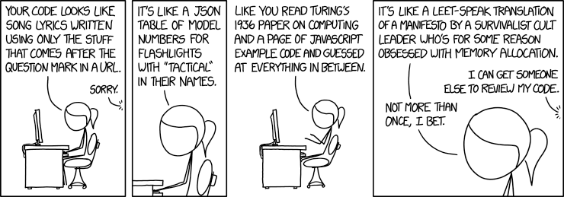
But remember to “play nice”
From https://xkcd.com/1833/

Slide 52
Learning to love version control

Slide 53
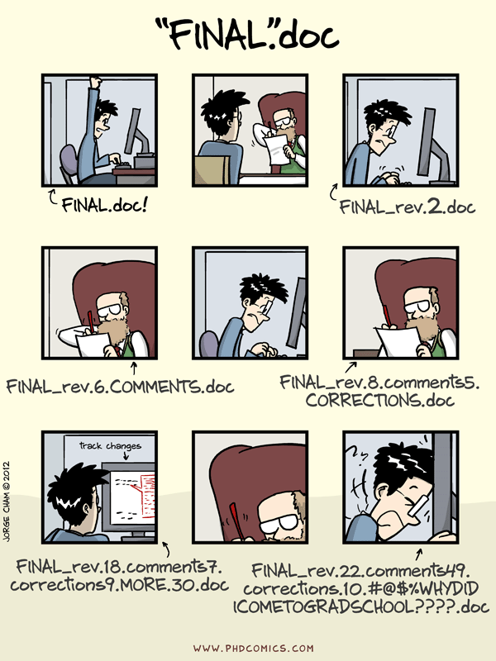
This is version control
http://phdcomics.com/comics/archive.php?comicid=1531
“Piled Higher and Deeper" by Jorge Cham www.phdcomics.com

Slide 54
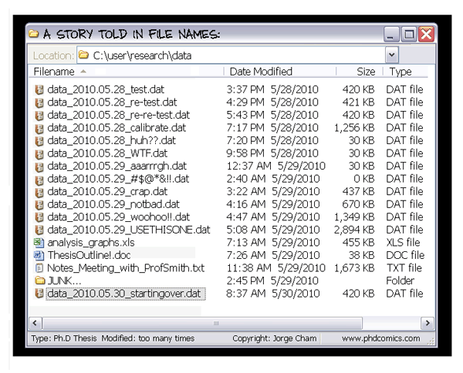
This is also version control
Everyone’s done this at some point in their life
Are you still doing it now?
Piled Higher and Deeper" by Jorge Cham www.phdcomics.com
http://phdcomics.com/comics/archive.php?comicid=1323

Slide 55
This is not version control
Change-bound
Google Drive: 100 revisions
Time-bound
Google Drive: 30 days
DropBox: Last 30 days, 1 year (by subscription)
What if multiple changes to multiple files need to be treated as a single change?
How/where to record why changes were made?

Slide 56
Version control / revision control / source code repository
Unlimited changes
Unlimited time
Bound only by available storage
Treat changes to multiple files as a single change
Record/view who changed what files, when and why
And, for ASCII files, what they changed
Tag specific versions e.g. “RELEASE-1.0”, “CHEP-2017”
Retrieve any previous version by version number or tag
Collaborate on shared files without losing work
“a lab notebook for code and documents”

Slide 57
Which version to choose?
System
Client-Server
Subversion (SVN)
CVS
Distributed
Git
Mercurial
Hosting Platform
Local
SVN
Gitlab
External
GitHub
BitBucket

Slide 58
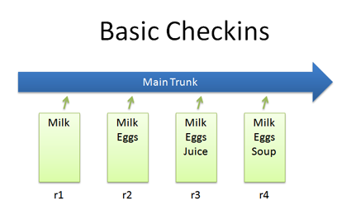
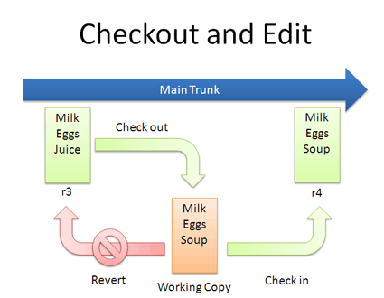
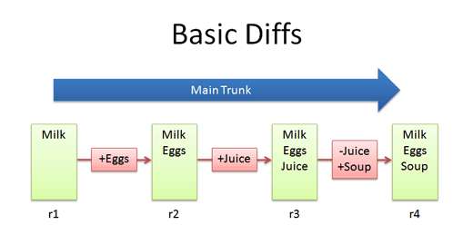
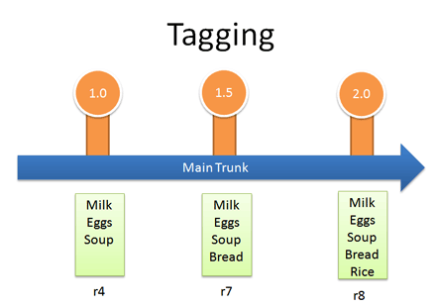
Using version control
https://betterexplained.com/articles/a-visual-guide-to-version-control/

Slide 59
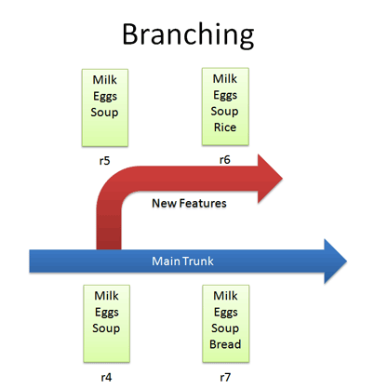
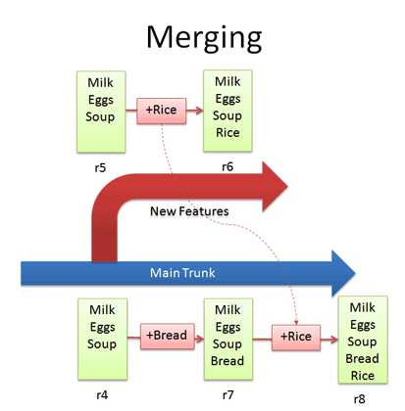
Using version control
https://betterexplained.com/articles/a-visual-guide-to-version-control/

Slide 60
Record who, what, when & why

Slide 61
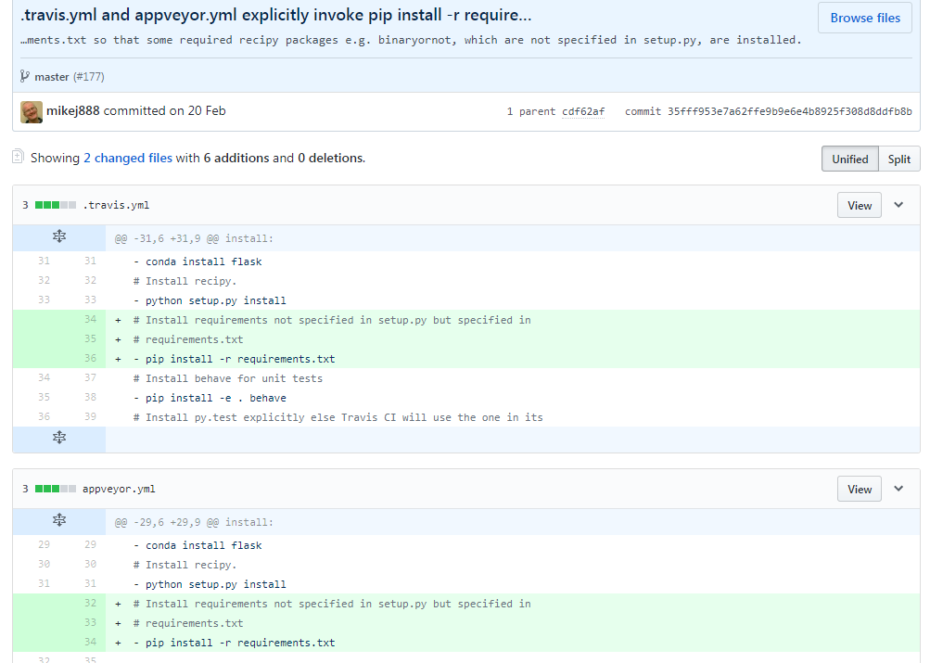
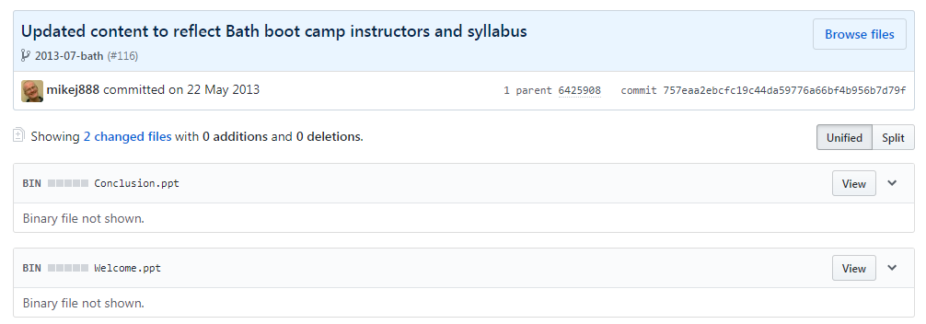
Record/view what was changed

Slide 62
Put in everything created manually
Source code
C, C++, Fortran, Java, Python, R, ...
Shell scripts
LaTeX
Word, Powerpoint, Visio
Build scripts e.g. Makefiles, ANT files
Configuration files
Meta-data for images/audio
Store images/audio in an archive

Slide 63
The feeling of (version) control
“Your laptop's just been stolen”
“No problem, I’ve pushed regularly to a remote repository”
“Can I have the code you used to create the data that you graphed in your conference paper?”
“Let me check the logs then get the version with that tag”
“You deleted my analysis section from our paper”
“Go and get the previous version from the repository then!”
“Why did they rewrite my function?”
“Look at the commit messages and see why they did it”

Slide 64
Software Management Plans
Much research software development is not formally planned
Developed to solve a research question
Evolved rather than planned
Even larger research software projects tend to be driven by a single person to start
Software Management Plans are a way of thinking through the process of running a research software development project

Slide 65
How do I write a plan?
The Software Sustainability Institute has drawn up a checklist
http://www.software.ac.uk/software-management-plans
Series of questions to help you consider all aspects of the development of your software
Complementary to Data Management Plans
https://dmponline.dcc.ac.uk/

Slide 66
A Minimal Plan
What software will you write?
What will your software do?
Will your software have a name?
Who are the intended users of your software?
Is for one type of user or for many?
What expertise is required?
How will you make your software available?
How will your software contribute to research and how will you measure its contribution?

Slide 67
Don’t be afraid to publish your code
Notes:
Don’t be afraid to publish your work – you’ll benefit yourself and your fellow researchers

Slide 68
Sharing is key to reproducibility
Improves transparency
Improves understanding
Elimination of errors
Encourages collaboration
Easier on-ramping
Improves trust
“Deep intellectual contributions now encoded only in software" – Stodden
“Scholarship is the full software environment, code and data, that produced the result” - Claerbout

Slide 69
Get and give credit for software
Mechanisms
Software papers http://bit.ly/softwarejournals
Software citation e.g. Software Citation Working Group https://www.force11.org/group/software-citation-working-group
Tools
Researcher Identifiers e.g. ORCID http://orcid.org/
Alt-Metrics e.g. ImpactStory http://impactstory.org/
Guidelines for Journals (also useful for authors)
TOP Guidelines on Citation Standards & Code Transparency
Be a better reviewer
Ask to see code and data
Be constructive in your criticism
Notes:
Roles
Project Credit http://credit.casrai.org/
Transitive Credit http://doi.org/10.5334/jors.be

Slide 70
Choosing a license
Don’t overthink it
Commercial
Retain complete control
Open Source – Permissive (MIT, BSD, Apache)
Make available as widely as possible
Open Source – Copyleft (GPL, LGPL)
Ensure that changes are contributed back

Slide 71
Choosing a license
Think about who you want to use your software and how they will interact with you
Non-judgemental Guidance
https://choosealicense.com/
Software Licenses in plain English
https://tldrlegal.com/
Often software you are working on will have an existing license you should use

Slide 72
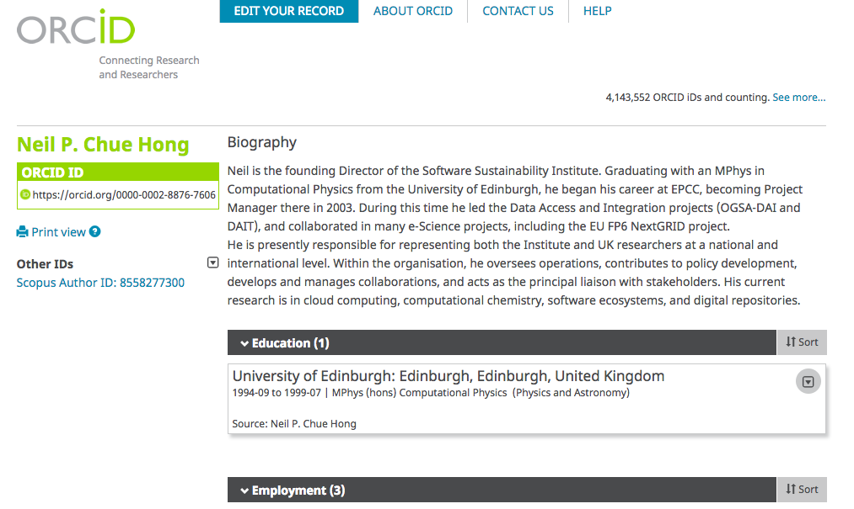
Get an ORCID

Slide 73
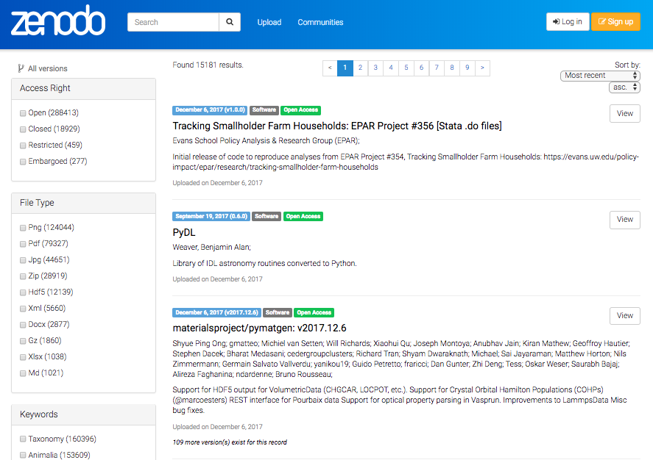
Software in Zenodo
Zenodo is a digital repository
It allows you to deposit software easily

Slide 74
Deposit software in Zenodo
If your software is in GitHub, it’s easy to put in Zenodo:
https://guides.github.com/activities/citable-code/
Gives your code a Digital Object Identifier (DOI)
Preserves a particular version
E.g. used for a paper, major release

Slide 75
Publish a software paper
Publish a software paper: http://bit.ly/softwarejournals
Geoscientific Model Development
Journal of Open Research Software
Journal of Open Source Software
Research Ideas and Outcomes

Slide 76
Publish notebooks
Traditional papers are just advertisements
A literate computing document is the research
Climate Modelling Courseware
https://github.com/brian-rose/ClimateModeling_courseware

Slide 77
Literate Programming
Traditional papers are just advertisements
A literate computing document is the research
The technology is out there
Jupyter notebooks
Mathematica
R Markdown
knitR
MATLAB Live scripts

Slide 78
LIGO Example
LIGO Paper:
http://journals.aps.org/prl/abstract/10.1103/PhysRevLett.116.061102
LIGO Notebook:
https://losc.ligo.org/s/events/GW150914/GW150914_tutorial.ipynb
Notes:
LIGO Paper:
http://journals.aps.org/prl/abstract/10.1103/PhysRevLett.116.061102
LIGO Notebook:
https://losc.ligo.org/s/events/GW150914/GW150914_tutorial.ipynb

Slide 79
Make your code easy to cite
Make it clear what your preferred citation is and more people will cite you, e.g:
To a publication
To a software paper
To a software archive
To a software repository

Slide 80
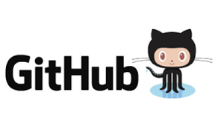
Research Software Workflow
describe
develop ➔ share ➔ preserve
Developed and versioned using code repository
Published via code repository
or website
Deposited in digital repository with paper / for preservation

Slide 81
This doesn’t have to be you!
Piled Higher and Deeper" by Jorge Cham www.phdcomics.com
http://phdcomics.com/comics.php?f=1690

Slide 82
Summary
Write for strangers, including yourself
Get someone else to review your code
Learn to be in (version) control
Don’t be afraid to publish your code
Help others improve their software

Slide 83
Learning from Open Source
Scientific software development projects share characteristics with open source software projects
But more research has been done on OSS projects
Karl Fogel’s “Producing Open Source Software: How to Run a Successful Free Software Project” distills this knowledge into a practical guide
producingoss.com

Slide 84
Extra Courses
Crash Course in Clean Code
https://github.com/softwaresaved/clean-code-workshop
Software Licensing for Researchers
https://github.com/softwaresaved/software-licensing-workshop

Slide 85
Other resources
Software sustainability evaluation
https://www.software.ac.uk/online-sustainability-evaluation
Software Sustainability Institute resources
Guides: https://www.software.ac.uk/guides
Top Tips: https://www.software.ac.uk/resources/top-tips
Scientific Software Practice
Good Enough Practices in Scientific Computing: https://doi.org/10.1371/journal.pcbi.1005510
Best Practices for Scientific Computing: https://doi.org/10.1371/journal.pbio.1001745
Software Citation
Principles: https://peerj.com/articles/cs-86/
GitHub – Zenodo: https://guides.github.com/activities/citable-code/
Ten Simple Rules Series
http://collections.plos.org/ten-simple-rules

Slide 86
Find out more about the SSI
Community Engagement (Lead: Shoaib Sufi)
Fellowship Programme & Events and Workshops
Consultancy (Lead: Steve Crouch)
Open Call for Projects / Collaborations
Online Software Evaluation & Software Management Planning
Policy and Publicity (Lead: Simon Hettrick)
Case Studies / Policy Campaigns
Software and Research Blog
Training (Lead: Aleksandra Nenadic)
Software Carpentry and Data Carpentry
Guides and Top Tips
Journal of Open Research Software (Editor: Neil Chue Hong)
Collaboration between universities of Edinburgh, Manchester, Oxford and Southampton Supported by EPSRC Grant EP/H043160/1 + EPSRC/ESRC/BBSRC grant EP/N006410/1

Slide 87
Acknowledgements
The SSI team/alumni:
Aleksandra Nenadic
Aleksandra Pawlik
Alexander Hay
Arno Proeme
Carole Goble
Claire Wyatt
Clem Hadfield
Dave De Roure
Devasena Prasad
Giacomo Peru
Graeme Smith
Iain Emsley
James Graham
John Robinson
Les Carr
Malcolm Atkinson
Malcolm Illingworth
Mario Antonioletti
Mark Parsons
Mike Jackson
Olivier Philippe
Priyanka Singh
Raniere Silva
Rob Baxter
Robin Wilson
Shoaib Sufi
Simon Hettrick
Stephen Crouch
Tim Parkinson
Toni Collis
Plus the SSI Fellows and RSE community
Scientific software:
Dan Katz
Heather Piowowar
James Howison
Jeff Carver
Jennifer Schopf
Kaitlin Thaney
Martin Fenner
Victoria Stodden
WSSSPE community
Software/Data Carpentry
Greg Wilson
Jonah Duckles
Tracy Teal
Instructor Community
Supported by EPSRC Grant EP/H043160/1 + EPSRC/ESRC/BBSRC grant EP/N006410/1

Slide 88
Software Sustainability Institute
A national facility for cultivating better, more sustainable, research software to enable world-class research
Software reaches boundaries in its development cycle that prevent improvement, growth and adoption
Providing the expertise and services needed to negotiate to the next stage
Developing the policy and tools to support the community developing and using research software
Supported by EPSRC Grant EP/H043160/1 + EPSRC/ESRC/BBSRC grant EP/N006410/1
Notes:
The Software Sustainability Institute can help with: software reviews and refactoring, collaborations to develop your project, guidance and best practice on software development, project management, community building, publicity and more…
Drawing on pool of specialists to drive the continued improvement and impact of research software developed by and for researchers
Providing services for research software users and developers
Developing research community interactions and capacity
Promoting research software best practice and capability

Slide 89
Software
Training
Helping the community to develop software that meets the needs of reliable, reproducible, and reusable research
Delivering essential software skills to researchers via CDTs, institutions & doctoral schools
Outreach
Exploiting our platform to enable engagement, delivery & uptake
Collecting evidence on the community’s software use & sharing with stakeholders
Bringing together the right people to understand and address topical issues
Policy
Community

Slide 90
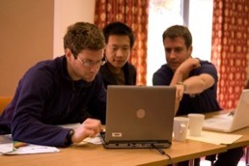
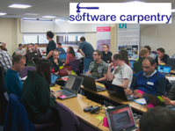
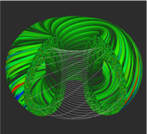
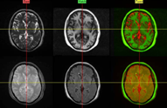
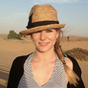
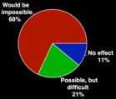
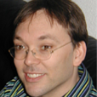
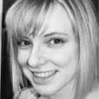
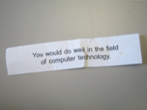
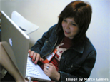
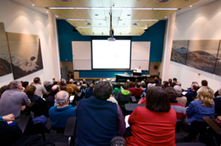
Software
Training
Advice
Courses
35+ UK SWC workshops
1000+ learners
Consultancy
50+ projects
130+ evaluations
4 surgeries
Guides
Outreach
80+ guides
50,000 readers
Website & blog
150+ contributed articles
20,000 unique visitors per month
3,000 Twitter followers
Research
740 researchers 50,000 grants analysed
Campaigns
Workshops
Fellowship
61 domain ambassadors
300+ RSEs engaged
2100 signatures
13 issues highlighted
Policy
Community
20+ workshops organised

