Slide 1
AN ORCID UPDATE
emug, June 21, 2018
Alice meadows, director of community engagement & support https://orcid.org/0000-0003-2161-3781

Slide 2
ORCID’s vision is a world where
all who participate in research, scholarship, and innovation are uniquely identified and connected to their contributions and affiliations across time, disciplines, and borders.
Together, we can make our vision a reality!
Notes:
Identifiers enable digital connections between people places and things, information that is persistent and uniquely identifiable, machine readable, accessible, and embedding identifiers in workflows make it immediately possible to ascertain HOW the connection was made, by whom, and when
This is our core messaging. The focus is for researchers in their orgs, but also for orgs – if you’re trying to sell it to your administration.

Slide 3
What is ORCID?
ORCID is an open, not-for-profit organization run by and for the research community
We provide researchers with a unique identifier, an ORCID iD, that reliably and clearly connects them with their research contributions and affiliations
Hundreds of systems have now integrated ORCID iDs – from grant application and manuscript submission to CRIS to repositories, and more!
Notes:
Notes for presenter:
The ORCID Organization was established in 2010 to address researcher name ambiguity
It was established by several organizations across the scholarly communication industry who were all independently trying to tackle this challenge of name ambiguity, and realized that a collective effort was needed to resolve the problem
We are supported by membership dues from our 880 or so (as of June 2018) member organizations
From the start ORCID was established to be non-profit, non-proprietary and community-driven. Our core principles establish that we be open to all who want to use a common person identifier for research activities and outcomes - regardless of country, discipline, or industry
ORCID is independently governed by a Board of Directors – representatives from member organizations (majority not-for-profit) plus two researcher representatives

Slide 4
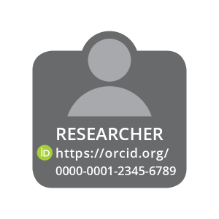
Enter once
reuse often
interoperability
PUBLISHER
Assert authorship
EMPLOYER
Assert affiliation
CONNECT
CONNECT
COLLECT
COLLECT
CONNECT
COLLECT
FUNDER
Assert award
Notes:
These connections matter because research progress is based on the communication of ideas – between individuals, and organizations – and research credit and careers are built on the quality and success of those communications.
This infographic shows at a high level how ORCID iDs enable interoperability between different systems, helping us make our mantra of ‘Enter once, reuse often’ a reality for researchers and their organizations.
In addition, and very importantly, by validating your researchers’ ORCID iDs when they interact with your systems, you can assert the connection between them and your organization, building trust in scholarly communications overall. For funders, this means asserting the connection between awardees and their grants; for publishers, between authors and their works; and for employers, between researchers and their affiliation with a university or other institution.
Researcher in the middle is authenticating their ID with their institution, who collects their ID, and then connects their info

Slide 5
ORCID facts and figures
~5m registrants
~880 organizational members
78% research institutions
50% Europe, 27% US/Canada
17 consortia
43 countries
Over 560 live integrations
https://orcid.org/statistics
https://orcid.org/statistics
Notes:
Whether for researchers or admin, they will probably want facts and figures
Can get updated stats on our webpage https://orcid.org/statistics
Can get integration info from the website https://orcid.org/members or ask us directly

Slide 6
ORCID Connections
~ 2m iDs with external identifiers
Person, organization, funding, work, peer review activity
2.5m+ education affiliations
31m+ works
12m+ unique DOIs
~1m works added via Crossref auto-update
~0.5m funding activities
~0.25m peer review activities
https://orcid.org/statistics
https://orcid.org/statistics
Notes:
Whether for researchers or admin, they will probably want facts and figures
Can get updated stats on our webpage https://orcid.org/statistics
Can get integration info from the website https://orcid.org/members or ask us directly

Slide 7
ORCID and publishers
Open Letter
Working Groups:
Journal Display Guidelines (complete)
Books Workflows (complete)
User Facilities and Publications (in progress)
Review activities
New affiliations
ORCID Publishing User Group
https://orcid.org/statistics
Notes:
Whether for researchers or admin, they will probably want facts and figures
Can get updated stats on our webpage https://orcid.org/statistics
Can get integration info from the website https://orcid.org/members or ask us directly

Slide 8
ORCID user facilities and publications working group
Bring together publishers and facilities to:
Better understand research, publication, and reporting workflows
Define terms to enable conversation
Identify opportunities for working together to streamline and, where possible, automate impact reporting
https://orcid.org/blog/2017/12/07/using-identifiers-capture-and-expose-facilities-use
https://orcid.org/statistics
Notes:
Whether for researchers or admin, they will probably want facts and figures
Can get updated stats on our webpage https://orcid.org/statistics
Can get integration info from the website https://orcid.org/members or ask us directly

Slide 9
ORCID user facilities and publications working group
Recommendations for publishers include:
Enable ongoing collection of validated ORCID iDs from all authors
Implement ongoing collection of information about relevant user facilities leveraging information from author ORCID records and other sources
Work to amend the JATS standard and other DTDs to standardize the capture and tagging of user facility use information
Implement processes that enable inclusion of ORCID iD and user facilities metadata in the article and Crossref submission
Enable citation of relevant datasets during the manuscript publication process
https://orcid.org/blog/2017/12/07/using-identifiers-capture-and-expose-facilities-use
https://orcid.org/statistics
Notes:
Whether for researchers or admin, they will probably want facts and figures
Can get updated stats on our webpage https://orcid.org/statistics
Can get integration info from the website https://orcid.org/members or ask us directly

Slide 10
ORCID new affiliation types
Coming soon in our new 3.0 API release candidate:
Qualifications: Professional and continuing education qualifications, training, certification
Invited positions & distinctions: Emeritus professor, visiting lecturer, trophies, honorary degrees, etc
Membership & service: Association membership, editorial board service, etc
https://orcid.org/blog/2018/03/01/expanding-affiliations-orcid-update
https://orcid.org/statistics

Slide 11
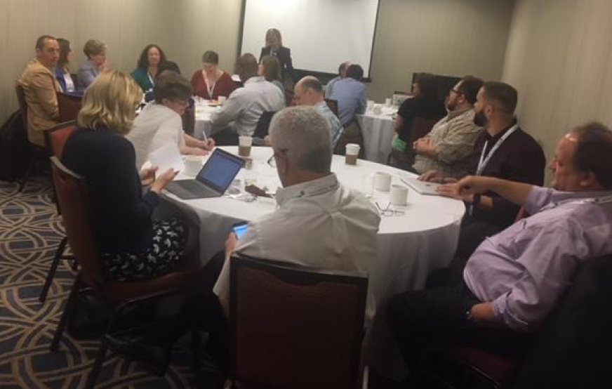
ORCID publishing user group
SSP breakfast meeting attended by ~40 people from ~30 organizations
Follow-up webinar to launch user group on June 28 10:30 AM Eastern/14:00 GMT
Register at:
orcid.org/about/events
https://orcid.org/blog/2018/03/01/expanding-affiliations-orcid-update
https://orcid.org/statistics

Slide 12
Thank you!
Questions, comments, ideas?
community@orcid.org

